Slide 1
Deep Learning with Theano
Presented by Chuong Ngo
Some slides and/or images provided by Kyle Wallace
Based on the work by White et. al

Slide 2
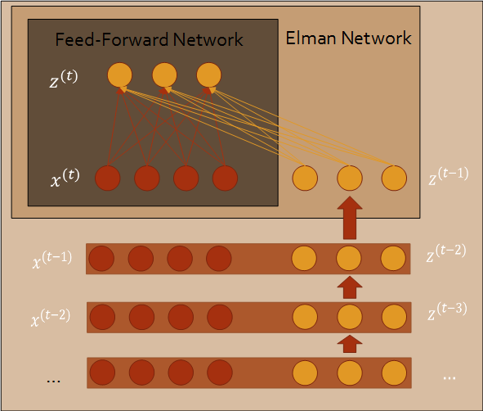
Recurrent Neural Networks (RNN)
Augmented with Elman Networks
Short-term memory
Deep Learning Structure
Greater previous context
Trained with backpropagation through time

Slide 3
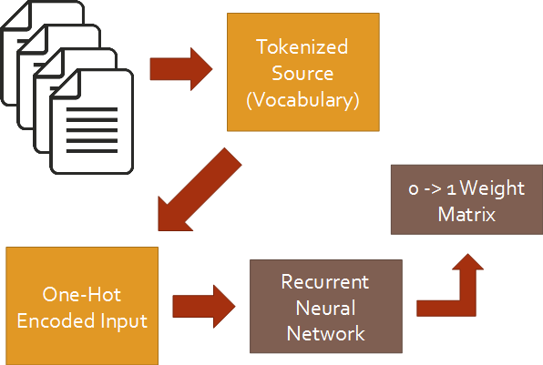
RNN and Software Engineering
Vocabulary set from tokenized source
One-hot encoding
Stochastic gradient descent
Softmax over classes and output
Decreases runtime.
Sigmoid activation

Slide 4

Theano Overview
Python library and optimizing compiler for ML
By University of Montreal
Package of various technologies
Compiled and function optimizations
Runs on CPU/GPU

Slide 5
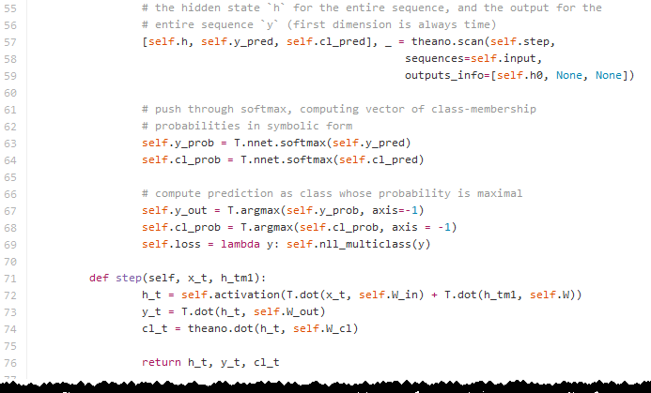
RNNs and Theano
Shared variables
Lower memory footprint
Scan
Less memory used
Slightly faster
Can see previous n time steps
Taps - allows for multiple inputs

Slide 6
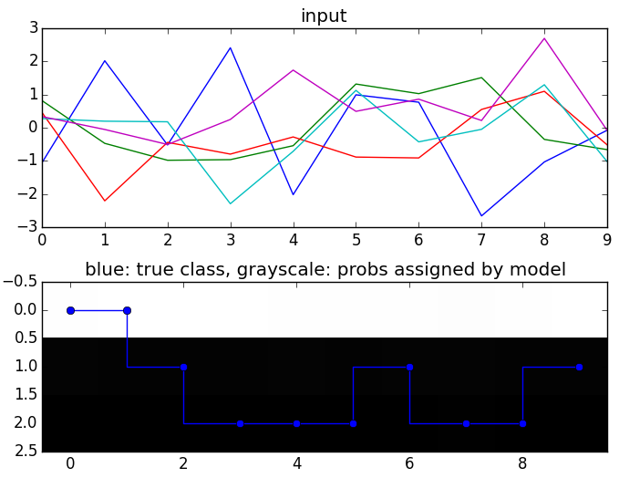
Way Ahead
Run one-hot encodes through RNN
Type errors
Compare performance (time)
Is Theano faster?
CPU vs GPU
Is the GPU worth it?

Slide 7
Deep Learning Structures & Software Engineering Tasks
Where else can Deep Learning be used?
Deep Autoencoders
Compressed representation of data
Clone detection?
Error prediction?
Deep Belief Networks
Error prediction?
API preconditions?

Slide 8
Questions?

