Slide 1
Top 10 Algorithms in Data Mining
(Part 1)
Authors:
Xindong Wu, Vipin Kumar, J. Ross Quinlan, Joydeep Ghosh, Qiang Yang, Hiroshi Motoda, Geoffrey J. McLachlan, Angus Ng, Bing Lu, Philip S. Yu, Zhi-Hua Zhou, Michael Steinbach, David J. Hand, Dan Steinberg
Presenter:
Vangelis Dimopoulos

Slide 2
Outline (Part 1)
What is Data Mining?
Data Mining Vs. Machine Learning
Data Mining Techniques / Classes
Top 10 Algorithms in Data Mining (Part 1: 3 Algorithms; Part 2: 7 Algorithms)
K-means
C4.5
Naïve Bayes

Slide 3
What is Data Mining?
An analytic process designed to explore data (usually large amounts of data) in search of new patterns and previously unknown relationships between variables.
Knowledge Discovery in Databases (KDD) Process (1996)
Selection
Preprocessing
Transformation
Data Mining
Interpretation/Evaluation

Slide 4
Data Mining vs. Machine Learning
Machine Learning
Data Mining
Explores the construction and study of algorithms and techniques that can “learn” from data; extracting information without human guidance
Known Properties – Rules and Patterns
Artificial Intelligence
Carried out by an entity to discover or generate previously unknown insights or patterns from initially unstructured data.
Unknown Properties / Co-linearity
Statistics/Databases

Slide 5
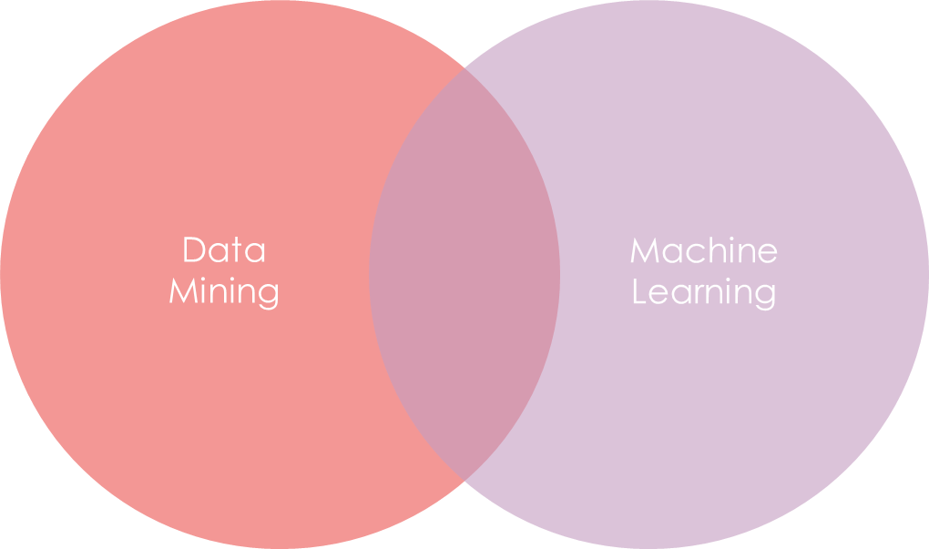
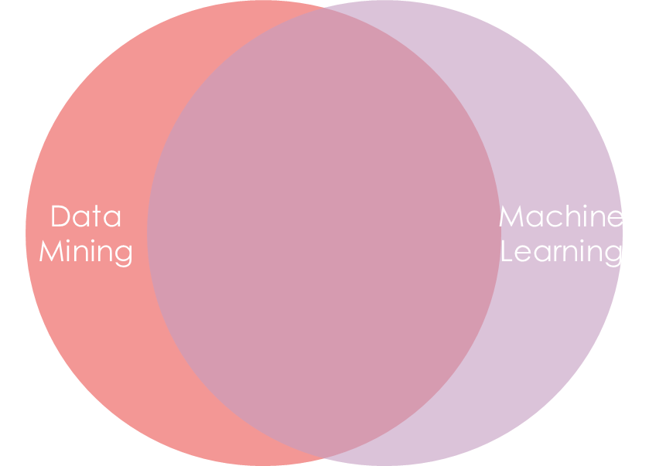
Data Mining vs. Machine Learning
Purpose
Algorithms

Slide 6
Data Mining Process
Solving a data mining problem can be broken down into three steps:
Pre-processing – assemble a target dataset (cleaning, transformations, selecting subsets of data, exploratory data analysis)
Data mining
Results validation – ensure the results apply to the dataset (both larger sample and new data)

Slide 7
Data Mining Techniques/Classes:
Anomaly Detection
Association Rule Learning
Attribute Importance
Clustering
Classification
Regression
Summarization/Feature Selection and Extraction
Notes:
Anomaly Detection – identify unusual data records that require further investigation
Association Rule Learning – searching for relationships between variables
Attribute Importance – Ranks attributed according to strength of relationship with the target
Clustering – discover groups of data that are naturally similar with no a priori knowledge
Classification – generalizing known structure to data
Regression – prediction technique to find a continuous function with the smallest squared error
Summarization/Feature Selection and Extraction – linear combination of predetermined attributes / compact representation

Slide 8
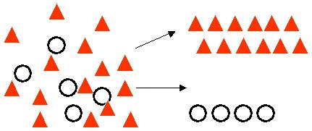
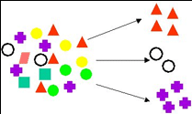
Data Mining Techniques/Classes:
Classification
Clustering

Slide 9
Top 10 Algorithms (2007)
Part(1)
C4.5 (Decision Tree)
K-means algorithm
Support Vector Machines (SVM)
The Apriori Algorithm
The Expectation Maximization (EM) Algorithm
PageRank
AdaBoost
K-nearest neighbor classification
Naïve Bayes
Classification and Regression Trees (CART)

Slide 10

K-means Algorithm
Technique: Clustering
Iterative method to partition a dataset into a user specified number of clusters
$D=\left\{x_{i} \right|i=1,…,N\}⇒x_{i}∈R^{d}$, pick k-points in $R^{d}$ (centroids)
2 Steps:
Data Assignment
Relocation of Means
Euclidean distance objective / convergence
Notes:
D = set of points
d = dimensions
i = vector number
R^d = d-dimensional space

Slide 11
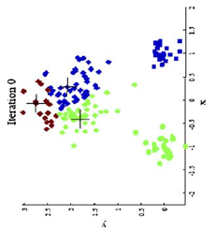
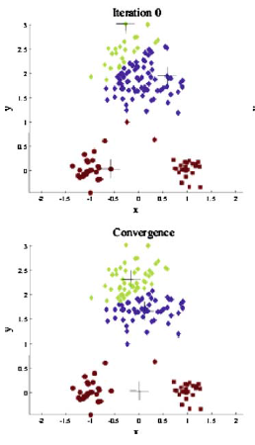
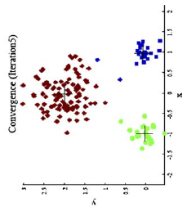
K-means Algorithm
Set and place the initial number of centroids (k) on the graph.
Find the closest centroid to a point
Based on these clusters, find the new center
Repeat/Loop until center is unmoved
Case 1
Case 2

Slide 12
K-means Algorithm
Items to note:
Highly sensitive to initial placement
Will fail when data is highly correlated
Curse of high dimensionality
Selecting (k) can be rather arbitrary
Outliers can throw off our data

Slide 13
C4.5 Algorithm
Technique: Classification
Statistical classifier / Set of Decision Tree
Either a Leaf, or a test on a Decision Tree (that connects to branches)
Build decision trees using a set of data with the goal of: Information entropy
At each node, the algorithm picks an attribute based on information gain
Tests performed until elements reach the leaves

Slide 14

$$u \sim U(0,1)$$
If CDF < .025
Acceptance-Rejection Method
decision tree at 5% threshold
No
Yes
If CDF > .975
Re-sample
No
Yes
Re-sample
Keep Value

Slide 15
C4.5
Tries to find small Decision Trees (or simple ones) based on:
If all cases of the came sample class, the tree is a leaf
For each attribute, calculate potential info provided by a test on the attribute
Two heuristic criteria for ranking of tests
Information gain – minimized total entropy of subsets
Conditional Information gain – divides information gain by information in test outcomes

Slide 16

C4.5
Attribute X1 (Car Brand) | Attribute X2 (Towed) | Attribute X3 (Year) | Class (Lemon)
A | True | 2013 | Yes (S2)
B | False | 2012 | No (S1)
A | False | 2012 | Yes (S2)
B | False | 2013 | No (S1)
C | True | 2012 | No (S1)
$Info\left(S\right)=−∑_{i=1}^{m}$ $\frac{\left|S_{i}\right|}{\left|S\right|}log\frac{\left|S_{i}\right|}{\left|S\right|}$
$Info_{X_{k}}\left(T\right)=∑_{j=1}^{n}$ $\frac{\left|T_{j}\right|}{\left|T\right|}Info(T_{j})$
$Gain\left(X_{k}\right)=Info\left(T\right)−Info_{X_{k}}(T)$
Goal: $\max_{k}{Gain(X_{k})}$
Test X1
X1 = A
X1 = B
X1 = C
X2 (Towed) | X3 (Year) | Class (Lemon)
True | 2013 | Yes
False | 2012 | Yes
X2 (Towed) | X3 (Year) | Class (Lemon)
False | 2012 | No
False | 2013 | No
X2 (Towed) | X3 (Year) | Class (Lemon)
True | 2012 | No
Notes:
First equation is constant (Maximum Shannon Entropy) – 1 = full disorder, 0 = no disorder
Second equation – once broken up into categories Use first function within category
Info(T) = -3/5*log(3/5) – 2/5*log(2/5)
Info_X1(T) = 2/5*[-0/2*log(0/2) – 2/2*log(2/2)]
+ 2/5*[-2/2*log(2/2) – 0/2*log(0/2)]
+ 1/5*[-1/1*log(1/1) – 0/1*log(0/1)] = 0
i = Classes
j = attributes to Xk
k = number of attributes
0 log_{b}(0) = 0 for our case
S = Set of Samples
S_i = samples in class i
|| = Cardinality
X_k = Attribute Test

Slide 17
C4.5
A Few Notes:
C4.5 is an evolution of prior algorithms
Principal disadvantage: CPU and memory intensive
Superseded by C5.0
Scalability improved
Extended range of data-types (i.e. Dates & N/A values)
Added boosting variant – ensemble of classifiers chosen, then votes for final classification

Slide 18

Naïve Bayes Algorithm
Find the best classification function to distinguish between members of two classes
Technique: Classification
Conditional Probability: $P\left(A | B\right)=\frac{P\left(A∩B\right)}{P\left(B\right)}=\frac{P\left(B\left|A\right)P(A\right)}{P\left(B\right)}$
Bayes Rule: $P\left(A\right)=P\left(A | B_{1}\right)P\left(B_{1}\right)+ …+P\left(A | B_{n}\right)P(B_{n})$
$P\left(A|B\right)=\frac{P\left(B\left|A\right)P(A\right)}{P\left(B\left|A\right)P\left(A\right)+P(B\left|¬A\right)P(¬A\right)}$

Slide 19

Naïve Bayes Algorithm
Assume (for now) $\left|y\right|=k, x=\left(x_{1},…, x_{n}\right)$
Assume components of $x$ are independent
$P\left(x|y\right)=P\left(x_{1} | y\right)∗…∗P\left(x_{n} | y\right)=Π_{j=1}^{n} P(x_{j}|y)$ - Naïve Bayes assumption
Now univariate distributions as opposed to multivariate distributions
Now, using the previous statements, we can create a predictive probability
$P\left(y_{k}|x\right)=P\left(y_{k} |(x_{1},…, x_{n})\right) =\frac{P\left(y_{k}\right)∗Π_{i}P(x_{i}|y_{k})}{\sum_{j}{[P\left(y_{j}\right)∗Π_{i}P(x_{i}|y_{j})]}}$
Select Y such that: $Y=argmax_{k} P(y_{k}|x)$ or $Y=argmax_{k} P\left(y_{k}\right)∗Π_{i} P(x_{i}|y_{k})$

Slide 20

Naïve Bayes Algorithm
Now, using the previous statements, we can create a predictive probability
$P\left(y_{k}|x\right)=P\left(y_{k} |(x_{1},…, x_{n})\right) =\frac{P\left(y_{k}\right)∗Π_{i}P(x_{i}|y_{k})}{\sum_{j}{[P\left(y_{j}\right)∗Π_{i}P(x_{i}|y_{j})]}}$
Select Y such that: $Y=argmax_{k} P(y_{k}|x)$ or $Y=argmax_{k} P\left(y_{k}\right)∗Π_{i} P(x_{i}|y_{k})$
Notes:
Structure used in the book correlate strongly with logistic regression.

Slide 21
Naïve Bayes Algorithm
Majority MC Correct (A) | Majority FITB Correct (B) | Essay Strength (C) | Pass Test?
Yes | Yes | Strong | Yes
Yes | No | Good | No
No | No | Weak | No
Yes | No | Strong | Yes
Yes | Yes | Good | Yes
No | Yes | Strong | Yes
No | No | Strong | No
Yes | Yes | Weak | Yes
Majority MC Correct (A) | Majority FITB Correct (B) | Essay Strength (C) | Pass Test?
No | Yes | Good | ???
Can we predict whether this student passed the test?

Slide 22




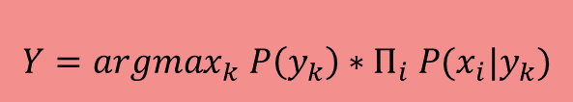














Naïve Bayes Algorithm
$$Y=argmax_{k} P\left(y_{k}\right)∗Π_{i} P(x_{i}|y_{k})$$
$$P\left(pass\right)=\frac{5}{8}$$
$$P\left(fail\right)=\frac{3}{8}$$
$$P\left(pass|(MC_{n},FITB_{y}, Essay_{g})\right)=$$
$P\left(pass\right)∗P\left(MC_{n} | pass\right)∗P\left(FITB_{y} | pass\right)∗P(Essay_{g}|pass)$
$$P\left(MC_{y}|pass\right)=\frac{4}{5}$$
$$P\left(MC_{y}|fail\right)=\frac{1}{3}$$
$= \frac{5}{8}∗\frac{1}{5}∗\frac{4}{5}∗\frac{1}{5}=\frac{20}{40∗25}=\frac{1}{50}=0.05$
$$P\left(MC_{n}|pass\right)=\frac{1}{5}$$
$$P\left(MC_{n}|fail\right)=\frac{2}{3}$$
$$P\left(FITB_{y}|pass\right)=\frac{4}{5}$$
$$P\left(FITB_{y}|fail\right)=\frac{0}{3}$$
$$P\left(fail|(MC_{n},FITB_{y}, Essay_{g})\right)=$$
$$P\left(FITB_{n}|pass\right)=\frac{1}{5}$$
$$P\left(FITB_{n}|fail\right)=\frac{3}{3}$$
$P\left(fail\right)∗P\left(MC_{n} | fail\right)∗P\left(FITB_{y} | fail\right)∗P(Essay_{g}|fail)$
$$P\left(Essay_{s}|pass\right)=\frac{3}{5}$$
$$P\left(Essay_{s}|fail\right)=\frac{1}{3}$$
$= \frac{3}{8}∗\frac{2}{3}∗\frac{3}{3}∗\frac{1}{3}=\frac{18}{27∗8}=\frac{1}{12}=0.0833$
$$P\left(Essay_{g}|pass\right)=\frac{1}{5}$$
$$P\left(Essay_{g}|fail\right)=\frac{1}{3}$$
Thus, we take the max and therefore
predict or assume the student failed
$$P\left(Essay_{w}|pass\right)=\frac{1}{5}$$
$$P\left(Essay_{w}|fail\right)=\frac{1}{3}$$

Slide 23
Naïve Bayes Algorithm
Notes:
Very biased (e.g. probability could be zero)
Simplistic, elegant, robustness, universal use
Flexibility sacrificed for simplicity, but modifications can be made.

Slide 25
Top 10 Algorithms in Data Mining
(Part 2)
Authors:
Xindong Wu, Vipin Kumar, J. Ross Quinlan, Joydeep Ghosh, Qiang Yang, Hiroshi Motoda, Geoffrey J. McLachlan, Angus Ng, Bing Lu, Philip S. Yu, Zhi-Hua Zhou, Michael Steinbach, David J. Hand, Dan Steinberg
Presenter:
Vangelis Dimopoulos

Slide 26
Outline (Part 2)
Top 10 Algorithms in Data Mining (Part 1: 3 Algorithms; Part 2: 7 Algorithms)
Apriori
Support Vector Machines
Expectation Maximization
AdaBoost
k-Nearest Neighbor
PageRank
CART
Summary

Slide 28
Apriori Algorithm
Technique: Attribute Importance
Iterative method to find frequent itemsets in a database using candidate generation
K – size, Fk frequent itemsets, Ck candidates
3 Steps: (start at k=1)
Generate c_k+1 candidates of frequent itemsets of size k+1 from frequent itemsets of size k
Scan database and calculate support of each candidate of frequent itemsets
Add those itemsets that satisfies the minimum support requirement/threshold to f_k+1
Notes:
D = set of points
d = dimensions
i = vector number
R^d = d-dimensional space

Slide 29
Apriori Algorithm
Let P_k and Q_k be frequent itemsets of size k
Then R_k+1 = P_k U Q_k
Prune Step: Check if itemsets of size k in R_k+1 are frequent and generate C_k+1 by removing those that do not pass this requirement from R_k+1 (any subset of size k of C_k+1 that is not frequent cannot be a subset of a frequent itemset (in other words, do not continue with exploring sets of bigger size)
Notes:
D = set of points
d = dimensions
i = vector number
R^d = d-dimensional space

Slide 30
Apriori Algorithm
I = set of items
T = set of transactions (with an ID)
Each t_i is a subset of I
If {I_1, I_2} a frequent itemset, then {I_1} and {I_2} are both frequent itemsets
Level-wise search (use k-itemsets to explore k+1 itemsets)
Itemsets explored only if cardinality is greater than the predefined support
Repeat until we get an empty candidate set (and check k-1-itemset sizes)
Notes:
D = set of points
d = dimensions
i = vector number
R^d = d-dimensional space

Slide 31
Apriori Algorithm
Support = 2
Candidate Set C_1
Transaction ID | Items
100 | 1 2 5
200 | 2 3 4
300 | 1 5
400 | 1 2 4 5
ItemSet | Support
{1} | 3
{2} | 3
{3} | 1
{4} | 2
{5} | 3
Frequent Set F_1
ItemSet | Support
{1} | 3
{2} | 3
{4} | 2
{5} | 3
Notes:
D = set of points
d = dimensions
i = vector number
R^d = d-dimensional space

Slide 32
Apriori Algorithm
Support = 2
Candidate Set C_2
Transaction ID | Items
100 | 1 2 5
200 | 2 3 4
300 | 1 5
400 | 1 2 4 5
Frequent Set F_2
ItemSet | Support
{1,2} | 2
{1,4} | 1
{1,5} | 3
{2,4} | 2
{2,5} | 2
{4,5} | 1
ItemSet | Support
{1,2} | 2
{1,5} | 3
{2,4} | 2
{2,5} | 2
Frequent Set F_1
ItemSet | Support
{1} | 3
{2} | 3
{4} | 2
{5} | 3
Notes:
D = set of points
d = dimensions
i = vector number
R^d = d-dimensional space

Slide 33
Apriori Algorithm
Support = 2
Candidate Set C_3
Frequent Set F_2
Transaction ID | Items
100 | 1 2 5
200 | 2 3 4
300 | 1 5
400 | 1 2 4 5
ItemSet | In F_2?
{1,2,4} {1,2},{1,4},{2,4} | No
{1,2,5} {1,2},{1,5},{2,5} | Yes
{1,4,5} {1,4},{1,5},{4,5} | No
{2,4,5} {2,4},{2,5},{4,5} | No
ItemSet | Support
{1,2} | 2
{1,5} | 3
{2,4} | 2
{2,5} | 2
I = {1,2,5} → Non-empty subset:
{1,2},{1,5},{2,5},{1},{2},{5}
Frequent Set F_3
ItemSet | Support
{1,2,5} | 2
A subset of a frequent itemset must also be a frequent itemset
Notes:
D = set of points
d = dimensions
i = vector number
R^d = d-dimensional space

Slide 34
Apriori Algorithm
Frequent Set F_1
Transaction ID | Items
100 | 1 2 5
200 | 2 3 4
300 | 1 5
400 | 1 2 4 5
ItemSet | Support
{1} | 3
{2} | 3
{4} | 2
{5} | 3
For every nonempty subset s of I:
if support count(I) / support count(s) >= min conf threshold (%)
R1: 1&2 → 5; Confidence = sc{1,2,5}/sc{1,2} = 2/2 = 100%
R2: 1&5 → 2; Confidence = sc{1,2,5}/sc{1,5} = 2/3 = 66.67%
R3: 2&5 → 1; Confidence = sc{1,2,5}/sc{2,5} = 2/2 = 100%
R4: 1 → 2&5; Confidence = sc{1,2,5}/sc{1} = 2/3 = 66.67%
R5: 2 → 1&5; Confidence = sc{1,2,5}/sc{2} = 2/3 = 66.67%
R6: 5 → 1&2; Confidence = sc{1,2,5}/sc{5} = 2/3 = 66.67%
Frequent Set F_2
ItemSet | Support
{1,2} | 2
{1,5} | 3
{2,4} | 2
{2,5} | 2
Frequent Set F_3
ItemSet | Support
{1,2,5} | 2
Notes:
D = set of points
d = dimensions
i = vector number
R^d = d-dimensional space

Slide 36
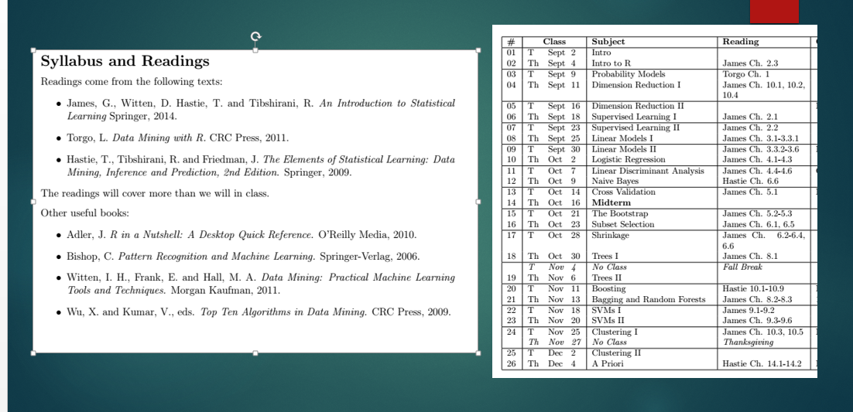

Slide 38
Data Mining vs. Machine Learning Algorithms
Data Mining
Machine Learning
Notes:
Machine Learning – Known Properties
Data Mining – Unknown Properties (often uses machine learning with other goals in mind)

Slide 39
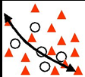
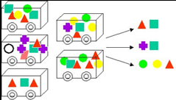
Data Mining Techniques/Classes:
Classification
Regression
Clustering
Association

Slide 40
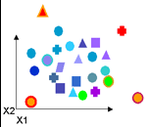
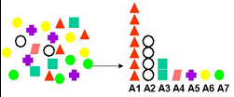
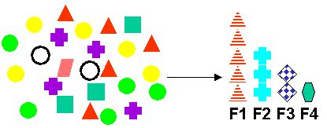
Data Mining Techniques/Classes:
Anomaly Detection
Attribute Importance
Feature Selection and Extraction

