Slide 1
Inferring the network structure of plankton community using time series data
24. 07. 17
Hyunsuk Choo, SNU
Mentor: Olive Cawiding, KAIST

Slide 2
Meaning of horizontal cutting should be focused on ‘data efficiency’, not ‘detecting changes of regulation’
Cutting window horizontally has two advantages :
Because we have high values and low values mixed, informations in low values are neglected. By separating values by scale, we can preserve informations in low values.
If regulations are not monotonic, regulations will be changed due to scale of values. (Ex. If Cyclopoids are high, self regulation will be negative…) By separating values by scale, we can detect the boundary of changing regulations.
But number 2 found out to be hard thing because 1) Data are not uniformly distributed, so finding boundaries & ensuring each window has sufficient data are not compatible 2) Boundaries may be complicated, but cutting horizontally means we can only check for square shaped boundaries.
So we should focus on number 1 (data efficiency).
TO-DO : For data sets that we already know it works with GOBI, we drop some data points and check horizontally cutting can detect the result with fewer data points.
Notes:
GOBI를 세로로 잘라야 하는 이유?
1. (출발점) 높은 값들 때문에 낮은 값들이 compress 되어 정보 가치가 떨어진다. 그래서 비슷한 값들끼리 묶어서 정보를 enrich하게 만들어야 한다.
2. non-monotonic한 경우 +와 -가 섞여서 제대로 된 결과가 안 나온다. 값의 크기에 따라 positive / negative regulation이 달라지기 때문에 세로로 자르면 결과를 얻을 수 있다.
2번으로 포커스를 맞추면 -> 1. roundf/roundx = 0 이 되는 경계를 찾아내야 하는건데, 형태가 어떨지도 모르고 어렵다. 사각형을 키우는 것으로 안 될 것이다. 각 지점마다 + - 를 찾아내서 경계를 봐야하는데 그러면 데이터가 굉장히 많이 필요하다. (component number) dimension 공간을 채워야 하므로.
그러므로 1번으로 포커스를 맞춘다. 즉, 효율적인 GOBI를 만드는 것에 목표를 둔다. 밑에 깔린 데이터들을 잘 볼 수 있다면 적은 수의 데이터로도 의미있는 결과를 얻을 수 있지 않을까? 그러니 GOBI 논문에서 쓴 모델 데이터들로 일단 그 실험을 해보자. 데이터를 적게 쓰고 결과 얻어내기.

Slide 3
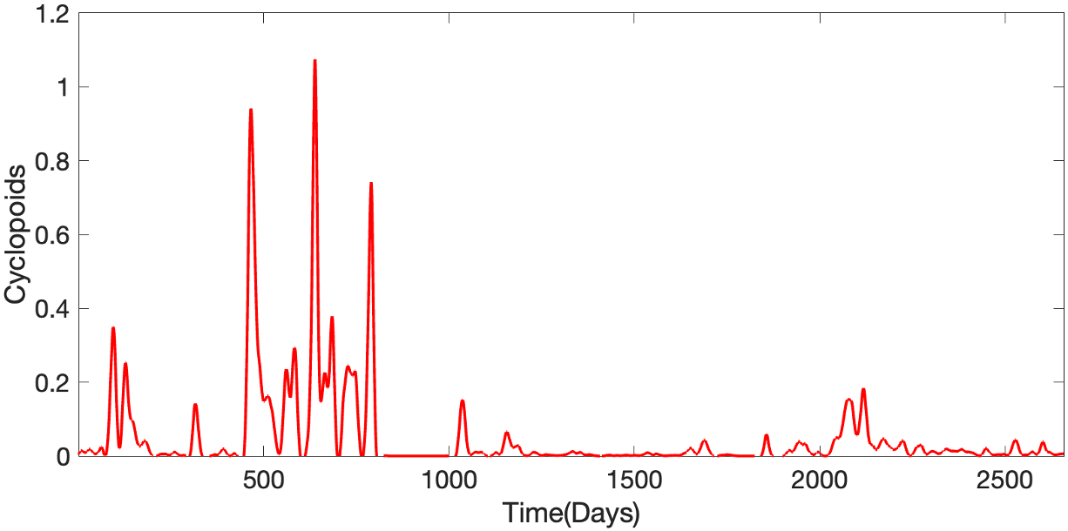
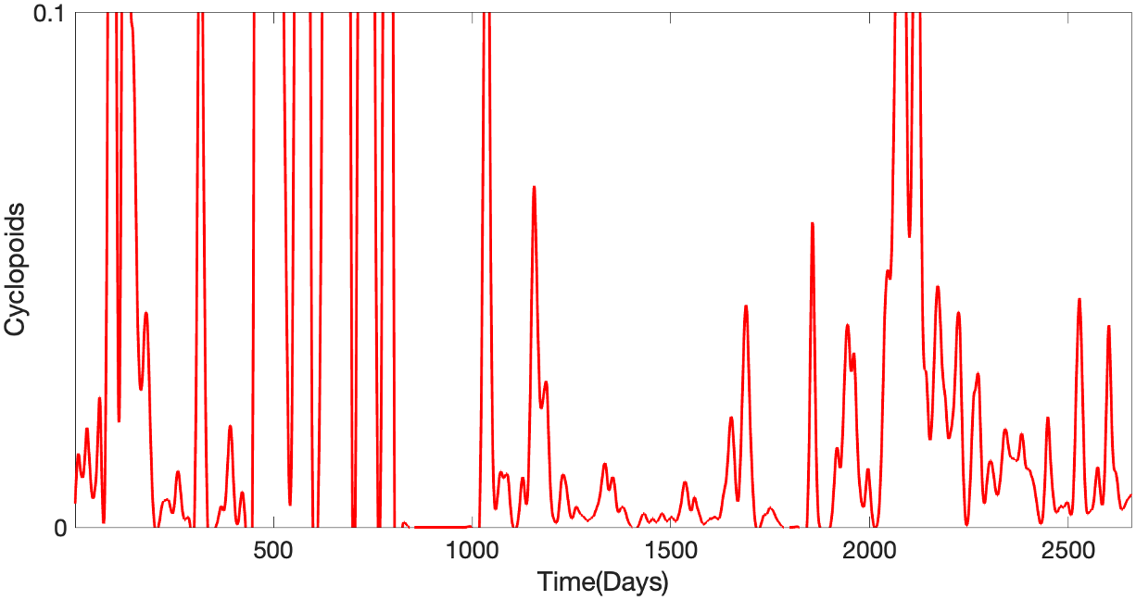






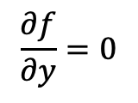
Previously: Meaning of horizontal cutting should be focused on ‘data efficiency’, not ‘detecting changes in regulation’
Cutting window horizontally has two advantages :
Preserving informations in low values
Detecting the boundary of changing regulations
$$y$$
$$x$$
$$y$$
$$x$$
$$y$$
$$x$$
But, boundaries may shape complicated
$$y$$
$$\frac{∂f}{∂y}=0$$
By preserving informations, we might get correct result with fewer data
$$x$$

Slide 4
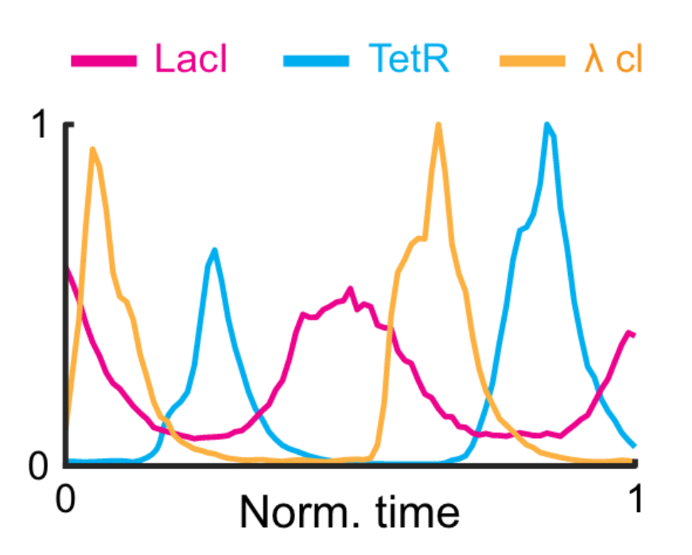
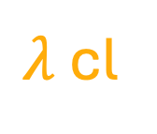
To claim data efficiency of horizontal cutting, we chose repressilator data.
TetR
$λ$cl
Lacl
Similar to plankton data, there are lots of low values
Park, et al, A general model-based causal inference method overcomes the curse of synchrony and indirect effect. Nat Comm, (2023).

Slide 5
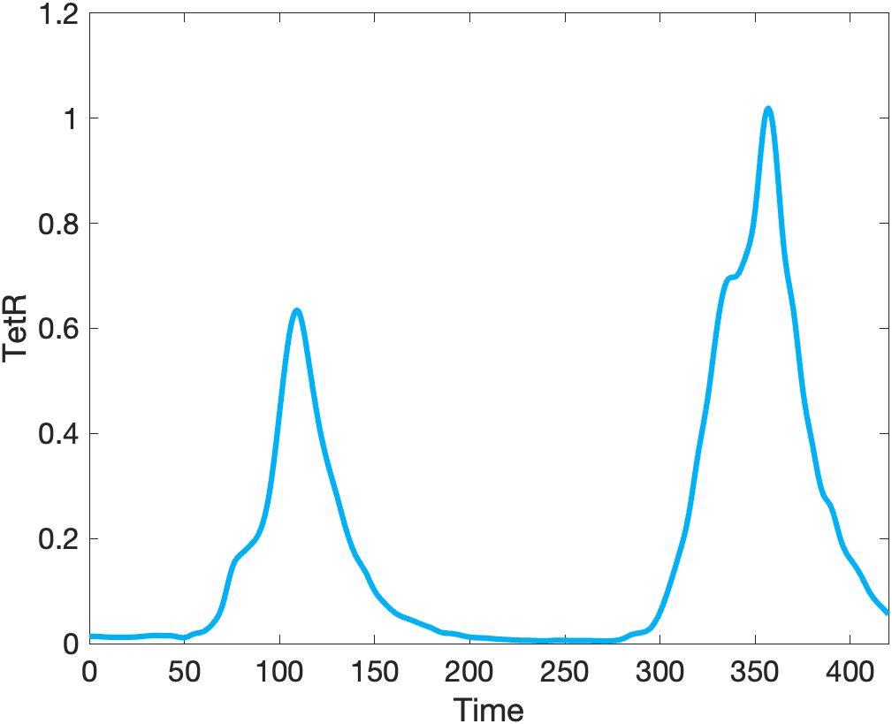
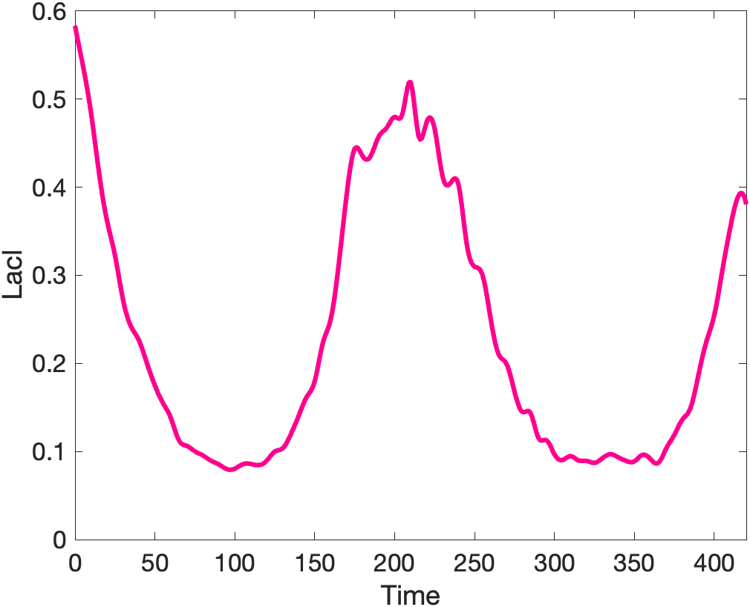
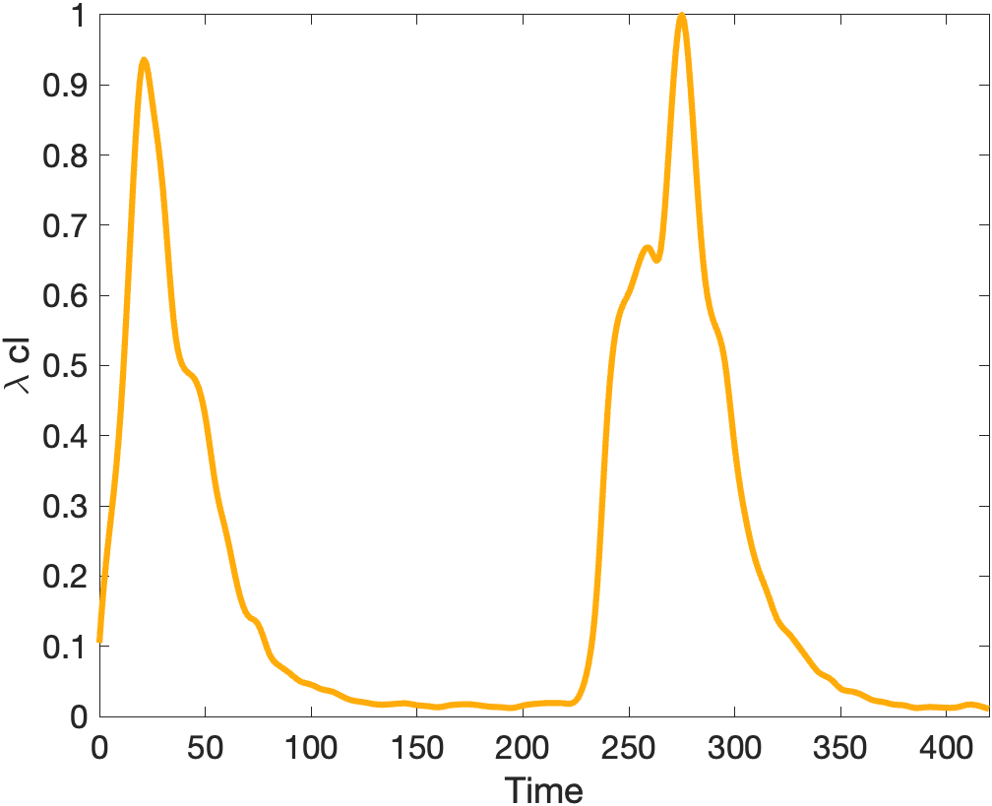
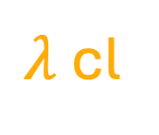
First, we tried to infer with whole data by cutting each component at median
Total : 421 data points (interpolated)
TetR
Lacl
$λ$cl
High
(211)
High
(211)
High
(211)
0.17
0.06
Low
(210)
0.05
Low
(210)
Low
(210)

Slide 6
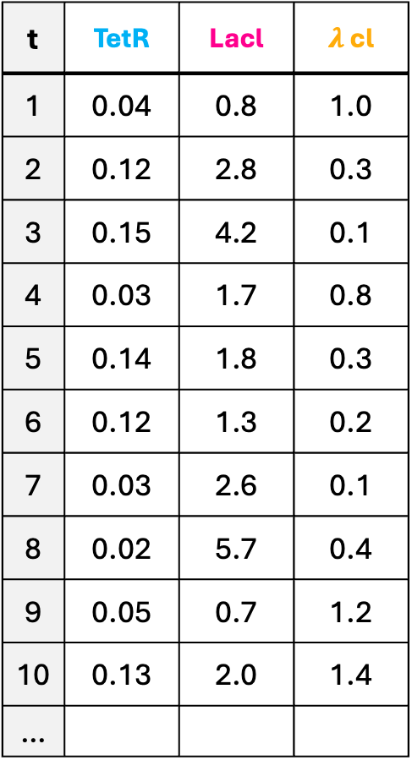

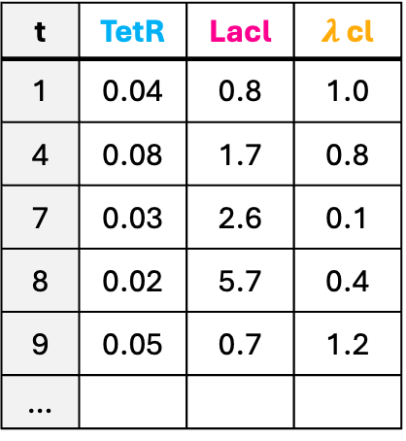
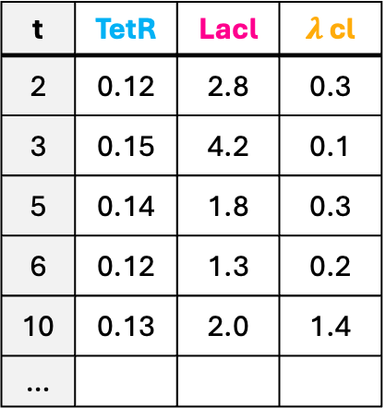
Divide data into 8 groups by scale
t | TetR | Lacl | $λ$ cl
2 | 0.12 | 2.8 | 0.3
3 | 0.15 | 4.2 | 0.1
5 | 0.14 | 1.8 | 0.3
6 | 0.12 | 1.3 | 0.2
10 | 0.13 | 2.0 | 1.4
…
t | TetR | Lacl | $λ$ cl
1 | 0.04 | 0.8 | 1.0
2 | 0.12 | 2.8 | 0.3
3 | 0.15 | 4.2 | 0.1
4 | 0.03 | 1.7 | 0.8
5 | 0.14 | 1.8 | 0.3
6 | 0.12 | 1.3 | 0.2
7 | 0.03 | 2.6 | 0.1
8 | 0.02 | 5.7 | 0.4
9 | 0.05 | 0.7 | 1.2
10 | 0.13 | 2.0 | 1.4
…
(TetR, Lacl, $λ$cl)
Data Points
(High, High, High)
0
(High, High, Low)
43
TetR >= 0.06
(211 / 421)
(High, Low, High)
72
(High, Low, Low)
96
t | TetR | Lacl | $λ$ cl
1 | 0.04 | 0.8 | 1.0
4 | 0.08 | 1.7 | 0.8
7 | 0.03 | 2.6 | 0.1
8 | 0.02 | 5.7 | 0.4
9 | 0.05 | 0.7 | 1.2
…
(Low, High, High)
97
TetR < 0.06
(210 / 421)
(Low, High, Low)
71
(Low, Low, High)
42
(Low, Low, Low)
0

Slide 7





Assuming negative self regulation, we couldn’t get correct result
(C, T)
+
-
Window with correct result
(TetR, Lacl)
0 | 0
0.333 | 0.167
0.167 | 0.167
0.5 | 0.333
0.333 | 0.167
0 | 0.167
(TetR, Lacl, $λ$cl)
(Lacl, TetR)
(Low, High, Low)
(TetR, $λ$cl)
(High, Low, Low)
Need to figure out why
($λ$cl, TetR)
(Lacl, $λ$cl)
($λ$cl, Lacl)
(Low, High, High)
TRS (ratio of windows)
: expected result

Slide 8
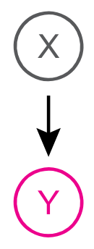
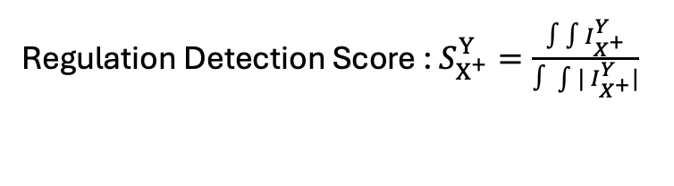

Feedbacks from poster session that can address efficiency problem :
1. Instead of integrating Regulation Detection Function, how about counting where it is positive?
Ex)
?
Regulation Detection Function : $I_{X^{+}}^{Y}=X^{d} × {\dot{Y}}^{d}$
Regulation Detection Score : $S_{X^{+}}^{Y}=\frac{∫∫I_{X^{+}}^{Y}}{∫\int{| I_{X^{+}}^{Y}|}}$
(Since we have discrete data, we sum up $I_{X^{+}}^{Y}$ for all pairs of $\left(t, t^{∗}\right)$)
Since we sum up $I_{X^{+}}^{Y}$, small values are neglected by big values.
What if we define Regulation Detection Score as : $S_{X^{+}}^{Y}=\frac{( \# of \left(t, t^{∗}\right) where I_{X^{+}}^{Y} > 0 )}{( \# of \left(t, t^{∗}\right) where X^{+} > 0 )}$

Slide 9
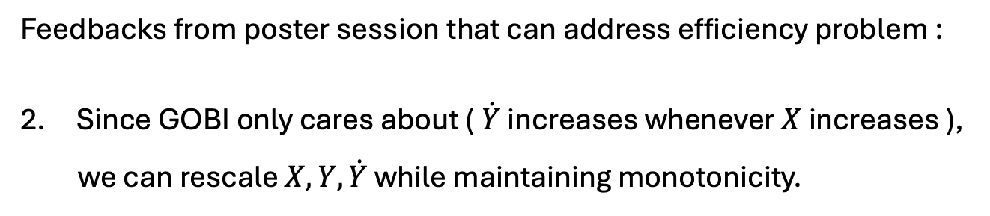





Feedbacks from poster session that can address efficiency problem :
Since GOBI only cares about ($\dot{Y}$ increases whenever $X$ increases ),
we can rescale $X, Y, \dot{Y}$ while maintaining monotonicity.
Ex)
$$X$$
$$X$$
1
1
0.9
0.75
0.5
0.002
0.001
0.25
$$t$$
$$t$$
If Regulation Detection Function : $I_{X^{+}}^{Y}$ is positive
Still positive
Time series $→$ Calculate derivative $→$ Rescale $→$ Run GOBI

Slide 10
Appendix

Slide 11
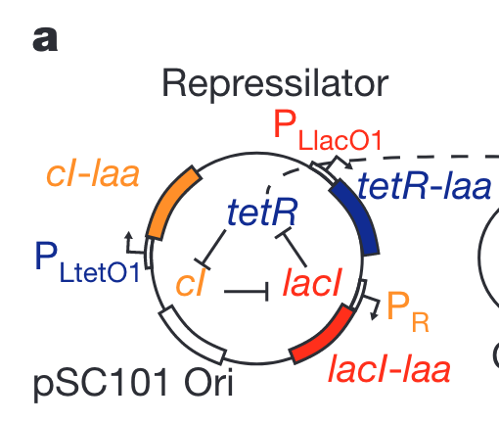
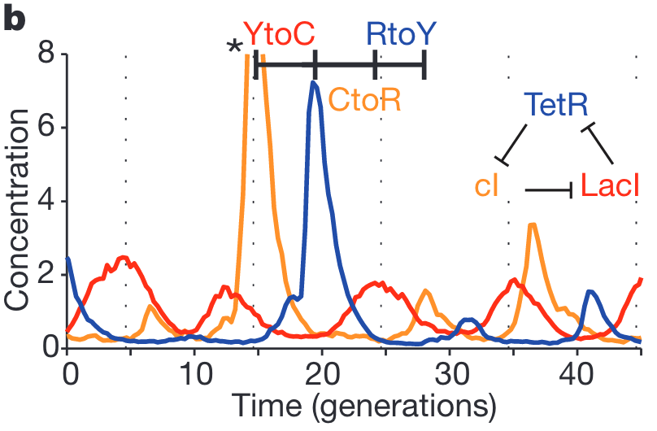
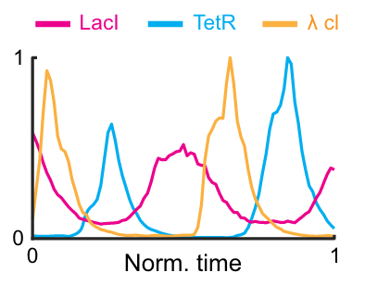
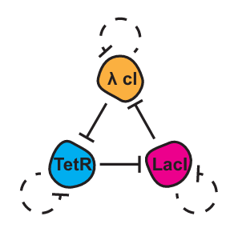
There’s something wrong with labeling repressilator system
1
2
Original
Potvin-Trottier, L., Lord, N., Vinnicombe, G. et al. Synchronous long-term oscillations in a synthetic gene circuit. Nature 538, 514-517 (2016)
Inference does not match
Label Matches
GOBI paper
Park, et al, A general model-based causal inference method overcomes the curse of synchrony and indirect effect. Nat Comm, (2023).

Slide 12
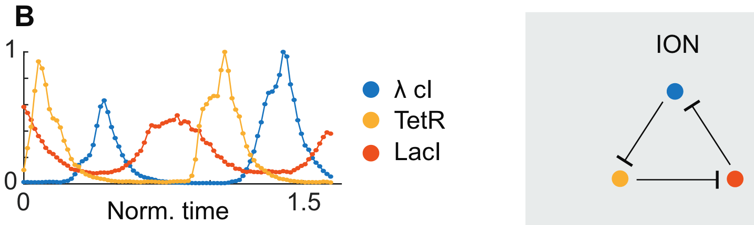
There’s something wrong with labeling repressilator system
1
2
Original
Potvin-Trottier, L., Lord, N., Vinnicombe, G. et al. Synchronous long-term oscillations in a synthetic gene circuit. Nature 538, 514-517 (2016)
Label does not match
Inference does not match
ION paper
Tyler, J., Forger, D. & Kim, J. K. Inferring causality in biological oscillators. Bioinformatics 38, 196–203 (2021).

Slide 13
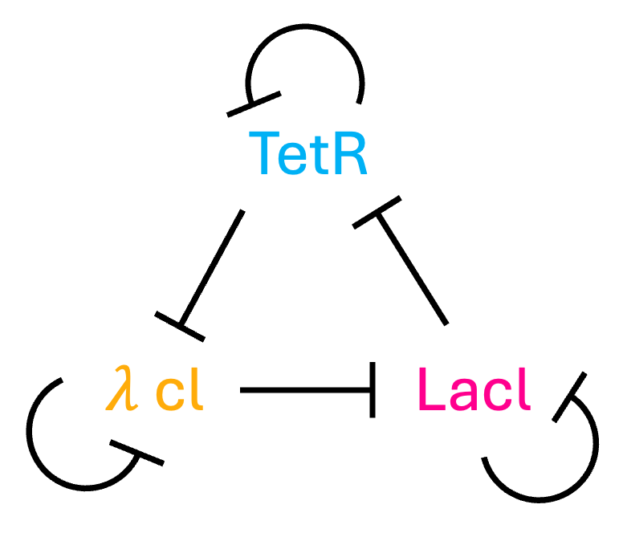
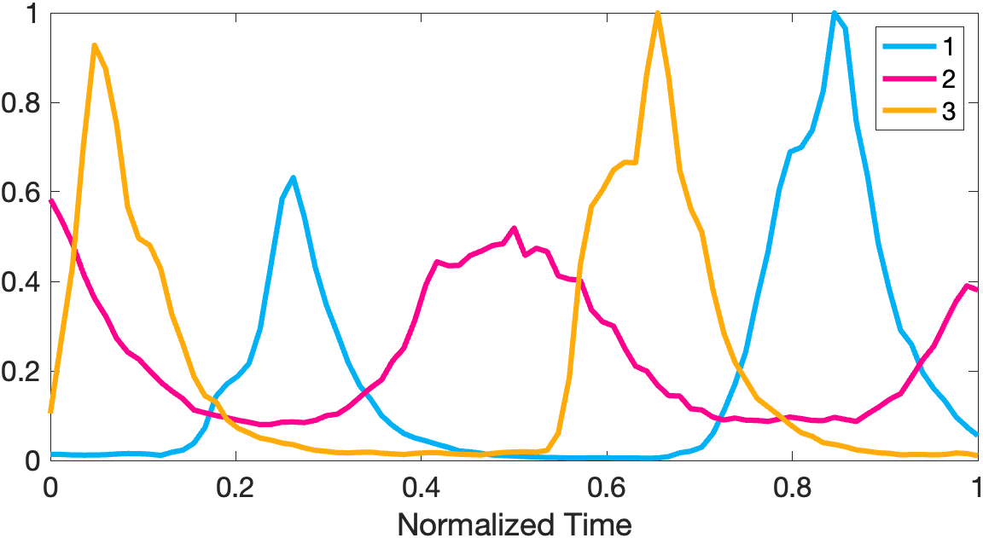
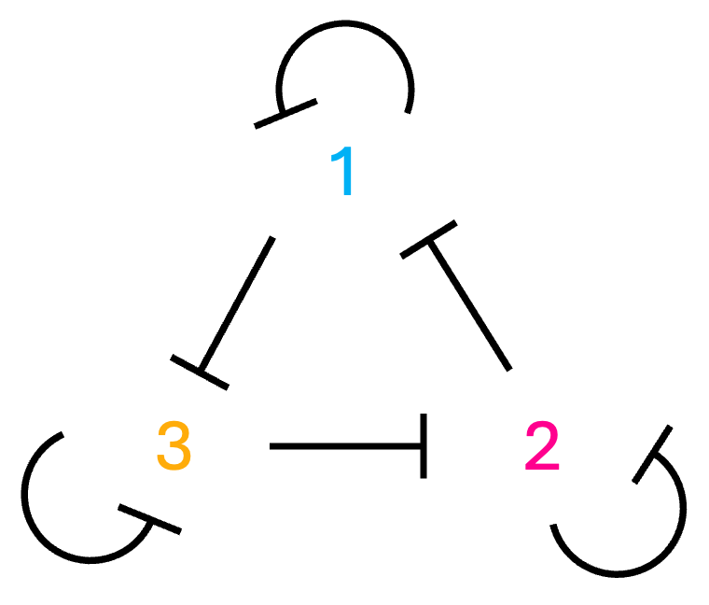
There’s something wrong with labeling repressilator system
1
2
Original
Potvin-Trottier, L., Lord, N., Vinnicombe, G. et al. Synchronous long-term oscillations in a synthetic gene circuit. Nature 538, 514-517 (2016)
Then
Inference
Matches
Label 1, 2, 3 to match
Reconstructed
From data in GOBI
Tyler, J., Forger, D. & Kim, J. K. Inferring causality in biological oscillators. Bioinformatics 38, 196–203 (2021).

