Slide 1
Inferring the network structure of plankton community using time series data
24. 06. 20
Hyunsuk Choo, SNU
Mentor: Olive Cawiding, KAIST

Slide 2
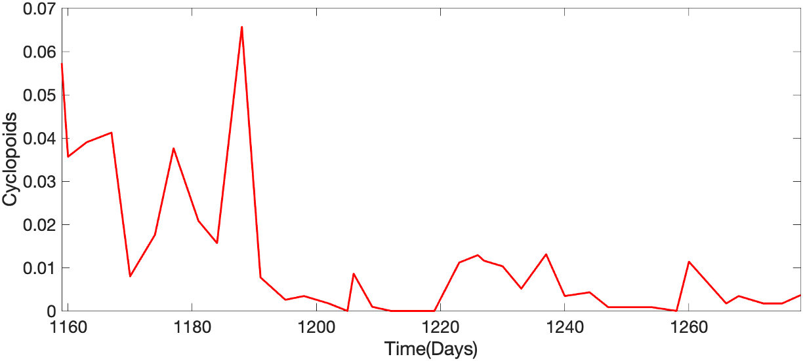
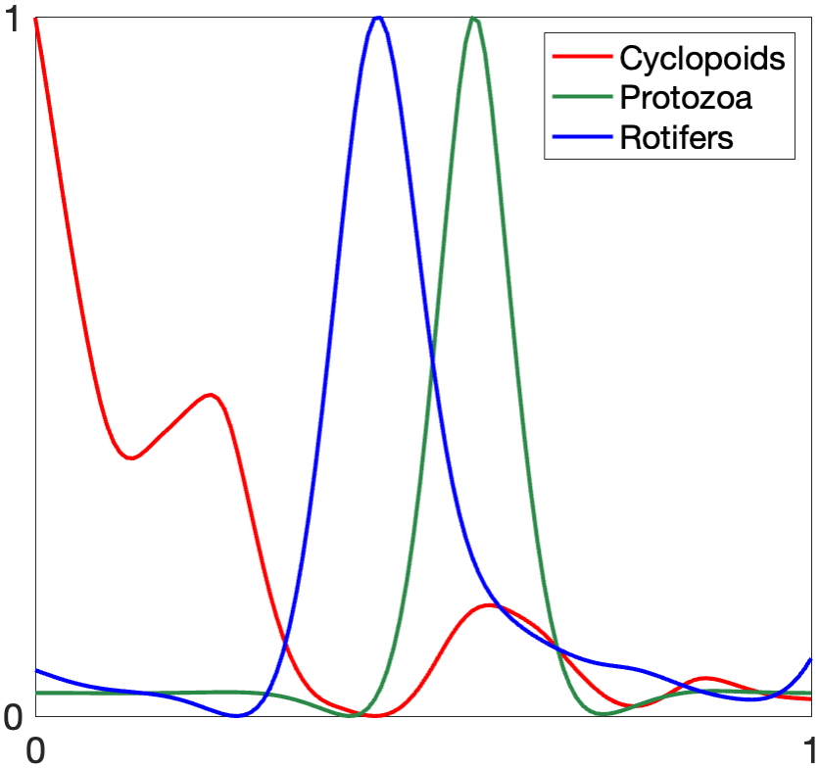
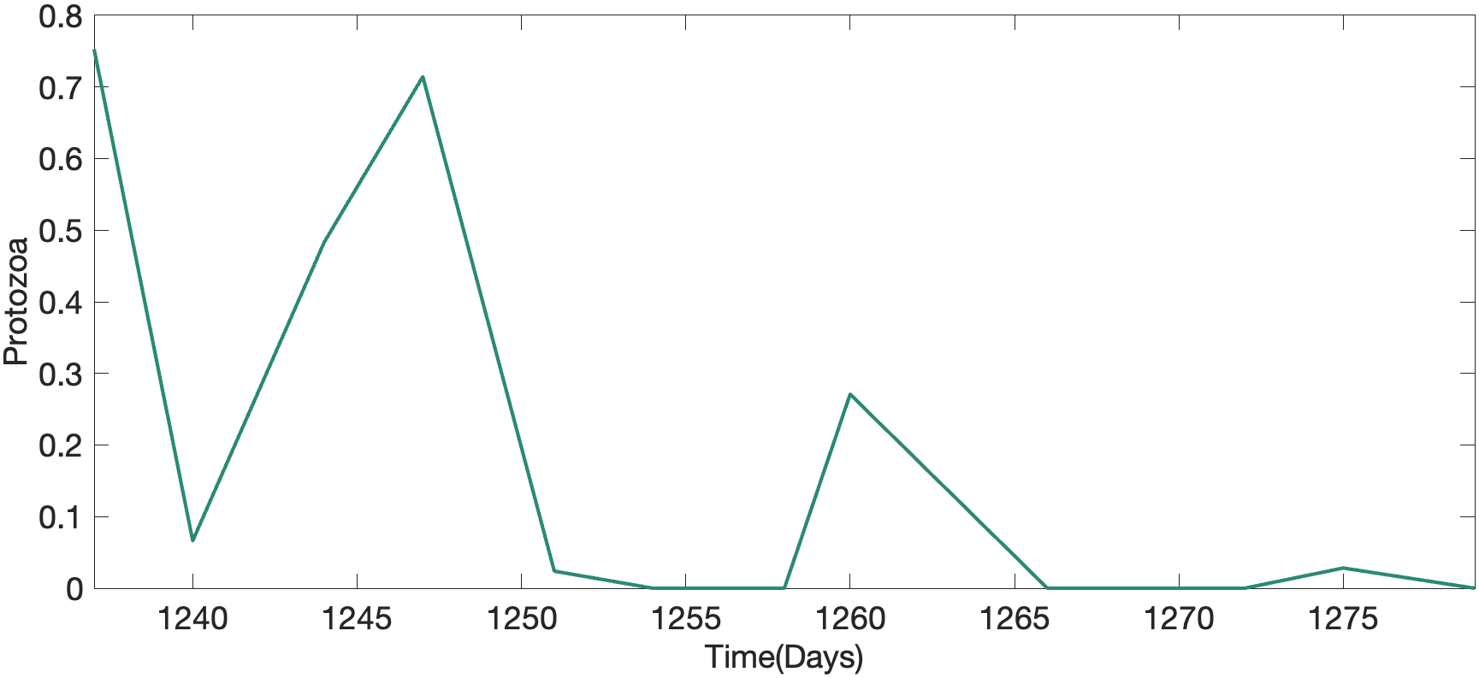
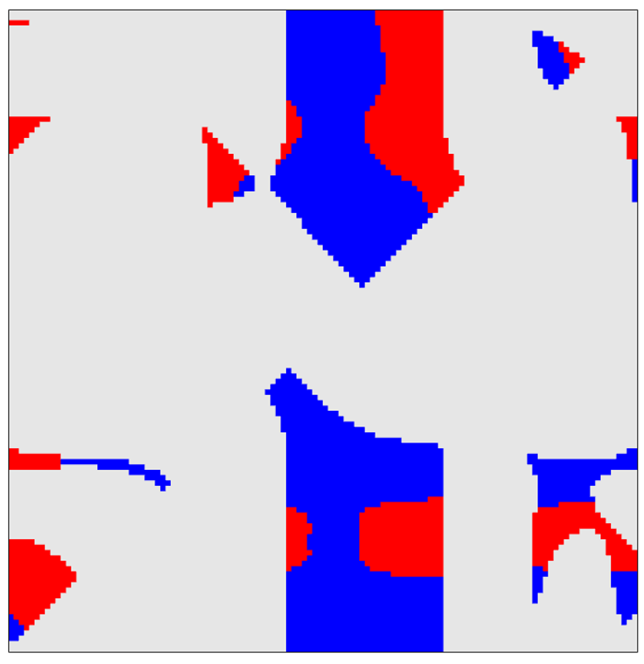
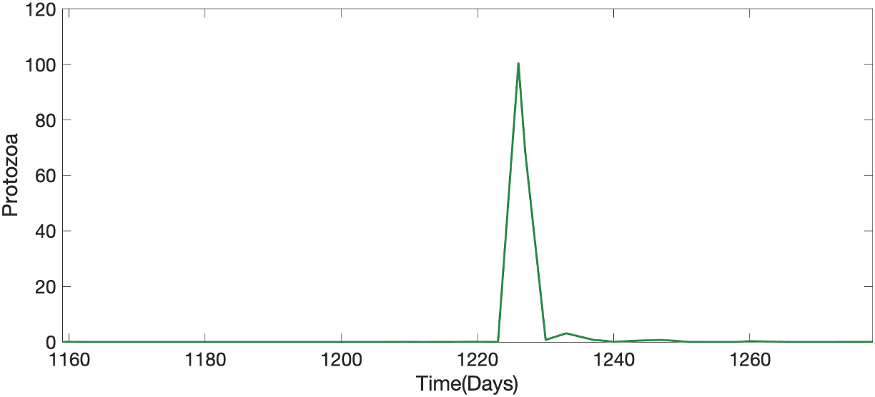
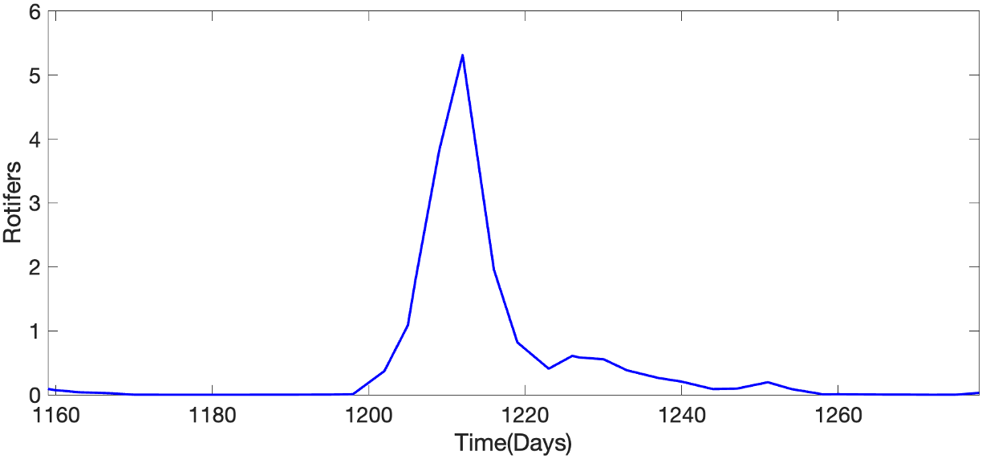
Previous work: Because of the extreme values, low values are neglected as zero
(Window 52)
Caused by peak
Nonzero values are suppressed by peak
RDS = 0.9464
RDF > 0
RDF < 0
Outside of region

Slide 3
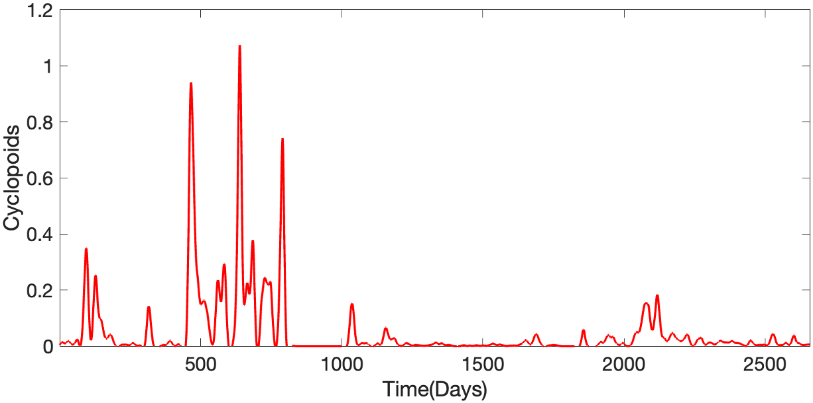
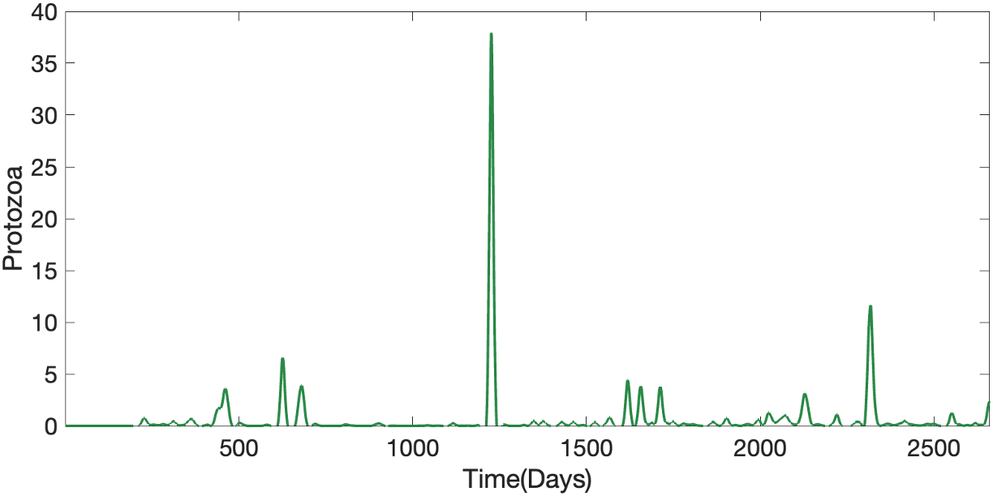
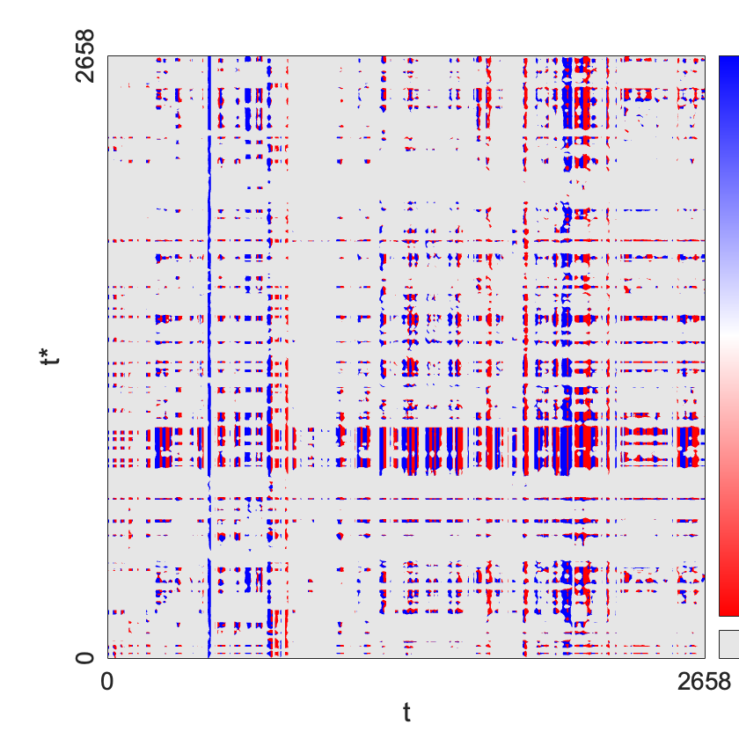
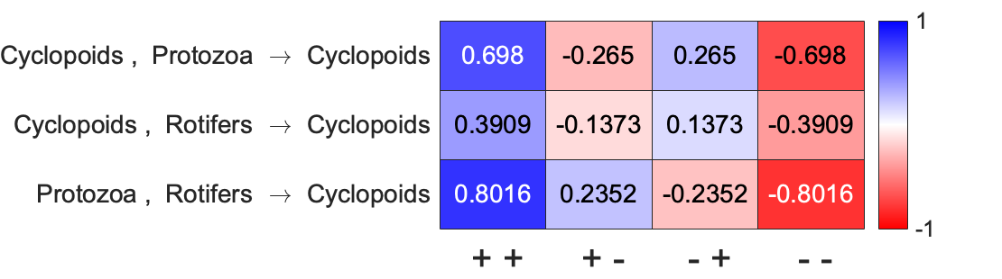
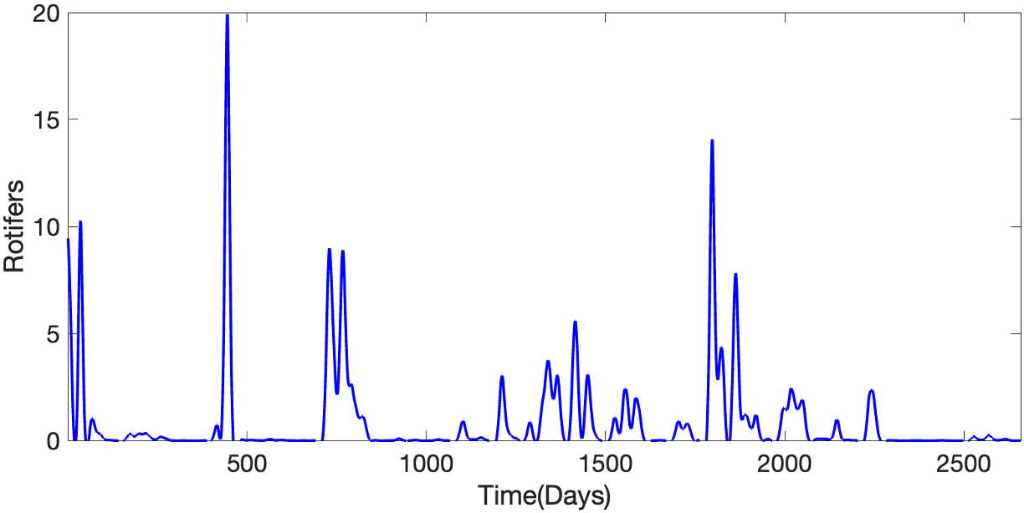
Using whole time series as one window, we can assume network with positive self regulation
Cyclopoids
Protozoa
Rotifers
RDF > 0
RDF < 0
Outside of region
Surrogate test result (p-value)
Shuffled Cyclopoids | Shuffled Protozoa | Shuffled Rotifers
0.0464 | 0.0762 | 0.0757
p-thres : 0.01

Slide 4
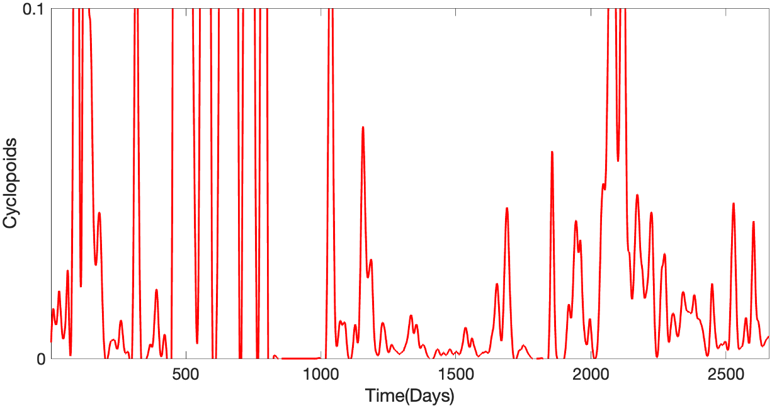
If we separate values by its scale, then we can conserve the information of low values
(Here, I determined boundary by my intuition)
High values
(>= 0.1)
Low values
(< 0.1)

Slide 5
Separating data based on Cyclopoids
t | Cyclopoids | Protozoa | Rotifers | (Cyclopoids)’
2 | 0.12 | 2.8 | 0.3
3 | 0.15 | 4.2 | 0.1
5 | 0.14 | 1.8 | 0.3
6 | 0.12 | 1.3 | 0.2
10 | 0.13 | 2.0 | 1.4
…
t | Cyclopoids | Protozoa | Rotifers | (Cyclopoids)’
1 | 0.04 | 0.8 | 1.0 | 3.37
2 | 0.12 | 2.8 | 0.3 | 2.18
3 | 0.15 | 4.2 | 0.1 | -4.3
4 | 0.08 | 1.7 | 0.8 | 3.2
5 | 0.14 | 1.8 | 0.3 | -0.6
6 | 0.12 | 1.3 | 0.2 | -4.2
7 | 0.03 | 2.6 | 0.1 | -1.2
8 | 0.02 | 5.7 | 0.4 | 3.6
9 | 0.06 | 0.7 | 1.2 | 2.6
10 | 0.13 | 2.0 | 1.4 | 1.1
…
Cyclopoids >= 0.1
(372 / 2658)
Cyclopoids < 0.1
(2286 / 2658)
t | Cyclopoids | Protozoa | Rotifers | (Cyclopoids)’
1 | 0.04 | 0.8 | 1.0 | 3.37
4 | 0.08 | 1.7 | 0.8 | 3.2
7 | 0.03 | 2.6 | 0.1 | -1.2
8 | 0.02 | 5.7 | 0.4 | 3.6
9 | 0.06 | 0.7 | 1.2 | 2.6
…

Slide 6
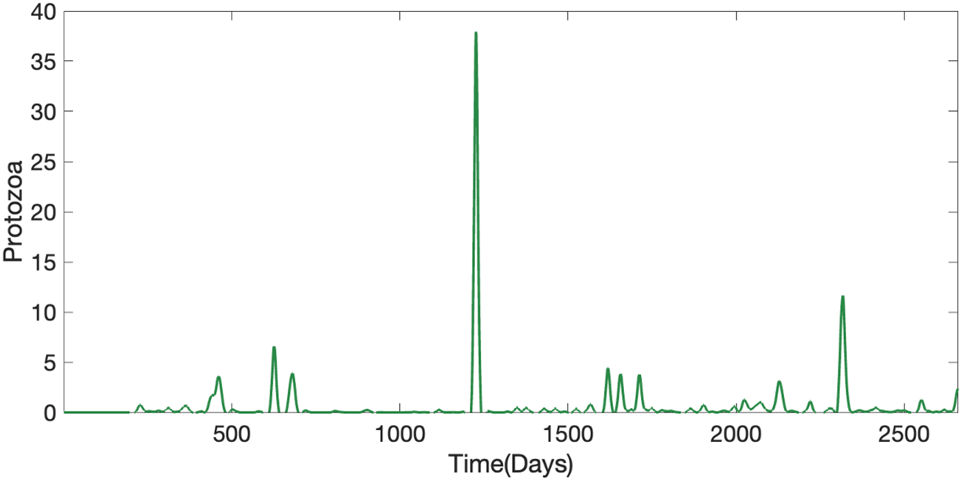
Separate Cyclopoids, Protozoa, Rotifers into high / low values
High values
(>= 1)
Low values
(< 1)

Slide 7
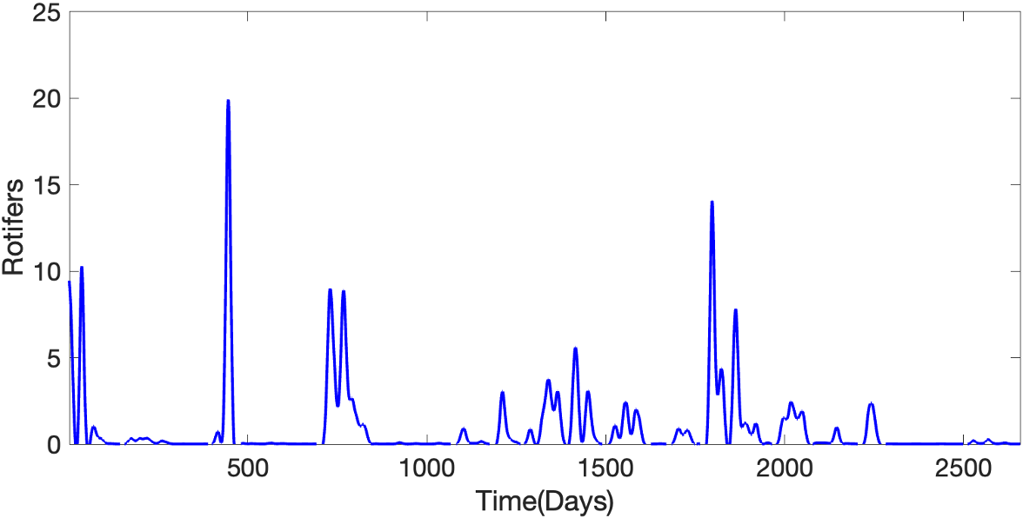
Separate Cyclopoids, Protozoa, Rotifers into high / low values
High values
(>= 0.5)
Low values
(< 0.5)

Slide 8
Different inference results came out after separation
( Protozoa, Rotifers )
( High, High )
( High, Low )
( Low, High )
( Low, Low )
Cyclopoids
Cyclopoids
Cyclopoids
Cyclopoids
( High )
Protozoa
Rotifers
Protozoa
Rotifers
Protozoa
Rotifers
Protozoa
Rotifers
( Cyclopoids )
Cyclopoids
Cyclopoids
Cyclopoids
Cyclopoids
( Low )
Protozoa
Rotifers
Protozoa
Rotifers
Protozoa
Rotifers
Protozoa
Rotifers

Slide 9
But due to the imbalance in the number of data samples, the reliability of the results decreases
( Protozoa, Rotifers )
( High, High )
( High, Low )
( Low, High )
( Low, Low )
( High )
9
67
68
228
( Cyclopoids )
( Low )
67
124
624
1471

Slide 10
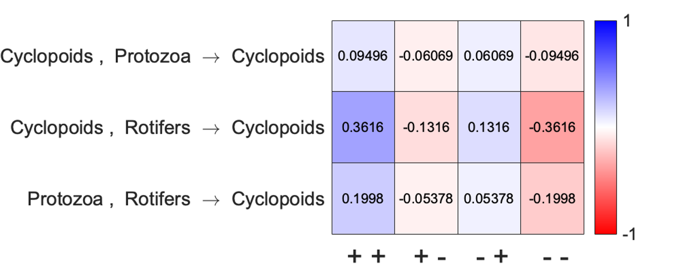
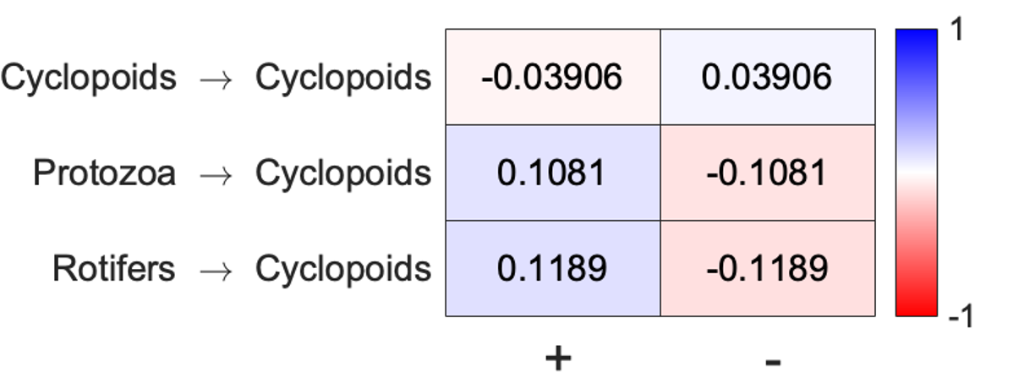
When all three components are low, no significant regulation is detected
L
L
Nearly half (1471 out of 2658) of data points are in this category,
So maybe positive and negative effects are mixed.
L

Slide 11
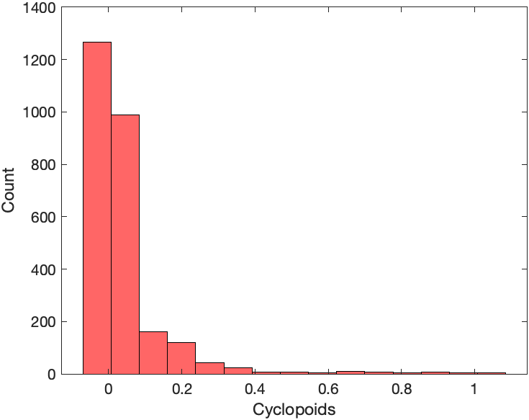
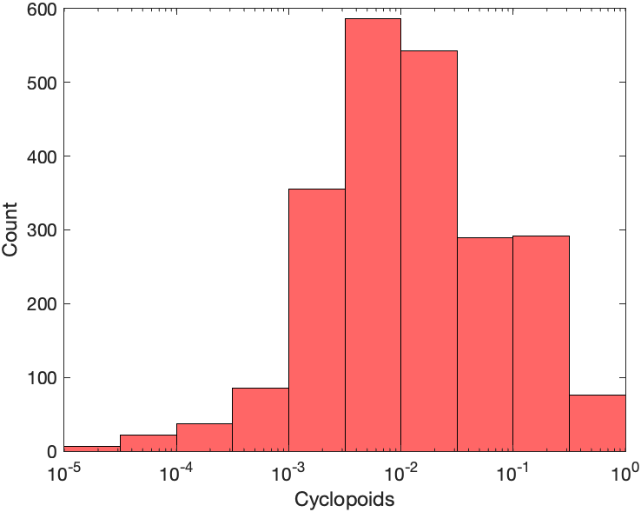
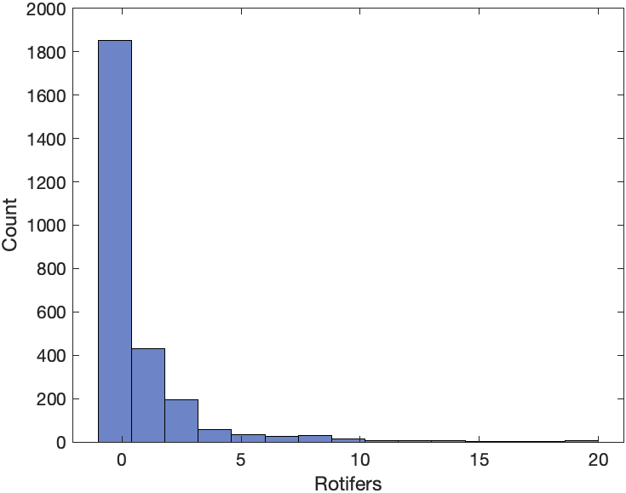
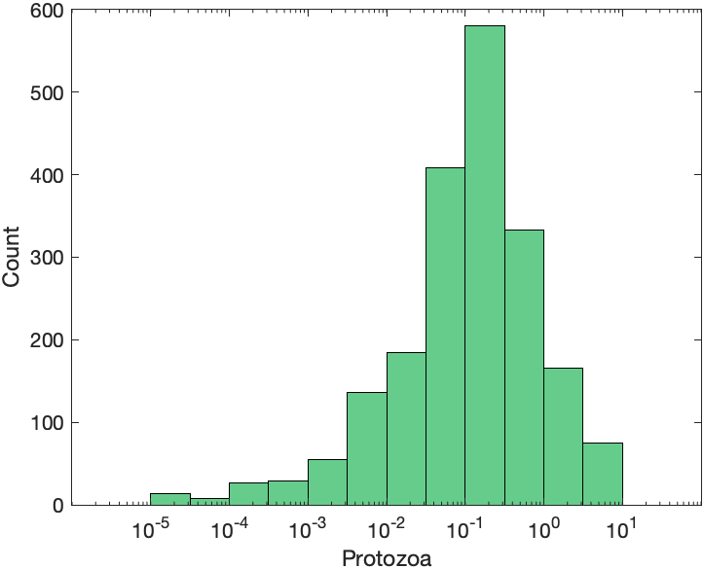
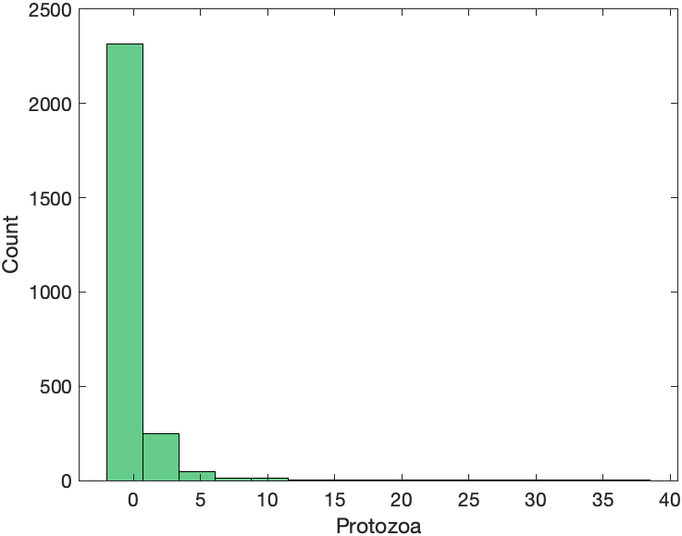
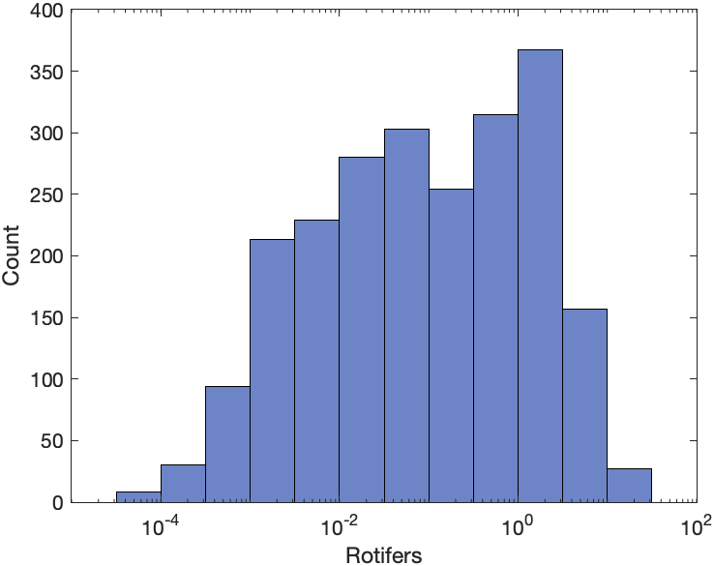
To resolve imbalance of data points, I adjusted the boundaries to the midpoint of each components
Log scale
Cyclopoids: 0.1 -> 0.0079
Protozoa: 1 -> 0.0691
Rotifers: 1 -> 0.0469

Slide 12
Luckily, separating each components in half made every section balanced
( Protozoa, Rotifers )
( High, High )
( High, Low )
( Low, High )
( Low, Low )
( High )
284
348
318
381
( Cyclopoids )
( Low )
400
297
328
302

Slide 13
By balancing every sections, inferred results were quite different, meaning that boundaries are important
(Balanced)
( Protozoa, Rotifers )
( High, High )
( High, Low )
( Low, High )
( Low, Low )
Cyclopoids
Cyclopoids
Cyclopoids
Cyclopoids
( High )
Protozoa
Rotifers
Protozoa
Rotifers
Protozoa
Rotifers
Protozoa
Rotifers
( Cyclopoids )
Cyclopoids
Cyclopoids
Cyclopoids
Cyclopoids
( Low )
Protozoa
Rotifers
Protozoa
Rotifers
Protozoa
Rotifers
Protozoa
Rotifers

Slide 14
By balancing every sections, inferred results were quite different, meaning that boundaries are important
(Unbalanced)
( Protozoa, Rotifers )
( High, High )
( High, Low )
( Low, High )
( Low, Low )
Cyclopoids
Cyclopoids
Cyclopoids
Cyclopoids
( High )
Protozoa
Rotifers
Protozoa
Rotifers
Protozoa
Rotifers
Protozoa
Rotifers
( Cyclopoids )
Cyclopoids
Cyclopoids
Cyclopoids
Cyclopoids
( Low )
Protozoa
Rotifers
Protozoa
Rotifers
Protozoa
Rotifers
Protozoa
Rotifers
Notes:
분리의 필요성 주장 -> monotonic 하지 않은 모델에서 얻어진 데이터들을 GOBI 돌렸을 때 나오는 결과,

Slide 15
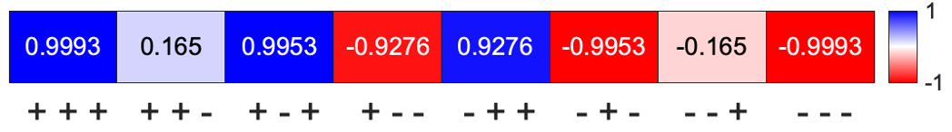
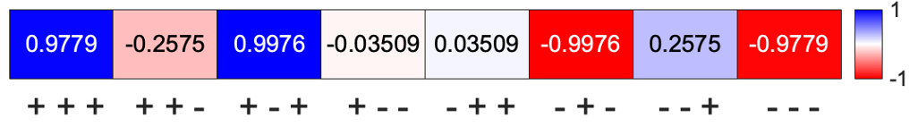

How to determine appropriate window boundary?
Maybe change continuously?
If we can find when does the result dramatically change, then it will be the appropriate boundary, and we might figure out when the $f$ of underlying ODE changes monotonicity

Slide 16






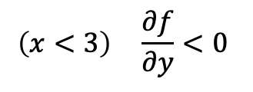
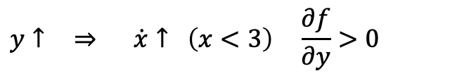
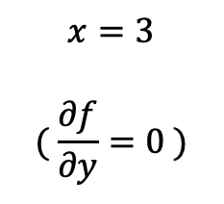






How to determine appropriate window boundary?
For example, we have a dynamic system :
$$y$$
$$\dot{x}=\left(3−x\right)y=f(x, y)$$
$$x↑ ⇒ \dot{x}↓$$
$$x$$
$$y$$
$$x$$
$$y$$
$$\dot{y}=x$$
$$y↑ ⇒ \dot{x}↑ \left(x<3\right) \frac{∂f}{∂y}>0$$
$$(x, y>0)$$
$$\left(x<3\right) \frac{∂f}{∂y}<0$$
$$y↑ ⇒ \dot{x}↓$$
$$x$$
1. Calculate RDS with small region (with dense data points)
If we ran GOBI with whole time series,
$$x=3$$
$$( \frac{∂f}{∂y}=0 )$$
2. Expand region and see when RDS dramatically changes
$$x$$
$$y$$
This would be a result
What if this boundary is complicated, not simple line?
Notes:
GOBI를 세로로 잘라야 하는 이유?
1. (출발점) 높은 값들 때문에 낮은 값들이 compress 되어 정보 가치가 떨어진다. 그래서 비슷한 값들끼리 묶어서 정보를 enrich하게 만들어야 한다.
2. non-monotonic한 경우 +와 -가 섞여서 제대로 된 결과가 안 나온다. 값의 크기에 따라 positive / negative regulation이 달라지기 때문에 세로로 자르면 결과를 얻을 수 있다.
2번으로 포커스를 맞추면 -> 1. roundf/roundx = 0 이 되는 경계를 찾아내야 하는건데, 형태가 어떨지도 모르고 어렵다. 사각형을 키우는 것으로 안 될 것이다. 각 지점마다 + - 를 찾아내서 경계를 봐야하는데 그러면 데이터가 굉장히 많이 필요하다. (component number) dimension 공간을 채워야 하므로.
그러므로 1번으로 포커스를 맞춘다. 즉, 효율적인 GOBI를 만드는 것에 목표를 둔다. 밑에 깔린 데이터들을 잘 볼 수 있다면 적은 수의 데이터로도 의미있는 결과를 얻을 수 있지 않을까? 그러니 GOBI 논문에서 쓴 모델 데이터들로 일단 그 실험을 해보자. 데이터를 적게 쓰고 결과 얻어내기.

Slide 17
Meaning of horizontal cutting should be focused on ‘data efficiency’, not ‘detecting changes of regulation’
Cutting window horizontally has two advantages :
Because we have high values and low values mixed, informations in low values are neglected. By separating values by scale, we can preserve informations in low values.
If regulations are not monotonic, regulations will be changed due to scale of values. (Ex. If Cyclopoids are high, self regulation will be negative…) By separating values by scale, we can detect the boundary of changing regulations.
But number 2 found out to be hard thing because 1) Data are not uniformly distributed, so finding boundaries & ensuring each window has sufficient data are not compatible 2) Boundaries may be complicated, but cutting horizontally means we can only check for square shaped boundaries.
So we should focus on number 1 (data efficiency).
TO-DO : For data sets that we already know it works with GOBI, we drop some data points and check horizontally cutting can detect the result with fewer data points.
Notes:
GOBI를 세로로 잘라야 하는 이유?
1. (출발점) 높은 값들 때문에 낮은 값들이 compress 되어 정보 가치가 떨어진다. 그래서 비슷한 값들끼리 묶어서 정보를 enrich하게 만들어야 한다.
2. non-monotonic한 경우 +와 -가 섞여서 제대로 된 결과가 안 나온다. 값의 크기에 따라 positive / negative regulation이 달라지기 때문에 세로로 자르면 결과를 얻을 수 있다.
2번으로 포커스를 맞추면 -> 1. roundf/roundx = 0 이 되는 경계를 찾아내야 하는건데, 형태가 어떨지도 모르고 어렵다. 사각형을 키우는 것으로 안 될 것이다. 각 지점마다 + - 를 찾아내서 경계를 봐야하는데 그러면 데이터가 굉장히 많이 필요하다. (component number) dimension 공간을 채워야 하므로.
그러므로 1번으로 포커스를 맞춘다. 즉, 효율적인 GOBI를 만드는 것에 목표를 둔다. 밑에 깔린 데이터들을 잘 볼 수 있다면 적은 수의 데이터로도 의미있는 결과를 얻을 수 있지 않을까? 그러니 GOBI 논문에서 쓴 모델 데이터들로 일단 그 실험을 해보자. 데이터를 적게 쓰고 결과 얻어내기.

Slide 18
How to determine appropriate window boundary?
Divide each component equally into n parts
Although, the combination of divided components may still be unbalanced.
Boundaries may not match with real boundaries where regulation types change.
-> Try dividing each component into 3 parts

Slide 19
Bursty data - circadian rhythm, neuronal oscillation, ecological data

