Slide 1
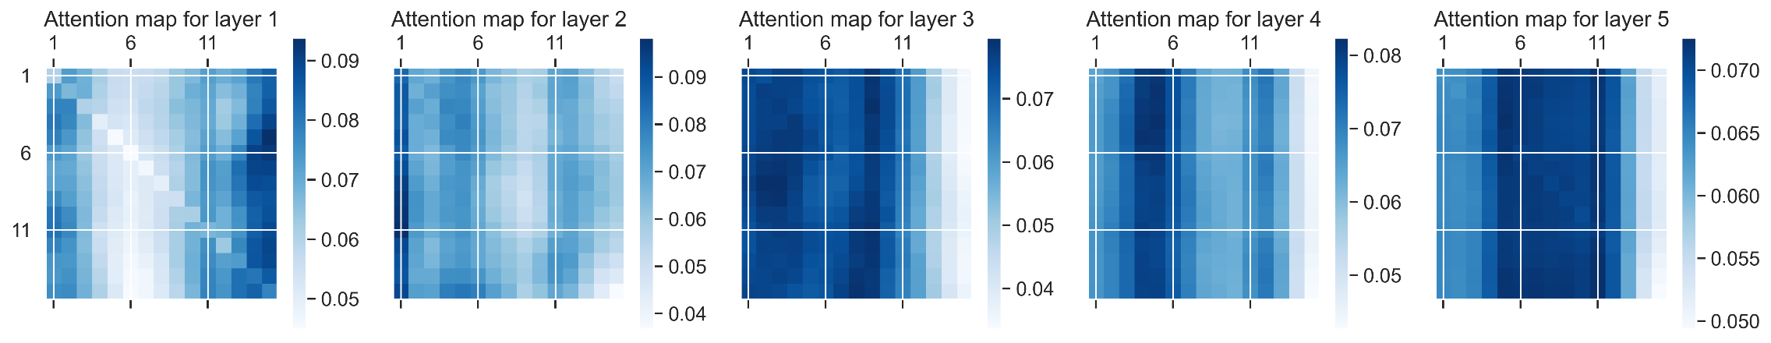
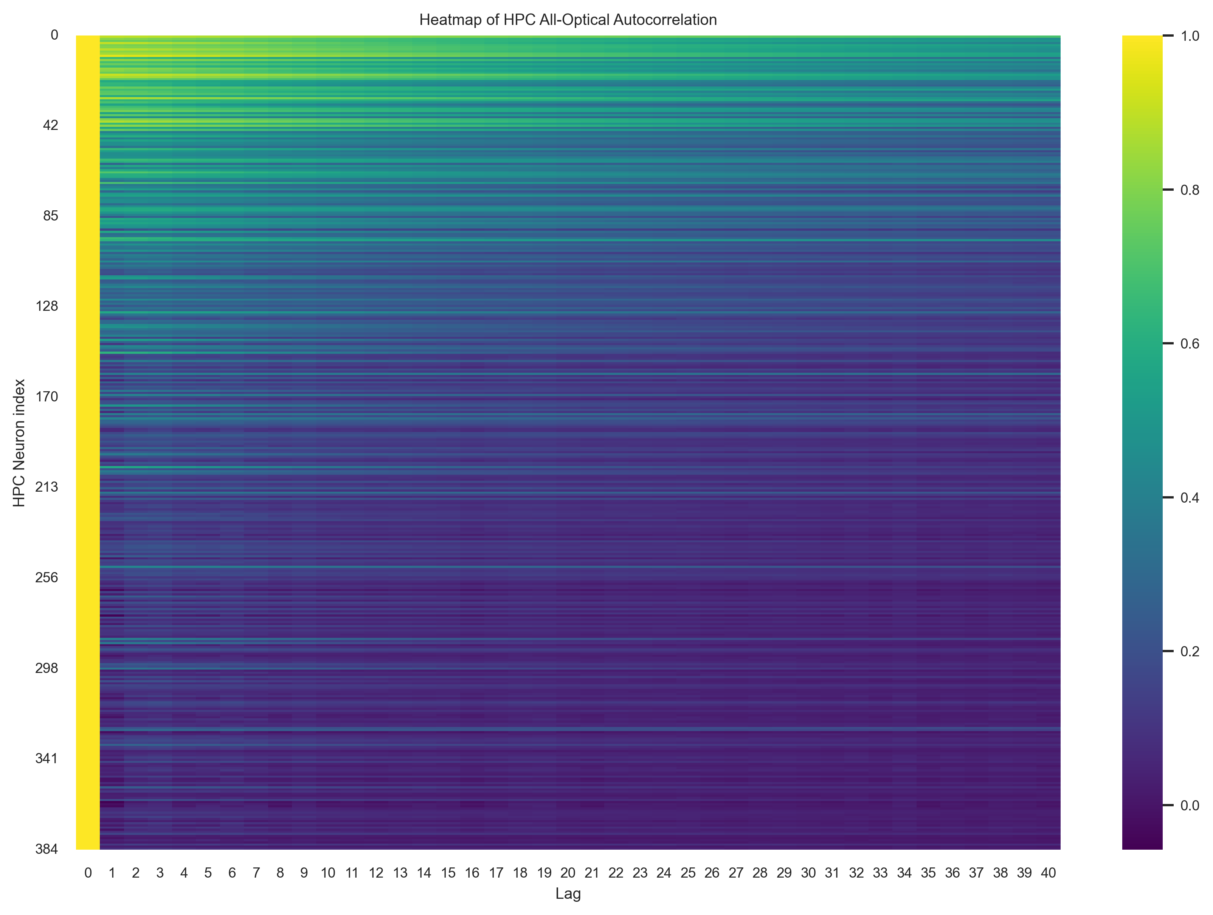
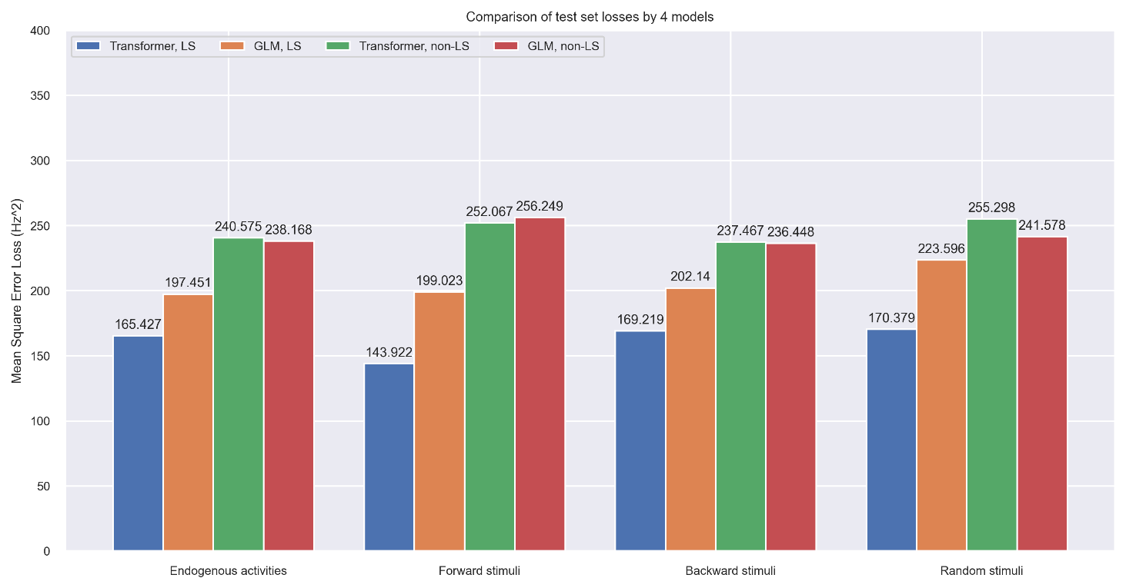
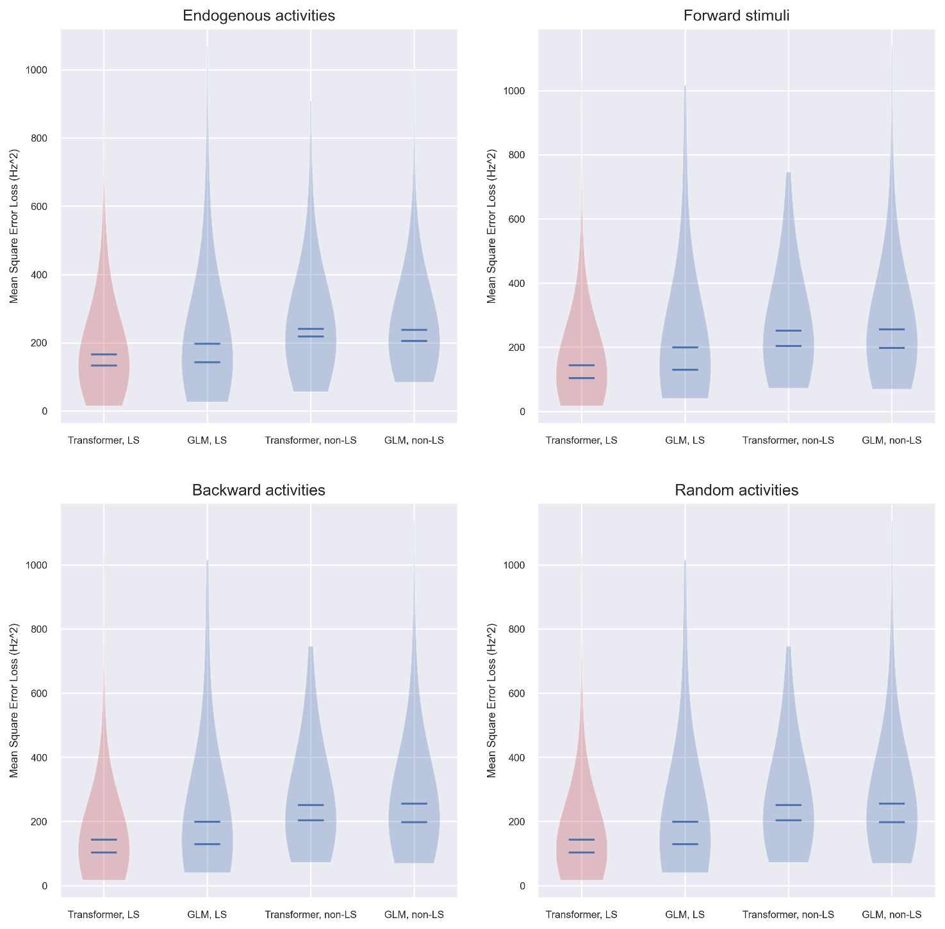
Transformer Learns HPC – LS Neural Circuit
N.Ame1*; A.Nother2,3*; & C.Barry¹
1 UCL Dept of Cell & Developmental Biology. 2 UCL Inst yyy. 3 UCL Inst of xxx. * Equal contribution. Correspondence to first.author@ucl.ac.uk or caswell.barry@ucl.ac.uk
Introduction and Motivation
Our brain is an incredibly complicated organ that processes information in a continuous manner. To understand the brain we need to understand the computations performed by neural circuits. One approach is to use observed data to distil the functions that underlie circuits into artificial neural networks. This requires us to have access to the neural data that maps between the input and output neurons of the circuit.
To do this, we optically recorded neural activities as fluorescence signals from the 384 CA1 neurons, and simultaneously recorded spikes activities in the lateral septum using Neuropixel probes. The circuit has been found to mediate spatial memory (CITE SOMETHING). We then trained sets of Transformer network models on the data pairs.
Transformer models (CITE SOMETHING) have demonstrated their potentials in high-dimensional sequential models, particularly in large language models (LLMs). Our work found that this approach also applies to learning neural data and showed superiority in both data and compute efficiency and accuracy compared to traditional GLM models.
RECORDING SET UP
INSERT COOL ANATOMY DIAGRAM HERE
Acf of GCaMP
Example of Data
CORE RESULTS
Attention Maps
CONCLUSION
Attention Maps
Accuracy vs Amount of Data
(Figures to be generated)
CORE RESULTS
Trained performance
Violin Plots
REFERENCES

