Slide 1


Slide 2




Who’s this guy?
Harikrishnan
cn_harikrishnan
harikrishnann
harikrishnan-natarajan
nharishkrish

Slide 3
Agenda
Xamarin
Prism
Xamarin Forms – Prism
A simple Xamarin Forms demo using Prism

Slide 4

Write Once, Run Anywhere

Slide 5

Xamarin + Xamarin.Forms
iOS C# UI
Android C# UI
Windows C# UI
Shared UI Code
Shared C# Backend
Shared C# Backend
Traditional Xamarin Approach
With Xamarin.Forms: More code-sharing, all native

Slide 6
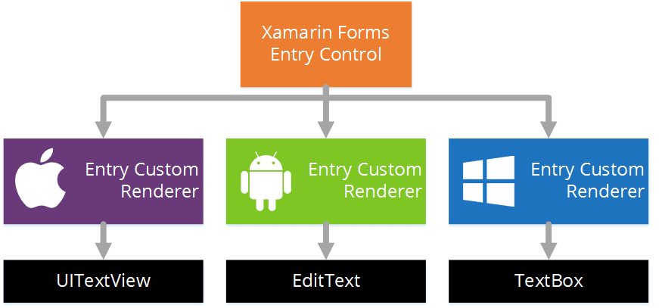
Xamarin Forms Rendering Model - Entry

Slide 7
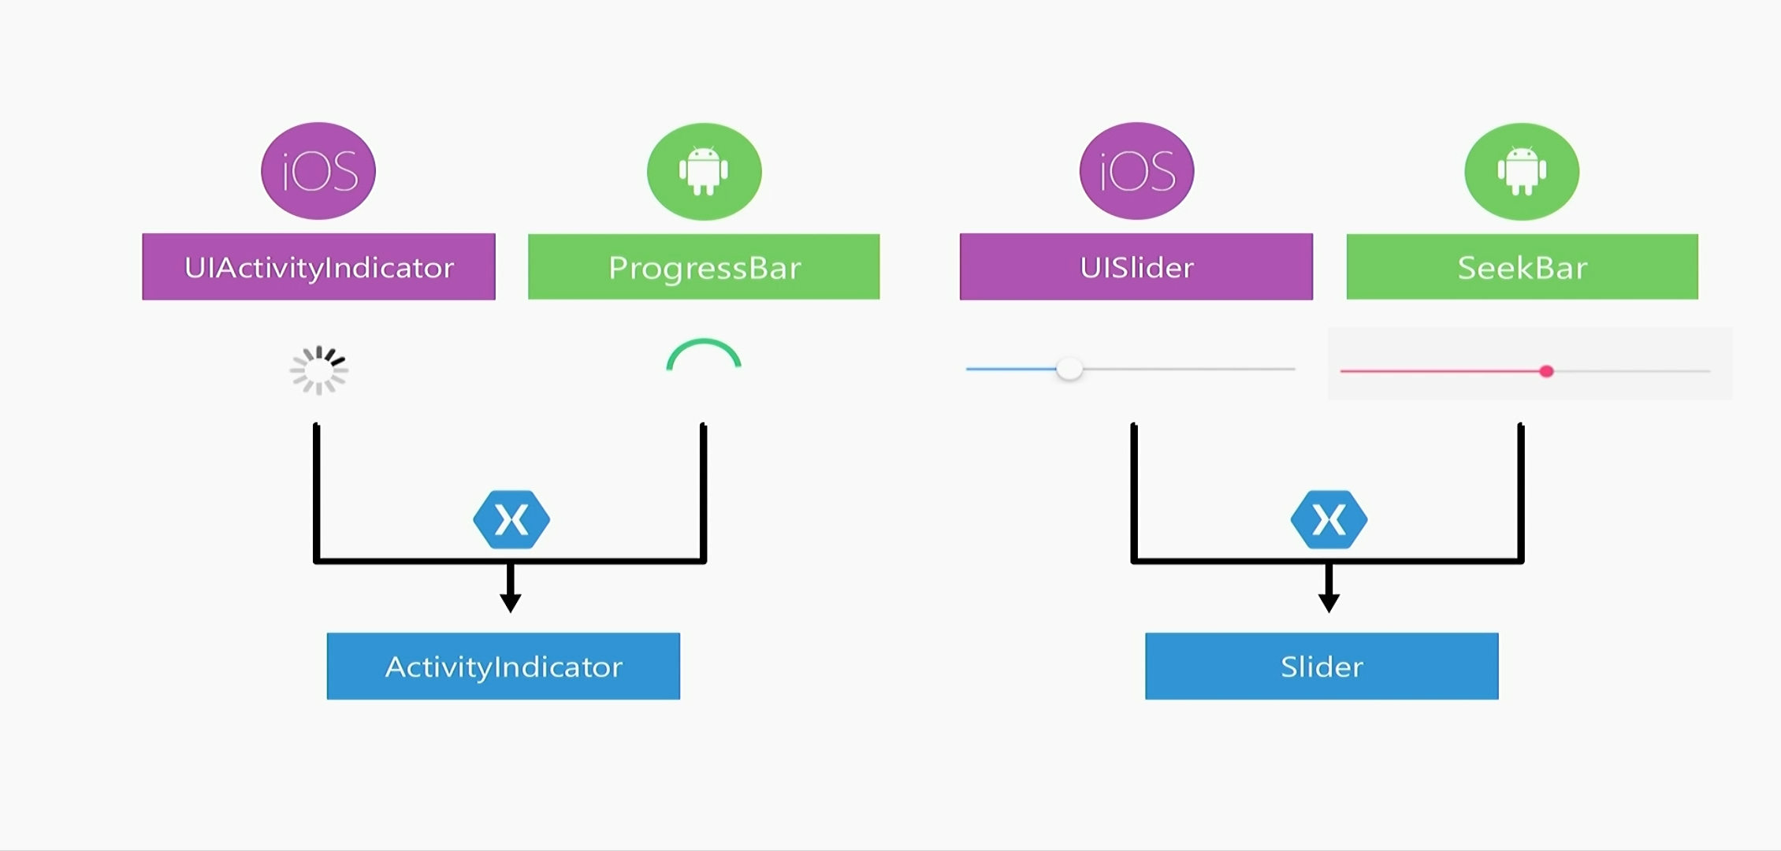
Xamarin.Forms Rendering Model

Slide 8
What’s included
✓ 50+ Pages, layouts, and controls
(Build from code behind or XAML)
✓ Two-way data binding
✓ Navigation
✓ Animation API
✓ Dependency Service
✓ Messaging Center
✓ Xamarin Essentials
Shared UI Code
Shared C# Backend

Slide 9


Slide 10
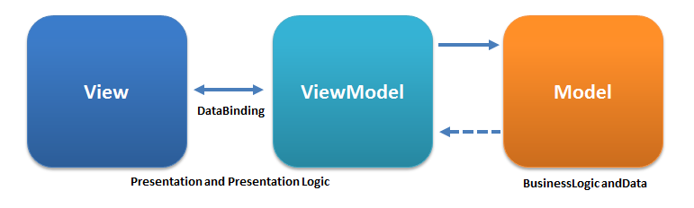
MVVM Patterns
Prism
MvvmLight
FreshMvvm
MvvmCross
Exrin
Etc…

Slide 11

Let’s get to know about

Slide 12
Prism – A framework for
✓ building loosely coupled
✓ maintainable
✓ testable XAML apps
✓ Simple, complete and handy.
✓ In other words, Prism helps us write better code.

Slide 13

Prism – What it Provides, Includes & Handles?
Provides : Implementation of a collection of design patterns that are handy in writing well-structured and maintainable XAML apps.
Includes : MVVM, dependency injection, commands, Event Aggregator, and others.
Handles : navigation, events, modules, everything a small project to a large project might need.

Slide 14
Prism : Container specific packages
Autofac
https://www.nuget.org/packages/Prism.Autofac.Forms/
DryIoc
https://www.nuget.org/packages/Prism.DryIoc.Forms/
Ninject
https://www.nuget.org/packages/Prism.Ninject.Forms/
Unity
https://www.nuget.org/packages/Prism.Unity.Forms/

Slide 15
Prism – Deep Linking
Home
Page A
Page B
Page C
Deep Linking : Intuitively create your own navigation stack of pages.
Home
Page A
Page B
Page C

Slide 16
Prism – EventToCommandBehavior
EventToCommandBehavior : Bind event to a command in View Model from XAML.
EventName : The name of the event to listen to. For example ItemTapped
Command : The ICommand that will be executed when the event is raised
CommandParameter : The parameter that will be sent to the ICommand.Execute(object) method
EventArgsConverter : Instance of IValueConverter that allows operating on the EventArgs type for the EventName
EventArgsConverterParameter : The parameter that will be sent as the parameter argument to IValueConverter.Convert method
EventArgsParameterPath : Parameter path to extract property from EventArgs that will be passed to ICommand.Execute(object)

Slide 17
Prism – EventToCommandBehavior
Declare namespace and Bind command.
<ContentPage xmlns="http://xamarin.com/schemas/2014/forms"
xmlns:x="http://schemas.microsoft.com/winfx/2009/xaml"
x:Class="MyNamespace.ContentPage"
xmlns:b="clr-namespace:Prism.Behaviors;assembly=Prism.Forms">
<ListView>
<ListView.Behaviors>
<b:EventToCommandBehavior EventName="ItemTapped"
Command="{Binding ItemTappedCommand}"
CommandParameter="MyParameter" />
</ListView.Behaviors>
</ListView>
</ContentPage>

Slide 18
Prism – Platform Services
public partial class AppDelegate : FormsApplicationDelegate, IPlatformInitializer
{
public override bool FinishedLaunching(UIApplication app, NSDictionary options)
{
global::Xamarin.Forms.Forms.Init();
LoadApplication(new App(this));
return base.FinishedLaunching(app, options);
}
public void RegisterTypes(IContainerRegistry containerRegistry)
{
containerRegistry.Register<ITextToSpeech, TextToSpeech>();
}
}
public class App : PrismApplication
{
public App(IPlatformInitializer initializer) : base(initializer)
{
}
}

Slide 19
Prism – What else it offers?
Passing & Receiving page parameters
Registering services
Displaying alerts
Delegate Commands
Bindable Base
IDestructible
Modules

Slide 20
Let's code an Application

Slide 21
Demo – What to expect?
Installing Prism Template Pack
Creating Prism Blank App
Prism Navigation
Passing & Receiving page parameters
Registering services
Displaying alerts
Deep Linking
Delegate Commands
Event To Commands

Slide 22
Reference
https://github.com/harikrishnann/2019-December-XamarinGeek
Short link
https://bit.ly/2EYDgeN

Slide 23
Any Queries?
☺
Harikrishnan
cn_harikrishnan
harikrishnann
harikrishnan-natarajan
nharishkrish

