Slide 1
Chennai – India 14 December 2019

Slide 2

Machine Learning HOL
@Chennai
Harikrishnan
Team Lead
@cn_harikrishnan
Anbu Mani
Associate Technical Analyst
@Anbu_Mani27

Slide 3






Slide 4
Walkthrough : Machine Learning HOL
Steps involved in doing ML HOL

Slide 5
Data Acquisition (Upload Data, Enter data manually, Import data)
ML Studio
Datasets
New experiment
Clean Data
Modeling
Drag the Dataset
Create/assign compute
Feature Engineering Execute Python Script or Execute R Script
Split Data
Train Model
Score Model
Evaluate Model
Deploy

Slide 6
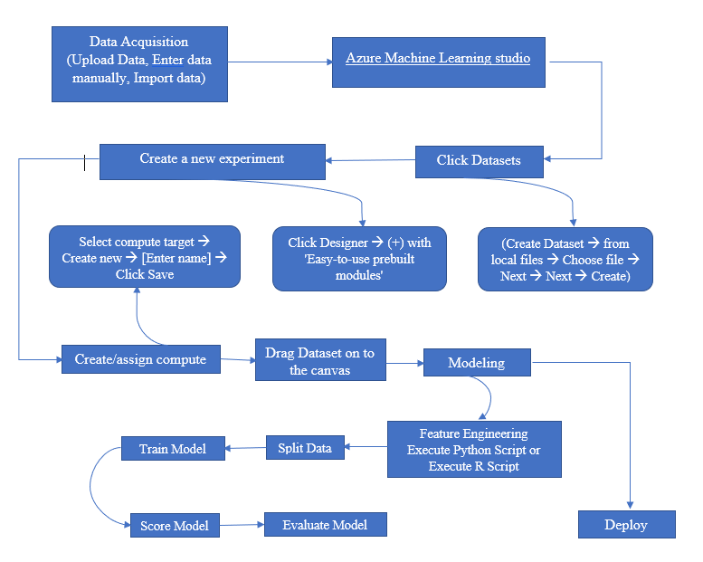
Flow chart

Slide 7
Azure Notebooks
Free service from Microsoft for anyone to develop and run code in their browser using Jupyter.
Supports Python 2, Python 3, R and F# and their popular packages
Run code, publish your experiment, Teach and its free for both computing and storage.
Learn Data Science, give a webinar online, GitHub users directly load and run notebooks by creating a GitHub launch badge, give PowerPoint like slideshows with executable code.

Slide 8
Machine Learning : HOL
Building a Machine Learning Model with the Azure Machine Learning designer to “Predict Wine Quality”

Slide 9
Reference
https://bit.ly/2PkucH3

Slide 10
Any Questions?

Slide 11
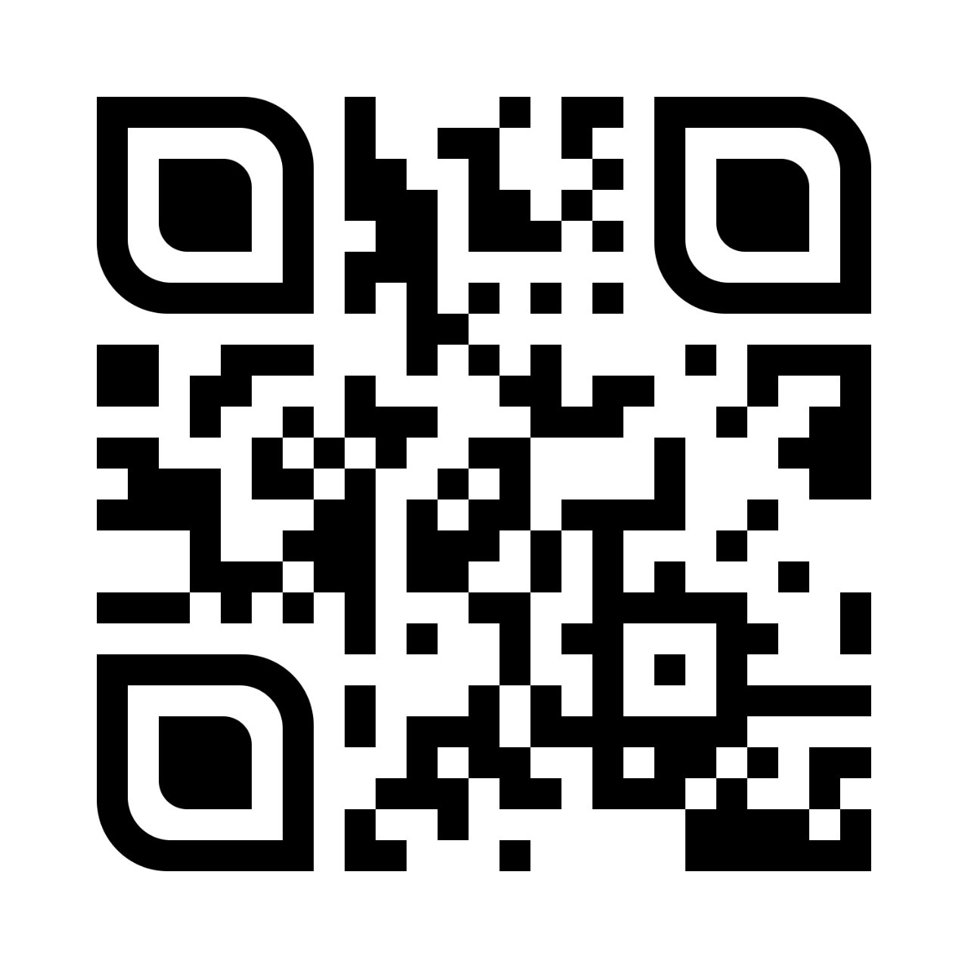
Machine Learning HOL
Harikrishnan
Team Lead
@cn_harikrishnan
Anbu Mani
Associate Technical Analyst
@Anbu_Mani27

