Slide 1
FootPrint
Audrey Tran-Thien
Hang Bui
Derek Cao
Eric Guo

Slide 2
The Problem
IntelliJ debugger will only show you current variable values
What if you overstep the debugger?
What if you want to look at a variable’s previous state?

Slide 3

Current Solution
Chronon
Reverse debugger
Only for IntelliJ Ultimate Edition
2 out of 5 star reviews

Slide 4
Our Solution
FootPrint = variable history viewer
Stores all previous values of variables and line number
Incorporates with IntelliJ’s debugger
Aimed towards students/beginners

Slide 5
Key Functions
Track local variables and fields
Track methods that were called
Live debugging

Slide 6
Demo!

Slide 7
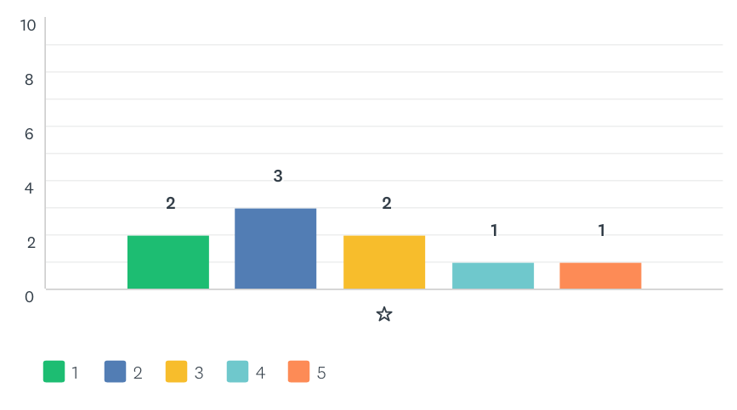
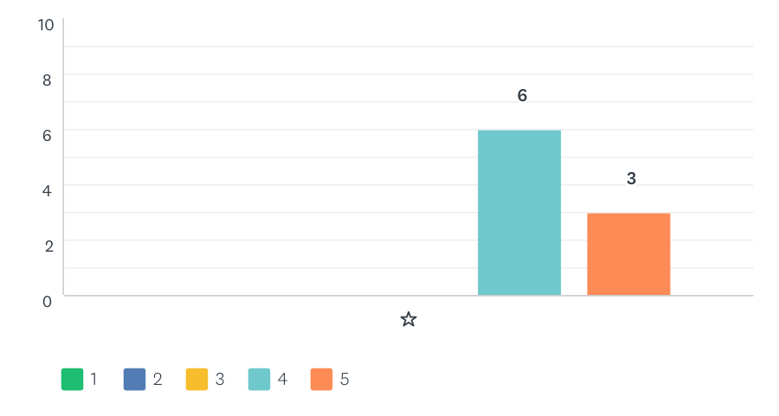
User study
Chronon’s average rating: 2.56/5
FootPrint’s average rating: 4.33/5

Slide 8
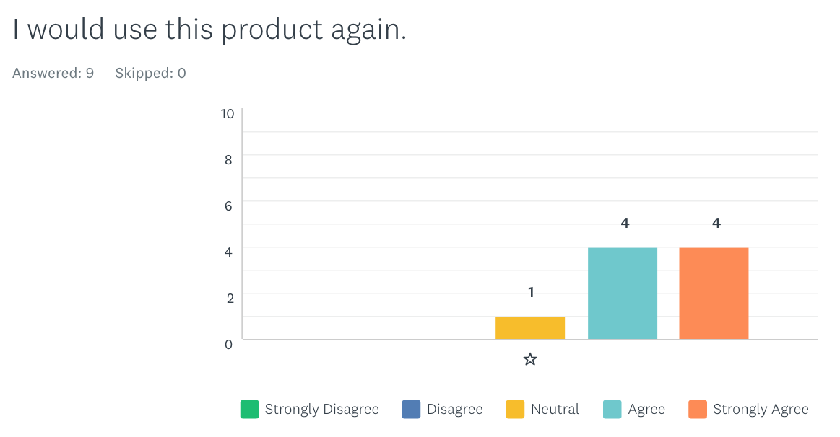
User study
Users liked:
Simple UI
Live debugging with IntelliJ
Works well with small assignments
Conclusion: achieved our goal of creating a plugin that’s easy to use

Slide 9
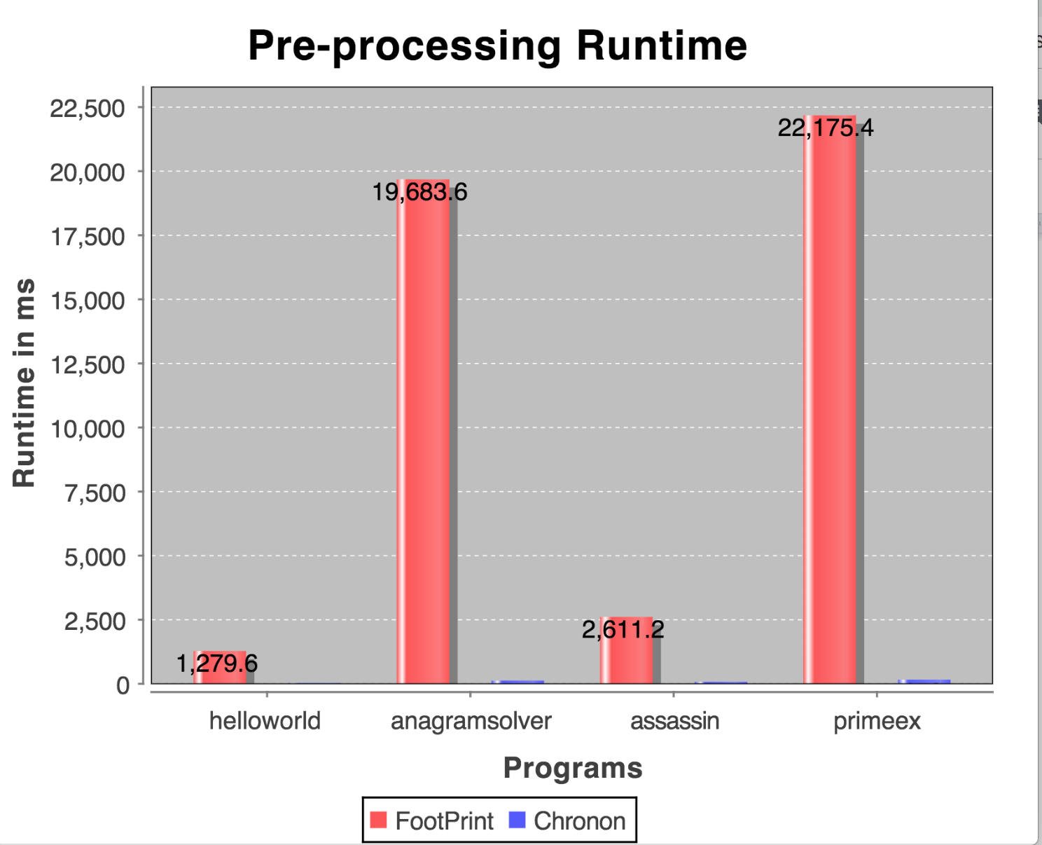
Performance Experiment
Measure pre-processing time
Use test programs from CSE 142/143 and open source
FootPrint was slower

Slide 10
Future Improvements
Make FootPrint scalable for larger programs
Do code analysis instead of setting breakpoints everywhere
Allow users to select specific variables to track in the UI

Slide 11
Conclusion
Deployed FootPrint to IntelliJ!
Successfully tracks variable histories
Easy to use and integrates with IntelliJ’s debugger
Continue to make improvements based on feedbacks

Slide 12
Thank you!

