Slide 1

Scaling AI Model Serving: QoS, Multimodality, and Beyond
Jayashree Mohan
MSR India
Microsoft Research India

Slide 2


















The era of GenAI : Powering applications
Chat
Programming
Healthcare
Finance
Biz ops
ChatGPT
LLM endpoints or hosted servers
Notes:
GenAI models are everywhere now. They're helping with finance, education, programming, and more. While these applications are exciting, there's something important happening behind the scenes. These models need huge clusters of GPUs to run. We're talking hundreds or thousands of GPUs just for one model.

Slide 3
Efficient LLM (GenAI) Inference
Scheduling and Deployment
Communication primitives
Splitwise, DynamoLLM, Mnemosyne, Cluster management (MSRA), Orca, LongContext, Sarathi [OSDI 24], ModServe, Niyama [Arxiv]
MSCCL and MSCCL++ (MSRR), TokenWeave (Arxiv)
Scheduling and Deployment
Communication primitives
GPU kernels
Memory management
LeanAttention and TurboAttention (M365),FlashAttention-1/2/3, FlashInfer, Thunderkittens,
POD-Attention (Asplos’25)
PagedAttention (vLLM, UC Berkeley), vAttention (Asplos’25)
Memory management
GPU kernels

Slide 4
Efficient LLM (GenAI) Inference
Scheduling and Deployment
Communication primitives
Splitwise, DynamoLLM, Mnemosyne (Azure Systems Research), Cluster management (MSRA), Orca, LongContext, Sarathi, ModServe, Niyama (MSRI)
MSCCL and MSCCL++ (MSRR), TokenWeave (MSRI)
ModServe, Niyama
This talk
Scheduling and Deployment
Communication primitives
GPU kernels
Memory management
LeanAttention and TurboAttention (M365),FlashAttention-1/2/3, FlashInfer, Thunderkittens,
POD-Attention (MSRI)
PagedAttention (vLLM, UC Berkeley), vAttention (MSRI)
Memory management
GPU kernels

Slide 5
Outline
Background
Niyama : QoS-aware deployment
Modserve : Modality-aware deployment
Future landscape

Slide 6

LLM Serving
auto-regressive
KV cache
Prompt: How can Mars be transformed into a habitable planet?
Simple!
First, warm it up. It
will thicken the atmosphere
which will protect Mars from …
Weights
Prefill Phase
Decode Phase
Prompt tokens are processed in parallel
LLM instance
One token processed
at-a-time

Slide 7
Architectural Overview
output
Softmax
Linear
output
Transformer
Block-n
Linear
Attention
Linear
Transformer
Block-k
FFN
Q
K
V
GeLU
Linear
Linear
Transformer
Block-0
Layer norm
Layer norm
Token embeddings
Positional embeddings
input
Notes:
At the heart of this revolution is a simple transformer architecture. These LLMs consist of a stack of layers – transformer blocks which are identical in nature. And if we zoom into one such transformer block, there are two major components
Show two main modules – FFN and self attention
Self attention - , enabling each part of a sequence to consider all previous parts for generating a contextual representation. FFN typically consists of two linear transformations with a non-linear activation in between.

Slide 8
LLM Inference Deployment Landscape
Copilot
Summarization
Daily insights
API access
App 1
App 2
App k
App n
ROUTER
Best-effort latency-sensitive (s)
Batch jobs (24hrs)
Best-effort
Replica 1
Replica i
Replica 1
Replica i
Replica 1
Replica i
GPU
GPU
GPU
GPU
GPU
GPU
GPU
GPU
GPU
GPU
GPU
GPU
CPU
CPU
CPU
CPU
CPU
CPU
CPU
CPU
CPU
CPU
CPU
CPU
Notes:
the inference deployment landscape looks like this
There are applications with diverse requirements on latency issue requests, which are managed by a router that appropriately redirects them to a replica.
Currently, these requests are broadly divided into three classes, best-effort latency sensitive jobs for user-facing interactive applications that are latency-critical.
Then we have the batch jobs which have a loose definition of 24 hour SLO on completion, and finally a PayGo tier/API access which is also best effort – low latency when theres low load and unbounded latencies when load is high.
And today, each of these classes are served using a dedicated set of replicas to avoid any interference from each other.
Office/M365 basically provisions PTUs for each of these tiers of jobs.

Slide 9
Problems with such deployment
Silo’d deployments and dedicated instances to minimize performance interference
Operational challenges
Overload management
Higher load fluctuations per deployment
Cumbersome capacity planning for each deployment
Overall, inefficient resource usage
Even within a deployment, not all applications need the same response time
When traffic exceeds capacity, we use techniques like
Rate limiting : Doesn’t consider relative importance of requests
Short request prioritization : Starve longer but potentially important requests
copilot (s)
summarization (min)
Low throughput
Low QoS
Notes:
Now, this seems neat – so whats wrong with this deployment?
These kind of coarse-grained, silo’d deployments are operationally inefficient due to several reasons.
One, the load fluctuations within each tier would be higher, requiring aggressive autoscaling to handle it.
As you can guess, capacity planning for each tier is non trivial.
SO overall such silos result in both operational complexity and inefficient resource utilization.
Moreover, even within each tier, applications may have different latency requirements, for example today a user-facing chat application and teams meeting summarization are placed in the same tier – while the chat needs sub second latencies, the latter could do with a minute latency.
There is no way of even loosely defining the diverse latency needs of applications today – other than creating a separate silod deployment for it, which adds to inefficiency.

Slide 10
LLM Inference Deployment Landscape
Cost-Efficiency
Quality of Service (QoS)
Performance
Reliability
Operational Cost
User satisfaction
Notes:
Whenever we talk about optimizing LLM inference deployment, there are two main factors to consider
First, is the cost efficiency of inference – this involves reducing operational costs and maximizing serving throughput.
Second, we must ensure a reliable quality of service throughout load variations to retain customers.
To commoditize inference

Slide 11
Outline
Background
Niyama : QoS-aware deployment
Modserve : Modality-aware deployment
Future landscape

Slide 12

QoS
Niyama
Throughput
How to achieve high throughput while meeting QoS under practical fluctuating load?
Niyama : Idea
Define QoS classes and perform SLO-aware scheduling.
Overload management using application hints and hybrid prioritization.
Key results
20% higher serving throughput without compromising QoS
Adapt to load fluctuations while reducing request denials by an order of magnitude
Notes:
, we need to balance both these aspects carefully.
So the question we ask here is, how to maximize serving throughput while meeting QoS targets under practical load conditions?
Our key idea is to define different classes or tiers of QoS to enable SLO-aware scheduling alongside overload management
These ideas enable us to serve with about 20% higher capacity without compromising the QoS even during overloads.
In the rest of this talk, I’ll walk you through how we can achieve this.

Slide 13




Why revisit QoS in the context of LLMs?
QoS and overload management is extensively studied in networking, web services etc!
LLM workload characteristics make this problem unique & interesting!
Unique Workload
Distinct application needs
Easy to define QoS classes
LLM-specific optimizations
High predictability for prefills, unknown decode length
LLM applications need to meet different SLOs for QoS :
TTFT, TBT, TTLT
Easier to set app-dependent SLOs
Slack-aware dynamic chunking
Notes:
You might ask, why revisit QoS in the context of LLMs while it has been previously explrored in the context of networks, web services etc.
The reason is, LLM workload characteristics is unique and interesting.
Unlike traditional applications, LLMs have two distinct phases – prefill and decode, one highly predictable and other inherently unknown. We can exploit the predicatability to improve serving throughput as we’ll see later in the talk.
Moreover, different applications using the same backend model need different QoS and latency metrics – and we need to take all of these into account while making scheduling decisions.
For traditional applications, seeting a precise SLO value is very challenging; but for LLMs this is relatively easier and hence QoS-driven throughput optimizations are more practical.
And finally, the techniques employed exploit the unique characterustics of LLM inference – including their two phase execution and the variety of SLOs.

Slide 14
Challenge 1
At a given load, current silo’d deployments meet QoS at the cost of throughput
Very loose notion of SLO – no defined values
Coarse grained QoS buckets
Latency sensitive
Batch
PayGo (best effort when load is low, batch like when load is high)
Notes:
That brings us to the first challenge, we are achieving QoS targets today by throwing more money at the problem – there is scope to improve serving throughput here.

Slide 15
Idea 1 : Define QoS metrics per app
copilot
QoS 1
TTFT +TBT : 6s + 50ms
App 1
TTLT (Time to last token)
summarization
Prefill
D
D
D
D
D
QoS 2
TTLT : 600s
App 2
TTFT (Time to first token)
TBT (Time between tokens)
Daily insights
QoS k
TTLT: 6000s
App k
Notes:
So the first step is defining the QoS metrics per application.
Any LLM application would execute a request in two phases – the prefill or prompt processing stage – which is highly parallel and compute intensive. This phase produces the first output token. This is followed by an autoregressive phase that generates one decode token at a time.
For interactive user facing applications like chat, we need two latency metrics – ttft and the average TBT, for optimal user experience.
For non intercative applications, all we care about is TTLT
As a running example, lets consider three applications, one interactive and two non interactive – they can have different latency SLOs as shown here.

Slide 16
Idea 2 : QoS-aware scheduler
copilot
QoS 1
6s + 50ms
App 1
App 1
App 2
App k
summarization
QoS 2
600s
App 2
Co-locate requests from all applications and schedule them based on their deadline
Daily insights
QoS k
6000s
Use SLO slack from one request to serve a request of another tier
App k
Notes:
Once we have defined the QoS buckets per application, our idea is to then co-schedule hem all on a single cluster instead of these indepenelt silod deployemnts.
And the key intuiton as to why this works is that, when we schedule jobs with diverse requirements together, we can use the SLO slack in the execution of a request to serve requests from different QoS tiers and results in minimizing SLO violations.

Slide 17
The prefill-decode conundrum
Prefill
Decode
200x
Prefill is efficient even
at low batch sizes
100x
51x
27x
16x
Decodes can be order(s) of magnitude more expensive than prefills
Notes:
Quantitatively, what is the impact of the differences we spoke bout in prefill and decode stages?
-Prefill has constant per-token cost – saturates GPU at batch 1

Slide 18
How is scheduling done today?
Timeline
…
C_{p}
D_{p}
A_{d} , B_{d}, C_{d}, D_{d}
C, D enter
Prefill
Prioritizing
Eg: vLLM
Option 1
Decodes for requests A, B stalled
Can we process the prefill of a new request, without pausing the ongoing decodes?
A_{d} , B_{d}
C_{p} + A_{d} , B_{d}
Decode
Prioritizing
Eg: FasterTransformer
Option 2
…
A_{d} , B_{d}
A_{d} , B_{d}
B_{d}
B_{d}
C_{p}
A exits
B exits
Low batch size poor throughput
Notes:
The processing time for prefill and decode batches can be very different. Ex: 2k length prefill takes 500ms, where as a decode iterations takes 50ms.
Fix time axis
Unclear when D, E enter

Slide 19
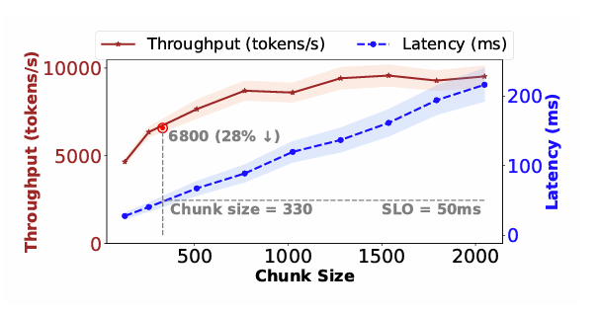
Scheduling today
Fixed chunk size
Prefill
Decodes
Sarathi - chunked prefills [OSDI’24]
Larger chunk -> better throughput, but higher latency
Notes:
Lets look at the challenges in co-scheduling requests with different QoS requirements. Lets consider 5 requests prefill and decode as shown
This is how scheduling would happen today.
In steady state, every batch processes a fixed number of tokens – called the chunk size. All the ongoing decodes are added to the batch, and the leftover token budget is allocated to prefills of pending requests. The choice of chunk size directly impacts serving throughput – higher is better, but higher also means increased latency – so based on the TBT we need to meet, in this case 50ms, we fix chunk size appropriately.

Slide 20
SLO-aware scheduling with dynamic chunking
Unaware of deadline differences
Earliest deadline first
Arrival
Treats all applications alike
Exploit predictability to increase chunk size
6000s
6s+ 50ms
600s
Deadlines
Arrival
Dynamic chunking
Deadlines
Slack
Slack
Notes:
With that background, lets consider these 5 requests that arrive in the cluster that fall into three different QoS buckets
They arrive at different times indicated by the color arrows and based on the QoS class they belong to, their deadlines are maked in appropriate colors
Today’s state of the art schedulers do the following – serve requests in their arrival order. Almost all requests miss their QoS targets. The main reason this happens is :
Unaware of different SLOs to be met by different requests
Sets a constant chunk size across the system which is an overkill for non-interactive applications that don’t care about TBT
Our solution is two fold. First, we use the QoS targets to schedule requests with the earliest deadline first. So the blue request goes before the orange one. Now we see, the blue one has finished prefills way before its expected deadline and accumulated slack – we can exploit this slack to schedule a larger chunk size now – which will result in throughput gains. But once the interactivce blue job starts its decode phase, we have to stick to the original chunk size that helps meet this job’s TBT requirement. Once it exists, we see we no longer have any other requests that impose a TBT constraint, so we can increase chunk size to maximize throughput. Essentially we are exploiting the predictable execution latency of LLMs to identify how to expand the chunk size dynamically during runtime to maximize throughput.

Slide 21
Practical Challenges Today
At a given load, current silo’d deployments meet QoS at the cost of throughput
QoS bucketing and SLO-aware scheduling on a unified deployment
Notes:
SO to summarize, we introduce fine-grained QoS bucketing and SLO-aware scheduling to maximize throughput while meeting QoS. So this handles QoS in the common case scenario. But in practical deployments, load fluctuations are extremely common

Slide 22
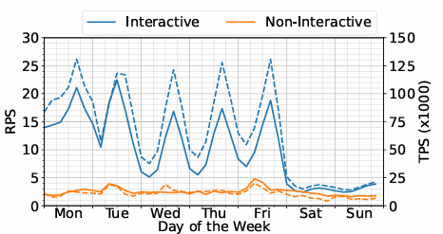
Challenge 2: Load fluctuation
GPT-4o arrival distribution over a day
Plenty of load fluctuations
New users
Failure of some replicas
Unplanned capacity reduction due to outages
For LLM serving, throughput is dictated by the composition of requests – which fluctuate even more!
Avg load across 4 models in production [Src]
[Src] : ]2502.14617
Notes:
For example, here I’ve plotted the GPT-4o arrival distribution over a day and as you can see there is significant variation in the load (requests per second) arriving at the deployments.
Further, if we look deeper into the composition of the request itself (the prefill and decode tokens), they vary significantly over time

Slide 23
What happens today?
SLO
Quality of service degrades across all requests, bloating latencies or increased service denials
Notes:
And what happens typically when load increases? To answer this, we ran an experiment where we varied load on the system beyond its ideal operating point of 3 requests per second, per replica and observe the latency of requests being served. And we’ve plotted the median, 90th and 99th percentile of request latency, in this case TTFT. What we observe is, beyond the ideal capacity point, latency of all the requests in the system severely degrade very quickly.
Essentially, it ends up degrading the quality of service for all requests by increasing the queueing delays and the a majority of requests will start missing their deadlines like a domino effect.

Slide 24
How different services deal with this today?
Current silo’d deployments meet QoS at the cost of throughput
QoS drops tremendously during load fluctuations
QoS bucketing and SLO-aware scheduling on a unified deployment
Notes:
And this brings us to the next problem with current deployments – QoS drops tremendously during overloads

Slide 25
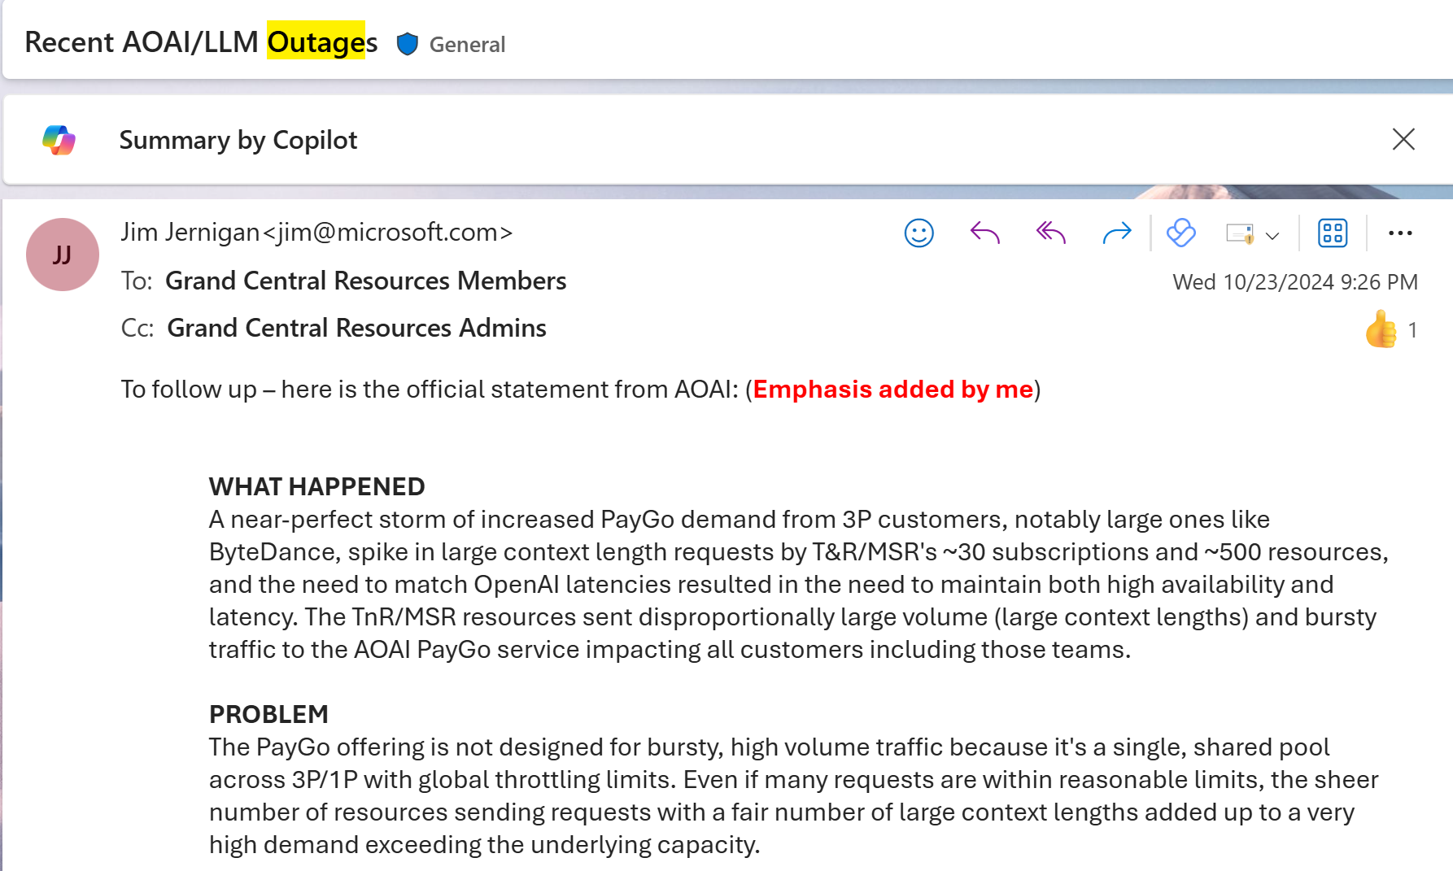

How different services deal with this today?
Substrate/AML
(Prod clusters)
Easy alternative
GCR (Research cluster)
Denial of service for all applications/customers
Throttle/Rate limit per user and per
application
Drop long requests
How to offer application-aware graceful service degradation at time of load fluctuations instead of letting all requests experience a poor QoS?
At high load, a high percentile of requests served must meet their latency SLOs at the expense of a small fraction of requests which may see increased service times or drops.
No graceful service degradation
No application or priority awareness
Notes:
So how do we handle this scenario today in our practical deployments? GCR recently faced a widespread outage of all its endpoints serving GPT-4o when a traffic burst happened. Exactly the scenario we saw in the graph I just shoed, and ended up denying service to all users alike.
Next, substrate and AML deployments impose a rate limit both at a user level and application level and throttles at an instance-level when the number of tokens received exceeds a threshold, thereby denying service to most requests at that replica.
Another easy alternative one can think of is to drop all long requests since they can block service to other jobs for a long time.
All these solutions have inherent problems. First, they don’t degrade service gracefully and start degrading QoS of majority of requests when load surges. Second, the reactive mechanisms employed such as dropping all long requests, or throttling all requests beyond a token limit have no understanding of either the latency requirement or the priority of requests.
So we want a mechanism to ensure that even during overloads, we can serve a high percentile of requests meeting their latency SLOs at the expense of a small fraction of requests that may see increased service times or even dropped entirely.

Slide 26
Intra-application prioritization
Is there a middle ground where we can keep meeting SLOs with low median, without exaggerating the tail, while not being explicitly unfair to long requests?
Tail worsens slowly beyond capacity before the system breaks down
Median latency is unaffected to a large extent
Median latency increases with load
Tail drastically worsens with load
Prioritizes short requests over long (fairness?)
Notes:
Today, we accept and schedule requests in their FCFS arrival order. we degrade all requests when load surges. Instead, we can consider a prioritization policy that favors short jobs and drops the long ones. The nice property this has is that the median is more or less stays resilient to load surges, but the tail latency drastically worsens – also the tail is skewed towards long requests – raises a question on whether this is fair to do?

Slide 27
Idea 3 : Hybrid Prioritization policy
FCFS prioritizes i over j if Arr_{i} < Arr_{j}
Shortest job policy prioritizes i over j if P_{i} < P_{j} (Execution time proportional to P)
Our prioritization:
Arr_{i}-Arr_{j} + C*(P_{i} – P_{j})
Arrival time
Prefill length
Notes:
Our solution here is to introduce a new prioritization policy that would help us tune how much weightage to place on arrival difference between requests and their length when deciding on the request priority order. This tunable metric we introduce helps us to navigate the tradeoff between median and tail latency depending on the load in the system. We can achieve low median like SJF, and lower tails like FCFS.

Slide 28
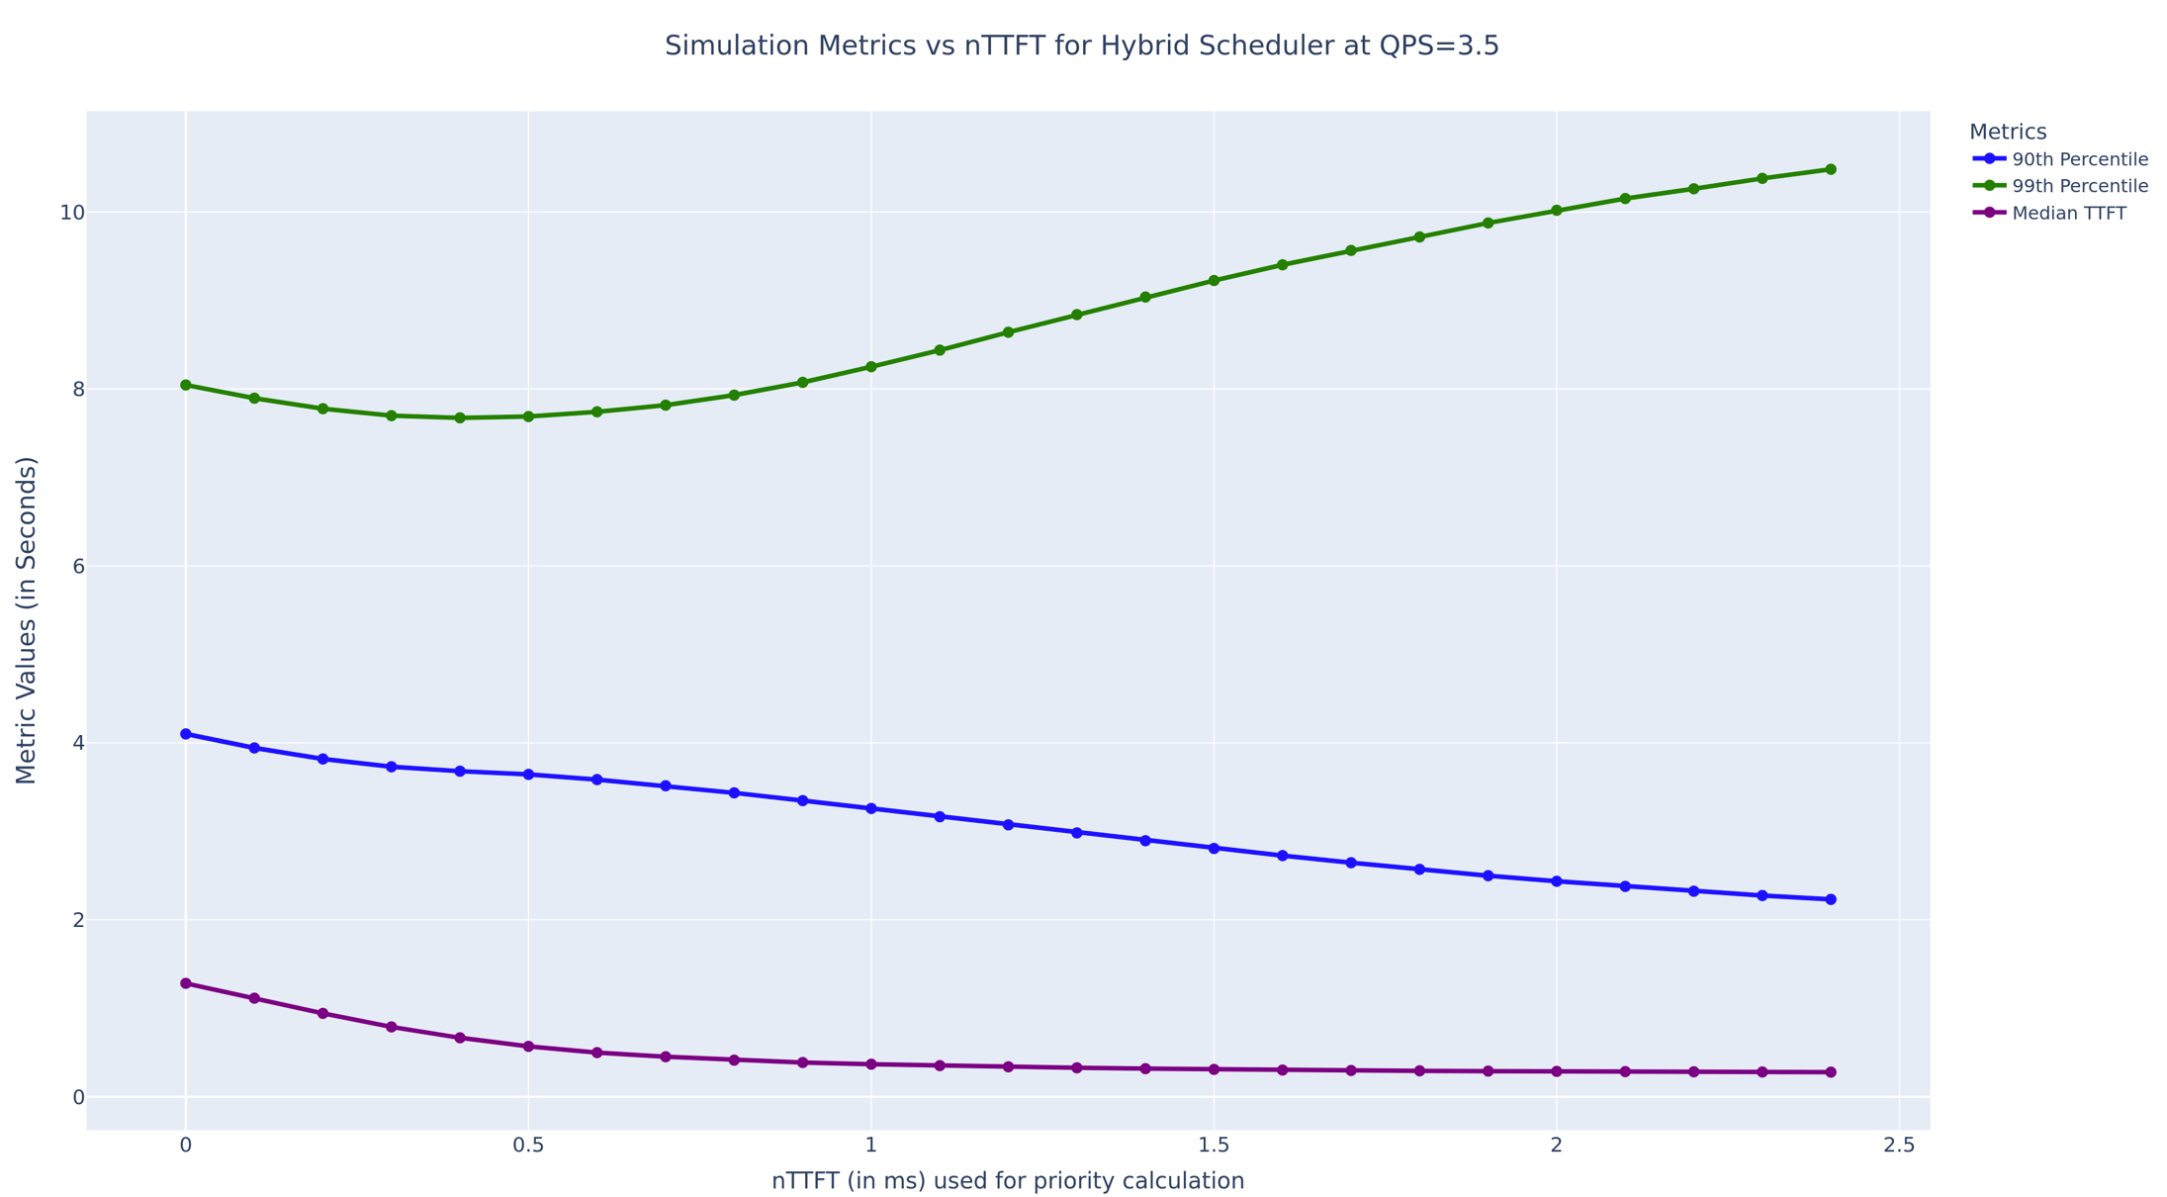
Hybrid prioritization
10
8
Provides a control knob to navigate the tradeoff between median and tail latency ( percentile of requests meeting SLOs), and selectively drop requests that may not meet the deadline..
Latency (s)
6
4
2
0
FCFS
0
0.5
1
1.5
2
2.5
Prioritize short
Constant c
Notes:
X axis is the tunable parameter that our hybrid prioritization policy introduces. Leftmost point where this const is 0 defaults strategy today and when its infinity, we tend to the policy prioritizing short jobs. What our policy provides is a tunable knob that helps us navigate the percentile of requests that meet SLA and help pick the minimum set of requests to drop, which will further help improve SLO attainment for the pending requests.
Overload beyond a point, application hints used to selectively drop requests

Slide 29
Idea 4 : Eager Relegation
Even with hybrid prioritization, overloads can break down a system, violating SLOs for most requests.
Proactively relegate a small fraction of requests which have a higher probability of violating their SLOs

Slide 30
Idea 4 : Eager Relegation
Even with hybrid prioritization, overloads can break down a system, violating SLOs for most requests.
Proactively relegate a small fraction of requests which have a higher probability of violating their SLOs
Ensures stability for majority – graceful service degradation

Slide 31
How different services deal with this today?
Current silo’d deployments meet QoS at the cost of throughput
QoS drops tremendously during load fluctuations
QoS bucketing and SLO-aware scheduling on a unified deployment
Hybrid prioritization and eager relegation
Notes:
To summarize, we introce hybrid prioritization and preferential load shedding to maintain QoS for overload management.

Slide 32




Niyama : Overall design
Idea 1 : Define QoS metrics per application
Idea 3 : Intra-application hybrid prioritization
Idea 4 : Selective
eager relegation
QoS 1
Hybrid
Prioritization
Scheduler
Prefill queue
1
Prefill
selector
2
Violation checker
QoS 2
Relegated queue
3
4
Chunk size estimator
Decode queue
5
Batch
QoS 3
Replica
GPUs
7
6
Idea 2 : QoS-aware dynamic chunking

Slide 33
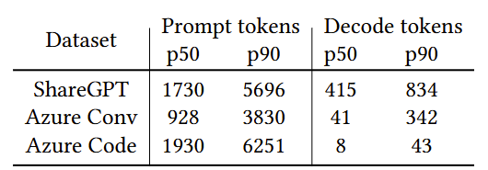
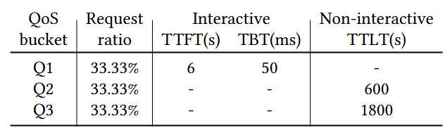
Niyama : Evaluation
Built on top of vLLM serving stack, using the Sarathi scheduler
Chunk size predictor build using profiles collected in Vidur
Datasets
Workload and SLOs
Model | GPU (#) | TP | Attention
Llama3-8B | A100 (1) | TP-1 | GQA
Qwen 7B | A100 (2) | TP-2 | MHA
Llama3-70B | H100(4) | TP-4 | GQA
Models - hardware

Slide 34
Cluster-scale e2e experiments
Eval across 4 DGX-stations (A100) = 16 GPUs
Az code trace, load : 35QPS across 30K requests and 3 QoS classes
Llama 8B TP1, p99 latencies reported below
Scheme(GPUs) | Total-GPUs | Q1(SLO-6s) | Q2(SLO-600s) | Q3(SLO-1800s) | Overall violations
Silo (7,3,3) | 13 | 3.09s | 172.84s | 171.11s | 0.24%
Silo-(6,2,2) | 10 | 11.39s | 4681.56s | 4678.17s | 60.4%
Niyama | 10 | 3.38s | 55.79s | 204.61s | 0%
23% fewer GPUs with Niyama compared to silo’d serving – while meeting QoS in all classes

Slide 35
Cluster-scale e2e experiments
Eval across 4 DGX-stations (A100) = 16 GPUs
Az code trace, load : 35QPS across 30K requests and 3 QoS classes
Llama 8B TP1, p99 latencies reported below
Scheme(GPUs) | Total-GPUs | Q1(SLO-6s) | Q2(SLO-600s) | Q3(SLO-1800s) | Overall violations
Silo (7,3,3) | 13 | 3.09s | 172.84s | 171.11s | 0.24%
Silo-(6,2,2) | 10 | 11.39s | 4681.56s | 4678.17s | 60.4%
Niyama | 10 | 3.38s | 55.79s | 204.61s | 0%
23% fewer GPUs with Niyama compared to silo’d serving – while meeting QoS in all classes
Given the same resources, silo’d deployment violates SLOs for 60% of the requests

Slide 36
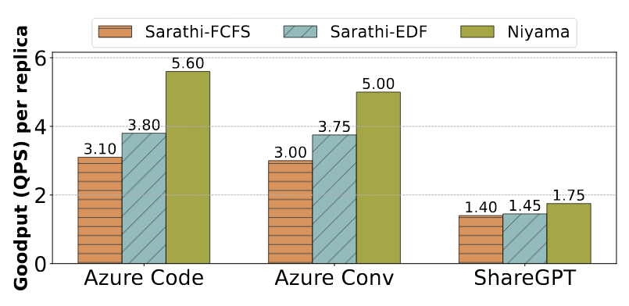
Shared cluster experiments
Goodput while serving a 4 hour trace of Az-Code
Highest load where p99 SLO is met (1% violations permissible)
1.5-2.4x higher goodput compared to Sarathi
Maximum goodput in a shared cluster – Qwen 7B TP2

Slide 37
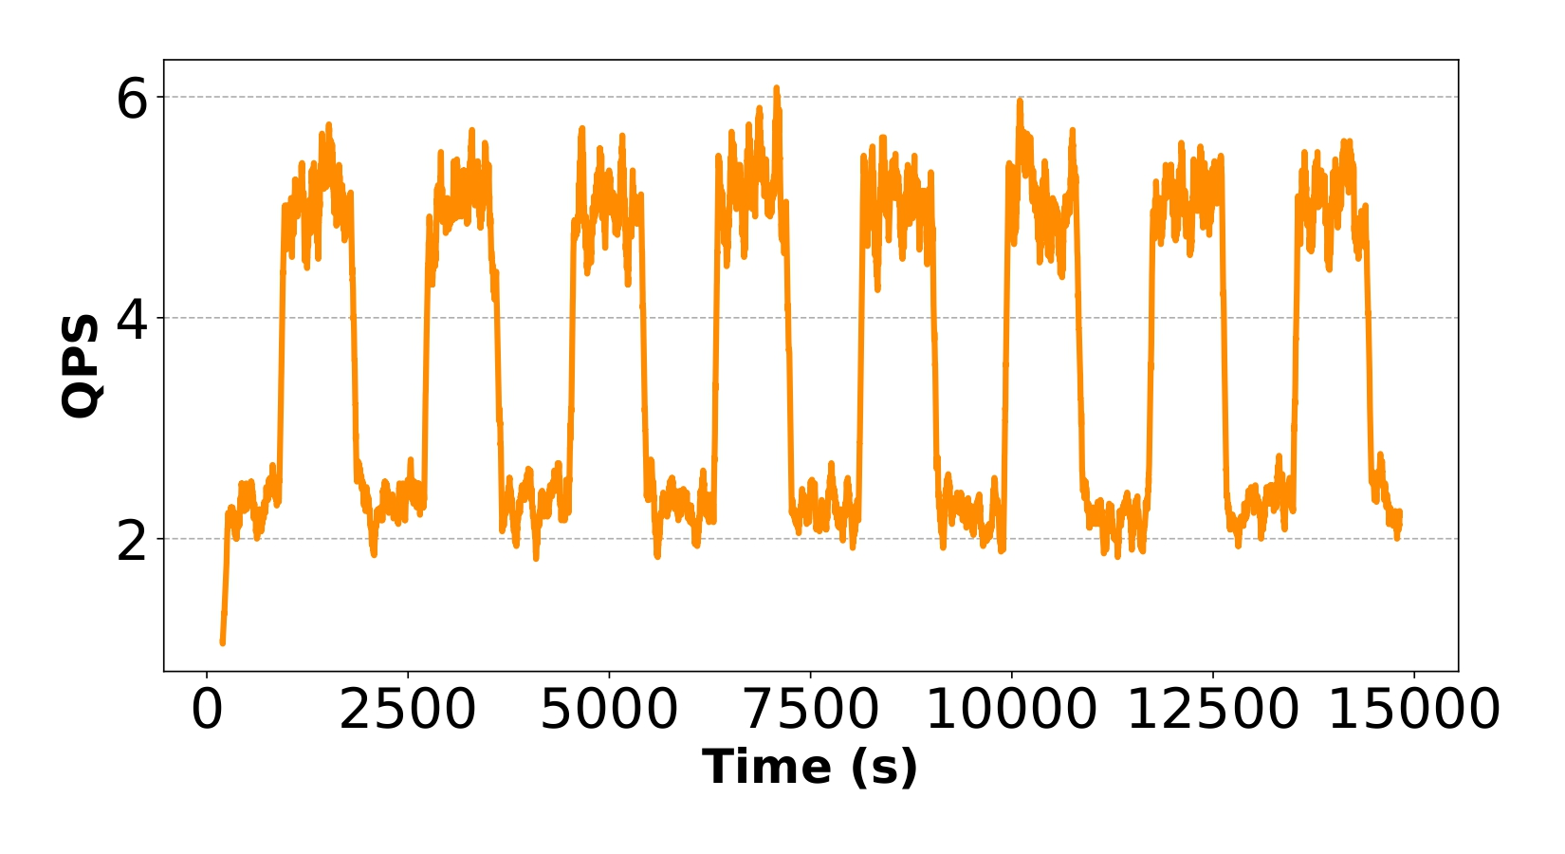
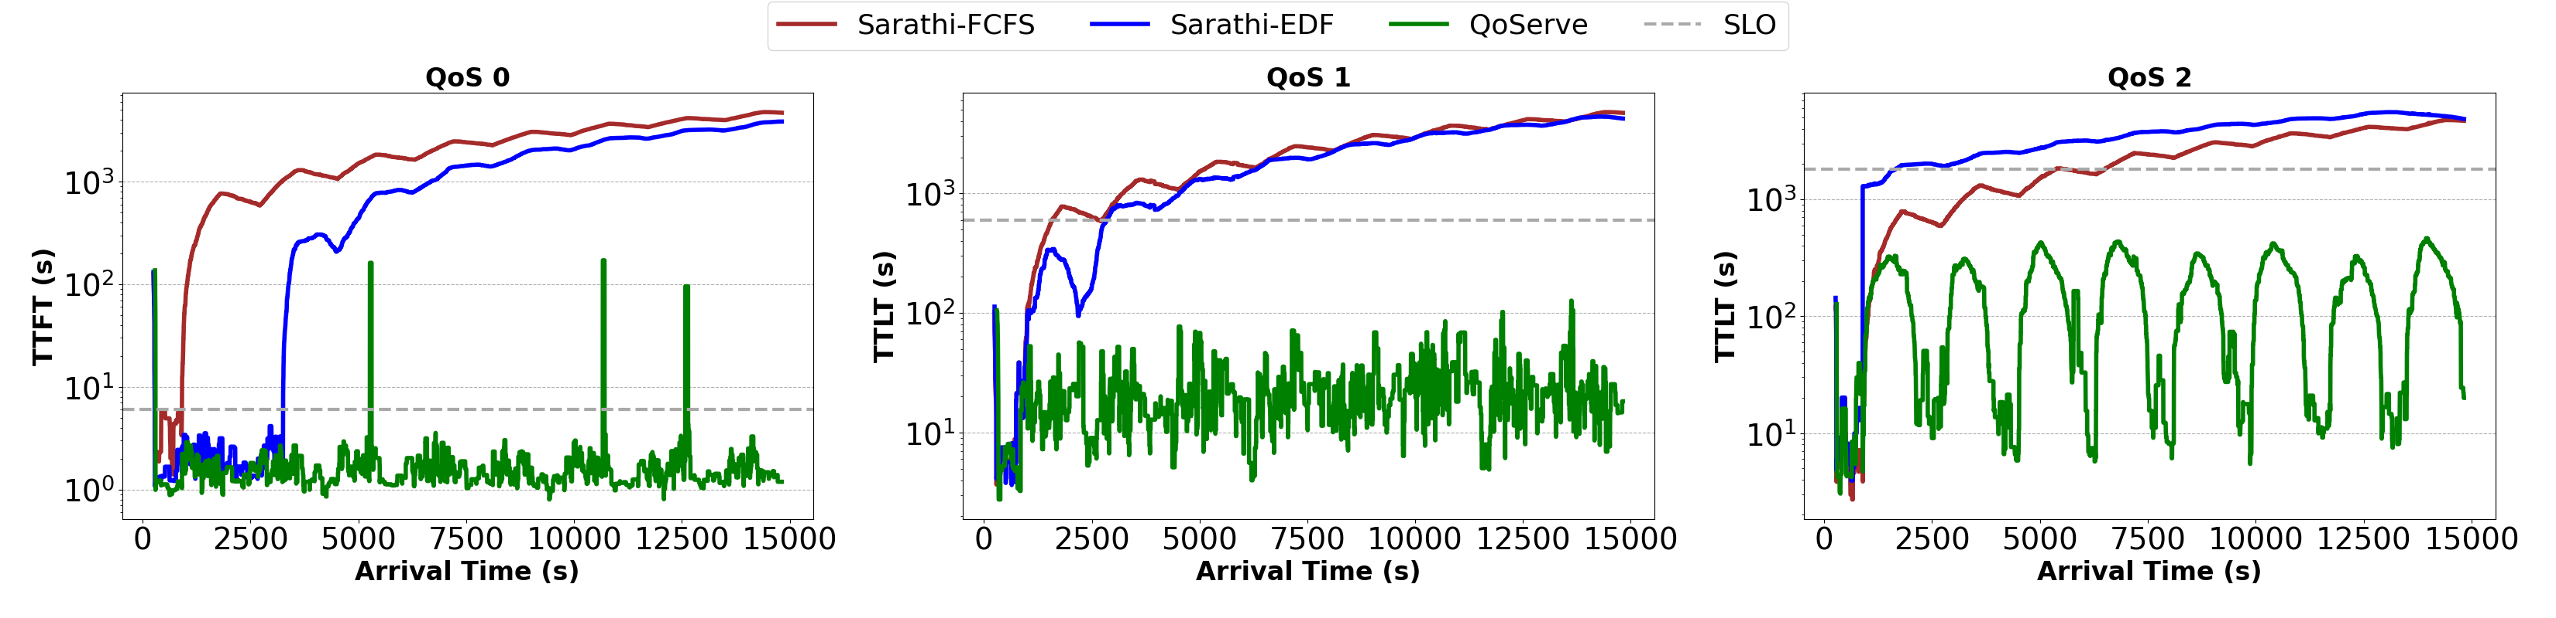
Transient overloads
Vary load in the system periodically
Baselines cant recover after an overload – about 80% of requests are violated.
Niyama eagerly relegates 8% of the requests, and maintains QoS for the rest

Slide 38
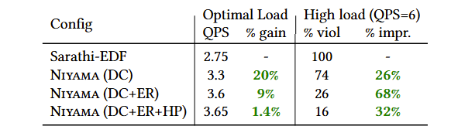
Ablation
Ablation of the three key techniques :
DC : Dynamic chunking
ER : Eager relegation
HP : Hybrid prioritization

Slide 39
Outline
Background
Niyama : QoS-aware deployment
Modserve : Modality-aware deployment
Future landscape

Slide 40

Large Multimodal Models (LMMs)
Resize, reshape, rescale, normalize
Image preprocessing
Text tokenization
Tiles (>=1)
ViT
CLIP + Adapter
Image encoder
Image tokens
(downsampled)
Text tokens
LLM Backend
Output tokens
Diffusion
Multimodal o/p

Slide 41
Two Dominant LMM Architectures
Decoder-only
Cross-attention
Image + Text tokens
Image tokens
Text tokens
Preprocessing
Text tokenization
Patches
LLM
LLM
Image encoder
Text tokens
Attention
Image tokens
Attention
Cross attention
LLM
FFN
FFN
Output tokens
…
…

Slide 42
Monolithic LMM serving
Today, (open-source) LMMs are served as a monolith
E.g., vLLM, DeepSpeed-Inference, HF-Transformers
The entire pipeline is scaled as an entire unit with identical batching, and model sharding strategies
Straightforward to implement but lacks flexibility
Encoder
6000 tokens/s
If there’s a bust of images, you’ll have to scale image encoders, but you’ll end up increasing the LLM serving capacity too, which will be severely underutilized in CroAttn models
LLM
4000 tokens/s

Slide 43
Characterization study
Setup
6 different models across two architectures on A100 GPUs
LMM | Arch | Encoder | LLM
Llama 3.2 (11B) | Cross attn | ViT – 630M | Llama 3.1 (8B)
Llama 3.2 (90B) | Cross attn | ViT – 630M | Llama 3.1 (70B)
Llava OV (7B) | Decoder-only | SigLIP – 400M | Qwen2 (7B)
Llava OV (72B) | Decoder-only | SigLIP – 400M | Qwen2 (72B)
InternVL 2.5 (26B) | Decoder-only | InternViT – 6B | InternLM (20B)
NVLM-D (72B) | Decoder-only | InternViT – 6B | Qwen2-I (72B)

Slide 44
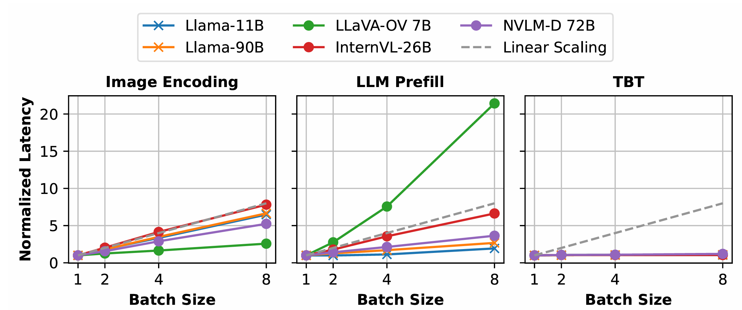

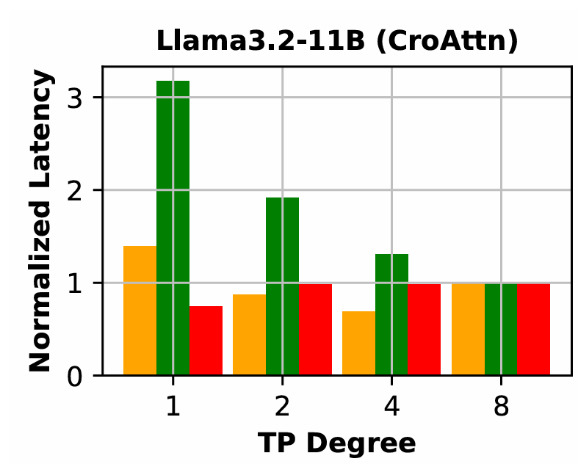
1. Stage-specific optimization
Ideal batching, parallelism strategies vary by stage

Slide 45
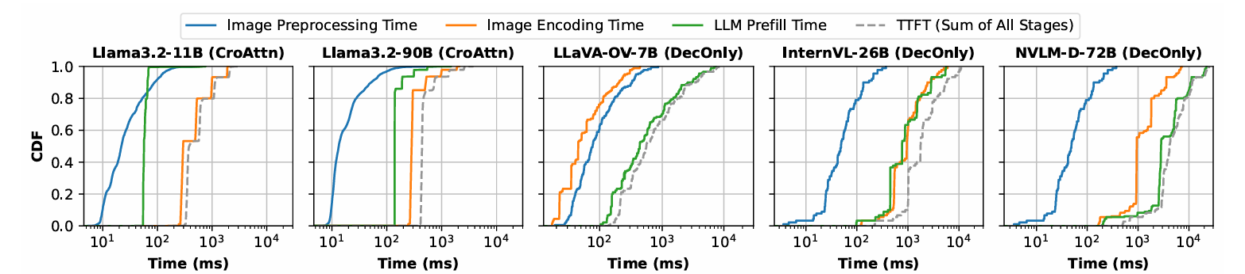
2. Encoding bottleneck
A major part of TTFT is spent in image encoding
22ms
295ms
57ms
Llama3.2 11B on ShareGPT-4o dataset
Pre-processing
Encoding
Prefill
80% of TTFT
Upto 50% for DecOnly models like NVML-D

Slide 46

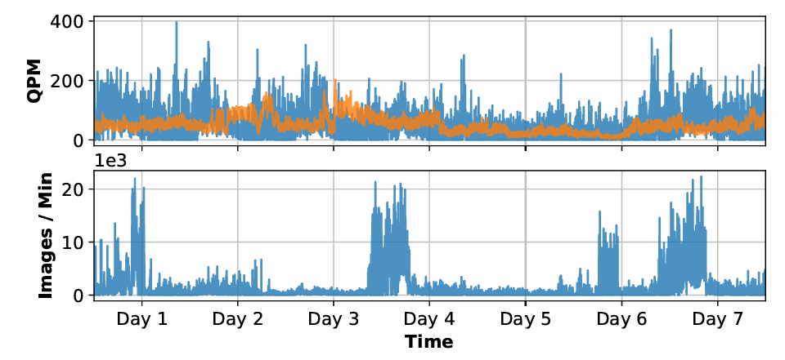
3. Scheduling and Routing
GPT4 - uswest over 7 days
Oct 2024
Production workloads exhibit modality-specific bursts
Image + Text
Text

Slide 47
Key challenges and ideas
LMM stages scale differently
Image encoding bottleneck
Modality-specific bursts
22ms
295ms
57ms
Llama3.2 11B on ShareGPT-4o dataset
Decouple the stages and optimize each stage independently
Encoding is embarrassingly parallel across images. Scale to multiple encoders to reduce TTFT
Image- and text-load aware routing and autoscaling
Pre-processing
Encoding
Prefill
80% of TTFT
MODSERVE

Slide 48
Our Idea : Decoupled LMM Serving
Decouple the serving of different stages, particularly encoder and LLM
Independent deployment, optimization, and scaling of each component
Transfer of intermediate state (image tokens) via RDMA
Image Nodes
Text Nodes
Image tokens
Image pre-processing + encoding
Prefill + Decode (vLLM)

Slide 49


ModServe : Design and workflow
Request Manager
Image Instance Pool
API Gateway
Image Instance
Image Instance
Image-Text req
…
Image Router
Image Instance
Image Instance
Update
Finish
Text-Only req
Image Token State Tracker
<id, #tokens, NodeIP>
RDMA Transfer of Image Tokens
Text Instance Pool
Ready
Image-Text req
Text Instance
Text Instance
…
Request Router
Text Instance
Text Instance
Finish

Slide 50

ModServe : Stage-aware optimization
Image Instance Pool
Num. instances (autoscaling)
Parallelism (sharding)
Max. batch size
Image Instance
Image Instance
Image Pool Manager
…
Image Instance
Image Instance
Offline Model Profile
Text Instance Pool
Num. instances (autoscaling)
Parallelism (sharding)
Max. batch size
Text Instance
Text Instance
Text Pool Manager
…
Text Instance
Text Instance

Slide 51
ModServe : Request routing and scheduling
Image Instance Pool
Image-Text req
Image Router
Image Instance
Image Instance
Image Instance
…
Instance with the least pending image tokens
Text Instance Pool
Text-Only req
Request Router
Text Instance
Text Instance
Text Instance
…
Instance with the least pending text(+img) tokens
SLO/deadline-aware Priority Queue
Text-Only req
Image-Text req with finished image tokens

Slide 52
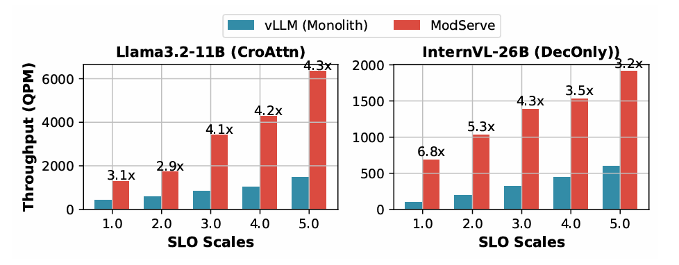
Evaluation Results – Throughput
Consistently higher throughput at varying load compared to monolithic deployment
Both setups use the same number of resources

Slide 53
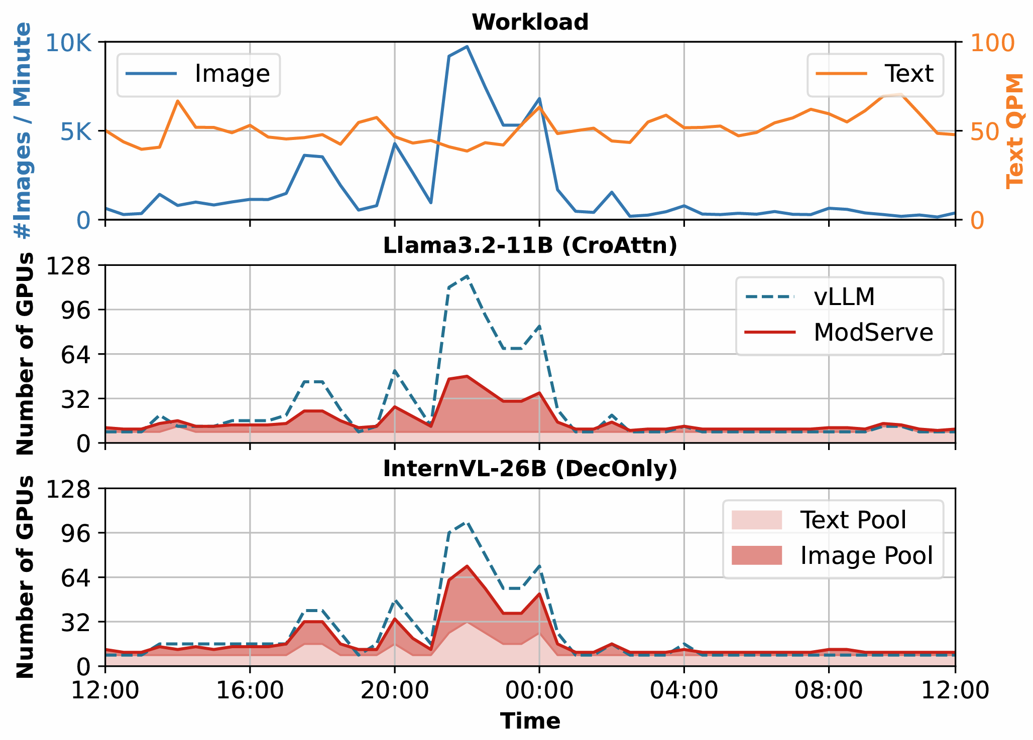
Evaluation Results – autoscaling
ModServe achieves upto 41% and 25% on resource saving while meeting TTFT/TBT SLOs, for CroAttn and DecOnly models
Benefits on resource saving are more profound at image bursts
Savings on CroAttn models are larger due to their prefill efficiency → a larger demand gap between image encoders vs. LLM backend

Slide 54
Outline
Background
Niyama : QoS-aware deployment
Modserve : Modality-aware deployment
Future landscape

Slide 55
What is beyond?
RL post training
AI Agents
Fine-tune the model's behavior for specific tasks, preferences, or user interactions.
Generates outputs (e.g., responses to prompts).
Receives feedback in the form of a reward signal—this can be from human preferences, automated metrics, or task-specific goals.
Updates its parameters to maximize expected rewards using RL algorithms
Infrastructure complexity : Variable resource needs, persistent storage needs, complex scheduling
Distributed management : Managing distributed agents, edge deployments, agent communication protocols
Privacy, security and robustness : Reliability, failure handling, data privacy
Scalability and monitoring

Slide 56
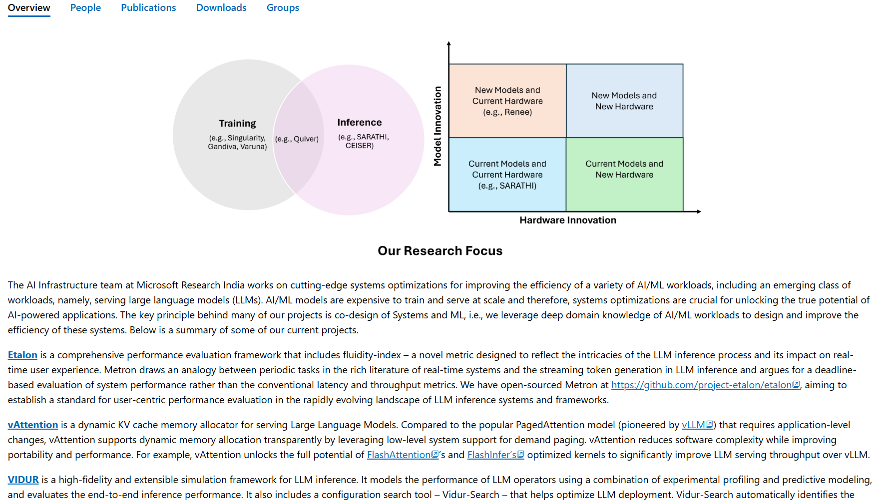
AI Infrastructure - Microsoft Research

Slide 57

Research Fellows Program at Microsoft Research India - Microsoft Research

