Slide 1

Optimal Scheduling in a Quantum Switch: Capacity and Throughput Optimality
Thiru Vasantham (Durham University, UK)
Joint work with Sanidhay Bhambay (Durham) and Neil Walton (Durham)
CNI Seminar Series
IISc, Bangalore

Slide 2
Informed-AI Hub: Bristol (lead), Durham, Imperial, Cambridge
URL: https://informed-ai.net/
INFORMED-AI is one of three EPSRC funded hubs on the mathematical foundations of artificial intelligence (AI).
Design of AI algorithms and their applications to networks with distributed and heterogeneous agents.
Topics: Quantum Internet, Communications, Machine Learning, Robotics etc.

Slide 3
OUTLINE
Quantum Networks: Basics and Motivation for Quantum Networking
Switching Architectures: Classical and Quantum
Results: Capacity and Throughput Optimality

Slide 4
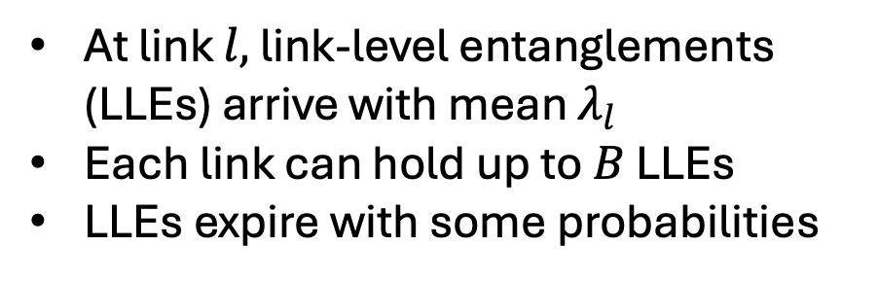
Objective
1
At link $l,$ link-level entanglements (LLEs) arrive with mean $λ_{l}$
Each link can hold up to $B$ LLEs
LLEs expire with some probabilities
3
Switch
2

Slide 5
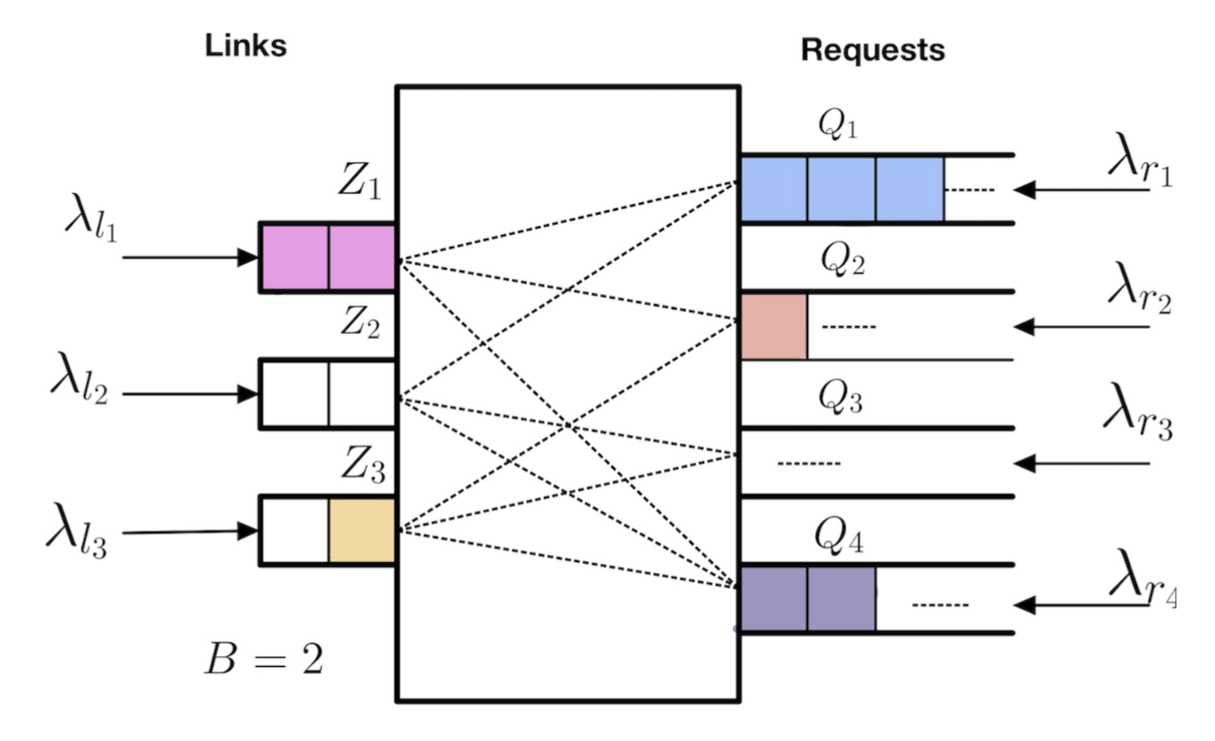

Objective
Type $r$ request arrive with mean $λ_{r}$
{1,2}
{1,3}
{2,3}
{1,2,3}
Objective:
What is the optimal way to distribute entanglements?

Slide 6
Motivation
As transistor size reaches to atomic level, their behaviour follows quantum mechanics
In 1981, Richard Feynman has suggested that, to simulate the nature in computers correctly we need to build quantum computers
Breakthrough results:
1984: BB84 QKD protocol
1994: Peter Shor’s algorithm
2016: China’s QKD distribution experiment using satellites

Slide 7
Qubit
Classical bit:
0 or 1
Quantum bit (Qubit):
Represents spin of an electron or polarization of photon etc.
Superposition of 0 and 1

Slide 8
Qubit
For communication: Photons
For storage and computation: trapped-ions, nitrogen vacancy centers in diamonds, super conducting qubits etc.

Slide 9
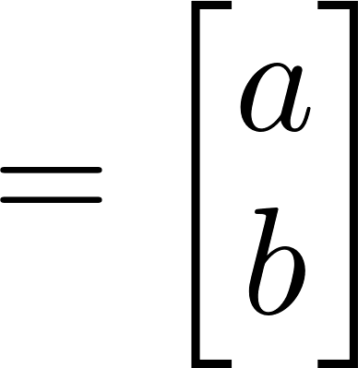
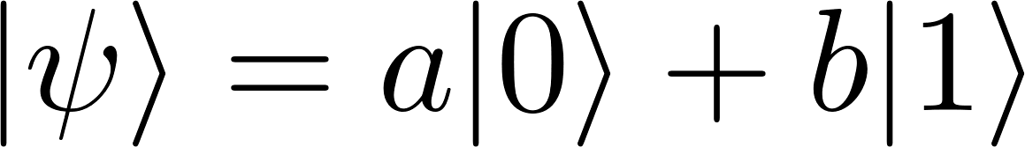
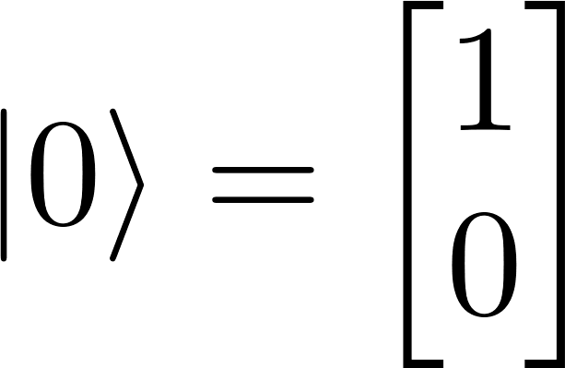
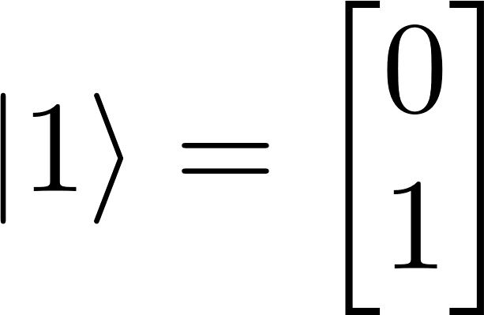
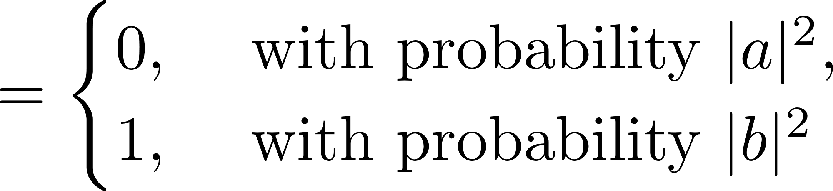
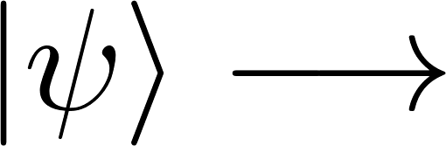

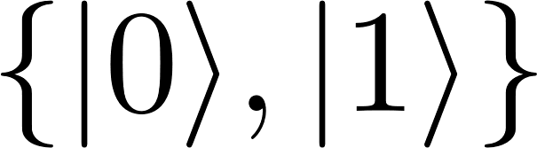
Qubit
A qubit is written as
where the basis is and
Ket 0
Measurement principle:
Measurement

Slide 10
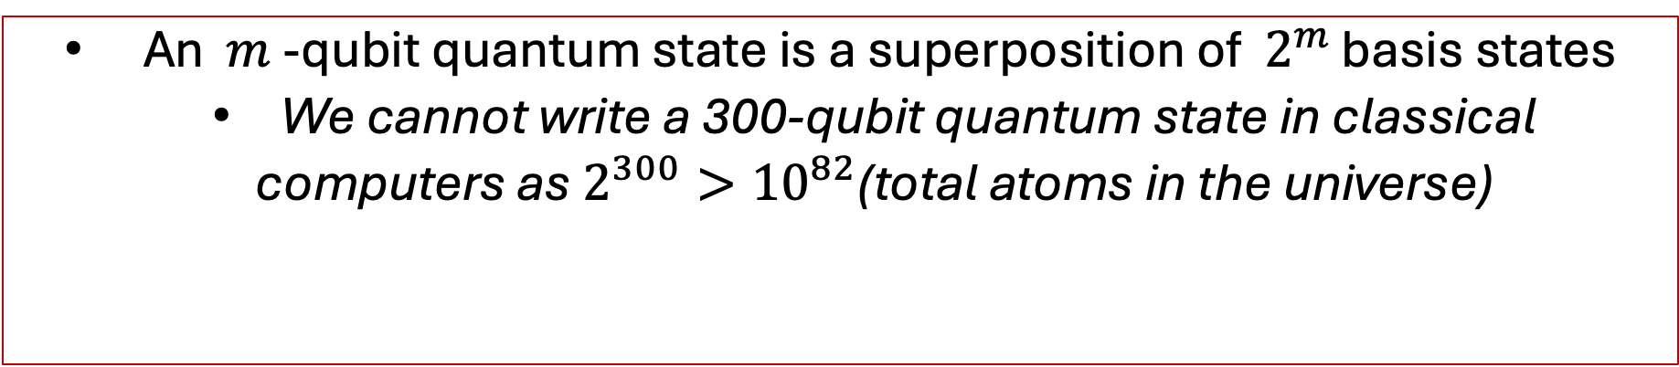
Multi-Qubit States
Two qubit quantum state is written as superposition of basis states
An $m$ -qubit quantum state is a superposition of $2^{m }$basis states
We cannot write a 300-qubit quantum state in classical
computers as $2^{300}>{10}^{82}$(total atoms in the universe)

Slide 11
Entanglement
Having strong correlation between two or more qubits
for any coefficients a, b, c, d.
There is no counterpart in classical mechanics; only
probabilistic correlations exist
Most applications require distribution of entanglements

Slide 12
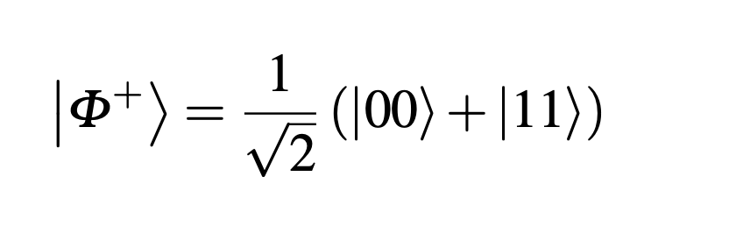




Entanglement
A
B
2-qubit entangled state shared between two users
Goal: Creation of multi-qubit entangled states shared by multiple users
An -qubit entangled state is shared by ‘ ’ users, each user holds one qubit
$$n$$
$$n$$

Slide 13

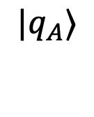


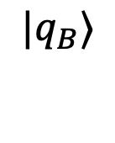

Entanglement
Applications: Quantum communication using teleportation
$$|v〉$$
A
B
$${|q}_{A}〉$$
$${|q}_{B}〉$$
{0,1}
A applies Bell-State measurement on and
Measurement outcome is communicated to B by sending classical bits
B applies some gates on its qubit, which changes to
$|v〉$
$${|q}_{A}〉$$
$$|v〉$$

Slide 14


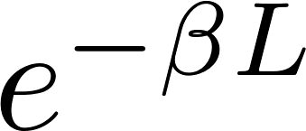
Photon Transmission
A
B
fiber length
Probability of successful transmission
=
fiber loss coefficient
L<100km in practice
Another challenge: No-cloning theorem
quantum information cannot be copied or recreated

Slide 15
Applications: Distributed Quantum Computing
Entanglement
Practical QPUs can have hundreds of qubits
However, important applications require millions of qubits
Quantum networking is needed to connect QPUs and exploit their capabilities
You can have communication between QPUs and apply non-local gates on qubits located in different QPUs if they share an entanglement
QPU 1
QPU 2
QPU 3
QPU 4

Slide 16
Entanglement
Other Applications:
Quantum key distribution (E91, BBM92)
Distributed quantum error correction
Quantum sensing
Clock synchronization

Slide 17
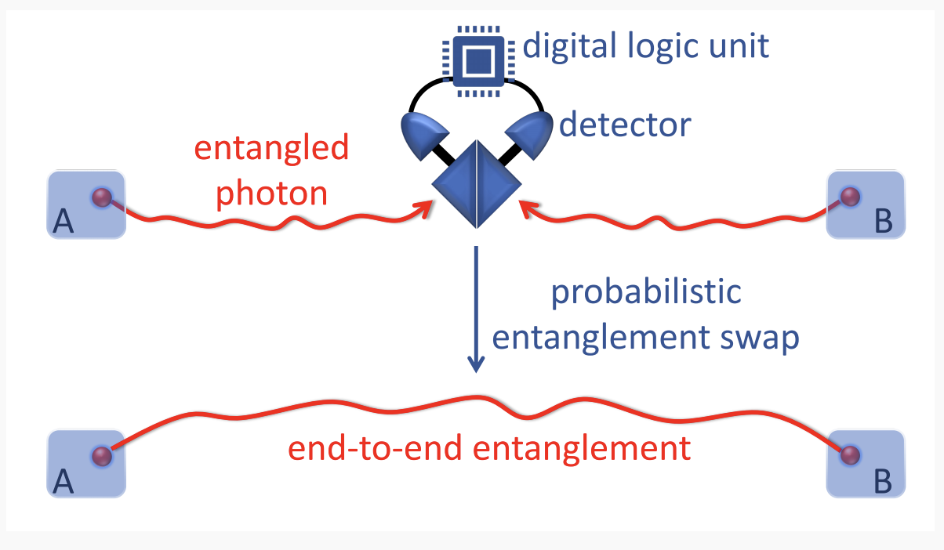
Link-Level Entanglement Distribution
Users and quantum switches have limited number of communication qubits.
If communication qubit is excited, then it breaks into two entangled particles:
another communication qubit and photon.
Photon is then transferred over fiber optic channel towards Bell-state analyser(BSA) for entanglement swapping.
Source: G.X. Yau et al, 2025

Slide 18
Long Distance Entanglement
Entanglement Swapping:
1
Switch
2
0,1
1
2
Switch
1
2
Switch

Slide 19
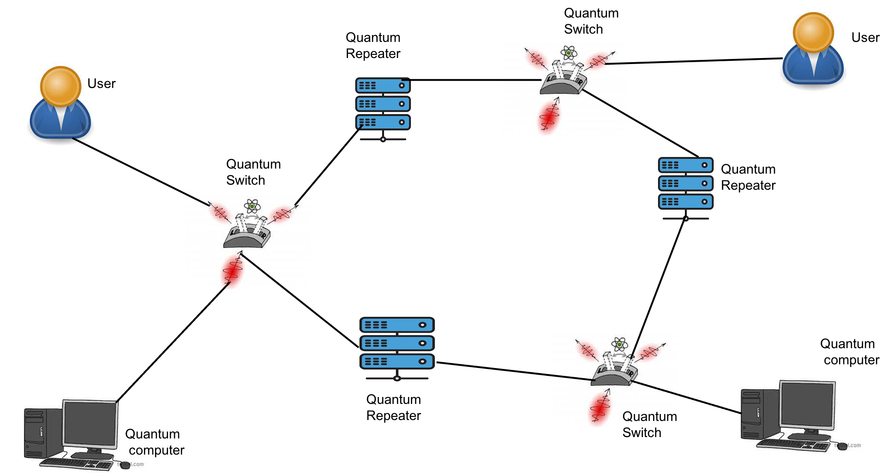
Quantum Network
Shared
Entanglement
Shared
Entanglement

Slide 20
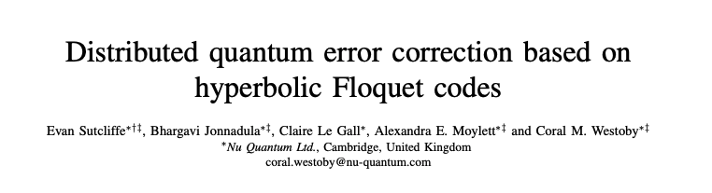
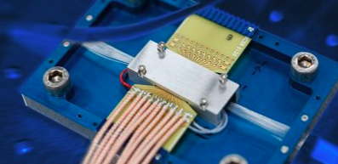
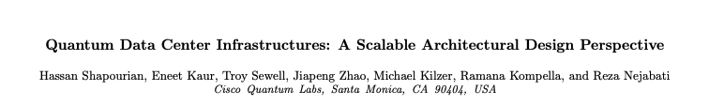
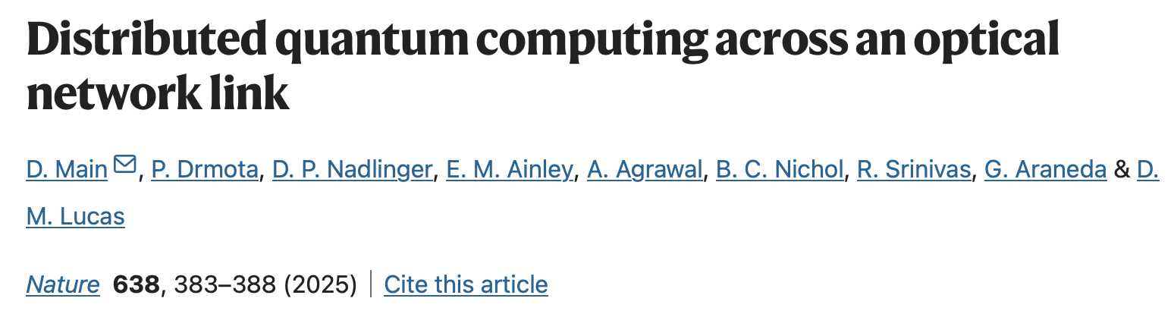
Why Quantum Networking?
Cisco’s Quantum Network Entanglement Chip

Slide 21
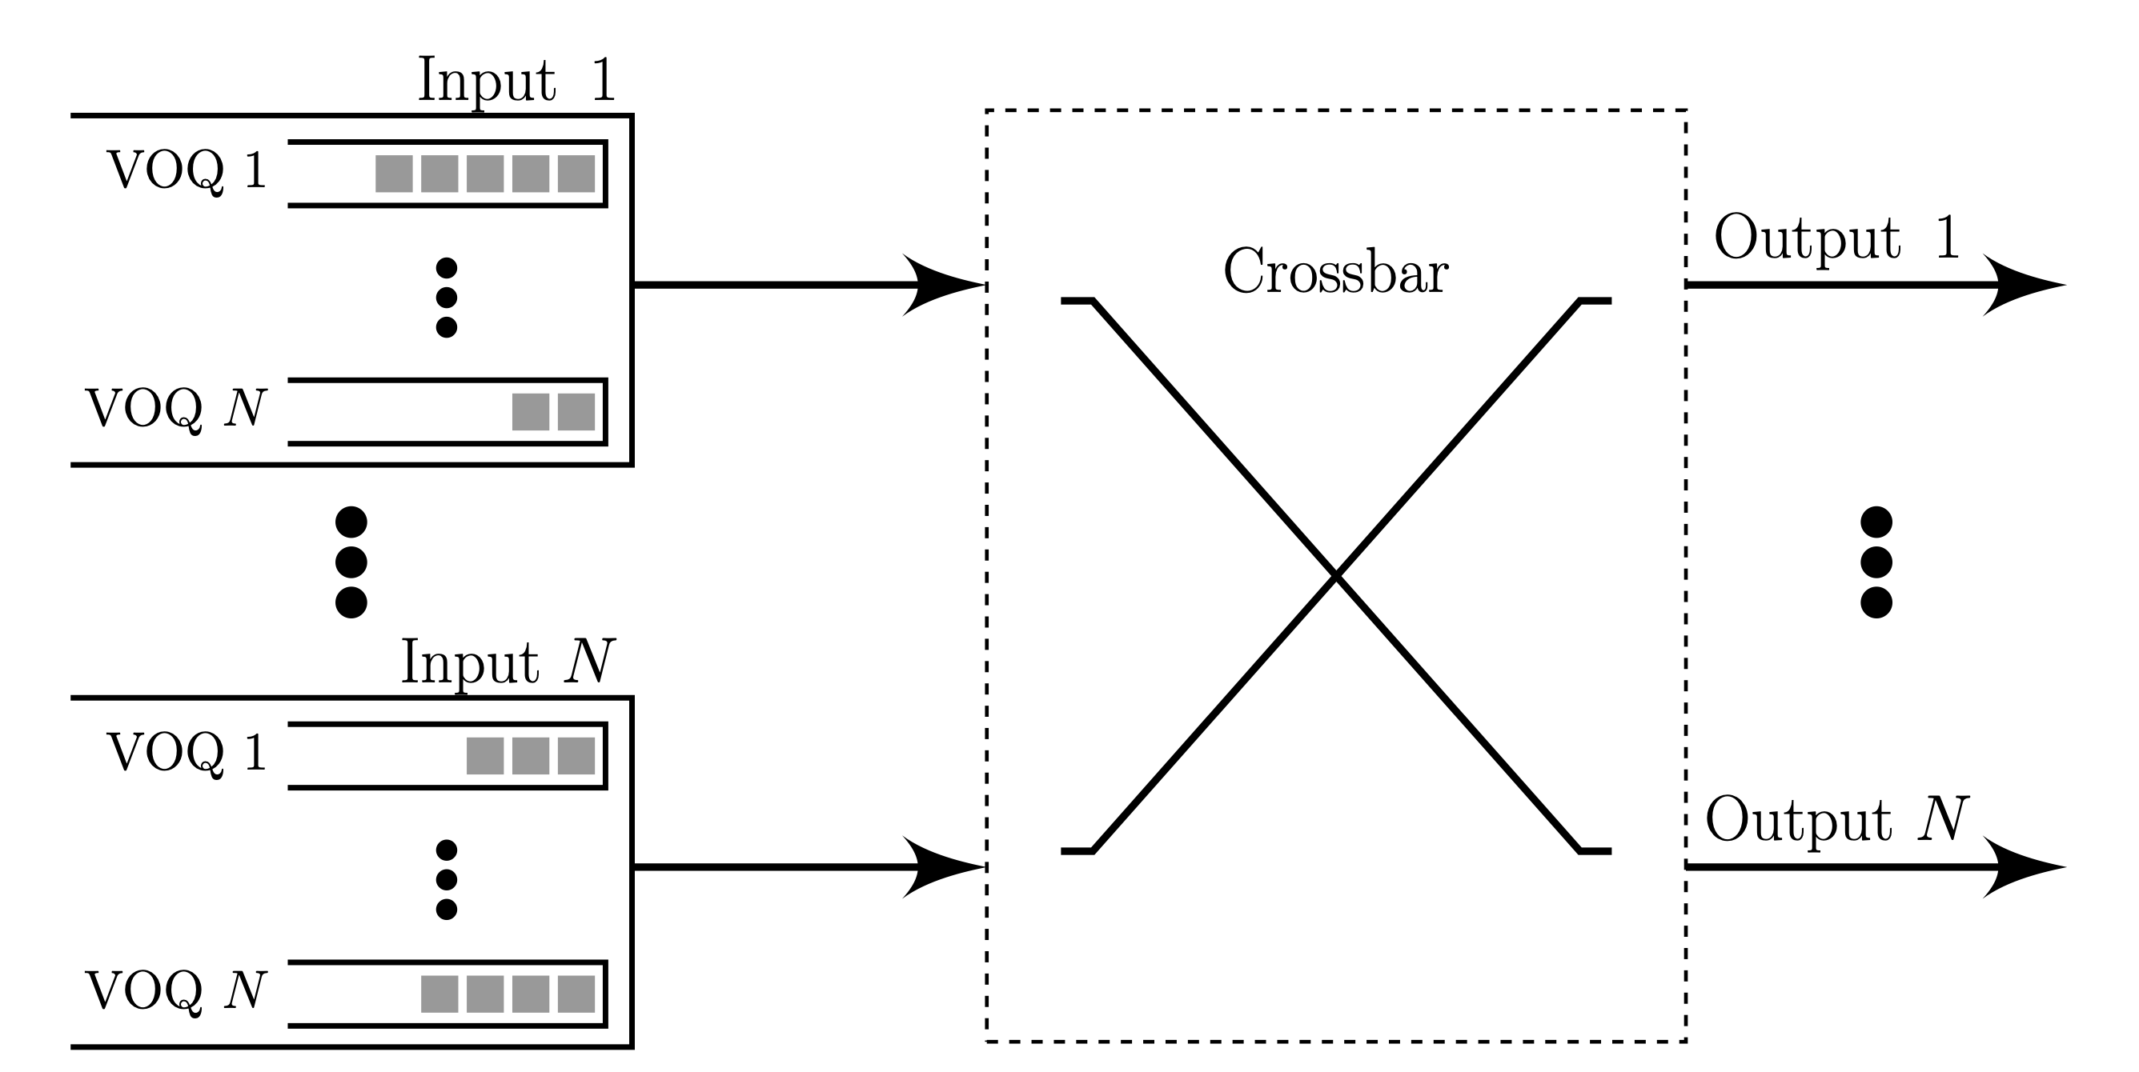


Internet Router/Classical Switch
Each input port maintains Virtual Output Queues (VOQs) of infinite capacity.
Goal is to match the input ports to output ports efficiently for maximizing the throughput
At any time, the MaxWeight policy selects a schedule $n^{MW}$ as
$$\sum_{ij}{Q_{ij}}n_{ij}$$
$${argmax}_{n}$$
N. McKeown, A. Mekkittikul, V. Anantharam and J. Walrand, "Achieving 100% throughput in an input-queued switch," in IEEE Transactions on Communications, vol. 47, no. 8, pp. 1260-1267, Aug. 1999

Slide 22
Quantum Switch
User requests come for different multi-qubit entangled states
LLEs decohere with time and there is limited memory to store them
Swapping operations to serve requests may fail
A scheduling cycle consists of two phases:
the matching phase
the swapping phase

Slide 23
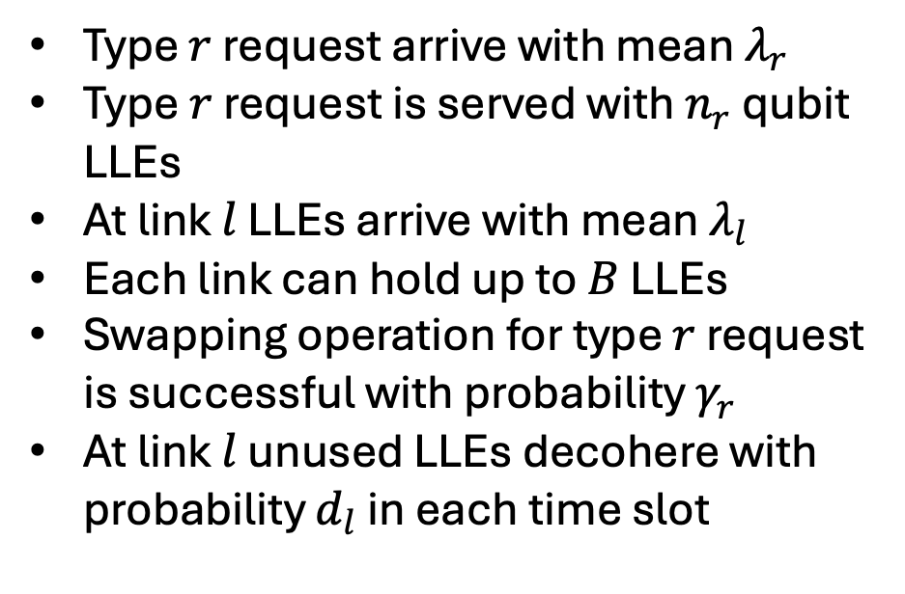
Quantum Switch Model
Type $r$ request arrive with mean $λ_{r}$
Type$r$ request is served with $n_{r}$ qubit LLEs
At link $l$ LLEs arrive with mean $λ_{l}$
Each link can hold up to $B$ LLEs
Swapping operation for type $r$ request is successful with probability $γ_{r}$
At link $l$ unused LLEs decohere with probability $d_{l}$ in each time slot

Slide 24
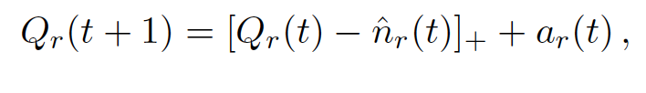


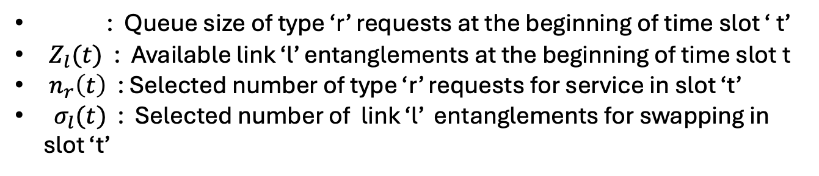
System Dynamics
: Queue size of type ‘r’ requests at the beginning of time slot ‘ t’
$Z_{l}(t)$ : Available link ‘l’ entanglements at the beginning of time slot t
$n_{r}\left(t\right)$ : Selected number of type ‘r’ requests for service in slot ‘t’
$σ_{l}(t)$ : Selected number of link ‘l’ entanglements for swapping in slot ‘t’
$$Q_{r}(t)$$

Slide 25
Related Works
G. Vardoyan, S. Guha, P. Nain and D. Towsley, " On the Stochastic Analysis of a Quantum Entanglement Distribution Switch," in IEEE Transactions on Quantum Engineering, vol. 2, pp. 1-16, 2021
Vasantam, Thirupathaiah, and Don Towsley. "A throughput optimal scheduling policy for a quantum switch," Quantum Computing, Communication, and Simulation II. Vol. 12015. SPIE, 2022.
Zubeldia, Martin, Prakirt R. Jhunjhunwala, and Siva Theja Maguluri. "Matching Queues with Abandonments in Quantum Switches: Stability and Throughput Analysis," Operations Research, 2025.

Slide 26
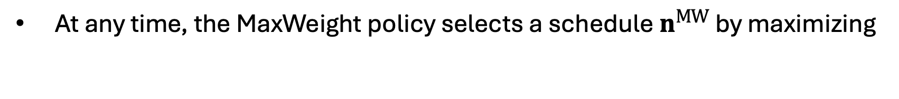
MaxWeight Policy
At any time, the MaxWeight policy selects a schedule $n^{MW}$ by maximizing
MaxWeight:
Easy to implement as it does not require the knowledge of arrival rates

Slide 27
Research Questions
Can MaxWeight-type schemes achieve maximum capacity for
Quantum Switches also?
Ans. No, we need new algorithms
2. Can we find a throughput-optimal scheme for Quantum Switches?
Ans. Yes, using RL/MDP algorithms

Slide 28
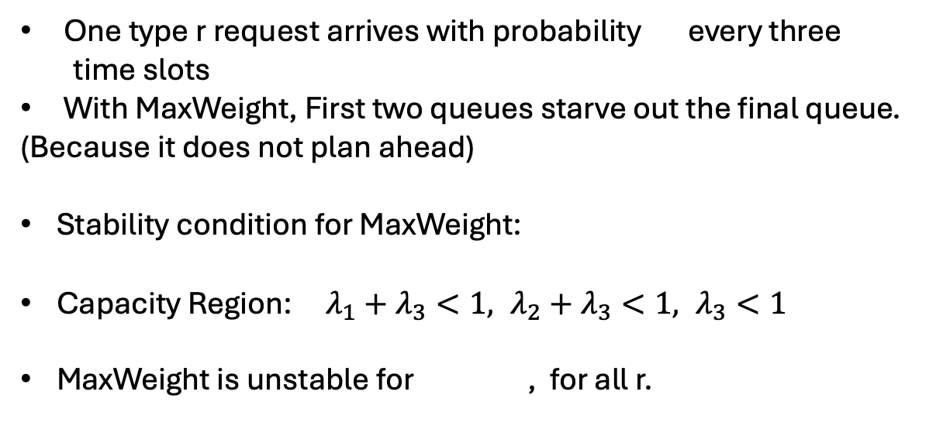


MaxWeight Doesn’t Work for a Quantum Switch
One type r request arrives with probability every three
time slots
With MaxWeight, First two queues starve out the final queue.
(Because it does not plan ahead)
Stability condition for MaxWeight:
Capacity Region: $λ_{1}+λ_{3}<1, λ_{2}+λ_{3}<1, λ_{3}<1$
MaxWeight is unstable for , for all r.
$$λ_{r}$$
t=1
t=2
t=3
$$λ_{3}<\left(1−λ_{1}\right)\left(1−λ_{2}\right)$$
$$λ_{r}=0.4$$

Slide 29
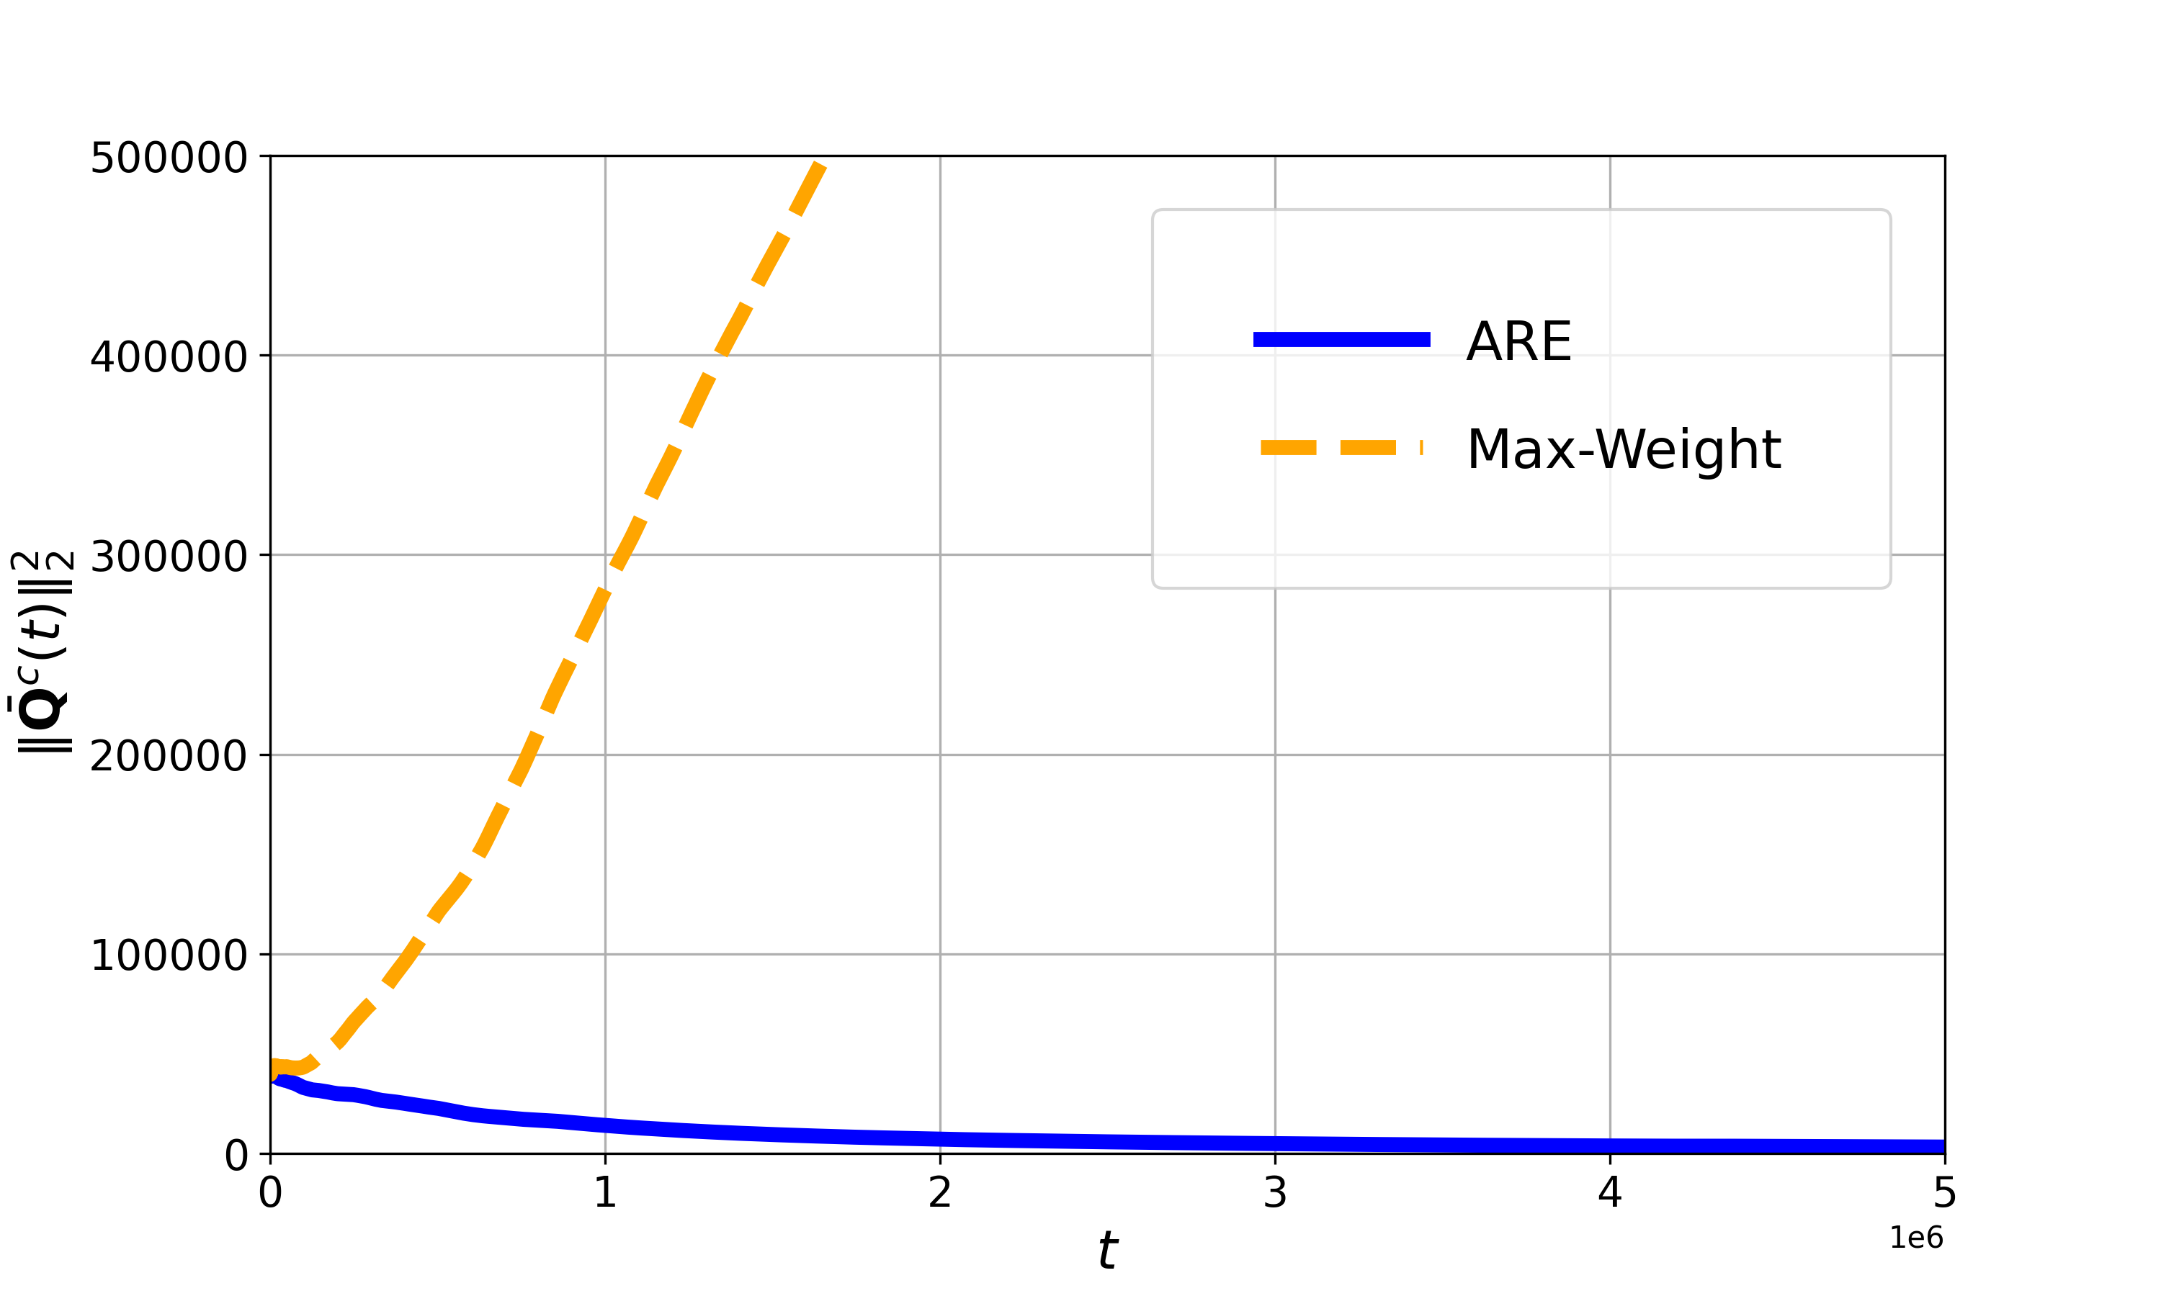
MaxWeight drift for a Quantum Switch

Slide 30
Lyapunov Function Drift
As LLEs expire with some probabilities, we expect two-time scale separation
where
To have maximum negative drift , we must maximize

Slide 31
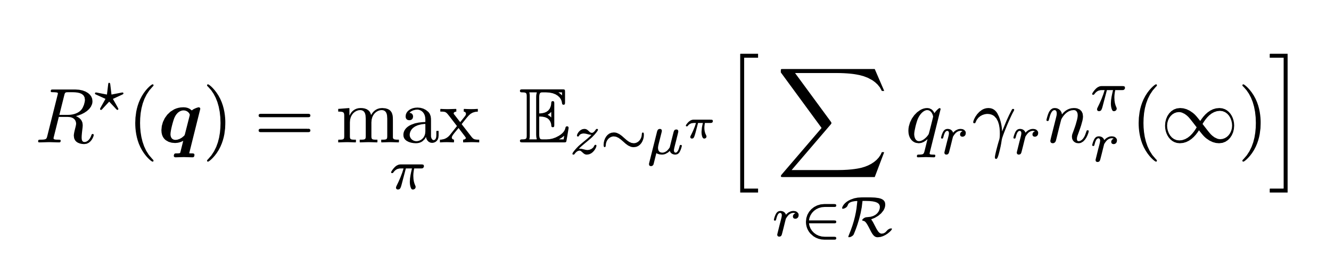

MDP and Reinforcement Learning for Switch Design
Average Reward Markov Decision Process
Optimal policy is denoted by
$$π^{∗}(q)$$
Bellman Equation

Slide 32

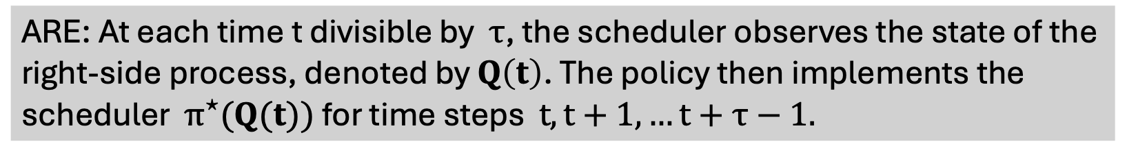



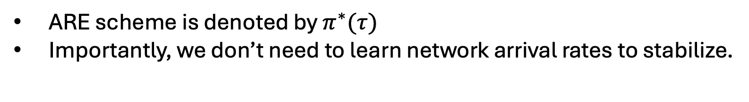
ARE policy: An optimal policy
Given $Q(t)$, we solve the average reward MDP for the left-side system
ARE: At each time t divisible by $τ$, the scheduler observes the state of the right-side process, denoted by $Q\left(t\right)$. The policy then implements the scheduler $π^{⋆}(Q(t))$ for time steps $t,t+1,…t+τ−1.$
$$τ_{mix}$$
$$2τ$$
ARE scheme is denoted by $π^{∗}(τ)$
Importantly, we don’t need to learn network arrival rates to stabilize.
$$0$$
$$τ$$

Slide 33
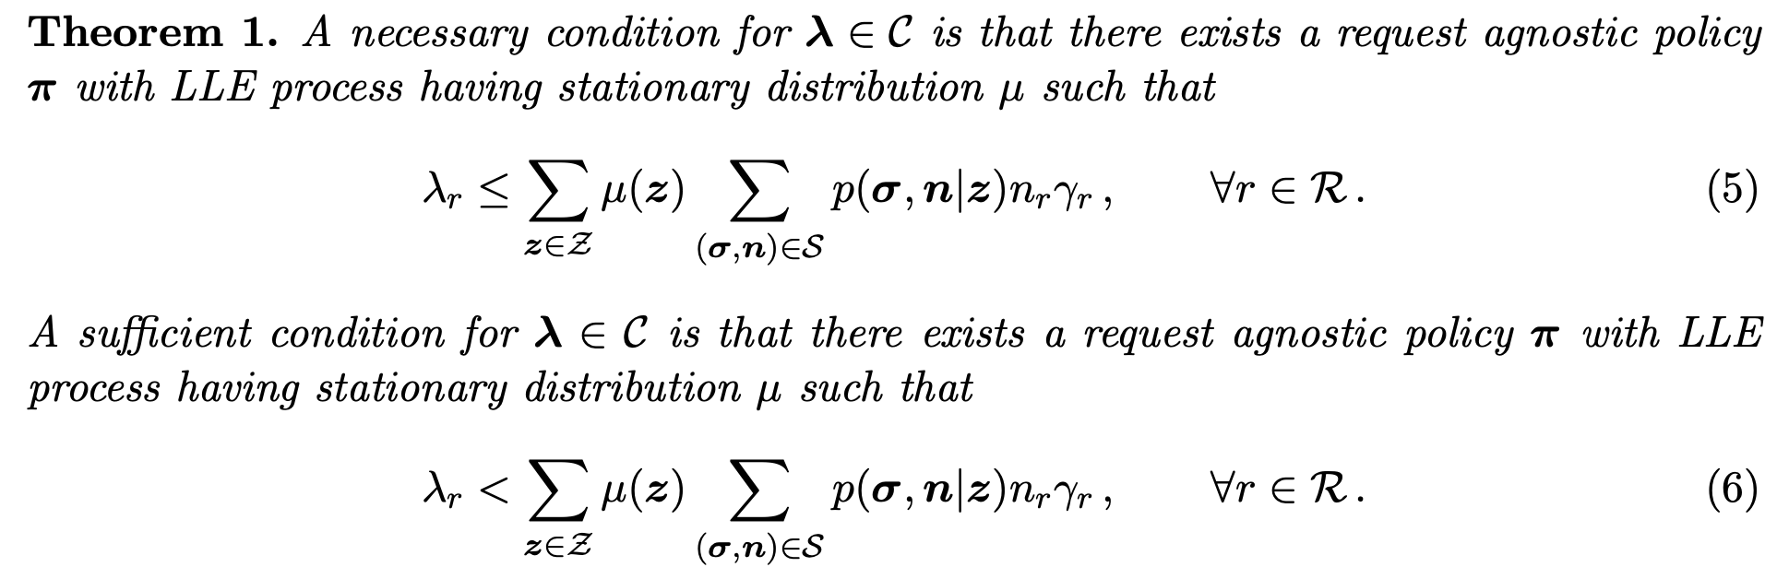
Capacity Region

Slide 34
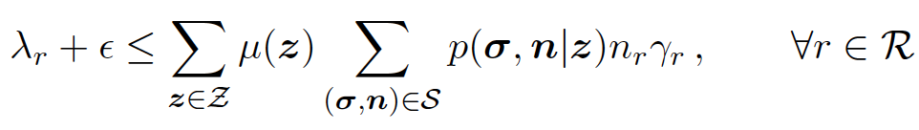
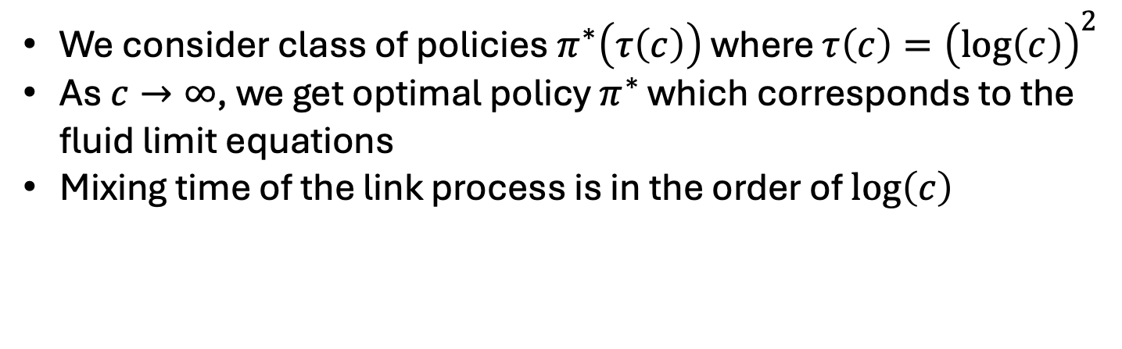
ARE policy: Optimality
Prove it is an optimal policy
Theorem 3: The ARE policies are asymptotically optimal
We consider class of policies $π^{∗}\left(τ\left(c\right)\right)$ where $τ\left(c\right)={\left(log\left(c\right)\right)}^{2}$
As $c→∞$, we get optimal policy $π^{∗}$ which corresponds to the fluid limit equations
Mixing time of the link process is in the order of $\log\left(c\right)$
Notes:
Note: A set of policies is asymptotically throughput optimal if there is a policy that can stabilize arrival rates within an arbitrarily small error of maximum set of arrival rates

Slide 35
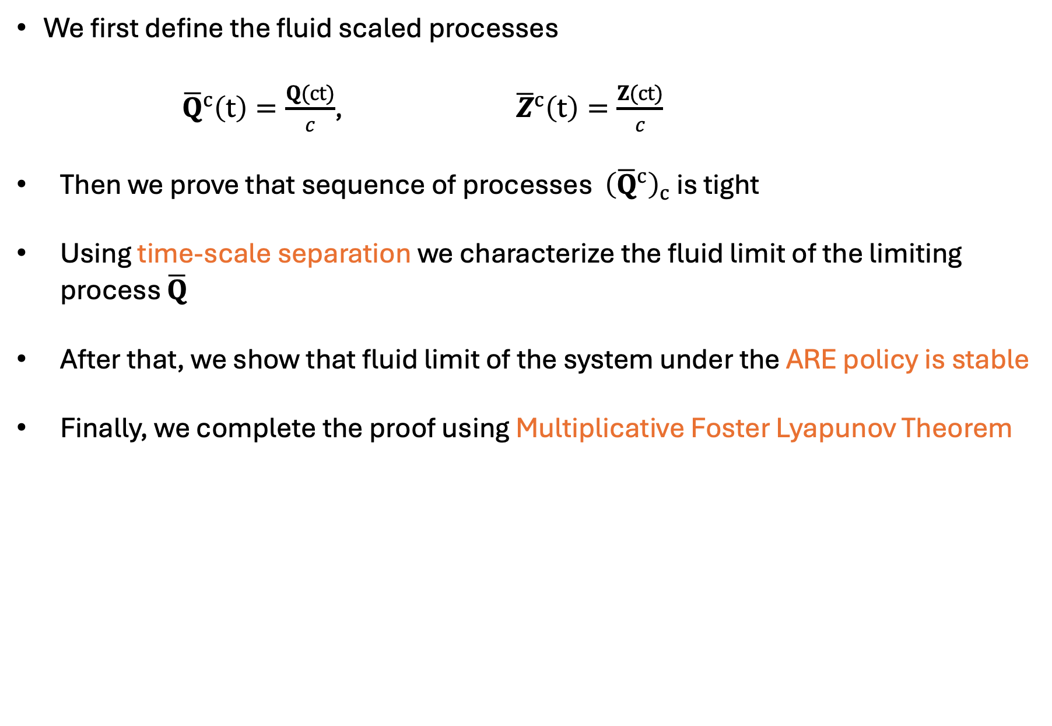
Proof sketch of Theorem 3
We first define the fluid scaled processes
${\overline{Q}}^{c}\left(t\right)=\frac{Q(ct)}{c}$, ${\overline{Z}}^{c}\left(t\right)=\frac{Z(ct)}{c}$
Then we prove that sequence of processes ${\left({\overline{Q}}^{c}\right)}_{c}$ is tight
Using time-scale separation we characterize the fluid limit of the limiting process ${\overline{Q}}^{ }$
After that, we show that fluid limit of the system under the ARE policy is stable
Finally, we complete the proof using Multiplicative Foster Lyapunov Theorem

Slide 36
Conclusions
MaxWeight Scheme Limitation: The MaxWeight scheme, which is optimal for classical switches, is no longer optimal for quantum switches. New algorithms are needed.
Proposed Optimal Scheduling Scheme: An optimal scheduling scheme based on Average Reward MDP was proposed to address the scheduling in quantum switches.
Capacity Region Characterization and Optimality: The capacity region for the quantum switch was characterized, and it was proven that the ARE policy is optimal for achieving this capacity.

Slide 37
Future Work
Future Work:
Extend the proof to the scenario where LLEs have bounded lifetimes
Designing algorithms for quantum networks
Low complexity algorithms

Slide 38
References
Sanidhay Bhambay, Thirupathaiah Vasantam, and Neil Walton, “Optimal Scheduling in a Quantum Switch: Capacity and Throughput Optimality,” SIGMETRICS Perform. Eval. Rev. 53, 1 (June 2025), 139–141, 2025.
Sanidhay Bhambay, Thirupathaiah Vasantam, and Neil Walton, “Optimal Scheduling in a Quantum Switch,” arXiv:2501.05380 [quant-ph] https://arxiv.org/abs/2501.05380, 2025.
G. X. Yau, T. Vasantam and G. Vardoyan, "Service-the-Longest-Queue Among d Choices Policy for Quantum Entanglement Switching," 2025 International Conference on Quantum Communications, Networking, and Computing (QCNC), Nara, Japan, 2025, pp. 1-8, doi: 10.1109/QCNC64685.2025.00011.

Slide 39
THANK YOU FOR LISTENING!

