Slide 1
Collaborative Decision-Making under Adversarial and Information Constraints
Aritra Mitra
Department of Electrical and Computer Engineering
North Carolina State University

Slide 2
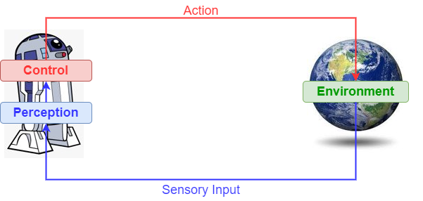
The Standard RL Pipeline
Agent takes action.
Environment provides feedback (rewards).
Agent learns to take “better” actions.
Goal: Maximize long-term returns.
Q. How do we take “good” decisions under environmental uncertainty?

Slide 3

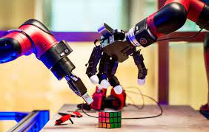
What Makes RL Challenging?
High-Dimensional Data.
Large State and Action Spaces.
Data Hungry Algorithms.
Q. Can we reduce the sample-complexity for learning in RL?

Slide 4



To Collaborate or Not?
The Fundamental Tension:
Collaboration can help reduce uncertainty.
Adversarial feedback can derail learning.
Q. Does more data help or hurt?
Q. How do we take “good” decisions under (environmental) uncertainty and adversarial feedback?

Slide 5

RL under Communication Constraints
Base Station
Motivation: Communication-bottleneck is a key challenge in modern computing paradigms such as federated learning and IoT networks.
Low-Bandwidth IoT Networks
Goal: Quantify the effects of communication constraints on the finite-time/non-asymptotic performance of RL algorithms.

Slide 6
Outline of the Talk
Background on Bandits
Part I: Collaborative Bandits with Adversarial Agents
Main Results
Algorithm and Proof Sketch
Part II: Linear Bandits with Communication Constraints
Ref 1: Collaborative Linear Bandits with Adversarial Agents: Near-Optimal Regret Bounds, Mitra, Adibi, Pappas, and Hassani, NeuRIPS 22.
Ref 2: Linear Stochastic Bandits over a Bit-Constrained Channel, Mitra, Hassani, and Pappas, L4DC 23 (Oral Presentation, Top 10%)

Slide 7
Part 0: A Whirlwind Tour of Bandits

Slide 8







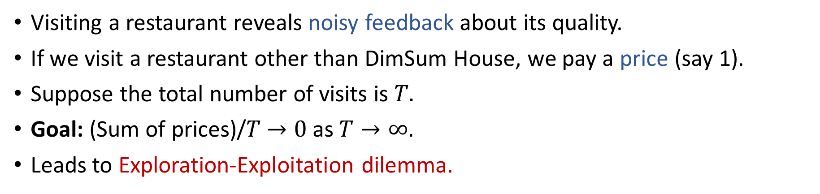
The Multi-Armed Bandit Problem
$$a_{1}$$
$$a_{2}$$
$$a_{3}$$
Visiting a restaurant reveals noisy feedback about its quality.
If we visit a restaurant other than DimSum House, we pay a price (say 1).
Suppose the total number of visits is $T.$
Goal: (Sum of prices)/$T$ $→0$ as $T→∞.$
Leads to Exploration-Exploitation dilemma.

Slide 9


The Linear Stochastic Bandit Problem
Correlations?
Action set $𝒜=\{a_{1}, …, a_{K}\}⊂ℝ^{d}$.
At time $t$, learner plays an action $a_{t}∈𝒜$ and observes reward $y_{t}:$
$y_{t}=\left\langle θ_{∗}, a_{t}\right\rangle +η_{t}.$
Goal is to minimize $R_{T}=𝔼[ \sum_{t∈[T]}{⟨θ_{∗}, a_{∗}−a_{t}⟩]},$ where $a_{∗}=argmax_{a∈𝒜}\left\langle θ_{∗},a\right\rangle .$
Unknown model that captures correlations
Zero-mean Gaussian noise

Slide 10
Part I: Collaborative Linear Bandits with
Adversarial Agents
Ref: Collaborative Linear Bandits with Adversarial Agents: Near-Optimal Regret Bounds, Mitra et al., NeuRIPS 22

Slide 11




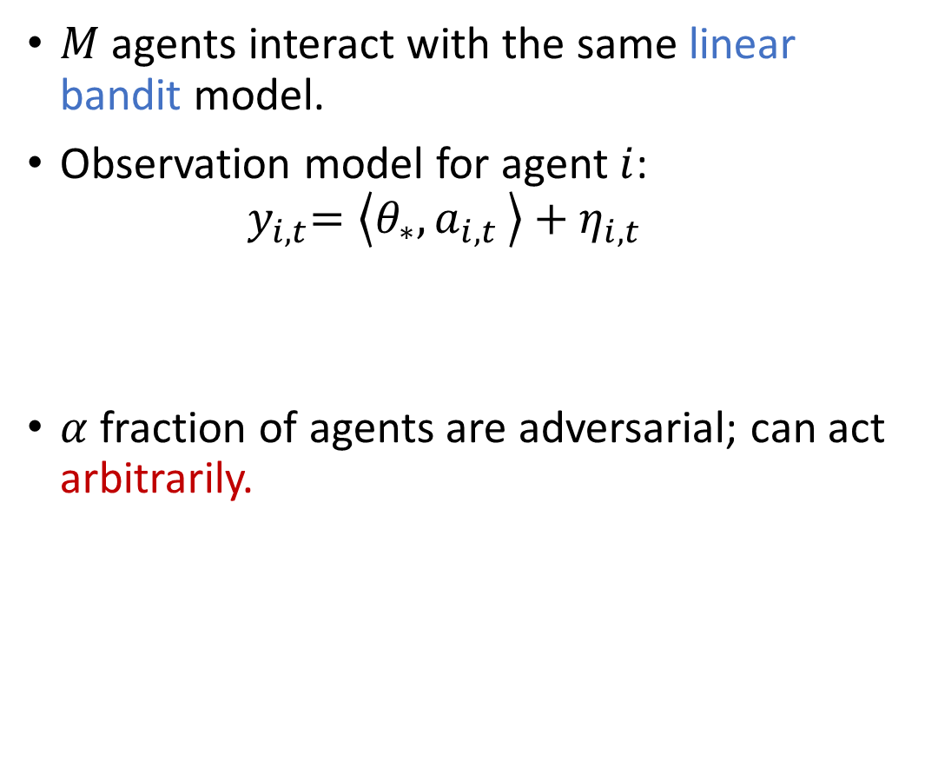
$M$ agents interact with the same linear bandit model.
Observation model for agent $i$: ${ y}_{i,t}=\left\langle θ_{∗}{,a}_{i,t}\right\rangle +η_{i,t}$
$α$ fraction of agents are adversarial; can act arbitrarily.
Server
(*)
Unknown parameter in $ℝ^{d}$
Gaussian noise
Q. Can collaboration help? If so, fundamental limits?

Slide 12

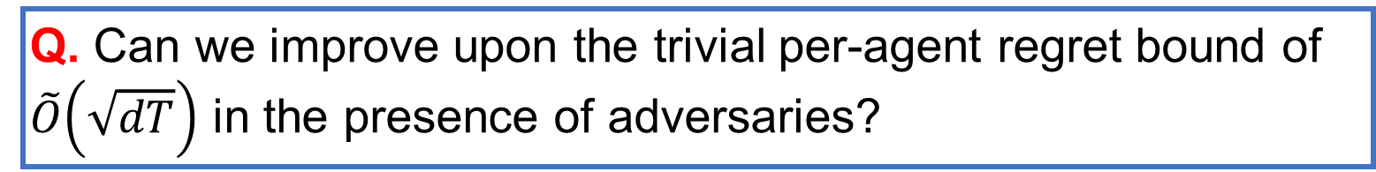
To Collaborate or Not?
Performance Measure: $R_{T}=\sum_{t∈\left[T\right]}{\left\langle θ_{∗}{,a_{∗}−a}_{i,t}\right\rangle ,}$ where $a_{∗}$ is best action.
Fundamental Tension: Collaboration might reduce regret but may also disrupt learning due to adversaries! Does more data help or hurt?
Q. Can we improve upon the trivial per-agent regret bound of $\tilde{O}\left(\sqrt{dT}\right)$ in the presence of adversaries?

Slide 13
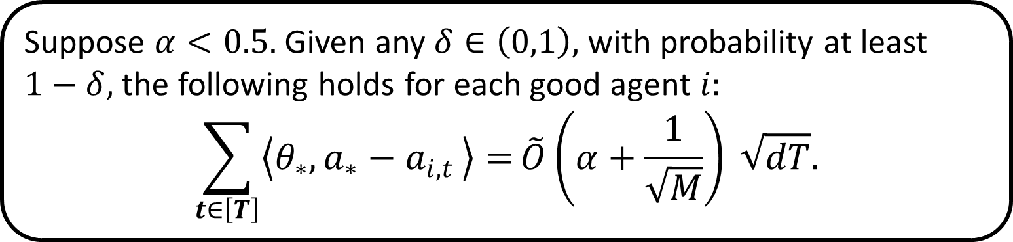
Main Result 1: Collaborative Gains
We propose a robust collaborative bandit algorithm called RCLB.
Phased elimination+distributed exploration+robust confidence intervals.
Theorem I (Performance of RCLB)
Suppose $α<0.5.$ Given any $δ∈\left(0,1\right),$ with probability at least $1−δ,$the following holds for each good agent $i:$
$$\sum_{t∈\left[T\right]}{\left\langle θ_{∗}{,a_{∗}−a}_{i,t}\right\rangle =}\tilde{O}\left(α+\frac{1}{\sqrt{M}}\right) \sqrt{dT}.$$
Effect of corruption
Benefit of collaboration
Main Takeaway: For small $α,$ there is a clear benefit of collaboration.

Slide 14
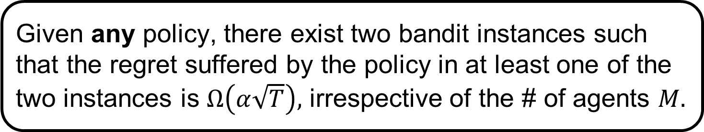
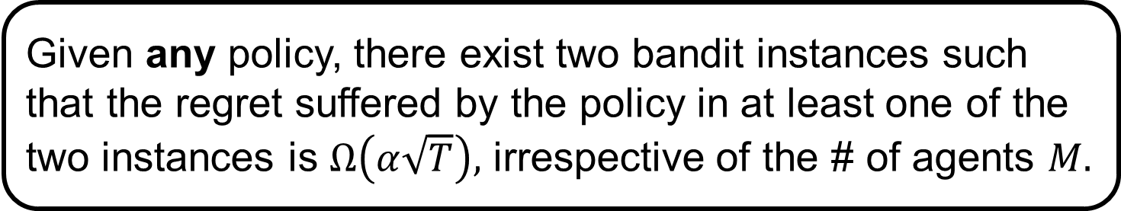
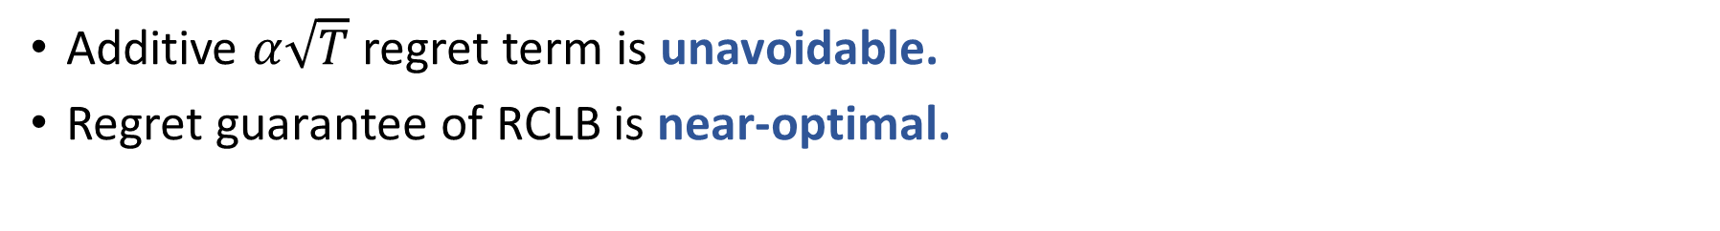
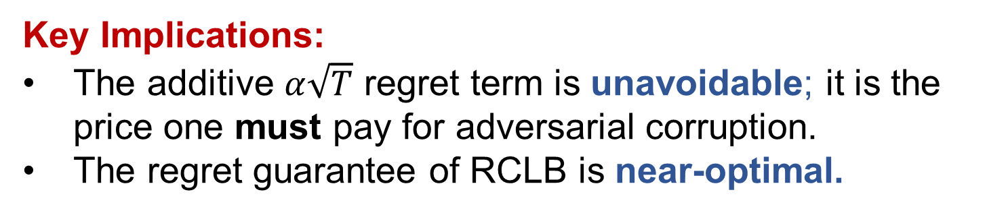
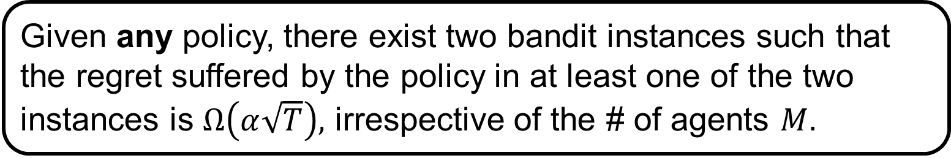
Main Result 2: Fundamental Limit
Theorem II (Fundamental Lower Bound)
Given any policy, there exist two bandit instances such that the regret suffered by the policy in at least one of the two instances is $Ω\left(α\sqrt{T}\right),$ irrespective of the # of agents $M.$
Theorem II (Fundamental Lower Bound)
Given any policy, there exist two bandit instances such that the regret suffered by the policy in at least one of the two instances is $Ω\left(α\sqrt{T}\right),$ irrespective of the # of agents $M.$
Key Implications:
The additive $α\sqrt{T}$ regret term is unavoidable; it is the price one must pay for adversarial corruption.
The regret guarantee of RCLB is near-optimal.
Theorem II (Fundamental Lower Bound)
Theorem II (Fundamental Lower Bound)
Given any policy, there exist two bandit instances such that the regret suffered by the policy in at least one of the two instances is $Ω\left(α\sqrt{T}\right),$ irrespective of the # of agents $M.$
Main Takeaways
Additive $α\sqrt{T}$ regret term is unavoidable.
Regret guarantee of RCLB is near-optimal.

Slide 15
Related Work
Robust Statistics:
Huber & Tukey, 1960s.
Lugosi and Mendelson, Annals of Statistics, 2020
Outlier-Robust Distributed Stochastic Optimization/Supervised Learning:
Yin, Chen, Ramchandran & Bartlett, ICML 2018.
Remark: Above problems have no decision-making component.

Slide 16
More Related Work
Robust Multi-Agent Bandits:
Private and Byzantine-proof cooperative decision-making, Dubey and Pentland, AAMAS 2020.
Robust multi-agent multi-armed bandits, Vial, Shakkottai, and Srikant, ACM MobiHoc 2021.
Remark: Above papers look at the unstructured multi-armed bandit problem, and provide no lower bounds.

Slide 17


Overview of RCLB: Key Ideas
Step 1: Server assigns exploration of “active arms” to agents.
Server
$$𝒜_{1}=𝒜$$
Epoch 1

Slide 18



Overview of RCLB: Key Ideas
Step 1: Server assigns exploration of “active arms” to agents.
Step 2: Agents explore “active arms” and estimate model $θ_{∗}$.
Server
$$𝒜_{1}=𝒜$$
Epoch 1

Slide 19


Overview of RCLB: Key Ideas
Step 1: Server assigns exploration of “active arms” to agents.
Step 2: Agents explore “active arms” and estimate model $θ_{∗}$.
Server
$$𝒜_{1}=𝒜$$
Epoch 1
$${\hat{θ}}_{1}^{\left(1\right)}$$
(*)
$${\hat{θ}}_{M}^{\left(1\right)}$$

Slide 20

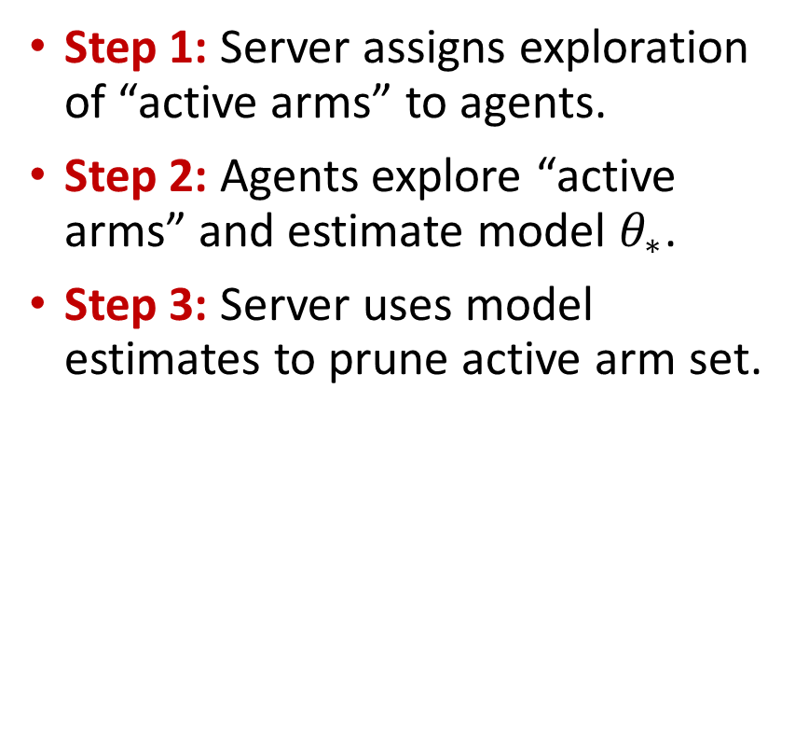
Overview of RCLB: Key Ideas
Step 1: Server assigns exploration of “active arms” to agents.
Step 2: Agents explore “active arms” and estimate model $θ_{∗}$.
Step 3: Server uses model estimates to prune active arm set.
Server
$$𝒜_{1}=𝒜$$
$$𝒜_{2}$$
Epoch 1

Slide 21
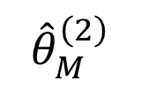


Overview of RCLB: Key Ideas
Server
$$𝒜_{1}=𝒜$$
$$𝒜_{2}$$
$$𝒜_{3}$$
….
Epoch 1
Epoch 2
$${\hat{θ}}_{1}^{\left(2\right)}$$
(*)
$${\hat{θ}}_{M}^{\left(2\right)}$$

Slide 22
A Closer Look at RCLB: Missing Gaps
Q. Sampling strategy in each epoch?
Q. Model estimation strategy?
Q. Construction of Robust Arm-Payoffs?
Q. Construction of Robust Confidence Intervals?
Q. Arm Elimination strategy?

Slide 23





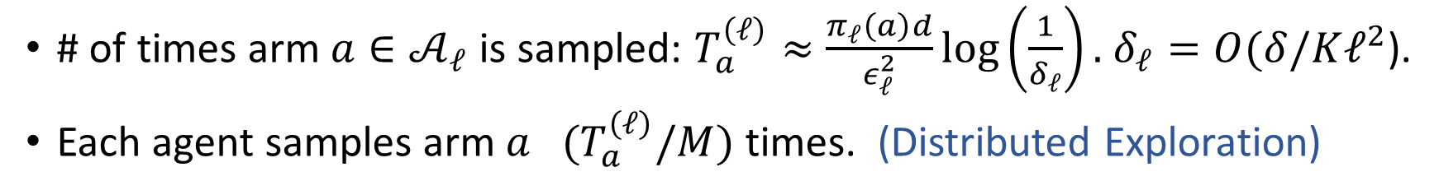

Sampling for Phased Elimination
Main Idea: At the end of epoch $ℓ,$ want to only retain arms that are at most $O(ε_{ℓ})$ away from optimal arm, where $ε_{ℓ}=\left(\frac{1}{2^{ℓ}}\right).$
$$ε_{ℓ}$$
$$a_{1}$$
$$𝒜_{ℓ}$$
(
(
(
(
$$⟨θ_{∗},a_{2}⟩$$
$$⟨θ_{∗},a_{1}⟩$$
$$a_{2}$$
Optimal Experiment Design
# of times arm $a∈𝒜_{ℓ}$ is sampled: $T_{a}^{\left(ℓ\right)}≈\frac{π_{ℓ}\left(a\right)d}{ε_{ℓ}^{2}}\log\left(\frac{1}{δ_{ℓ}}\right).$ $δ_{ℓ}=O(δ/Kℓ^{2}$).
Each agent samples arm $a {(T}_{a}^{\left(ℓ\right)}/M)$ times. (Distributed Exploration)

Slide 24
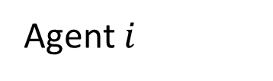



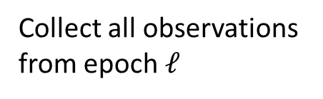
Local Model Estimation
$$𝒜_{ℓ}$$
….
Epoch $ℓ$
Collect all observations from epoch $ℓ$
$${\{y}_{i,t}=\left\langle θ_{∗}{,a}_{i,t}\right\rangle +η_{i,t}\}$$
Least Squares Estimator
$${\hat{θ}}_{i}^{\left(ℓ\right)}$$
Agent $i$

Slide 25
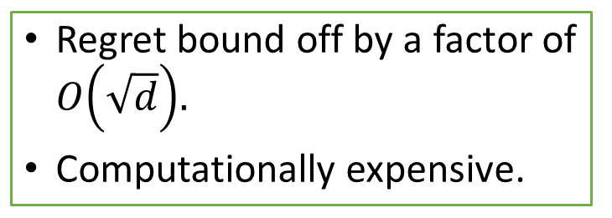

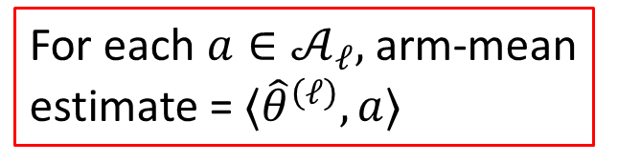



Robust Arm-Mean Estimation: Failed Attempts
Candidate Strategy 1
$${\hat{θ}}_{1}^{\left(ℓ\right)}$$
$$\{{\hat{θ}}_{i}^{\left(ℓ\right)}\}$$
High-Dimensional
Robust Mean
Estimator
$${\hat{θ}}^{(ℓ)}$$
(*)
Server
$${\hat{θ}}_{M}^{\left(ℓ\right)}$$
Robust arm-mean
estimator
For each $a∈𝒜_{ℓ},$ arm-mean estimate = $⟨{\hat{θ}}^{\left(ℓ\right)},a⟩$
Regret bound off by a factor of $O\left(\sqrt{d}\right).$
Computationally expensive.

Slide 26


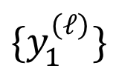
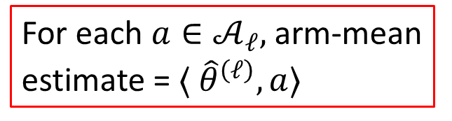



Robust Arm-Mean Estimation: Failed Attempts
Candidate Strategy 2
$$\{y_{1}^{\left(ℓ\right)}\}$$
$$\{y_{i}^{\left(ℓ\right)}\}$$
Robust Mean
Estimator
$${\{y}^{(ℓ)}\}$$
(*)
Server
$$\{y_{M}^{\left(ℓ\right)}\}$$
Robust arm-mean
estimator
For each $a∈𝒜_{ℓ},$ arm-mean estimate = $⟨ {\hat{θ}}^{\left(ℓ\right)},a⟩$
Regret bound off by a factor of $O\left(\sqrt{d}\right).$
Expensive Communication.
$${\{y}^{(ℓ)}\}$$
Least Squares Estimate using

Slide 27
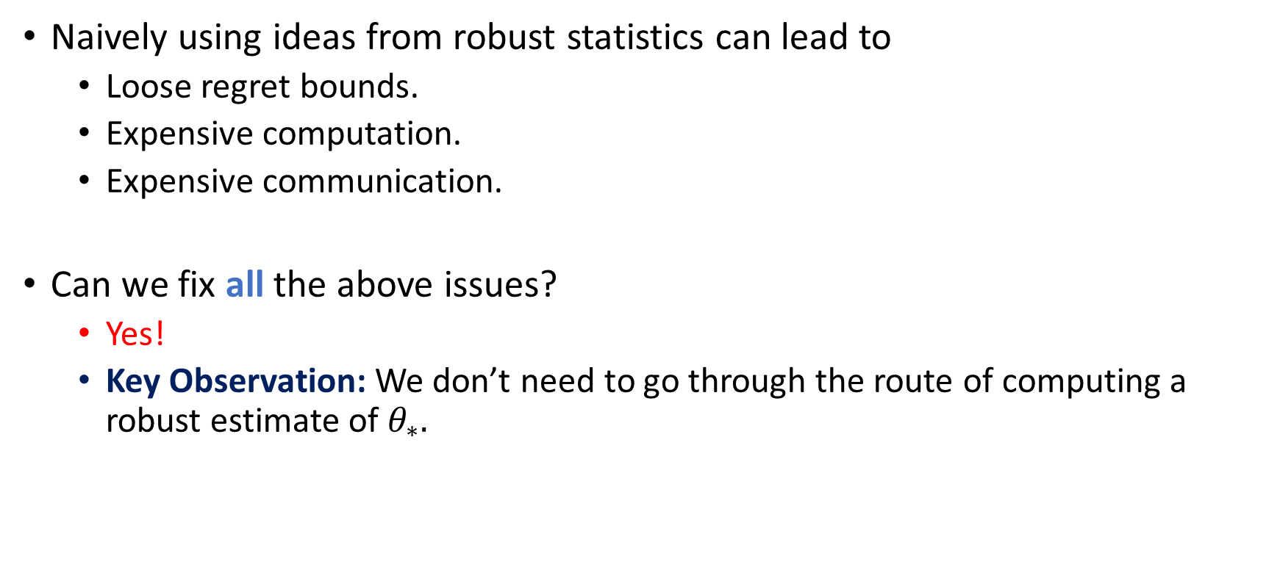
Lessons Learnt
Naively using ideas from robust statistics can lead to
Loose regret bounds.
Expensive computation.
Expensive communication.
Can we fix all the above issues?
Yes!
Key Observation: We don’t need to go through the route of computing a robust estimate of $θ_{∗}.$

Slide 28






Robust Arm-Mean Estimation: Finally!
$${\hat{θ}}_{1}^{\left(ℓ\right)}$$
Robust Arm-Mean Estimator
$$\{{\hat{θ}}_{i}^{\left(ℓ\right)}\}$$
$$μ_{a}^{\left(ℓ\right)}=Median(\{⟨{\hat{θ}}_{i}^{\left(ℓ\right)},a⟩, i∈\left[M\right]\})$$
(*)
Server
$${\hat{θ}}_{M}^{\left(ℓ\right)}$$
$$a$$
Robust estimate of the mean-payoff of arm $a,$ namely, $\left\langle θ_{∗},a\right\rangle$
$$𝒜_{ℓ}$$
Confidence Bounds?

Slide 29
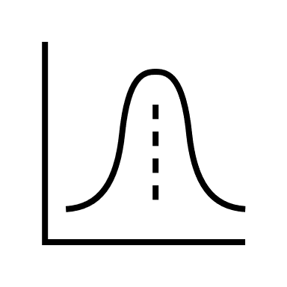
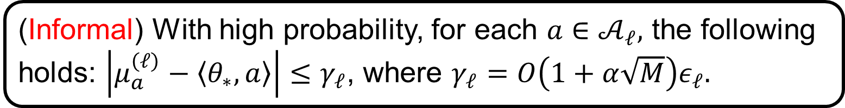
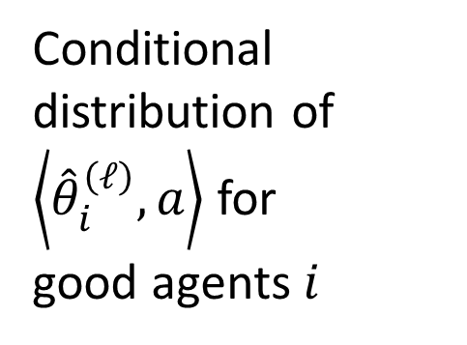

Robust Confidence Intervals
Estimates from
good agents
Conditional distribution of $\left\langle {\hat{θ}}_{i}^{\left(ℓ\right)},a\right\rangle$ for
good agents $i$
Key Observation
$$⟨θ_{∗},a⟩$$
Lemma (Robust Confidence Intervals)
(Informal) With high probability, for each $a∈𝒜_{ℓ},$ the following holds: $\left|μ_{a}^{\left(ℓ\right)}−\left\langle θ_{∗},a\right\rangle \right|≤γ_{ℓ}$, where $γ_{ℓ}=O\left(1+α\sqrt{M}\right)ε_{ℓ}.$
Inflated Confidence Threshold

Slide 30
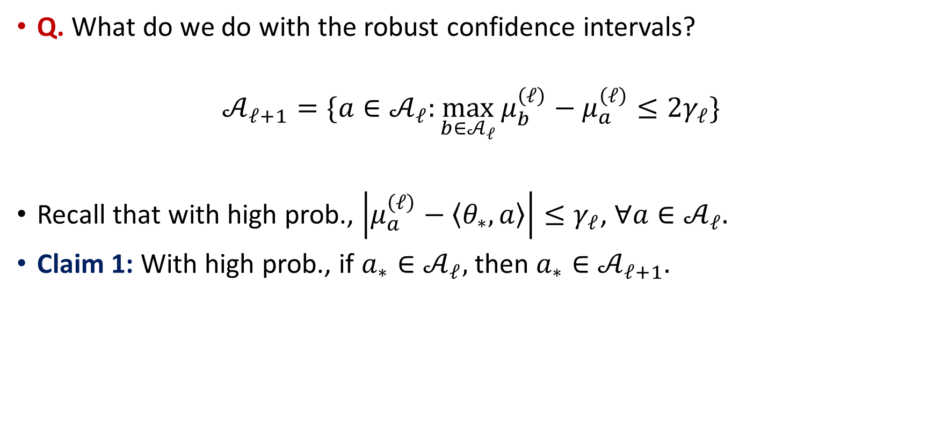
Phased Elimination
Q. What do we do with the robust confidence intervals?
$$𝒜_{ℓ+1}=\{a∈𝒜_{ℓ}:\max_{b∈𝒜_{ℓ}}{μ_{b}^{\left(ℓ\right)}−μ_{a}^{\left(ℓ\right)}≤2γ_{ℓ}\}}$$
Recall that with high prob., $\left|μ_{a}^{\left(ℓ\right)}−\left\langle θ_{∗},a\right\rangle \right|≤γ_{ℓ}$, $∀a∈𝒜_{ℓ}.$
Claim 1: With high prob., if $a_{∗}∈𝒜_{ℓ},$ then $a_{∗}∈𝒜_{ℓ+1}.$

Slide 31
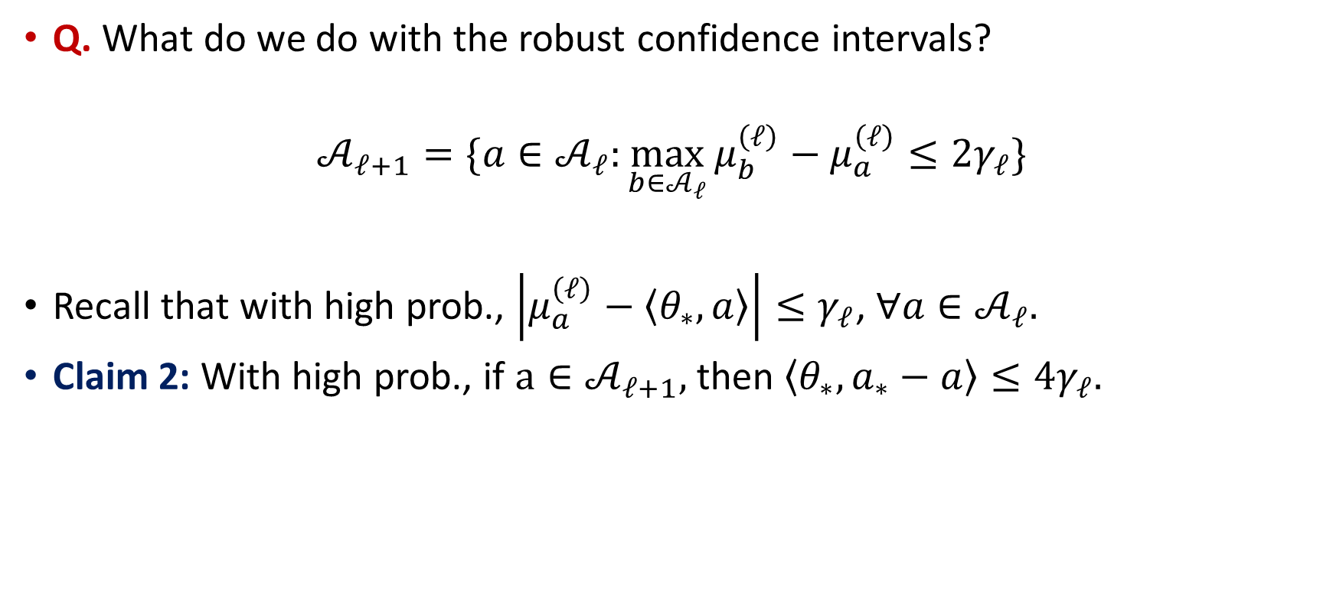
Phased Elimination
Q. What do we do with the robust confidence intervals?
$$𝒜_{ℓ+1}=\{a∈𝒜_{ℓ}:\max_{b∈𝒜_{ℓ}}{μ_{b}^{\left(ℓ\right)}−μ_{a}^{\left(ℓ\right)}≤2γ_{ℓ}\}}$$
Recall that with high prob., $\left|μ_{a}^{\left(ℓ\right)}−\left\langle θ_{∗},a\right\rangle \right|≤γ_{ℓ}$, $∀a∈𝒜_{ℓ}.$
Claim 2: With high prob., if $a∈𝒜_{ℓ+1},$ then $\left\langle θ_{∗},a_{∗}−a\right\rangle ≤4γ_{ℓ}.$

Slide 32
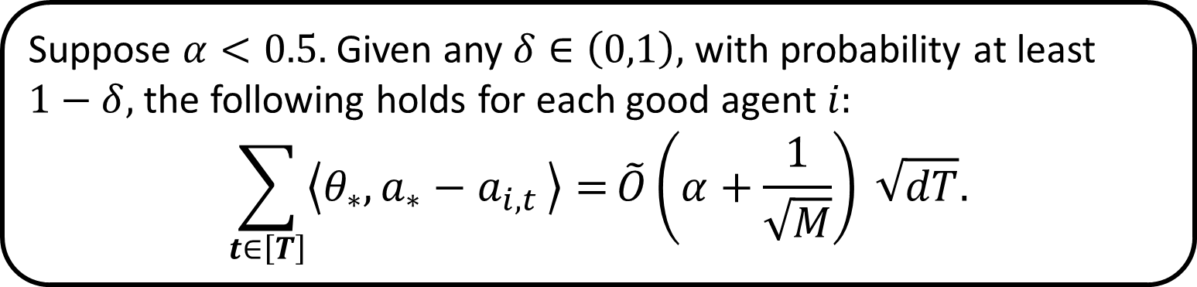
Putting it all together
Theorem I (Performance of RCLB)
Suppose $α<0.5.$ Given any $δ∈\left(0,1\right),$ with probability at least $1−δ,$the following holds for each good agent $i:$
$$\sum_{t∈\left[T\right]}{\left\langle θ_{∗}{,a_{∗}−a}_{i,t}\right\rangle =}\tilde{O}\left(α+\frac{1}{\sqrt{M}}\right) \sqrt{dT}.$$

Slide 33
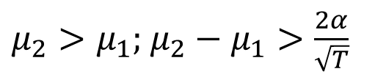




The Lower Bound Analysis
Observationally Equivalent!
Server
Server
(*)
(*)
$$a_{1}\sim 𝒩(0.5\left(μ_{1}+μ_{2}\right), 1)$$
Instance 1
Instance 2
$$a_{1}\sim 𝒩(0.5\left(μ_{1}+μ_{2}\right), 1)$$
$$a_{2}\sim 𝒩(μ_{1}, 1)$$
$μ_{2}>μ_{1};$ $μ_{2}−μ_{1}>\frac{2α}{\sqrt{T}}$
$$a_{2}\sim 𝒩(μ_{2}, 1)$$

Slide 34
The Lower Bound Analysis
Challenge 1: How do we account for multiple information sources with corruption?
Idea: Reduction to Robust Distributed Mean Estimation (Lai, Rao, & Vempala, FOCS 2016)
Challenge 2: How do we account for the online setting?
Idea: Information-theoretic arguments for full-information feedback setting (Bubeck, Perchet, and Rigollet, COLT 2013)
Note: Proof technique may apply to similar settings.

Slide 35
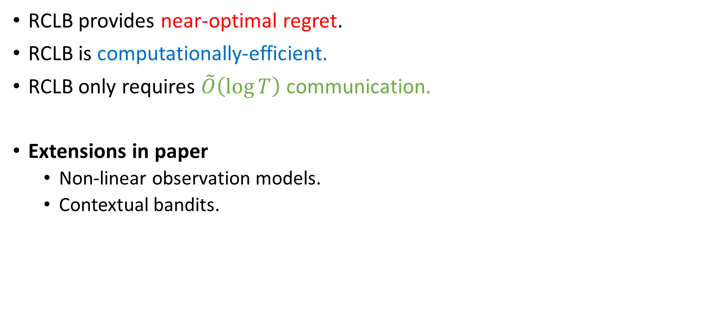
Quick Summary
RCLB provides near-optimal regret.
RCLB is computationally-efficient.
RCLB only requires $\tilde{O}\left(\log{T}\right)$ communication.
Extensions in paper
Non-linear observation models.
Contextual bandits.

Slide 36
Part II: Linear Bandits under Communication Constraints
Ref: Linear Stochastic Bandits over a Bit-Constrained Channel, Mitra et al., L4DC 23 (Oral)

Slide 37

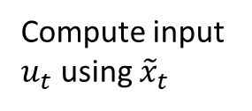
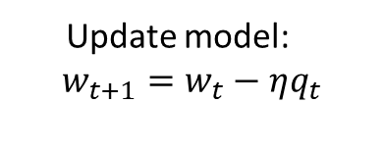

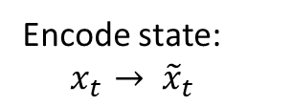
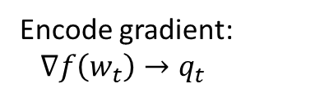






Motivating the Setting
Goal: Minimize a function $f(w)$
Goal: Stabilize an LTI system $x_{t+1}=Ax_{t}+Bu_{t}$
Model $w_{t}$
Control input $u_{t}$
Worker Agent
Server
Plant
Controller
$B$-bit channel
$B$-bit channel
Quantized gradient $q_{t}$
Quantized state ${\tilde{x}}_{t}$
Encode gradient: $∇f\left(w_{t}\right)→q_{t}$
Update model:
$$w_{t+1}=w_{t}−ηq_{t}$$
Encode state: ${ x}_{t }→ {\tilde{x}}_{t}$
Compute input $u_{t}$ using ${\tilde{x}}_{t}$
Q. How many bits (B) are needed to achieve optimal convergence rates?
Q. How many bits (B) are needed to stabilize the LTI system?
(Mayekar & Tyagi, AISTATS 20); (Lin, Kostina, & Hassibi, ISIT 21)
(Tatikonda & Mitter, TAC 2004); (Schenato et al., Proc. of IEEE)
Static problem, no decision-making
Dynamic problem, no uncertainty

Slide 38



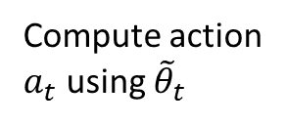
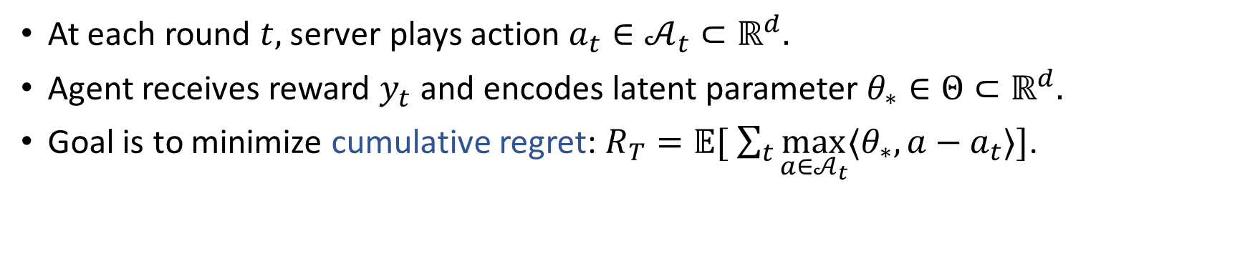
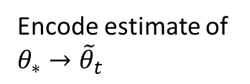
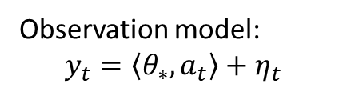


The Setup
Sensing
Control
Environment
$$a_{t}$$
Action $a_{t}$
Agent
Server
$B$-bit channel
$$y_{t}$$
Quantized parameter ${\tilde{θ}}_{t}$
Observation model:
$$y_{t}=\left\langle θ_{∗},a_{t}\right\rangle +η_{t}$$
Encode estimate of $θ_{∗}→{\tilde{θ}}_{t}$
Compute action $a_{t}$ using ${\tilde{θ}}_{t}$
Unknown parameter
Noise
At each round $t,$ server plays action $a_{t}∈𝒜_{t}⊂ℝ^{d}.$
Agent receives reward $y_{t}$ and encodes latent parameter $θ_{∗}∈Θ⊂ℝ^{d}.$
Goal is to minimize cumulative regret: $R_{T}=𝔼[ \sum_{t}{\max_{a∈𝒜_{t}}{⟨θ_{∗}, a−a_{t}}⟩]}$.

Slide 39
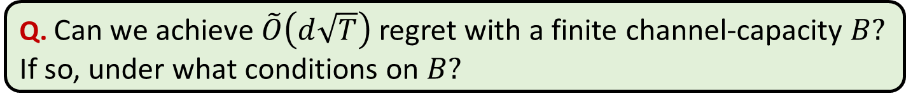
The Setup
Sensing
Control
Environment
$$a_{t}$$
Action $a_{t}$
Agent
Server
$B$-bit channel
$$y_{t}$$
Quantized parameter ${\tilde{θ}}_{t}$
Observation model:
$$y_{t}=\left\langle θ_{∗},a_{t}\right\rangle +η_{t}$$
Encode estimate of $θ_{∗}→{\tilde{θ}}_{t}$
Compute action $a_{t}$ using ${\tilde{θ}}_{t}$
Unknown parameter
Noise
When $B=∞,$ optimal regret is $\tilde{O}(d\sqrt{T})$. (Yadkori et al., NeurIPS 2011)
Q. Can we achieve $\tilde{O}\left(d\sqrt{T}\right)$ regret with a finite channel-capacity $B?$ If so, under what conditions on $B?$

Slide 40
Contributions
We propose a new algorithm: Information-Constrained LinUCB (IC-LinUCB).
Theorem (Performance of IC-LinUCB)
Suppose $B≥6d.$ Then, IC-LinUCB guarantees $R_{T}=\tilde{O}(d\sqrt{T})$.
Main Takeaways:
First result to show that we can achieve the minimax optimal regret bound with a horizon-independent channel capacity.
Complements results of a similar flavor for stochastic optimization (Mayekar & Tyagi, AISTATS 20).

Slide 41
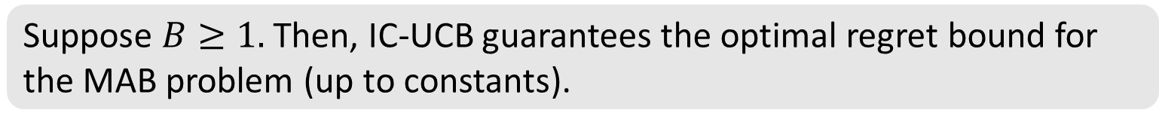
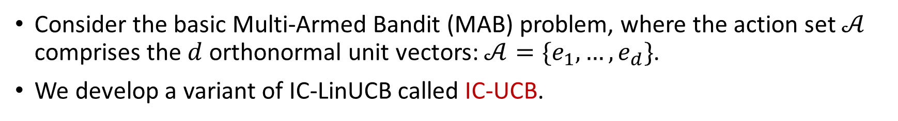
Contributions (Continued)
Q. When the actions sets have more structure, can we achieve optimal regret bounds with fewer bits?
Consider the basic Multi-Armed Bandit (MAB) problem, where the action set $𝒜$ comprises the $d$ orthonormal unit vectors: $𝒜=\{e_{1},…,e_{d}\}$.
We develop a variant of IC-LinUCB called IC-UCB.
Theorem (Performance of IC-UCB)
Suppose $B≥1.$ Then, IC-UCB guarantees the optimal regret bound for the MAB problem (up to constants).
Main Takeaway: 1-bit channel suffices to achieve order-optimal regret for the MAB problem

Slide 42
Key Algorithmic Ideas
Q1) How to encode the latent parameter?
Adaptive quantization of “innovations”.
Range of quantizer informed by statistical confidence bounds.
Q2) How to take decisions at the server?
Server constructs an inflated elliptical confidence set.
Inflation accounts for quantization errors.

Slide 43




Challenges in Large-Scale/Distributed Systems
Partial/Imperfect Information
Communication
Constraints
Adversarial
Attacks
Data Heterogeneity
Q. How do we account for the above challenges in sequential decision-making problems?

Slide 44
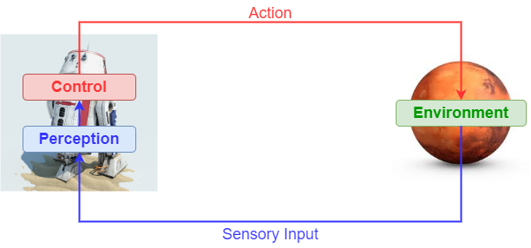
Exploiting Common Structure in Multi-Agent Learning
Motivation: Agents are typically heterogeneous in their observation models & actuation capabilities.
Transferring learning across different agents by exploiting common structure?
Modeling common structure?
Q. How can we transfer knowledge between agents interacting with different, yet similar environments?

Slide 45
Federated RL with Heterogeneous Environments
Server
….
Agent 1
Agent M
Q. Can an agent expedite the process of evaluating its own value function by exchanging information with other agents?

Slide 46
Federated RL with Heterogeneous Environments
Q. Can an agent expedite the process of evaluating its own value function by exchanging information with other agents?
Informal Result: Say each agent acquires $T$ samples. Then, the convergence rate of a federated version of the TD algorithm is:
$O(\frac{1}{MT}+ε)$
Linear Speedup in the # of agents
Captures heterogeneity in the agents’ MDPs.
Main Message: Each agent can quickly converge to a neighborhood of its own “optimal parameter” using information from other agents.
Ref: Federated TD Learning with Linear Function Approximation under Environmental Heterogeneity, Wang, Mitra, Hassani, Pappas, and Anderson, arXiv 2023

Slide 47
Future Directions
Fundamental Trade-offs
Algorithm Design
Sample-Complexity Analysis
Adversarial Robustness
Information
Constraints
Multi-armed
bandits
Linear bandits
MDPs with finite action/state spaces
MDPs with continuous action/state spaces
Heterogeneity
Problem Settings
Themes

Slide 48

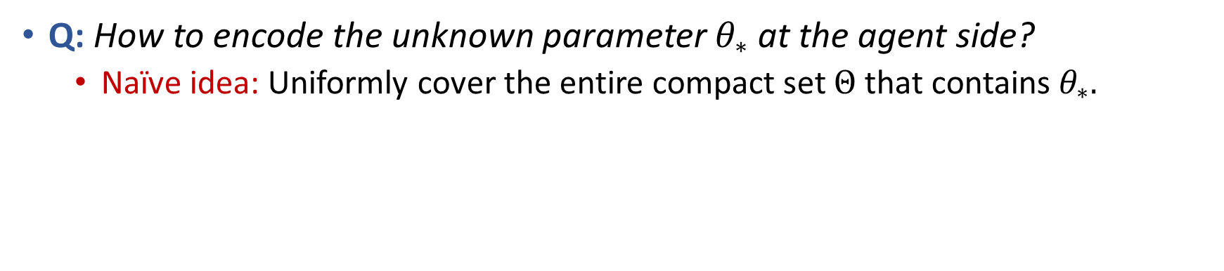

Building Intuition for Encoding Strategy
Q: How to encode the unknown parameter $θ_{∗}$ at the agent side?
Naïve idea: Uniformly cover the entire compact set $Θ$ that contains $θ_{∗}.$
$$θ^{∗}$$
$$Θ$$

Slide 49


Building Intuition for Encoding Strategy
Q: How to encode the unknown parameter $θ_{∗}$ at the agent side?
Naïve idea: Uniformly cover the entire compact set $Θ$ that contains $θ_{∗}.$
Need precision of cover $ε∝\frac{1}{T}$.
This will cause channel capacity $B$ to scale with horizon $T!$ Undesirable.
$$θ^{∗}$$
$$ε$$
$$Θ$$

Slide 50
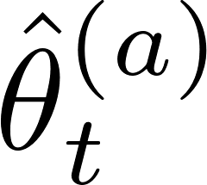

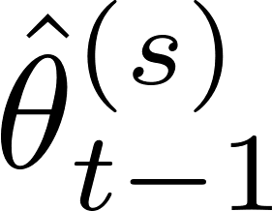
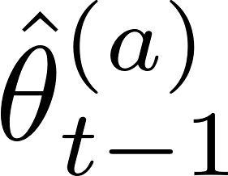
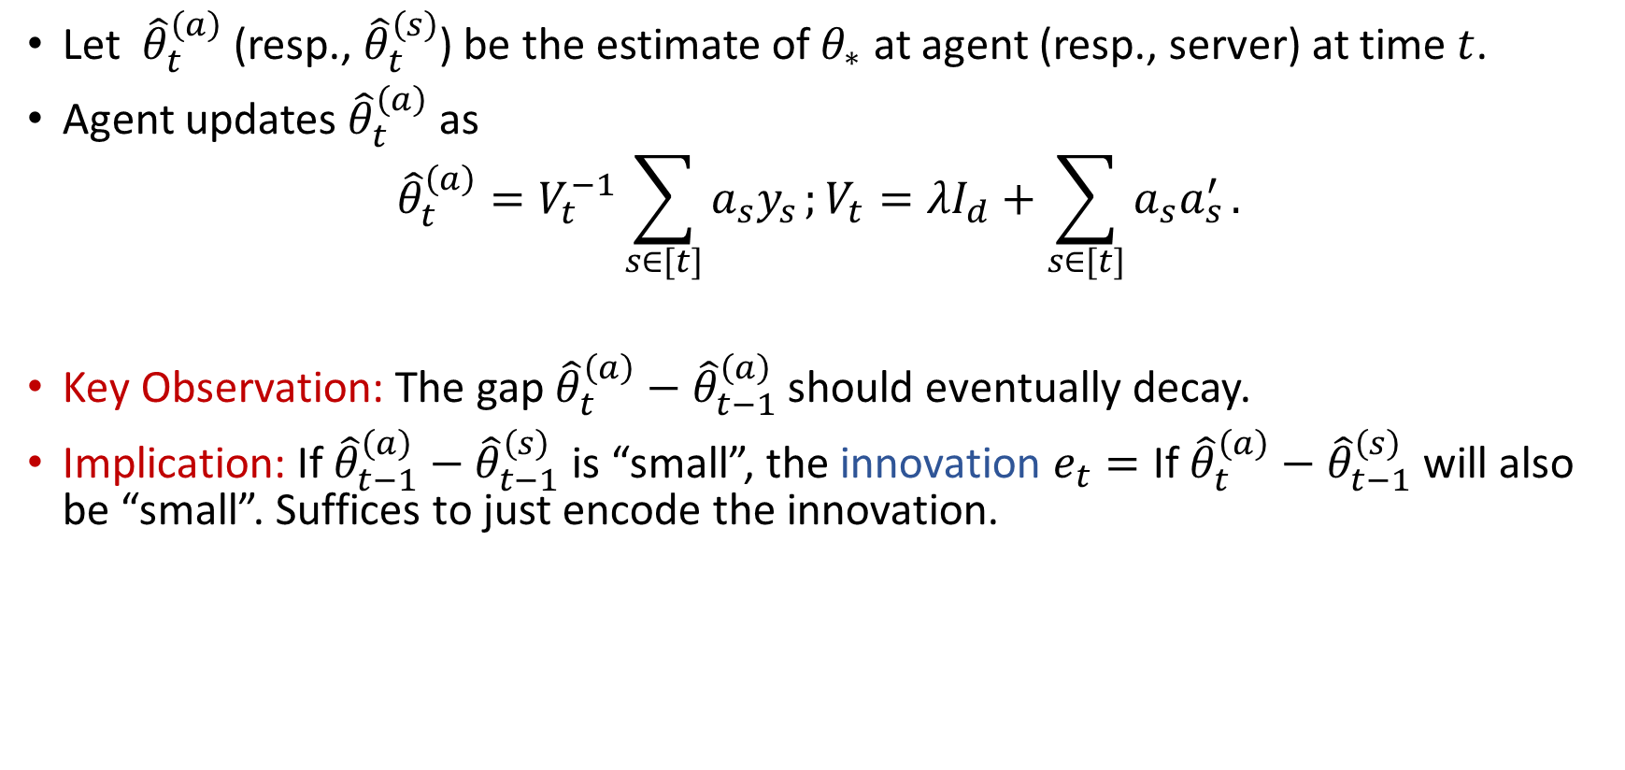

Building Intuition for Encoding Strategy
Let ${\hat{θ}}_{t}^{\left(a\right)}$ (resp., ${\hat{θ}}_{t}^{\left(s\right)}$) be the estimate of $θ_{∗}$ at agent (resp., server) at time $t$.
Agent updates ${\hat{θ}}_{t}^{\left(a\right)}$ as
$${\hat{θ}}_{t}^{\left(a\right)}=V_{t}^{−1}\sum_{s∈[t]}{a_{s}y_{s}};V_{t}=λI_{d}+\sum_{s∈[t]}{a_{s}a_{s}^{′}}.$$
Key Observation: The gap ${\hat{θ}}_{t}^{\left(a\right)}−{\hat{θ}}_{t−1}^{\left(a\right)}$ should eventually decay.
Implication: If ${\hat{θ}}_{t−1}^{\left(a\right)}−{\hat{θ}}_{t−1}^{\left(s\right)}$ is “small”, the innovation $e_{t}=\text{If} {\hat{θ}}_{t}^{\left(a\right)}−{\hat{θ}}_{t−1}^{\left(s\right)}$ will also be “small”. Suffices to just encode the innovation.
Challenge: But the innovation signal $e_{t}$ is random!

Slide 51








Adaptive Encoding at Agent
Key: Design of the dynamic quantizer range sequence $\{p_{t}\}$ exploits concentration bounds for linear bandits.
Fix some $ε∈\left(0,1\right).$ Generate deterministic sequences $q_{t}=ε\left(q_{t−1}+f\left(T\right)\right)$ and $p_{t}=q_{t}+f\left(T\right);$ here, $f\left(T\right)=O(\sqrt{d/T}$) is fixed a priori.
Encode $e_{t}$ by constructing $εp_{t}$-net of $ℬ_{d}(0,p_{t})$.

Slide 52





Decision-Making at Server
Pure
Exploration
Information Constrained Exploration-Exploitation
$$\overline{T}$$
$$T$$
$$\tilde{O}(d\sqrt{T})$$
Information-Constrained Explore-Exploit Phase: $∀t≥\overline{T}+2:$
Decode innovation ${\tilde{e}}_{t−1}; {\hat{θ}}_{t−1}^{\left(s\right)}={\hat{θ}}_{t−2}^{\left(s\right)}+ {\tilde{e}}_{t−1}.$
Construct “inflated” elliptical confidence set $𝒞_{t}^{\left(s\right)}:$
$$𝒞_{t}^{\left(s\right)}=\{θ∈ℝ^{d}:{\left\|θ− {\hat{θ}}_{t−1}^{\left(s\right)}\right\|}_{V_{t−1}}≤{\sqrt{β}}_{T}+\left(\sqrt{λ+tL^{2}}\right)q_{t}\}$$
Play optimistic action $a_{t}=argmax_{a∈𝒜_{t}}\max_{θ∈𝒞_{t}^{\left(s\right)}}{⟨θ,a⟩}.$
Pure Exploration Phase: For $t≤\overline{T}+1,$ play $a_{t}∼Unif(𝕊^{d−1})$
Standard confidence radius
Encoding error

Slide 53

Why does IC-LinUCB Work?
Key Result 1 (Effect of Pure Exploration): With high probability, we have
${\left\|{\hat{θ}}_{t+1}^{\left(a\right)}−{\hat{θ}}_{t}^{\left(a\right)}\right\|}_{2}≤f\left(T\right),∀t≥\overline{T},where f\left(T\right)=O(\sqrt{d/T}\text{)}\text{.}$
Key Result 2 (Encoding Region): With high probability, we have
$e_{t}∈ℬ_{d}\left(0,p_{t}\right), ∀t≥\overline{T}+1.$
Key Result 3 (Confidence Region): With high probability, we have $θ^{∗}∈𝒞_{t}^{\left(s\right)}, ∀t≥\overline{T}+2$. Moreover, for all $t≥\overline{T}+\tilde{T},$ we have that $\left(\sqrt{λ+tL^{2}}\right)q_{t}=O\left(\sqrt{β_{T}}\right),$ where $\tilde{T}=O(\log{dT).}$

Slide 54

The Multi-Armed Bandit Problem
Learner is presented a finite set of arms $𝒜= \{a_{1},…, a_{K}\}.$
Mean reward of arm $i$ is $μ_{i}∈ℝ.$
At each-time step $t$, an arm $i\left(t\right)$ is selected by the learner.
The learner observes a reward given by $y_{t}=μ_{i(t)}+η_{t}.$
Goal is to minimize cumulative regret:
$R_{T}=μ_{∗}T−𝔼\left[\sum_{t∈\left[T\right]}{μ_{i\left(t\right)}}\right],$where $μ_{∗}=\max_{i∈𝒜}{μ_{i}}$ is the mean of the best arm.
Zero-mean Gaussian noise

