Slide 1
Failure diagnosis in networked systems
Vipul Harsh
Based on joint work with
Tong Meng, Kapil Agrawal, Wenxuan Zhou, Sachin Ashok, Rahul Bothra, Radhika N. Mysore, Sujata Banerjee, P. Brighten Godfrey
1

Slide 2
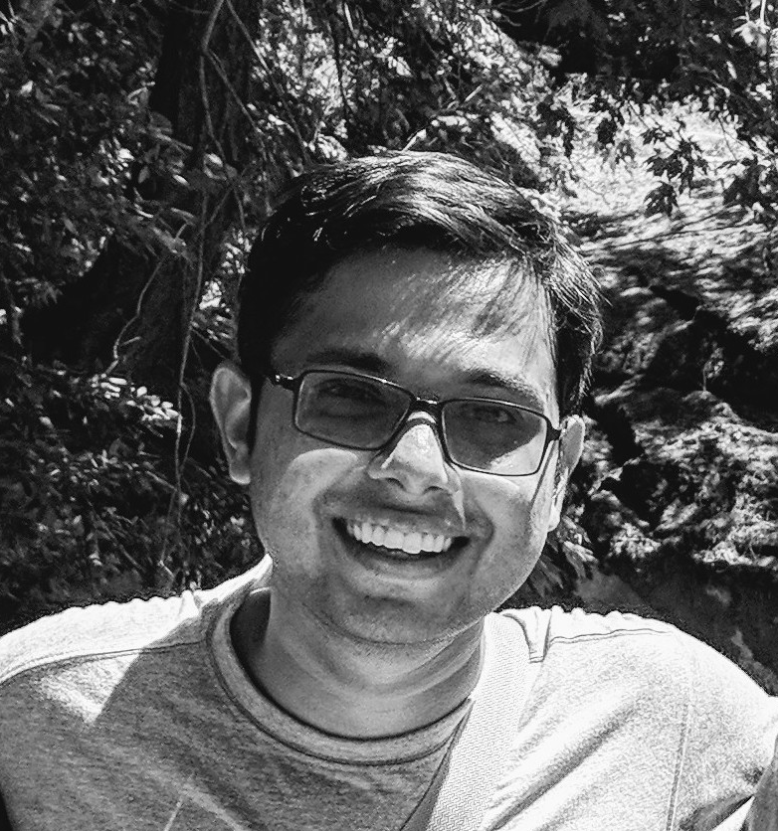
About me
Interested broadly in distributed and networked systems
worked on failure diagnosis, datacenter topology, distributed tracing, parallel algorithms
PhD at UIUC with Brighten Godfrey
Post-doc at Conviva with Vyas Sekar (CMU)
Long time ago, a spirited undergrad at IITB ☺

Slide 3
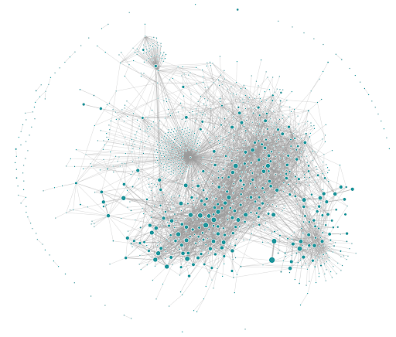
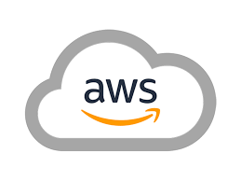
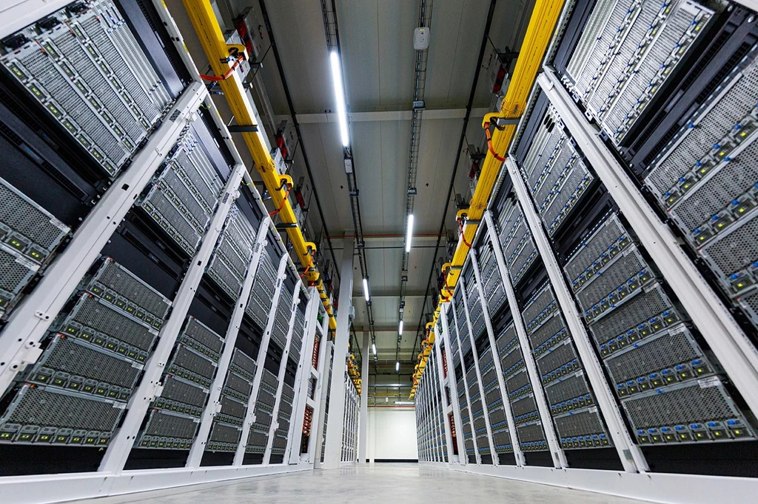
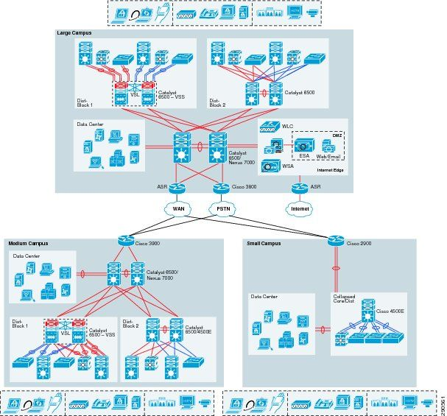
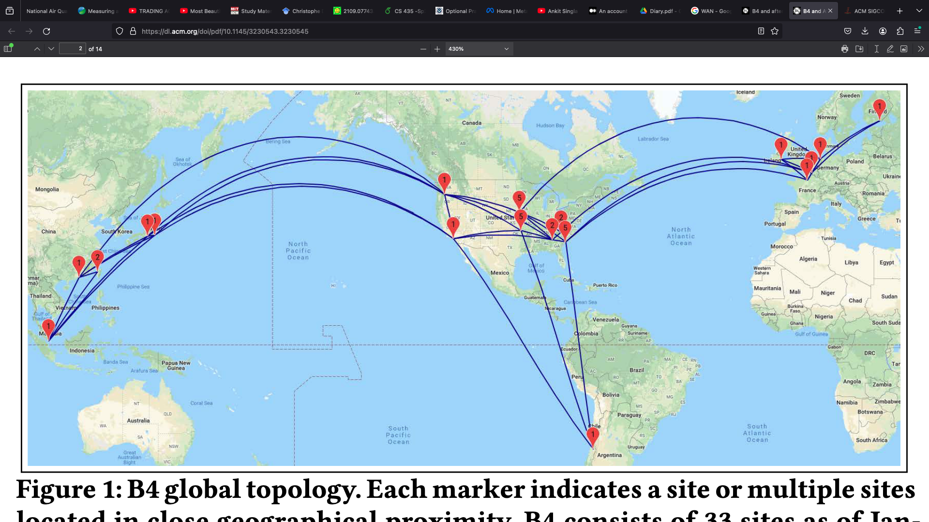


Networked systems are becoming increasingly complex
Large distributed services, microservice apps
Public/private Clouds
Datacenters
WANs
Enterprise networks
Scale: millions of components
Complex inter-dependencies between components
Images: WAN: Google B4, Sigcomm 2013, Datacenter: Microsoft Azure, miroservice app: Uber
3
Notes:
Networked systems are becoming increasingly complex.
Multiple factors contribute to complexity- scale, complex inter-dependencies
Often limited visibility into the system
If

Slide 4
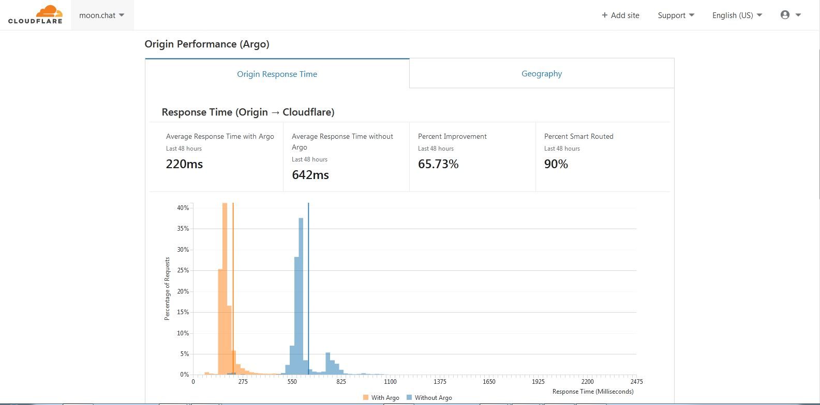
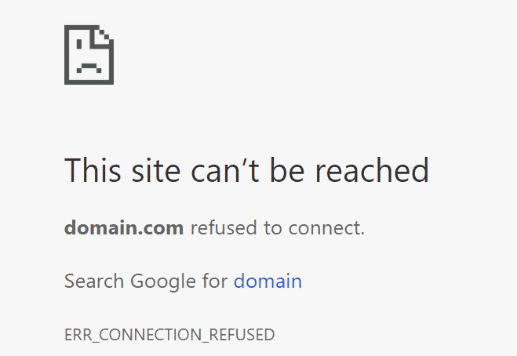
Failures are inevitable and costly
: (
Hourly cost of delays, lag, and downtime for avg. enterprise ~ $ 330K
Source: Gartner
Hourly cost of server downtime: >$1M for 44% of enterprises
Source: ITIC 2021 Hourly Cost of Downtime Survey Rising Downtime Costs (subhead)
Notes:
These systems have inevitable outage incidents
These incidents are costly
If audience is targeted, then say "as you know"

Slide 5


Operators need to quickly troubleshoot diverse failure types via diverse telemetry
high client response times
anomalous performance metrics
high latency
packet drops
unreachability
black holes
hardware failures
configuration bugs
…
Monitoring telemetry
Metrics
Events
Logs
Traces
Notes:
Operators have to troubleshoot various kinds of incidents- network issues, performance problems, software issues, hardware failures etc.
Often this troubleshooting is time consuming]]
]
Darko: specify what problems you solve first

Slide 6
Automated Root Cause Analysis (RCA) for quick diagnosis of failures
performance problems, network issues, hardware failures, software bugs etc.
RCA: find the entity(s) that caused a problematic symptom
Monitoring telemetry
Monitoring telemetry
RCA
Monitoring telemetry
Root causes
implemented by major cloud providers
leads to faster resolution of issues
Notes:
Thus, an important goal is to design automated root cause analysis tools
At a high level, root cause analysis is about finding the faulty component that can explain a problematic symptom
This is a very general definition, and encompasses a wide range of troubleshooting problems are covered under this definition
Root cause analysis is interesting from both a research and an industry perspective
It has been implemented by major cloud providers, and it leads to faster resolution of issues
On the research side, it’s a rich problem space depending upon the type of problem and available telemetry
How do you evaluate your approach? How do you analyze your tool?
Make it clear what is a root cause, one entity in the graph or multiple entities in th e graph
Don't have time to explain intuition and all -->
Depending on the fault and monitoring data, this is not an uniform definition.
Figure out who the audience is.
More general vision of how PGMs can be useful, for inference and predictions. Finding a broader vision would really help. Articulate the larger view.
Give one more practice talk.
If you get non-clarification questions: postpone it to the end. "Let's come back to it

Slide 7
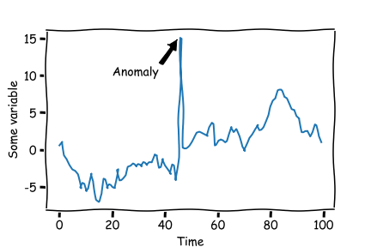
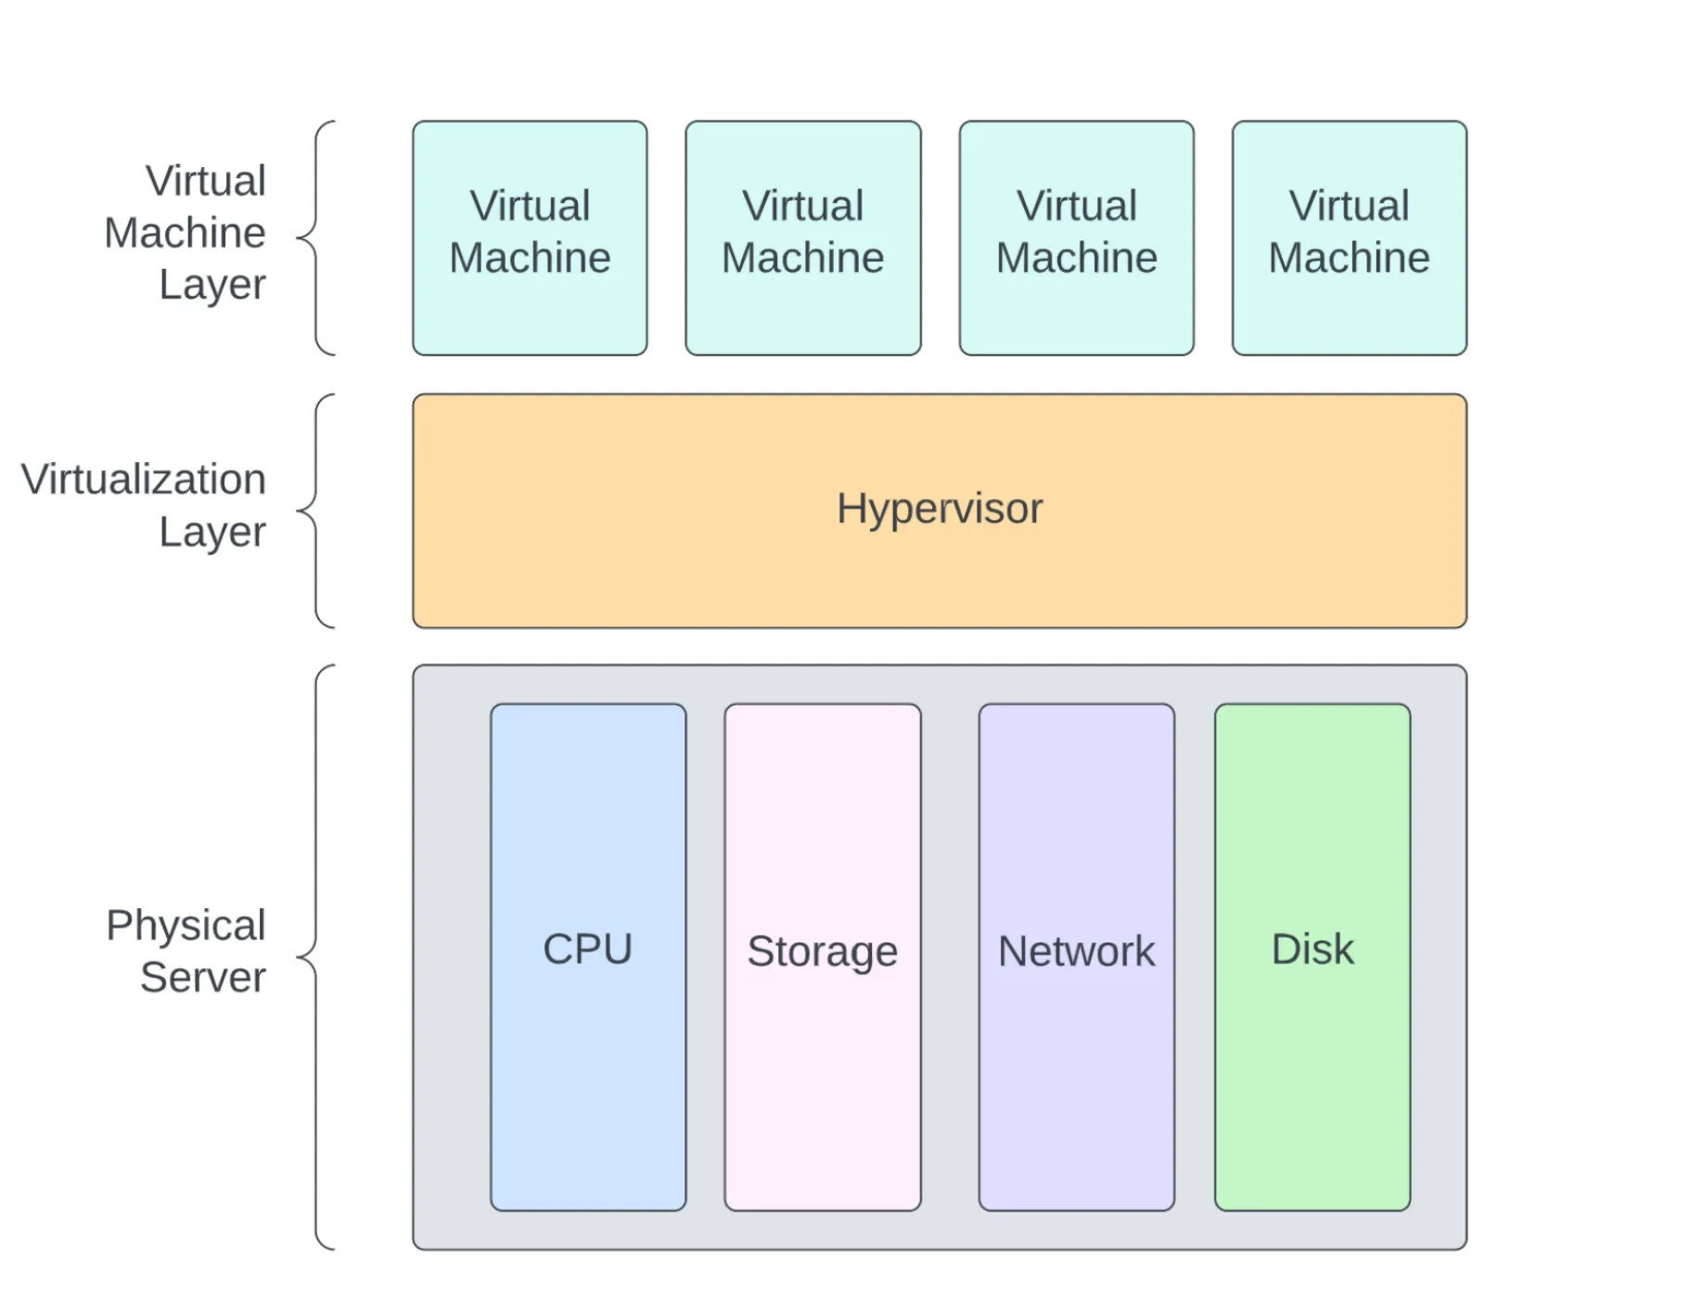




Need to handle many complex aspects of networked systems
Search
Front-end
DNS
DB1
DB2
Scale:
Microservice apps: 1000s of services
Datacenter: > 100K components
which service talks to whom $✅$
Exact dependency information unknown X
Aggregated view of metrics
e.g. resource usage or client latency over 10mins
(instead of finer-grained data)
Flow
ToR Switch
Flow
Flow
Flow
VM
VM
VM
VM
VM
VM
VM
VM
VM
VM
VM
VM
Host
vNIC
vNIC
vNIC
Host
vNIC
vNIC
Host
vNIC
vNIC
Host
vNIC
vNIC
vNIC
vNIC
vNIC
flow from src → dst can take any (unknown) ECMP path
Cyclic dependencies
VMs → Host and Host → VMs
VM1 ←→ VM2 via flows
Virtualization
Source: https://faun.pub/virtualization-the-big-picture-ce0bf87d0e9d
Notes:
There are various complexities that make it challenging to design automated root cause analysis techniques.
One is scale- the large number of components in the system
You might have a distributed application where you only know who talks to whom, but the exact dependency and the order might be fuzzy
You might only have access to an aggregated view of metrics, rather than finer grained data
In a datacenter, you might now know the path of a flow
There could be cyclic dependencies among components
Or virtualization, sometimes it can be hard to just know whether a bug is in the virtualization layer or the physical layer
And this is not an exhaustive list, all of these things make it difficult to design RCA tools

Slide 8
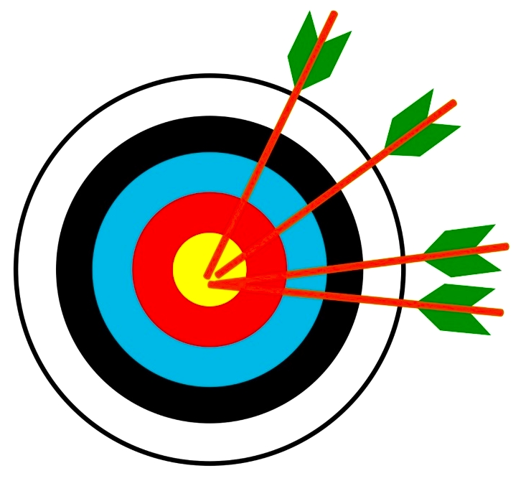

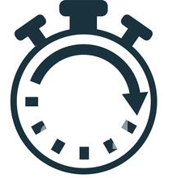
Given these complexities, how do we design RCA that achieves …
High inference accuracy
robust solutions based on principled techniques
Based on practical telemetry
rely on monitoring data that’s available in the real world
Reasonably fast inference
few minutes okay, hours not

Slide 9
To meet goals, address two aspects of RCA
Model behavior & interactions of system components precisely
Extract high inference-accuracy via the model
ToR Switch
Monitoring telemetry
Flow
Flow
Flow
Monitoring telemetry
Monitoring telemetry
Host
Host
SWITCH
VM
VM
VM
VM
VM
VM
VM
VM
VM
Flow
VM
vNIC
Flow
Flow
Host
vNIC
vNIC
Host
vNIC
vNIC
vNIC
Host
vNIC
vNIC
vNIC
VM
Crawler
Flow
VM
Flow
VM
vNIC
vNIC
Training + inference
algorithms
Topology
SWITCH
Host
Host
Flow
VM
Flow
Flow
VM
Crawler
Flow
VM
Flow
VM
vNIC
vNIC

Slide 10
RCA: two categories of related work
Solutions whose models are too simplistic or do not capture system behavior accurately, or do not generalize to all environments
NetMedic
ExplainIT
Sage
PathDump
NetSeer
NetNorad
PingMesh
MaxCoverage
007
Uses accurate model, but training/inference algorithms do not handle practical constraints of the real world
NetBouncer
DiffProv
Omnimon
Dapper
Sherlock
Seer
NetSeer

Slide 11
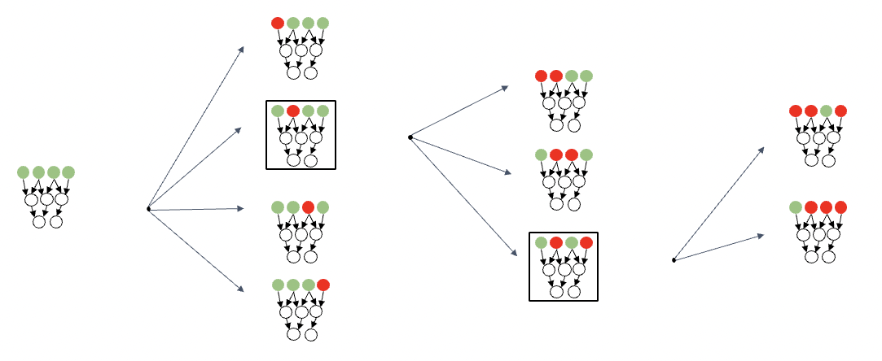
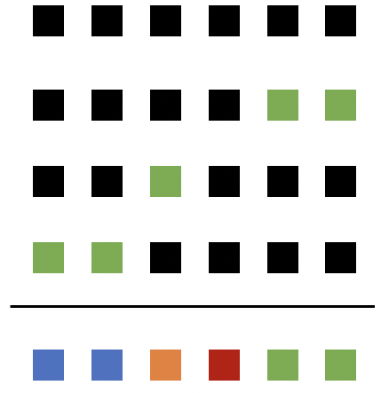
Two high level ideas for RCA design
Use powerful reasoning models to model complex interactions
Use custom training + inference to handle real world constraints
TOR
SWITCH
Host
Host
Flow
VM
Flow
Flow
VM
Crawler
Flow
VM
Flow
VM
vNIC
vNIC
Probabilistic Graphical Models (PGMs)
Algorithmic innovations
Notes:
Given all this complexity, is it even possible to design accurate RCA techniques that can handle all of this complexity?
Through this talk, I want to convince you that the answer is yes. We can use powerful reasoning techniques to design highly accurate tools. We will draw ideas from Probabilistic Graphical Models, which is a class of statistical or machine learning models based on a graph (either a directed graph or an undirected graph). We adopt some of these tools for various troubleshooting problems that we attempt to solve
Should be emphasized more. Should be about the person.very. Important
Careful phrasing → need to adapt these \techniqus

Slide 12
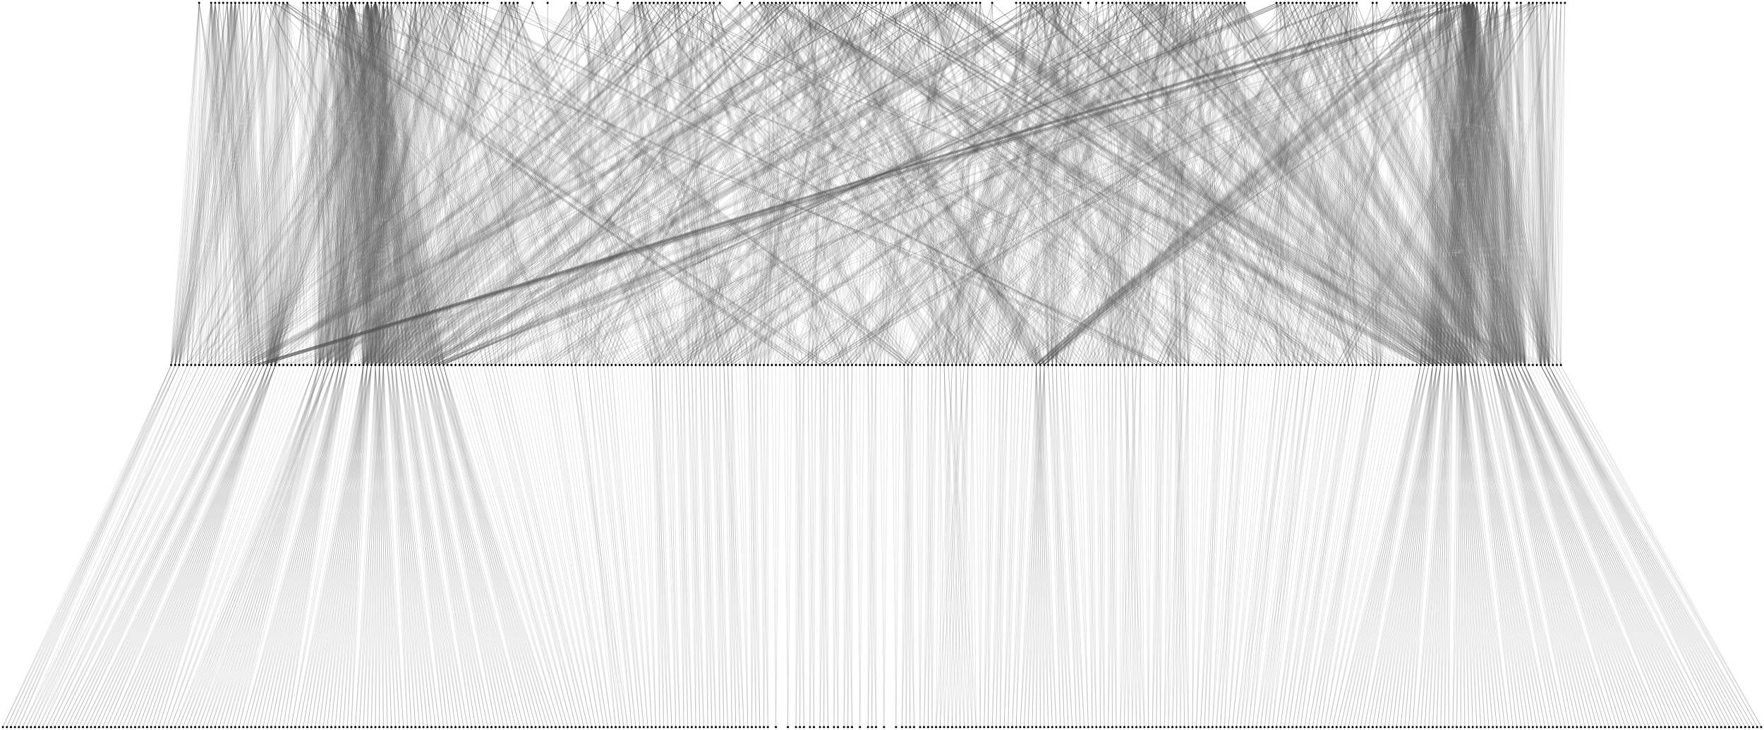
Talk overview: 3 practical systems for Root Cause Analysis
Murphy: Performance diagnosis in distributed cloud applications
ToR
Switch
Host
vNIC
Host
Flow 3
Backend VM
ACM SIGCOMM 2023
Adopted as a product at VMware
Crawler VM
Flow 1
Frontend VM
Flow 2
Backend VM
vNIC
vNIC
Host
Host
vNIC
VM
Flock: Localize gray failures in large datacenter networks
ACM CoNext 2023
Challenge: deal with unknown paths for flows
FaultFerence: Diagnosing gray failures via micro-changes
In the works
Challenge: work with weak dependency information present in the monitoring telemetry
Notes:
enhance pubs
say vmware product
Madhu- broaden your talk? where these techniques can be used?
Larger story about analyzing performance.
Finding causal connections for general prediction, I am going to
use it for troubleshooting. But it can be applicable to other areas.
--> Ask host for what talk are they expecting? Which people are in the audience?
--> Highlight your research skills, deriving insights from monitoring data
--> Put use cases of the techniques, potential applications
--> make some examples more concrete:
---> broad audience or targeted audience: skip some intro for targeted audience

Slide 13
Talk overview: practical systems for Root Cause Analysis
Murphy: Performance diagnosis in distributed cloud applications
ToR
Switch
Host
vNIC
Host
Flow 3
Backend VM
ACM SIGCOMM 2023
Adopted in a product at VMware
Crawler VM
Flow 1
Frontend VM
Flow 2
Backend VM
vNIC
vNIC
Host
Host
vNIC
VM
Flock: Localize gray failures in large datacenter networks
ACM CoNext 2023
FaultFerence: Localizing gray failures among symmetric components
In the works
Notes:
enhance pubs
say vmware product
Madhu- broaden your talk? where these techniques can be used?
Larger story about analyzing performance.
Finding causal connections for general prediction, I am going to
use it for troubleshooting. But it can be applicable to other areas.
--> Ask host for what talk are they expecting? Which people are in the audience?
--> Highlight your research skills, deriving insights from monitoring data
--> Put use cases of the techniques, potential applications
--> make some examples more concrete:
---> broad audience or targeted audience: skip some intro for targeted audience

Slide 14
Problem: troubleshoot incidents in distributed cloud applications
Large number of entities
VMs, flows, switches, hosts etc.
complex dependencies between entities
Monitoring data is coarse-grained
entities have metrics (e.g. VMs have CPU usage)
ToR Switch
Flow 1
Frontend
Server
Flow 3
Flow 2
VM
VM
VM
VM
VM
VM
VM
VM
VM
VM
VM
VM
Host
Host
vNIC
vNIC
vNIC
vNIC
Host
vNIC
vNIC
Host
vNIC
vNIC
vNIC
vNIC
vNIC
vNIC
Timeseries: each point is an aggregate over a few minutes
cpu usage
Enterprise network, private/public cloud, WAN
Time
Automate troubleshooting using this telemetry?
Notes:
Troubleshooting incidents in networked systems is hard. And there are a few reasons for this
One, the system might have a large number of entities, both virtual and physical such as VMs, flows, switches, NICs, services etc.
And these entities depend on each other in complex ways
The second reason why troubleshooting is challenging is because often the monitoring infrastructure provides coarsely aggregated data for each entity.
So an entity will have metrics e.g. VMs have CPU usage. These metrics are associated with timeseries data where each data point is an aggregate over a few minutes
This environment is pretty common in many environments such as an enterprise network, WANs, clouds, Kubernetes cluster etc. hence its important to design automated tools based on this common telemetry for various troubleshooting tasks

Slide 15
Goal: Performance Diagnosis
Frontend
Server
Backend Servers (high cpu)
ToR Switch
Flow 1
Flow 3
Flow 2
VM
VM
VM
VM
VM
VM
VM
VM
VM
VM
VM
VM
Host
Host
vNIC
vNIC
vNIC
vNIC
Host
vNIC
vNIC
Host
vNIC
vNIC
vNIC
vNIC
vNIC
vNIC
App stopped responding due to high CPU of backend VMs
Notes:
But monitoring telemetry alone is not sufficient, consider this incident
Change color

Slide 16
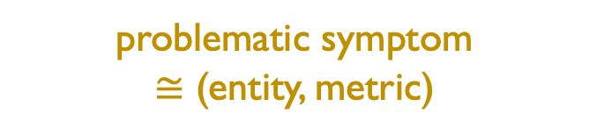
Goal: Performance Diagnosis
Flows: 2502
VMs: 3640
ToRs: 12
vNICs: 1187
Hosts: 136
Interfaces: 1661
Infer root cause entity
problematic symptom
$≅$ (entity, metric)
Frontend
Server
Backend Servers (high cpu)
ToR Switch
Flow 1
Flow 3
Flow 2
VM
VM
VM
VM
VM
VM
VM
VM
VM
VM
VM
VM
Host
Host
vNIC
vNIC
vNIC
vNIC
Host
vNIC
vNIC
Host
vNIC
vNIC
vNIC
vNIC
vNIC
vNIC
App stopped responding due to high CPU of backend VMs
Notes:
But monitoring telemetry alone is not sufficient, consider this incident
Change color
A problematic symptom can also be a high user response times, high drop rate of a flow

Slide 17
Goal: Performance Diagnosis
Flows: 2502
VMs: 3640
ToRs: 12
vNICs: 1187
Hosts: 136
Interfaces: 1661
root cause entity
Infer root cause entity
problematic symptom
$≅$ (entity, metric)
e.g. (a flow to the front-end)
Frontend
Server
Backend Servers (high cpu)
ToR Switch
Crawler
Machine
Flow 1
Flow 3
Flow 2
VM
VM
VM
VM
VM
VM
VM
VM
VM
VM
VM
VM
Host
Host
vNIC
vNIC
vNIC
vNIC
Host
vNIC
vNIC
Host
vNIC
vNIC
vNIC
vNIC
vNIC
vNIC
App stopped responding due to high CPU of backend VMs
Notes:
At the end, somehow mention dependencies. The root cause could be far off from the symptom. How do we model how one entity depends on other entities?
We focus on one troubleshooting task which we refer to as Performance diagnosis
Let me define it in the context of an incident that occurred in an enterprise network
An application stopped responding because its backend servers were overwhelmed with high CPU usage
Operators wanted to reason about this problematic symptom, which we can define as a pair of entity and a metric of that entity that might have an anomalous value
The goal of performance diagnosis is to infer the root cause of the problematic symptom and the root cause is another entity in the system
Here in the incident, the root cause was a crawler machine which was sending a lot of requests to the front-end to crawl the entire backend
Need to incorporate information from common telemetry to run analysis

Slide 18
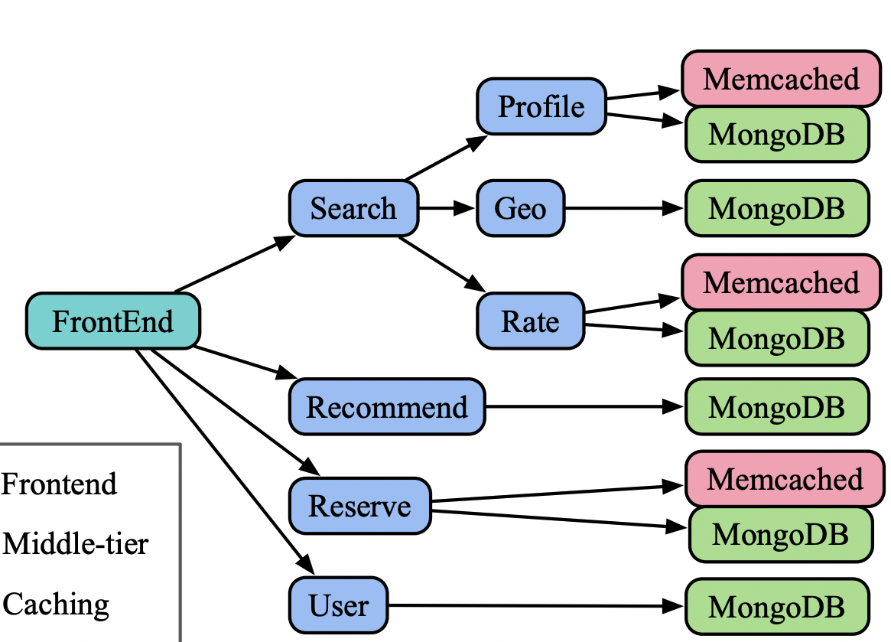
How do we model dependencies between entities?
Infeasible to infer strict dependencies in many cases
Loses information about topological structure → poor accuracy
VM
Host
ToR Switch
VM
Flow 1
VM
vNIC
vNIC
VM
ExplainIT, SIGMOD 2019
Sage, ASPLOS 2019
Sherlock, SIGCOMM 2007
Dependencies between entities:
None
Dependencies between entities:
Acyclic (DAG)
Notes:
A good analogy here is how humans interact with each other.
Infeasibilty is not coming across of DAGs
, rich figure
Middle groud pracgtical wording
Simplify that text. Spectrum is not coming across
Small text below the arrow. . Mention the word restrictive
- Existing works lie on a spectrum.
- On one end are systems such as ExplainIT which assume no dependencies.
However, assuming no dependencies loses information about topological structure about how these entities are organized and thus leads to poor accuracy.
On the other end are systems such as Sage or Sherlock which assume a perfect acyclic DAG of dependencies.
These DAGs define clearly which entities affect other entities and causality is only in one direction
Mention that this is related work slide, give citations
Show edges in DAG: have a more clearer picture

Slide 19
Cyclic dependencies among entities are the norm
Two reasons
True cyclic influences
Hard to infer dependency direction → over-approximate by assuming both directions
All application entities were involved in cycles
VMs Host
VMs also influence each other via flows
Flow
ToR Switch
Flow
Flow
Flow
VM
VM
VM
VM
VM
VM
VM
VM
VM
VM
VM
VM
Host
vNIC
vNIC
vNIC
Host
vNIC
vNIC
Host
vNIC
vNIC
Host
vNIC
vNIC
vNIC
vNIC
vNIC
Notes:
We seek a middle ground here because in our environment, cyclic dependencies among entities are the norm. There are 2 reasons to model cyclic dependencies.
True cyclic influence between entities. Consider two VMs that reside on the same host. They affect the metrics of the host, but the host also affects the metrics of the VMs. Further, VMs affect each other via flows between them. Incorporating all these dependencies introduces cycles in the system.
Another reason to model dependencies is that even if the dependency is unidirectional, the direction of the dependency is hard to infer using coarse grained telemetry that’s available. Sowe over-approximate the dependency by assuming influence in both directions
Because of these 2 reasons, we found that in our environment, all application entities were involved in at least one cycle
TODO: change choice of colors; yellow is bad
e.g. two peer VMs affect each other indirectly via the host
In fact there can be cycles of dependencies b/w entities
Add edge in both directions → judge the strength in each direction from data

Slide 20
How do we model dependencies between entities?
Infeasible to infer strict dependencies in many cases
Loses information about topological structure → poor accuracy
VM
Host
work with weak dependencies?
ToR Switch
VM
Flow 1
VM
vNIC
vNIC
VM
ExplainIT, SIGMOD 2019
Sage, ASPLOS 2019
Sherlock, SIGCOMM 2007
Dependencies between entities:
None
Dependencies between entities:
Acyclic (DAG)
Notes:
A good analogy here is how humans interact with each other.
Infeasibilty is not coming across of DAGs
, rich figure
Middle groud pracgtical wording
Simplify that text. Spectrum is not coming across
Small text below the arrow. . Mention the word restrictive
- Existing works lie on a spectrum.
- On one end are systems such as ExplainIT which assume no dependencies.
However, assuming no dependencies loses information about topological structure about how these entities are organized and thus leads to poor accuracy.
On the other end are systems such as Sage or Sherlock which assume a perfect acyclic DAG of dependencies.
These DAGs define clearly which entities affect other entities and causality is only in one direction
Mention that this is related work slide, give citations
Show edges in DAG: have a more clearer picture

Slide 21
Murphy for performance diagnosis
Inputs
A problematic metric
e.g. foo’s high CPU usage
Monitoring
telemetry
Construct model of entities and dependencies
Find root causes in the model
Generate explanations
Output
Root cause with explanation
e.g. Root cause: Crawler machine
Crawler machine sent high requests to front-end
Which sent high requests to back-end
Which caused high load at the back-end
Notes:
The first step in the system is to construct a model of the entities and dependencies between them.

Slide 22
Challenge: extract weak dependencies from the monitoring data?
Frontend
Server
Backend Servers
ToR Switch
Crawler
Machine
Flow 1
Flow 3
Flow 2
VM
VM
VM
VM
VM
VM
VM
VM
VM
VM
VM
VM
vNIC
Host
vNIC
vNIC
Host
vNIC
vNIC
Host
Host
vNIC
vNIC
vNIC
vNIC
vNIC
vNIC
vNIC

Slide 23
Model weak dependencies between entities
Actual system
Frontend
Server
Backend Servers
ToR Switch
Crawler
Machine
Flow 1
Flow 3
Flow 2
VM
VM
VM
VM
VM
VM
VM
VM
VM
VM
VM
VM
vNIC
Host
vNIC
vNIC
Host
vNIC
vNIC
Host
Host
vNIC
vNIC
vNIC
vNIC
vNIC
vNIC
vNIC
Notes:
Add animations to edges when you mention VMs, bring up the VM edges

Slide 24
Model weak dependencies between entities
Actual system
Relationship graph
Backend Servers
(thousands of entities)
ToR
Switch
Frontend
Server
Host
ToR Switch
vNIC
Crawler
Machine
Flow 1
Flow 3
Flow 3
Backend VM
Flow 2
Host
VM
VM
VM
VM
VM
VM
VM
VM
VM
VM
VM
VM
Crawler VM
Frontend VM
Backend VM
vNIC
Flow 1
Flow 2
Host
vNIC
vNIC
Host
vNIC
vNIC
Host
Host
vNIC
vNIC
vNIC
vNIC
vNIC
vNIC
vNIC
vNIC
vNIC
vNIC
Host
VM
Host
Edges based on loosely defined “neighborhood” relationship
e.g. VM and its host, flow and its src, dst
Notes:
Add animations to edges when you mention VMs, bring up the VM edges

Slide 25
Model via “relationship graph” (instead of a DAG)
Actual system
Relationship graph
Backend Servers
(thousands of entities)
ToR
Switch
Frontend
Server
Host
ToR Switch
vNIC
Crawler
Machine
Flow 1
Flow 3
Flow 3
Backend VM
Flow 2
Host
VM
VM
VM
VM
VM
VM
VM
VM
VM
VM
VM
VM
Crawler VM
Frontend VM
Backend VM
vNIC
Flow 1
Flow 2
Host
vNIC
vNIC
Host
vNIC
vNIC
Host
Host
vNIC
vNIC
vNIC
vNIC
vNIC
vNIC
vNIC
vNIC
vNIC
vNIC
Host
VM
Host
Edges based on loosely defined “neighborhood” relationship
e.g. VM and its host, flow and its src, dst
Captures topological structure, while allowing cycles
Notes:
The idea here is instead of a causal DAG, we model the dependencies using a general ”relationship” graph.
The nodes in this graph are entities in the system
And the edges are based on loosely defined neighborhood relationship for e.g. we add an edge between VMs and their hosts, between flows and their endpoints and so on
Using a relationship graph allows us to capture the structure that’s naturally present among entities, while also allowing complex cyclic dependencies to be present

Slide 26
Murphy next step: find root causes in this model
Inputs
A problematic symptom
e.g. foo’s high CPU usage
Monitoring
telemetry
Construct model of entities and dependencies
Find root causes in the model
Generate explanations
Output
Root cause with explanation
e.g. Root cause: Crawler machine
Crawler machine sent high requests to front-end
Which sent high requests to back-end
Which caused high load at the back-end
Notes:
The next step in the analysis is to find the root causes via this model

Slide 27
Which entity caused a problematic symptom?
ToR
Switch
Host
vNIC
Flow 3
Backend VM
Problematic symptom:
(backend VM, high CPU)
Host
Crawler VM
Flow 1
Frontend VM
Flow 2
Backend VM
vNIC
vNIC
vNIC
Host
VM
Host
How to infer root cause in this general relationship graph ?
Notes:
Abrupt change to the next slide, have some visuals

Slide 28
Murphy RCA: two components
Relationship graph of entities
ToR
Switch
Host
vNIC
Host
Flow 3
Backend VM
Crawler VM
Flow 1
Frontend VM
Flow 2
Backend VM
Murphy RCA
vNIC
vNIC
vNIC
Host
VM
Host
Learn distribution of metrics via relationship graph
Counterfactual reasoning algorithm
Root causes
Historical metrics of entities
Notes:
More effective if I can show instead of tell (say as you are describing the model)

Slide 29
1: Learn a joint prob. distribution on all entity metrics
Markov Random Field (MRF): composition of smaller models
Toy example:
1 metric per entity
A
P(A, B, C, D, E) = P[A | nbrs(A)] P[B | nbrs(B)]…
B
“predict B given neighbors(B)”
C
E
trained on historical metrics of B and its neighbors
D
Evaluated various models on telemetry from 300+ production apps
Notes:
Evaluated this model on a large dataset of 300+ apps production

Slide 30
Counterfactual reasoning: would changing A resolve D’s high value?
Pick a different value for A: A*
Toy example:
1 metric per entity
A
A → A*
B
C
E
D
Problematic symptom: D’s high CPU
Notes:
We can use the learnt distribution to determine if we change the value of A , what effect would it have on D and we can use this counterfactual analysis to get the root causes
This is how it works- we first pick a different value of A, say A* . It could be a lower value
Next we resample B using the distribution assuming the newer value of A
Similarly, we resample the other entities assuming the newer values we sample before
And we repeat this resampling a few times to propagate the effect of any cyclic effects
At the end, we obtain a new value for D which is the result of starting out with a different value for A
And if this new value is smaller than the original D, we can say that changing A would resolve D and hence can be a potential root cause\
Finally, to get all possible root causes, we can simply check the entire pool of candidate entities one by one

Slide 31
Counterfactual reasoning: would changing A resolve D’s high value?
Pick a different value for A: A*
Resample B* assuming A*
Toy example:
1 metric per entity
A
A → A*
B
B →B*
C
E
D
Problematic symptom: D’s high CPU

Slide 32
Counterfactual reasoning: would changing A resolve D’s high value?
Pick a different value for A: A*
Resample B* assuming A*
Similarly resample C*, E*, D*
Toy example:
1 metric per entity
A
A → A*
B
B →B*
C
E
C →C*
E →E*
D
D →D*
Problematic symptom: D’s high CPU

Slide 33
Counterfactual reasoning: would changing A resolve D’s high value?
Pick a different value for A: A*
Resample B* assuming A*
Similarly resample C*, E*, D*
Repeat 2, 3 a few times (Gibbs sampling)
Toy example:
1 metric per entity
A
A → A*
B
B →B’
C
E
C →C’
E →E’
D
D →D’
Problematic symptom: D’s high CPU
Notes:
We do this a few times to propagate the effects of the new values across dependency cycles.

Slide 34
Is A a root cause for D’s high value?
Pick a different value for A: A*
Resample B* assuming A*
Similarly resample C*, E*, D*
Repeat 2, 3 a few times (Gibbs sampling)
Toy example:
1 metric per entity
A
A → A*
B
B →B’
C
E
If D’ < D, then A is a root cause
C →C’
E →E’
D
D →D’
Problematic symptom: D’s high CPU

Slide 35
Learn Markov Random Field (MRF) model
ToR
Switch
Host
vNIC
For each entity, learn via historical data
P[ Flow 1 | neighbors(Flow 1)]
Flow 3
Backend VM
Host
Crawler VM
Flow 1
Frontend VM
Flow 2
Backend VM
vNIC
vNIC
vNIC
Host
VM
Host
MRF over entities A, B…
P(A, B, C, D, E) = P[A | nbrs(A)] . P[B | nbrs(B)]…
Notes:
- Recall, that we want to find the entities responsible for the problematic symptom, in the relationship graph we constructed
- If we had a DAG of dependencies, it would be clear how entities affect the problematic symptom. But its not obvious in this graph
- Hence, we need a powerful inference algorithm to infer root causes in this relationship graph

Slide 36
Evaluate a root cause candidate via counterfactual analysis
ToR
Switch
Host
vNIC
sessions_cnt (per min)
cpu_util
Flow 3
Backend VM
1402
0.75
Host
Crawler VM
Flow 1
Frontend VM
Flow 2
Backend VM
vNIC
vNIC
vNIC
Host
VM
Host
Notes:
Add more about the model

Slide 37
Evaluate a root cause candidate via counterfactual analysis
ToR
Switch
Host
vNIC
sessions_cnt (per min)
cpu_util
Flow 3
Backend VM
1402 → 701
0.75 → ??
Host
Crawler VM
Flow 1
Frontend VM
Flow 2
Backend VM
vNIC
vNIC
vNIC
Host
VM
Host
Notes:
- Recall, that we want to find the entities responsible for the problematic symptom, in the relationship graph we constructed
- If we had a DAG of dependencies, it would be clear how entities affect the problematic symptom. But its not obvious in this graph
- Hence, we need a powerful inference algorithm to infer root causes in this relationship graph

Slide 38
Evaluate a root cause candidate via counterfactual analysis
ToR
Switch
Host
vNIC
sessions_cnt (per min)
cpu_util
Flow 3
Backend VM
1402 → 701
0.75 → 0.3
Host
Crawler VM
Frontend VM
Backend VM
cpu_util decreases
=> classify Flow 1 as a root cause
Flow 1
Flow 2
vNIC
vNIC
vNIC
Host
VM
Host
Notes:
Might come across as too easy →

Slide 39
Identify root causes in the relationship graph
ToR
Switch
Host
vNIC
Flow 3
Backend VM
Problematic symptom:
(backend VM, high CPU)
Host
Crawler VM
Flow 1
Frontend VM
Flow 2
Backend VM
vNIC
vNIC
vNIC
Host
VM
Host

Slide 40
Identify root causes in the relationship graph
ToR
Switch
Host
Potential
root causes
vNIC
Flow 3
Backend VM
Problematic symptom:
(backend VM, high CPU)
Host
Crawler VM
Flow 1
Frontend VM
Flow 2
Backend VM
vNIC
vNIC
vNIC
Host
VM
Host
Notes:
Using this analysis, Murphy concludes that these entities are the root causes for the problematic symptom.

Slide 41
Structure helps in filtering out correlated but irrelevant entities
ToR
Switch
Host
vNIC
Root cause
Problematic symptom:
(VM 1, high CPU)
Flow 3
VM 1
Host
Crawler VM
Flow 1
Frontend VM
Flow 2
VM 2
vNIC
vNIC
vNIC
Host
VM
Host
VM2 is correlated to VM1, but not responsible for it
→ no significant “influence path” from VM2 to VM1
Notes:
The path of influence is weak in this incident

Slide 42
Murphy
Inputs
A problematic symptom
e.g. foo’s high CPU usage
Monitoring
information
Construct model of entities and dependencies
Find root causes in the model
Generate explanations
Output
Root cause with explanation
e.g. Root cause: Crawler machine
Crawler machine sent high requests to front-end
Which sent high requests to back-end
Which caused high load at the back-end
Notes:
Visual depiction of monitoring

Slide 43
Generate explanation chains (root cause → problematic symptom)
ToR
Switch
Host
Note this does not affect the root cause analysis
vNIC
Flow 3
Backend VM
Host
HEAVY-HITTER
HEAVY-HITTER
HEAVY-HITTER
Crawler VM
Flow 1
Frontend VM
Flow 2
Backend VM
vNIC
HEAVY-HITTER
vNIC
vNIC
HIGH DROP RATE
Host
Host
VM
Assign labels to entities based on their metrics
Notes:
The two flows are heavy hitters

Slide 44
Generate explanation chains (root cause → problematic symptom)
ToR
Switch
Host
vNIC
Flow 3
Backend VM
Host
HEAVY-HITTER
HEAVY-HITTER
HEAVY-HITTER
Crawler VM
Flow 1
Frontend VM
Flow 2
Backend VM
vNIC
HEAVY-HITTER
vNIC
vNIC
HIGH DROP RATE
Host
Host
VM
Trace chain of influence from root cause to problematic symptom
Notes:
So we trace the chain of influence from the root cause to the problematic symptom and this serves as an explanation for the operator.
Note that you could not have done this if you didn’t have the structure of the entities.

Slide 45
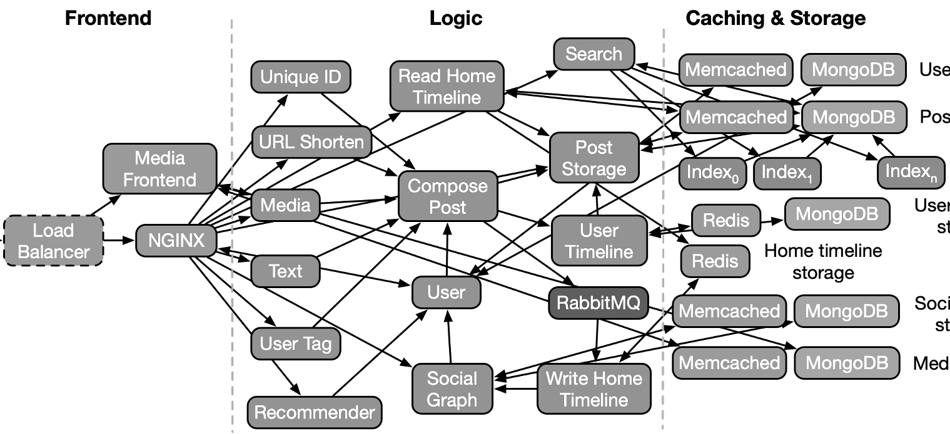
Failure scenario: high latency of client 1 caused by client 2
API 2
Root cause
Common services
Client 2
API 1
Client 1
Problematic symptom: High response times for client 1
Notes:
So here is a scenario where you have client 1 who is experiencing high delay for its requests to API 1
And the root cause here is client 2 who is sending a lot of requests to API 2 and interferes with Client 1 because there are common downstream services that’s shared between the 2 APIs
Here you if only had a DAG, you would be able to model the effect between clients and services in one directions.
We need to model cyclic dependencies to capture the effect of client 2 on the common backend services and back from the services to client 1

Slide 46
Murphy finds the true root cause with good accuracy
Notes:
Murphy produced the correct root cause with high accuracy in this scenario whereas others performed poorly,

Slide 47

Scenario 2 (no cyclic dependencies): high response times of client caused by resource contention at a container
Problematic symptom: High response times for client
Root cause: this container
Notes:
Here’s a different scenario which doesn’t require capturing cyclic dependencies.
There’s a client who is experiencing high latency for its requests and the root cause is a container with resource contention on it.

Slide 48
Scenario 2 (no cyclic dependencies): Both Murphy and Sage do well
Notes:
- Murphy also does well here and is marginally better than Sage, probably because in our environment, we don’t have a lot training points for Sage’s neural networks
Clean up the graph, have labels next to the lines

Slide 49
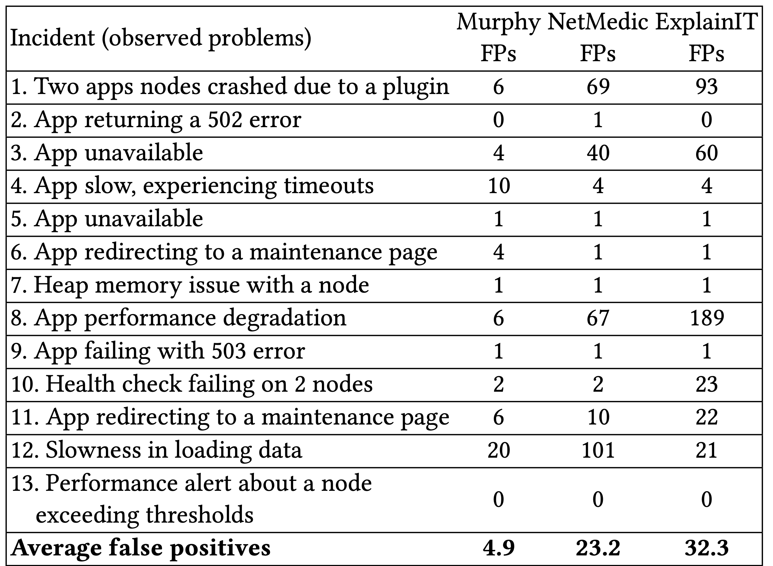
Production incidents in an enterprise environment
5x fewer false positives
Notes:
Say what the ground truth is, spend more time here

Slide 50
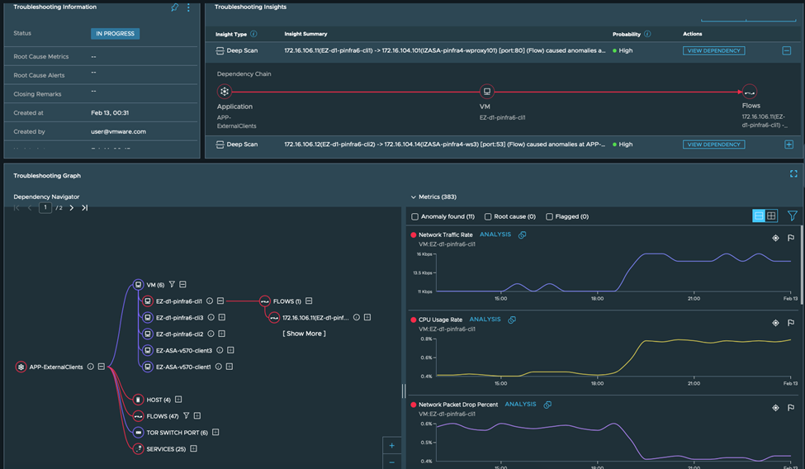
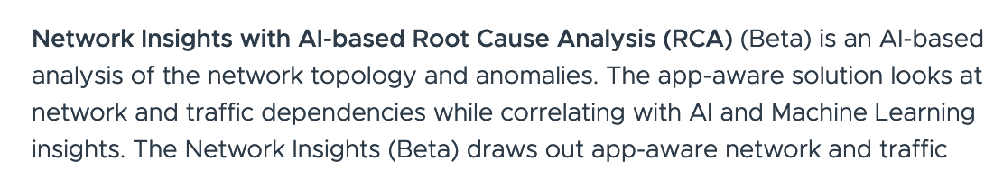
Murphy → product DeepScan (shipped with VMware Aria Operations for Networks)
Source: VMware Explore, Las Vegas 2023
https://blogs.vmware.com/management/2023/08/whats-new-for-vmware-aria-operations-for-networks-at-vmware-explore-las-vegas.html

Slide 51

Summary: Murphy for performance diagnosis
MRF-based learning framework
incorporate weak dependencies between entities
Check paper for more:
model evaluation on a large dataset (300+ production apps)
modeling cycles helps accuracy
VMware’s blog post: https://shorturl.at/efvT2
details about product adoption
Notes:
Check out our blog post about commercial adoption.

Slide 52
Talk overview: practical systems for Root Cause Analysis
Murphy: Performance diagnosis in distributed cloud applications
ToR
Switch
Host
vNIC
Host
Flow 3
Backend VM
ACM SIGCOMM 2023
Adopted in a product at VMware
Crawler VM
Flow 1
Frontend VM
Flow 2
Backend VM
vNIC
vNIC
Host
Host
vNIC
VM
Flock: Localize gray failures large datacenter networks
- inference using a large PGM with a custom inference algorithm to handle scale
ACM CoNext 2023
FaultFerence: Localizing failures within symmetric components
In the works
Notes:
enhance pubs
say vmware product
Madhu- broaden your talk? where these techniques can be used?
Larger story about analyzing performance.
Finding causal connections for general prediction, I am going to
use it for troubleshooting. But it can be applicable to other areas.
--> Ask host for what talk are they expecting? Which people are in the audience?
--> Highlight your research skills, deriving insights from monitoring data
--> Put use cases of the techniques, potential applications
--> make some examples more concrete:
---> broad audience or targeted audience: skip some intro for targeted audience

Slide 53
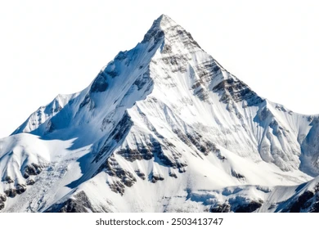
(Only) enhancing models and algorithms: an untenable trajectory for failure diagnosis
Comprehensive RCA
Point RCA solutions
Fixed input telemetry
Single algorithm
Capture a narrow class of failures
Can’t have comprehensive RCA using point solutions, real-world has diverse telemetry, diverse failure modes

Slide 54
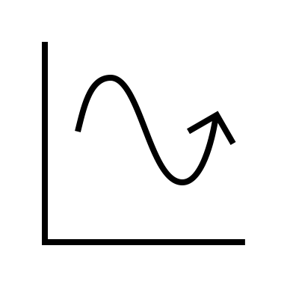

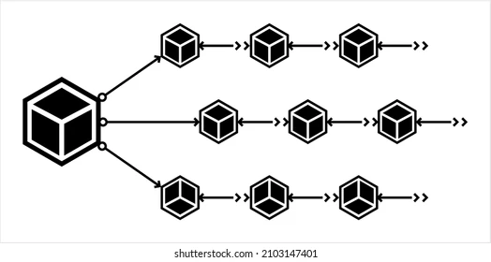
Beyond point solutions: a systems framework for RC A
Diverse telemetry
Diverse failure incidents
high client response times
anomalous performance metrics
application errors
high latency
packet drops
unreachability
black holes
hardware failures
configuration bugs
…
Metrics
RCA system for
high Coverage of failures
Extensibility
Scalability
Events
Logs
Traces

Slide 55
Summary: ensuring reliability of systems via effective RCAs is a major goal
High fidelity modeling allows accurate inference for RCA
Murphy: staying true to weak dependencies (via MRF), rather than enforcing a causal DAG, helps inference
reduced error rate by 1.35 – 4.7x
88% accuracy in failure scenarios not captured by past work
Flock, FaultFerence: accurately modeling path uncertainty and noisy packet drops (via Bayesian nets) resulted in higher accuracy
Flock reduced error rate by 1.2 – 16x with same input, 1.2 – 55x with passive info
FaultFerence reduced #micro-actions by 3.5x
Need an overarching “RCA system” beyond point solutions for
High coverage of failure scenarios
Extensibility (add new failure modes, new telemetry, new RCA)
Scalability
Thank you!
vharsh@conviva.com

