Slide 1


GROUP TESTING: A Survey
Sidharth (Sid) Jaggi

Slide 2
INFORMED-AI:
Information Theory for Distributed AI
“Information theory and machine
learning are two sides of the same coin”
Sir David Mackay

Slide 3




Distributed AI
Internet
Smart traffic
Stock markets
Energy grids

Slide 4

Shannon’s Information theory laid the foundations of many technologies:
Data compression: JPEG / MPEG / zip / gzip
Digital modem → Internet
Multiple access schemes (CDMA, OFDM/OFDMA)
Low density parity check codes (4G), Polar codes (5G)
Secure multi-party computation

Slide 5
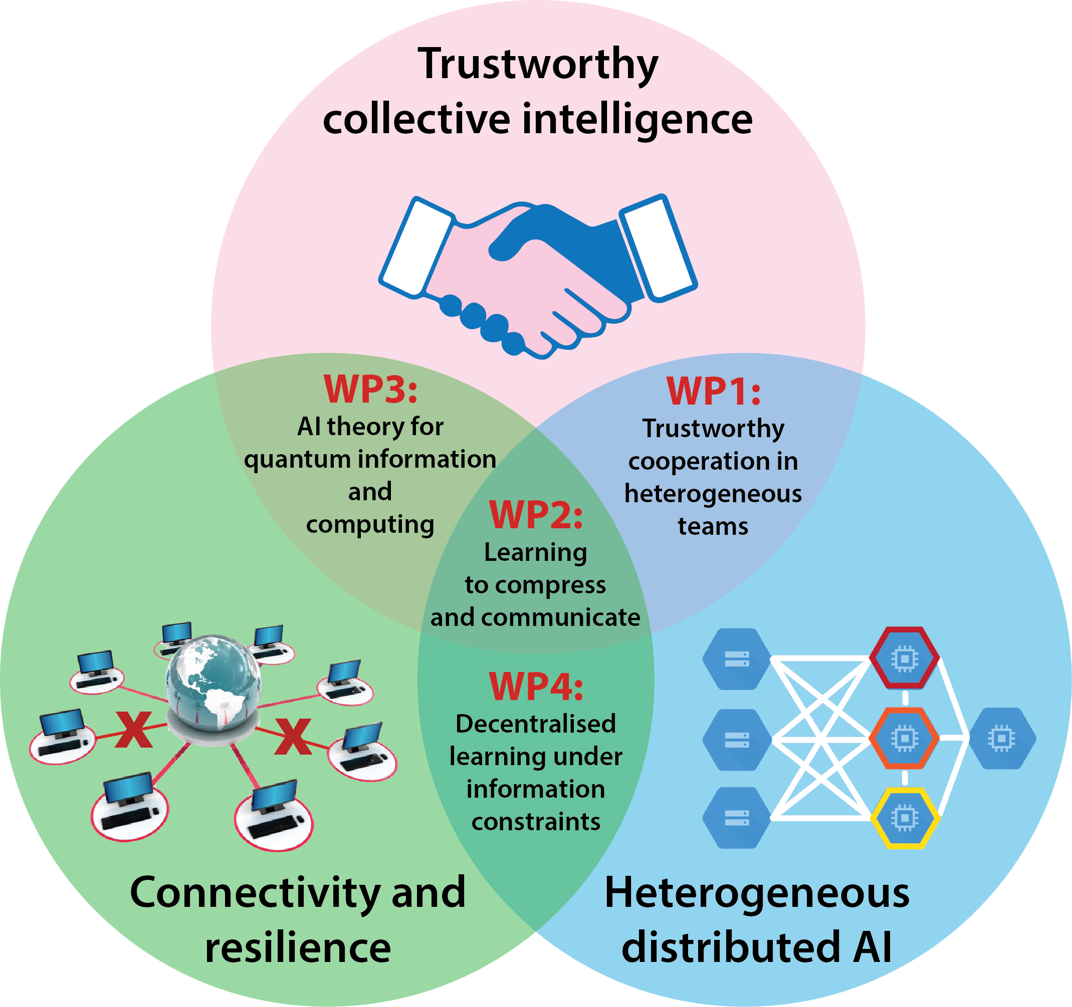
Smart
traffic
Internet
Stock
markets
Energy
grids

Slide 6
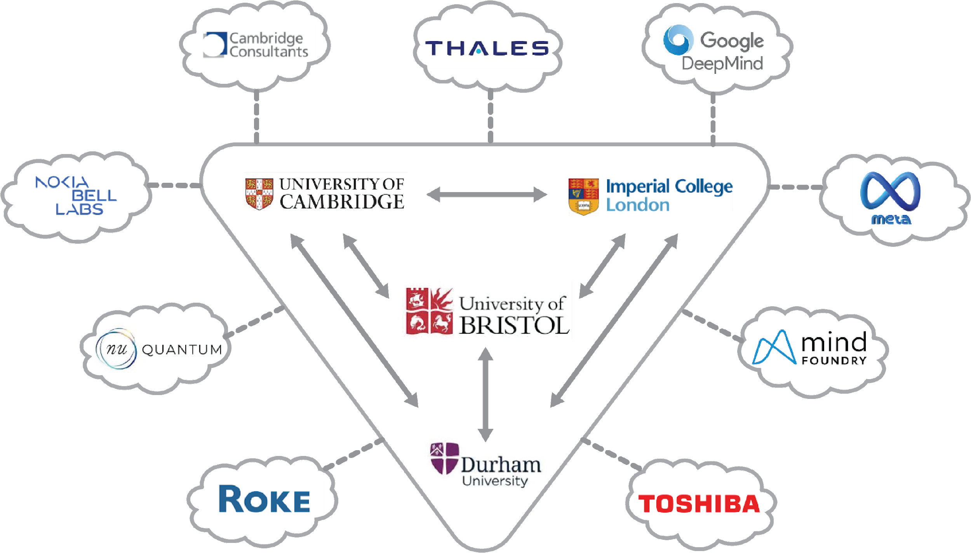

Slide 7
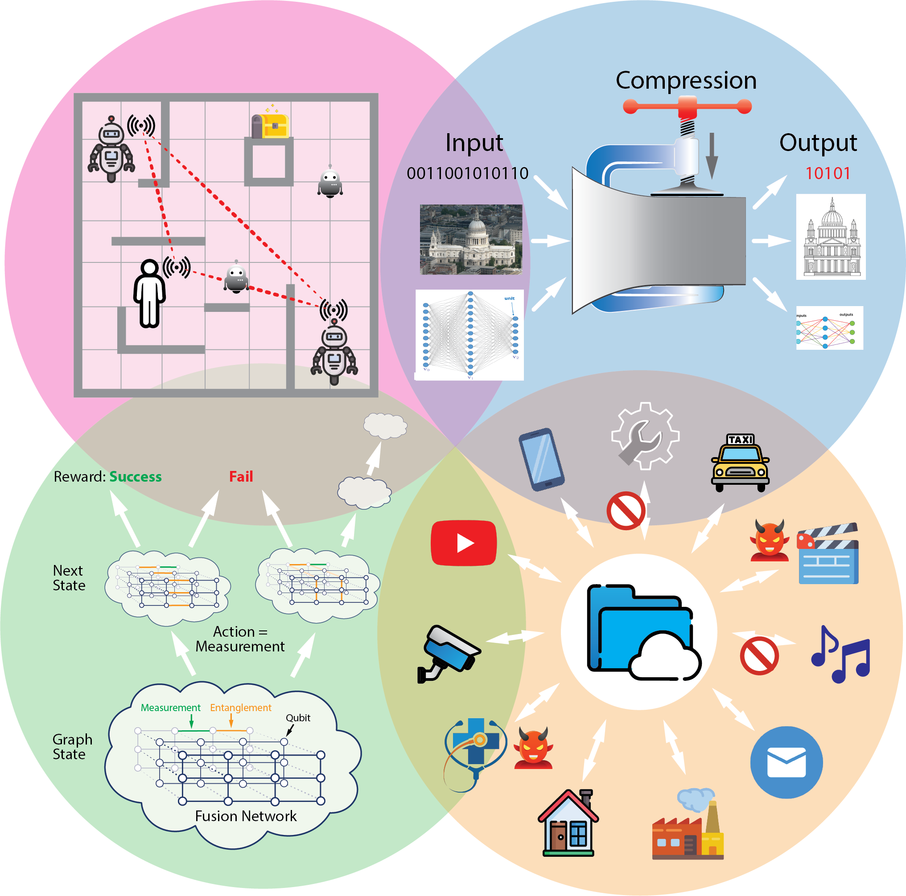


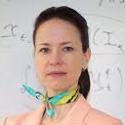




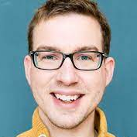





WP1: Cooperation in Heterogeneous Teams
WP2: Learning to Compress
and Communicate
Yiannis
Kontoyiannis
Cambridge
Deniz
Gunduz
Imperial
Amanda Prorok
Cambridge
Yiannis Demiris
Imperial
Jonathan Lawry
Bristol
Sidharth
Jaggi
Bristol
Oliver Johnson
Bristol
WP3: Quantum
Information
and Computing
WP4: Trustworthy Decentralised
Learning
Neil
Walton
Durham
Nilanjana
Datta
Cambridge
Thiru
Vasantam
Durham
Po-Ling
Loh
Cambridge
Ayalvadi
Ganesh
Bristol
Seyed
Moosavi-Dezfooli
Imperial

Slide 8
GROUP TESTING: A Survey
Sidharth (Sid) Jaggi

Slide 9
1. Background

Slide 10





Group Testing
Adaptive vs. Non-adaptive
What’s known
[CCJS11]
For Pr(error)< ε , Lower bound of number of tests:
Notes:
(1-\epsilon)d\log\left(\frac{n}{d} \right )
Introduce the group testing model
Test model (noiseless/noisy)
Objective (reconstruct set of defectives with minimal tests)
Known lower bounds on number of tests for both noiseless and noisy cases
Adaptive and non-adaptive models considered in this work

Slide 11
What’s known
Intuition:
# subsets of size d, out of n items =
Therefore # tests
Notes:
\geq \log {{n}\choose{d}} = d\log\left (\frac{n}{d} \right ) + {\cal O}(d)

Slide 12
Adaptive vs. non-adaptive testing schemes
Adaptive testing “easy”
Find one diseased in log(n) tests via binary search*
Repeat d times – total of d.log(n) tests
Sometimes not desirable:
Sequential rather than parallel – therefore much slower
Harder to implement in hardware
Rest of this talk – non-adaptive testing schemes
* Cleverer choice of splitting sizes can get constant factor improvement

Slide 13
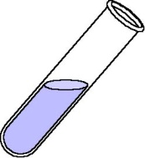
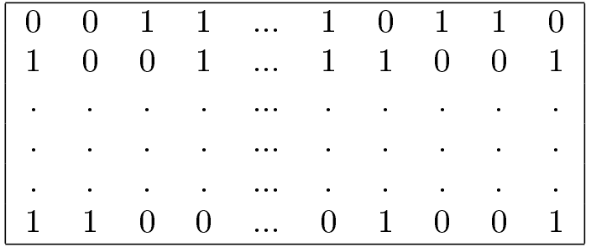
Test Matrices for non-adaptive group-testing
IN
OUT
Negative
0
Positive
1
Test outcomes → Y
Notes:
Each row corresponds to a certain test
Each column corresponds to a certain item
1 means the item is in the test and 0 means that the item is not in the test
For the outcome, 1 means positive and 0 means negative

Slide 14
“Good” Test Matrices: What’s known
Intuition:
“Good” design → each test outcome has entropy about 1 bit
Therefore
Therefore in (near)-optimal designs:
Matrix density
# tests per item
n
O(d log(n/d))
Notes:
\forall i,~~\Pr(Y_i = 1) \approx \Pr(Y_i = 0) \approx \frac{1}{2}
\Theta \left ( \frac{n}{d} \right )

Slide 15
“Good” Test Matrices: What’s known
Intuition:
“Good” design → each test outcome has entropy about 1 bit
Therefore
Therefore in (near)-optimal designs:
Matrix density
Bernoulli random design
# tests per item
n
O(d log(n/d))
Notes:
\forall i,~~\Pr(Y_i = 1) \approx \Pr(Y_i = 0) \approx \frac{1}{2}
\Theta \left ( \frac{n}{d} \right )

Slide 16
“Good” Test Matrices: What’s known
Intuition:
“Good” design → each test outcome has entropy about 1 bit
Therefore
Therefore in (near)-optimal designs:
Matrix density
Bernoulli random design
# tests per item
Column items sampled w/replacement
times
n
O(d log(n/d))
Notes:
\forall i,~~\Pr(Y_i = 1) \approx \Pr(Y_i = 0) \approx \frac{1}{2}
\Theta \left ( \frac{n}{d} \right )

Slide 17
Performance: What’s known
Notes:
\frac{d\log \left (\frac{n}{d} \right )}{\min~\#~~tests}

Slide 18
COMP decoder
n
y
Greedy decoding rule:
Test matrix M
Notes:
supp({\mathbf M_i}) \subseteq {\mathbf y} \Rightarrow x_i=1

Slide 19
COMP decoder
n
y
Greedy decoding rule:
i
defective
Notes:
supp({\mathbf M_i}) \subseteq {\mathbf y} \Rightarrow x_i=1

Slide 20
COMP decoder
n
y
Greedy decoding rule:
i
Not defective
Notes:
supp({\mathbf M_i}) \subseteq {\mathbf y} \Rightarrow x_i=1

Slide 21


Decoding Algorithm Philosophy
Innocent until proven guilty
Defective until proven innocent

Slide 22

Decoding Algorithm
Algorithm: Marks item i non-defective if some test which includes i is negative
Observations:
CANNOT incorrectly identify defective items
Incorrectly marks non-defective item i if all tests which include i are positive

Slide 23
COMP decoder
n
# tests =
d
Notes:
\approx \left (1 - \frac{1}{cd\log(n/d)} \right)^{\alpha d \log(n/d)} \rightarrow e^{-\alpha/c}

Slide 24
COMP decoder
n
# tests =
d
Fraction of negative test outcomes
Notes:
\approx \left (1 - \frac{1}{cd\log(n/d)} \right)^{\alpha d \log(n/d)} \rightarrow e^{-\alpha/c}
\alpha(1-\theta)\left (1- e^{-\alpha/c} \right ) d\log(n)

Slide 25
COMP decoder
n
y
# tests =
d
Fraction of positive test outcomes
fraction of
positive test outcomes
Notes:
\approx \left (1 - \frac{1}{cd\log(n/d)} \right)^{\alpha d \log(n/d)} \rightarrow e^{-\alpha/c}
\alpha(1-\theta)\left (1- e^{-\alpha/c} \right ) d\log(n)

Slide 26
COMP decoder
y
i
d
Probability item i false positive
fraction of
positive test outcomes
Notes:
=\left (1-e^{-\alpha/c} \right )^{\alpha(1-\theta)\log(n)}
\leq (n-d)\left (1-e^{-\alpha/c} \right )^{\alpha(1-\theta)\log(n)} \leq \exp\left (\log(n) \left (1+\alpha(1-\theta)\log \left(1-e^{-\alpha/c} \right) \right) \right )
\alpha(1-\theta)\left (1- e^{-\alpha/c} \right ) d\log(n)

Slide 27
COMP decoder
y
n-d
Probability at least one false positive
(Union bound)
Therefore, need to find smallest c s.t. one can find ⍺ s.t. exponent negative.
,
Notes:
=\left (1-e^{-\alpha/c} \right )^{\alpha(1-\theta)\log(n)}
\leq (n-d)\left (1-e^{-\alpha/c} \right )^{\alpha(1-\theta)\log(n)} \leq \exp\left (\log(n) \left (1+\alpha(1-\theta)\log \left(1-e^{-\alpha/c} \right) \right) \right )
\alpha(1-\theta)\left (1- e^{-\alpha/c} \right ) d\log(n)

Slide 28
2. Faster algorithms

Slide 29
This work
# Tests
◉
Adaptive
◉
Non-Adaptive
Lower
bound
◉
Two-Stage Adaptive
◉
[NPR12]
O(poly(D)log(N)),O(D²log(N))
◉
◉
O(DN),O(Dlog(N))
O(Dlog(N))
◉
◉
Lower bound
O(Dlog(N))
Decoding complexity
Notes:
Performance of existing results in terms of number of tests and decoding complexity (the NPR is Ngo, Porat and Rudra).
Talk about the performance of our three algorithms (table in next slide). Red region information theoretically impossible.

Slide 30
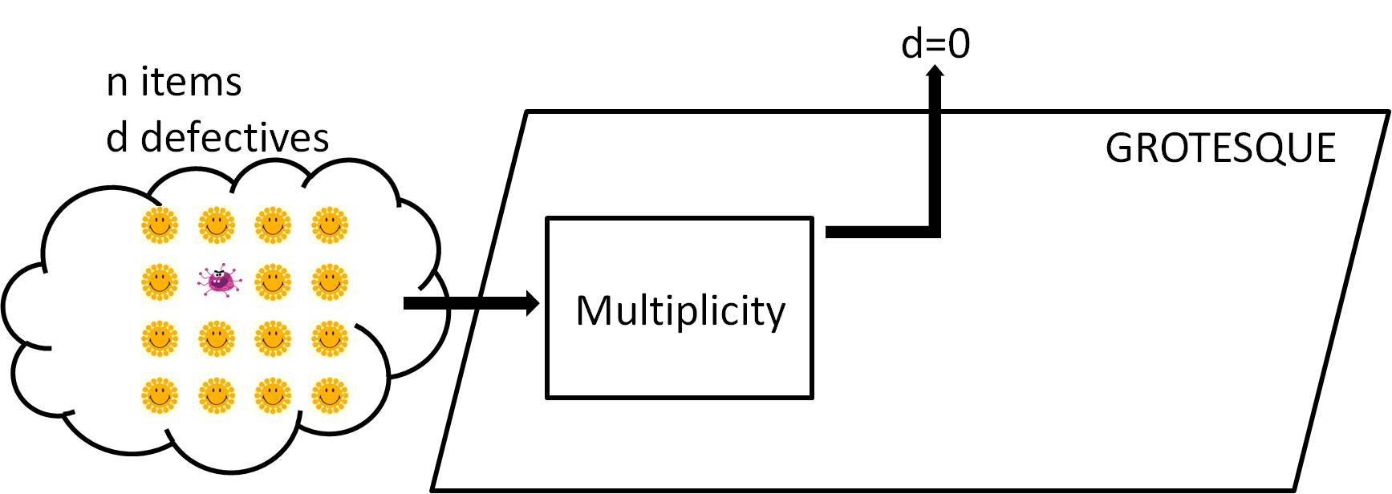

Hammer: GROTESQUE Testing
Notes:
The critical part of our algorithm design: “grotesque” testing. Black box. Note it takes in n items (<N in general), containing d defectives (<D in general).
First case: no defectives in n.

Slide 31
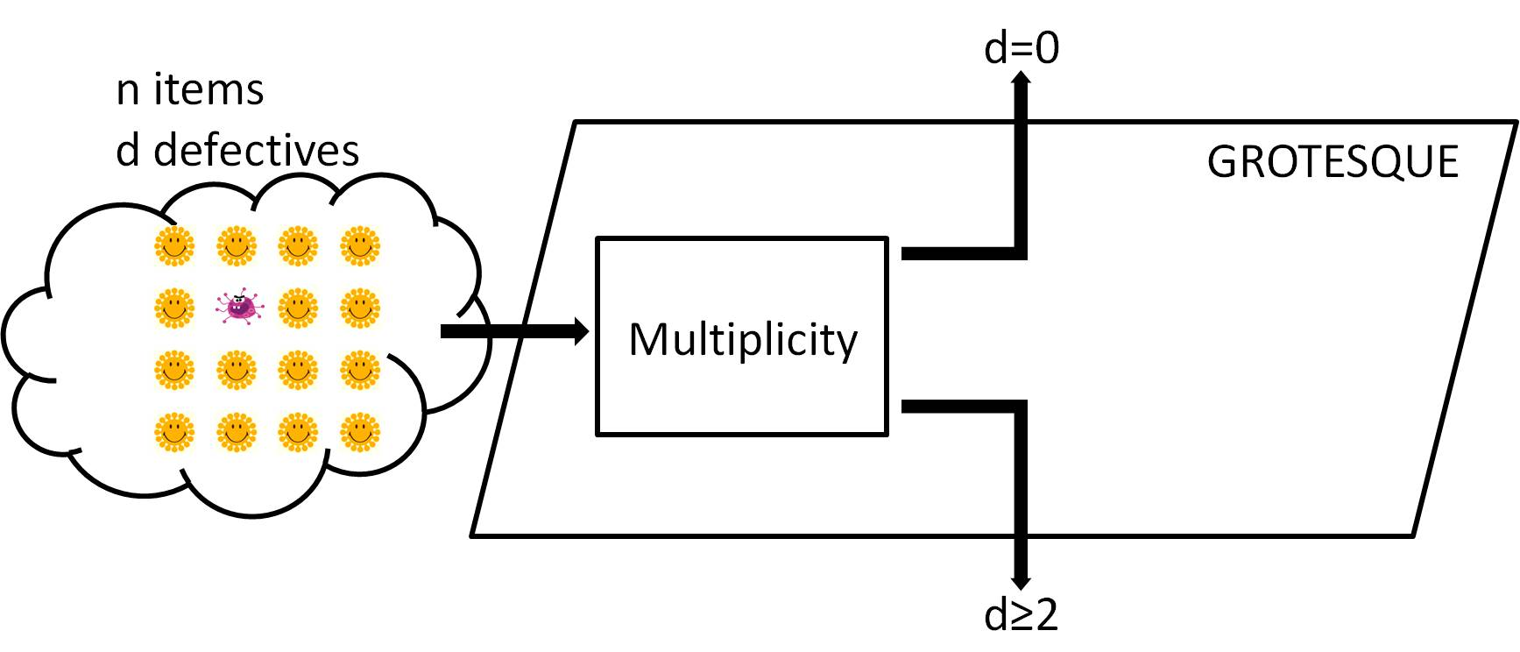
Hammer: GROTESQUE Testing
Notes:
Second case: more than 2 defectives

Slide 32
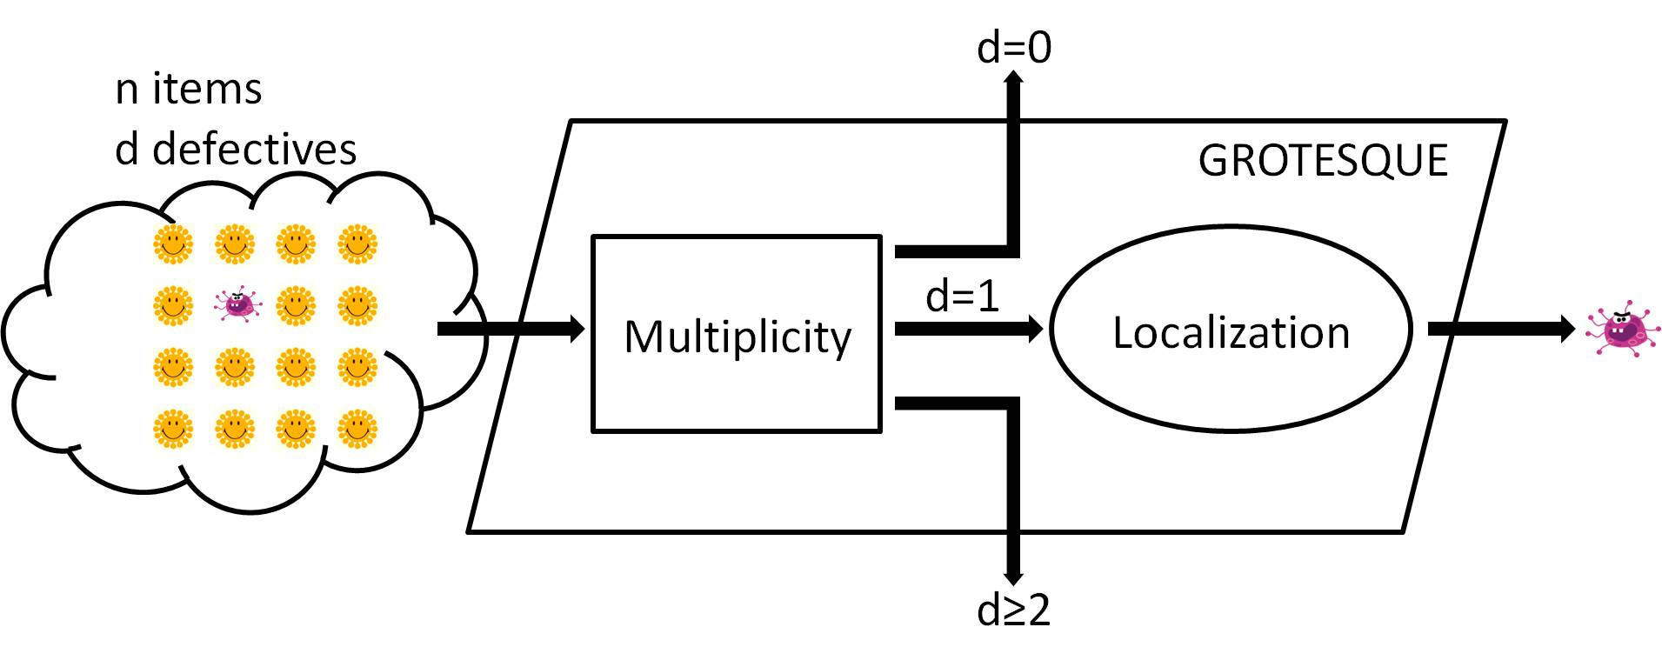
Hammer: GROTESQUE Testing
Notes:
Third case: exactly 1 defective
If so, localization part will pin point which one is defective

Slide 33
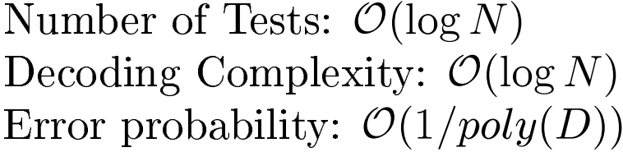
Hammer: GROTESQUE Testing
Notes:
The performance of grotesque testing (note again the difference between (d,n) and (D,N))

Slide 34
Testing Matrix
IN
OUT
Negative
0
Positive
1
Notes:
Each row corresponds to a certain test
Each column corresponds to a certain item
1 means the item is in the test and 0 means that the item is not in the test
For the outcome, 1 means positive and 0 means negative

Slide 35
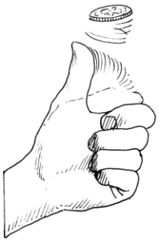



Multiplicity
?
Notes:
For multiplicity testing, each item is in a test with probability 1/2

Slide 36
Multiplicity (d = 0)
Notes:
(Noiseless case) For the first case, no defective, non of the tests is positive (blue means negative and red means positive)

Slide 37
Multiplicity (d = 0)

Slide 38
Multiplicity (d = 0)

Slide 39
Multiplicity (d = 0)
d = 0
No positive tests

Slide 40
Multiplicity (d = 1)
Notes:
For the second case, exactly 1 defective, half of the tests in expectation will be positive

Slide 41
Multiplicity (d = 1)

Slide 42
Multiplicity (d = 1)

Slide 43
Multiplicity (d = 1)
d = 1
50% positive tests

Slide 44
Multiplicity (d = 2)
Notes:
For the third case, more than 2 defectives, over ¾ tests are positive on expectation
We do the estimation by finding out the statistical difference!

Slide 45
Multiplicity (d = 2)

Slide 46
Multiplicity (d = 2)

Slide 47
Multiplicity (d = 2)
d = 2
75% positive tests
Statistical Difference!

Slide 48

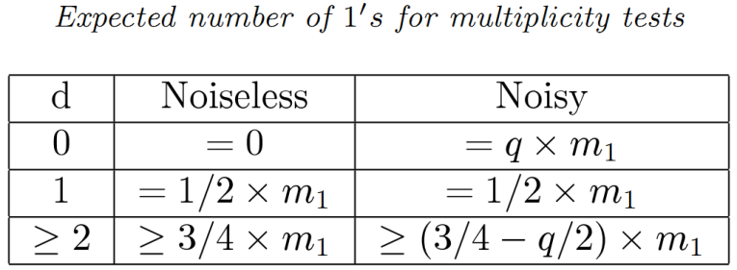

Multiplicity
?
Notes:
It works even for the noisy case since there exists statistical difference for three cases
Mention the performance of Multiplicity testing

Slide 49


Localization
?
Notes:
The design of localization testing is based on “expander code” (capacity achieving error-correcting codes with linear time decoding).
Each item is assigned a codeword of the expander code
Think of m_2 as O(log(n)), since # codewords (n) exponential in block-length (m_2).

Slide 50
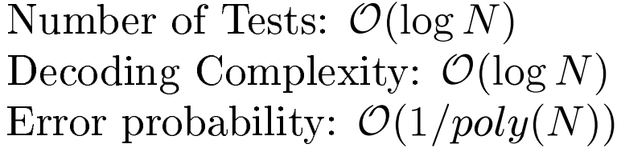
Localization
Signature
Test Outcome
BSC (q) Channel
Expander Codes
Decoder
Particular
Signature
Notes:
The distinct codeword performs like signature of each item
If there is exactly 1 defective, then the output of the decoder will be one of the codeword, i.e., signature. Therefore, we can trace back to which item is defective

Slide 51
Hammer: GROTESQUE Testing
Notes:
The performance of grotesque testing (note again the difference between (d,n) and (D,N))

Slide 52
Nail: “Good” Partioning
N items
D defectives
Notes:
The second idea is that if the groups we pick have good property. The good property is that with high probability, it contains exactly 1 defective item.
Grotesque testing can identify the defective item in that group

Slide 53
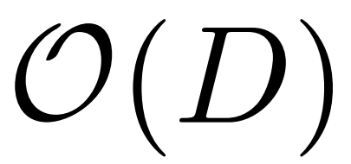
Adaptive Group Testing
Groups
Notes:
For the adaptive algorithm, in the first stage, do the same test design as in the non-adaptive one.
Constant fraction of defectives are identified. Suppose the fraction is half.

Slide 54


Adaptive Group Testing
Groups
Decaying geometrically
Tests
Notes:
In the second stage, exclude the identified defective items and partition all the remaining items into O(D/2) groups.
The number of tests and decoding complexity decays geometrically, therefore the number of tests and decoding complexity is dominated in the first stage

Slide 55


Adaptive Group Testing
The number of unidentified defectives <
Notes:
The problem is that when the unidentified items is less than logD, the random partition doesn’t work anymore.

Slide 56


Adaptive Group Testing
Tests of size
Coupon Collection
Notes:
Randomly pick items of size O(N/logD) such that with constant probability it contains exactly 1 remaining unidentified defective item.
By the coupon collection argument, o(Dlog(N)) tests are sufficient to decode all the logD defective items.
Overall number of tests is O(D\logN)

Slide 57

Non-Adaptive Group Testing
Groups
constant fraction of “Good” groups
Tests
Notes:
For non-adaptive algorithm, do O(logD) partitions independently.
For each partition, each group is of size O(N/D)
With high probability, constant fraction of the groups contain exactly 1 defective item.
Apply grotesque on each group (O(D) groups). Therefore, number of tests is O(Dlog(N)) (D * log(N)) decoding complexity is O(DlogN)

Slide 58
Non-Adaptive Group Testing

Slide 59


Non-Adaptive Group Testing
Independent partitions
Coupon Collection
Tests
Notes:
By the coupon collection argument, O(logD) independent partitions can decode all the defective items.
Therefore, the total number of tests is O(DlogDlogN)

Slide 60


2-Stage Adaptive Group Testing
Groups (Birthdays)
Notes:
In the first stage, randomly partition all the items into Poly(D) (say D^3) groups. By birthday paradox argument, with high probability, each group contains at most one defective item.

Slide 61

2-Stage Adaptive Group Testing
Non-adaptive
Group Testing
+
Tests
Notes:
Then, treat each group as an item and apply non-adaptive group testing algorithm. The number of tests is O(DlogDlogPoly(D))=O(Dlog²D)
In the second stage, apply grotesque to each group. The number of tests is O(DlogN)
Overall number of tests is O(DlogN+Dlog²D)

Slide 62
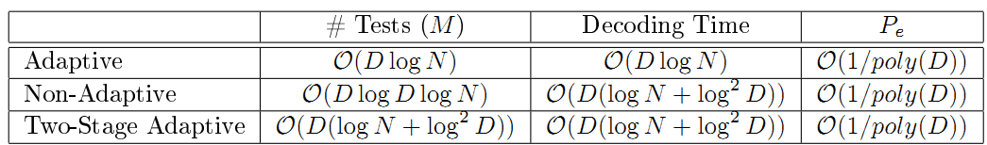
Summary of this work
# Tests
◉
◉
O(Dlog(N))
◉
O(Dlog(N))
Decoding complexity
Notes:
If all you care about is # tests, plenty of good algos out there.
If you also care about decoding complexity (important in some applications such as streaming algorithms), these algorithms are near-optimal (and kick ass compared to other work).

Slide 63
3. Constrained tests

Slide 64
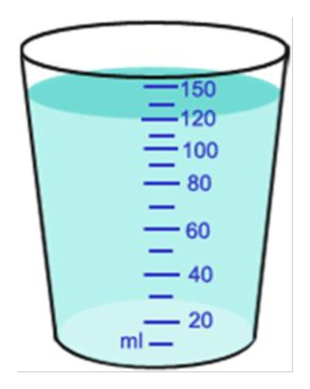

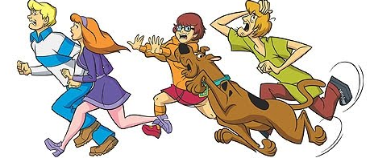
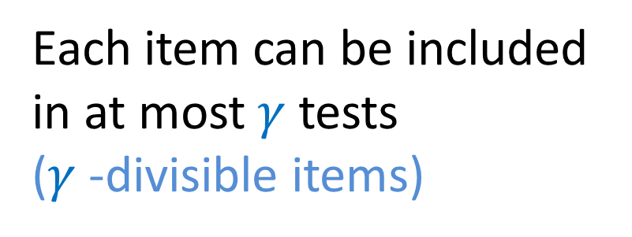
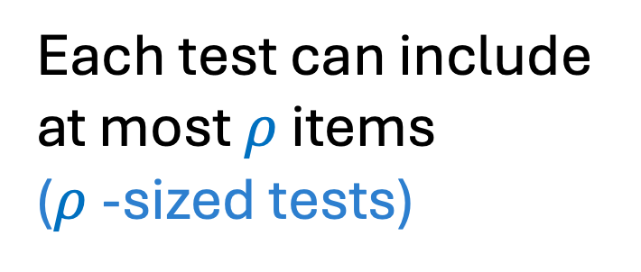
Real World Limitations
Each test can include at most $ρ$ items
($ρ$-sized tests)

Slide 65
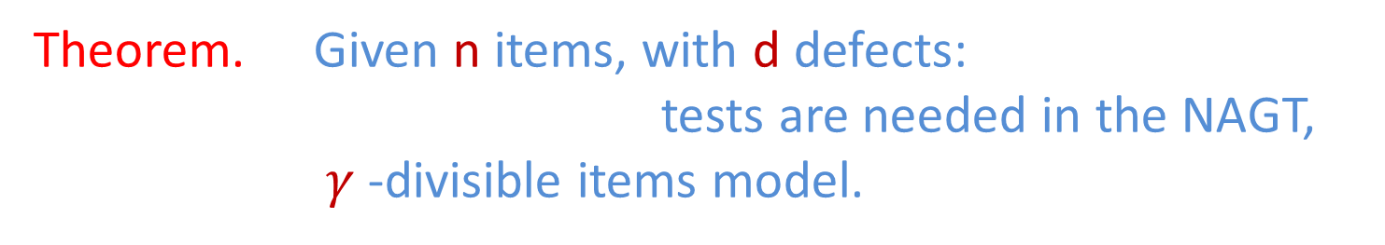

Our Results: $γ$-divisible items
Theorem. Ǝ a randomized algorithm: T =
Theorem. Ǝ a deterministic algorithm: T =

Slide 66

Our Results: $ρ$-sized tests
Theorem. Given n items, with d defects:
tests are needed in the
NAGT, ρ-sized tests model.
Theorem. Ǝ a randomized algorithm: T =
Theorem. Ǝ a deterministic algorithm: T =
Notes:
I get a weird display of symbols here too

Slide 67
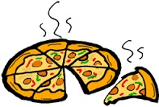
Upper Bounds: Randomized
Consider the -divisible items model

Slide 68


Upper Bounds: Randomized
Recall: Total items tested is at most
Idea: Have each test include roughly items.
Columns of test matrix M are uniformly sampled from with weight .
How to decode?

Slide 69


Upper Bounds: Randomized
Recall: Total number of positive tests is at most d .
Probability an item is included only in positive tests:
Union bound over all (n-d) non-defective items, so we require:

Slide 70

Upper Bounds: Randomized
Recall: Total number of positive tests is at most d .
Probability an item is included only in positive tests:
Union bound over all (n-d) non-defective items, so we require:

Slide 71
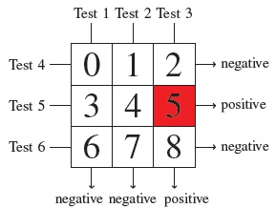
Upper Bounds: Deterministic
Intuition: Should be able to “encode” each item so that test outcomes uniquely identify defectives
Idea: Use -dimensional hypergrid, represent each item by base-b representation, where
If n = 9, = 2, d = 1, the above test uniquely determines that item 5 is defective.
Notes:
Too much text on this slide…

Slide 72
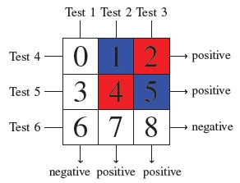

Upper Bounds: Deterministic
What if we have multiple defectives?
These tests cannot distinguish whether the red items or the blue items are defective.
Notes:
Emphasize that if there is only one defect, we can uniquely determine defects

Slide 73
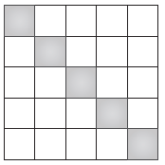
Upper Bounds: Deterministic
What if we have multiple defectivess?
Idea: Divide and Conquer!
Each gray box catches one defective item with high probability

Slide 74
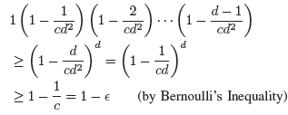
Upper Bounds: Deterministic
How many blocks are necessary?
Probability that no two defects fall into the same block:
In summary: blocks, each requiring tests, for a total of

Slide 75
Structure of Talk
Background
Achievability: Randomized Construction
Achievability: Deterministic Construction
Lower Bounds

Slide 76
Structure of Talk
Background
Achievability: Randomized Construction
Achievability: Deterministic Construction
Lower Bounds

Slide 77

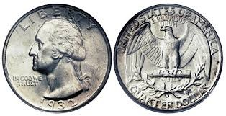
Classical NAGT Design Philosophy
0 1 0 0 0 0 1 0 0 1 0 0 1
Each test gives ̴1 bit of information

Slide 78
Lower Bounds: -divisible items
Total number of items tested is at most n
“Light” tests: each includes less than items.
“Heavy” tests: each includes at least items.

Slide 79
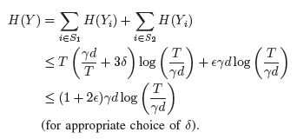
Lower Bounds: -divisible items
“Light” tests: each includes less than items.
“Heavy” tests: each includes at least items.

Slide 80
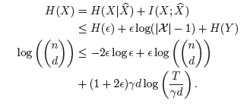
Lower Bounds: -divisible items
Data processing inequality
Fano’s inequality
Entropy over all possible combinations of d defects

Slide 81
Lower Bounds: -divisible items
Implies
Data processing inequality
Fano’s inequality
Entropy over all possible combinations of d defects

Slide 82
4. Generalizations

Slide 83
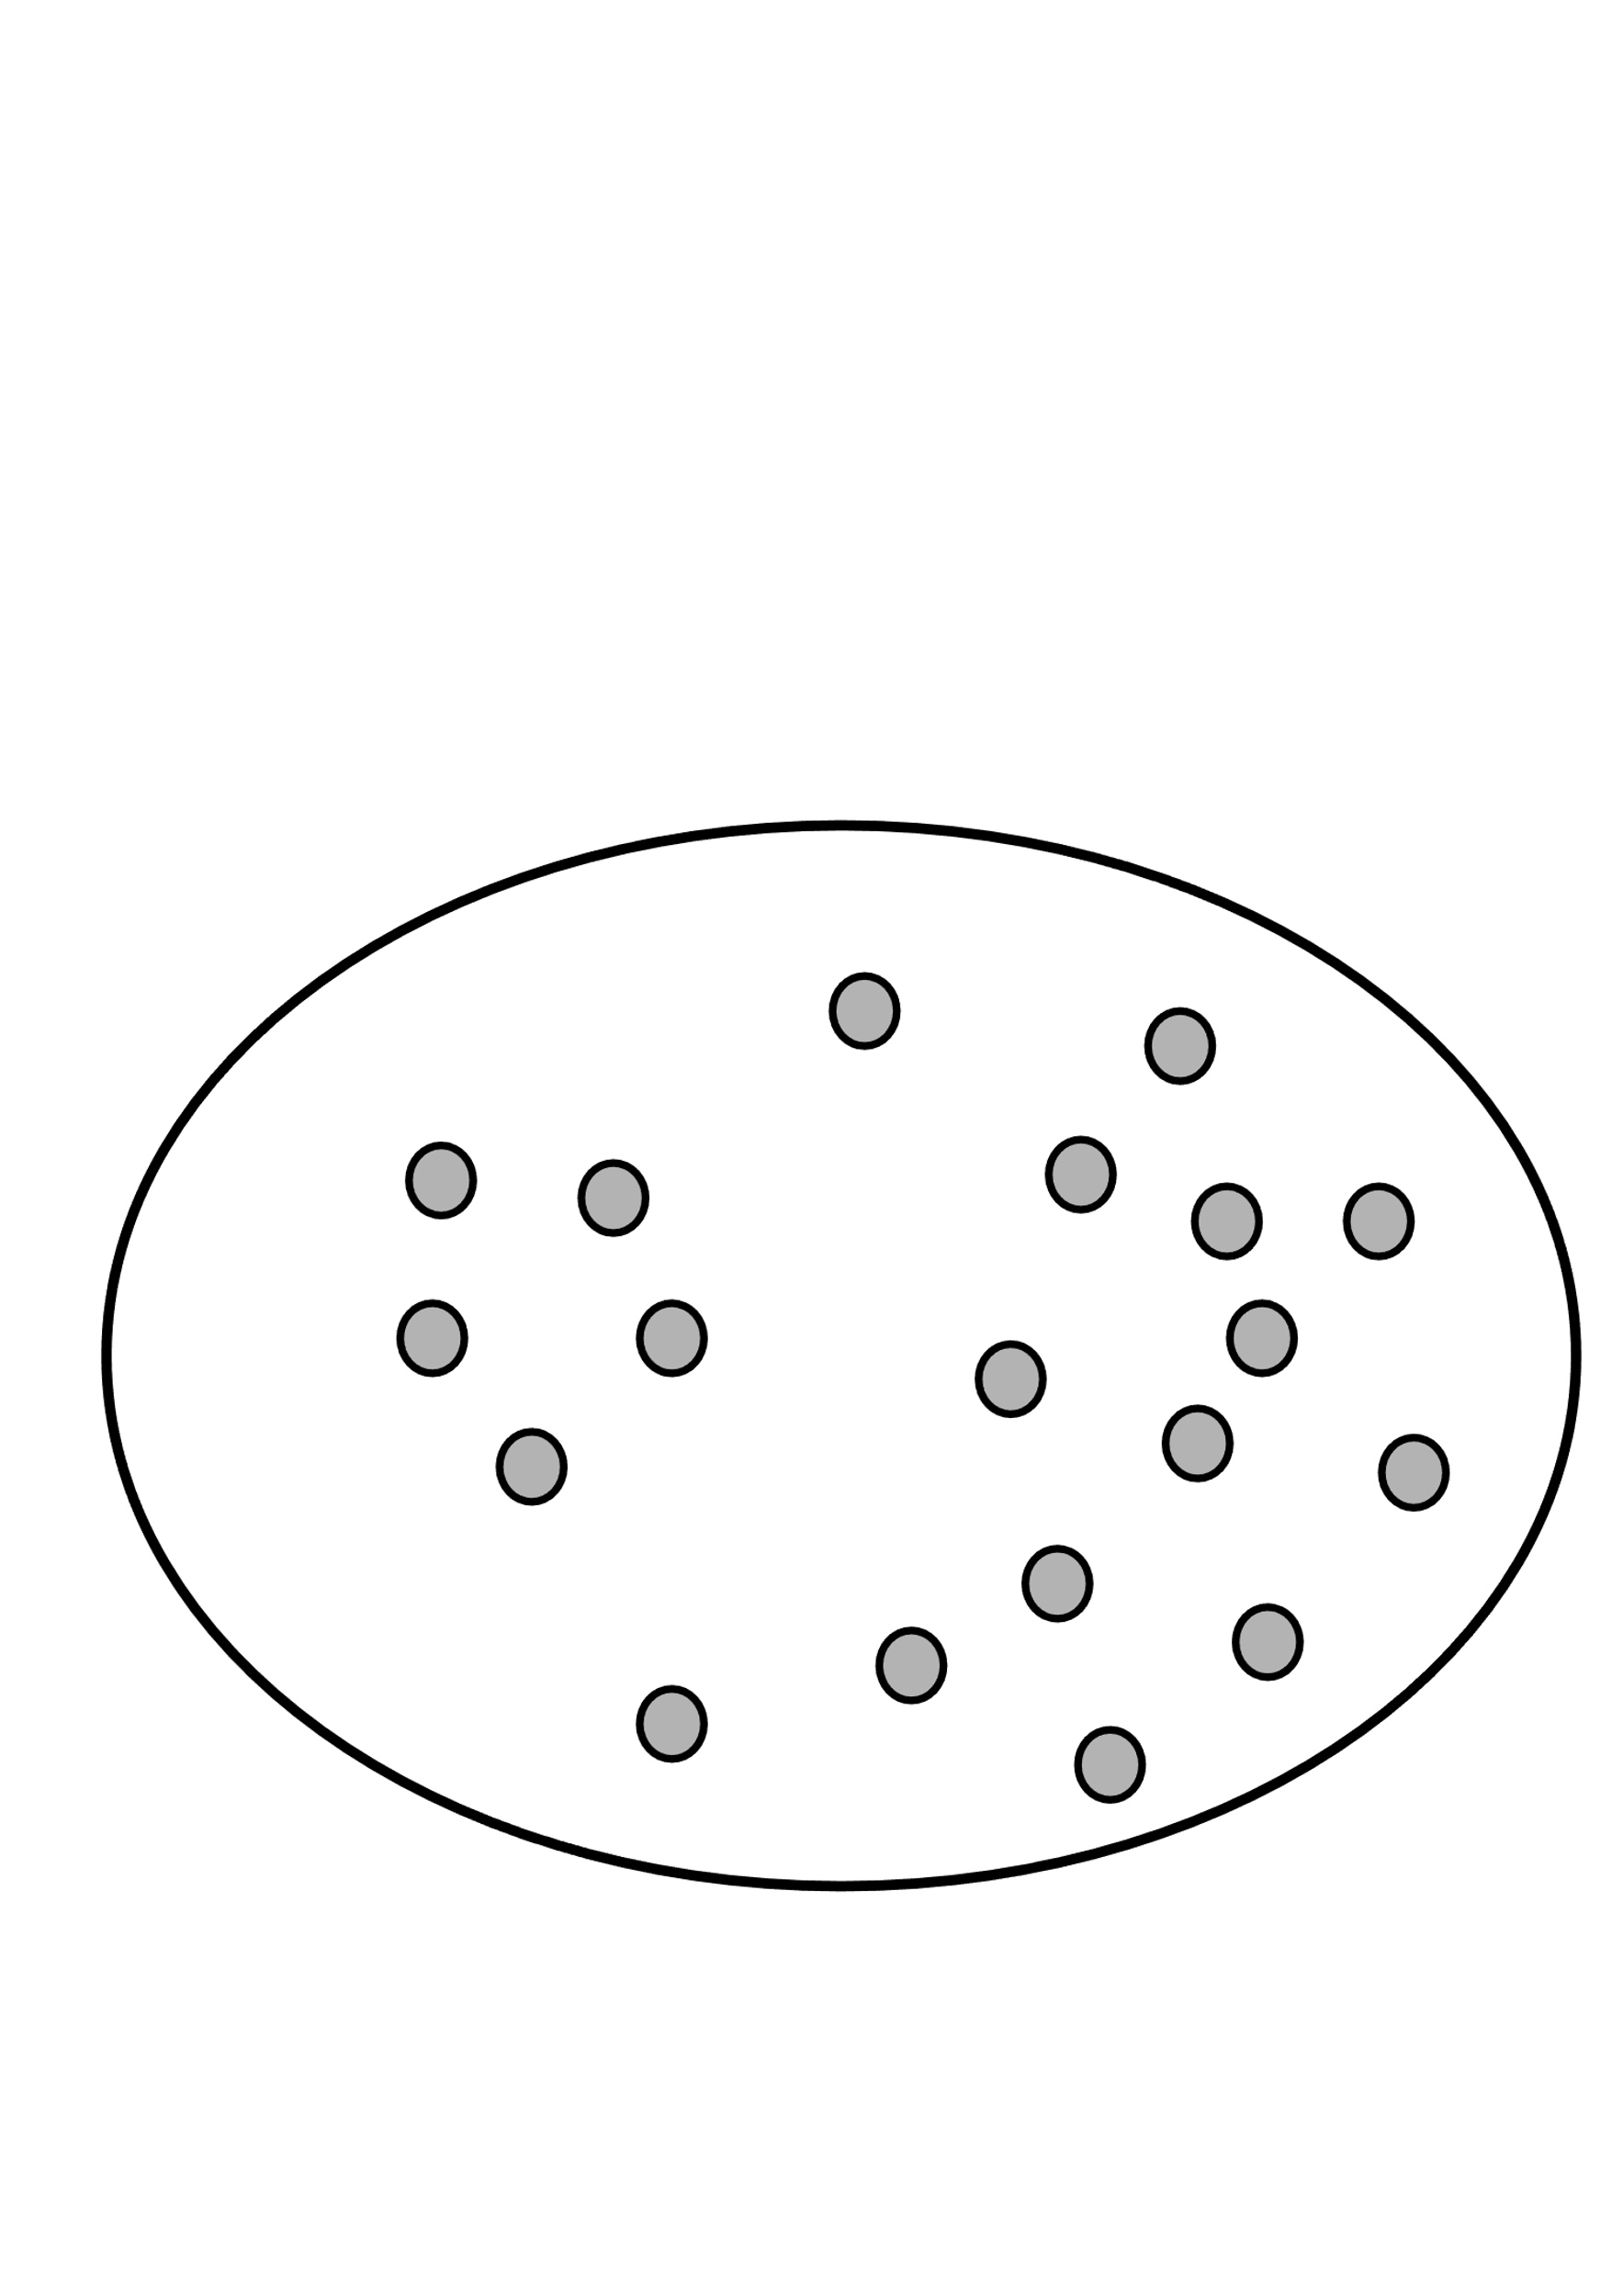
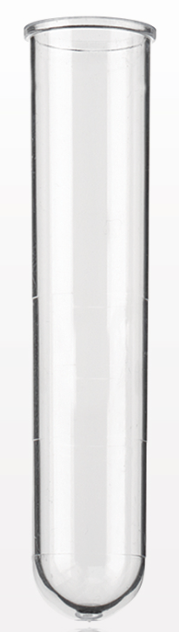
Generalized Group Testing
outcome: +/-
insensitivity?
noise?

Slide 84
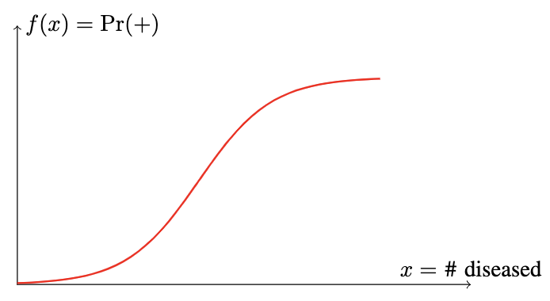
Generalized Group Testing
outcome: +/-

Slide 85

Test Design
Bernoulli test design
$$\operatorname{Pr}{=q}$$

Slide 86


Decoding Rule
i
item i
i

Slide 87
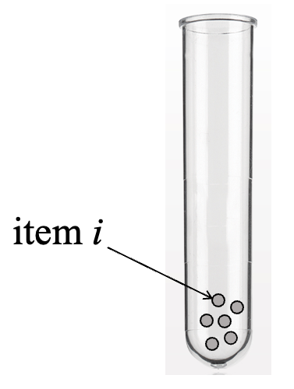
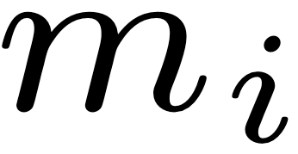
Decoding Rule
tests

Slide 88
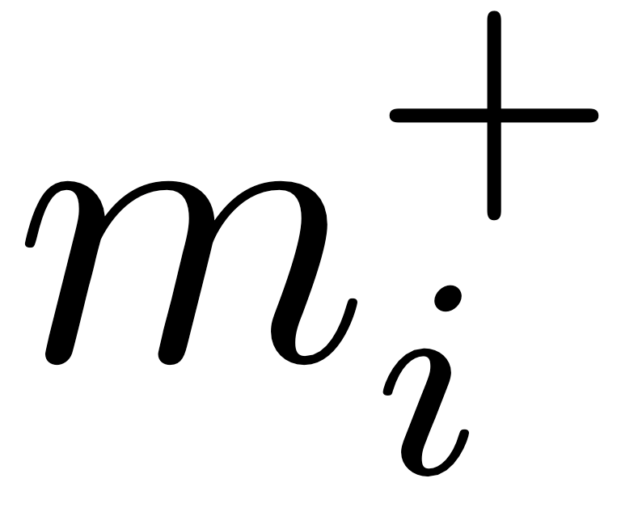
Decoding Rule
positive outcomes
+
+
-
-
-
tests

Slide 89
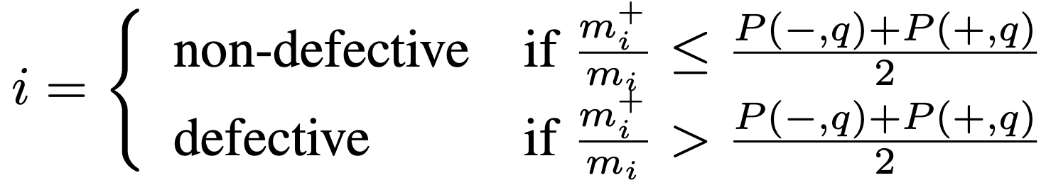
Decoding Rule
positive outcomes
+
+
-
-
-
tests

Slide 90

Decoding Rule
positive outcomes
+
+
-
-
-
only efficient when !
$$q≤0.5$$
tests

Slide 91



Decoding Rule
(when )
$$q>0.5$$
i
item i
i

Slide 92
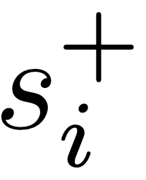
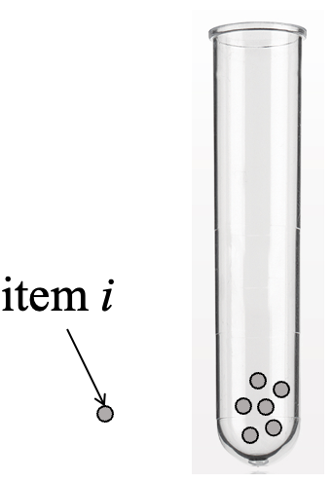
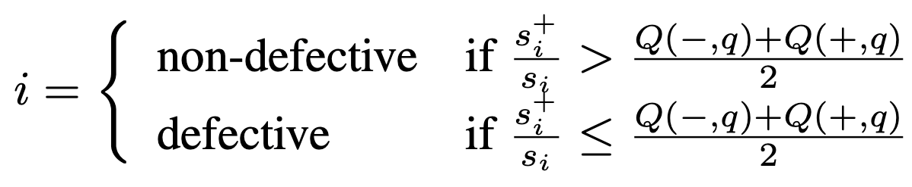
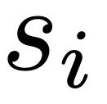
Decoding Rule
(when )
$$q>0.5$$
positive outcomes
+
+
-
-
-
tests

Slide 93

Achievability/Upper Bound

Slide 94
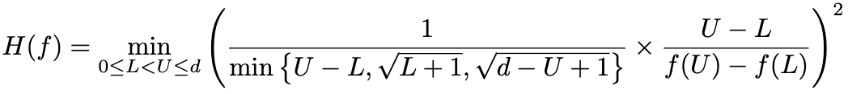

Achievability/Upper Bound
sensitivity parameter

Slide 95

Converse/Lower Bound
concentration parameter

Slide 96
Comparison
Our algorithm is order-wise optimal for:
classical test function;
threshold test function;
linear test function;
all noisy test functions;
……

Slide 97
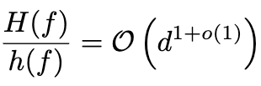
Comparison
Our algorithm is order-wise optimal for:
classical test function;
threshold test function;
linear test function;
all noisy test functions;
……
For all other functions:

Slide 98
5. Prior statistics

Slide 99

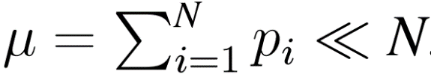
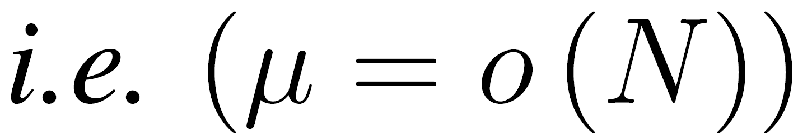
INTRODUCTION
General Probabilistic Group Testing
Notes:
Performance of existing results in terms of number of tests and decoding complexity (the NPR is Ngo, Porat and Rudra).
Talk about the performance of our three algorithms (table in next slide). Red region information theoretically impossible.

Slide 100
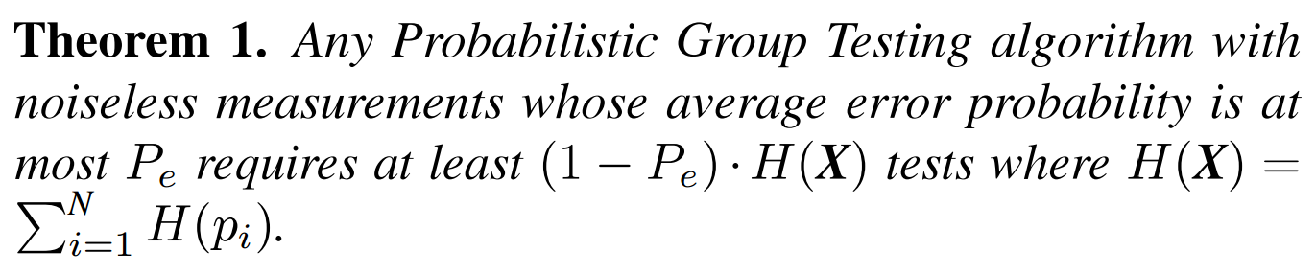
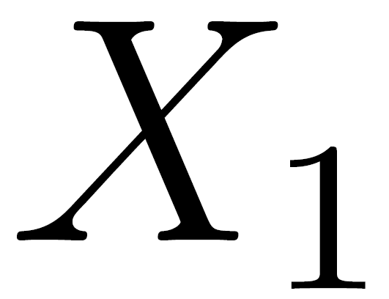
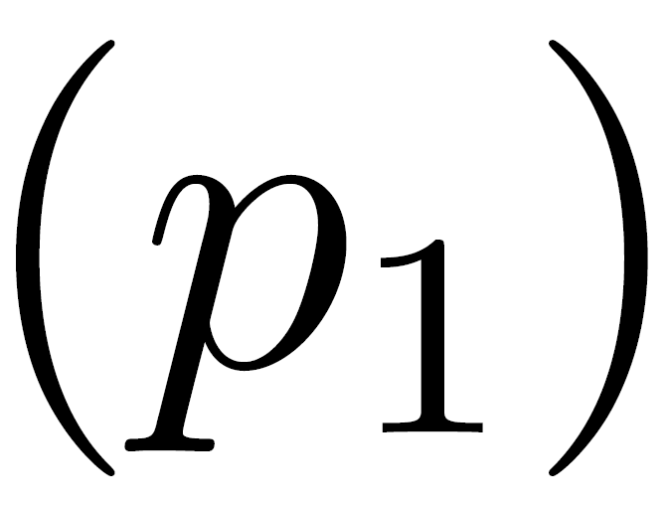
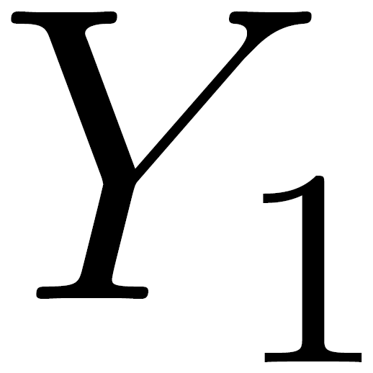
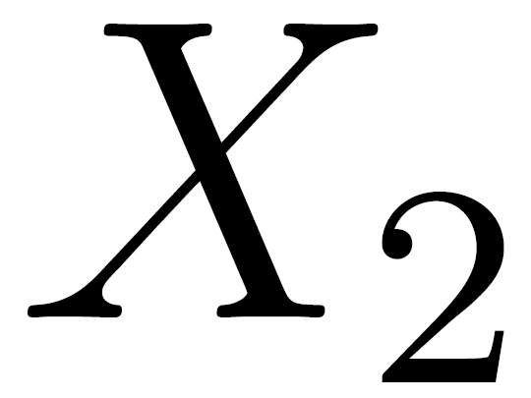
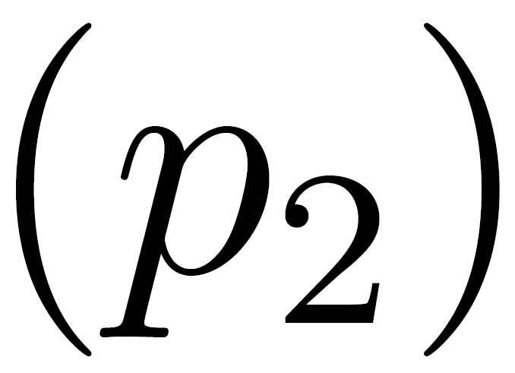











RESULTS
# of Tests: Lower Bound
Testing Procedures
Data Compression with “restriction”
(Union Measurements)
Intuition

Slide 101









RESULTS
Algorithms #1: “ Nested Algorithms” (Adaptive)
[W85]
(No “Intersection”)
$X_{1}$ $X_{2}$ $X_{3}$ $X_{4}$ $X_{5}$ $X_{6}$ $X_{7}$ $X_{8}$ $X_{9}$ $X_{10}$
$X_{1}$ $X_{2}$ $X_{3}$
$X_{4}$ $X_{5}$ $X_{6}$ $X_{7}$
$X_{8}$ $X_{9}$ $X_{10}$
$X_{4}$ $X_{5}$
$X_{6}$ $X_{7}$
$$X_{4}$$
$$X_{5}$$
[W85]
J. Wolf, “Born again group testing: Multi-access communications,” Information Theory, IEEE Transactions on, vol. 31, no. 2, pp.
185–191, 1985.

Slide 102















RESULTS
Algorithms #1: “ Nested Algorithms” (Adaptive)
[W85]
Construction #1: MAXIMUM ENTROPY
Example
$$X_{1}$$ | $$X_{2}$$ | $$X_{3}$$ | $$X_{4}$$ | $$X_{5}$$ | $$X_{6}$$ | $$X_{7}$$ | $$X_{8}$$ | $$X_{9}$$ | $$X_{10}$$
0.2 | 0.2 | 0.2 | 0.2 | 0.007 | 0.003 | 0.3 | 0.2 | 0.3 | 0.1
First Stage
$X_{1}$ $X_{2}$ $X_{3}$
$$X_{4}$$ | $$X_{5}$$ | $$X_{6}$$ | $$X_{7}$$
0.2 | 0.007 | 0.003 | 0.3
$X_{8}$ $X_{9}$ $X_{10}$
Second Stage
$$X_{4}$$ | $$X_{5}$$
0.2 | 0.007
$X_{6}$ $X_{7}$
Third Stage
$$X_{4}$$
$$X_{5}$$
[W85]
J. Wolf, “Born again group testing: Multi-access communications,” Information Theory, IEEE Transactions on, vol. 31, no. 2, pp.
185–191, 1985.

Slide 103














RESULTS
Algorithms #1: “ Nested Algorithms” (Adaptive)
[W85]
Construction #2: SOURCE CODES
Example
$$X_{1}$$ | $$X_{2}$$ | $$X_{3}$$ | $$X_{4}$$ | $$X_{5}$$ | $$X_{6}$$ | $$X_{7}$$ | $$X_{8}$$ | $$X_{9}$$ | $$X_{10}$$
0.2 | 0.2 | 0.2 | 0.2 | 0.007 | 0.003 | 0.3 | 0.2 | 0.3 | 0.1
$X_{1}$ $X_{2}$ $X_{3}$
$$X_{6}$$ | $$X_{5}$$ | $$X_{4}$$ | $$X_{7}$$ | $$X_{r}$$
0.003 | 0.007 | 0.2 | 0.3 | 0.4
$X_{8}$ $X_{9}$ $X_{10}$
First Stage
(The same)
Next Stages
$$X_{6}$$ | $$X_{5}$$ | $$X_{4}$$
0.003 | 0.007 | 0.2
$$X_{7}$$
$$X_{6}$$ | $$X_{5}$$
0.003 | 0.007
$$X_{5}$$
Necessary Condition
$$X_{6}$$
$$X_{5}$$
[W85]
J. Wolf, “Born again group testing: Multi-access communications,” Information Theory, IEEE Transactions on, vol. 31, no. 2, pp.
185–191, 1985.

Slide 104

RESULTS
Algorithms #1: “ Nested Algorithms” (Adaptive)
[W85]
General Framework
[W85]
J. Wolf, “Born again group testing: Multi-access communications,” Information Theory, IEEE Transactions on, vol. 31, no. 2, pp.
185–191, 1985.

Slide 105





RESULTS
Algorithms #1: “ Nested Algorithms” (Adaptive)
[W85]
# of Tests: Upper Bound
(Construction #1: MAXIMUM ENTROPY)
(Construction #2: SOURCE CODES)
Since each child need to be tested
[W85]
J. Wolf, “Born again group testing: Multi-access communications,” Information Theory, IEEE Transactions on, vol. 31, no. 2, pp.
185–191, 1985.

Slide 106
RESULTS
Algorithms #1: “ Nested Algorithms” (Adaptive)
[W85]
Concentration
Question: Can we get some concentration result?
Answer: Not directly because of some “extreme distribution”.
Solution: Pre-partitioned Model
[W85]
J. Wolf, “Born again group testing: Multi-access communications,” Information Theory, IEEE Transactions on, vol. 31, no. 2, pp.
185–191, 1985.

Slide 107


RESULTS
Algorithms #1: “ Nested Algorithms” (Adaptive)
[W85]
Concentration: Pre-partitioned Model
(Also used in Algorithm #2)
Idea: Restriction on the Entropy $H(X)$
[W85]
J. Wolf, “Born again group testing: Multi-access communications,” Information Theory, IEEE Transactions on, vol. 31, no. 2, pp.
185–191, 1985.

Slide 108















RESULTS
Algorithms #1: “ Nested Algorithms” (Adaptive)
[W85]
Concentration: Pre-partitioned Model
Set $\overline{P_{e}}=0.2$
ranked
$$Γ=3$$
$$p_{1}$$ | $$p_{2}$$ | $$p_{3}$$ | $$p_{4}$$ | $$p_{5}$$ | $$p_{6}$$ | $$p_{7}$$ | $$p_{8}$$ | $$p_{9}$$ | $$p_{10}$$
0.003 | 0.007 | 0.1 | 0.2 | 0.2 | 0.2 | 0.2 | 0.2 | 0.3 | 0.3
$$p_{1}$$ | $$p_{2}$$
$$p_{3}$$
$$p_{4}$$ | $$p_{5}$$ | $$p_{6}$$ | $$p_{7}$$ | $$p_{8}$$ | $$p_{9}$$ | $$p_{10}$$
$$∥$$
$$∥$$
$$∥$$
0.003 | 0.007
$$0.01$$
0.1
$$0.1$$
0.2 | 0.2 | 0.2 | 0.2 | 0.2 | 0.3 | 0.3
$$0.316$$
Set $X_{1}, X_{2}$ to be 0
Test $X_{3}$ individually
Group Testing
[W85]
J. Wolf, “Born again group testing: Multi-access communications,” Information Theory, IEEE Transactions on, vol. 31, no. 2, pp.
185–191, 1985.

Slide 109

RESULTS
Algorithms #1: “ Nested Algorithms” (Adaptive)
[W85]
Concentration: Pre-partitioned Model
General Framework
[W85]
J. Wolf, “Born again group testing: Multi-access communications,” Information Theory, IEEE Transactions on, vol. 31, no. 2, pp.
185–191, 1985.

Slide 110

RESULTS
Algorithms #1: “ Nested Algorithms” (Adaptive)
[W85]
Concentration: Pre-partitioned Model
Idea: Restriction on the Entropy $H(X)$
[W85]
J. Wolf, “Born again group testing: Multi-access communications,” Information Theory, IEEE Transactions on, vol. 31, no. 2, pp.
185–191, 1985.

Slide 111









RESULTS
Algorithms #2: “ Block Algorithms” (Non-Adaptive)
Coupon Collector Algorithm
[CCJS11]
Idea: Just use 0 in the result vector $Y$
Example
decoder
Testing Procedures
Use 0 in $Y$
[CCJS11]
Chun Lam Chan; Pak Hou Che; Jaggi, S.; Saligrama, V.; , "Non-adaptive probabilistic group testing with noisy measurements: Near-optimal bounds with efficient algorithms," 49th Annual Allerton Conference on Communication, Control, and Computing, pp.1832-1839, 28-30 Sept. 2011

Slide 112

RESULTS
Algorithms #2: “ Block Algorithms” (Non-Adaptive)
Coupon Collector Algorithm
[CCJS11]
Idea: Just use 0 in the result vector $Y$
Far from the lower bound
[CCJS11]
Chun Lam Chan; Pak Hou Che; Jaggi, S.; Saligrama, V.; , "Non-adaptive probabilistic group testing with noisy measurements: Near-optimal bounds with efficient algorithms," 49th Annual Allerton Conference on Communication, Control, and Computing, pp.1832-1839, 28-30 Sept. 2011

Slide 113


RESULTS
Algorithms #2: “ Block Algorithms” (Non-Adaptive)
Pre-partitioned Model

Slide 114
What we know… …and what we don’t
Classic group testing
Fast algorithms
Constraints on group/test sizes
General noise models
Prior statistics
…
General (correlated) statistics
Constraints on types of tests
(network tomography)
List-decoding
General inverse problems
Arbitrary input alphabet
Arbitrary output alphabet
Arbitrary test function
…

Slide 115

Questions?

