Slide 1
SMART CITY WASTE MANAGEMENT SYSTEM WITH CONNECTED TRASH CANS
Notes:
SMART CITY WASTE MANAGEMENT SYSTEM WITH CONNECTED TRASH CANS

Slide 2

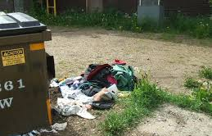

Problem Statements :
The main Concern with our environment has been waste management which impacts the
society in several ways.
The Detection, Monitoring & Management of waste is one of the major problem of present
era.
The traditional way of manually monitoring wastes in waste bins is a cumbersome process
and utilizes more human effort, time and cost which can easily be avoided with our
proposed model.
Figure : 01

Slide 3
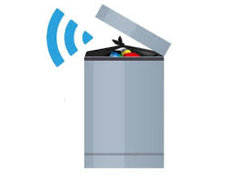
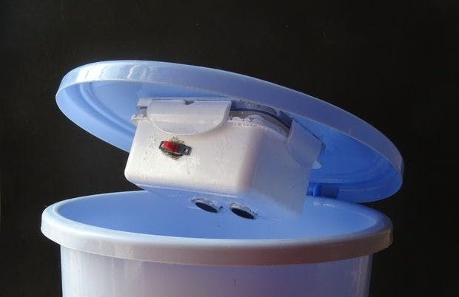
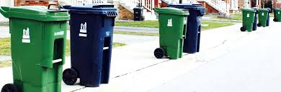
Solution :
Our proposed model provide real time monitoring to the garbage bins placed in various
locations.
These garbage boxed have been assigned with a unique id which determines the garbage
bin identity.
The garbage bins are build with a sensor module (Ultrasonic sensor) which continuously
monitors the garbage level inside the garbage bin.
Any moment the garbage level passes over the critical level (i.e 80%), the system generates
a notification to the monitoring panel (admin panel/garbage cleaning team) and so the
the cleaning team collects the garbage from the identified garbage bin.
Figure : 02

Slide 4
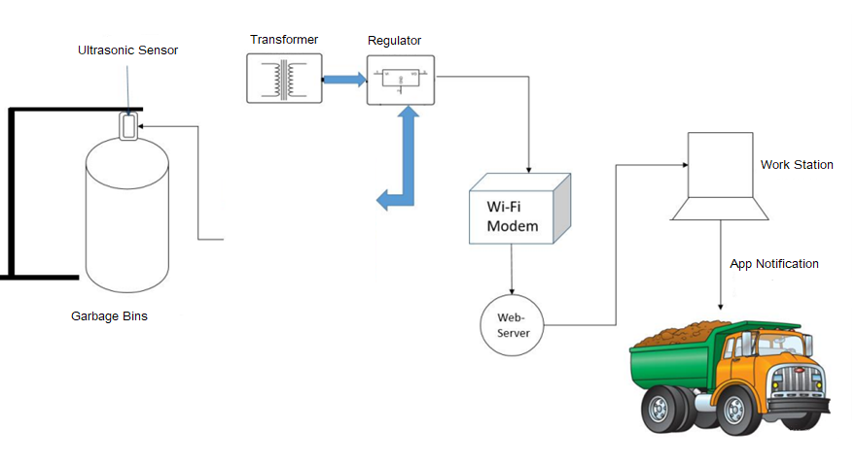
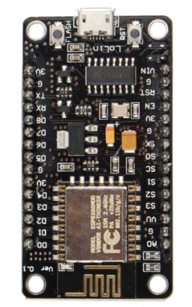
Architecture Flow Diagram of Proposed Model :
NodeMCU (ESP-12E)
Figure 03 : System Architecture Diagram

Slide 5
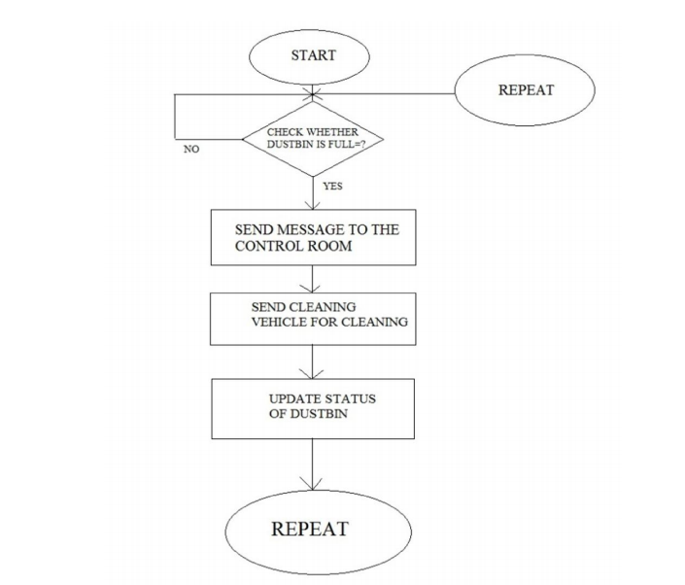
Work Flow Diagram :
Checking for dustbin status
If not filled ? Check for future status.
If filled ? Send Notification to team
Take desired action
example – releasing garbage cleaning team
Updating status of action on garbage box
Repeat the above process
Figure : 04

Slide 6
Hardware & Software Used :
Hardware list :
Ultrasonic Sensor
NodeMCU / Arduino Uno / Gsm Module
Wi-Fi modem
Dustbin box customized model
Software list :
Arduino IDE
CodeVision AVR
Script editor
Hosting/domain

Slide 7
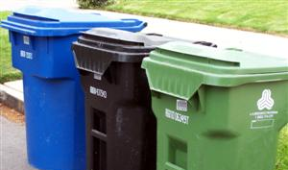
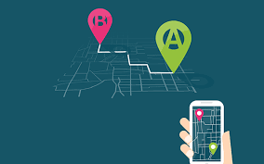

Advantage of Smart Garbage Monitoring :
Improved Cleanliness : In densely populated area, a rapid waste
generation often leads to overflowing waste bins and unsightly
streets. Our solution enables waste collection staff to read fill
levels in real time and receive notification of waste overflows.
Dynamic Routing : The solution optimizes waste collection routes
And schedules based on real time and historical data, provides
predictive analytics to enable decision making ahead of time and
Offer consultation on waste bin allocations.
Cost Reduction : Our smart waste logistics solution reduces waste
collection frequency dramatically, which enables you to save on
fuel, labor and fleet maintenance costs.

