Slide 1
Text Encodings and Extracting Patterns from Text with Regular Expressions
Winter 2015
Instructor: Dr. Yuhang Wang
Some slides from: Kevyn Collins-Thompson, Qiaozhu Mei, Charles Severance and Patrick Dudas

Slide 2
Lab & Homework Grading
Ming Jiang will grade labs & homeworks starting from today
Grades will be posted in a week
If you have questions about your homework/lab grades, please email Ming (mjng@umich.edu) and copy me (yuhangw@umich.edu).

Slide 3
Individual project: one-page proposal
Initial one-page project proposal due Jan 27, 2015 at 5PM
20% of project grade (Overall, project is worth 30% of grade)
One page
I will provide feedback by Feb 4, and may ask you to meet in my office hour.
Proposal Guidelines (20 points):
1. (4 points) Summarize and motivate your proposed project.
2. (6 points) Choose and describe two different datasets.
3. (6 points) Describe how you might manipulate and join the two datasets.
4. (4 points) Describe one interesting visualization that you might perform with the joined data.
You can propose an alternative project structure with prior approval

Slide 4
Text is a fundamental data type Text encodes language and other critical information types
Text (unstructured)
Structured text
Structured data (+ text)
Graphics: images
Video, multimedia
Understanding text encoding and pattern matching is critical to data manipulation.
Log file analysis: extract IP addresses, user IDs, etc.
Parsing and extracting text fields for import to a database.
Cleaning or normalizing text for further processing.

Slide 5
Today's Class Roadmap
Text encodings and Unicode
Regex: Wildcards and other basics
Regex: Sets, ranges and alternatives
Regex: Advanced operations
Lab 2: Regular expressions

Slide 6
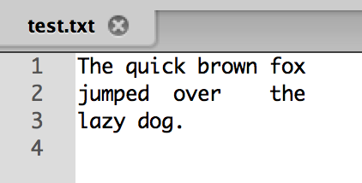
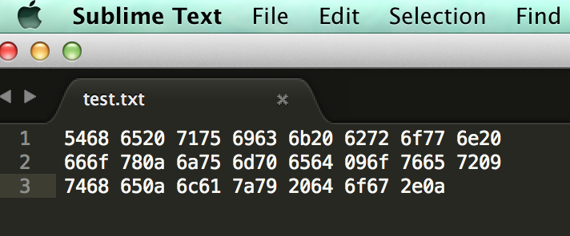
How is plain text stored in a file?
The text is encoded as a stream of numbers. Each number represents
a letter, symbol, or special character like tab or space.
Byte 00 84 104 101 32 113 117 105 99 107 32 98 114 111 119 110 32
T h e q u i c k b r o w n
Byte 16 102 111 120 10 106 117 109 112 101 100 9 111 118 101 114 9
f o x \n j u m p e d \t o v e r \t
Byte 32 116 104 101 10 108 97 122 121 32 100 111 103 46 10
t h e \n l a z y d o g . \n
Delimiter: a sequence of one or more characters used to specify the boundary between
separate, independent regions in plain text or other data streams
Special whitespace delimiters:
\t Tab = 9
\n End-of-line = 10
‘ ‘ Space = 32

Slide 7
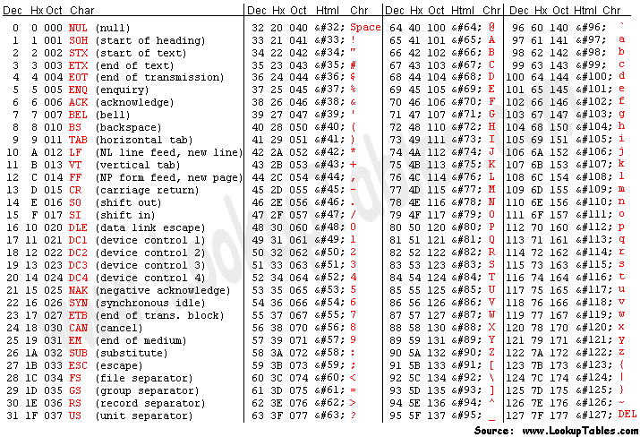
Who decided this? Enter the ASCII encoding from 1963
0000000 84 104 101 32 113 117 105 99 107 32 98 114 111 119 110 32
T h e q u i c k b r o w n
0000016 102 111 120 10 106 117 109 112 101 100 9 111 118 101 114 9
f o x \n j u m p e d \t o v e r \t
0000032 116 104 101 10 108 97 122 121 32 100 111 103 46 10
t h e \n l a z y d o g . \n
* ASCII = American Standard Code for Information Interchange

Slide 8
Be aware: A text file created on one platform (e.g. Windows) may use slightly different convention than another platform (e.g. Unix)
File saved with Windows/MS-DOS convention:
To deal with this issue, use input_file = open('inputfile.txt', 'rU')
0000000 84 104 101 32 113 117 105 99 107 32 98 114 111 119 110 32
T h e q u i c k b r o w n
0000016 102 111 120 13 10 106 117 109 112 101 100 9 111 118 101 114
f o x \r \n j u m p e d \t o v e r
0000032 9 116 104 101 13 10 108 97 122 121 32 100 111 103 46 13
\t t h e \r \n l a z y d o g . \r
0000048 10
\n
File saved with Unix convention:
0000000 84 104 101 32 113 117 105 99 107 32 98 114 111 119 110 32
T h e q u i c k b r o w n
0000016 102 111 120 10 106 117 109 112 101 100 9 111 118 101 114 9
f o x \n j u m p e d \t o v e r \t
0000032 116 104 101 10 108 97 122 121 32 100 111 103 46 10
t h e \n l a z y d o g . \n

Slide 9
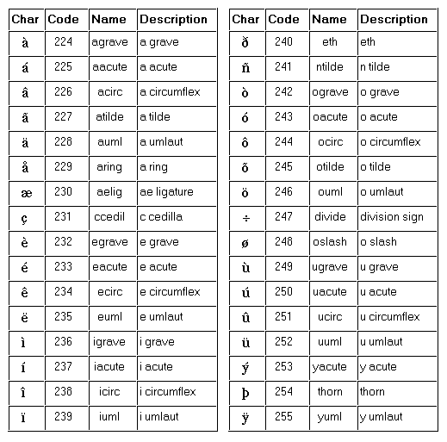
A character set specifies how numbers should be interpreted as character symbols
ASCII
7 bits per character (0-127) = 1 byte
Since 1960, from telegraph codes
ISO-Latin-1 (ISO-8859-1)
8-bit (0-255) = 1 byte
Superset of ASCII
Basis for original Web standard for HTTP and HTML
High-bit characters add e.g. accented characters for most ‘Western’ languages
The last 32 characters of the ISO-Latin-1 encoding

Slide 10
There is no such thing as plain text.*
We live in a multilingual world
It doesn't make sense to have a string without knowing what encoding it uses.
To deal with textual data, you first have to know how to decode the text!
Every working programmer must know the basics of character sets, encodings.
Enter… Unicode.
*Source: http://www.joelonsoftware.com/articles/Unicode.html

Slide 11
Unicode
Encoding standard that covers more than 110,000 characters and more than 100 human languages.
Contains ISO-Latin-1: first 256 characters the same
First draft standard 1991: owned by Unicode Consortium
Beginning to replace ASCII and ISO character sets
In theory, 0x0 to 0x10FFFF (1,114,112 characters)
Almost every language and past/present symbol you can think of
Coming soon: Star Trek languages, e.g. Klingon: private use area
Implemented in most modern operating systems programming languages, and software
Including XML, Java, .NET framework, etc.
Source: http://www.joelonsoftware.com/articles/Unicode.html

Slide 12
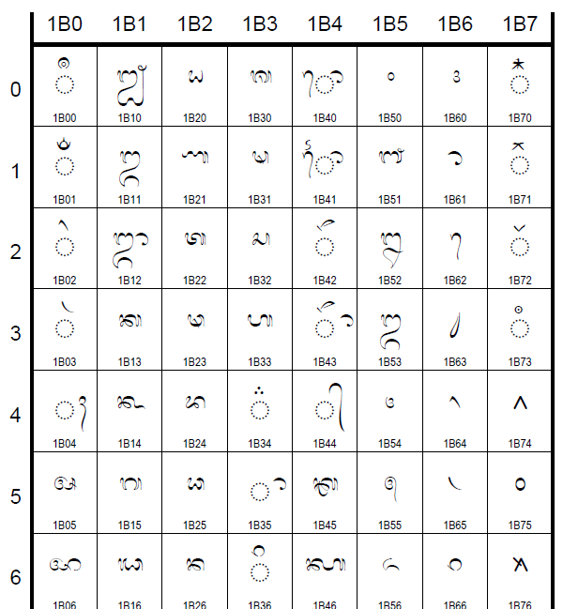
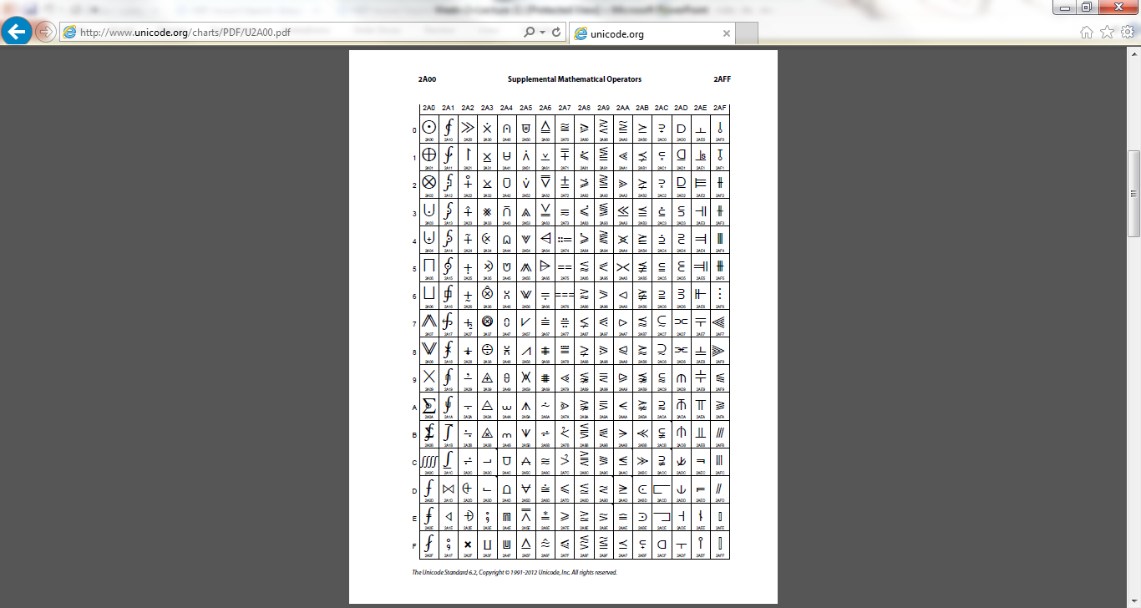
In case you needed convincing that Unicode is serious about being a universal encoding…
[Source: http://www.unicode.org/charts/PDF/U1B00.pdf http://www.unicode.org/charts/PDF/U2A00.pdf]

Slide 13
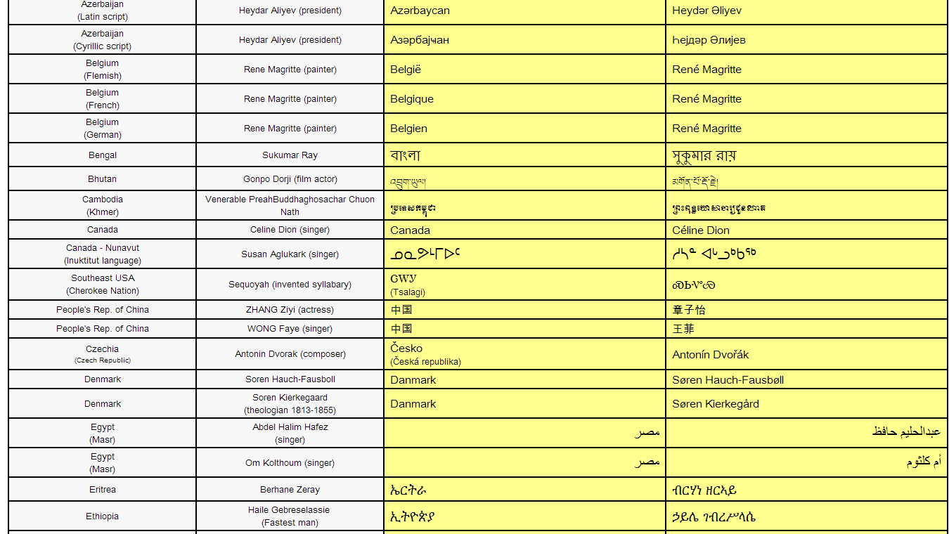
Unicode support in a correctly-implemented Web browser

Slide 14
Unicode characters: 'code points'
Every character is assigned an integer number by the Unicode consortium. This integer number is called the code point.
A code point is an integer value, usually denoted in base 16. In the standard, a code point is written using the notation U+12ca to mean the character with value 0x12ca (4810 decimal).
The U+ means "Unicode" and the numbers are hexadecimal (base 16)
They’re all listed on the Unicode web site.
HELLO => U+0048 U+0065 U+006C U+006C U+006F
UTF-8 Encoding:
In UTF-8, every code point from 0-127 is stored in a single byte. 7 bits = 1 byte
Only code points 128 and above are stored using 2, 3, or 4 bytes.
Neat side effect: English letters looks exactly the same in UTF-8 as it did in ASCII

Slide 15
Someone gives you a document. How do you know the encoding?
Email:
Content-Type: text/plain; charset="UTF-8"
HTML:
<html><head> <meta http-equiv="Content-Type" content="text/html; charset=utf-8">
Sometimes missing, so clever browsers will try to figure out the language and encoding from the frequency distribution of byte patterns
Python scripts: First line special comment, e.g.
# -*- coding: utf-8 -*-
or
# -*- coding: latin-1 -*-
"Plain" Text files:
The BOM (byte order mark) at the beginning of the file (example on next slide)
If BOM is missing, you will have to ask the sender what encoding was used.

Slide 16
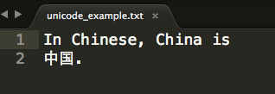

Example text file with UTF-8 encoding
Open as text file in Sublime Text:
Open as binary file in Hex Fiend:
UTF-8 encoding of BOM
(http://en.wikipedia.org/wiki/Byte_order_mark)

Slide 17
Python 2.x support for Unicode
In Python 2.5+, the default encoding for scripts is ASCII. (In Python 3, default is Unicode.)
Unicode literals are prefixed with ‘u’ or ‘U’ : foo = u'abcdefghijk'
Unicode string constructor encodes 8 bit string into unicode string: s = unicode('foo') # foo is an 8-bit string
s2= unicode('foo', 'utf-8')
s3 = unicode('\xe4\xb8\xad\xe5\x9b\xbd') # error message, why? s4 = unicode('\xe4\xb8\xad\xe5\x9b\xbd', 'utf8') print s4
s5 = unicode(u'abcd', 'utf-8') # false, why?
Unicode strings have same 8-bit string methods for searching, formatting, e.g. s.find('bird')
Specific code points are written using the \u escape sequence, which is followed by four hex digits giving the code point.
>>> s = u'\u4e2d\u56fd'
>>> print s
中国
Source: http://docs.python.org/2/howto/unicode.html

Slide 18
Converting from Unicode to 8-bit strings in Python 2.x
The .encode method of a Unicode string converts it to an 8-bit string in the requested encoding
>>> s = u'\u4e2d\u56fd'
>>> s.encode('utf-8')
'\xe4\xb8\xad\xe5\x9b\xbd'
>>> print s.encode('utf-8')
中国
You can encode unicode strings before writing to file, for a better way, see unicode_demo.py
Reference: http://docs.python.org/2/howto/unicode.html

Slide 19
Converting from 8-bit strings to Unicode strings
Python 8-bit strings have a .decode method that converts to Unicode given the original encoding
>>> s = u'\u4e2d\u56fd' # original 16-bit unicode string
>>> utf8_version = s.encode('utf-8')
>>> type(utf8_version), utf8_version
(<type 'str'>, '\xe4\xb8\xad\xe5\x9b\xbd')
>>> u2 = utf8_version.decode('utf-8') # Convert UTF-8 to Unicode
>>> u == u2 # The two strings match
True

Slide 20
Regular Expressions
A concise and flexible means to "match" (specify and recognize) strings of text, such as particular characters, words, or patterns of characters.
Similar regular expression syntax appears in many other tools
grep, flex, editors, ….
So you'll be able to re-apply most of what you learn here to other settings
Python comes with a powerful regex engine in the re package
Light bedtime reading:
Unicode standard regular expression guidelines
http://unicode.org/reports/tr18/

Slide 21
What you need to learn
Just one thing and three functions
One thing: regular expression syntax
Three functions:
re.match()checks for a match only at beginning of string
re.search()finds first occurrence of a pattern anywhere in string
re.findall()finds all occurrences of a pattern, not just first one

Slide 22
A Simple example
import re
str = 'a simple example!' # want to see if ‘simple’ appears as # a word by itself
match = re.search(r'simple\s', str) if match: print 'found', match.group()
else: print 'did not find'

Slide 23
Python raw string notation: r'text'
Keeps regular expressions sane
Without it, every backslash '\' in a regexp would need '\' prefix
r'\n' is a two-character string containing '\' and 'n'
'\n' is a one-character string containing newline character
Use r'\\' instead of '\\\\'
Can be combined with Unicode 'u' prefix
>>> b = ur'\n'
>>> b
u'\\n'
>>> b.encode('utf-8')
'\\n'

Slide 24
help(re.search)
search(pattern, string, flags=0)
Scan through string looking for a match to the pattern, returning a match object, or None if no match was found.

Slide 25
Basic Patterns
a, X, 9, < -- ordinary characters just match themselves exactly. The meta-characters which do not match themselves because they have special meanings are: . ^ $ * + ? { [ ] \ | ( ) (details below)
. (a period) -- matches any single character except newline '\n'
\w -- (lowercase w) matches a "word" character: a letter or digit or underbar [a-zA-Z0-9_]. Note that although "word" is the mnemonic for this, it only matches a single word char, not a whole word. \W (upper case W) matches any non-word character.
\b -- boundary between word and non-word
\s -- (lowercase s) matches a single whitespace character -- space, newline, return, tab, form [ \n\r\t\f]. \S (upper case S) matches any non-whitespace character.
\t, \n, \r -- tab, newline, return
https://developers.google.com/edu/python/regular-expressions

Slide 26
Basic Patterns
\d -- decimal digit [0-9]. \D matches any non-digit character
^ = start, $ = end -- match the start or end of the string
\ -- inhibit the "specialness" of a character. So, for example, use \. to match a period or \\ to match a slash. If you are unsure if a character has special meaning, such as '@', you can put a slash in front of it, \@, to make sure it is treated just as a character.
[aeiou] -- matches a single character in the given set
[^aeiou] -- matches a single character outside the given set
[aeiou]{2,} – match 2 or more characters in {a,e,i,o,u}
(foo|bar|baz) matches any of the alternatives specified
https://developers.google.com/edu/python/regular-expressions

Slide 27
Ranges of Regular Expressions
Valid:
[A-Z] Upper Case Roman Alphabet
[a-z] Lower Case Roman Alphabet
[A-Za-z] Upper/Lower Case
[A-F] Upper Case (only A – F)
[0-9] All Digits
Invalid
[a-Z]
[F-A]
[9-0]

Slide 28
Negation of Ranges of Regular Expressions
[^0-9] Anything BUT digits
[^a] Anything BUT a lower case a
[^A-Z] Anything BUT upper case letters
[^,] Anything BUT ,
So:
^[^A-Z] The word starts with a letter other than a capital letter

Slide 29
Alternatives
The | (pipe) metacharacter is used for alternatives
note also the use of parentheses for grouping
th(is|at|eother)
matches “this”,”that”, or “the other”
the|re
matches “the” or “re”
What does this mean?
^(T|t)oday

Slide 30
Matching repetitions
* zero or more of the previous thing
+ one or more of the previous thing
? zero or one of the previous thing
{3} matches exactly 3 of the previous thing
{3,6} matches between 3 and 6 of the previous thing
{3,} matches 3 or more of the previous thing

Slide 31
Help(re.match)
match(pattern, string, flags=0)
Try to apply the pattern at the start of the string, returning
a match object, or None if no match was found.

Slide 32
Group Extraction
Often times you would want to pick out parts of the matching text.
str = 'My email address is santa@umich.edu. Hohoho.'
match = re.search('([\w.-]+)@([\w.-]+)', str)
if match: with no order
print match.group() # the whole match
print match.group(1) # the username part
print match.group(2) # the hostname part

Slide 33
Very useful power: You can refer back to an earlier group match within the same regular expression. How?
\N where N is the group number
\1 matches group 1 result
Example:
r'<(.*?)>(.*?)</\1>'
Matches tag pairs with matching begin/end tags
<X>foobar</X> <ABCD>baz</ABCD>

Slide 34
Help(re.findall)
findall(pattern, string, flags=0)
Return a list of all non-overlapping matches in the string.
If one or more groups are present in the pattern, return a
list of groups; this will be a list of tuples if the pattern
has more than one group.
Empty matches are included in the result.

Slide 35
findall() Example
str = 'I have two email addresses: santa@umich.edu \ and santa@northpole.org. Hohoho.'
# Here re.findall() returns a list of all the found # email strings
emails = re.findall(r'[\w\.-]+@[\w\.-]+', str)
for email in emails:
print email

Slide 36
findall() and Group Extraction
str = 'I have two email addresses: santa@umich.edu \ and santa@northpole.org. Hohoho.'
# Here re.findall() returns a list of all the found # email strings
emails = re.findall(r'([\w\.-]+)@([\w\.-]+)', str)
for email in emails:
print email[0]
print email[1]

Slide 37
Options
The option flag can be added as an extra argument to search(), findall() etc.,
e.g. re.search(pat, str, re.IGNORECASE)
re.IGNORECASE Ignore upper/lowercase differences for matching, so 'a' matches both 'a' and 'A'.
re.DOTALL Make the '.' special character match any character at all, including a newline; without this flag, '.' will match anything except a newline.
re.MULTILINE Within a string made of many lines, allow ^ and $ to match the start and end of each line. Normally ^/$ would just match the start and end of the whole string.
re.UNICODE Match against Unicode strings: invoke Unicode character properties for word-vs-nonword characters, etc.

Slide 38
Greedy Matching is the Default
Python always tries to match as much as possible.
Example:
str = “the cat in the hat”
match = re.search(r'^(.*)(at)(.*)$', str)
Now, what do we have in
match.group(1), match.group(2) and match.group(3)?

Slide 39
Non-greedy Matching
Non-greedy quantifiers ?? ,*? , +?, and {}? try to match as minimal as possible.
Example: $x = “the cat in the hat”;
match = re.search(r'^(.*?)(at)(.*)$', str)
Now, what do we have in
match.group(1), match.group(2) and match.group(3)?

Slide 40
Options
The option flag can be added as an extra argument to search() or findall() etc., e.g. re.search(pat, str, re.IGNORECASE).
re.IGNORECASE -- ignore upper/lowercase differences for matching, so 'a' matches both 'a' and 'A'.
re.DOTALL -- Make the '.' special character match any character at all, including a newline; without this flag, '.' will match anything except a newline.
re.MULTILINE -- Within a string made of many lines, allow ^ and $ to match the start and end of each line. Normally ^/$ would just match the start and end of the whole string.

Slide 41
Compile regex Patterns
If a regex pattern is going to be reused, it is a good idea to compile it first.
Example:
p = re.compile('\d+')
# search demo
m = p.search('12 drummers drumming, 11 pipers piping, 10 lords a-leaping')
if m:
print 'Match found: ', m.group()
else:
print 'No match'
# findall demo
print p.findall('12 drummers drumming, 11 pipers piping, 10 lords a-leaping')

Slide 42
Substitution
sub(pattern, repl, string, count=0, flags=0)
Return the string obtained by replacing the leftmost
non-overlapping occurrences of the pattern in string by the
replacement repl. repl can be either a string or a callable;
if a string, backslash escapes in it are processed. If it is
a callable, it's passed the match object and must return
a replacement string to be used.

Slide 43
Substitution Example
str = 'My email is santa@umich.edu. Hohoho.'
print re.sub(r'@[\w\.-]+', '@northpole.org', str)
# prints out My email is santa@northpole.org Hohoho.

Slide 44
Look ahead assertions: zero-width matching
Problem:
We want to match any single character q that is not followed by u?
Why not use q[^u]
Means: q followed by a character that is not a u
Iraqi population
q[^u] returns qi (q followed by i). This is two characters.
What's the problem?
The regexp matcher has just 'used up' the i as part of this match and is now looking past it, at the 'space' character.
But the 'i' may be important in an upcoming regexp match
Solution: check for the presence of 'not u' without letting regexp 'eat' it…
You do this by using a zero-width negative lookahead assertion q(?!u)
Assertions do not 'use up' characters: they are zero-width, like start/end of line, or start/end of word
This will match the single character q only, not trailing letters

Slide 45
Positive and negative lookahead assertions
(?=...) Positive lookahead assertion. This succeeds if the contained regular expression, represented here by ..., successfully matches at the current location, and fails otherwise. But, once the contained expression has been tried, the matching engine doesn’t advance at all; the rest of the pattern is tried right where the assertion started.
(?!...) Negative lookahead assertion. This is the opposite of the positive assertion; it succeeds if the contained expression doesn’t match at the current position in the string.
https://docs.python.org/2/howto/regex.html

Slide 46
One more useful function
re.split()
# split on a regex pattern
line = 'Where the \t mountain meets the moon \n'
words = re.split('\s+', line)
# words = ['Where', 'the', 'mountain', 'meets', 'the', 'moon', '']

Slide 47
More Regex Examples
Going over regex_tutorial.py in Examples.zip

Slide 48
Learning resources
https://developers.google.com/edu/python/regular-expressions
http://docs.python.org/2/howto/regex.html
http://docs.python.org/2/library/re.html

Slide 49
What’s Due Next Week
Lab 2
Homework 2
1-page project idea proposal

Slide 50
Lab Time!

