Slide 1
Machine learning
Compressing Models with Few Samples: Mimicking then Replacing
Tian-Shuang Wu

Slide 2
01
Introduction
02
Related Work
03
Method
04
Experiments
05
Conclusion

Slide 3
Introduction
01

Slide 4
Introduction
network compression
deep models
decrease the latency and memory consumption
assume full access to the training data
small devices
Network pruning methods、quantization methods、knowledge distillation methods...
sensitive data？(e.g., medical or commercial data)
heavy restriction of layer-wise method
simple to use
general
unsupervised
highly accurate
MiR
FSKD、Cross Distillation...

Slide 5
Related Work
02

Slide 6
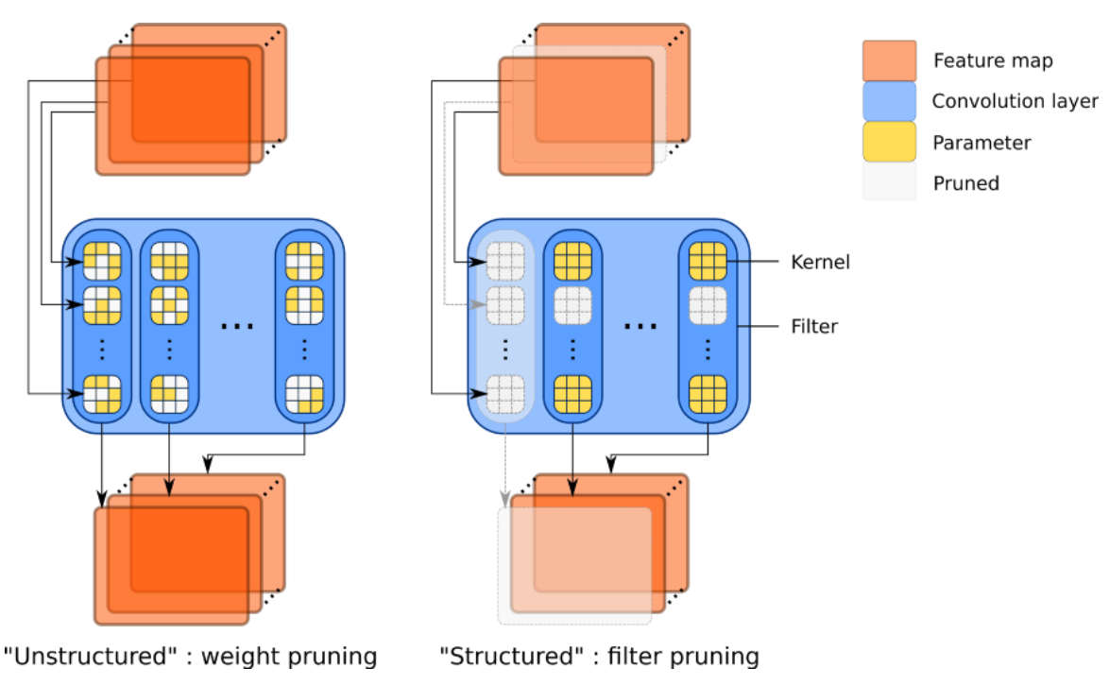
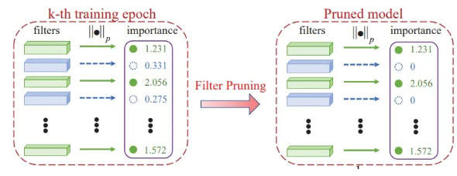
Related Work
Pruning
unstructured pruning
-prune connections leading to unstructured sparsity of models
structured pruning
-tries to prune less useful channels and is friendly to all platforms

Slide 7
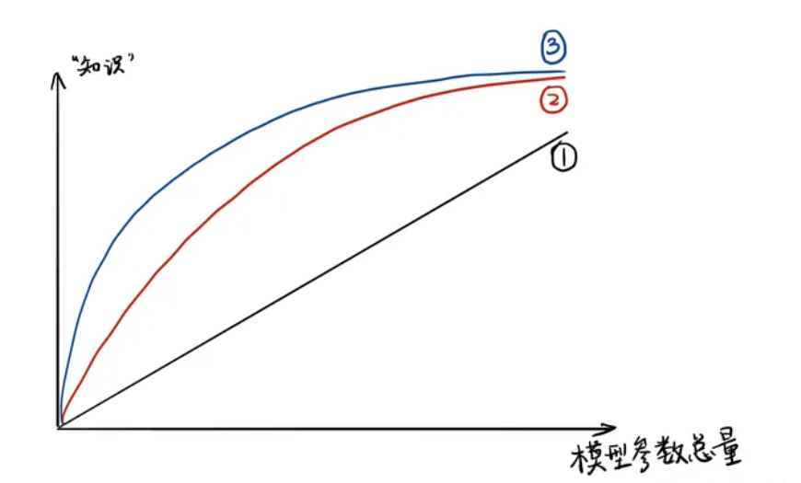
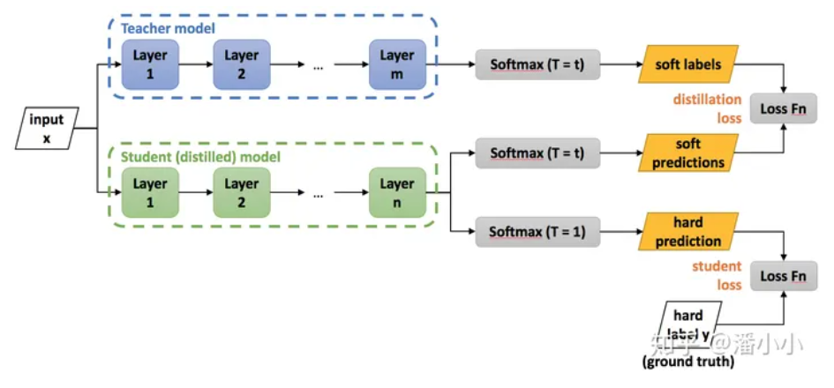
Related Work
Knowledge distillation (KD)
transfer the knowledge from the cumbersome model to a small model that is more suitable for deployment
large model’s class probabilities-->soft targets

Slide 8
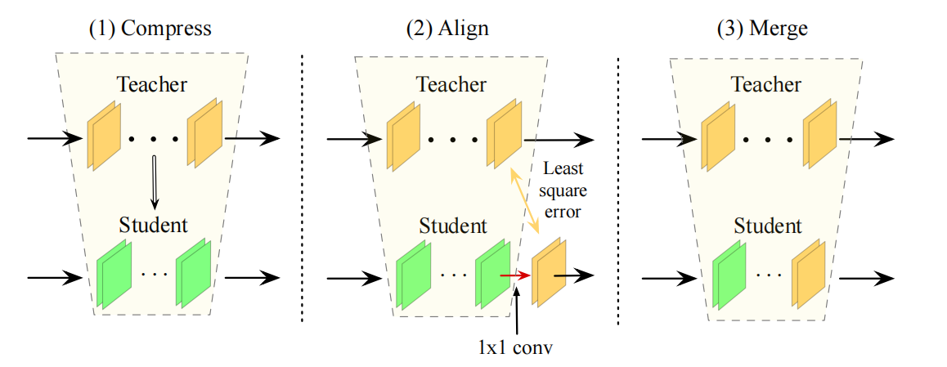
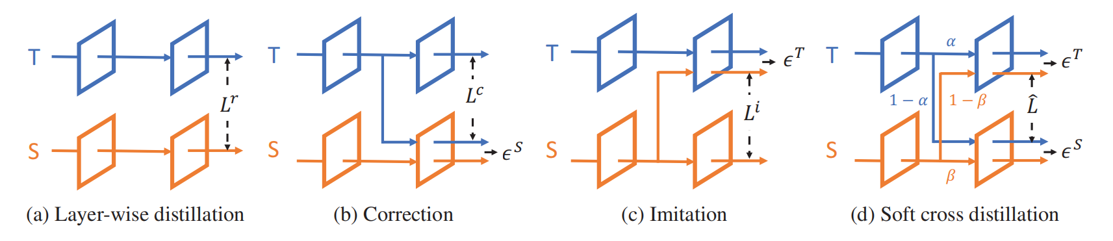
Related Work
Compression with limited data
FSKD
CD
A 1×1 convolution layer is added at the end of each
layer block of the student-net, and we fit the block-level out_x0002_
puts of the student-net to the teacher-net by estimating the
parameters of the added layers.
direct the teacher’s hidden layers to the student network,
which is called correction
reverse the strategy by directing
the student’s hidden layers to the teacher
network to make the teacher aware of the
errors accumulated on the student network

Slide 9
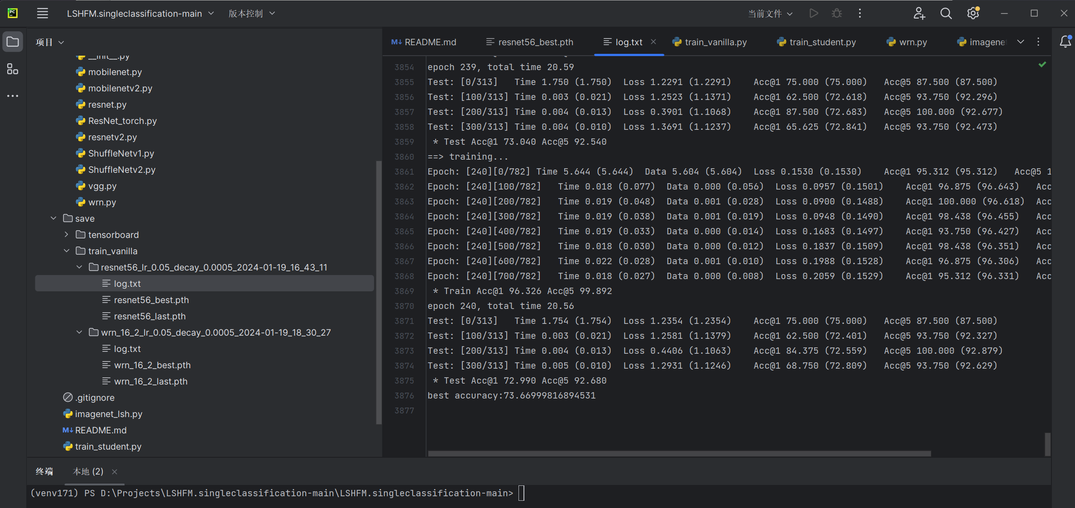
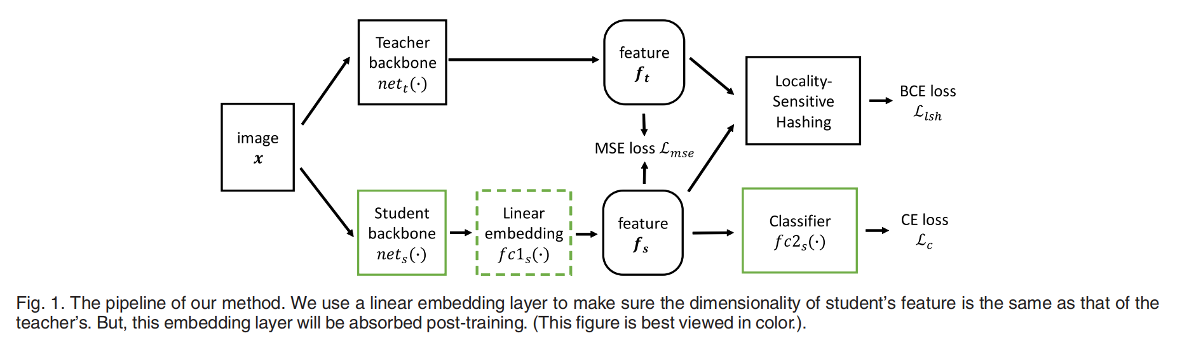
Related Work
LSHKD
directly mimicking features in the penultimate layer is advantageous for knowledge distillation
the feature’s direction contains more effective information than its magnitude, and we should allow more freedom to the student feature’s magnitude
propose a training strategy for mimicking fea_x0002_tures in transfer learning

Slide 10
MIR
03

Slide 11


MIR
To abolish the layer-wise scheme
Previous uses a layer-wise reconstruction manner to resume the representation ability of each layer
Problem With some channels pruned, the output dimensionality of layer l
willchange and cause a dimension mismatch issue.
Apart from the dimensionality issue, this layer-wise
re-construction framework suffers from error accumulation
Recent and effective pruning approaches render existing layer-wise few-
shot compression scheme unusable

Slide 12

MIR
To find a new few-sample pruning paradigm that is both general (i.e., applicable to all sorts of pruning schemes and network architectures) and highly accurate
Mimicking then Replacing
First urges the pruned model to output the same feature representations as those of the original model for the same image
Then replace the teacher’s backbone with the smaller student but keep the head unchanged to obtain the final compressed model
We follow the feature mimicking idea of LSHKD, but allows more freedom in choosing the layer for feature mimicking (i.e.,mimicking features in one of the layers, but not necessarily the penultimate layer).
Mimicking features before pooling

Slide 13
Experiment
04

Slide 14
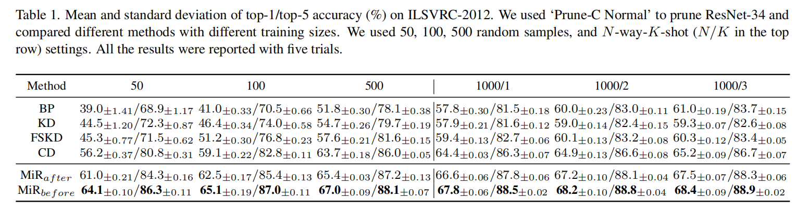
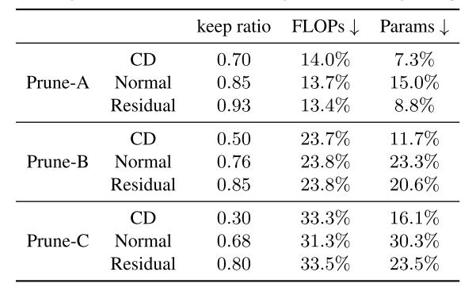
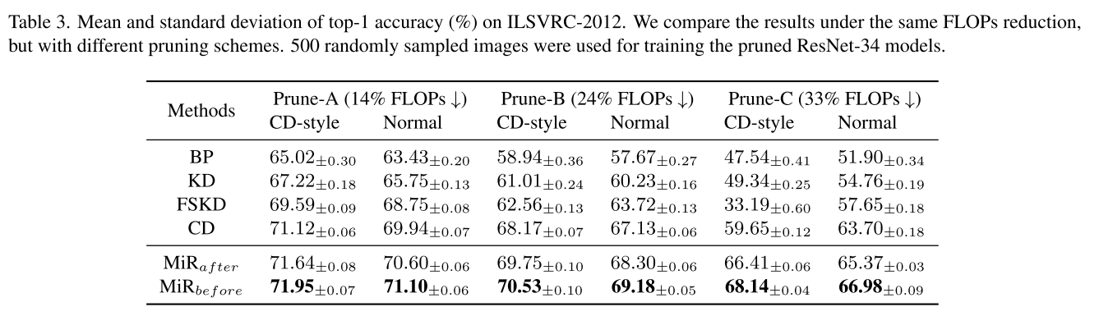
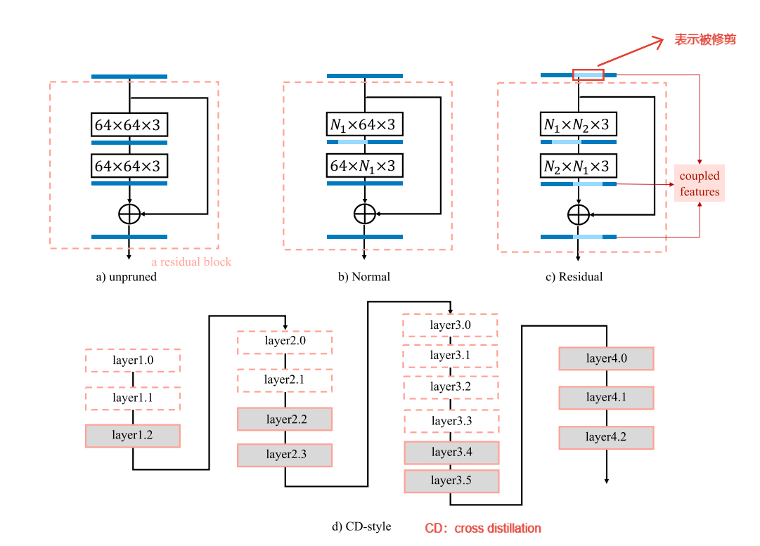
Experiment
Effectiveness
Prepraration
BP
KD
FSKD
CD
MIRbefore
MIRafter
Generality

Slide 15
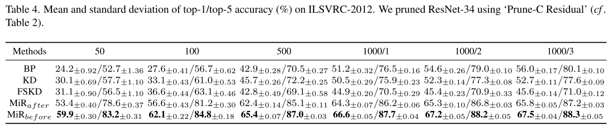
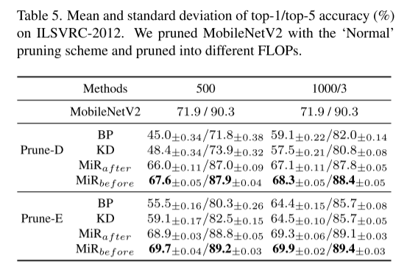
Experiment
Pruning residual connections
Results on MobileNetV2

Slide 16
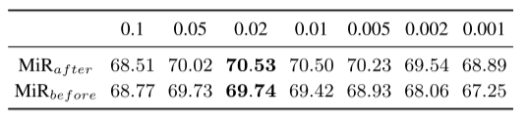
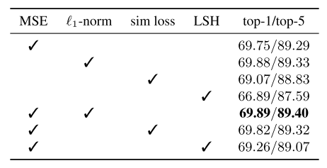
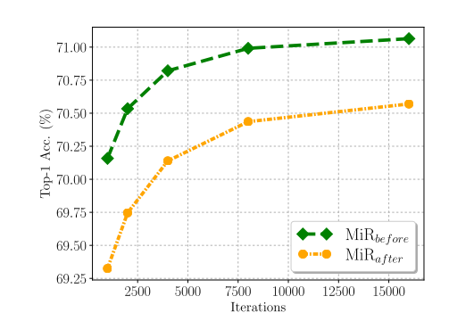
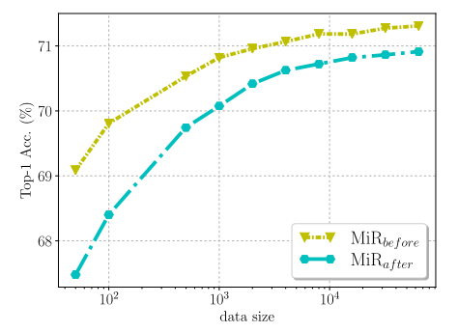
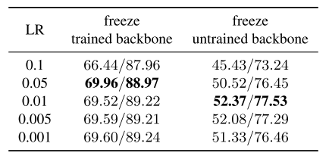
Experiment
Further Analyses
Hyperparameters（different initial learning rates）
Training time and training set size
loss functions
Freeze backbone and train classifier

Slide 17
Conclusion
05

Slide 18
Conclusion
Limitations
The accuracy of the pruned model is bounded from above by the accuracy of the original model.
Potential directions
to augment the input data
to add loss functions

Slide 19
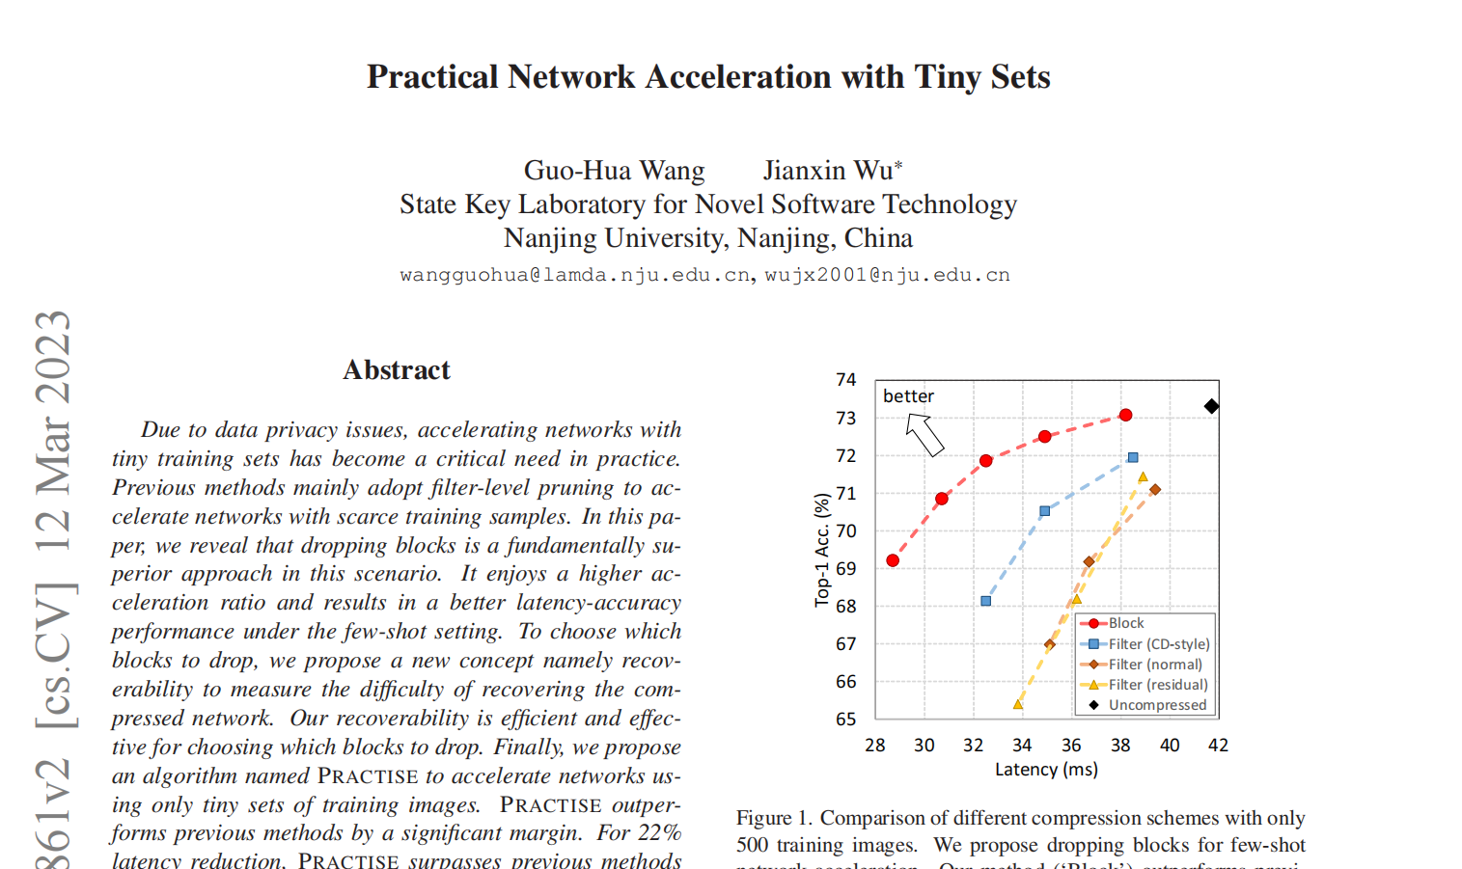
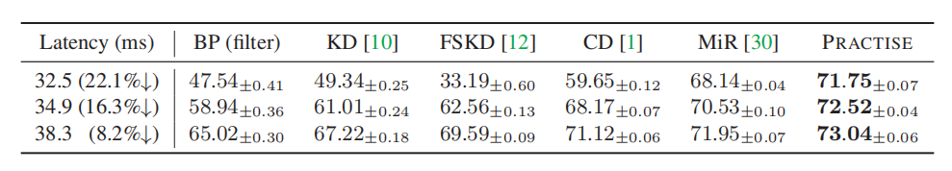
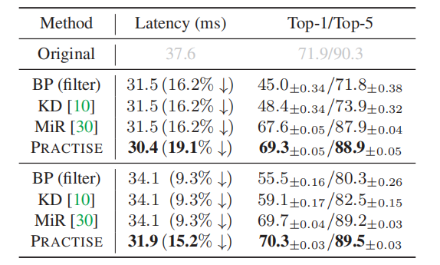
Conclusion
Latest progress

Slide 20
Thank you for your
listening and guidence
Tian-Shuang Wu

