Slide 1
Practical Network Acceleration with Tiny Sets
Tianshuang-Wu
Tutor：Shenhuan-Lv
wts001122@qq.com
2024/1/28

Slide 2
Contents
1
Research Background
2
Related Works
3
PRACTISE
4
Experiments
5
Conclusion

Slide 3
Background 1: The remarkable success of CNNs
However, CNNs suffer from high computational costs
Network pruning
Network decoupling
Network quantization

Slide 4
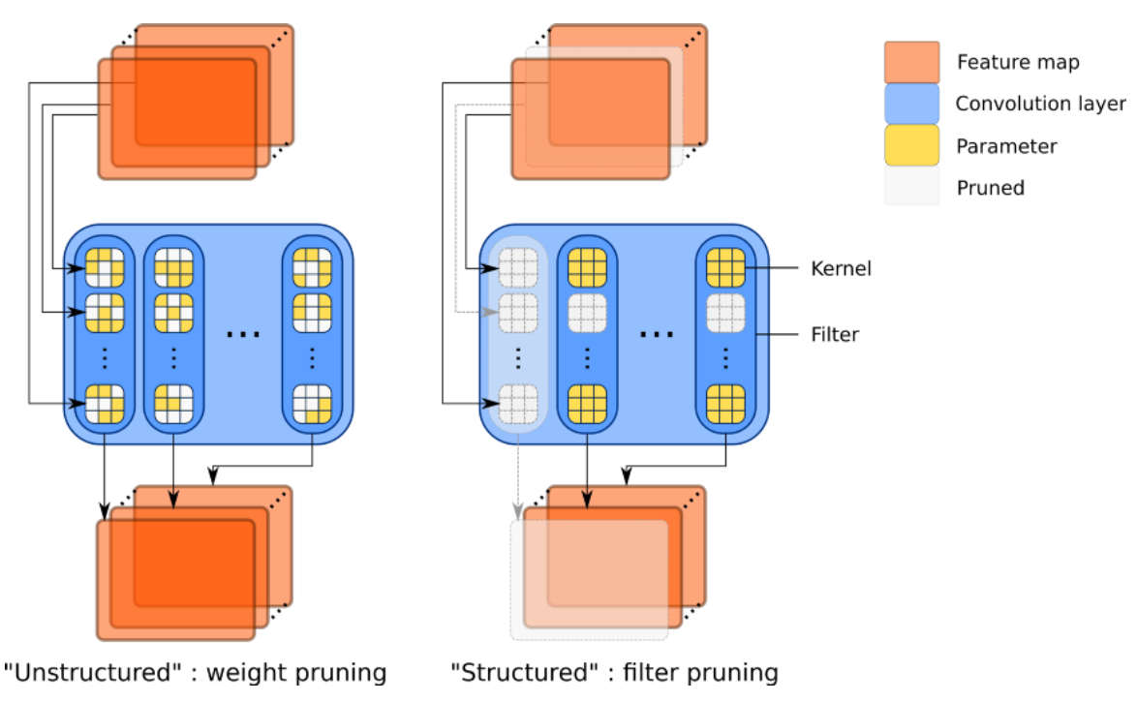
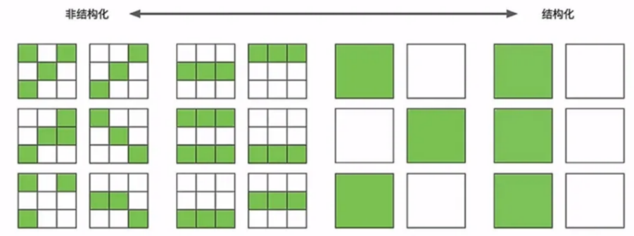
Network pruning
Pruning is a model compression technique used to reduce the size of neural networks.
Structured Pruning
It removes specific structured patterns of connections or neurons, making it easier to implement while maintaining network structure.
Unstructured Pruning:
It removes connections or neurons without a specific structure, providing more flexibility but requiring careful handling to maintain network connectivity.

Slide 5
Network decoupling
Network decoupling can achieve network compression by enhancing the independence and modularity of different components or layers within the network. This independence allows for a reduction in redundancy, leading to a decrease in the overall complexity of the network, which includes parameters and computations.

Slide 6
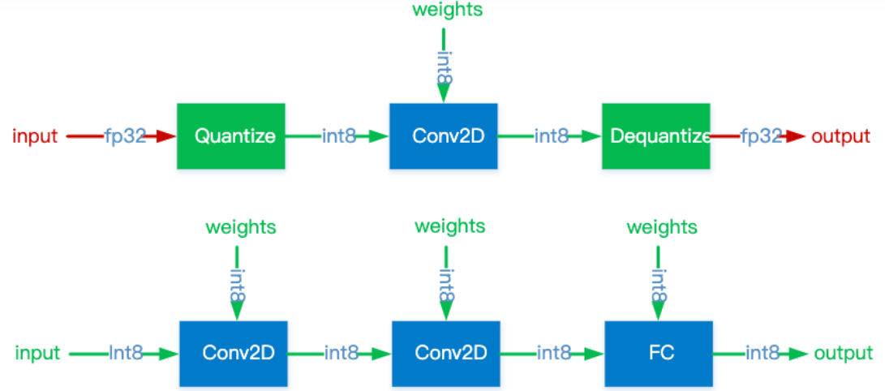
Network quantization
Model quantization is a commonly used model compression technique that reduces the precision of parameters in a neural network model, typically from 32-bit floating-point numbers to lower-bit fixed-point numbers or integers. This reduction in precision significantly reduces the model's size, thereby reducing storage requirements and computational complexity while attempting to preserve the model's performance.
Weight quantization
Activation quantization
Symmetric quantization & Asymmetric quantization

Slide 7
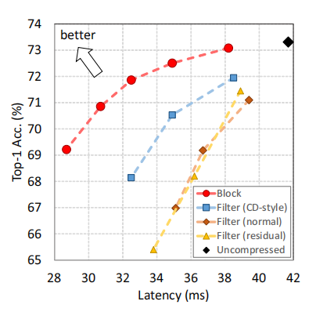
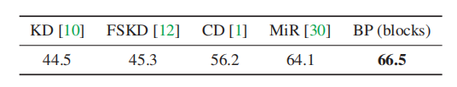
Background 2: Few-shot compression
Limited data
FSKD
MIR
CD
Block-level pruning is fundamentally superior!
All filter-level pruning!

Slide 8
Contents
1
Research Background
2
Related Works
3
PRACTISE
4
Experiments
5
Conclusion

Slide 9
The drawback of Filter-level pruning
When facing data privacy issues, these filter-level pruning methods suffer from poor latency-accuracy performance with tiny training sets.
It requires pruning lots of parameters and FLOPs to reduce latency. That results in a large capacity gap between the pruned and the original networks. So it is challenging to recover the pruned network accuracy on only a tiny training set.
low acceleration ratio

Slide 10
Block-level pruning
Previous works about block-level pruning
BlockDrop introduces a reinforcement learning approach to derive instance-specific inference paths in ResNets.
DBP proposes using linear probing to evaluate the accuracy of each block’s features, and dropping blocks with low accuracy.
ϵ-ResNet adds a sparsity-promoting function to discard the block if all responses of this block are less than a threshold ϵ. Both DBP and ϵ-ResNet require a large dataset for training and testing.
CURL uses a proxy dataset to evaluate the KL-divergence change before/after block removal. However, it neglects the finetuning process.
“recoverability”
the accuracy of the pruned network after finetuning

Slide 11
Data Limited Knowledge Distillation
Method of this paper
Previous Method
FSKD
VS
PRACTISE
MIR
CD
DFKD

Slide 12
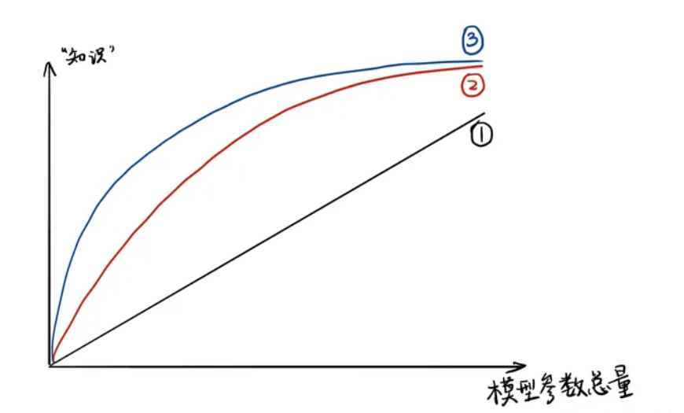
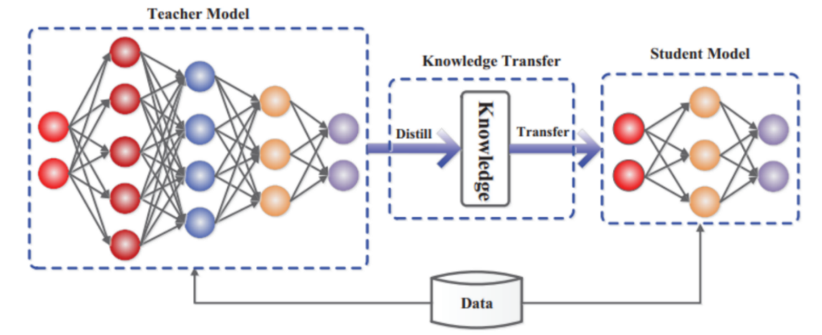
KD
Knowledge distillation (KD)
transfer the knowledge from the cumbersome model to a small model that is more suitable for deployment
large model’s class probabilities-->soft targets
Geoffrey E. Hinton, Oriol Vinyals, and Jeffrey Dean. Distilling the knowledge in a neural network. arXiv preprint arXiv:1503.02531, 2015.

Slide 13
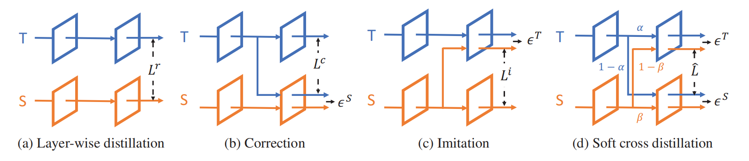
CD
Cross Distillation (CD)
direct the teacher’s hidden layers to the student network, which is called correction
reverse the strategy by directing the student’s hidden layers to the teacher network to make the teacher aware of the errors accumulated on the student network
Haoli Bai, Jiaxiang Wu, Irwin King, and Michael Lyu. Few shot network compression via cross distillation. In AAAI, volume 04, pages 3203–3210, 2020.

Slide 14
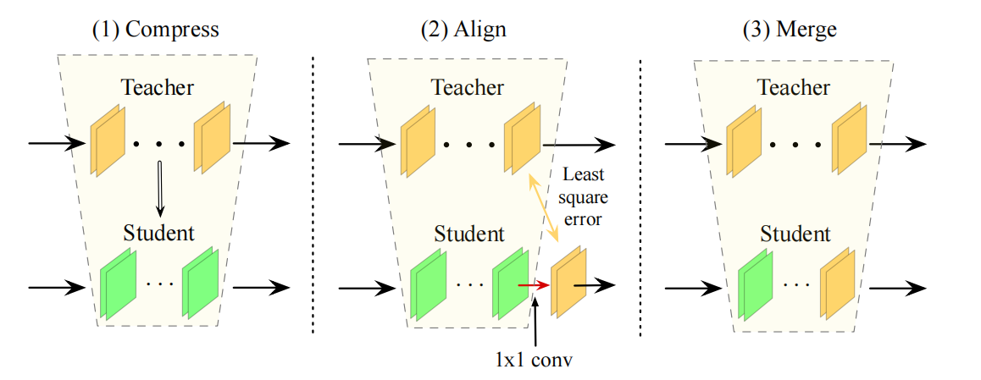
FSKD
Few Sample Knowledge Distillation (FSKD)
A 1×1 convolution layer is added at the end of each layer block of the student-net, and we fit the block-level outputs of the student-net to the teacher-net by estimating the parameters of the added layers.
Tianhong Li, Jianguo Li, Zhuang Liu, and Changshui Zhang. Few sample knowledge distillation for efficient network compression. In CVPR, pages 14639–14647, 2020.

Slide 15

MIR
Mimicking then Replacing (MIR)
First urges the pruned model to output the same feature representations as those of the original model for the same image
Then replace the teacher’s backbone with the smaller student but keep the head unchanged to obtain the final compressed model
We follow the feature mimicking idea of LSHKD, but allows more freedom in choosing the layer for feature mimicking (i.e.,mimicking features in one of the layers, but not necessarily the penultimate layer).
Mimicking features before pooling
Huanyu Wang, Junjie Liu, Xin Ma, Yang Yong, Zhenhua Chai, and Jianxin Wu. Compressing models with few samples: Mimicking then replacing. In CVPR, pages 701–710, 2022.

Slide 16
DFKD
Data Free Knowledge Distillation (DFKD)
Haoli Bai, Jiaxiang Wu, Irwin King, and Michael Lyu. Few shot network compression via cross distillation. In AAAI, volume 04, pages 3203–3210, 2020.

Slide 17
Contents
1
Research Background
2
Related Works
3
PRACTISE
4
Experiments
5
Conclusion

Slide 18
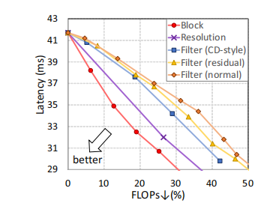
The motivation to drop blocks
latency & accuracy
Achieve the same latency with less reduction of FLOPs
large FLOPs reductions may lead overfitting and unstable problems

Slide 19
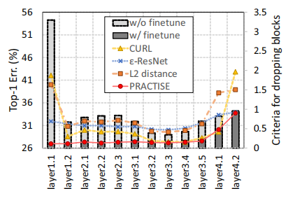
The recoverability of the pruned model
How to choose blocks to drop?
Recoverability
finetuning with a tiny training set
PRACTISE enjoys a high consistency
with the Top-1 error of the finetuned model!

Slide 20

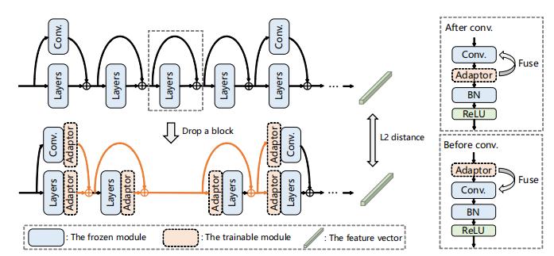

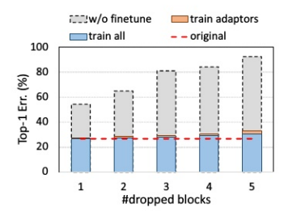
The recoverability of the pruned model
Recoverability + Latency =

Slide 21
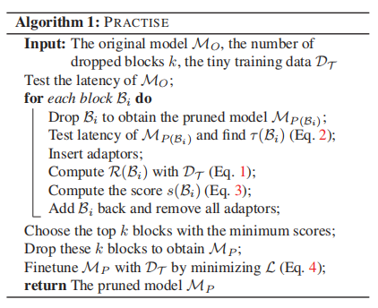
Recover the accuracy of the pruned model
Use the features before the global average pooling for the pruned model to mimic and achieved state-of-the-art performance with few training samples.
——MIR

Slide 22
Contents
1
Research Background
2
Related Works
3
PRACTISE
4
Experiment
5
Conclusion

Slide 23
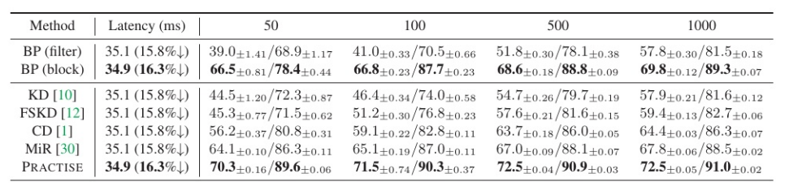
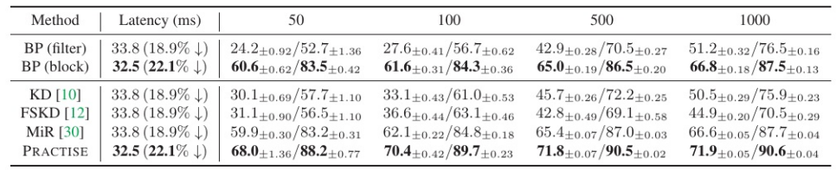
The superiority of dropping blocks
BP(block): just removed the first few blocks to reach the latency goal and then simply finetuned the network with the cross-entropy loss

Slide 24
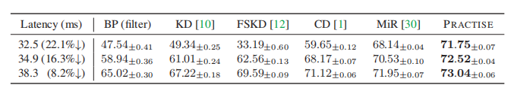
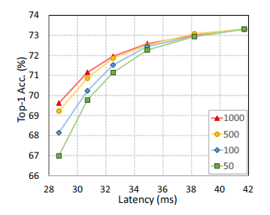
Acceleration ratios & Data-latency-accuracy
When the acceleration ratio becomes larger, PRACTISE enjoys higher accuracy than others!
With less latency reduction, the accuracies for different amounts of training data are comparable.
For a large latency reduction, it is challenging to recover the accuracy by only a tiny training set.
The accuracy gap becomes large w.r.t. different amounts of training data.

Slide 25
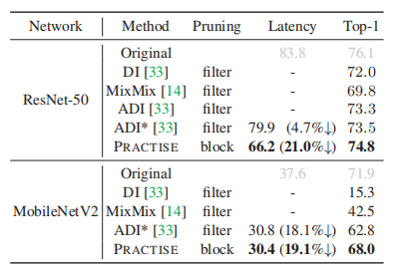
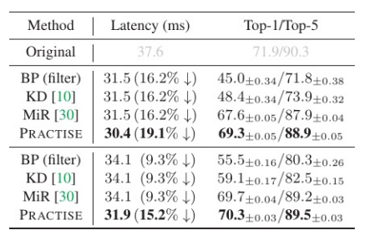
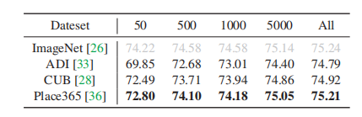
Generalization & Application
Zero-shot pruning with synthesized images
( ADI )
MobileNetV2
Zero-shot pruning with out-of-domain images

Slide 26
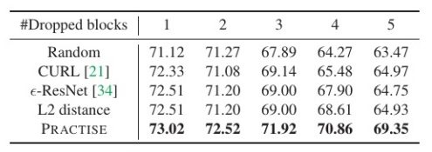
Different criteria for dropping blocks
Most existing methods mainly measure the gap between the original network and the pruned network without finetuning.
They neglect the recoverability of each dropped block, hence resulting in an inferior strategy for dropping blocks.
The more blocks are dropped,
the more superiority PRACTISE shows

Slide 27
Contents
1
Research Background
2
Related Works
3
PRACTISE
4
Experiments
5
Conclusion

Slide 28
Conclusion and Future Works
dropping blocks is more effective
Adopt dropping blocks for DFKD in the future to accelerate networks more effectively.
Apply PRACTISE for tuning a pretrained model on downstream tasks is promising.
Extend PRACTISE for other models (e.g., Transformer) or other vision tasks (e.g., object detection and segmentation).

Slide 29
Thank you for your
listening and guidance

