Slide 1
Impacts of COVID-19 on criminality in Germany
Final Project
Data Analysis for Social Sciences
Fall 2023
Koç University
Can Aktaran
Istanbul, 12.01.2024

Slide 2
How did the COVID-19 pandemic affect criminality in Germany?
My main goals are to:
Examine the criminality in Germany before and after the pandemic
Analyse what kind of crimes have seen an increase and which ones were declining (e.g. was there an increase to domestic violence or cybercrimes due to isolation?)
Explore patterns regarding the characteristics of delinquents (age, gender, location)

Slide 3
Data Sources – Bundeskriminalamt BKA (Federal Police Office)
Police Crime Statistics
Annual reports and statistics
Tables I used for each year between 2017 and 2022:
Suspects per age group
Suspects per state
Suspects per district
Population
→ Extensive data pre-processing
https://www.bka.de/EN/CurrentInformation/Statistics/PoliceCrimeStatistics/policecrimestatistics_node.html

Slide 4
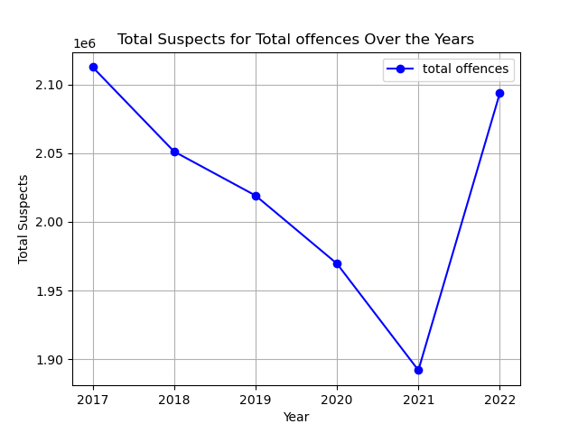
Exploratory Data Analysis
Decreasing number of crimes
Isolation
Dark figures probably higher
“Back to normal” in 2022

Slide 5
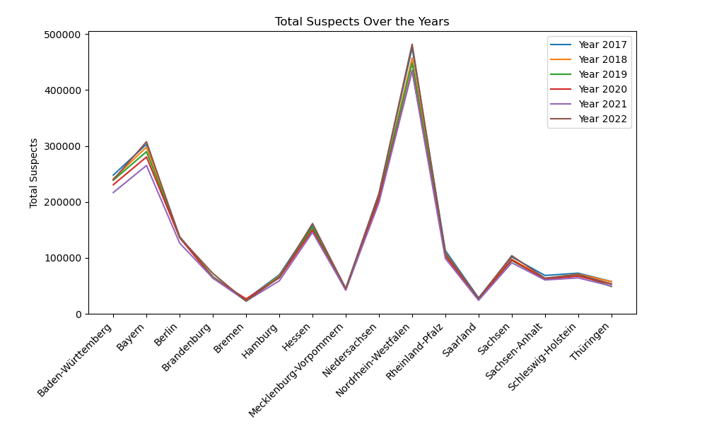
Exploratory Data Analysis

Slide 6
Exploratory Data Analysis
Most committed crimes in 2020
Offences involving brutality and crimes against personal freedom
Supplementary criminal laws
Property and forgery offences
Average crime rate per inhabitant per year
2018: 2.76%, 2019: 2.72%, 2020: 2.69%, 2021: 2.55%, 2022: 2.79%
Highest/lowest crime rate per state in 2020
Bremen: 3.93% (→ in other years Berlin is leading by far)
Rheinland-Pfalz: 2.65%

Slide 7
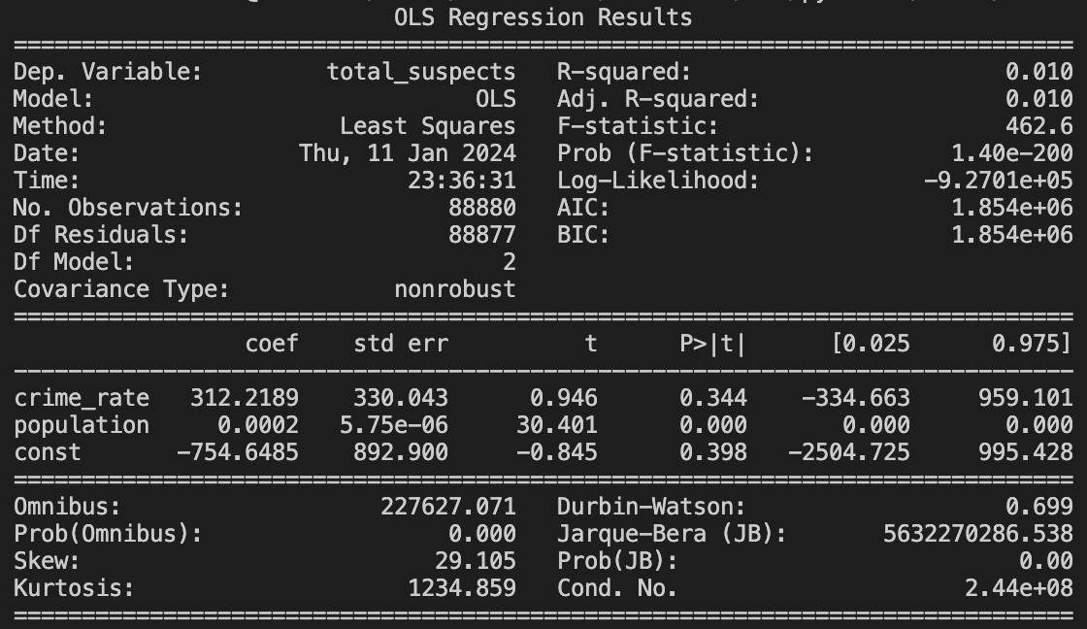
Regression Analysis – Can The Data Be Used To Predict Future Suspects?
R-squared and Adjusted R-squared
0.010 → variables (crime rate and population) are not a measure for total suspects
Prob (F-statistic)
1.20e-200 → quite low, model is therefore statistically significant
Coefficients
Crime rate: 312.22
Population: 0.0002

Slide 8
Conclusion and Outlook
Huge chunks of data lead to endless analysis possibilities → Streamlining data into common format very time-intensive
Accuracy of data not 100% given → A person can be suspect of more than one crime, but only counts as 1 for total suspects
Possible approaches for future research → Which other factors are influencing the criminality?

