Slide 1
codes.py
codes for calculating correlation
subject_id_1053.txt
subject IDs of 1053 participants
FFA_gyralCrown.csv (N=1053)
gyral crown: Minimum sulcus depth across vertices in each individual FFA
FFA_sulc.csv (N=1053)
sulcus depth: Average sulcus depth across vertices in each individual FFA
FFA_sulcBtm.csv (N=1053)
sulcus bottom: Maximum sulcus depth across vertices in each individual FFA
FFA_va.csv (N=1053)
surface area: Sum vertex area across vertices in each individual FFA
FFA_activ.csv (N=1053)
face selectivity (FACE-AVG in Working Memeory task): Average Z values across vertices in each individual FFA
FFA_activ-emo.csv (N=1053)
face selectivity (FACE-SHAPE in Emotion task): Average Z values across vertices in each individual FFA

Slide 2
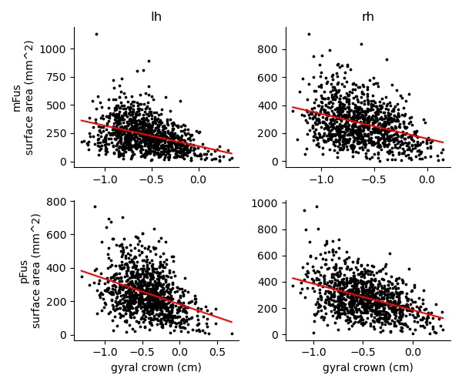
gyralCrown-corr-va.jpg
r=-0.38, p<0.001
r=-0.35, p<0.001
r=-0.37, p<0.001
r=-0.43, p<0.001
More detailed correlation values are in the remarks, and the same goes for subsequent slides.
Notes:
gyralCrown-corr-va in lh_mFus:
PearsonRResult(statistic=-0.37747440489759115, pvalue=1.711960810236716e-36)
gyralCrown-corr-va in rh_mFus:
PearsonRResult(statistic=-0.3502934940882956, pvalue=2.181858026672117e-31)
gyralCrown-corr-va in lh_pFus:
PearsonRResult(statistic=-0.37320269670682993, pvalue=4.0040759367338185e-35)
gyralCrown-corr-va in rh_pFus:
PearsonRResult(statistic=-0.42754495539036125, pvalue=2.078979859543496e-46)

Slide 3
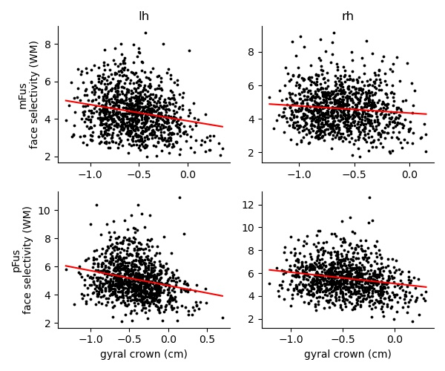
gyralCrown-corr-activ.jpg
r=-0.22, p<0.001
r=-0.10, p=0.001
r=-0.24, p<0.001
r=-0.20, p<0.001
Notes:
gyralCrown-corr-activ in lh_mFus:
PearsonRResult(statistic=-0.21537981498531644, pvalue=2.3290173234527714e-12)
gyralCrown-corr-activ in rh_mFus:
PearsonRResult(statistic=-0.09981437719795967, pvalue=0.0012681221715460582)
gyralCrown-corr-activ in lh_pFus:
PearsonRResult(statistic=-0.24230202776348247, pvalue=4.0318484179976136e-15)
gyralCrown-corr-activ in rh_pFus:
PearsonRResult(statistic=-0.20108796543967652, pvalue=9.936252144678468e-11)

Slide 4
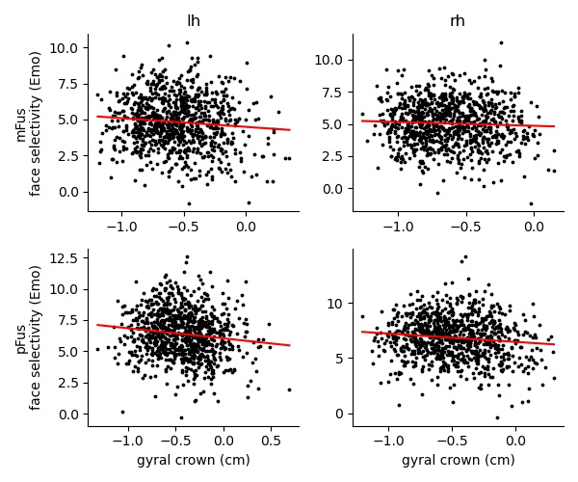
gyralCrown-corr-activ-emo.jpg
r=-0.09, p=0.004
r=-0.05, p=0.158
r=-0.13, p<0.001
r=-0.11, p<0.001
Notes:
gyralCrown-corr-activ-emo in lh_mFus:
PearsonRResult(statistic=-0.09438843381924733, pvalue=0.004418193777023491)
gyralCrown-corr-activ-emo in rh_mFus:
PearsonRResult(statistic=-0.0469264102695128, pvalue=0.15769517570240602)
gyralCrown-corr-activ-emo in lh_pFus:
PearsonRResult(statistic=-0.13188345498182932, pvalue=7.510759880148633e-05)
gyralCrown-corr-activ-emo in rh_pFus:
PearsonRResult(statistic=-0.11244120956857631, pvalue=0.000778321777426486)

Slide 5
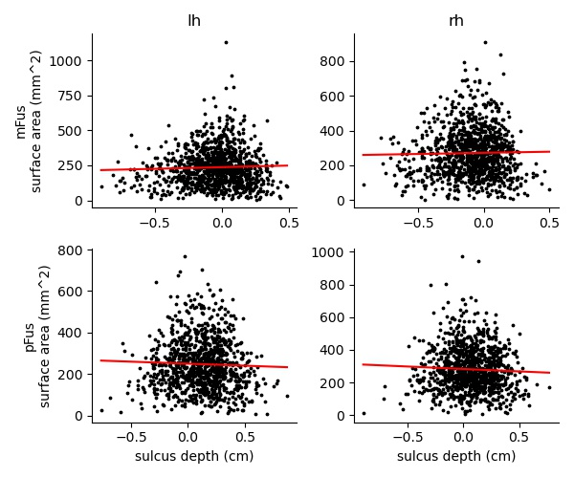
sulc-corr-va.jpg
r=0.04, p=0.223
r=0.02, p=0.524
r=-0.04, p=0.241
r=-0.05, p=0.130
Notes:
sulc-corr-va in lh_mFus:
PearsonRResult(statistic=0.03787556475819583, pvalue=0.22275220558124403)
sulc-corr-va in rh_mFus:
PearsonRResult(statistic=0.01976610814575401, pvalue=0.5242984722819904)
sulc-corr-va in lh_pFus:
PearsonRResult(statistic=-0.03667802562218986, pvalue=0.24139411567570604)
sulc-corr-va in rh_pFus:
PearsonRResult(statistic=-0.04751441082645521, pvalue=0.13015252863356266)

Slide 6
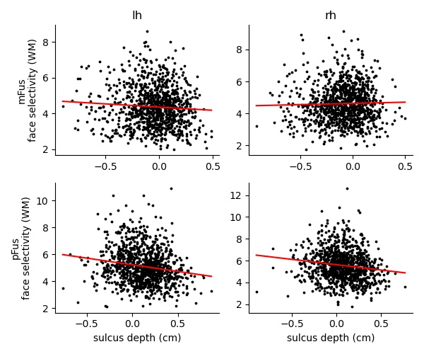
sulc-corr-activ.jpg
r=-0.07, p=0.023
r=0.03, p=0.374
r=-0.17, p<0.001
r=-0.15, p<0.001
Notes:
sulc-corr-activ in lh_mFus:
PearsonRResult(statistic=-0.07034879602929967, pvalue=0.023416158520902765)
sulc-corr-activ in rh_mFus:
PearsonRResult(statistic=0.0276229037085065, pvalue=0.3735139963127098)
sulc-corr-activ in lh_pFus:
PearsonRResult(statistic=-0.17416609123423907, pvalue=2.095348783985795e-08)
sulc-corr-activ in rh_pFus:
PearsonRResult(statistic=-0.14790509580907932, pvalue=2.193810403220141e-06)

Slide 7
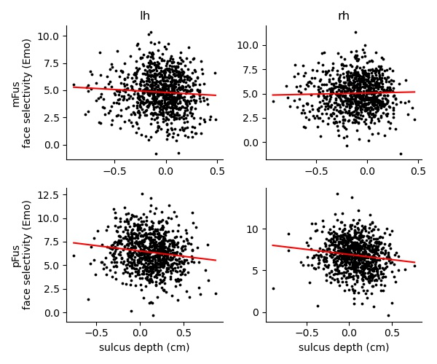
sulc-corr-activ-emo.jpg
r=-0.07, p=0.044
r=0.03, p=0.404
r=-0.14, p<0.001
r=-0.14, p<0.001
Notes:
sulc-corr-activ-emo in lh_mFus:
PearsonRResult(statistic=-0.0669030888530514, pvalue=0.043854929297862236)
sulc-corr-activ-emo in rh_mFus:
PearsonRResult(statistic=0.027722499442471717, pvalue=0.40407095802440307)
sulc-corr-activ-emo in lh_pFus:
PearsonRResult(statistic=-0.13963906554913977, pvalue=2.7337238097717997e-05)
sulc-corr-activ-emo in rh_pFus:
PearsonRResult(statistic=-0.13648710325153873, pvalue=4.4036786642607664e-05)

Slide 8
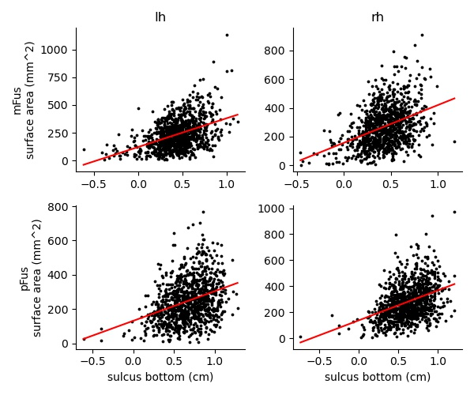
sulcBtm-corr-va.jpg
r=0.43, p<0.001
r=0.40, p<0.001
r=0.34, p<0.001
r=0.39, p<0.001
Notes:
sulcBtm-corr-va in lh_mFus:
PearsonRResult(statistic=0.42854538251691565, pvalue=1.2941255239148554e-47)
sulcBtm-corr-va in rh_mFus:
PearsonRResult(statistic=0.3989720768207354, pvalue=5.150314121178228e-41)
sulcBtm-corr-va in lh_pFus:
PearsonRResult(statistic=0.33976634722305354, pvalue=4.940648226622765e-29)
sulcBtm-corr-va in rh_pFus:
PearsonRResult(statistic=0.3941300801936467, pvalue=4.256020096362209e-39)

Slide 9
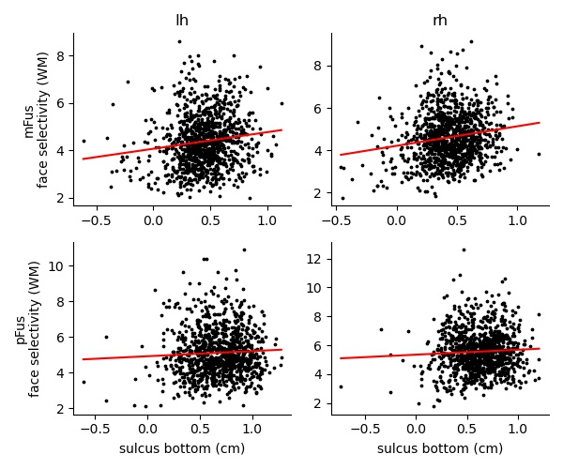
sulcBtm-corr-activ.jpg
r=0.14, p<0.001
r=0.17, p<0.001
r=0.05, p=0.092
r=0.06, p=0.077
Notes:
sulcBtm-corr-activ in lh_mFus:
PearsonRResult(statistic=0.13889655235141557, pvalue=7.076805702051134e-06)
sulcBtm-corr-activ in rh_mFus:
PearsonRResult(statistic=0.16715009867736502, pvalue=5.88913436391102e-08)
sulcBtm-corr-activ in lh_pFus:
PearsonRResult(statistic=0.05272436037040325, pvalue=0.09205801403394559)
sulcBtm-corr-activ in rh_pFus:
PearsonRResult(statistic=0.05558544236685401, pvalue=0.07656725742298472)

Slide 10
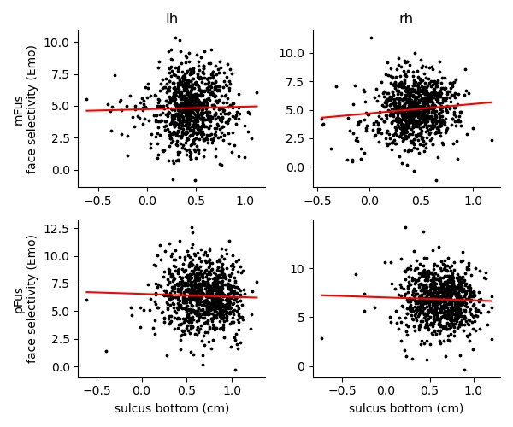
sulcBtm-corr-activ-emo.jpg
r=0.02, p=0.456
r=0.10, p=0.002
r=-0.04, p=0.282
r=-0.03, p=0.316
Notes:
sulcBtm-corr-activ-emo in lh_mFus:
PearsonRResult(statistic=0.02478450578393745, pvalue=0.4557167920837692)
sulcBtm-corr-activ-emo in rh_mFus:
PearsonRResult(statistic=0.10120406240649996, pvalue=0.0022639445452424917)
sulcBtm-corr-activ-emo in lh_pFus:
PearsonRResult(statistic=-0.033516482951310524, pvalue=0.3162766608525213)
sulcBtm-corr-activ-emo in rh_pFus:
PearsonRResult(statistic=-0.03611345179431157, pvalue=0.2818356937547243)

