Slide 1

Worldreader Query Data Project
A Capstone Project for the Data Science and Big Data course
at Universitat de Barcelona
Team members:
Cary Lewis
Aina Pascual
Patricia Araguz
Enrique Rodríguez

Slide 2
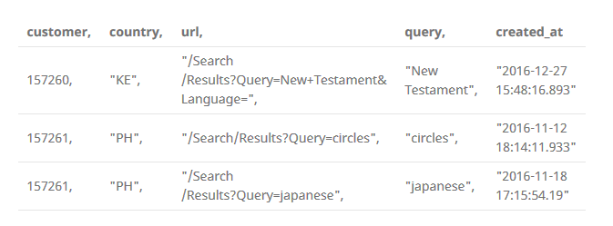
Introduction & Project Scope
Worldreader is non-profit organization working to reduce illiteracy through its reading applications and sponsorship programs. The organization has a collection of over 40,000 books in more than 40 languages with the mission “to unlock the potential of millions of people through the use of digital books in places where access to reading material is very limited.”
The Project Scope was to analyze queries made by users on the feature phone application by using clustering techniques to identify similar searches.
Worldreader provided our team with 6 CSV files consisting of over 3,000,000 queries and related information.

Slide 3
Project Work
Data processing
Classification and Topic Modeling
P01
P02
P03
P04
Data cleaning and language detection
Language selection and error correction
Sampling & Descriptive Stats.
Classification
- Data loading and general examination. Removing duplicates.
- Data cleaning: removal of punctuation, spaces before and after query, empty queries, queries of only numerical numbers and queries with special characters.
- Language detection.
- Select queries in English.
- Correct spelling errors.
P02A Frequecy of misspelled words.
P02B Correction of misspelled words.
- Descriptive analysis of the sample.
- Graphical analysis of terms to identify possible themes: Word frequency, bigrams, and wordcloud.
- Sample selection of 20,000 queries run though the Google Books API supplementing the data.
- Load the supplemented queries with the information pulled from the Google API.
- Segmentation of complete dataset through:
LDA Algorithm with best-match and with 5 results.
NMF Algorithm with best-match and 5 more results.
- Choose best fit model, test accuracy and stability.

Slide 4
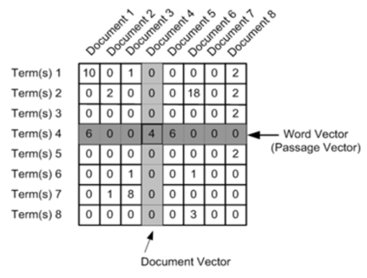
Classification Algorithms : LDA vs NMF
LDA (Latent Dirichlet Allocation) and NMF (Non-negative Matrix Factorization) are unsupervised techniques for topic discovery in large document collections. Discover different topics that a set of documents represent and how much of each topic is present in a document (or corpus).
Each algorithm has a different mathematical underpinning:
LDA is is based on a bayesian probabilistic graphical modeling
NMF relies on linear algebra.
Both algorithms take as input a bag of words matrix (i.e., each document represented as a row, with each columns containing the count of words in the corpus) and produce 2 smaller matrices:
a document to topic matrix (no documents * k topics)
a word to topic matrix (k topics * no words) that when multiplied together reproduce the bag of words matrix with the lowest error.
The output of the derived topics generated by both models involved assigning a numeric label to the topic and printing out the top words in a topic.
NMF and LDA are not able to automatically determine the number of topics and this must be specified.
NMF is usually cheaper in computation compared to LDA.
In cases where we believe that the topic probabilities should remain fixed per document (oftentimes unlikely)—or in small data settings — NMF performs better.

Slide 5
Searches file(s) process
Total Searches
Correct Searches
File 1
+
Searches in English
File 2
Searches Sample for Google Books API
(Sign. 99%)
Searches Sample with Title or non Author Searches
+
Classification Data File
File 3
Train File (80%)
Test File (20%)
Test File (20%)
1.500.000
3 x 500.000
944.963
63%
661.000
70%
20.000
15.716
3.131 No author
1.153 Author

Slide 6
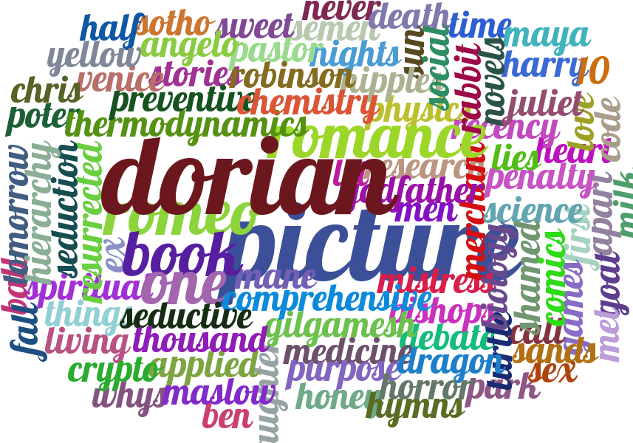
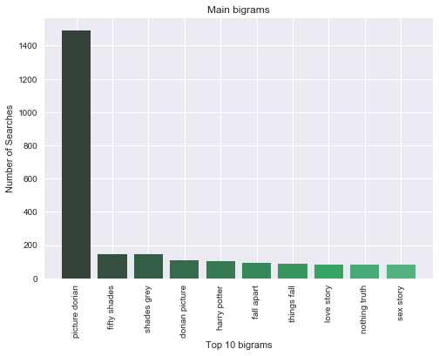
Word cloud Sample
Bigrams Sample

Slide 7
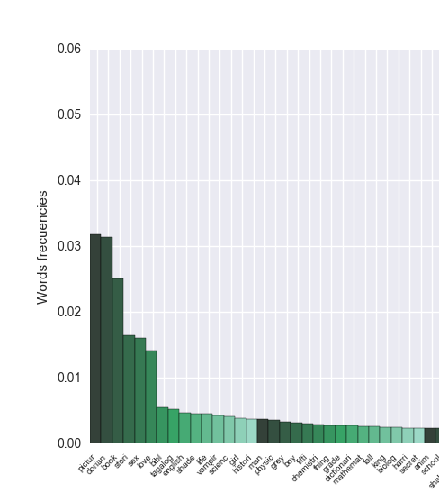

Sampling significance
Total Searches (N=661.000)
Sample (n=20.000)

Slide 8
Number of Topics
Iterative approach in both cases:
LDA
Perplexity is a commonly used measurement in information theory to evaluate how well a statistical model describes a dataset. Low perplexity indicates the probability distribution of the model is good at predicting the sample.
K | Perplexity
K = 5 | 249.759001877
K = 10 | 254.351936899
K = 15 | 250.765157719
K = 20 | 251.955603856
K = 25 | 254.939880397
NMF
Tested with same K numbers. K = 15 was the one that performed best too.

Slide 9
LDA Topic classification : Complete Train vs. Best Match
LDA Complete Train (Time 37’, words average 214)
Topic 0:
Topic 1:
Topic 2:
Topic 3:
Topic 4:
Topic 5:
Topic 6:
Topic 7:
Topic 8:
Topic 9:
Topic 10:
Topic 11:
Topic 12:
Topic 13:
Topic 14:
student
book
learn
use
practic
mathemat
includ
studi
english
book
languag
bibl
word
dictionari
use
includ
harri
potter
lord
give
will
war
shall
must
histori
world
studi
cultur
book
polit
new
social
sex
sexual
book
stori
work
women
psycholog
men
book
manag
system
use
research
develop
inform
new
book
will
vampir
find
new
seri
power
love
horror
stori
film
fiction
ghost
fan
the
tale
dorian
wild
gray
pictur
stori
portrait
beauti
edit
book
game
think
will
kid
get
can
success
comic
book
novel
music
time
life
work
stori
anim
novel
thing
fall
african
apart
stori
africa
shade
fifti
grey
christian
book
recip
ana
world
play
shakespear
poem
tale
romeo
juliet
othello
includ
love
stori
life
will
can
book
time
live
LDA Best Match (Time 37’, words average 92)
Topic 0:
Topic 1:
Topic 2:
Topic 3:
Topic 4:
Topic 5:
Topic 6:
Topic 7:
Topic 8:
Topic 9:
Topic 10:
Topic 11:
Topic 12:
Topic 13:
Topic 14:
book
student
use
includ
practic
guid
learn
provid
book
languag
english
tagalog
stori
play
student
will
will
book
romanc
seri
magic
ring
king
fantasi
histori
work
war
cultur
new
book
art
poem
stori
short
film
book
horror
sex
adult
night
love
life
book
will
can
live
time
make
shakespear
princ
warrior
year
will
play
world
book
manag
busi
account
market
econom
develop
technolog
system
law
africa
life
dictionari
legal
stori
tale
white
dorian
gray
reader
pictur
wild
young
first
modern
book
women
sex
food
vampir
men
journal
recip
sex
harri
english
sexual
dictionari
potter
word
book
shade
fifti
grey
christian
love
ana
dark
passion
book
histori
scienc
social
polit
human
studi
new
dorian
beauti
portrait
pictur
begin
depict
gray
physic

Slide 10
NMF Topic classification : Complete Train vs. Best Match
NMF Complete Train (Time 15’’, words average 214)
Topic 0:
Topic 1:
Topic 2:
Topic 3:
Topic 4:
Topic 5:
Topic 6:
Topic 7:
Topic 8:
Topic 9:
Topic 10:
Topic 11:
Topic 12:
Topic 13:
Topic 14:
dorian wild gray pictur portrait ward oscar mr
love
poem
date relationship romanc heart
alway marriag
student mathemat book chemistri engin practic scienc
use
shade
fifti
grey christian ana anastasia steel darker
sex
sexual disabl gender patient mark
men
studi
shakespear romeo
juliet
play
othello william languag colour
apart acheb
fall
thing chinua okonkwo african novel
vampir caitlin journal legend rachel book twilight caleb
ring
king
fantasi
dragon
sorcer
epic
destini
thor
harri
potter
shall
lord
leav
harm
breath
climb
bibl
nameless
holi
god
translat
biblic
christian
promis
life
live
book
god
girl
secret
make
want
stori
short
erotica
tale
children
erot
horror
collect
dictionari english languag tagalog word grammar entri
law
histori
polit
cultur
war
social
studi
american world
NMF Best Match (Time 15’’, words average 92)
Topic 0:
Topic 1:
Topic 2:
Topic 3:
Topic 4:
Topic 5:
Topic 6:
Topic 7:
Topic 8:
Topic 9:
Topic 10:
Topic 11:
Topic 12:
Topic 13:
Topic 14:
dorian gray wild pictur reader remain paint portrait
life
book live
time world make god famili
dorian beauti portrait pictur depict gray begin hedonist
sex
sexual men
male
adult enlighten bodi character
book student mathemat scienc engin
use
practic studi
vampir journal book twilight legend rachel diari seri
shade
fifti
grey christian ana
steel anastasia darker
bibl nameless hero histori holi heaven way
god
english
languag dictionari
word
oxford
tagalog grammar
use
harri
potter
shall
lord
leav
sky
drive
breath
shakespear romeo
play
juliet
william
othello
colour classroom
histori
cultur
polit
studi
war
american social
centuri
law
legal
dictionari
entri
sourc
crime
term
inform
love
poem
marriag relationship heal
peter
richard
romant
stori
short
erotica
sexi
night
erot
adult
romanc

Slide 11
LDA Topics classification : LDA Complete T. vs. NMF Complete T.
LDA Complete Train
Topic 8:
Topic 12:
Topic 13:
Topic 2:
Topic 11:
Topic 3:
Topic 6:
Topic 7:
Topic 1:
Topic 9:
Topic 4:
Topic 14:
Topic 10:
Topic 5:
Topic 0:
dorian
wild
gray
pictur
stori
portrait
beauti
edit
shade
fifti
grey
christian
book
recip
ana
world
play
shakespear
poem
tale
romeo
juliet
othello
includ
harri
potter
lord
give
will
war
shall
must
anim
novel
thing
fall
african
apart
stori
africa
histori
world
studi
cultur
book
polit
new
social
book
will
vampir
find
new
seri
power
love
horror
stori
film
fiction
ghost
fan
the
tale
english
book
languag
bibl
word
dictionari
use
includ
book
game
think
will
kid
get
can
success
sex
sexual
book
stori
work
women
psycholog
men
love
stori
life
will
can
book
time
live
comic
book
novel
music
time
life
work
stori
book
manag
system
use
research
develop
inform
new
student
book
learn
use
practic
mathemat
includ
studi
99%
65%
45%
48%
41%
50%
73%
62%
73%
75%
64%
60%
51%
40%
78%
60%
40%
Topic #0
Topic#3
Topic#5
Topics#9
Topic#6
Topic#14
Topic#7
Topic#8
Topic#13
Topic#10
Topic#4
Topic#1
Topic#11
Topic#12
Topic#2
dorian wild gray pictur portrait ward oscar mr
shade
fifti
grey christian ana anastasia steel darker
shakespear romeo juliet
play
othello william languag colour
harri
potter
shall
lord
leav
harm
breath
climb
apart acheb
fall
thing chinua okonkwo african novel
histori
polit
cultur
war
social
studi
american world
vampir caitlin journal legend rachel book twilight caleb
ring
king
fantasi
dragon
sorcer
epic
destini
thor
dictionari english languag tagalog word grammar entri
law
bibl
nameless
holi
god
translat
biblic
christian promis
sex
sexual disabl gender patient mark
men
studi
love
poem
date relationship romanc heart
alway marriag
life
live
book
god
girl
secret
make
want
stori
short
erotica
tale
children
erot
horror
collect
student mathemat book chemistri engin practic scienc
use
NMF Complete Train

Slide 12
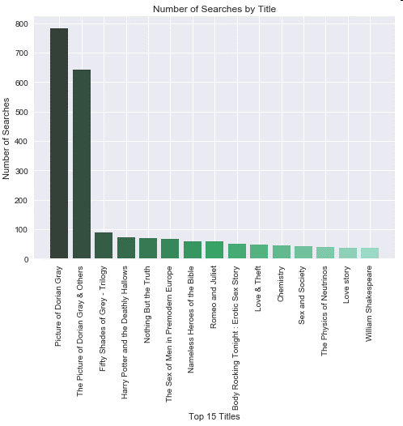
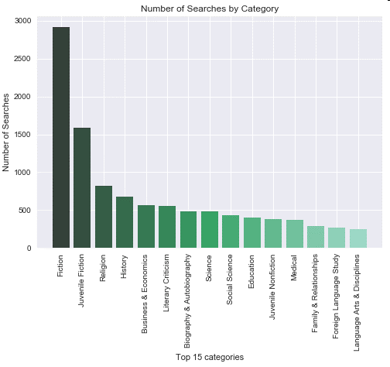
NMF Complete Train Google Categories
Novel
Book
Topic #0
Topic #5
Topic #6
Topic #7
Topic #8
Topic #9
Topic #1
Topic #11
Topic #3
Topic#12
Topic #4
Topic #2
Topic #14
Topic #13
Topic #1
dorian wild gray pictur portrait ward oscar mr
shakespear romeo
juliet
play
othello william languag colour
apart
acheb
fall
thing chinua okonkwo african novel
vampir caitlin journal legend rachel book twilight caleb
ring
king
fantasi
dragon
sorcer
epic
destini
thor
love
poem
date relationship romanc heart
alway marriag
shade
fifti
grey christian ana anastasia steel darker
harri
potter
shall
lord
leav
harm
breath
climb
life
live
book
god
girl
secret
make
want
stori
short
erotica
tale
children
erot
horror
collect
sex
sexual disabl gender patient mark
men
studi
student mathemat book chemistri engin practic scienc
use
histori
polit
cultur
war
social
studi
american world
dictionari english languag tagalog word grammar entri
law
bibl
nameless
holi
god
translat
biblic
christian
promis
English Literature
African
Liter.
Fiction/Juvenile Fiction
Family and relationships
Erotic Literature
Sex / Medical
Science
History
LanguageStudy
Religion
Searches Top 15 Titles
Searches Top 15 Google Categories
Google Books example categories
Recurrent Titles | Google Category
Picture of Dorian Gray | Juvenile Fiction
Harry Potter | Juvenile Fiction
Fifty Shades | Fiction
Romeo and Julieta | Drama
Twilight | Literacy Criticism
Bible | Religion
Things Fall Apart | Social Science

Slide 13
Insights for Worldreader and Recommendations
Users use the open search field looking for specific titles or looking for literature related to a topic. Low searches with author names.
High frequency titles searched need to be included if not in catalog: The Picture of Dorian Grey, The Bible, Fifty Shades of Gray, Romeo and Julieta, Things fall Apart, Twilight and Harry Potter Series.
Solve user ID instability in order to understand user profiles, searches and behavior.
Create a country by country strategy in order to enhance libraries.

Slide 14
Conclusions in terms of analysis
LDA and NMF use information about the word co-occurrences to extract the latent topics of the data. For this reason, they promote the predictive capacity of the titles of the books in the categories.
Topics generated by LDA are close to human understanding, in terms of grouping co-occuring words together. However, these topics may not necessarily be the ones that distinguish different groups of documents-sometimes enforcing the documents to be sparse and specific in topics may help.
The results of LDA seem unstable and are different depending on the sample of 80% chosen.
When perplexity was calculated LDA seemed to be more stable for 5 or 15 topics. 15 topics seemed to reflect more precisely the diverse range of documents.
NMF can be mostly seen as a LDA of which the parameters have been fixed to enforce a sparse solution. It may not be as flexible as LDA if you want to find multiple topics in single documents (e.g., from long articles), but it usually works better with short texts of different nature.
NMF is faster than LDA for short text analysis, its computation time is lower.
NMF seems to be a more stable model both with the best match and with all the suggestions.
For the purposes of this work, we think the results of NMF complete help us to understand better user’s type of searches and recurrent topics.

Slide 15
Possible next steps
Classification of queries based off user information
Supplement data further with user profile information.
Supplement data further with information related to success or failure of the search results.
Increase sample size to see if it improves the function of the models. Test different sample sets.
Analysis of organization's catalog.
Try to find other libraries with description. We could not access to any as good as Google Books.
Compare the supplemented queries with the information extracted from the Google Books API against the organizational book catalog:
Identify the catalog books in high demand
A list of books in high demand and not part of the catalog
Create a recommenders system of the catalog based off the queries
Query Classification Methodologies:
Test LDA removing words of low frequency.
Use PCA to try to find core topics within the data. Feature extraction method before NMF and LDA
Apply TextRank with the descriptions to extract keywords and run the models.
Apply technical analysis for graphs of the hyperonyms of the main search terms, using the NLTK library to retrieve WordNet hyperonyms.

Slide 16
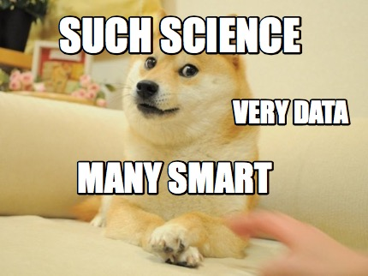
Thank you for your attention!

