Slide 1
Let’s talk about Memory Leak of JavaScript
<<C series>>
part 1
by Bosn Ma
bosn@outlook.com

Slide 2
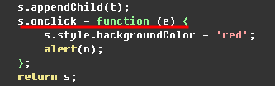
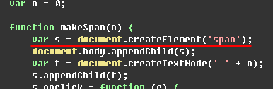
Why Leaking in IE?
DOM manager
Jscript Interpreter
DOM
Object
JScript
Object
GC

Slide 3
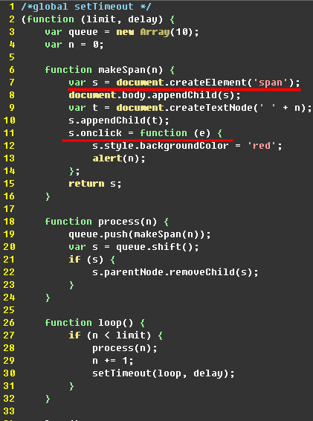
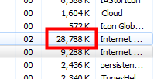
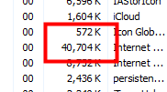
Memory Leak Demo
IE9 quirks mode
Start
Closure!
End

Slide 4
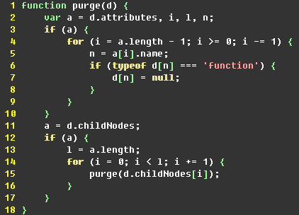
Solution in this Case
Only for IE6 & 7

Slide 5
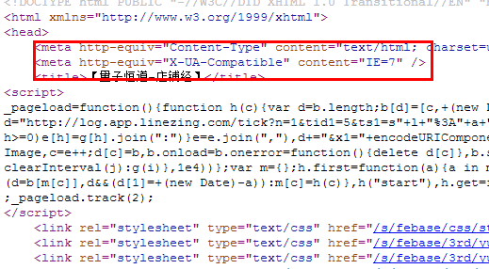
Problems in our Biz

Slide 6
How worse it is?!
Demo

Slide 7
Thank U

