Slide 1

一、百事开头易
by Bosn
Notes:
寒暄页
有句话叫“万事开头难”，可也有些事情上手容易，深入却很难。JavaScript就是这样。

Slide 2

About
2012.03 => NOW 一淘数据平台FE
花名: 霍 雍
真名: 马圣博
微博: @Bosn
爱好: 写歌、健身、游泳
邮件: bosnma@live.com
2011.07 => 2012.02 独到科技Co-Founder
2009.12 => 2011.06 百度ECOM-FE
Notes:
自我介绍

Slide 3
《JS公开课》系列分享 1). 认识JavaScript 2). 数据类型 & 操作符 4). 谈对象 5). 基于原型的继承机制 6). 运行上下文 7). 神奇的闭包 8). 高性能JavaScript
READY?
Notes:
课程介绍

Slide 4
声明
关于默认为ES5标准的限定
关于默认用例环境为V8引擎的限定
关于本PPT的备注
Notes:
简短声明
本节主要是概要，后面的课程我们会深入学习，难免会涉及兼容性、ECMA-262标准的差异。我们在不特殊说明时，默认以ES5（也就是ECMA-262-5）为准，并且默认我们将以最新的Chrome自带的V8引擎来做JavaScript用例的测试。
JavaScript之父是：Brendan Erich。我不是JavaScript之父。本着严谨态度，我会尽量让每一个观点有出处，有考证。时间精力有限，错误之处欢迎批评指正！

Slide 5
OOP
Host
Script
关于JavaScript
Weakly Typed
First-class function
Notes:
定义 – OOP – Host - Scripting
维基百科中的定义：
JavaScript（有时简称JS）是一种基于原型的脚本语言，它是动态的，弱类型的，并拥有第一级函数（first-class function）特性。它是一种多泛型语言，支持面向对象，
KEY WORDs
OOP: ECMA-262-5第一页，4 Overview：ECMAScript是在托管环境下进行计算、操控对象的面向对象编程（OOP）语言。
Host: 在托管中执行，如客户端（如各种浏览器）提供了各种对象如：window, cookies, frames, forms, DOM操作等等。更多的，还有各种事件机制，鼠标点击的响应。而服务器端（如NoteJS）的托管环境可能要提供：请求和响应的处理、文件处理、锁定和共享数据等等。
Scripting Language: 边解释边执行。例如浏览器中的解释器。
弱类型：意味着变量不需要指定类型。
第一级函数特性：函数也可以作为参数传递

Slide 6
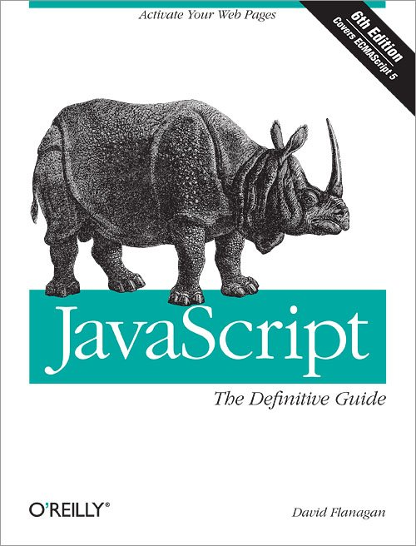

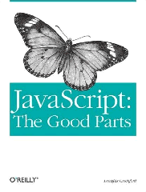
Douglas Crockford的神吐槽
命名误解
变化多端
糟糕实现
误解最多的语言？
设计缺陷
糟糕书籍
其它吐槽
Notes:
Douglas Intro –> name –> variety –> design –> impl –> book –> what we recommend
命名误解：JavaScript不是Java。
变化多端：最初的JavaScript弱爆了，没有异常处理、内部函数、继承等等。而今天的JavaScript已经是一个完整的OOP语言，但很多人对它的见解依然停留在它最不成熟的原始形态。同时ECMA委员会也在不停的开发新的标准、特性，这加重了一个语言最大的问题：有太多的版本。这也常常给人带来误解。（ES3？ES5？区别？）
糟糕实现：IE6，一个词，别的什么都不想说。你懂的。
设计缺陷：没有语言是完美的，JavaScript也不例外。它的缺陷如：1). 操作符“+”不仅意味着加法计算，也有强制转换类型后的拼接；2). 容易引起错误的with语句、保留字策略过于严格、…。幸运的是用JsLint检查工具可以缓解这些问题。惊奇的是ECMAScript委员会没兴趣修正这些问题，或许他们有兴趣创造新的问题。（JavaScript大师级人物：Douglas Crockford的话。个人觉得委员会还好拉，比如with在ES5-strict-mode下已经被弊了。或许是因为委员会的人们看到了这篇文章…）
其它吐槽：ECMA标准手册晦涩难懂…文中也提到的关于OO编程的问题。JavaScript没有类，但它有constructor去做类可以做的事情。没有类继承，但支持基于原型的继承。JavaScript可以实现信息隐蔽，也支持继承。当然还有一些争议，很正常，因为JavaScript是世界上误解最多的语言嘛！详情拜读下面的原文中附带了更具体解释的链接。
参考文献：http://www.crockford.com/javascript/javascript.html
中文版：http://javascript.crockford.com/zh/javascript.html
作者简介：
Douglas Crockford是Web开发领域最知名的技术权威之一，ECMA JavaScript2.0标准化委员会委员。被JavaScript之父Brendan Eich称为JavaScript的大宗师（Yoda）。曾任Yahoo!资深JavaScript架构师，现任PayPal高级JavaScript架构师。
他是JSON、JSLint、JSMin和ADSafe的创造者，也是名著《JavaScript: The Good Parts》（中文版《JavaScript语言精粹》）的作者。撰写了许多广为流传、影响深远的技术文章，包括“JavaScript:世界上最被误解的语言(就是这篇)”。

Slide 7
你没得选

Slide 8
但你可以选择如何运用

Slide 9


JavaScript
人的身体

Slide 10
“如果你有一个身体，你就是一个运动员。”
Bill Bowerman, Nike联合创始人

Slide 11
如果你写Web应用，那么
你就是一个JavaScript开发者

Slide 12
控制

Slide 13
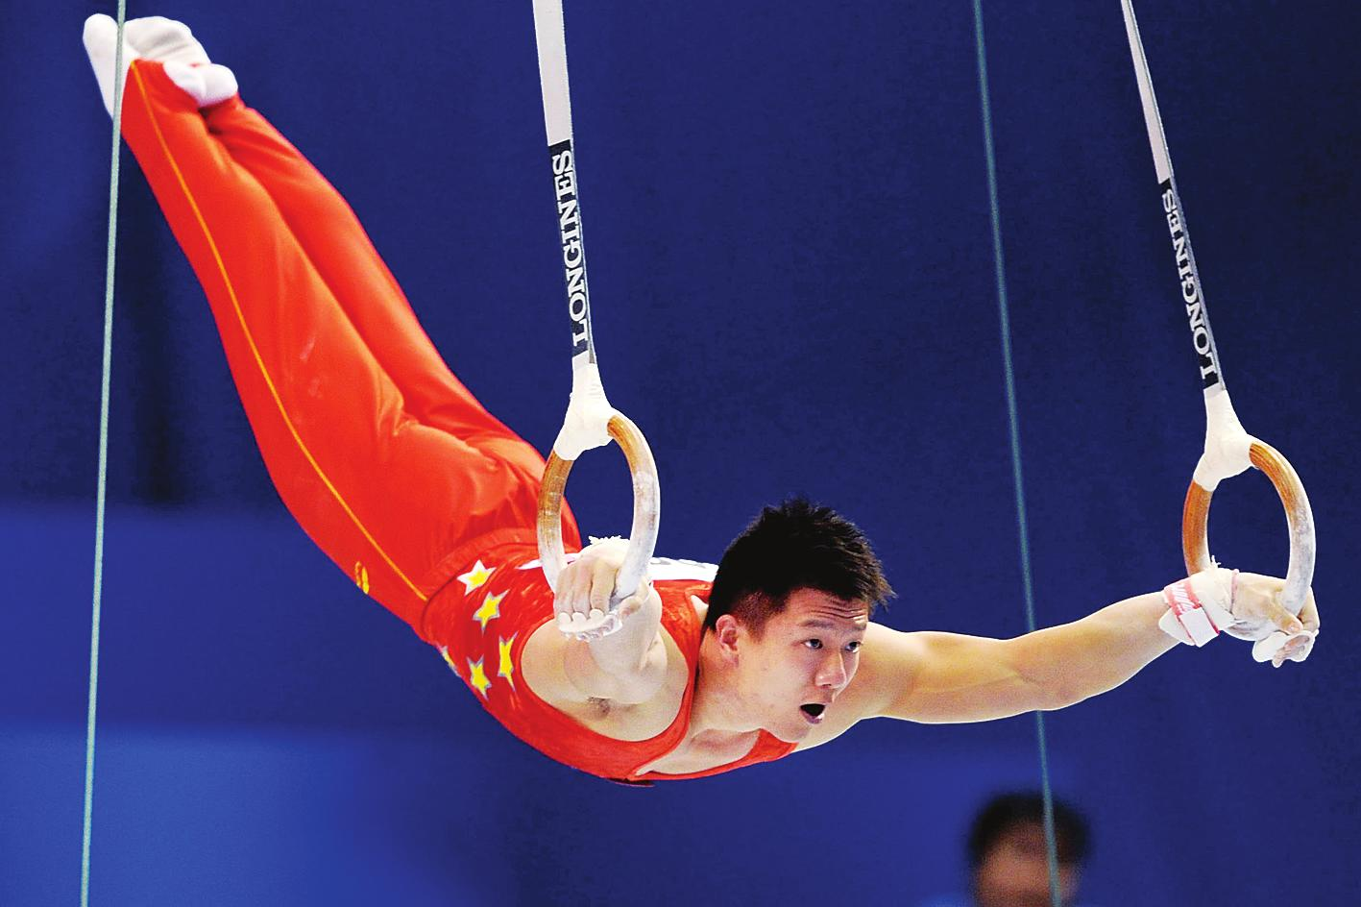

Slide 14
“矮油~~这个不重要了啦~~~”
“矮油~~都XXX世纪了，不需要了啦~”
“矮油~~伦家编程能力太差了啦~~”
“矮油~~酱紫太复杂了啦~~~”
“矮油~~伦家粉忙木时间了啦~”

Slide 15

Kyle Maynard – MMA摔跤手
CNN著名主持人，美国名人

Slide 16

先天性四肢缺损

Slide 17
六个重点

Slide 18
1
类型 & 类型强制转换

Slide 19
object
number
string
boolean
null
undefined
基元类型
Notes:
Weakly typed -> primitive type -> object -> type coercion
ECMA-262-5 Document reference:
4.3.2 NOTE A primitive value is a datum that is represented directly at the lowest level of the language implementation.
4.3.3 NOTE An object is a collection of properties and has a single prototype object. The prototype may be the null value.

Slide 20
5 – “4”
5 + “4”
+!{}[true]
+[1]
+[1, 2]
7 – “a”
7 / 0
…
// 1
// 54
// 1
// 1
// NaN
// NaN
// Infinity
Notes:
Interaction -> solving problems
Chrome21.0.1180.60m自带V8引擎下的结果：1, 54, 1, 1, NaN, NaN, Infinity
ECMA-262-5 Document reference:
4.3.2 NOTE A primitive value is a datum that is represented directly at the lowest level of the language implementation.
4.3.3 NOTE An object is a collection of properties and has a single prototype object. The prototype may be the null value.
11.6.1 The Addition Operator (+)
7. If Type(lprim) is String or Type(rprim) is String, then
a. Return the String that is the result of concatenating ToString(lprim) followed by ToString(rprim)
8. Return the result of applying the addition operation to ToNumber( lprim) and ToNumber(rprim). See the
Note below 11.6.3.
11.6.2 The Subtracktion Operator (-)
5. Let lnum be ToNumber(lval).
6. Let rnum be ToNumber(rval).
关于操作符优先级的参考：
https://developer.mozilla.org/en-US/docs/JavaScript/Reference/Operators/Operator_Precedence

Slide 21
2
操作符
尤其是“+” 和 “==”

Slide 22
5 + “4”
5 + null
4 == “4.00”
4 === “4.00”
null == undefined
0 == false
0 == null
null == false
// 54
// 5
// true
// false
// true
// true
// false
// false
Notes:
Interaction -> solving problems -> type coercion in equality operators
Chrome21.0.1180.60m自带V8引擎下的结果：54, 5, true, false, true, true, false, false
11.9.3 The Abstract Equality Comparison Algorithm
1. If Type(x) is the same as Type(y), then
a. If Type(x) is Undefined, return true.
b. If Type(x) is Null, return true.
c. If Type(x) is Number, then
i. If x is NaN, return false.
© Ecma International 2011 81
ii. If y is NaN, return false.
iii. If x is the same Number value as y, return true.
iv. If x is +0 and y is 0, return true.
v. If x is 0 and y is +0, return true.
vi. Return false.
d. If Type(x) is String, then return true if x and y are exactly the same sequence of characters (same
length and same characters in corresponding positions). Otherwise, return false.
e. If Type(x) is Boolean, return true if x and y are both true or both false. Otherwise, return false.
f. Return true if x and y refer to the same object. Otherwise, return false.
2. If x is null and y is undefined, return true.
3. If x is undefined and y is null, return true.
4. If Type(x) is Number and Type(y) is String,
return the result of the comparison x == ToNumber(y).
5. If Type(x) is String and Type(y) is Number,
return the result of the comparison ToNumber(x) == y.
6. If Type(x) is Boolean, return the result of the comparison ToNumber(x) == y.
7. If Type(y) is Boolean, return the result of the comparison x == ToNumber(y).
8. If Type(x) is either String or Number and Type(y) is Object,
9.3 ToNumber Conversions
Undefined => NaN
Null => +0
Boolean => 1 | 0

Slide 23
typeof 100 === “number”
typeof true === “boolean”
typeof function () {} === “function”
typeof null === “object”
typeof [1， 2] === “object”
typeof new Object() === “object”
Object.prototype.toString.apply([]); === “[Object Array]”;
Object.prototype.toString.apply(null); === “[Object Null]”;
[1， 2] instanceof Array === true
new Object() instanceof Array === false
Notes:
Typeof intro -> distinguish Array
11.4.3 The typeof Operator
Undefined => “undefined”
Null => “object”
Boolean => “boolean”
Number => “number”
String => “string”
Object(native and does not implement [[Call]]) => “object”
Object(native or host and does implement [[Call]] => “function”
Object (host and does not implement [[Call]]) => Implementation-defined except may not be “undefined”, “boolean”, “number”, or “string”.

Slide 24
3
对象 & 基元类型

Slide 25
var a = “string”;
alert(a.length);
a.t = 3;
alert(a.t);
Notes:
Explain primitive datatype wrapper object -> explain the example on the screen
Reference: <<JavaScript: the definitive guide, 5th edition>>
Section 3.13. Primitive Datatype Wrapper Objects
When we discussed strings earlier in this chapter, I pointed out a strange feature of that datatype: to operate on strings, you use object notation.[*] For example, a typical operation involving strings might look like the following: [*] This section covers advanced material, which you may want to skip on your first reading. var s = "These are the times that try people's souls."; var last_word = s.substring(s.lastIndexOf(" ")+1, s.length); If you didn't know better, it would appear that s was an object and that you were invoking methods and reading property values of that object. What's going on? Are strings objects, or are they primitive datatypes? The typeof operator (see Chapter 5) assures us that strings have the datatype "string", which is distinct from the datatype "object". Why, then, are strings manipulated using object notation? The truth is that a corresponding object class is defined for each of the three key primitive datatypes. That is, besides supporting the number, string, and boolean datatypes, JavaScript also supports Number, String, and Boolean classes. These classes are wrappers around the primitive datatypes. A wrapper contains the same primitive data value, but it also defines properties and methods that can be used to manipulate that data. JavaScript can flexibly convert values from one type to another. When you use a string in an object contexti.e., when you try to access a property or method of the stringJavaScript internally creates a String wrapper object for the string value. This String object is used in place of the primitive string value. The object has
properties and methods defined, so the use of the primitive value in an object context succeeds. The same is true, of course, for the other primitive types and their corresponding wrapper objects; you just don't use the other types in an object context nearly as often as you use strings in that context. Note that the String object created when you use a string in an object context is a
transient one; it allows you to access a property or method, and then it is no longer needed, so it is reclaimed by the system. Suppose s is a string and the length of the string is determined with a line like this: var len = s.length; In this case, s remains a string; the original string value itself is not changed. A new transient String object is created, which allows you to access the length property, and then the transient object is discarded, with no change to the original value s. If you think this scheme sounds elegant and bizarrely complex at the same time, you are right. Typically, however, JavaScript implementations perform this internal conversion very efficiently, and it is not something you should worry about. If you want to use a String object explicitly in your program, you have to create a
nontransient one that is not automatically discarded by the system. String objects are created just like other objects, with the new operator. For example: var s = "hello world"; // A primitive string value
var S = new String("Hello World"); // A String object Once you've created a String object S, what can you do with it? Nothing that can't be done with the corresponding primitive string value. If you use the typeof operator, it says that S is indeed an object and not a string value, but except for that case, you'll find that you can't normally distinguish between a primitive string and the String object.[*] As I've already shown, strings are automatically converted to String objects whenever necessary. It turns out that the reverse is also true. Whenever you use a String object where a primitive string value is expected, JavaScript automatically converts the String to a string. So if you use a String object with the + operator, a transient primitive string value is created so that the string concatenation operation can be performed: [*] Note, however, that the eval( ) method treats string values and String objects differently, and it will not behave as you expect it to if you inadvertently pass it a String object instead of a primitive string value. msg = S + '!'; Bear in mind that everything discussed in this section about string values and String objects applies also to number and boolean values, and their corresponding Number and Boolean objects. You can learn more about the Number and Boolean classes from their respective entries in Part III. Finally, note that any number, string, or boolean value can be converted to its corresponding wrapper object with the Object( ) function: var number_wrapper = Object(3);

Slide 26
4
函数 & 构造器

Slide 27
function f() {};
var a = f,
b = f(),
c = new f,
d = f(f);

Slide 28
5
闭包

Slide 29
function add(a) {
return function (b) {
return a + b;
};
}
add(3)(4) == 7

Slide 30
var uniqueID = (function() {
var id = 0;
return function () {
return id++;
};
})();

Slide 31
6
原型

Slide 32
5分钟 了解JavaScript原型

Slide 33
function f () {};
P2
f
P
z : 0
x : 3
f.prototype.x = 3;
var a = new f;
a.x = 2;
c
a
b
a.y = 1;
x : 2
y : 1
var b = new f;
f.prototype = {z : 0};
b.constructor == f
c.constructor == Object
var c = new f;

Slide 35
“如果你花费太多的时间想一件事情，
那么你永远也做不成。”
李小龙

Slide 36
Thank U

