Slide 1

二、玩转数据类型
by Bosn

Slide 2

本节目录 1). 回顾上节 2). 基础知识 3). 包装对象 4). 类型检测 5). 动手实践 6). 讨论时间
关于课程 & 讲师
var aboutMe =
{
‘nickname’ : ‘霍 雍’,
‘name’ : ‘马圣博’,
‘title’ : ‘FE’,
‘dept’ : ‘一淘数据部’,
‘weibo’ : ‘@Bosn’,
‘hobby’ : [‘写歌’, ‘健身’, ‘游泳’],
‘mail’ : ‘bosn@outlook.com’,
};

Slide 3
《JS公开课》系列分享 1). 认识JavaScript DONE 2). 数据类型 & 操作符 3). 谈对象 4). 基于原型的继承机制 5). 运行上下文 6). 神奇的闭包 7). 高性能JavaScript
READY?

Slide 4
声明
关于默认为ES5标准的限定
关于默认用例环境为V8引擎的限定
关于本PPT的备注
Notes:
简短声明
我们在不特殊说明时，默认以ES5（也就是ECMA-262-5）为准，并且默认我们将以最新的Chrome自带的V8引擎来做JavaScript用例的测试。
本着严谨态度，但时间精力有限，错误之处还请海涵并批评指正！

Slide 5
1
Looking Back

Slide 6
5 – “4”
5 + “4”
+!{}[true]
+[1]
+[1, 2]
7 – “a”
7 / 0
…
Notes:
Interaction -> solving problems
Chrome21.0.1180.60m自带V8引擎下的结果：1, 54, 1, 1, NaN, NaN, Infinity
ECMA-262-5 Document reference:
4.3.2 NOTE A primitive value is a datum that is represented directly at the lowest level of the language implementation.
4.3.3 NOTE An object is a collection of properties and has a single prototype object. The prototype may be the null value.
11.6.1 The Addition Operator (+)
7. If Type(lprim) is String or Type(rprim) is String, then
a. Return the String that is the result of concatenating ToString(lprim) followed by ToString(rprim)
8. Return the result of applying the addition operation to ToNumber( lprim) and ToNumber(rprim). See the
Note below 11.6.3.
11.6.2 The Subtracktion Operator (-)
5. Let lnum be ToNumber(lval).
6. Let rnum be ToNumber(rval).
关于操作符优先级的参考：
https://developer.mozilla.org/en-US/docs/JavaScript/Reference/Operators/Operator_Precedence

Slide 7
5 + “4”
5 + null
4 == “4.00”
4 === “4.00”
null == undefined
0 == false
0 == null
null == false
Notes:
Interaction -> solving problems -> type coercion in equality operators
Chrome21.0.1180.60m自带V8引擎下的结果：54, 5, true, false, true, true, false, false
11.9.3 The Abstract Equality Comparison Algorithm
1. If Type(x) is the same as Type(y), then
a. If Type(x) is Undefined, return true.
b. If Type(x) is Null, return true.
c. If Type(x) is Number, then
i. If x is NaN, return false.
© Ecma International 2011 81
ii. If y is NaN, return false.
iii. If x is the same Number value as y, return true.
iv. If x is +0 and y is 0, return true.
v. If x is 0 and y is +0, return true.
vi. Return false.
d. If Type(x) is String, then return true if x and y are exactly the same sequence of characters (same
length and same characters in corresponding positions). Otherwise, return false.
e. If Type(x) is Boolean, return true if x and y are both true or both false. Otherwise, return false.
f. Return true if x and y refer to the same object. Otherwise, return false.
2. If x is null and y is undefined, return true.
3. If x is undefined and y is null, return true.
4. If Type(x) is Number and Type(y) is String,
return the result of the comparison x == ToNumber(y).
5. If Type(x) is String and Type(y) is Number,
return the result of the comparison ToNumber(x) == y.
6. If Type(x) is Boolean, return the result of the comparison ToNumber(x) == y.
7. If Type(y) is Boolean, return the result of the comparison x == ToNumber(y).
8. If Type(x) is either String or Number and Type(y) is Object,
9.3 ToNumber Conversions
Undefined => NaN
Null => +0
Boolean => 1 | 0

Slide 8
2
Basic

Slide 9
动态弱类型
var num = 32;
num = “this is a string”;
Notes:
http://zh.wikipedia.org/wiki/JavaScript
JavaScript是一种广泛用于客户端网页开发的脚本语言，最常是于HTML上使用，用来给HTML网页添加动态功能。然而JavaScript也被用于不同的接口上，如服务器。它最初由网景公司的Brendan Eich设计，是一种动态、弱类型、基于原型的语言，内置支持类型。JavaScript是甲骨文公司的注册商标。^{[4]} Ecma国际以JavaScript为基础制定了ECMAScript标准。JavaScript也可以用于其他场合，如服务器端编程。完整的JavaScript实现包含三个部分：ECMAScript，文档对象模型，浏览器对象模型。

Slide 10
基元类型
Primitive Type
不变的
Immutable
类型数组
Typed Array
不变的字符串
Immutable String
64位双精度二进制格式IEEE754值
double-precision 64-bit binary format IEEE 754 value
WeakMaps, Maps, Sets
Khrono Working Draft
object
number
string
boolean
null
undefined
基元类型
Notes:
更多WeakMap的介绍：https://developer.mozilla.org/en-US/docs/JavaScript/Reference/Global_Objects/WeakMap
关于WeakMap引入到ECMAScript提案：http://wiki.ecmascript.org/doku.php?id=harmony:weak_maps#weakmap
更多Typed Array的介绍：http://www.khronos.org/registry/typedarray/specs/latest/

Slide 11
加减
+ -
var x = ‘The answer is ‘ + 42;
var y = 42 + ‘ is the answer’;
num - 0
num + ‘’
“37” – 7
“37” + 7
// 30
// 377
巧用加减转换类型
Notes:
最常用且容易疑惑的是加法运算，除了算数意义，还表示着字符串拼接。

Slide 12
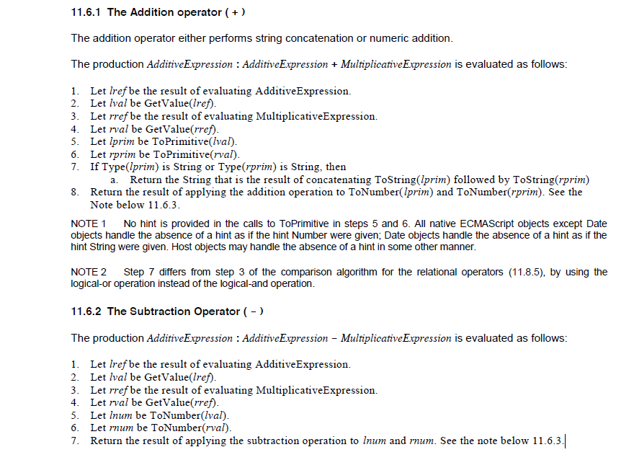
Notes:
二元加法操作符“+”：任意一个操作数是字符串，理解为字符串拼接。
二元减法操作符“-”：操作数尝试转换成数字并做减法运算。

Slide 13
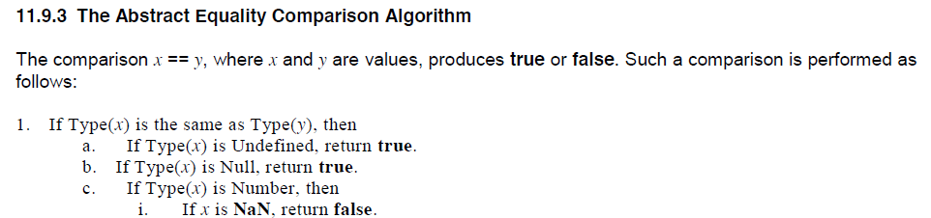
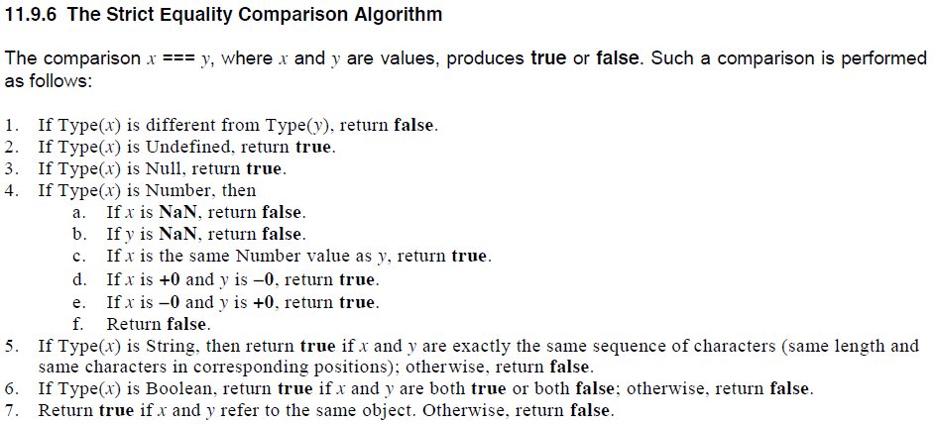
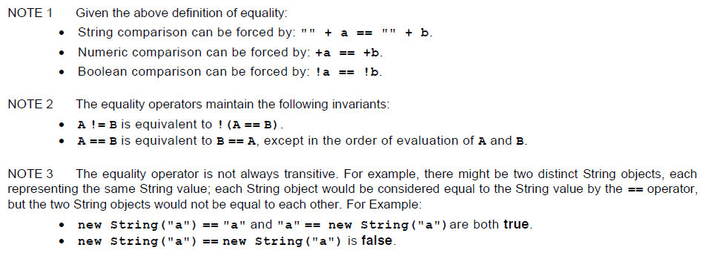
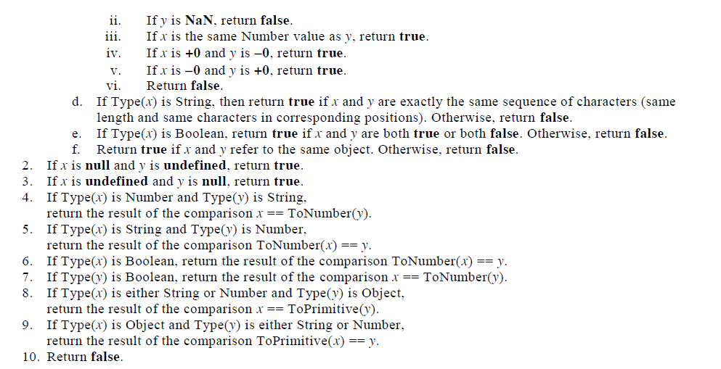
== 和 ===
类型转换
== ===
类型判断
4 == “4.00” //true
4 === “4.00” // false
Notes:
11.9.3 The Abstract Equality Comparison Algorithm
The comparison x == y, where x and y are values, produces true or false. Such a comparison is performed as
follows:
1. If Type(x) is the same as Type(y), then
a. If Type(x) is Undefined, return true.
b. If Type(x) is Null, return true.
c. If Type(x) is Number, then
i. If x is NaN, return false.
© Ecma International 2011 81
ii. If y is NaN, return false.
iii. If x is the same Number value as y, return true.
iv. If x is +0 and y is 0, return true.
v. If x is 0 and y is +0, return true.
vi. Return false.
d. If Type(x) is String, then return true if x and y are exactly the same sequence of characters (same
length and same characters in corresponding positions). Otherwise, return false.
e. If Type(x) is Boolean, return true if x and y are both true or both false. Otherwise, return false.
f. Return true if x and y refer to the same object. Otherwise, return false.
2. If x is null and y is undefined, return true.
3. If x is undefined and y is null, return true.
4. If Type(x) is Number and Type(y) is String,
return the result of the comparison x == ToNumber(y).
5. If Type(x) is String and Type(y) is Number,
return the result of the comparison ToNumber(x) == y.
6. If Type(x) is Boolean, return the result of the comparison ToNumber(x) == y.
7. If Type(y) is Boolean, return the result of the comparison x == ToNumber(y).
8. If Type(x) is either String or Number and Type(y) is Object,
return the result of the comparison x == ToPrimitive(y).
9. If Type(x) is Object and Type(y) is either String or Number,
return the result of the comparison ToPrimitive(x) == y.
10. Return false.

Slide 14
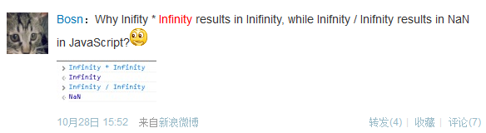

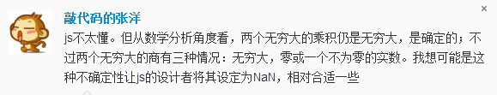

乘除
* /
var x = ‘32‘ * 42;
var y = 42 / ‘ 32’;
true * 100
false / 1
To
Num
Infinity
Infinity * Infinity结果为Infinity
1 / 0结果为Infinity
-1 / 0 结果为-Infinity
Infinity / Infinity结果为NaN
NaN
任一操作数是NaN结果为NaN
Infinity * 0结果为NaN
Notes:
最常用且容易疑惑的是加法运算，除了算数意义，还表示着字符串拼接。

Slide 15
3
Wrapper Object

Slide 16
String
Object
a
“str”
length
String
Object
‘str’
var a = “string”;
alert(a.length);
a.t = 3;
alert(a.t);
Number
Object
123
Boolean
Object
true
Notes:
Explain primitive datatype wrapper object -> explain the example on the screen
Reference: <<JavaScript: the definitive guide, 5th edition>>
Section 3.13. Primitive Datatype Wrapper Objects
When we discussed strings earlier in this chapter, I pointed out a strange feature of that datatype: to operate on strings, you use object notation.[*] For example, a typical operation involving strings might look like the following: [*] This section covers advanced material, which you may want to skip on your first reading. var s = "These are the times that try people's souls."; var last_word = s.substring(s.lastIndexOf(" ")+1, s.length); If you didn't know better, it would appear that s was an object and that you were invoking methods and reading property values of that object. What's going on? Are strings objects, or are they primitive datatypes? The typeof operator (see Chapter 5) assures us that strings have the datatype "string", which is distinct from the datatype "object". Why, then, are strings manipulated using object notation? The truth is that a corresponding object class is defined for each of the three key primitive datatypes. That is, besides supporting the number, string, and boolean datatypes, JavaScript also supports Number, String, and Boolean classes. These classes are wrappers around the primitive datatypes. A wrapper contains the same primitive data value, but it also defines properties and methods that can be used to manipulate that data. JavaScript can flexibly convert values from one type to another. When you use a string in an object contexti.e., when you try to access a property or method of the stringJavaScript internally creates a String wrapper object for the string value. This String object is used in place of the primitive string value. The object has
properties and methods defined, so the use of the primitive value in an object context succeeds. The same is true, of course, for the other primitive types and their corresponding wrapper objects; you just don't use the other types in an object context nearly as often as you use strings in that context. Note that the String object created when you use a string in an object context is a
transient one; it allows you to access a property or method, and then it is no longer needed, so it is reclaimed by the system. Suppose s is a string and the length of the string is determined with a line like this: var len = s.length; In this case, s remains a string; the original string value itself is not changed. A new transient String object is created, which allows you to access the length property, and then the transient object is discarded, with no change to the original value s. If you think this scheme sounds elegant and bizarrely complex at the same time, you are right. Typically, however, JavaScript implementations perform this internal conversion very efficiently, and it is not something you should worry about. If you want to use a String object explicitly in your program, you have to create a
nontransient one that is not automatically discarded by the system. String objects are created just like other objects, with the new operator. For example: var s = "hello world"; // A primitive string value
var S = new String("Hello World"); // A String object Once you've created a String object S, what can you do with it? Nothing that can't be done with the corresponding primitive string value. If you use the typeof operator, it says that S is indeed an object and not a string value, but except for that case, you'll find that you can't normally distinguish between a primitive string and the String object.[*] As I've already shown, strings are automatically converted to String objects whenever necessary. It turns out that the reverse is also true. Whenever you use a String object where a primitive string value is expected, JavaScript automatically converts the String to a string. So if you use a String object with the + operator, a transient primitive string value is created so that the string concatenation operation can be performed: [*] Note, however, that the eval( ) method treats string values and String objects differently, and it will not behave as you expect it to if you inadvertently pass it a String object instead of a primitive string value. msg = S + '!'; Bear in mind that everything discussed in this section about string values and String objects applies also to number and boolean values, and their corresponding Number and Boolean objects. You can learn more about the Number and Boolean classes from their respective entries in Part III. Finally, note that any number, string, or boolean value can be converted to its corresponding wrapper object with the Object( ) function: var number_wrapper = Object(3);

Slide 17
4
Type Detection

Slide 18
几种类型检测
typeof
instanceof
CASE
Object.prototype
.toString
duck typing
Go
Notes:
关于鸭子类型（Duck Type）：http://zh.wikipedia.org/wiki/%E9%B8%AD%E5%AD%90%E7%B1%BB%E5%9E%8B

Slide 19
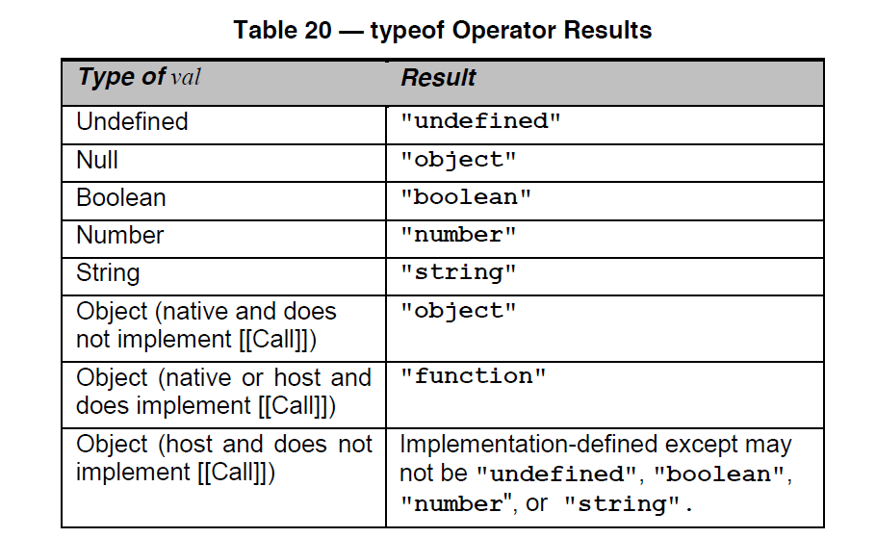
typeof 100 === “number”
typeof true === “boolean”
typeof function () {} === “function”
typeof(null) === “object”
typeof( [1， 2] ) === “object”
typeof(new Object() ) === “object”
typeof(NaN ) === “number”

Slide 20

Why typeof null === “object”
检测null
obj === null
检测NaN
NaN === NaN; // false
isNaN(NaN); // true
isNaN(42); // false
Notes:
http://wiki.ecmascript.org/doku.php?id=harmony:typeof_null

Slide 21
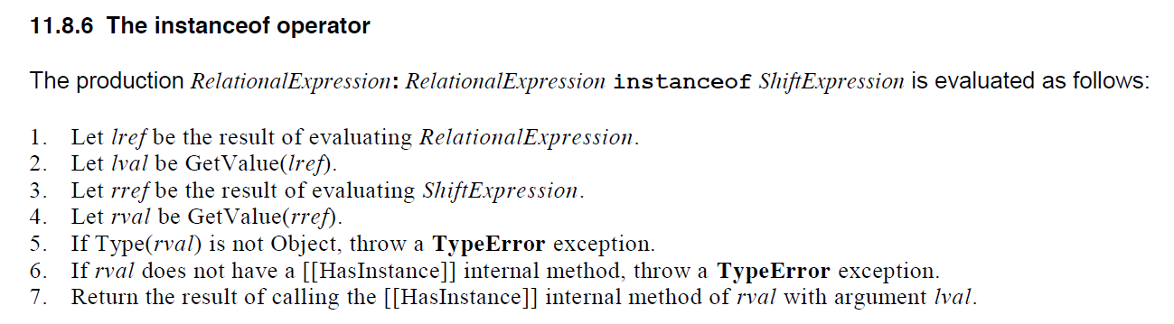
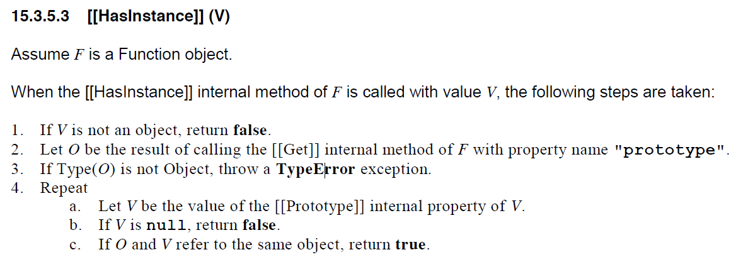

Slide 22
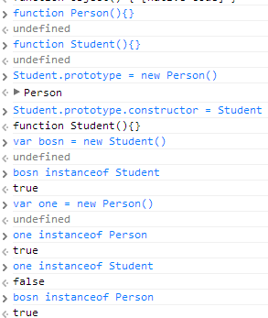
Return
Instanceof的使用
[1, 2] instanceof Array === true
new Object() instanceof Array === false
_proto_
_proto_
Caution！不同window或iframe间的对象类型检测不能使用instanceof！
Person
prototype
Student
prototype
Bosn
Notes:
MDN上关于跨越iframe的instanceof的解释：
instanceof and multiple context (e.g. frames or windows)
Different scope have different execution environments. This means that they have different built-ins (different global object, different constructors, etc.). This may result in unexpected results. For instance, [] instanceof window.frames[0].Array will return false, because Array.prototype !== window.frames[0].Array and arrays inherit from the former. This may not make sense at first but when you start dealing with multiple frames or windows in your script and pass objects from one context to another via functions, this will be a valid and strong issue. For instance, you can securely check if a given object is in fact an Array using Array.isArray(myObj)

Slide 23
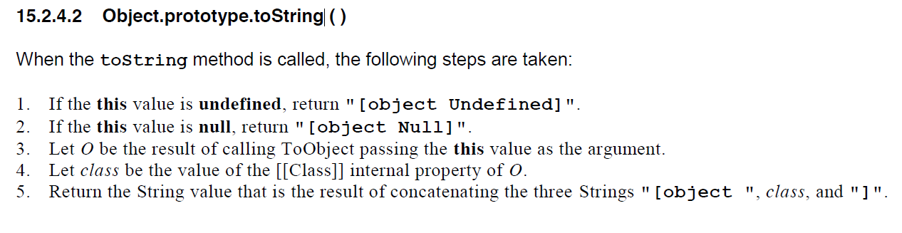
Object.prototype.toString.apply([]); === “[Object Array]”;
Object.prototype.toString.apply(function(){}); === “[Object Function]”;
Object.prototype.toString.apply(null); === “[Object Null]”;
IE6/7/8 Object.prototype.toString.apply(null) 返回’[object Object]’

Slide 24

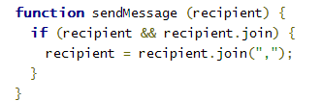
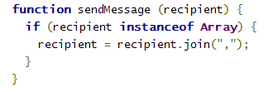
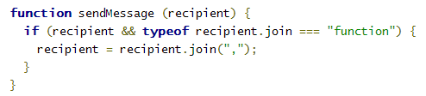

类型检测实践
Notes:
文中关于类型检测的原文：http://united-coders.com/matthias-reuter/all-about-types-part-4/

Slide 25
类型检测小结
typeof
适合基元类型及function检测，遇到null完蛋。
[[Class]]
通过{}.toString拿到，适合内置对象和基元类型，遇到null和undefined完蛋(IE678等返回[object Object])。
instanceof
适合自定义对象，也可以用来检测原生对象，在不同iframe和window间检测时完蛋。

Slide 26
5
Practice Make Perfect

Slide 27
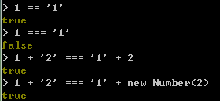
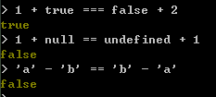
1 == ‘1’
Practise 1
1 === ‘1’
1 + ‘2’ === ‘1’ + 2
▷ 1 + ‘2’ === ‘1’ + new Number(2)
1 + true === false + 2
▷ 1 + null == undefined + 1
‘a’ - ‘b’ == ‘b’ - ‘a’

Slide 28
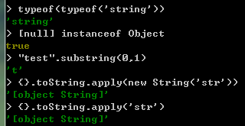
Practise 2
typeof(typeof(‘string’))
[null] instanceof Object
▷“test”.substring(0 ,1)
▷{}.toString.apply(new String(‘str’));
▷{}.toString.apply(‘str’);

Slide 29
？
prototype
functionA
About Next

Slide 30
6
Let’s Chat！

Slide 31
Thank U

