Slide 1
Let’s talk about DOM Event
<<JavaScript in Deep>>
part 1
by Bosn Ma
bosnma@live.com

Slide 2
About <<JavaScript in Deep>>
before we start
Closures
DOM level 3
Hard
New
Key
Execution Context
HTML5
For learning JavaScript in system
JavaScript: The Definitive Guide (EN&CN)
http://javascript.info (English only)
深入理解JavaScript系列 (EN&CN)
wikipedia
DOM Events
Func DEF&EXP
CSS Hack
JS Opt

Slide 3
DIR a). summary b). event classification c). DOM levels d). event flow e). some interfaces f). demo g). Q&A | reference
READY?

Slide 4
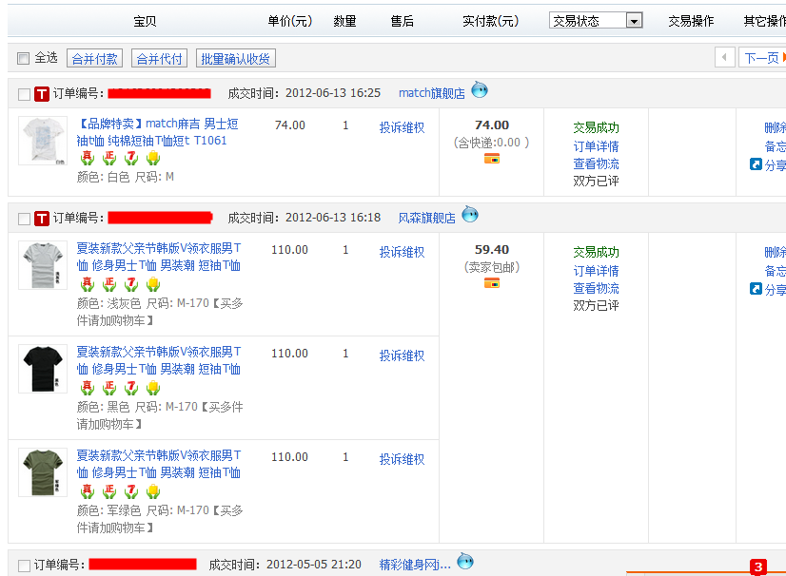
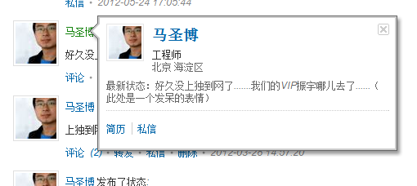
a) Summary
eg -> Bubble on Hover
Notes:
start from an classical “event delegate” example

Slide 5

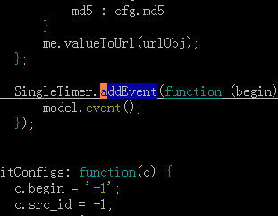
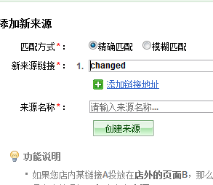
b) event Classification
UI events
UI Logical events
Mutation events
click
mousedown
keydown
... ...
load
DOMNodeInserted
DOMNodeRemoved
DOMAttrModified
... ...
unload
submit
... ...

Slide 6
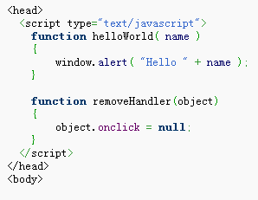
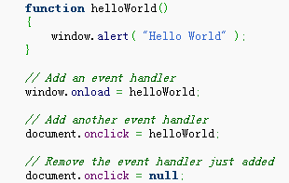

c) DOM levels
DOM Level 0
Inline
Traditional

Slide 7
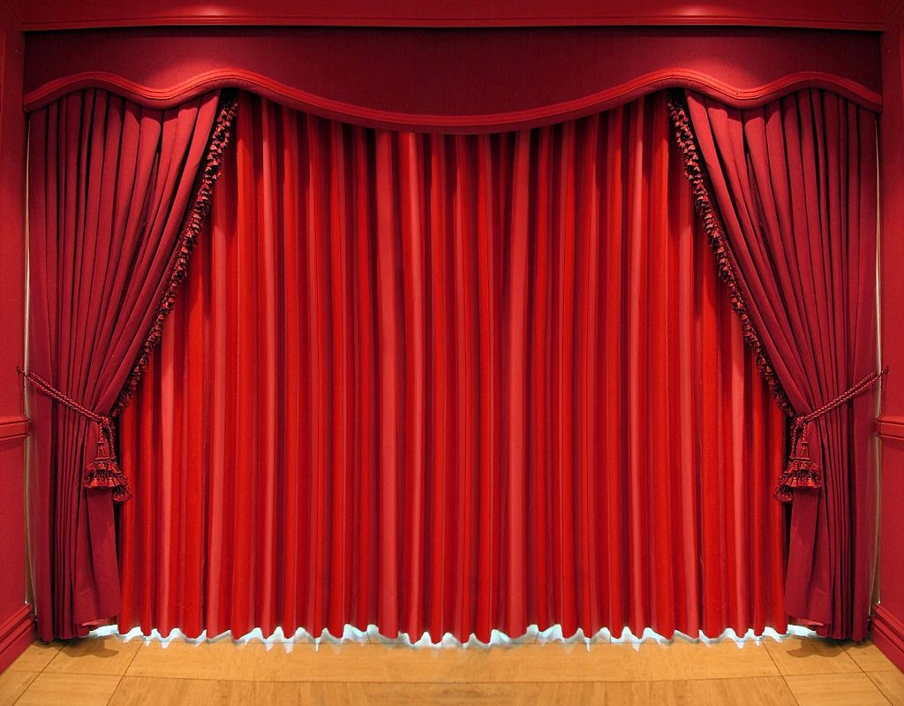
c) DOM levels
DOM Level 2

Slide 8
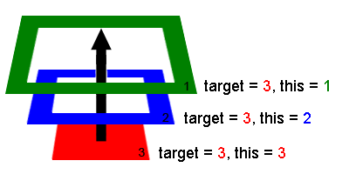
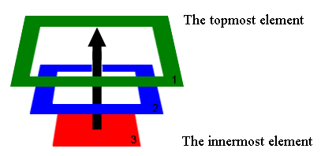
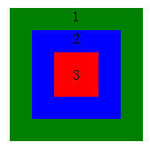
d) Event flow
BUBBLING

Slide 9
d) Event flow
CAPTURING

Slide 10
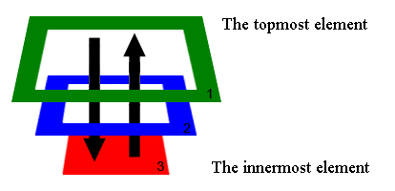
d) Event flow
Capture
Target
Bubble
*IE < 9 only bubbles
Any exceptions thrown inside an EventListener will not stop propagation of the event. It will continue processing any additional EventListener in the described manner.

Slide 11
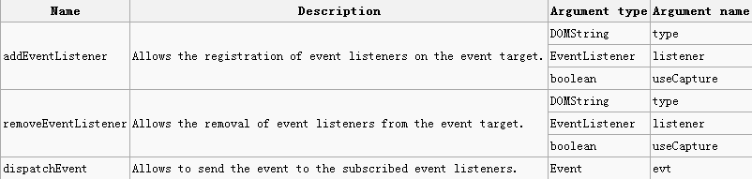
c) DOM levels
DOM Level 2
To prevent from bubbling, developers must call the "stopPropagation()" method of the event object.
To prevent the default, developers must call the "preventDefault" method of the event object.
Feature Testing: document.implementation.hasFeature('Events', '2.0')

Slide 12
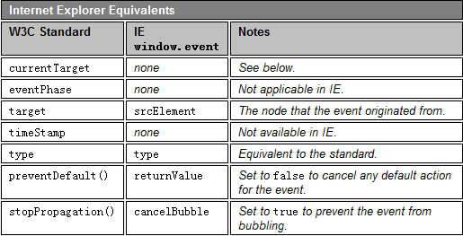
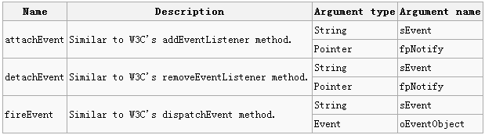
c) DOM levels
Microsoft Specific Model
1). To prevent an event bubbling, developers must set the event's "cancelBubble" property.
2). To prevent the default action of the event to be called, developers must set the event's "returnValue" property.
3). The this keyword refers to the global window object.
Microsoft does not follow the W3C model up until IE8, as its own model was created prior to the ratification of the W3C standard. IE9 is supposed to follow DOM level 3 events.

Slide 13
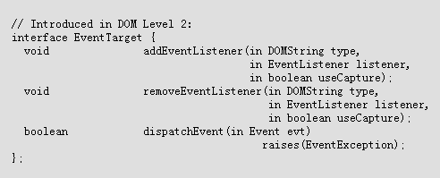
e) Event Interface
Interface EventTarget

Slide 14

e) Event Interface
Interface EventListener

Slide 15
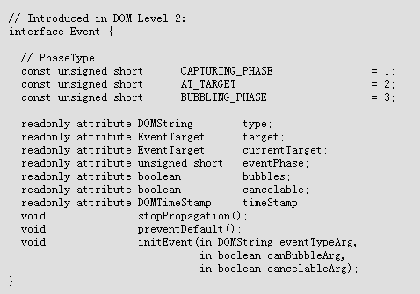
e) Event Interface
Interface Event

Slide 16
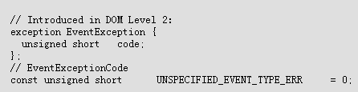
e) Event Interface
Exception EventException

Slide 17

e) Event Interface
Interface DocumentEvent

Slide 18
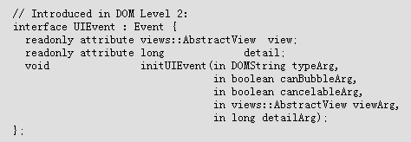
e) Event Interface
Interface UIEvent

Slide 19
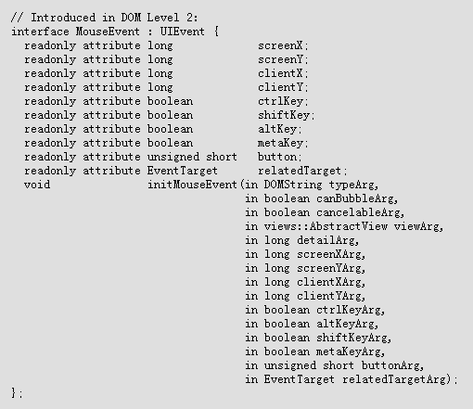
e) Event Interface
Interface MouseEvent

Slide 20
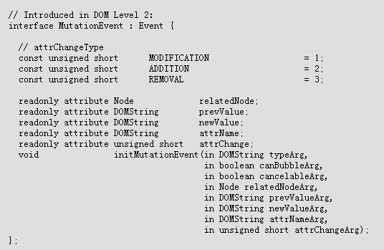
e) Event Interface
Interface MutationEvent

Slide 21
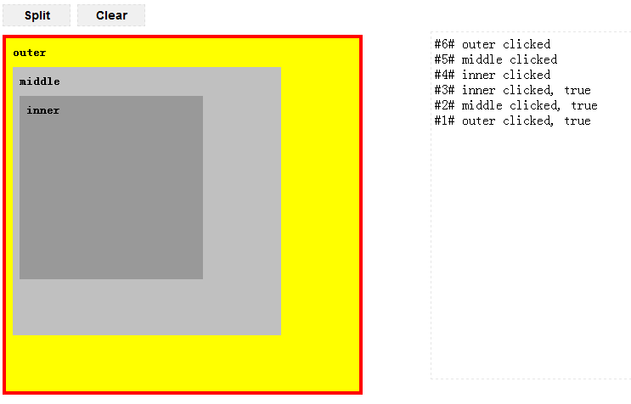
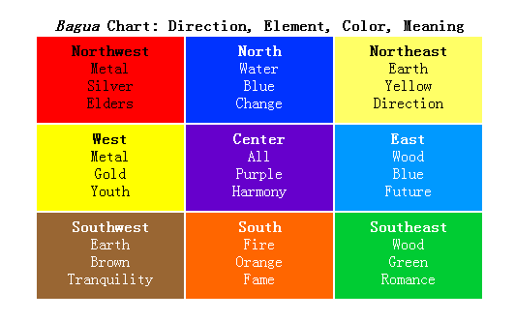
f) demo

Slide 22
DOM level 3

Slide 23
g) Q&A
REFERENCE
http://www.w3.org/TR/DOM-Level-2-Events/events.html
http://javascript.info/tutorial/bubbling-and-capturing
DETAIL DOC
http://www.w3.org/TR/DOM-Level-2-Events/
http://www.w3.org/TR/DOM-Level-3-Events/
NEW FEATURES
http://www.w3.org/TR/DOM-Level-3-Events/#changes-Changes

Slide 24
PREVIEW
Diff between Function Def and Expression
NEXT TIME
<<JavaScript in Deep>>, part 2

Slide 25
Thank U

