Slide 1
So, you think you know JavaScript?
<<JavaScript in Deep>>
part 3
by Bosn Ma
bosnma@live.com

Slide 2
DIR 1). DOM levels 2). Project: Rigel Automation Platform 3). Execution Context 4). Named Function Expressions 5). etc
READY?

Slide 3


About
2012.03 => NOW 一淘数据平台FE
花名: 霍 雍
真名: 马圣博
微博: @Bosn
爱好: 写歌、健身、游泳
邮件: bosnma@live.com
2011.07 => 2012.02 独到科技Co-Founder
2009.12 => 2011.06 百度ECOM-FE

Slide 4

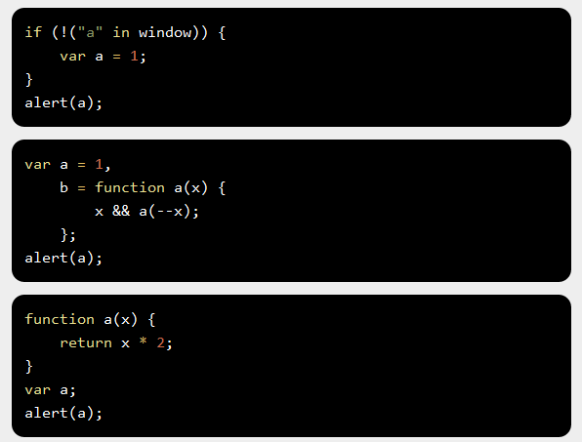
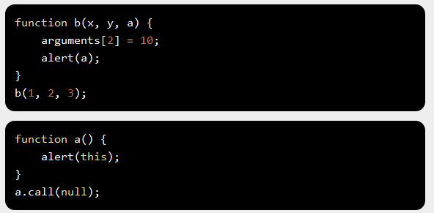

Fun Problems

Slide 5
Execution Context
Activation Object
Variable
Object
Global Context
Window Object

Slide 6
Func Vs. Global
Global Context
var a = 10;
(function() {
var b = 20;
})();
alert(a); // 10
alert(b); // error, b in not defined
Function Context
for (var item in {a : 1, b : 2}) {
alert(item);
}
alert(item); // item still in scope

Slide 7
Variable Object
how and where the interpreter finds our data(functions, variable)?
A variable object (in abbreviated form — VO) is a special object related with an execution context and which stores:
1. variables
2. function declarations
3. function formal parameters
#DEF

Slide 8
VO in EC
activeExecutionContext = {
VO : { // VO => Variable Object
data_var, // var i = 0;
data_func_declaration, // function foo() {}
data_func_arguments // func(30, 20)
}
};
GlobalContextVO (VO === this === global === window)
FunctionContextVO (VO === AO)
VO(globalContext) = {
a : 10,
test : <ref to function>
};
VO(test functionContext) = {
x : 30,
b: 20
};
var a = 10;
function test(x) {
var b = 20;
}
test(30);

Slide 9
VO in Global
VO(globalContext) === global;
global = {
Math : <...>,
String : <...>,
isNaN : function() {[Native Code]}
...
...
window : global
};
String(10); // means global.String(10);
// with prefixes
window.a = 10; // === global.window.a = 10 === global.a = 10;
this.b = 20; // global.b = 20;

Slide 10
VO in Function
VO(functionContext) === AO;
AO = {
arguments : <Arg0>
};
arguments = {
callee, // ref to the current function
length, // quantity of real passed arguments
properties-indexes // arguments[0] => param1,
//arguments[1] => param2, ... ...
}; => [].join.apply(arguments, ‘,’);

Slide 11
VO in Function
function foo(x, y, z) {
alert(foo.length); // 3
alert(arguments.length); // 2
alert(arguments.callee === foo); // true
alert(x === arguments[0]); // true
alert(x); // 10
arguments[0] = 20;
alert(x); // 20
x = 30;
alert(arguments[0]); // 30
z = 40;
alert(arguments[2]); // undefined
arguments[2] = 50;
alert(z); // 40
}
foo(10, 20);

Slide 12
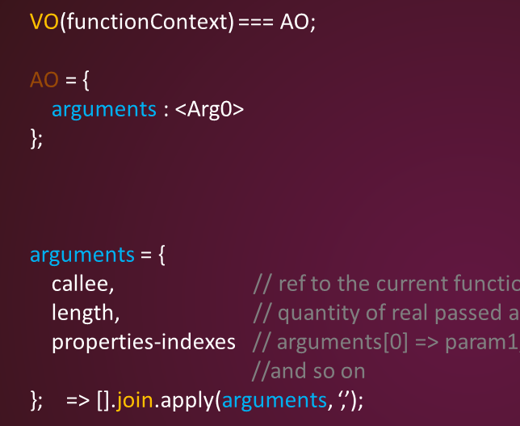
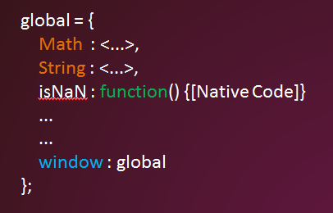
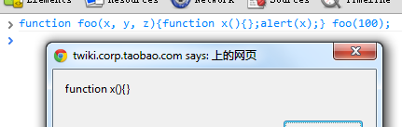
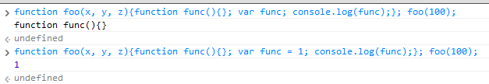
Execution Phase1
Phases of processing the context code
Entering the execution context
VO filled with the following properties:
formal parameter (if not passed in => “[name] : undefined” created)
FD (function, declaration, if conflicts => replace it)
var (“[name]:undefined” created, if conflicts => ignored!)
function test(a, b) {
var c = 10;
function d() {}
var e = function _e() {};
(function x() {});
b = 20;
}
test(10); l
AO(test) = {
a: 10,
b: undefined,
c: undefined,
d: <reference to FunctionDeclaration "d">
e: undefined
};
Function Expression doesn’t affect on VO

Slide 13
Execution Phase2
2. Code Execution
VO[‘c’] = 10;
VO[‘e’] = function _e() {};
VO[‘b’] = 20;
AO(test) = {
a: 10,
b: undefined,
c: undefined,
d: <reference to FunctionDeclaration "d">
e: undefined
};
function test(a, b) {
var c = 10;
function d() {}
var e = function _e() {};
(function x() {});
b = 20;
}
test(10); l
AO(test) = {
a: 10,
b: 20,
c: 10,
d: <reference to FunctionDeclaration "d">
e: function _e() {};
};

Slide 14
Have a test
alert(x);
var x = 10;
alert(x);
x = 20;
function x() {}
alert(x);
if (true) {
var a = 1;
} else {
var b = true;
}
alert(a);
alert(b);
// function
// 10
// 20
// 1
// undefined

Slide 15
Have a test
a = 10;
alert(window.a);
alert(delete a);
alert(window.a);
var b = 20;
alert(window.b);
alert(delete b);
alert(window.b);
eval('var a = 10;');
alert(window.a);
alert(delete a);
alert(window.a);
// 10
// true
// undefined
// 20
// false
// still 20
// 10
// true
// undefined
Firebug & Chrome console pitfall
Variables {DontDelete} attribute

Slide 16
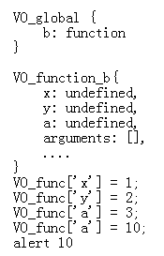

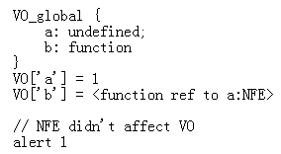
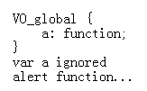
Let’s solve

Slide 17
g) Q&A
REFERENCE
http://dmitry.baranovskiy.com/post/91403200

Slide 18
Thank U

Slide 19
PREVIEW & QA
Let’s talk about NFE
NEXT TIME
<<JavaScript in Deep>>, part 4

