Slide 1
Let’s talk about Memory Leak of JavaScript
<<C series>>
part 1
by Bosn Ma
bosn@outlook.com

Slide 2
JavaScript and Host
HOST
Java
Script
NodeJS
WebKit
File
Request
Response
… …
DOM
window
cookie
… …

Slide 3
var obj1 = new Object();
var obj2 = new Object();
obj1.ref = obj2;
obj2.ref = obj1;
obj1 = null;
obj2 = null;
Circle Reference
Object1
Object2

Slide 4
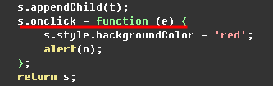
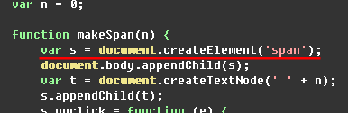
Why Leaking in IE?
DOM manager
JavaScript Interpreter
DOM
Object
JScript
Object
GC

Slide 5
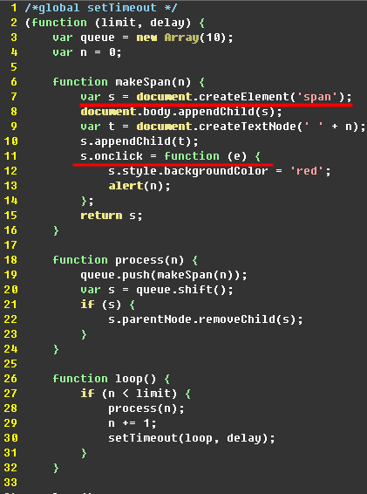
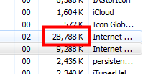

Memory Leak Demo
IE9 quirks mode
Start
Closure!
End

Slide 6
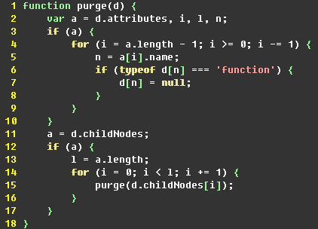
Solution in this Case
Only for IE6 & 7

Slide 7
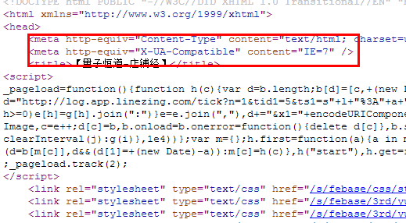
Problems in our Biz

Slide 8
How worse it is?!
Demo

Slide 9
What should we do?
significance of removing IE7 compatibility tags
prevent modern browsers from being buggy
use new features
enjoy high performance
for IE6/7 users, prevent circular references
correctly dispose views before menu switch
use event delegate

Slide 10
Thank U

