Slide 1
Midterm Project
By Christina Martino

Slide 2
Objective:
For my Midterm Project in Creative Coding, I want to create an interactive online DogDressup game.

Slide 3
Who?
This project is targeted toward children between the ages of 3-7. The audience would most likely be female, but that is not necessarily the case.

Slide 4
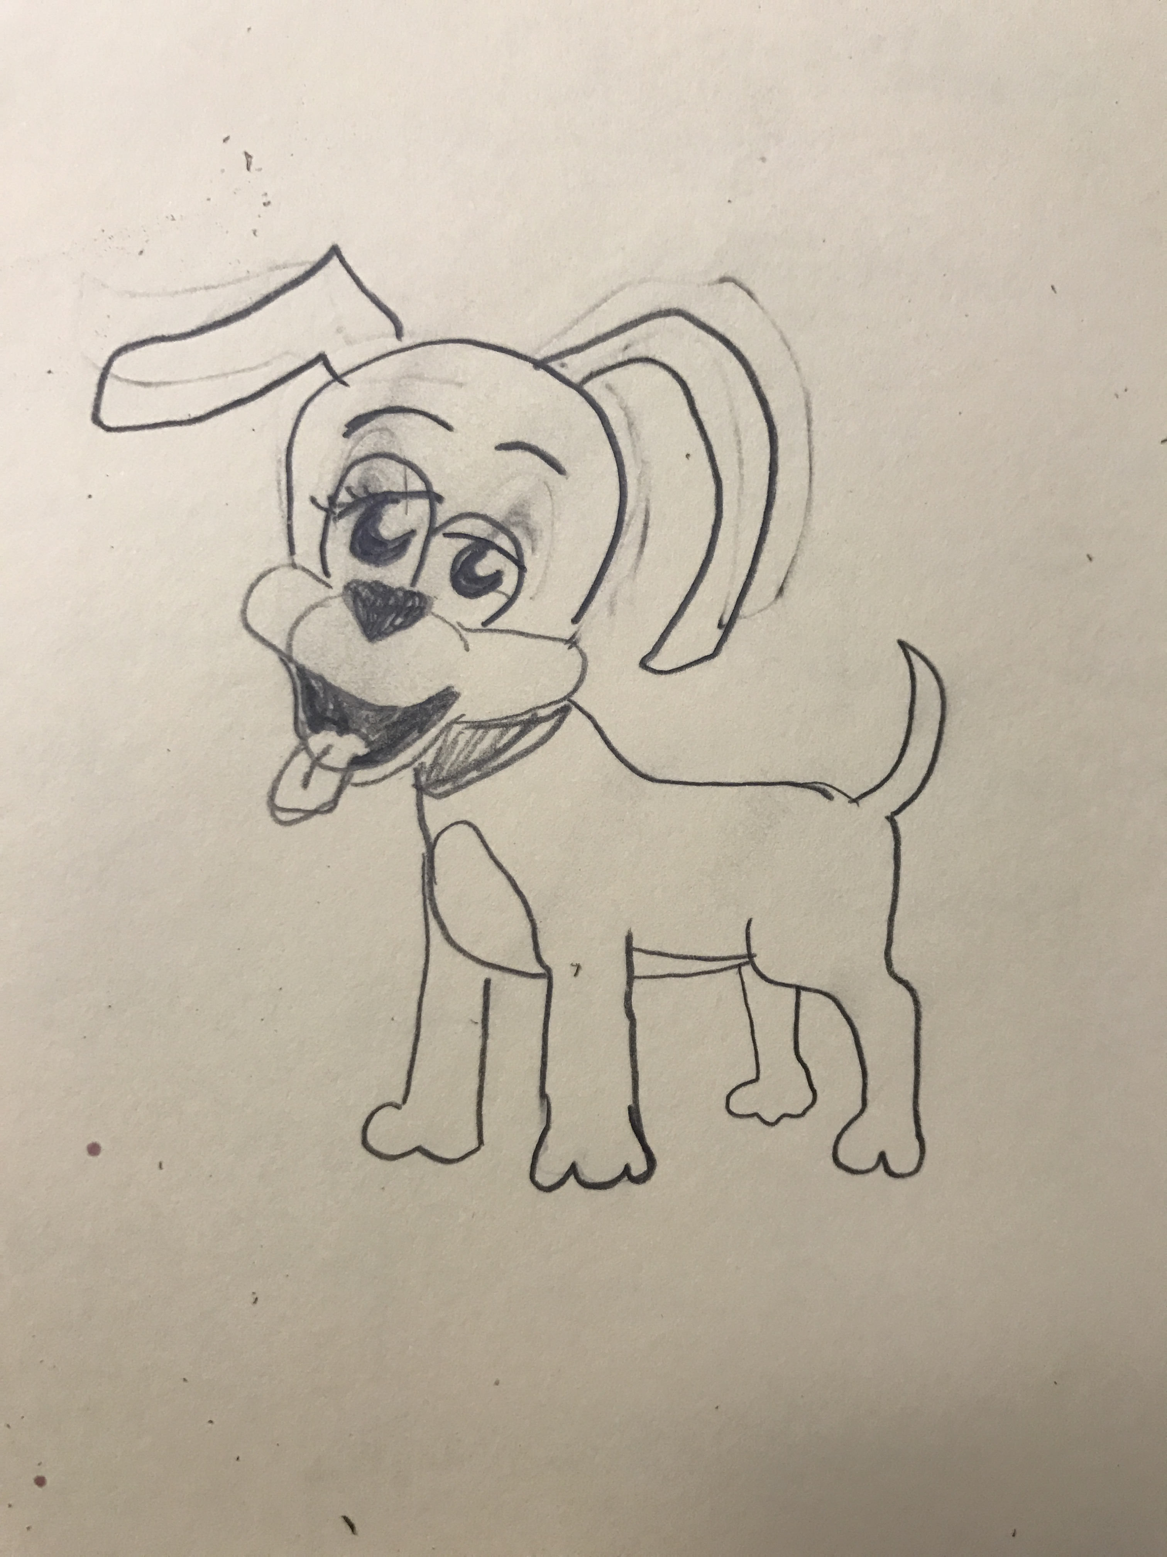
What?
Dani the Dog is going to a big party and wants to try on some outfits! A caption comes up on the top of the screen that reads what outfit she wants to try on. For example, the caption could say “Red dress, blue hat, black shoes.” In order to receive one point, the user must get Dani dressed in the right outfit based on the caption.

Slide 5
Why?
This game promotes learning for young children. The user must be able to read the command in order to follow it. The visual aspect of the clothing allows children a way to remember the word and its meaning in a fun way.
Red Dress Yellow Shoes
Blue Hat

Slide 6

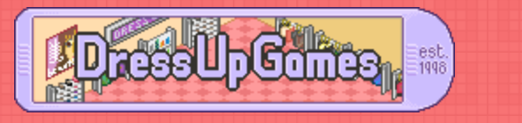
Where?
DogDressup would be displayed on a game sight such as dressupgames.com or pbskids.org. The game could also be used in a classroom setting for students to learn how to read.

Slide 7
How?
Using Photoshop, I will create the dog and her outfits and put them into p5.js. Then, using p5.js I will have words like red, blue, green, dress, hat, shoes, etc. randomly cycle through on the caption so the outfit prompt changes each time. I will use mouse pressed and mouse released to make it so that when the user clicks on the dress, the dress shows up on the dog. I will also create a rectangle button the says “I’m Ready!” on it. The user will click this button when the outfit is “correct.” I will check the user’s work by using an if statement: If the captions says red dress and the user selects the image of the red dress, then the user gets one point. The way I will show the points is by using key value pairs.

Slide 8
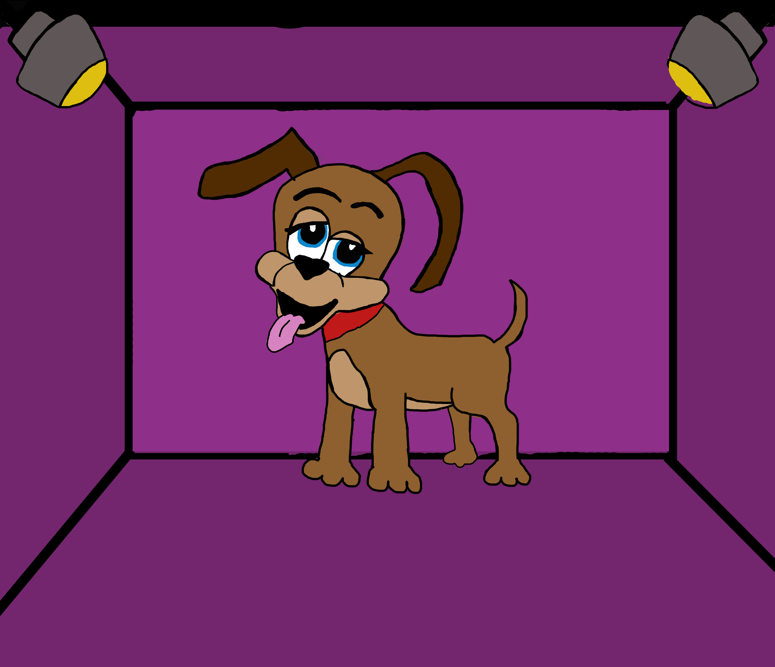
Here’s what I have so far:

