Slide 1
Model Validation of Continuous Response

Slide 2
The Validation Set Approach Review
The validation set approach allows us to take a single dataset and break it up into two groups - a training set and a validation set or hold out set.
Outcomes
Features
X_train
Y_train
Data Instances
X_test
Y_test

Slide 3
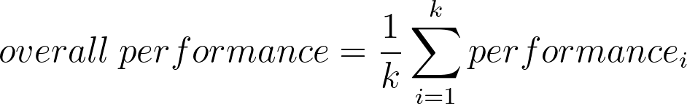
Cross Validation Review
The cross validation process is generally split into the following steps:
1. Data is split into training and testing sets
2. A model is trained using the training data
3. The model is validated using the testing data. i.e. a performance metric is calculated between the values predicted by model and those in the sample data
4. This is repeated k times. Aggregate the performance metrics across k.
Training
Testing
Iteration 1
Performance Metric 1
Performance Metric 2
Iteration 2
Iteration k
Performance Metric k

Slide 4
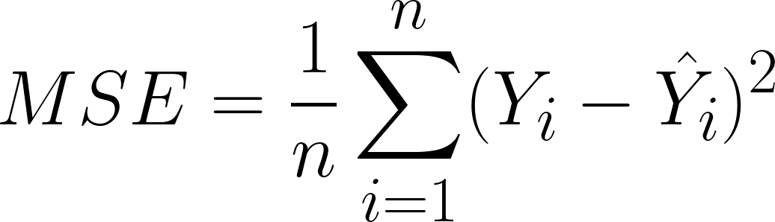
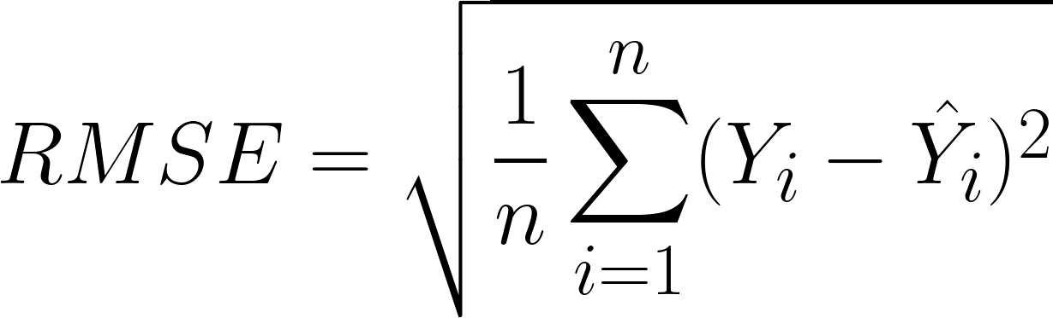
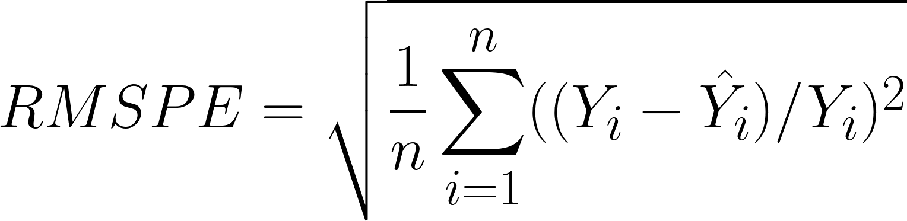
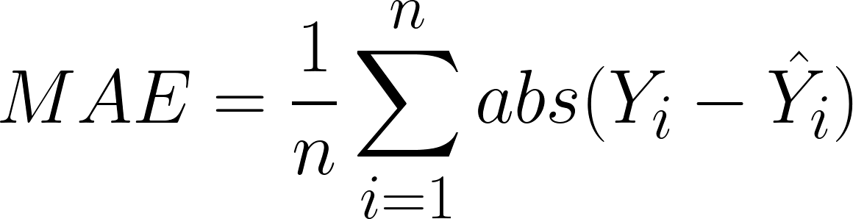
Error Metrics - Continuous Data
Mean Squared Error (MSE)
  Take the difference between predicted and actual result, square it, take average for all points
  Makes outliers more heavily weighted. In squared units of the response.
Root Mean Squared Error (RMSE)
  Square root of MSE.
  Is in the same units as the response.
Root Mean Squared Percentage Error (RMSPE)
  Scales the RMSE based on the value of the response.
Mean Absolute Error (MAE)
  Average of absolute value of differences
  Does not make outliers more heavily weighted

