Slide 1
Naive Bayes Classification

Slide 2
Gaussian Naive Bayes
Gaussian Naive Bayes is a type of Naive Bayes classifier that assumes that your predictors follow a normal (Gaussian) distribution.
It can be used when your predictors are continuous.

Slide 3
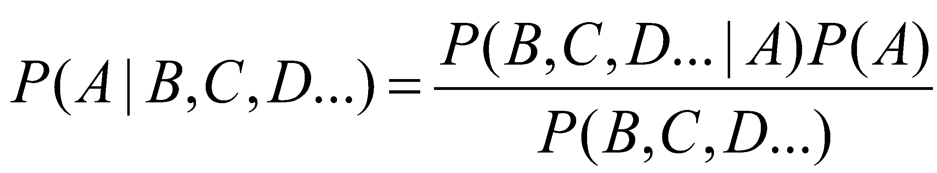
What if we have multiple predictors?
P(A|B,C,D…) = P(B,C,D,...|A) * P(A) / P(B,C,D,...)
P(~A|B,C,D…) = P(B,C,D,...|~A) * P(~A) / P(B,C,D,...)
P(A|B,C,D…) + P(~A|B,C,D…) = 1
P(B,C,D,...|A) * P(A) / P(B,C,D,...) + P(B,C,D,...|~A) * P(~A) / P(B,C,D,...) = 1
P(B,C,D,...|A) * P(A) + P(B,C,D,...|~A) * P(~A) = P(B,C,D,...)
P(B,C,D,...|A) = P(B|A) * P(C|A) * P(D|A) …
Chapter 18 in Machine Learning with Python Cookbook

Slide 4
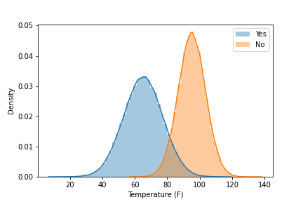
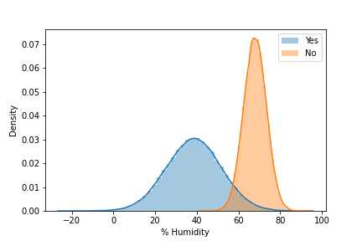
Temperature | Humidity | Play
54 | 40 | Yes
63 | 42 | Yes
81 | 60 | No
72 | 28 | Yes
68 | 70 | Yes
59 | 40 | Yes
83 | 43 | Yes
99 | 67 | No
66 | 20 | Yes
42 | 35 | Yes
103 | 70 | No
98 | 75 | No
80 | 30 | Yes
Will we play tennis if it is 100 degrees with 70% humidity?
n = 13

Slide 5
P(A|B,C) = P(B,C|A)*P(A) / P(B,C)
P(A|B,C) * P(B,C) = P(B,C|A)*P(A)
P(B,C|A)*P(A) + P(B,C|~A)*P(~A) = P(B,C)
A = Play: Yes
B = Temperature: 100
C = Humidity: 70
Will we play tennis if it is 100 degrees with 70% humidity?

Slide 6
P(Yes|100,70) * P(100,70)
= P(100|Yes)*P(70|Yes)*P(Yes)
= 0.002*0.003*(9/13)
= 4.15e^-6
P(No|100,70) * P(100,70)
= P(100|No)*P(70|No)*P(No)
= 0.045*0.08*(4/13)
= 1080e^-6
Will we play tennis if it is 100 degrees with 70% humidity?

Slide 7
P(100,70)
= 4.15e^-6 + 1080e^-6
= 1084.15e^-6
P(Yes|100,70)
= 4.15e^-6 / 1084.15e^-6
= 0.38%
P(No|100,70)
= 1080e^-6 / 1084.15e^-6
= 99.62%
Will we play tennis if it is 100 degrees with 70% humidity?

Slide 8
Naive Bayes Pros & Cons
Pros
Cons
Easy & fast
Can handle multi-class predictions
Performs well when assumption of independence holds
Is fairly robust even if independence assumption doesn’t hold
Works well with large datasets
Can run into issues if a category was not observed in training data set
Posterior probabilities are not true probabilities
May not perform as well as other more complex machine learning methods

