Slide 1
Research Lab #3: Applications of Programming
Topic: XOR Encryption

Slide 2
Cryptography
Also called cryptology.
Comes from the Greek roots kryptós, for "hidden, secret"; -graphein, for "writing", or -logia, for "study".
It is the practice and study of techniques for secure communication in the presence of third parties called adversaries.
More generally, cryptography is about constructing and analyzing protocols that prevent third parties or the public from reading private messages.

Slide 3
Modern Cryptography
Heavily based on mathematical theory and computer science practice.
Cryptographic algorithms are designed around computational hardness assumptions, making such algorithms difficult to break in practice by any adversary.
Theoretical advances, for example, improvements in integer factorization algorithms, and faster computing technology, require these solutions to be continually adapted.

Slide 4
Current Legal and Ethical Cryptography Concerns
The growth of cryptographic technology has raised a number of legal issues in the information age.
Cryptography's potential for use as a tool for espionage and sedition has led many governments to classify it as a weapon and to limit or even prohibit its use and export.
In some jurisdictions where the use of cryptography is legal, laws permit investigators to compel the disclosure of encryption keys for documents relevant to an investigation.
Cryptography also plays a major role in digital rights management and copyright infringement of digital media.

Slide 5

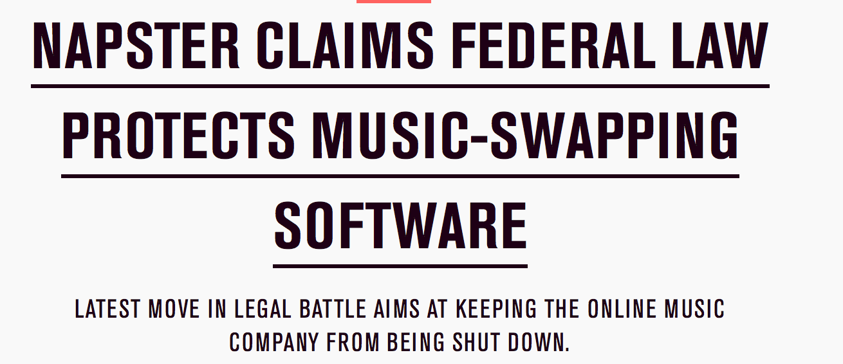
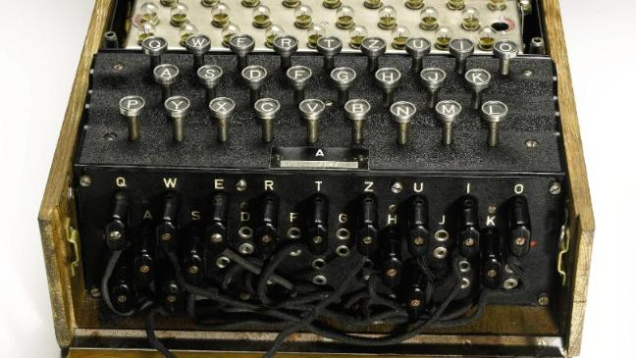

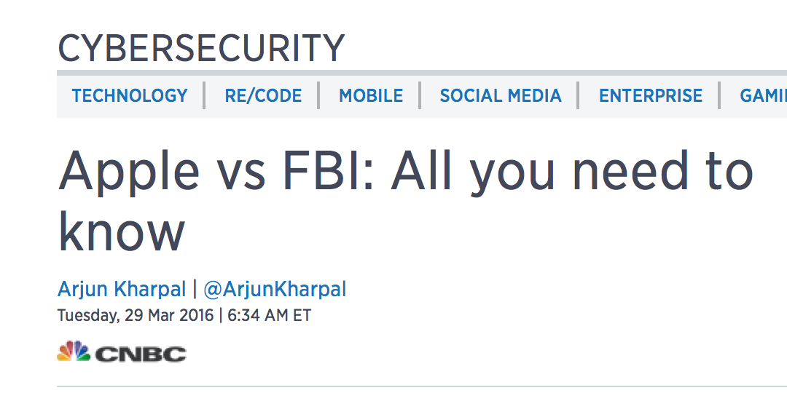
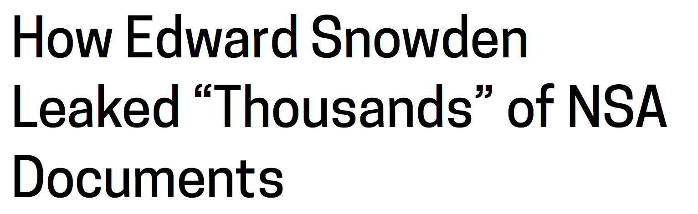

Slide 6
The Exclusive OR (XOR) Operator
The Exclusive OR (XOR) operator is a fundamental technique in cryptography. It is still used today in most encryption algorithms.
It will return true if one, and only one, of the two values is true.
A | B | XOR
true | true | false
true | false | true
false | true | true
false | false | false
A | B | XOR
1 | 1 | 0
1 | 0 | 1
0 | 1 | 1
0 | 0 | 0
Using bits, 1 represents true and 0 represents false.
A byte is 8 bits.

Slide 7
Example
Each character can be represented as a binary number.
For example, 4 has the binary representation of 00110100, and Q has the binary representation of 01010001.
Q XOR 4:
01010001
00110100
01100101
e
We use XOR on each bit.
We encrypted Q with the key 4 to get the letter e!

Slide 8
XOR Encryption
The idea behind exclusive-OR encryption is that it is impossible to reverse the operation without knowing the initial value of one of the two arguments.
For example, if you XOR two variables of unknown values, you cannot tell from the output what the values of those variables are.
For example, if you take the operation A XOR B, and it returns TRUE, you cannot know whether A is FALSE and B is TRUE, or whether B is FALSE and A is TRUE.
Furthermore, even if it returns FALSE, you cannot be certain if both were TRUE or if both were FALSE.

Slide 9
XOR Encryption, cont.
However, if you know either A or B it is entirely reversible.
If you don't have the key, it is impossible to decrypt it without making entirely random keys and attempting each one of them until the decryption program's output is something akin to readable text.
The longer you make the encryption key, the more difficult it becomes to break it.

Slide 10
XOR Encryption: Algorithm
The actual way XOR encryption is used is to take the key and encrypt a file by repeatedly applying the key to successive segments of the file and storing the output.
The output will be the equivalent of an entirely random program, as the key is generated randomly.
Once a second person has access to the key, that person is able to decrypt the files by using the exact same algorithm.
For every bit added to the length of the key, you double the number of tries it will take to break the encryption through brute force.

Slide 11
Algorithm
Read in an entire file as bytes - in other words, each character is represented as an 8-bit value. (Note: If you print out a byte in Java, it will be an integer value between -128 and 127).
This means that your file is a byte array!
Read in a key value from a separate file as bytes (also a byte array - yay!).
Is it possible that your key byte array and your file byte array are different lengths?
Yes!

Slide 12
Example
byte[] key: { 01110010, 00110101 }
byte[] file : { 01101000, 01100101, 01101100, 01101100, 01101111 }
You will need to use the modulus operator (%) to figure out which key bit to use!
01101000
01110010
01100101
00110101
01101100
01110010
01101100
00110101
01101111
01110010
00011010
01010000
00011110
01011001
00011101
🁤
P
🁤
Y
🁤
You will not necessarily recognize or even be able to see some of the encrypted characters.

Slide 13
Bytes and the XOR operator in Java
XOR: ^
Java prints out a byte as an integer value.
Example: byte[] file : { 01101000, 01100101, 01101100, 01101100, 01101111 }
In Java, the above array printed out would be: 104, 101, 108, 108, 111,

Slide 14
Reading from a file
You learned about using the Scanner class for reading from files.
But, the Scanner class stops at delimiters when reading (using next()) and we want to encode the delimiters (spaces and new lines) to preserve the file format.
In addition, if we tried to use nextLine() and read each line in as a String and then convert to bytes, we could potentially have conversion errors.
Because of this, it's important to use a Java class that can read in each character from the file as a byte or a stream of bytes.

Slide 15
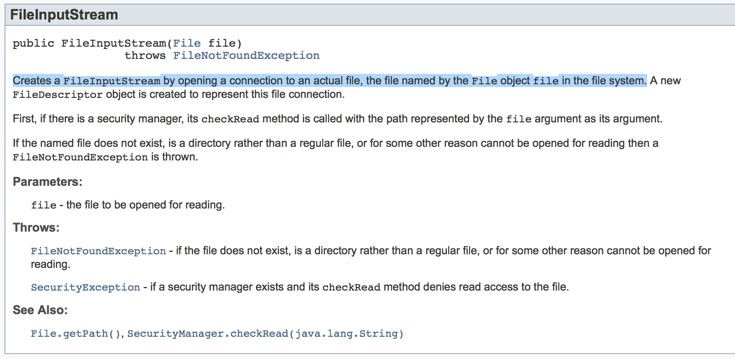
The FileInputStream class
Creates a FileInputStream object by opening a connection to an actual file.
What kind of exception is this?
A checked exception!
Notes:
Note: You still need a file object.
You MUST handle the checked exception.

Slide 16
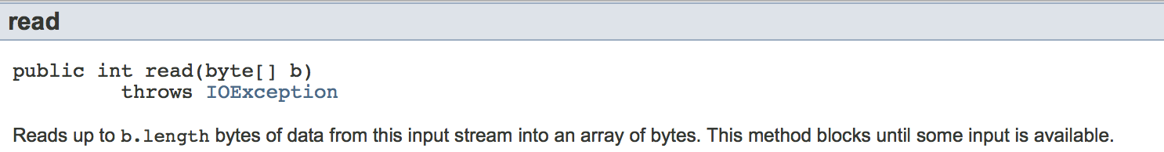
How do we read from the file?
IOException is also a checked exception. You must handle it.
You will need to know how many bytes are in your file.
A File object has a method named length() that gives you the number of bytes in your file. You can use this value to set the length of your byte array before you read.
The read method is strange because it takes a byte array as a parameter and modifies that parameter by saving the data to the parameter. But it also returns an int value that we will not be using.

Slide 17
Output
You need to output the resulting byte array representing the encrypted values.
Use the FileOutputStream class.
This class has a method named write that takes a byte array and writes it to a file.
Use the constructor to specify the name of a file as a String. If that file does not exist, it will create the file for you.
Make sure to close all your resources!

Slide 18

Let's encrypt a file!

