Slide 1
Team amazon
Chidi Nna
Venkata Naga Akhil Kuchimanchi

Slide 2
AGENDA
Why this topic?
Research question and scope
Literature Review
Methodology
Flowchart
Results
Conclusion
Future work

Slide 3
Topic and motivation
How do product attributes such as price, discount percentage, and review sentiment influence Amazon product ratings and review counts, and can these factors be used to build a predictive model for product popularity?
We choose this topic to inspect more about how amazon algorithm works in suggesting a product based on preview reviews
This model will be helpful in E-commerce websites
It helps in better suggestion of products from previews insights

Slide 4
Research Question and scope
How do product attributes such as price, discount percentage, and review sentiment influence Amazon product ratings and review counts, and can these factors be used to build a predictive model for product popularity?
How to identify the importance of factors influencing Amazon product ratings and review counts?
How to build a predictive model for product popularity based on identified features?
The Scope analysis include
Understanding key influencers
Feature importance for influencing ratings
Predictive model for product popularity

Slide 5
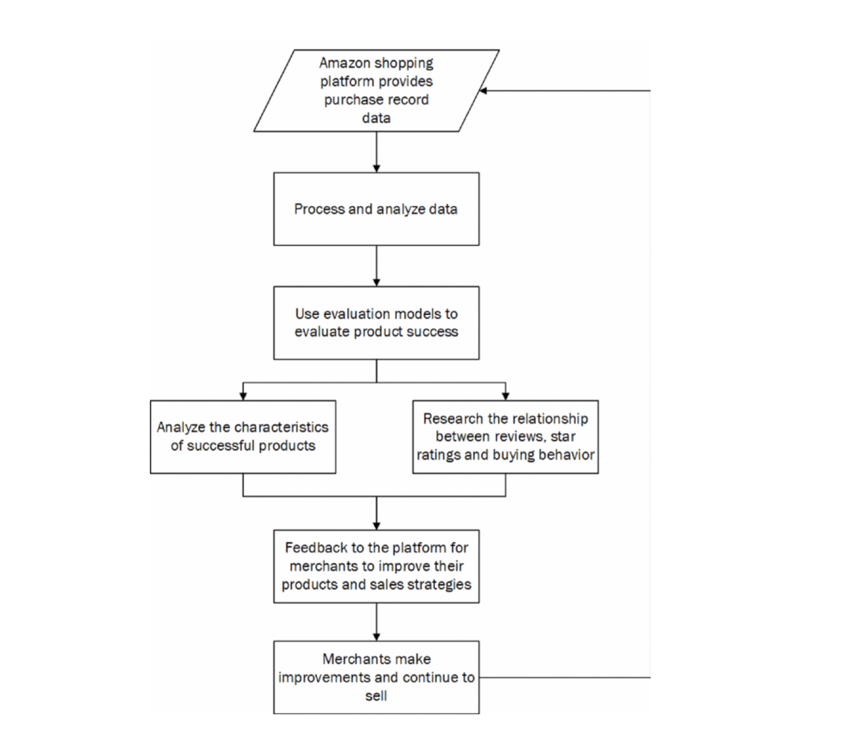
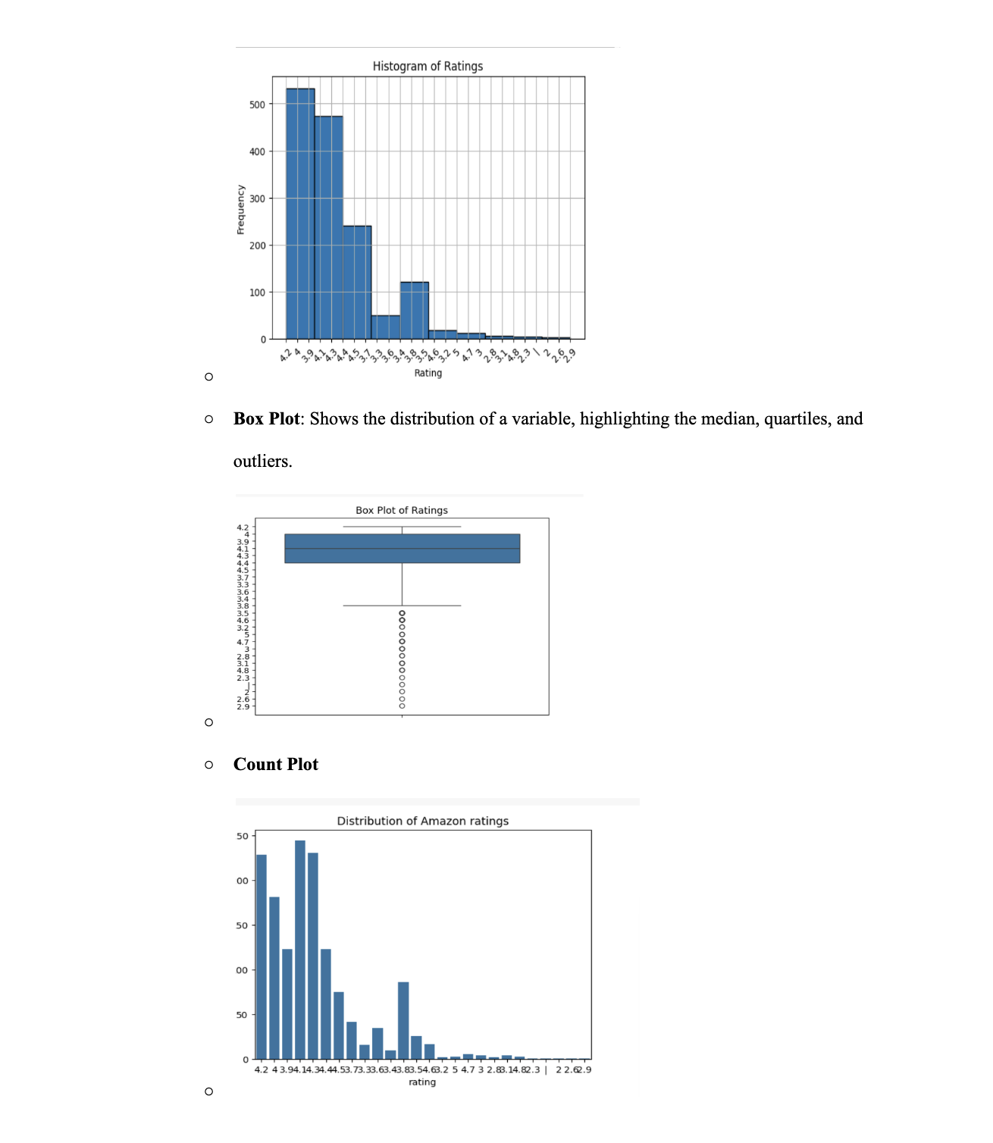
Literature review
Graphicals and flowcharts

Slide 6
Methodology
Product Details:
product_id: Unique identifier for each product.
product_name: Name of the product.
category: Product category for classification.
discounted_price and actual_price: Prices of the product, allowing analysis of discounts.
discount_percentage: The percentage discount applied to products
User Ratings and Reviews:
rating: Average product rating on a scale (e.g., 1-5)
rating_count: Total number of ratings submitted by users.
review_title and review_content: Detailed user feedback for sentiment analysis.
User Information:
user_id and user_name: Identifiers for users, enabling user behavior analysis.
review_id: Unique review identifier for tracking purposes

Slide 7
Data Techniques
Data cleaning and preprocessing
Sentimental analyisis
Exploratory data analysis (EDA)
Feature engineering
Predictive modelling

Slide 8
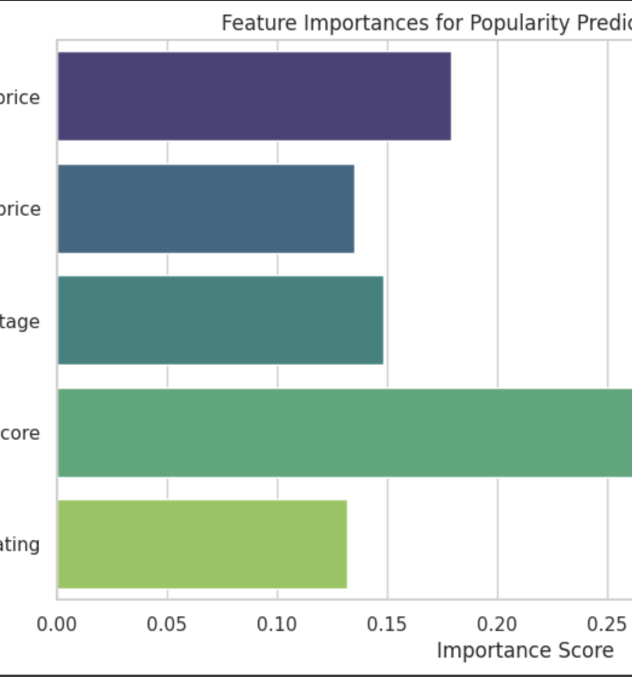
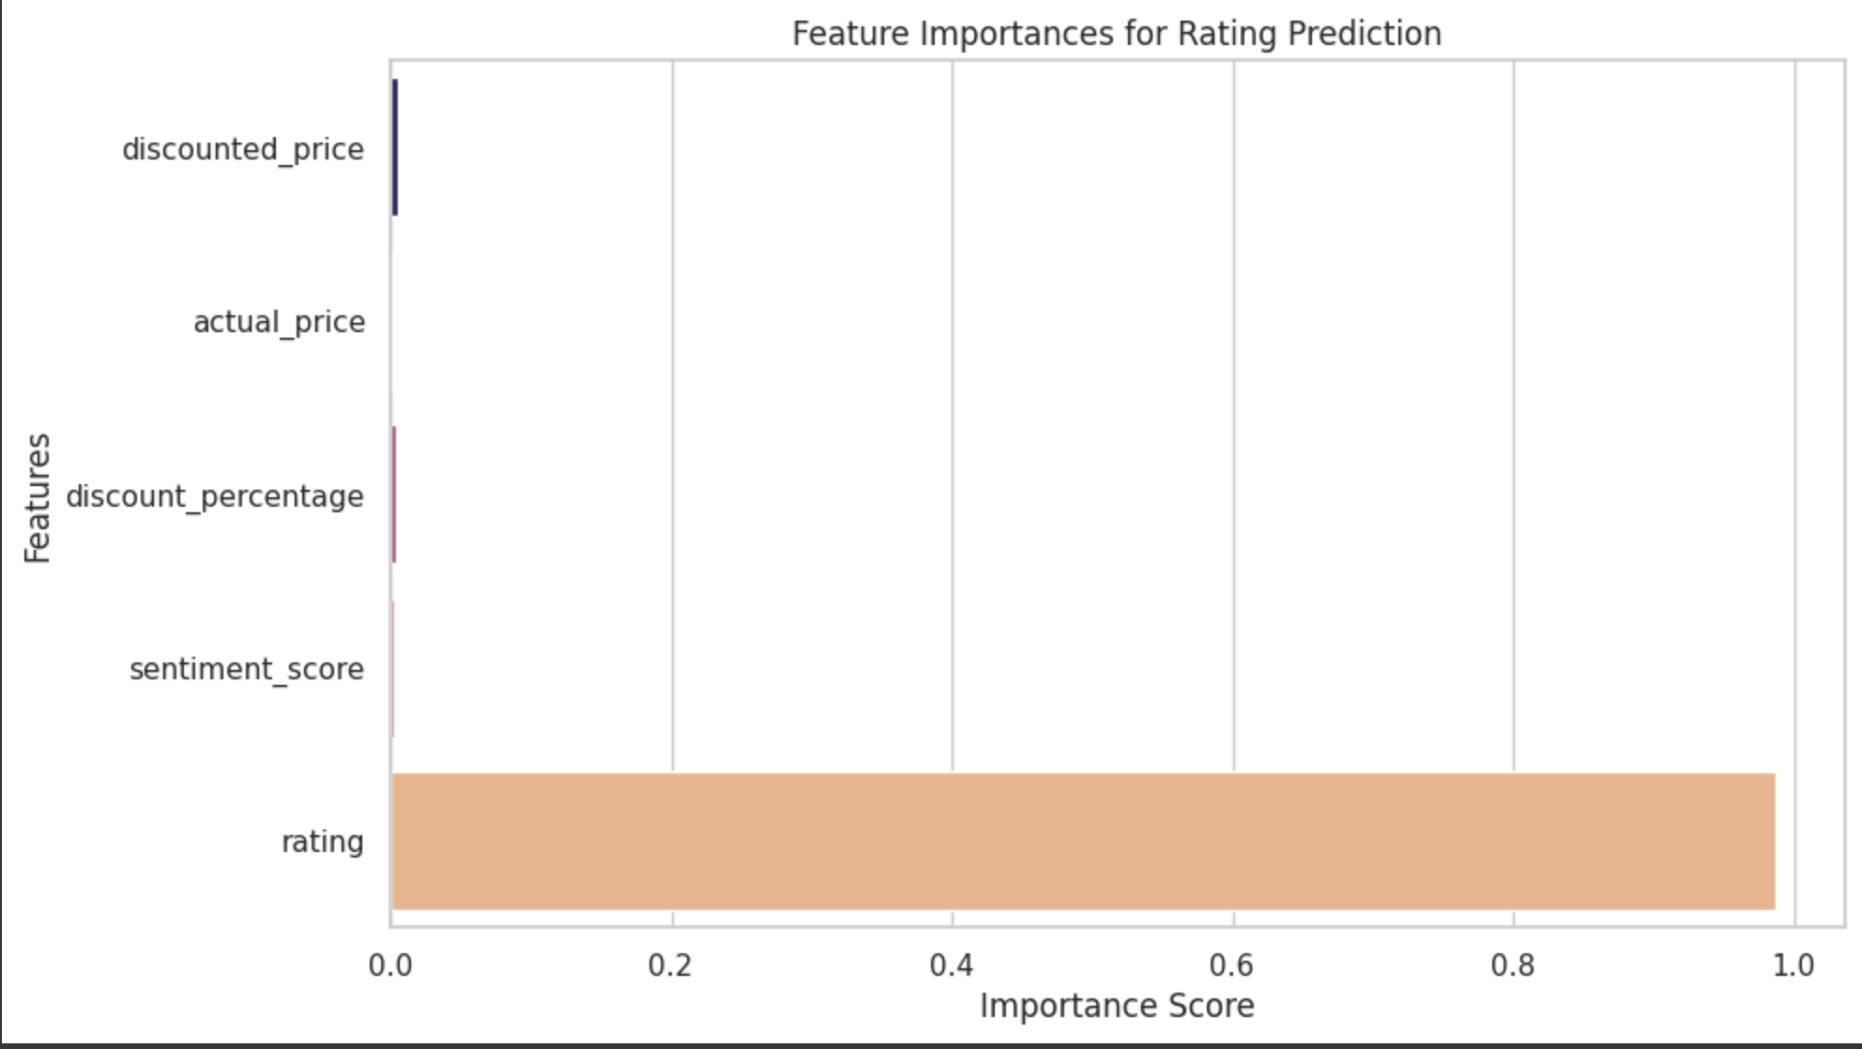
Results

Slide 9
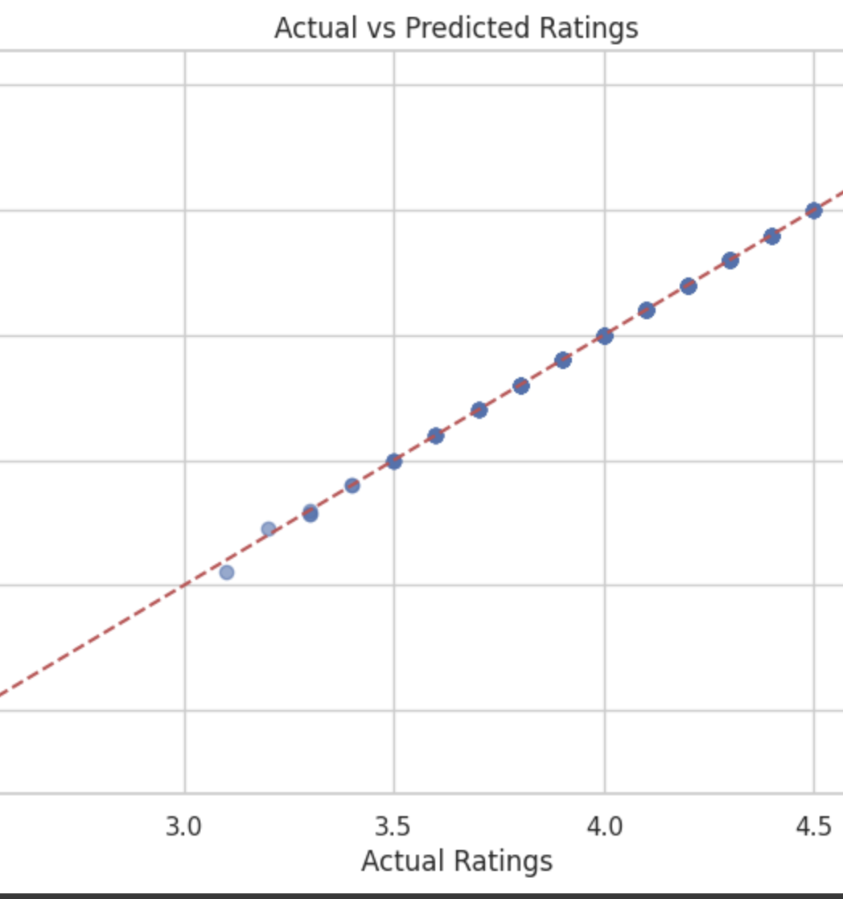
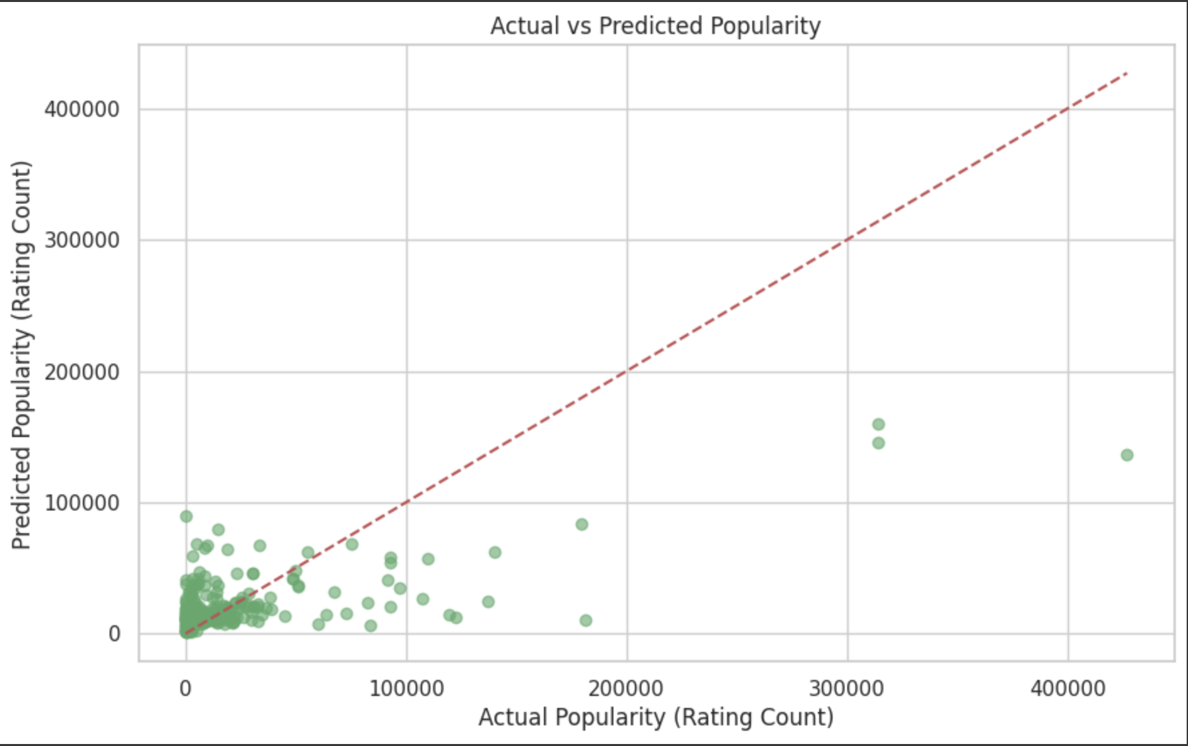
Results

Slide 10
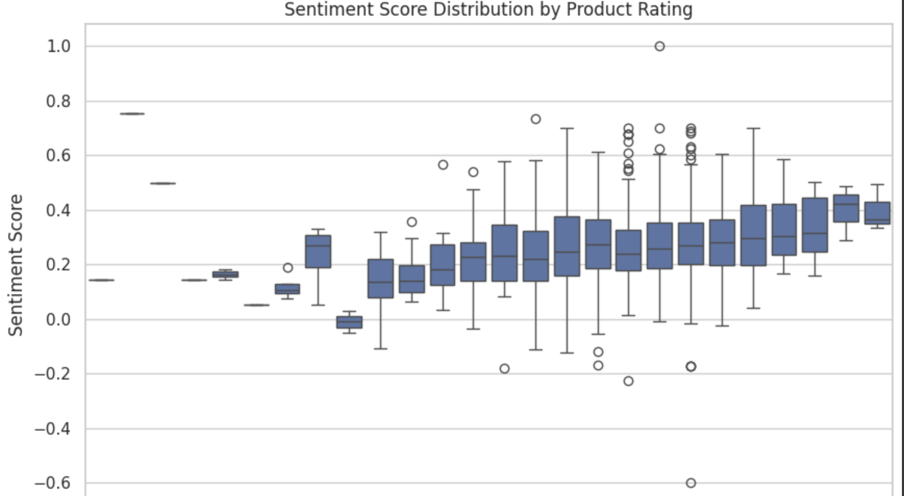
Results

Slide 11
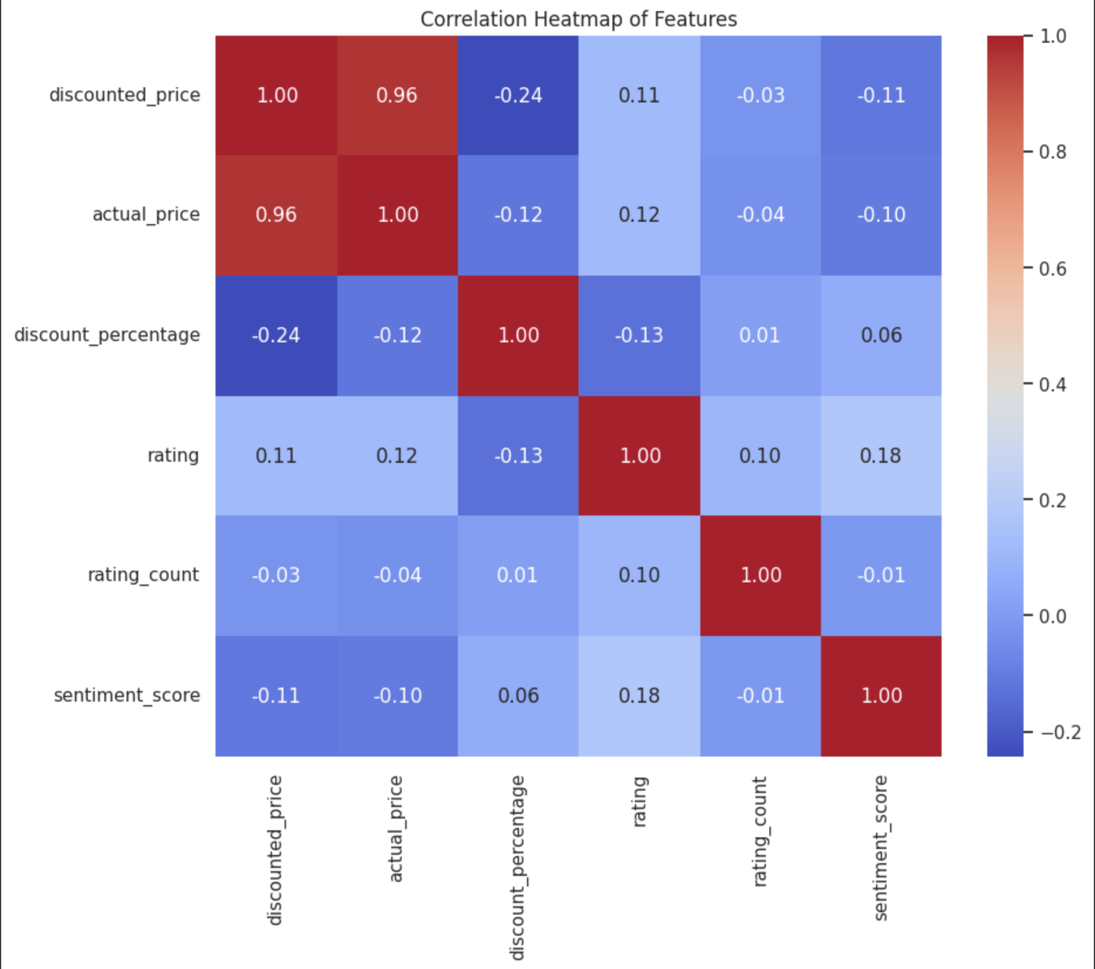
Results

Slide 12
Conlusion
This analysis can help businesses better understand what drives product success on Amazon and optimize their strategies accordingly.
By combining data analysis, feature engineering, and predictive modeling, we can accurately forecast product popularity and identify actionable factors that enhance performance in the competitive e-commerce landscape.
This approach not only improves decision-making but also helps businesses stay competitive in the dynamic e-commerce landscape.
Ultimately, leveraging these insights fosters customer satisfaction and increases sales, reinforcing the value of data-driven strategies in modern retail.

Slide 13
limitations
Data Limitations
Incomplete or noisy data
Data Availability
Modelling Limitations
Cold Start Problem
Overfitting Risks
Interpretability
Complexity of machine learning models
Generalizability
Domain specific trends
Sentimental analysis Limitations
Computational Challenges
Scalability
Data processing time

Slide 14
Future work
To address limitations and enhance the quality, scalability, and applicability of this project
Data Improvements
Model Enhancements
Sentiment Analysis Improvements
Scalability and Efficiency

Slide 15
THANK YOU
Team Amazon
Chidi Nna
Venkata Naga Akhil Kuchimanchi

