Slide 1

About Me - Connor Zanin
Boston
Programming in Go ~1 year
Working with MR since 2014
MSc from Northeastern
https://connorzanin.com
https://github.com/cnnrznn
https://github.com/gomr

Slide 2
GoMR: A MapReduce Framework for Golang
Connor Zanin
Notes:
Hi everyone, my name is Connor and tonight I’m going to talk about a package I wrote using Go.
The package is called GoMR, and it is a fast, efficient implementation paradigm used for processing big-data.

Slide 3
Outline
Problem
MapReduce Background
GoMR
Evaluation
GoMR on K8s
Ask Questions!

Slide 4
Previously…
P
Asymmetry in channels
Channels exposed by libraries
Notes:
Tracing my program to optimize
Closing on multiple-sender channels
Channels as an API

Slide 5
The Problem
Class on large-scale data processing (MR)
Implement triangle count on Hadoop MapReduce
2 JOIN ops
Large intermediate tables
Notes:
TODO investigate importance of triangle count

Slide 6

The Problem – Triangle Count
Edge table
SRC | DST
1 | 2
2 | 3
3 | 1
SRC | DST
1 | 2
2 | 3
3 | 1
SRC | MID | DST
1 | 2 | 3
2 | 3 | 1
3 | 1 | 2
$$⇒$$
JOIN

Slide 7
The Problem – Triangle Count
SRC | MID | DST
1 | 2 | 3
2 | 3 | 1
3 | 1 | 2
SRC | DST
1 | 2
2 | 3
3 | 1
SRC | MID | DST
1 | 2 | 3
2 | 3 | 1
3 | 1 | 2
Hash Lookup
$$⇒$$
#triangles = rows / 3

Slide 8
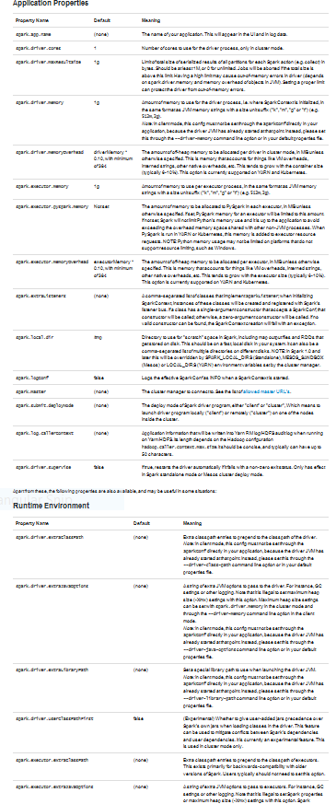
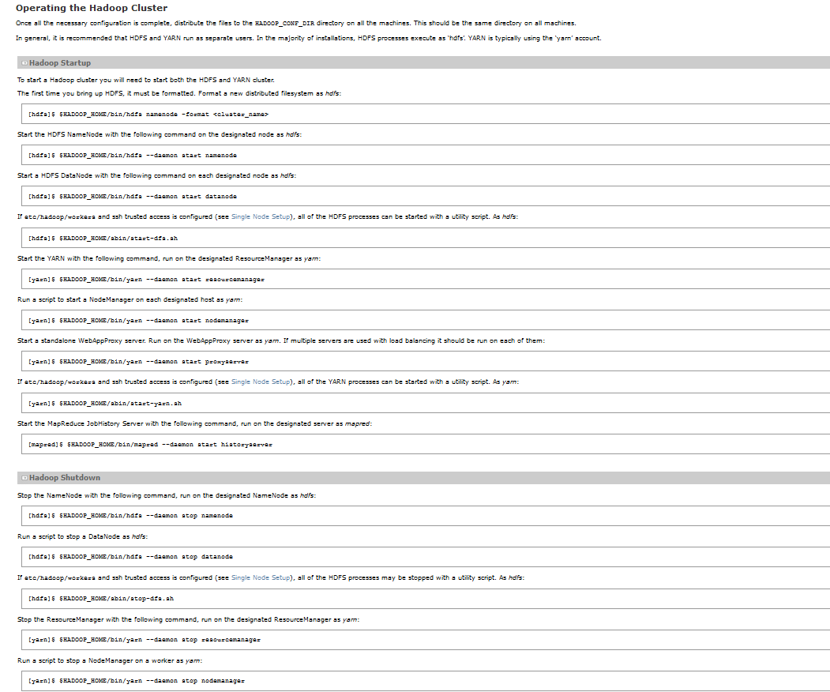
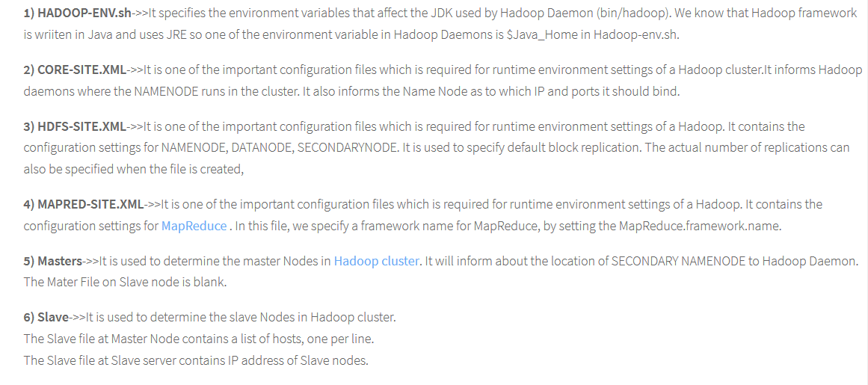
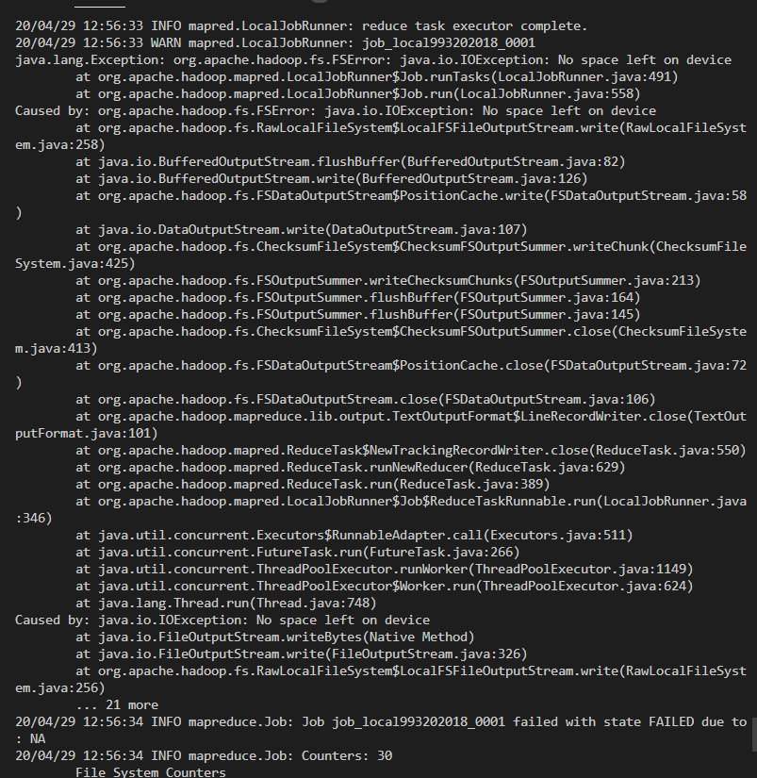
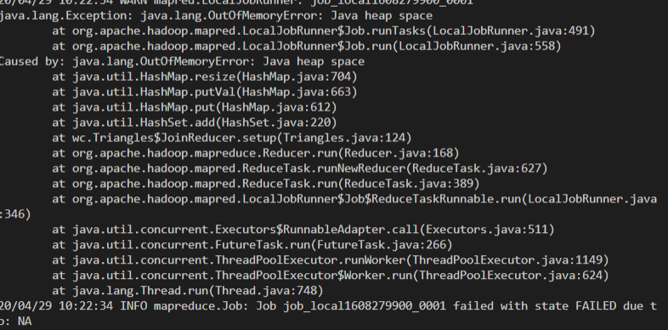
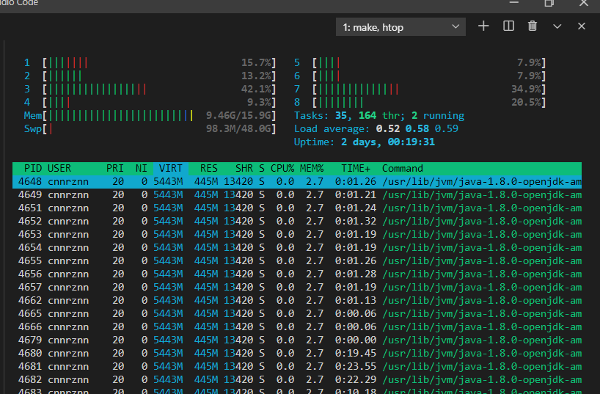
The Problem
Configurations
Error messages
Performance
Notes:
I was frustrated
I knew what I wanted to do
Painful to do in Hadoop – wasn’t having fun
Can I use go for this?

Slide 9
Background: MapReduce
Invention
Components
Example

Slide 10
What is MapReduce?
Jeff Dean, Sanjay Ghemawat @ Google
MapReduce: Simplified data processing on large clusters
“Hundreds of special-purpose computations that process large amounts of raw data”
Simple computations
Complex distribution + fault tolerance code

Slide 11
What is MapReduce?
“MapReduce is a programming model and implementation for processing … big data sets with a parallel, distributed algorithm on a cluster”
- Wikipedia

Slide 12
MapReduce - Definitions
Map: Transform input elements to <Key, Value> pairs
Reduce: Transform all Values per Key
Notes:
Mapreduce comes from functional programming
2 functions
Map -> function over items in collection
Reduce -> derive single value from collection

Slide 13

MapReduce – Word Count
[cat, dog, cat]
x => (x, 1)
Map
[(cat, 1), (dog, 1), (cat, 1)]
$$\sum_{k}{v}$$
Reduce
[(cat, 2), (dog, 1)]
Notes:
Map Reduce comes from functional programming conceptually

Slide 14
MapReduce - Pipeline
x => (x, 1)
∑
Input
Map
Reduce
Output
[(cat, 2), (dog, 1)]
[cat, dog, cat]

Slide 15
MapReduce - Parallel Pipeline
Mapper
Reducer
Input
Mapper
Reducer
Output
Mapper
Reducer
Notes:
We can parallelize the map-reduce model
Need an additional step, shuffle, for useful programs

Slide 16
MapReduce - Parallel Pipeline
(Cat,1)
Cat
Dog
(Dog,1)
Cat
(Cat,1)
Notes:
We can parallelize the map-reduce model
Need an additional step, shuffle, for useful programs

Slide 17
MapReduce - Parallel Pipeline
Mapper
Reducer
Input
Mapper
?
Reducer
Output
Mapper
Reducer
Notes:
We can parallelize the map-reduce model
Need an additional step, shuffle, for useful programs

Slide 18
MapReduce - Definitions
Map: Transform input elements to <Key, Value> pairs
Reduce: Transform all Values per Key
Partition: Group <Key, Value> pairs by Key

Slide 19
MapReduce - Parallel Pipeline
(Cat, 1)
(Cat, 2)
Cat
Dog
(Dog, 1)
Cat
(Cat, 1)
Notes:
We can parallelize the map-reduce model
Need an additional step, shuffle, for useful programs

Slide 20



MapReduce - Conference Registration
Map - Register on website
Partition - Collect Badge
Reduce – Metrics per table
A - O
M - Z
A - O
Registered: 2000
Present: 1850
Notes:
As an example, consider conference registration
First, attendants register online
This is the map
Then, the attendants arrive and are sorted alphabetically
This is the partition
Finally, each registrar may keep metrics about how many of their assigned attendees actually show up

Slide 21
GoMR
Goals
Design
Implementation
Notes:
Implementation for single machine
38 lines

Slide 22

GoMR - Goal
Minimal configuration
Simple error messages
Memory, CPU efficient
Let’s

Slide 23
GoMR - Pipeline
Goroutines
Mapper
Partitioner
Reducer
Input
Output
Mapper
Partitioner
Reducer
Channels
Notes:
Mapper, partitioner, reducer === user logic
Library defines interface
User implements Map(), Partition(), Reduce()
Library allocates goroutines, channels
Library handles synchronization

Slide 24
GoMR - Interfaces
type Mapper interface {
Map(in <-chan interface{},
out chan<- interface{})
}
type Partitioner interface {
Partition(in <-chan interface{},
outs []chan interface{},
wg *sync.WaitGroup)
}
type Reducer interface {
Reduce(in <-chan interface{},
out chan<- interface{},
wg *sync.WaitGroup)
}
Mapper
Partitioner
Reducer

Slide 25
GoMR - Interfaces
type Job interface {
Mapper
Partitioner
Reducer
}

Slide 26
GoMR - Wiring
inChansMap = make([]chan interface{}, numMappers)
inChansPartition := make([]chan interface{}, numMappers)
inChansReduce := make([]chan interface{}, numReducers)
outChanReduce = make(chan interface{}, CHANBUF)
1
2
3
4
1
2
3
4
Mapper
Partitioner
Reducer
Input
Output
Mapper
Partitioner
Reducer

Slide 27
GoMR - Wiring
inChansMap = make([]chan interface{}, numMappers)
inChansPartition := make([]chan interface{}, numMappers)
inChansReduce := make([]chan interface{}, numReducers)
outChanReduce = make(chan interface{}, CHANBUF)
Mapper
Partitioner
Reducer
Input
Output
Mapper
Partitioner
Reducer

Slide 28
GoMR - Wiring
inChansMap = make([]chan interface{}, numMappers)
inChansPartition := make([]chan interface{}, numMappers)
inChansReduce := make([]chan interface{}, numReducers)
outChanReduce = make(chan interface{}, CHANBUF)
Mapper
Partitioner
Reducer
Input
Output
Mapper
Partitioner
Reducer

Slide 29
GoMR - Wiring
inChansMap = make([]chan interface{}, numMappers)
inChansPartition := make([]chan interface{}, numMappers)
inChansReduce := make([]chan interface{}, numReducers)
outChanReduce = make(chan interface{}, CHANBUF)
Mapper
Partitioner
Reducer
Input
Output
Mapper
Partitioner
Reducer

Slide 30
GoMR - Wiring
inChansMap = make([]chan interface{}, numMappers)
inChansPartition := make([]chan interface{}, numMappers)
inChansReduce := make([]chan interface{}, numReducers)
outChanReduce = make(chan interface{}, CHANBUF)
Mapper
Partitioner
Reducer
Input
Output
Mapper
Partitioner
Reducer

Slide 31
GoMR – Channels & Goroutines
for i := 0; i < numReducers; i++ {
inChansReduce[i] = make(chan interface{}, CHANBUF)
go j.Reduce(inChansReduce[i], outChanReduce, &wgReduce)
}
for i := 0; i < numMappers; i++ {
inChansMap[i] = make(chan interface{}, CHANBUF)
inChansPartition[i] = make(chan interface{}, CHANBUF)
go j.Map(inChansMap[i], inChansPartition[i])
go j.Partition(inChansPartition[i], inChansReduce, &wgPartition)
}
Mapper
Partitioner
Reducer
Input
Output
Mapper
Partitioner
Reducer

Slide 32
GoMR – Channels & Goroutines
for i := 0; i < numReducers; i++ {
inChansReduce[i] = make(chan interface{}, CHANBUF)
go j.Reduce(inChansReduce[i], outChanReduce, &wgReduce)
}
for i := 0; i < numMappers; i++ {
inChansMap[i] = make(chan interface{}, CHANBUF)
inChansPartition[i] = make(chan interface{}, CHANBUF)
go j.Map(inChansMap[i], inChansPartition[i])
go j.Partition(inChansPartition[i], inChansReduce, &wgPartition)
}
Mapper
Partitioner
Reducer
Input
Output
Mapper
Partitioner
Reducer

Slide 33
GoMR - Synchronization
P
go func() {
wgPartition.Wait()
for i := 0; i < numReducers; i++ {
close(inChansReduce[i])
}
wgReduce.Wait()
close(outChanReduce)
}()
var wgPartition, wgReduce sync.WaitGroup
wgPartition.Add(numMappers)
wgReduce.Add(numReducers)
Mapper
Partitioner
Reducer
Input
Output
Mapper
Partitioner
Reducer
Notes:
Each stage needs to know when the previous is done
Input and map => close(ch)
Partitioner, reducer => wg.Done()

Slide 34
GoMR - Synchronization
go func() {
wgPartition.Wait()
for i := 0; i < numReducers; i++ {
close(inChansReduce[i])
}
wgReduce.Wait()
close(outChanReduce)
}()
var wgPartition, wgReduce sync.WaitGroup
wgPartition.Add(numMappers)
wgReduce.Add(numReducers)
Mapper
Partitioner
Reducer
Input
Output
Mapper
Partitioner
Reducer
Notes:
Each stage needs to know when the previous is done
Input and map => close(ch)
Partitioner, reducer => wg.Done()

Slide 35
GoMR - Channels or Values?
type Mapper interface {
Map(in <-chan interface{},
out chan<- interface{})
}
Initialization / cleanup
One item in => any # out
Code complexity
No decorators
type Mapper interface {
Map(val interface{})
interface{}
}
No communication logic
Decorators
No initialization / cleanup
GoMR must offer flatmap

Slide 36

Evaluation
GoMR
Notes:
Why compare to spark?
Easier to setup for local execution
Uses JVM still

Slide 37
Why Spark?
Pyspark
Simple install
Uses all cores

Slide 38
Wordcount - PySpark
words = sc.textFile(sys.argv[1]) \
.flatMap(lambda line: line.split(" ")) \
.map(lambda word: (word, 1)) \
.reduceByKey(lambda a, b: a + b, int(parallelism))

Slide 39
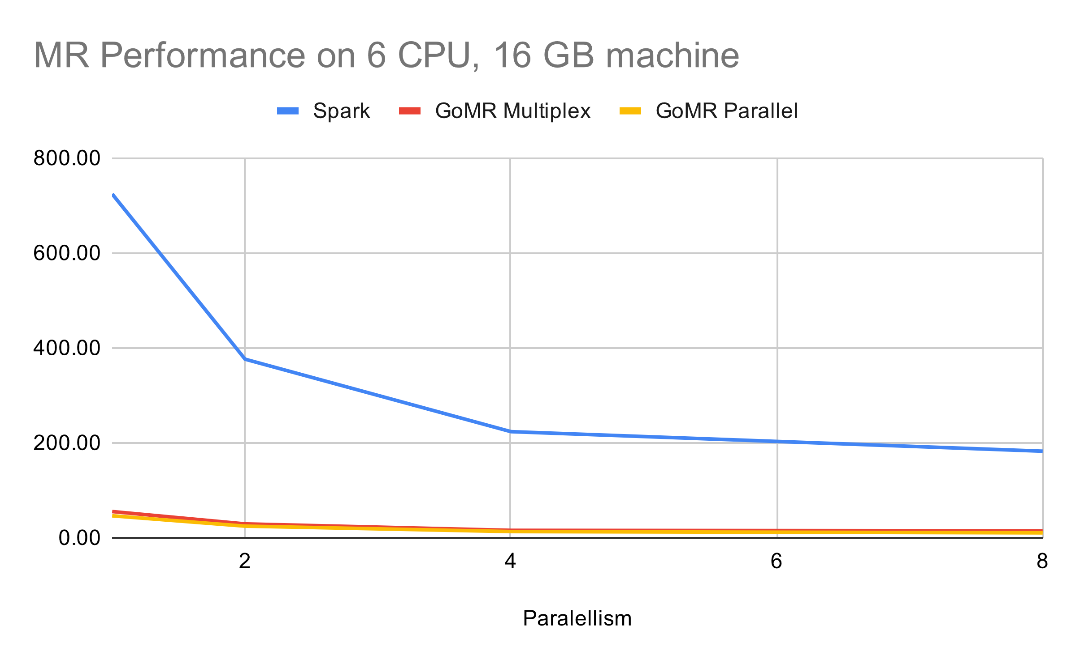
Evaluation - Laptop
Notes:
TODO fix this!!!

Slide 40
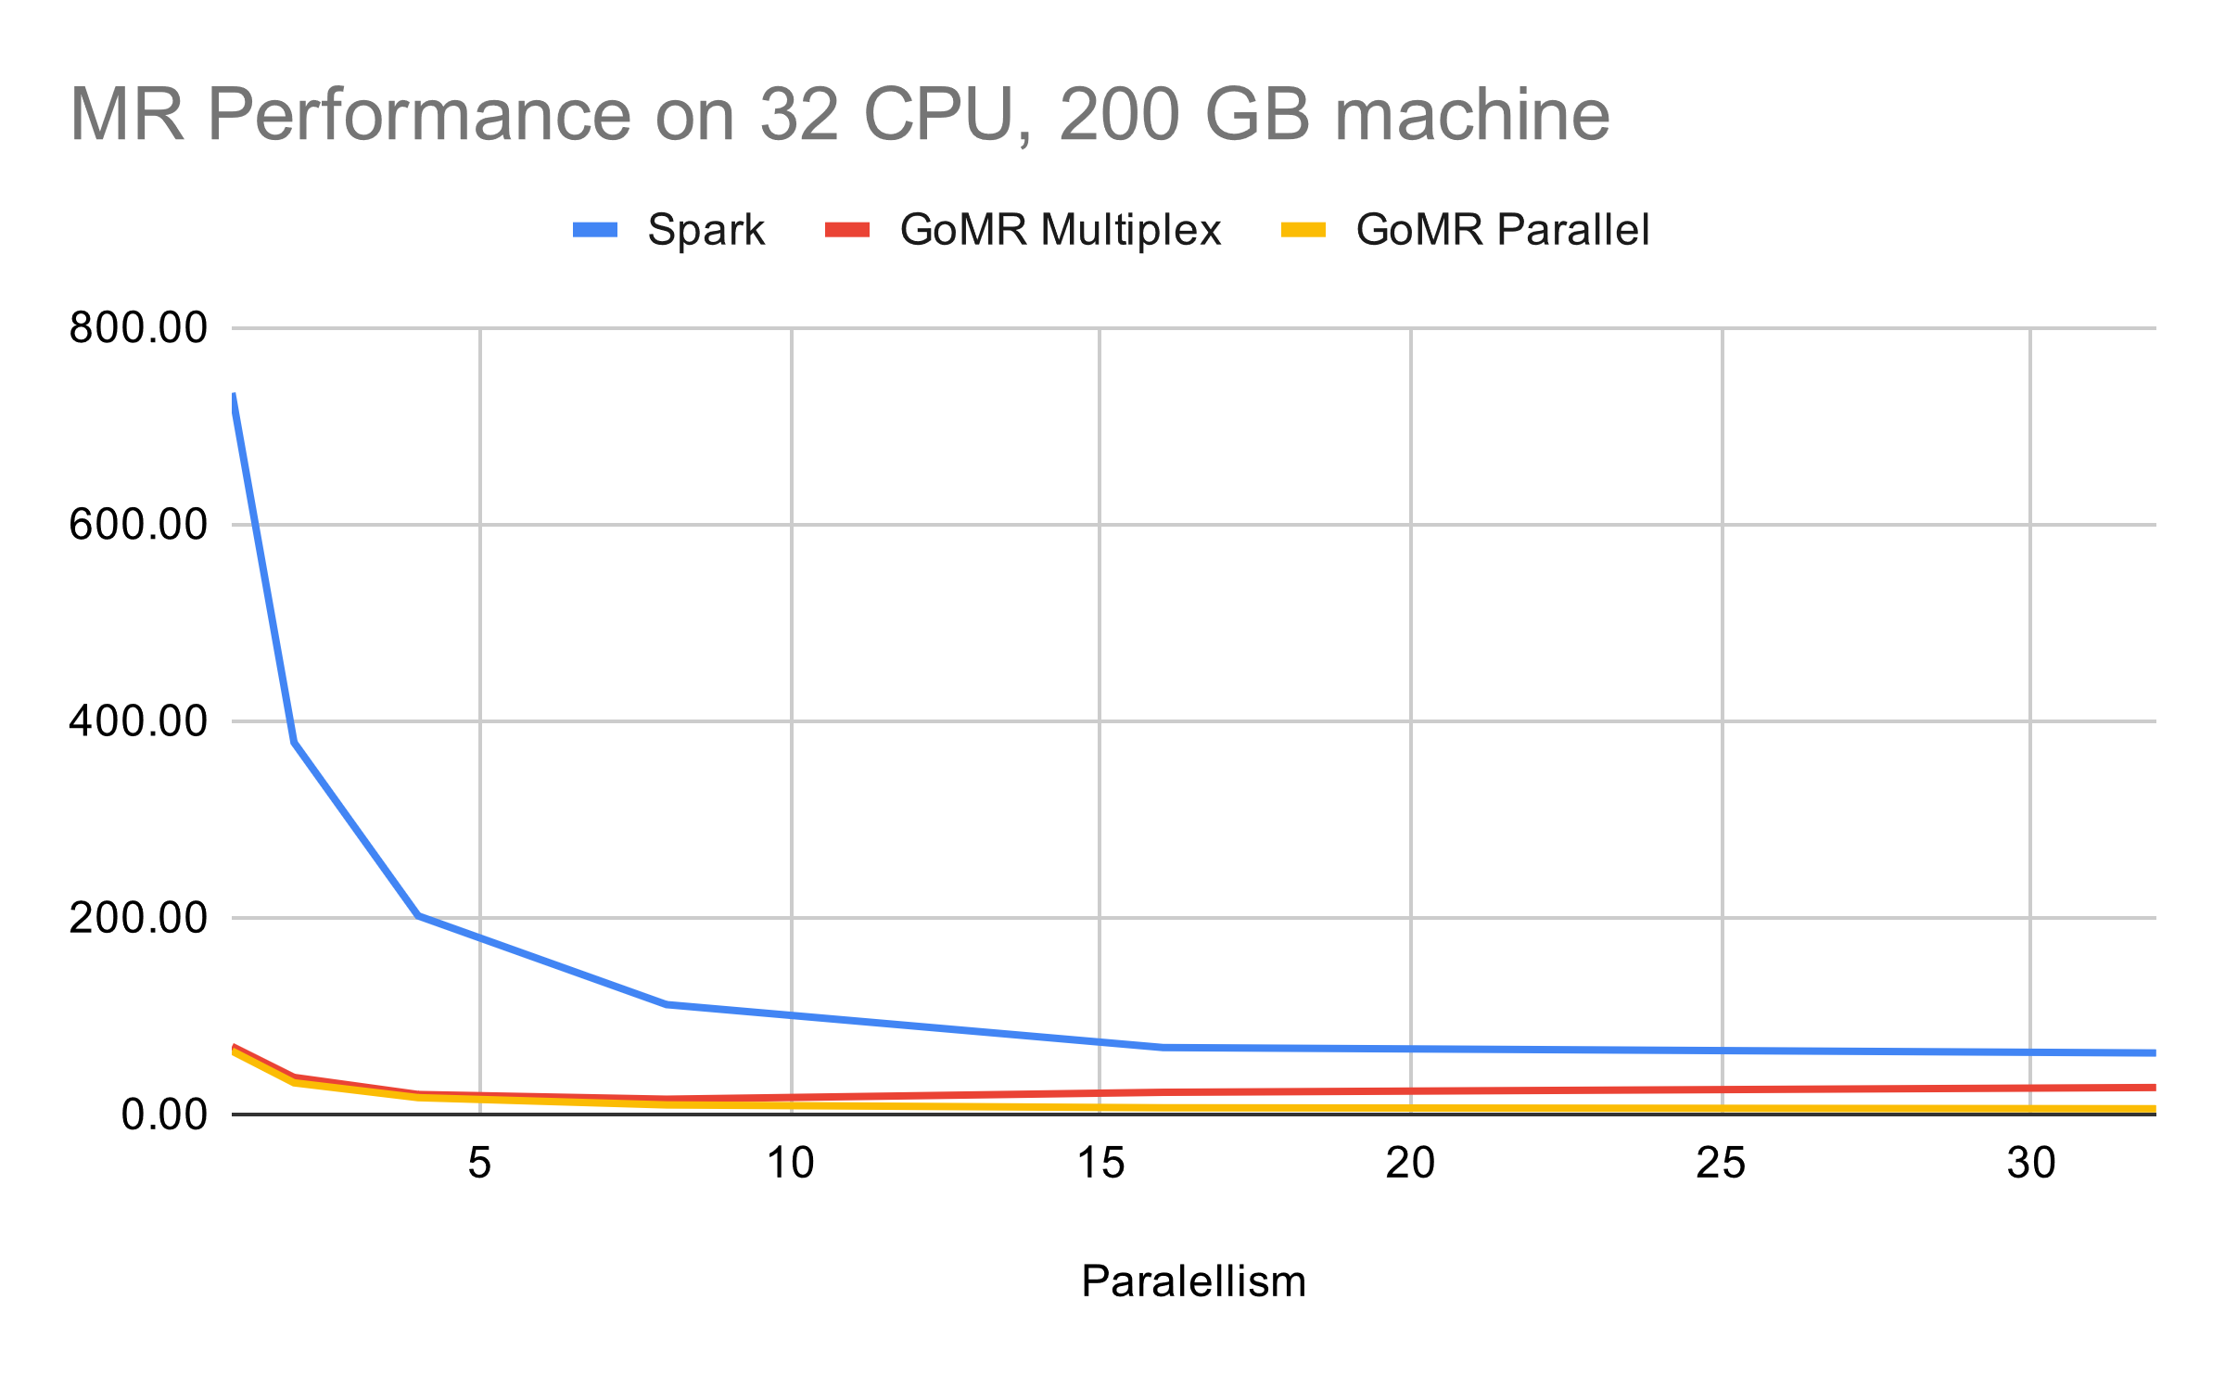
Evaluation - Server
Notes:
TODO fix this!!!

Slide 41
Evaluation - Errors
GoMR - 7
panic: interface conversion: interface {} is main.Count, not string
goroutine 28 [running]:
main.(*WordCount).Partition(0x5e5740, 0xc000130540, 0xc000132100, 0x8, 0x8, 0xc00012a250)
/home/cnnrznn/go/src/github.com/cnnrznn/gomr/examples/wordcount/wordcount.go:51 +0x23d
created by github.com/cnnrznn/gomr.RunLocal
/home/cnnrznn/go/src/github.com/cnnrznn/gomr/gomr.go:148 +0x2d6
Spark - 256
org.apache.spark.api.python.PythonException: Traceback (most recent call last):
File "/home/cnnrznn/spark/python/lib/pyspark.zip/pyspark/worker.py", line 377, in main
process()
File "/home/cnnrznn/spark/python/lib/pyspark.zip/pyspark/worker.py", line 372, in process
serializer.dump_stream(func(split_index, iterator), outfile)
File "/home/cnnrznn/spark/python/lib/pyspark.zip/pyspark/rdd.py", line 2499, in pipeline_func
File "/home/cnnrznn/spark/python/lib/pyspark.zip/pyspark/rdd.py", line 2499, in pipeline_func
File executor driver): org.apache.spark.api.python.PythonException: Traceback (most recent call last):
File "/home/cnnrznn/spark/python/lib/pyspark.zip/pyspark/worker.py", line 377, in main
process()

Slide 42
Evaluation - Configuration
wc := &WordCount{}
nprocs := runtime.NumCPU()
ins, out := gomr.RunLocal(nprocs, nprocs, wc)

Slide 43
GoMR on K8s
Kubernetes
I/O
Jobs & Drivers

Slide 44
Kubernetes
Containers
Pod == set of containers
Scheduling
Networking
Why spin my own control plane?
Node
Node
Pod
Pod
Pod
Node
Node
Pod
Pod
Pod
Pod

Slide 45
I/O
Containers are ephemeral
PersistentVolumeClaim mounts a drive on the container
Input and output through mounted drive

Slide 46
Prerequisites
kubectl with access to a cluster
PersistentVolume and PersistentVolumeClaim
https://github.com/cnnrznn/wordcount-gomr

Slide 47
MR Application
Input.1
Output.1
Input.2
Output.2
Job
Job
…
Input.3
Output.3
Input.4
Output.4

Slide 48
Jobs
Container
type WordCount struct{}
func (w *WordCount) Map(in <-chan interface{}, out chan<- interface{}) {
// …
}
func (w *WordCount) Partition(in <-chan interface{}, outs []chan interface{}, wg *sync.WaitGroup) {
// …
}
func (w *WordCount) Reduce(in <-chan interface{}, out chan< interface{}, wg *sync.WaitGroup) {
// …
}
func main() {
gomr.RunDistributed(&WordCount{})
}
Notes:
Code compiled to container

Slide 49
Drivers
package main
import "github.com/cnnrznn/gomr/pkg/driver"
func main() {
d := driver.NewDriver("Wordcount App", 3)
d.Run("wordcount", "/data/moby.txt", "/data/wc.txt")
}

Slide 50
Kubernetes
Node
Node
Reduce
Reduce
Map
Map
Node
Node
Driver
Reduce
Pod
Pod
Map
Job
Notes:
Driver talks to Kubernetes
Re-run if the jobs fail

Slide 51
Future Work
Performance improvements
Programmability?
Combine driver + job code

Slide 52
Existing solutions
One-off / Straight-line
http://marcio.io/2015/07/cheap-mapreduce-in-go/
https://godoc.org/github.com/ahamidi/go-mapreduce
https://medium.com/@jayhuang75/a-simple-mapreduce-in-go-42c929b000c5
https://appliedgo.net/mapreduce/
https://blog.gopheracademy.com/advent-2015/glow-map-reduce-for-golang/
https://github.com/chrislusf/gleam
https://github.com/darkjh/go-mapreduce
Hard-coded types
Mature
Almost Mature

Slide 53
Questions?
Problem
MapReduce Background
GoMR
Evaluation
GoMR on K8s

Slide 54
Connor Zanin
Programming in Go ~1 year
MSc from Northeastern
https://connorzanin.com
https://github.com/cnnrznn
https://github.com/gomr
Hire Me

Slide 55
Design Questions
Values or Channels?
Separate driver and job?
Using K8s job vs Deployment
UUID for k8s jobs

Slide 56
Wordcount - GoMR
func (w *WordCount) Map(in <-chan interface{},
out chan<- interface{}) {
counts := make(map[string]int)
for elem := range in {
for _, word := range strings.Fields(elem.(string)) {
counts[word]++
}
}
for k, v := range counts {
out <- Count{k, v}
}
close(out)
}

Slide 57
Wordcount - GoMR
func (w *WordCount) Partition(in <-chan interface{},
outs []chan interface{}, wg *sync.WaitGroup) {
for elem := range in {
key := elem.(Count).Key
h := sha1.New()
h.Write([]byte(key))
hash := int(binary.BigEndian.Uint64(h.Sum(nil)))
if hash < 0 {
hash = hash * -1
}
outs[hash%len(outs)] <- elem
}
wg.Done()
}

Slide 58
Wordcount - GoMR
func (w *WordCount) Reduce(in <-chan interface{},
out chan<- interface{}, wg *sync.WaitGroup) {
counts := make(map[string]int)
for elem := range in {
ct := elem.(Count)
counts[ct.key] += ct.Value
}
for k, v := range counts {
out <- Count{k, v}
}
wg.Done()
}

Slide 59
Wordcount - GoMR
P
func main() {
wc := &WordCount{}
par := runtime.NumCPU()
ins, out := gomr.RunLocal(par, par, wc)
gomr.TextFileParallel(os.Args[1], ins)
for count := range out {
fmt.Println(count)
}
}

Slide 60
Wordcount - GoMR
func main() {
wc := &WordCount{}
par := runtime.NumCPU()
ins, out := gomr.RunLocal(par, par, wc)
gomr.TextFileParallel(os.Args[1], ins)
for count := range out {
fmt.Println(count)
}
}

