Slide 1
EMS Ambulance Placement Analytics Results of NOLAlytics project
June 6, 2017

Slide 2
Executive Summary
EMS partnered with OPA to create a data-driven ambulance placement policy that aimed at improving the reliability and equity of timely response to emergency calls
Leveraging advanced analytics, open source software, and a pro bono partnership with LSU, OPA provided EMS a no-cost map of optimal posting locations for both day shifts and nights shifts that is scalable to resource levels
Testing shows that the new protocol enhanced equity in response times across districts and benefited the historically poorest served districts (4th district/West Bank) the most. Fourth district response time compliance improved 20% under the new ambulance placement protocol
Overall, there was a modest, but statistically significant improvement in overall response time compliance during the night shift
During the day shift, when there are typically fewer ambulances available, response time compliance held flat

Slide 3
Problem
Service calls up 12% between 2014 and 2016
Response times have fallen from 80% of code 3 calls <12 minutes (2014) to 72% of code 3 calls <12 minutes (2016)
Response times in outer reaches of the city, especially the 4th district (Algiers) and 7th district (New Orleans East) lag from rest of the city

Slide 4
Proposed solution
Revise EMS’ ambulance placement protocols to improve coverage of likely calls
Goal: Maximize area of city within acceptable (<12 minute) time threshold
Assumptions learned from user engagement:
Low elasticity of movement of ambulances while waiting for calls. Not practical to have a different scenarios as each ambulance becomes available
Desire for low-tech solution – paper map is best
Realistic locations include existing set plus hospitals, police and fire stations

Slide 5
Methodolgy
Developed in conjunction with LSU Analytics program
Given modal ambulances available (3), find combination of candidate location points that cover most historic call points (3 yrs EMS 911 calls) within 8 minute drive time (from ESRI’s network analysis tool for high-traffic and low-traffic scenarios)
Data:
EMS 911 calls (3 yrs)
High traffic and low drive times (ESRI network analysis)
Candidate locations – existing locations plus fire, police stations and ambulances
Analysis conducted in R (less ESRI drive time polygons)

Slide 6
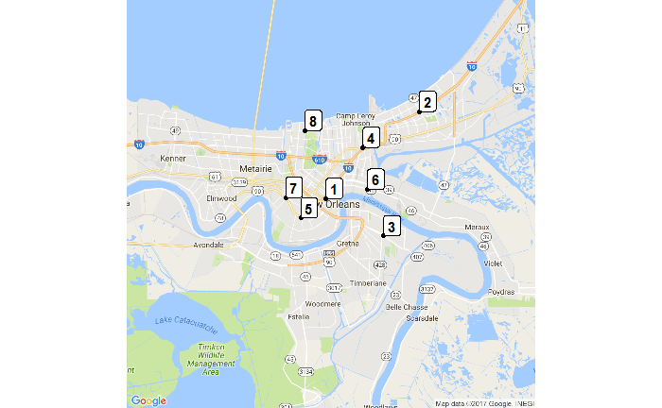
New maps
Day time (assumes high traffic and day time demand)

Slide 7
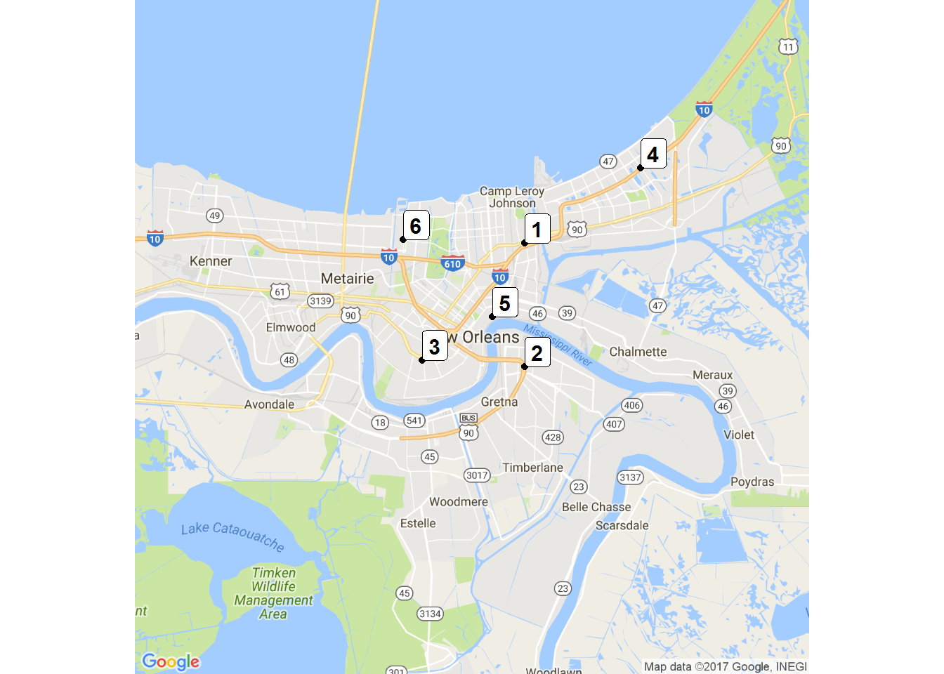
New maps
Night time (assumes low traffic and night time demand)

Slide 8
Reflections on maps
The day time map for the most part confirmed existing intuition about the best places to put ambulance (first Tulane Medical Center, then NO East, then West Bank)
The night time map proposed a substantially different list that what was used previously (first Gentilly, TMC unused)

Slide 9
Reflections on maps
Prior Locations Used
New Dayshift List
Name | Address | Primary Location | Rank
Tulane Medical Center |  | X | 1
I-10 and Read Blvd |  | X | 2
Holiday and DeGaulle |  | X | 3
Old Gentilly/5000 |  |  | 4
Baptist |  |  | 5
ENGINE 24 | 1040 POLAND AVE. |  | 6
SQUIRT 25 | 2430 S. CARROLLTON AVE. |  | 7
SQUIRT 13 | 987 ROBERT E. LEE BLVD. |  | 8

Slide 10
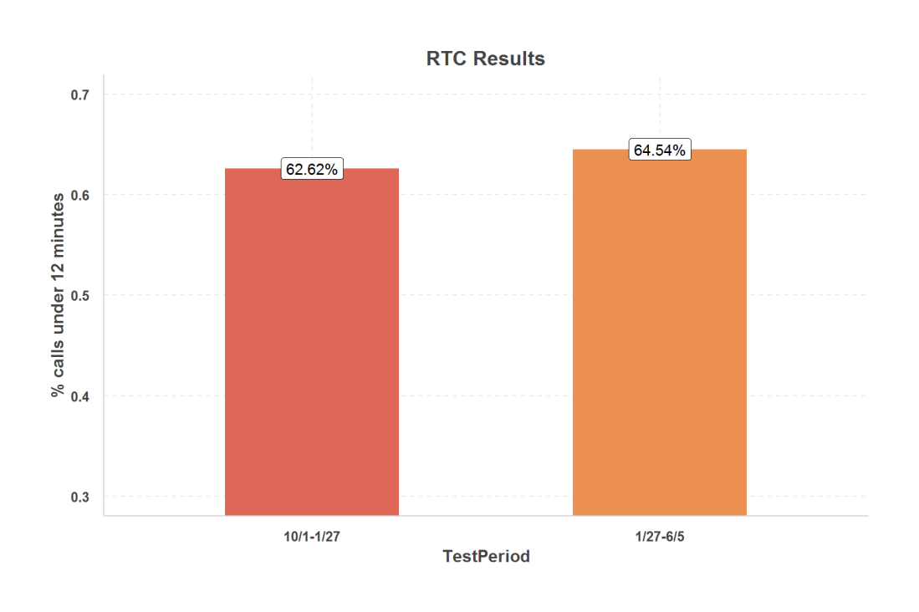
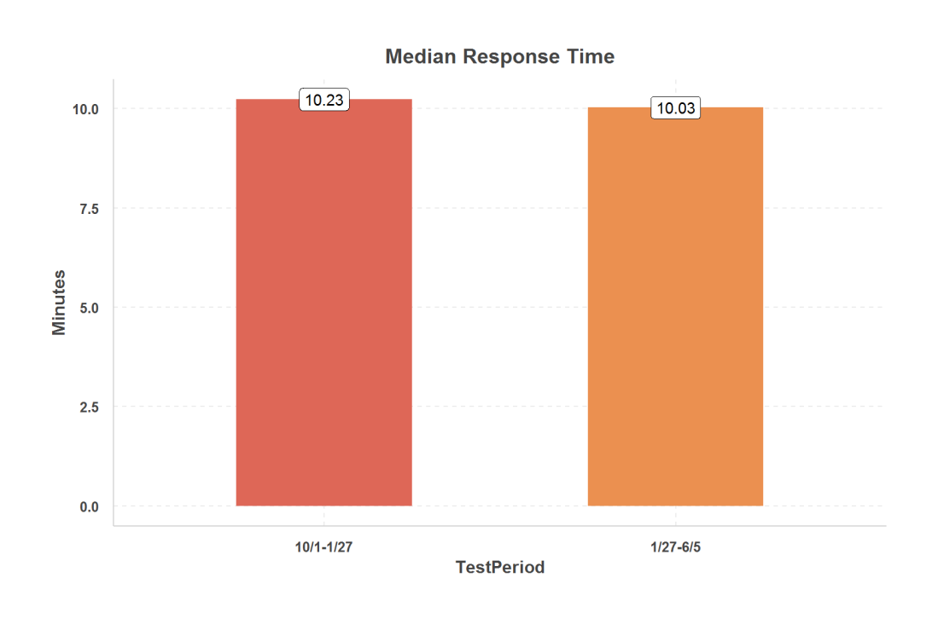
Results from testing
Night time protocol results in faster response times

Slide 11
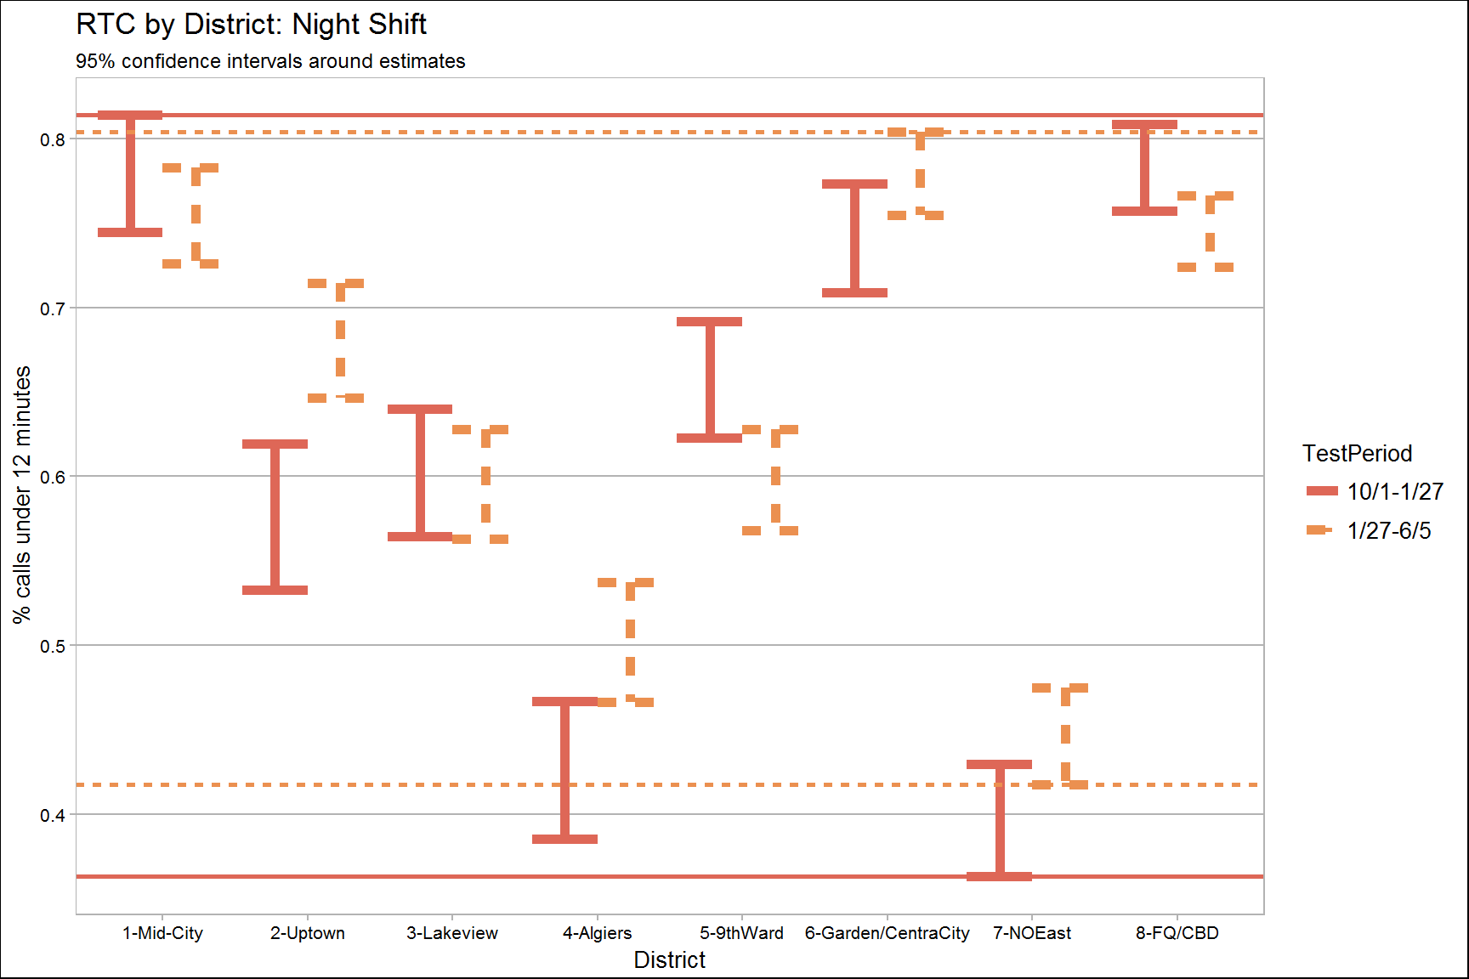
Results for testing
Night time protocol benefits the poorest performing districts the most, promoting equity
 | 10/1-1/27 | 1/27-6/5
maxRTC | 78.4% | 78.0%
minRTC | 39.6% | 44.6%
spread | 38.8% | 33.5%

Slide 12
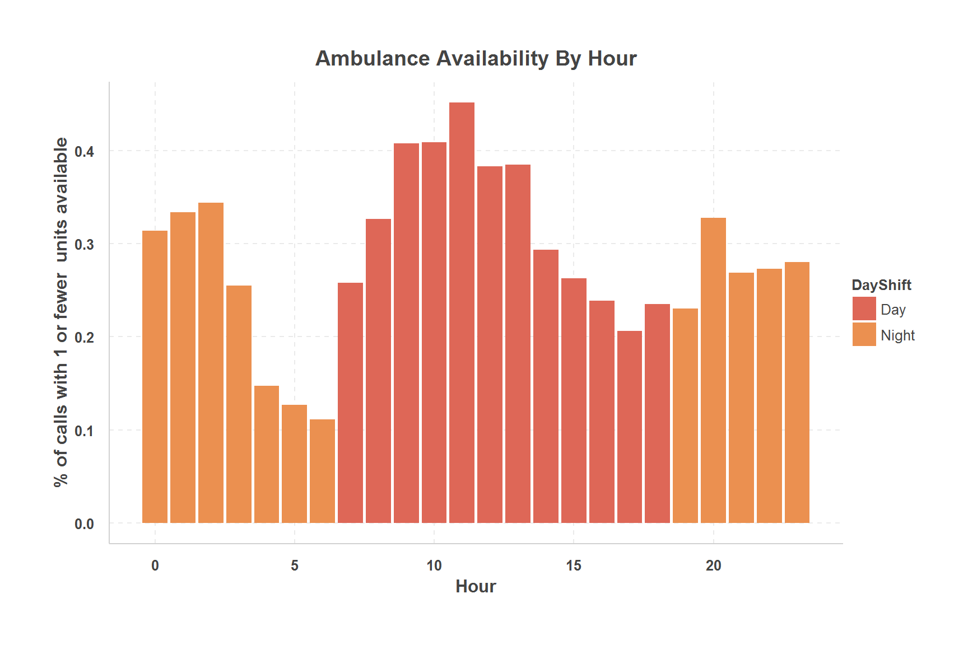
Daytime Testing
The question of where to position units is only relevant when there are units available to post, but there are typically less than 2 ambulances available for much of the day shift.

Slide 13
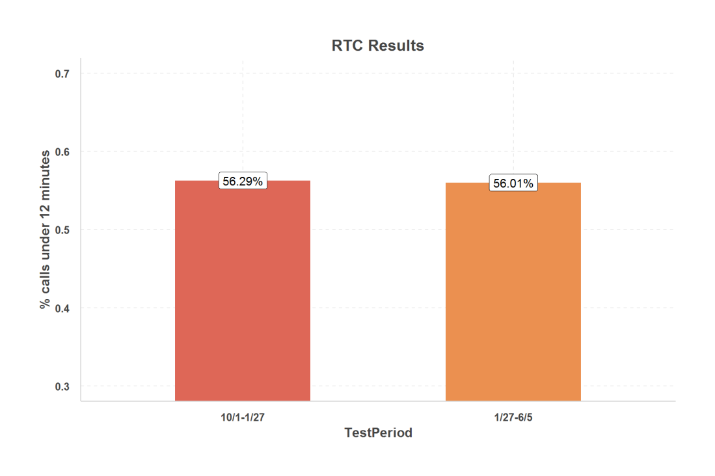
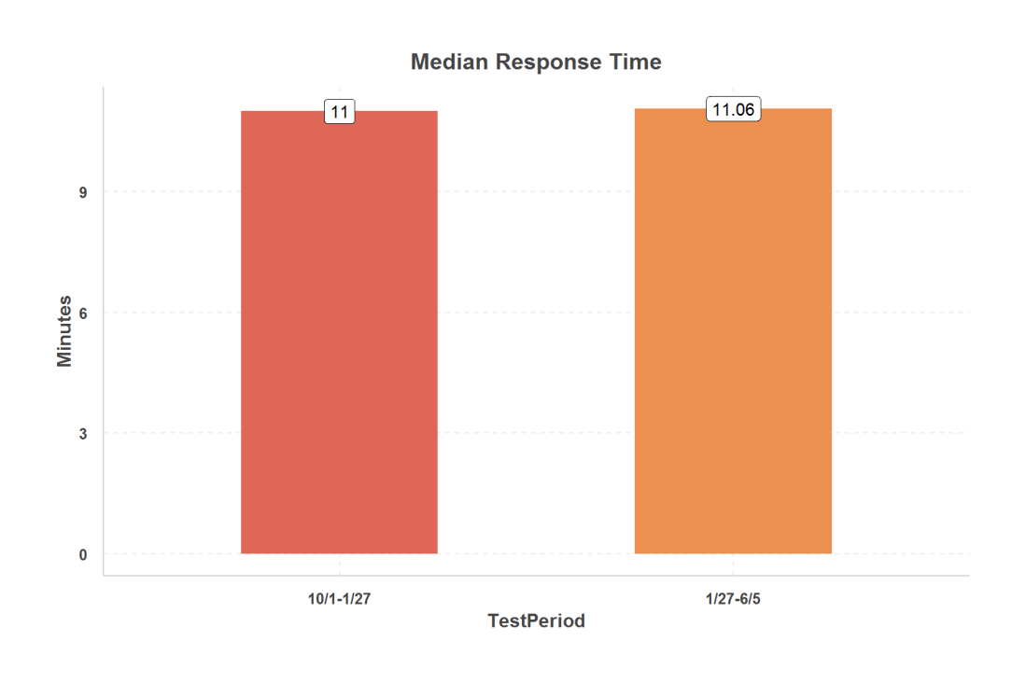
Daytime testing
As expected, there was no statistically significant changes to overall response times.

Slide 14
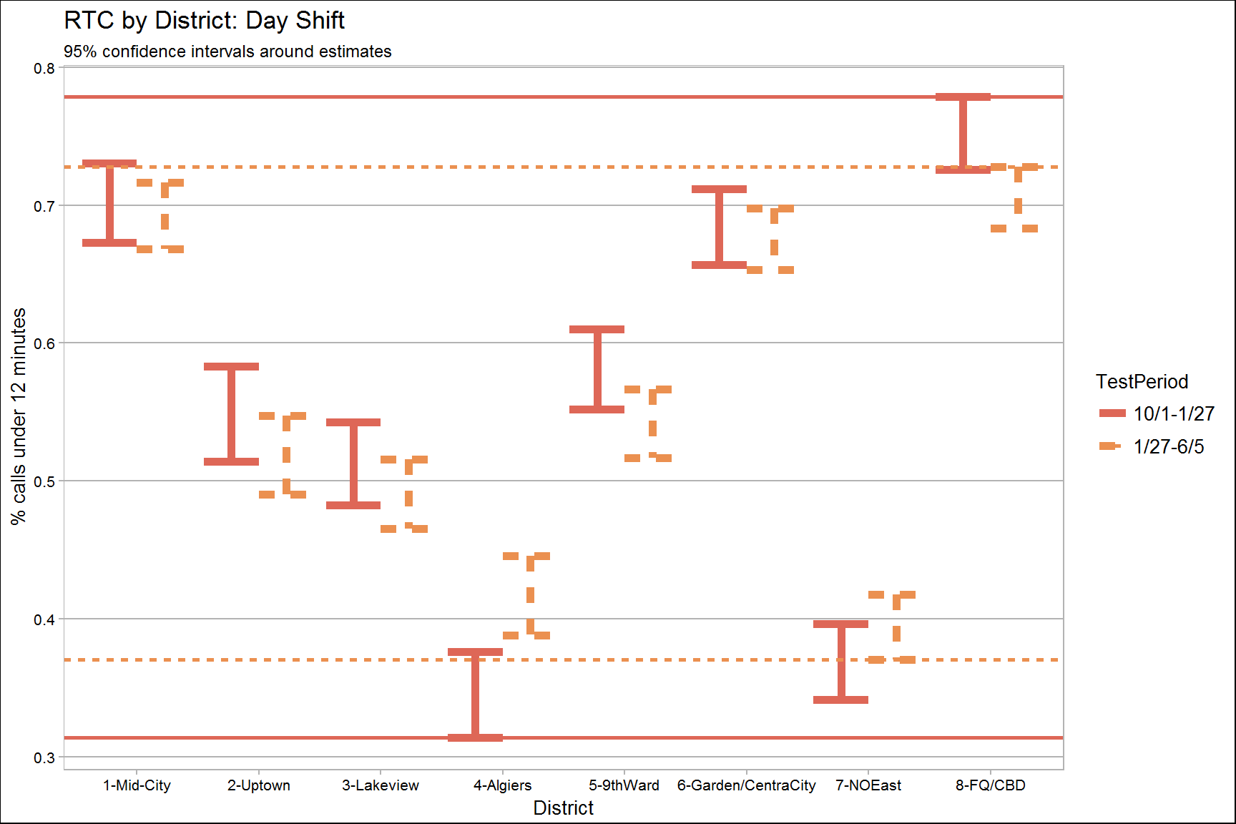
Daytime
But equity among districts improved
 | 10/1-1/27 | 1/27-6/5
maxRTC | 75.3% | 70.6%
minRTC | 34.4% | 39.4%
spread | 40.9% | 31.2%

Slide 15
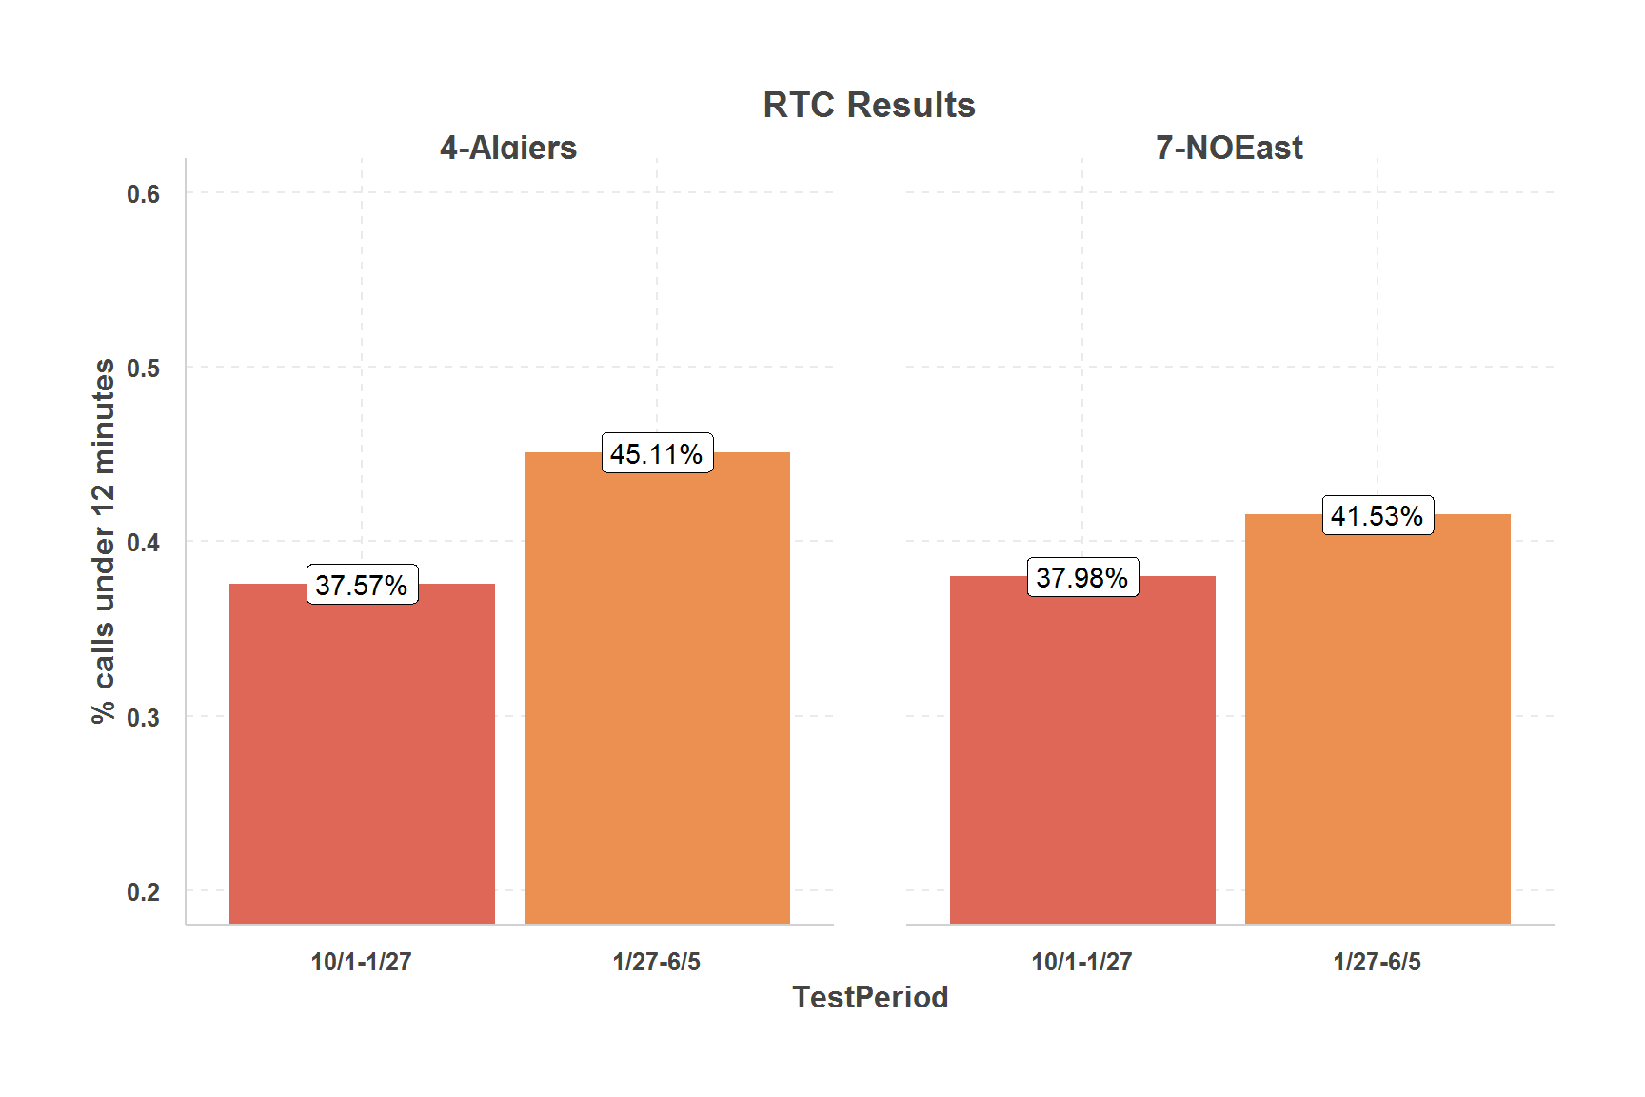
The initiative benefited the areas of the city (West Bank and New Orleans East) that suffered from slower response times the most

