Slide 1
Inflation Report

Slide 2
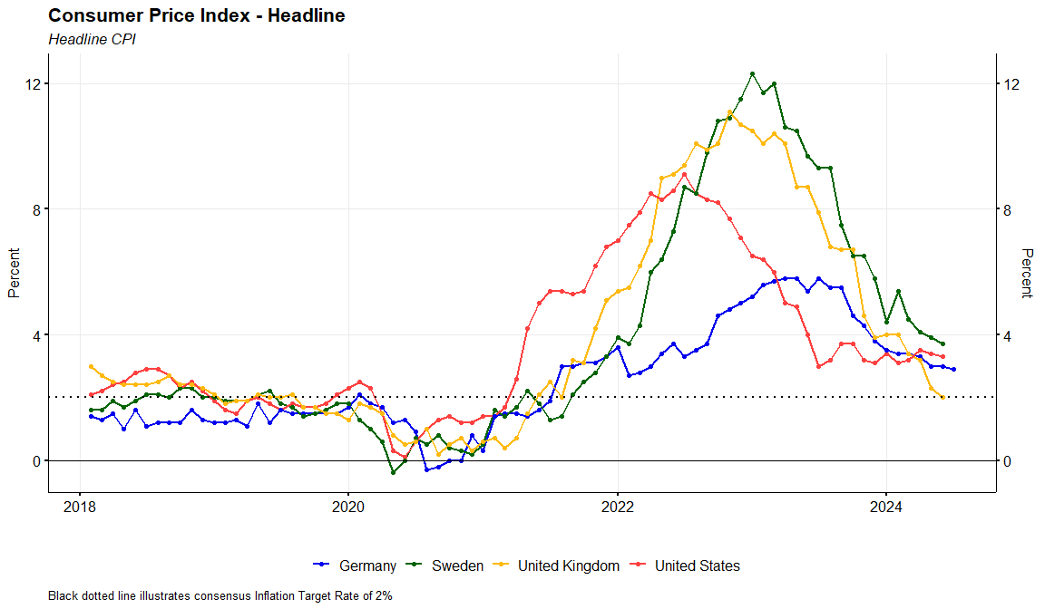
CPI Headline

Slide 3
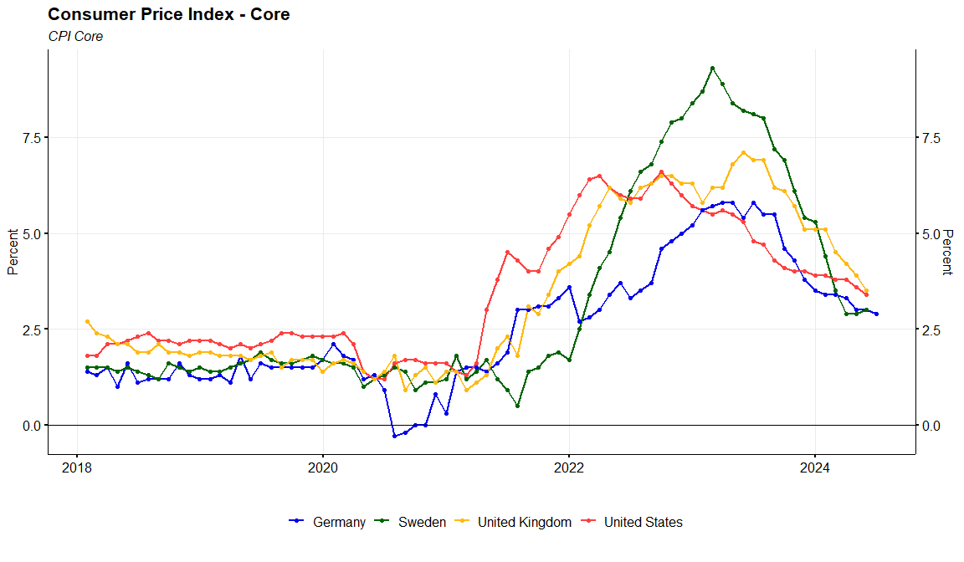
CPI Core

Slide 4
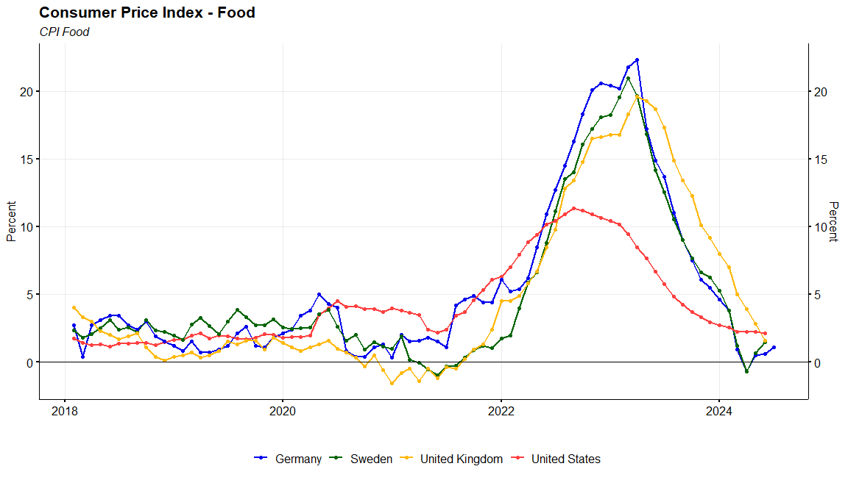
CPI Food

Slide 5
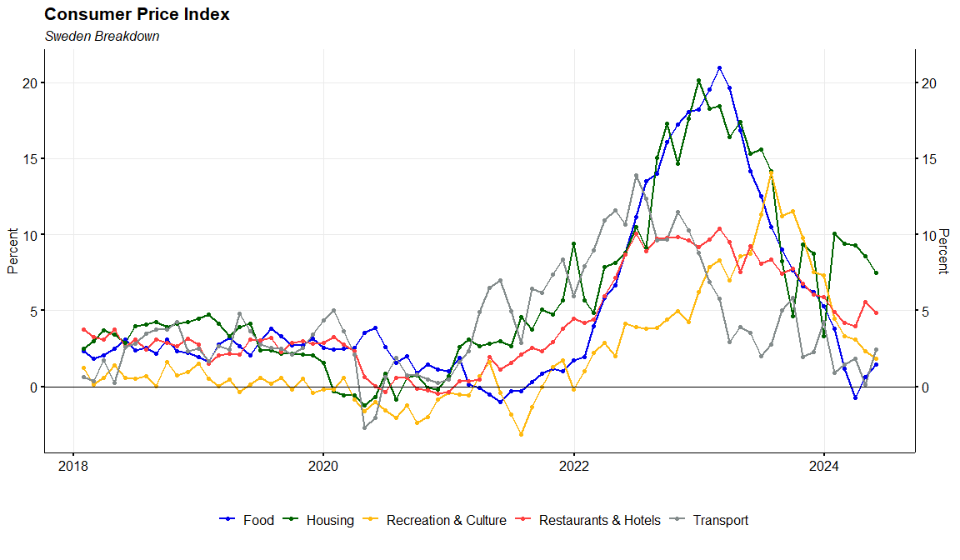
CPI Sweden Breakdown

Slide 6
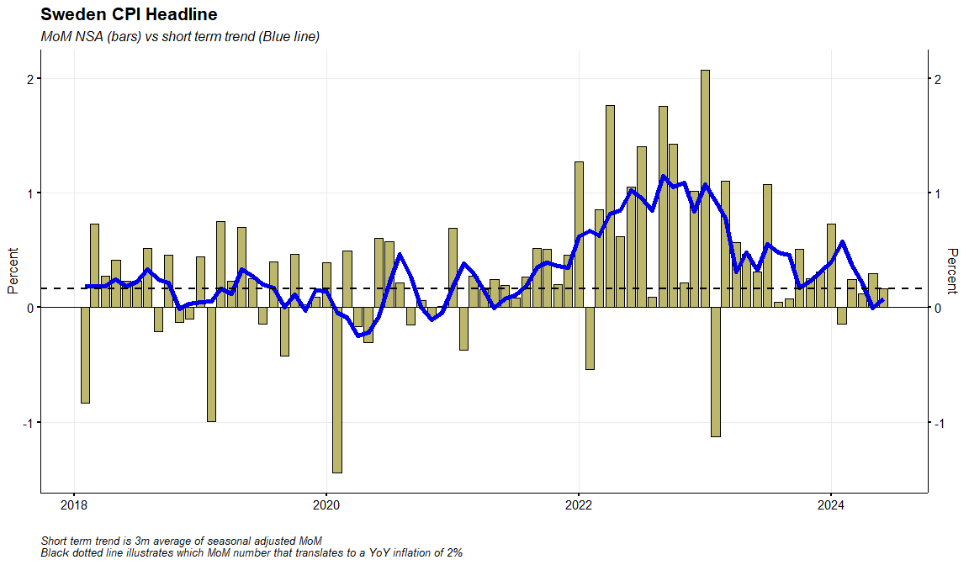
Sweden CPI Headline

Slide 7
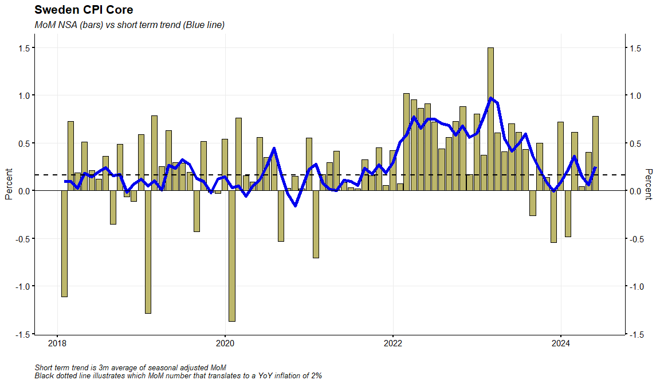
Sweden CPI Core (CPIF ec Energy)

Slide 8
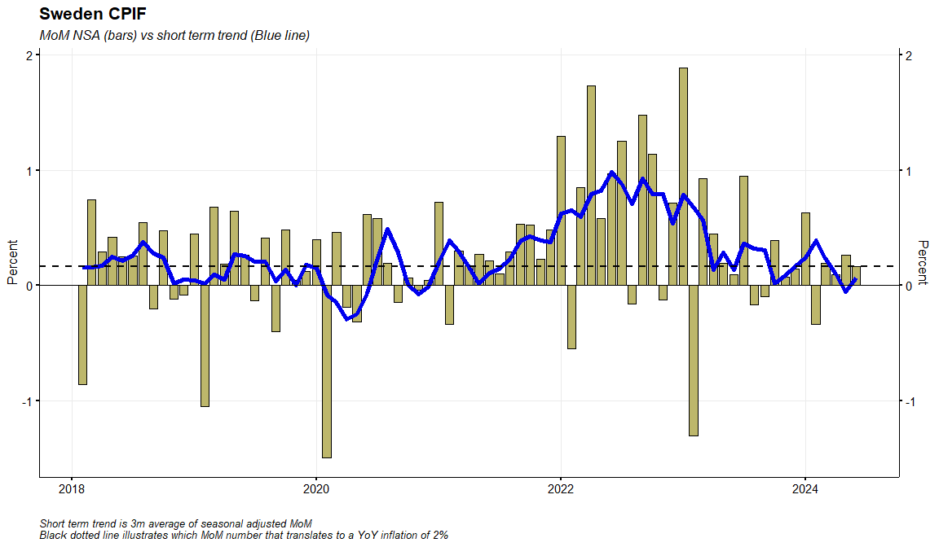
Sweden CPIF

Slide 9
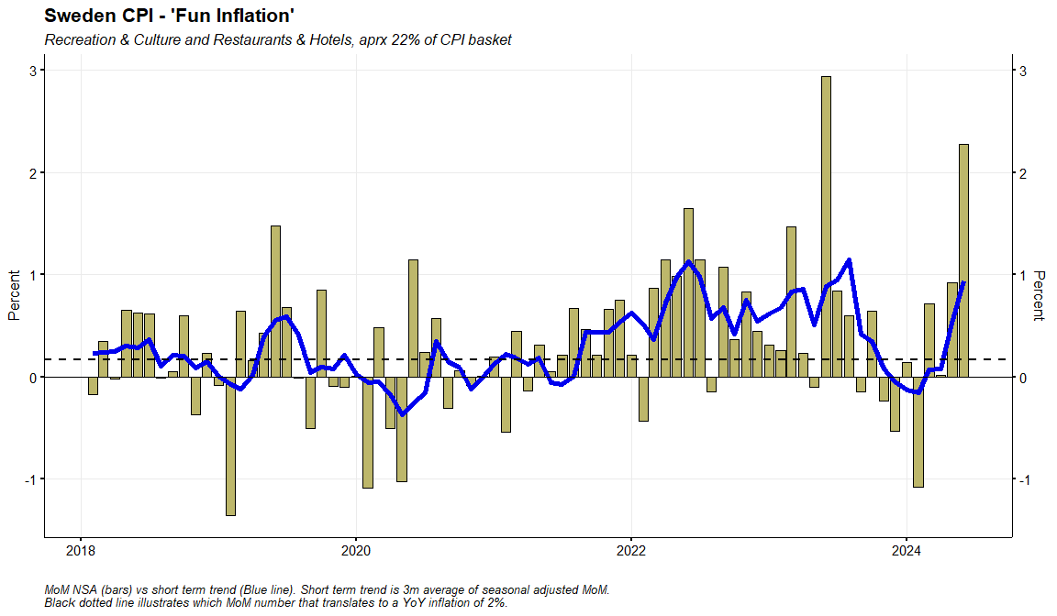
Sweden CPI - ‘Fun Inflation’

Slide 10
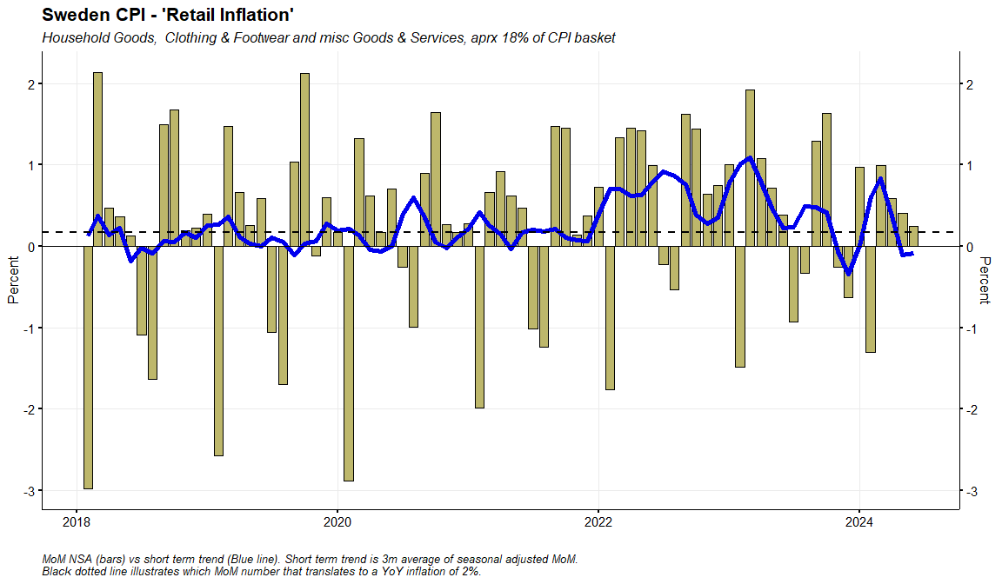
Sweden CPI - ‘Retail Inflation’

Slide 11
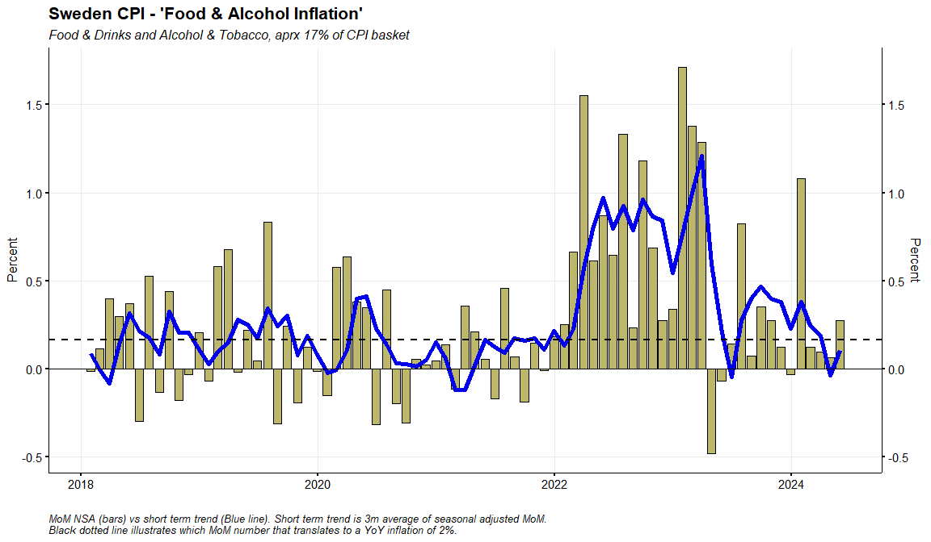
Sweden CPI - ‘Food & Alcohol Inflation’

Slide 12
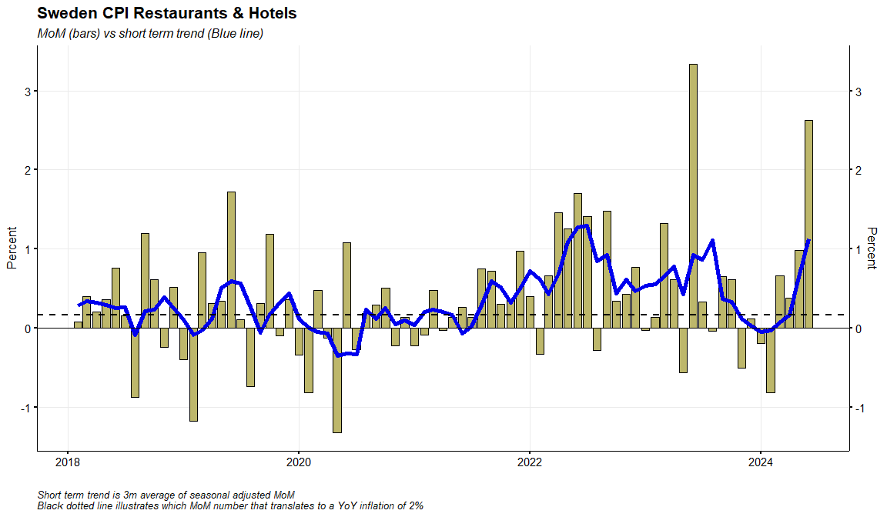
Sweden CPI Restaurants & Hotels

Slide 13
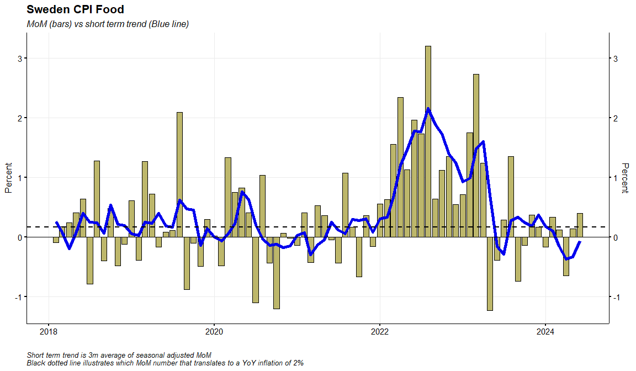
Sweden CPI Food

Slide 14
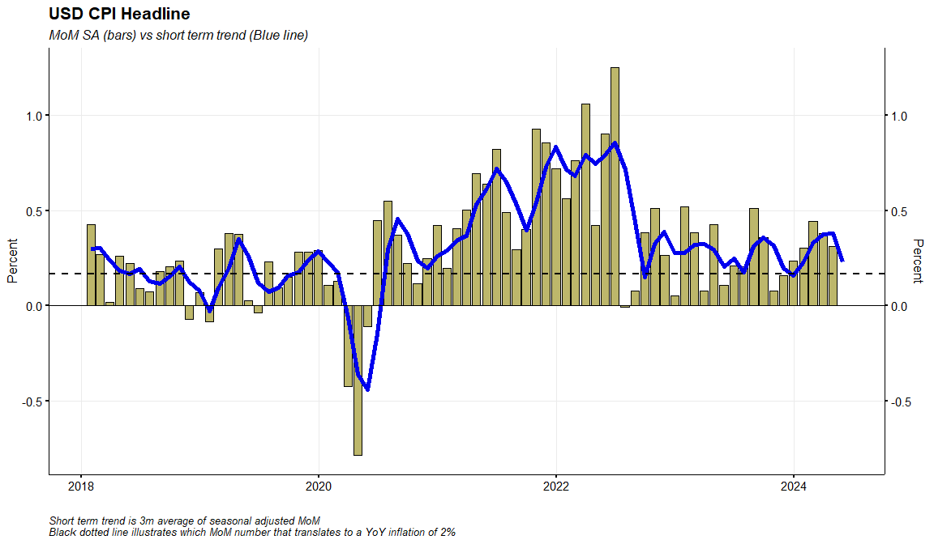
US CPI Headline

Slide 15
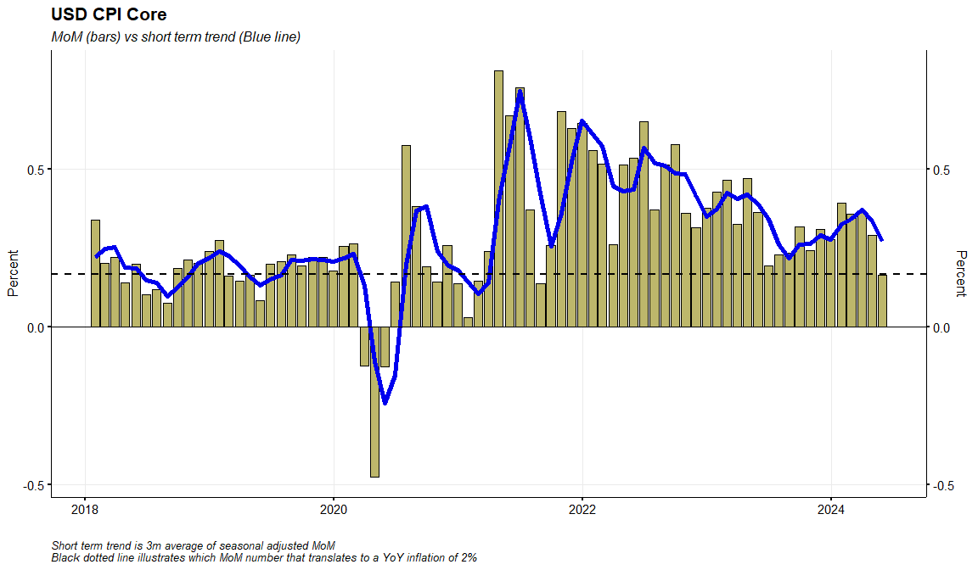
US CPI Core

Slide 16
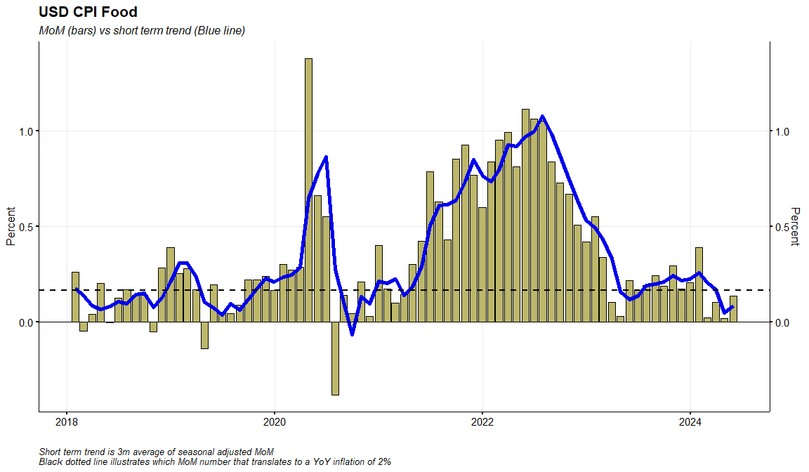
US CPI Food

Slide 17
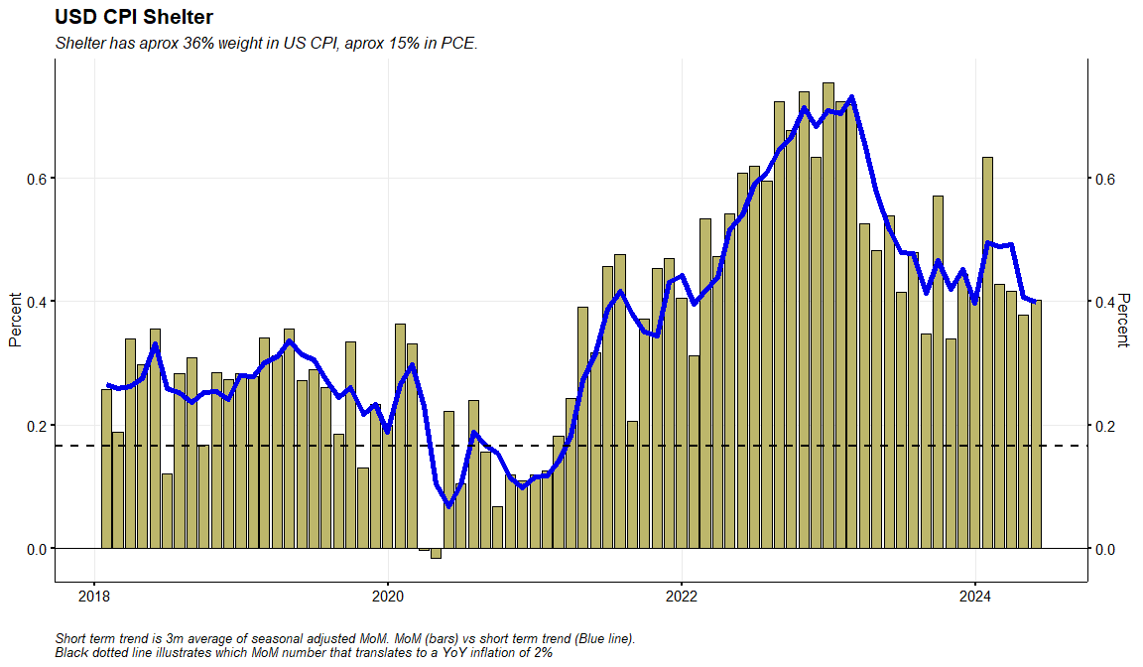
US CPI Shelter

Slide 18
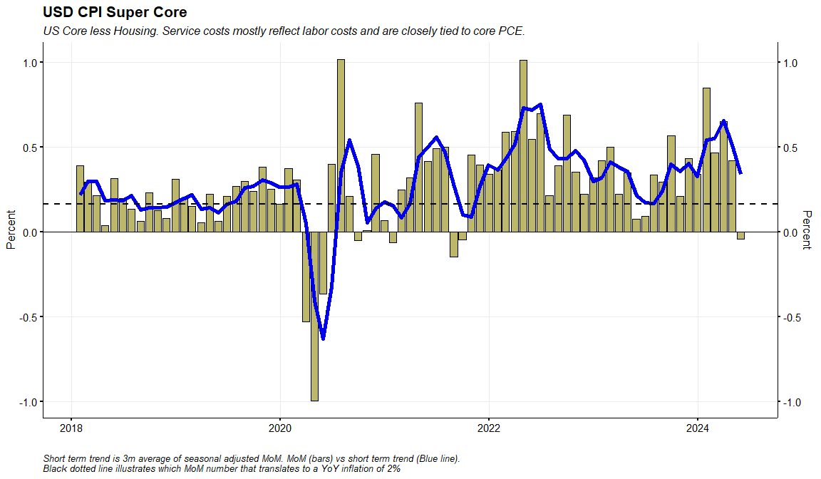
US CPI Super Core

Slide 19
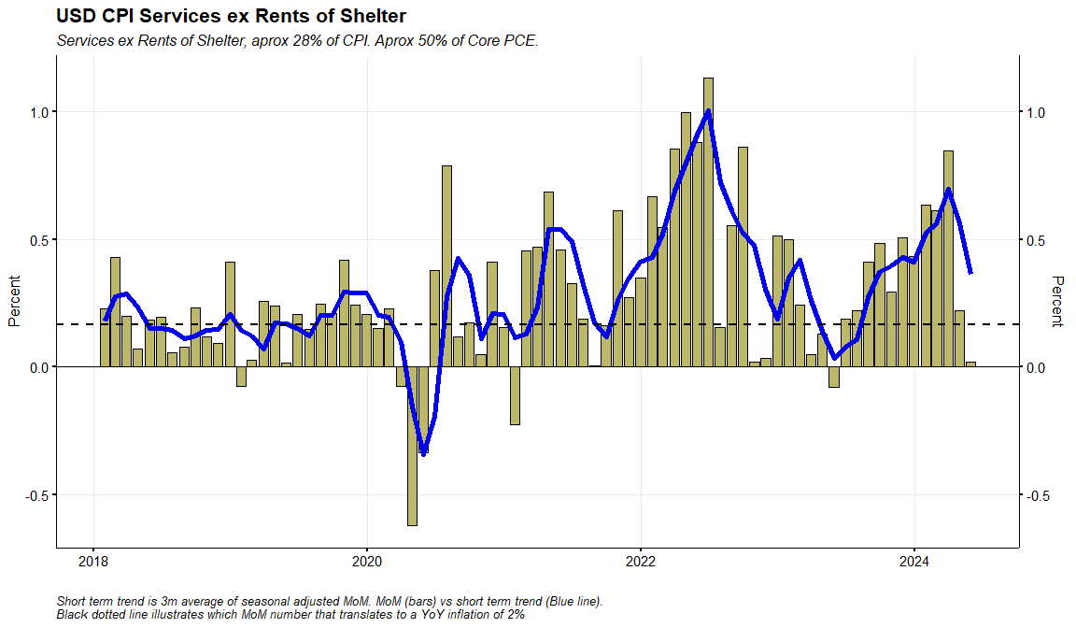
US CPI Services ex Rents of Shelter

Slide 20
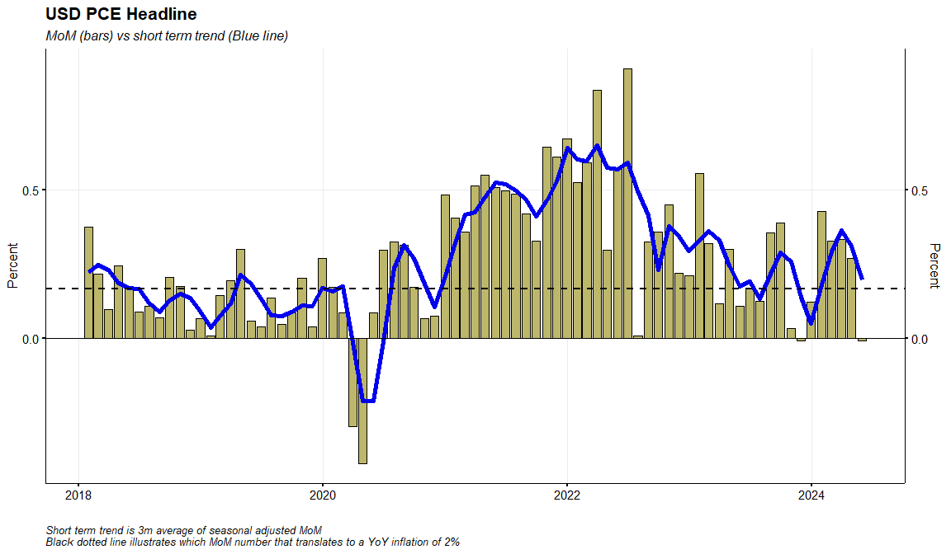
US PCE Headline

Slide 21
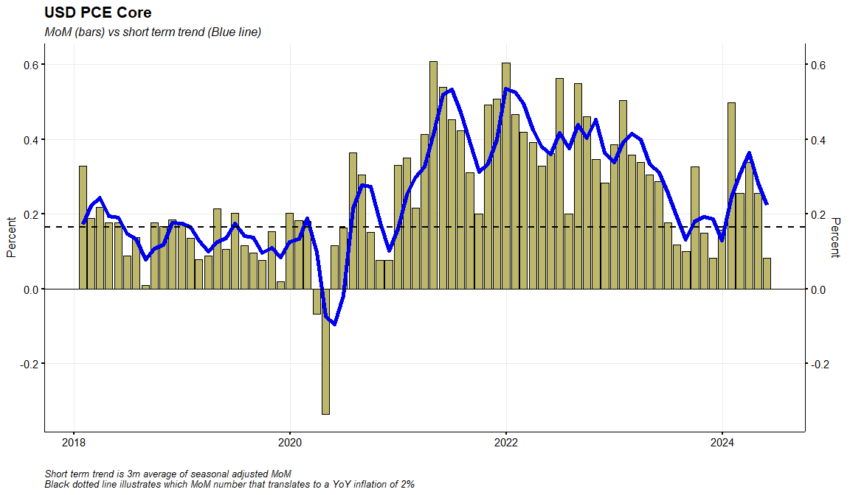
US PCE Core

Slide 22
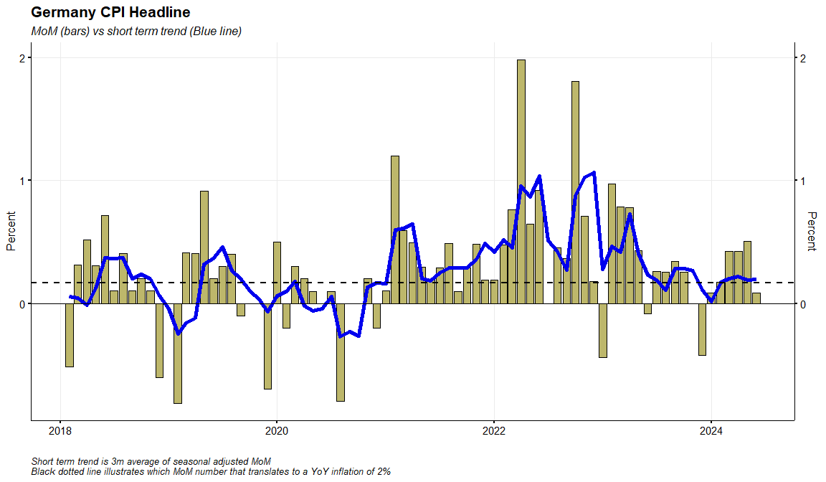
Germany CPI Headline

Slide 23
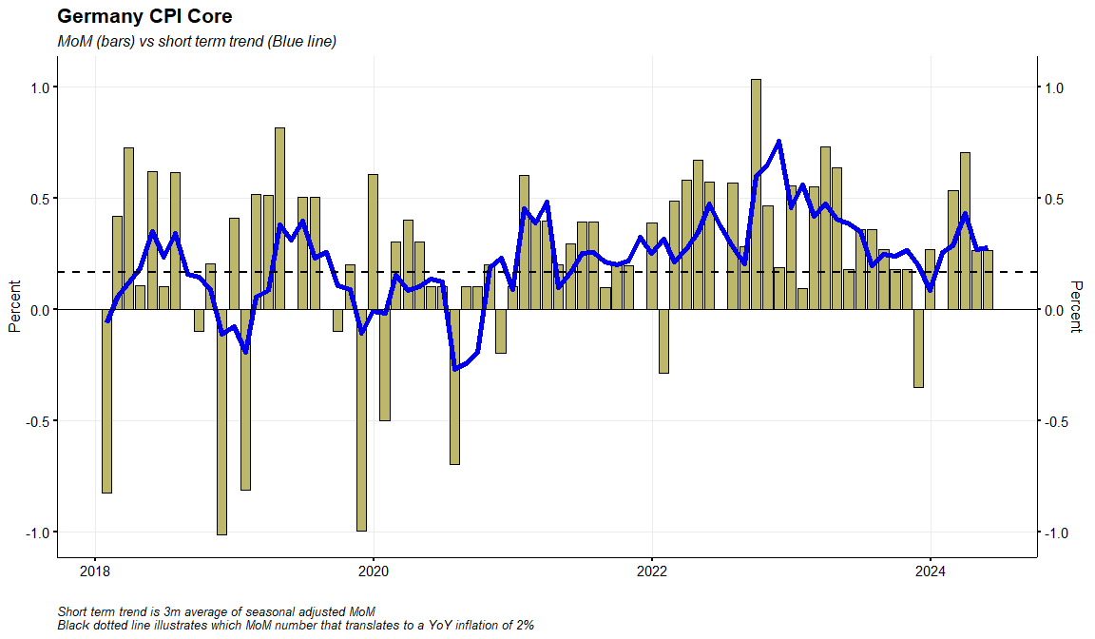
Germany CPI Core

Slide 24
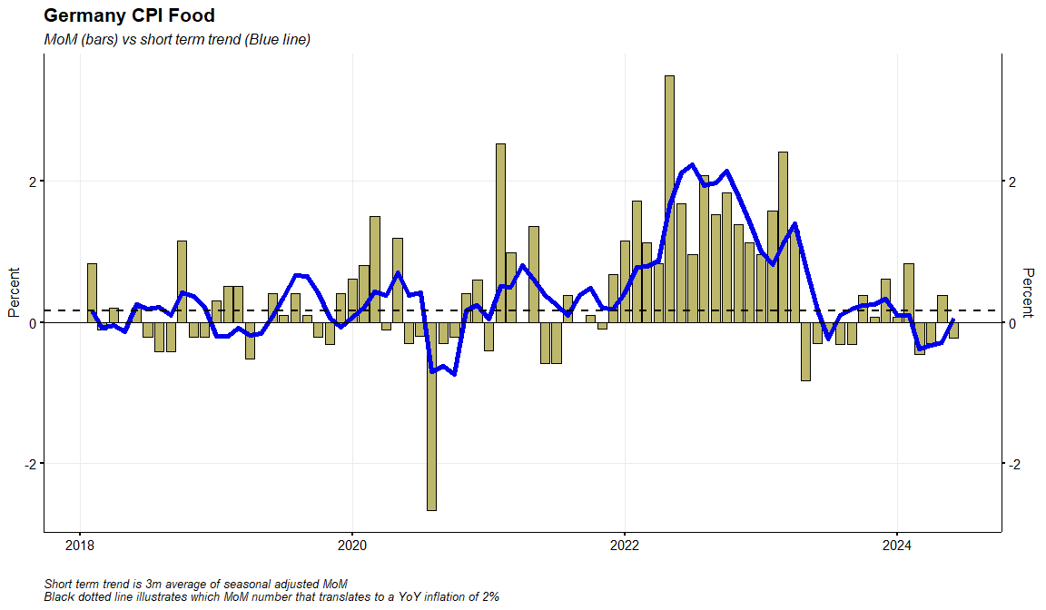
Germany CPI Food

Slide 25
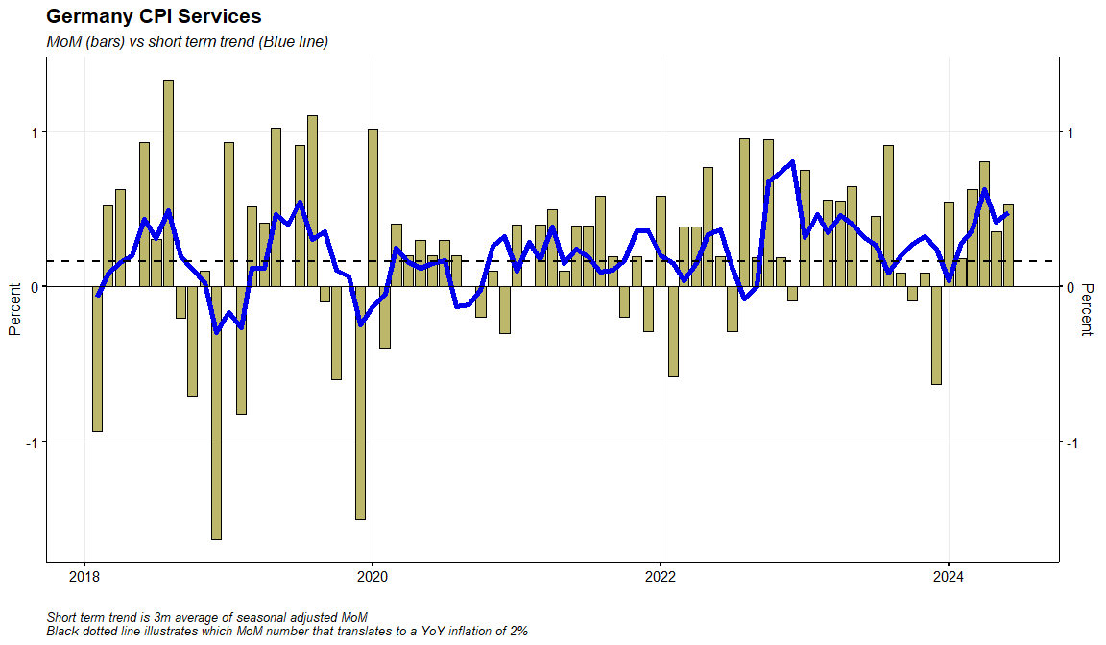
Germany CPI Services

Slide 26
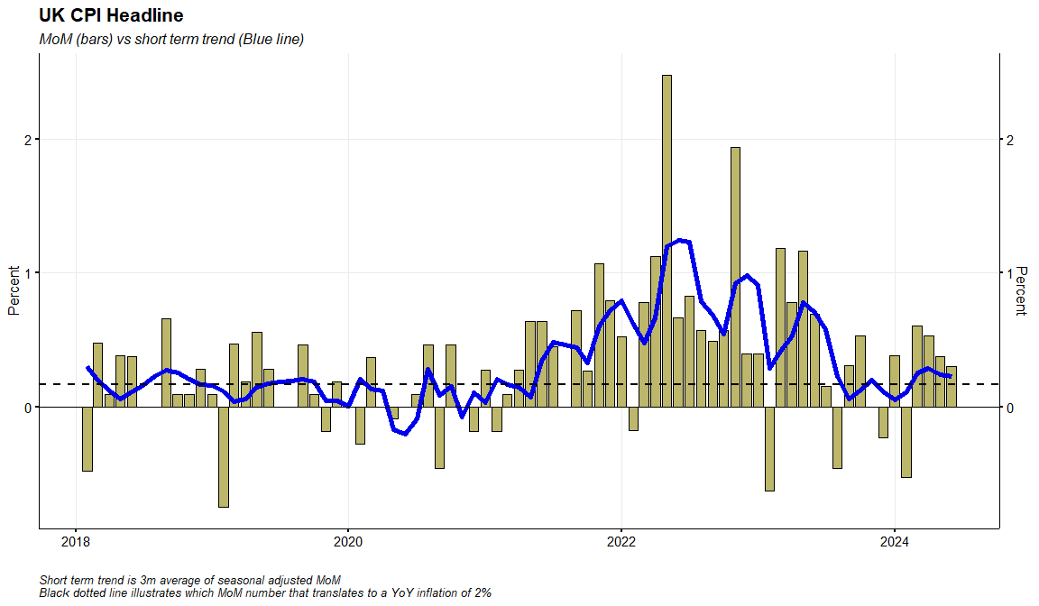
UK CPI Headline

Slide 27
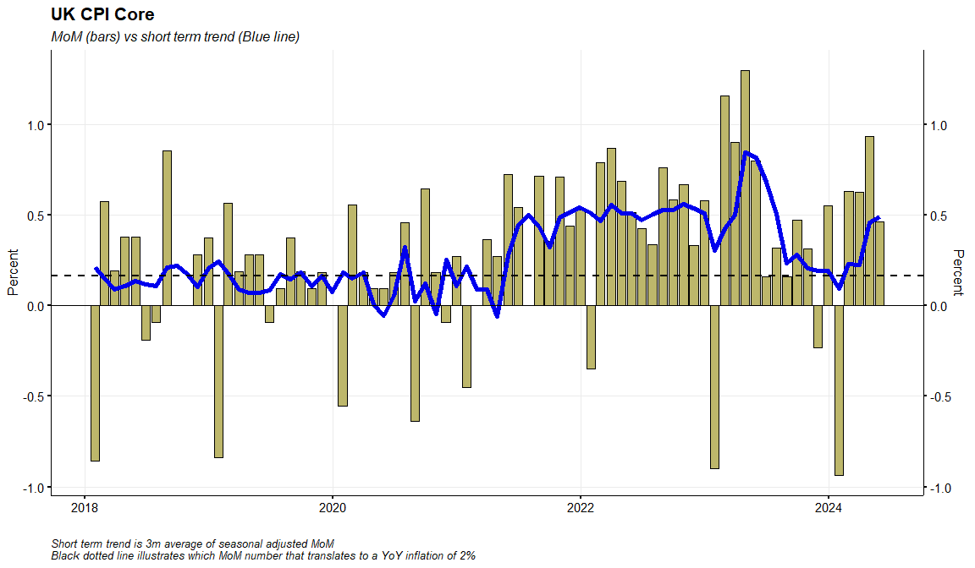
UK CPI Core

Slide 28
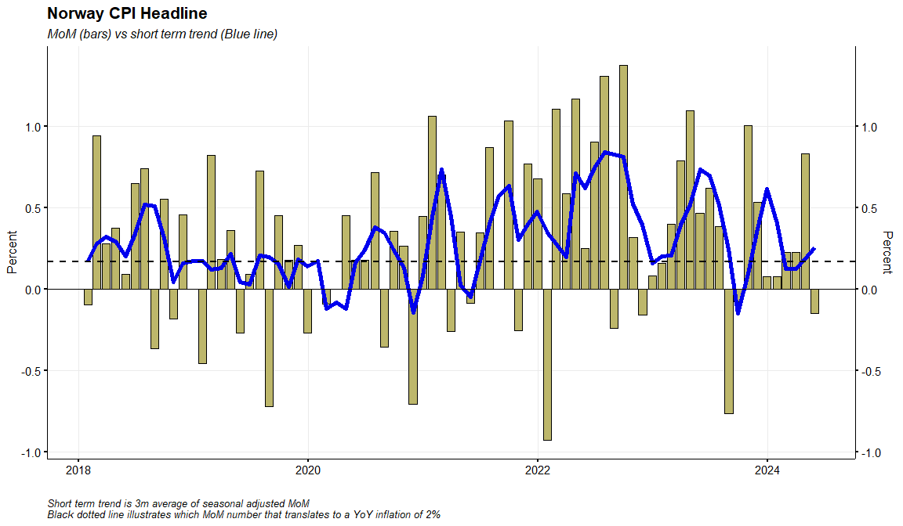
Norway CPI Headline

Slide 29
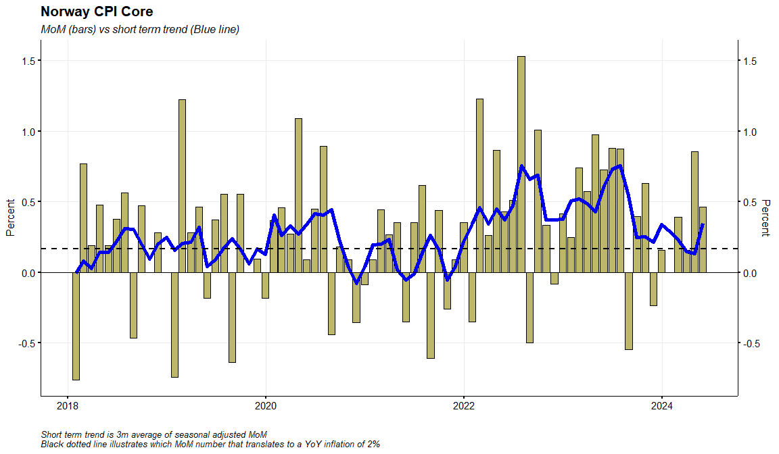
Norway CPI Core

Slide 30
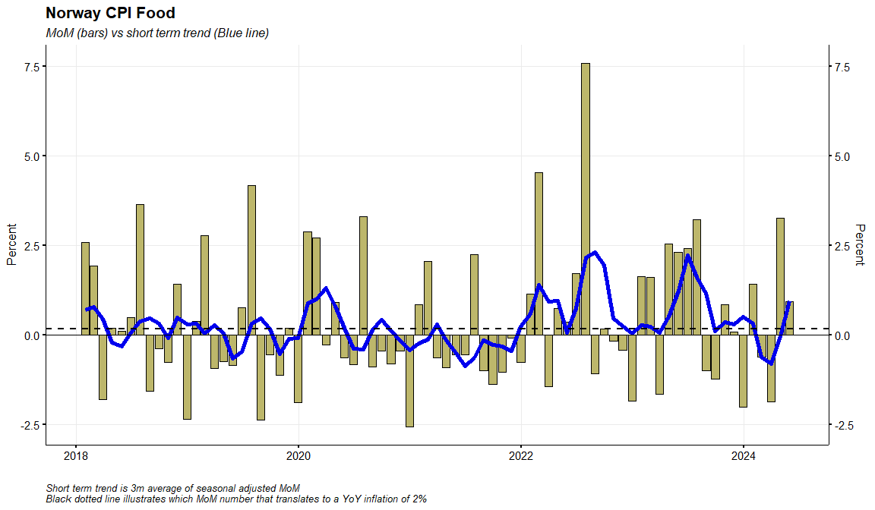
Norway CPI Food

Slide 31
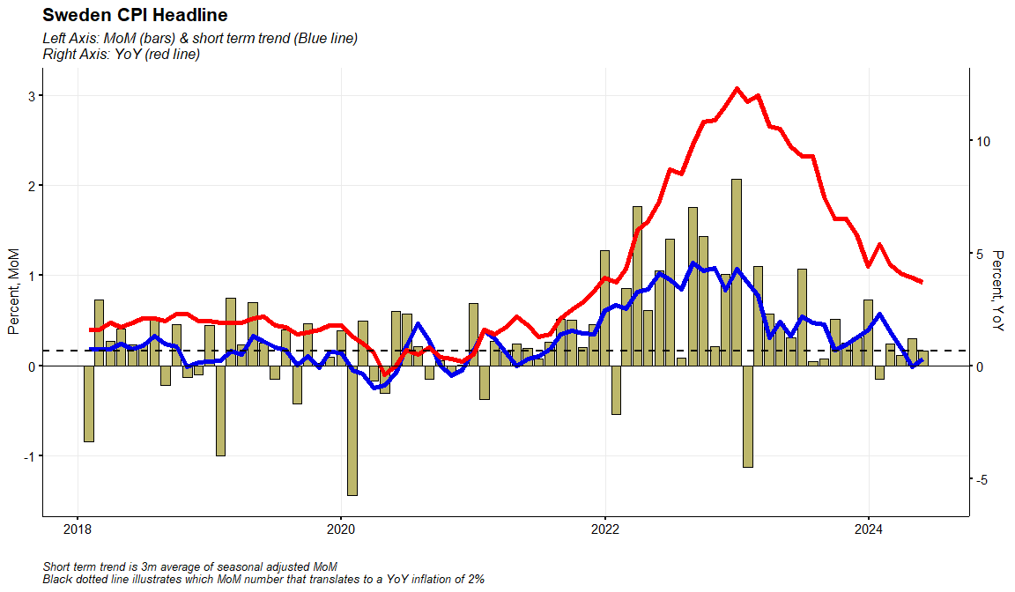
Sweden CPI Headline

Slide 32
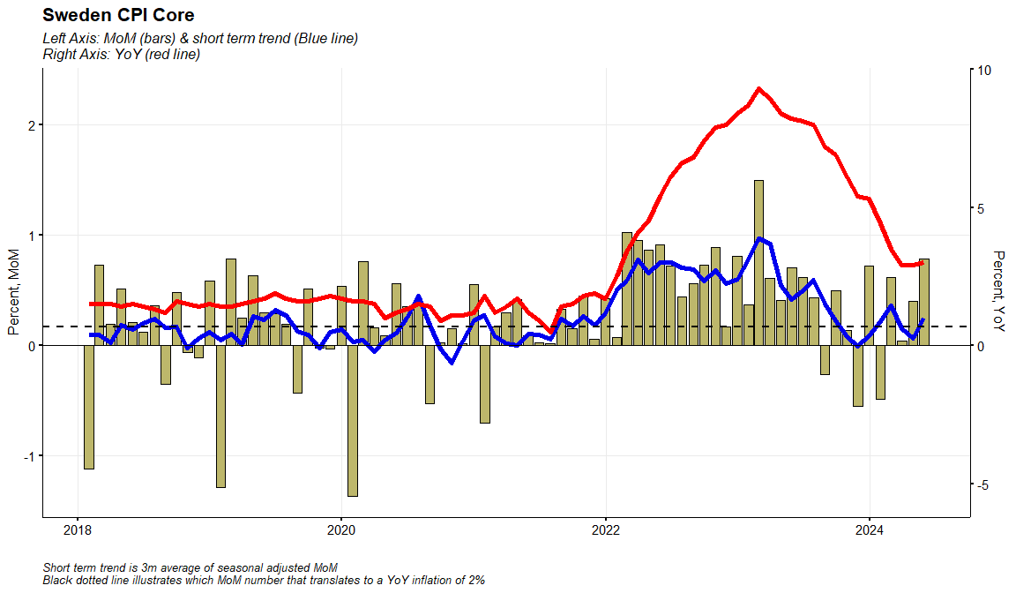
Sweden CPI Core (CPIF ex Energy)

Slide 33
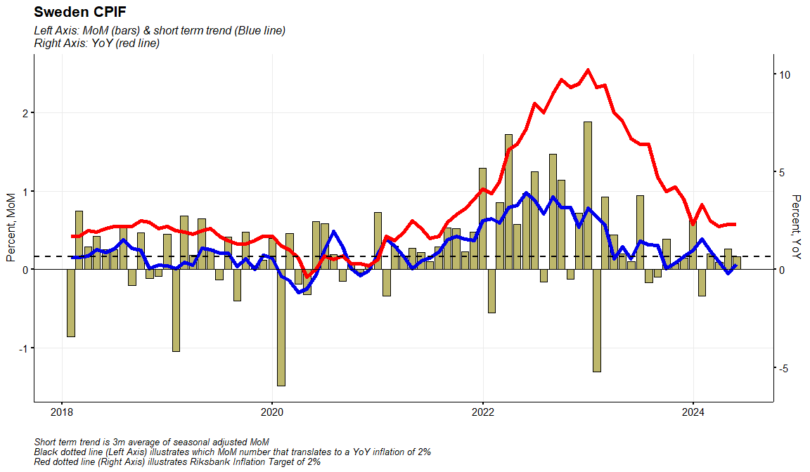
Sweden CPIF

Slide 34
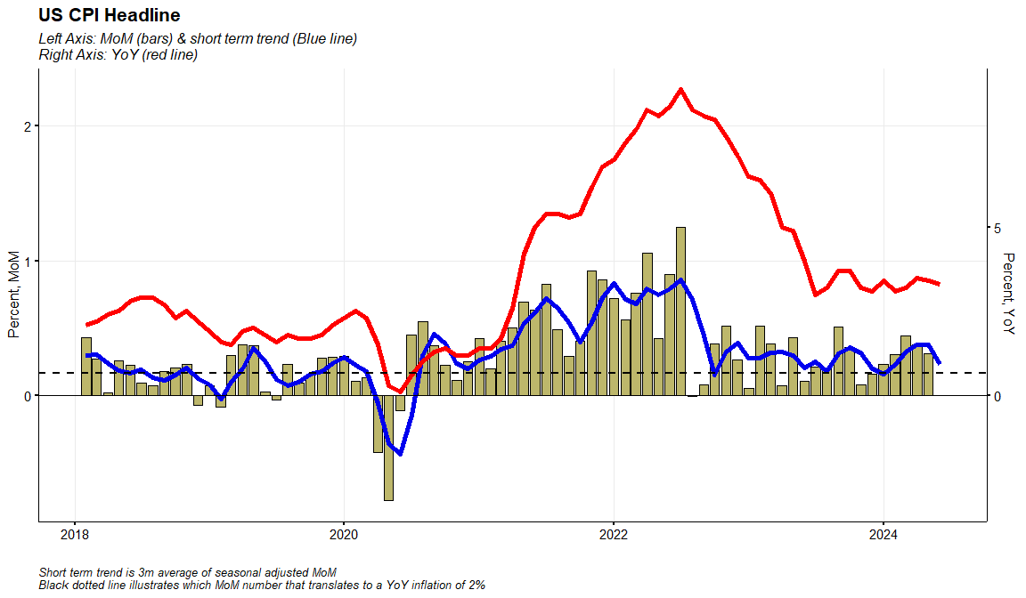
US CPI Headline

Slide 35
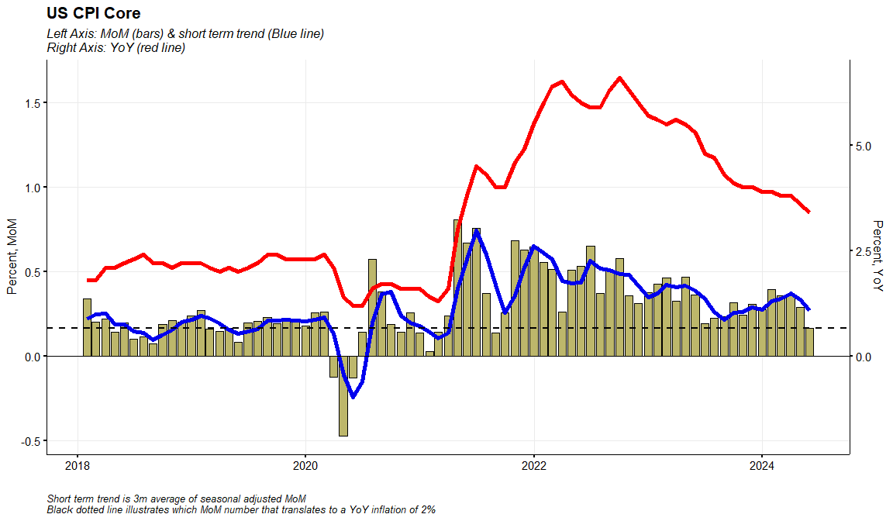
US CPI Core

Slide 36
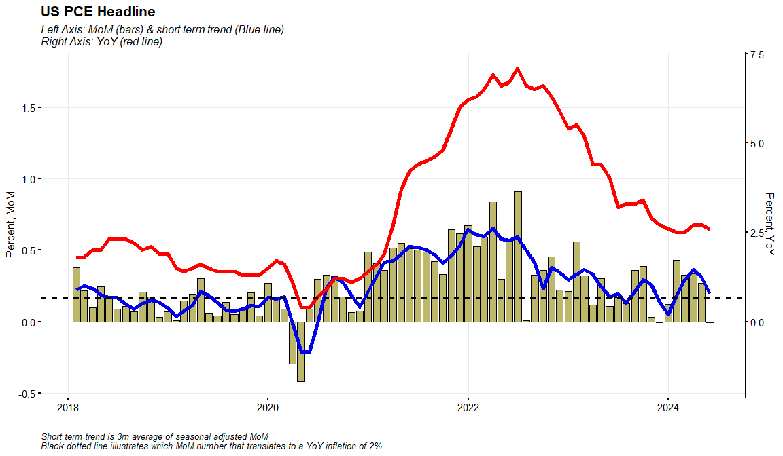
US PCE Headline

Slide 37
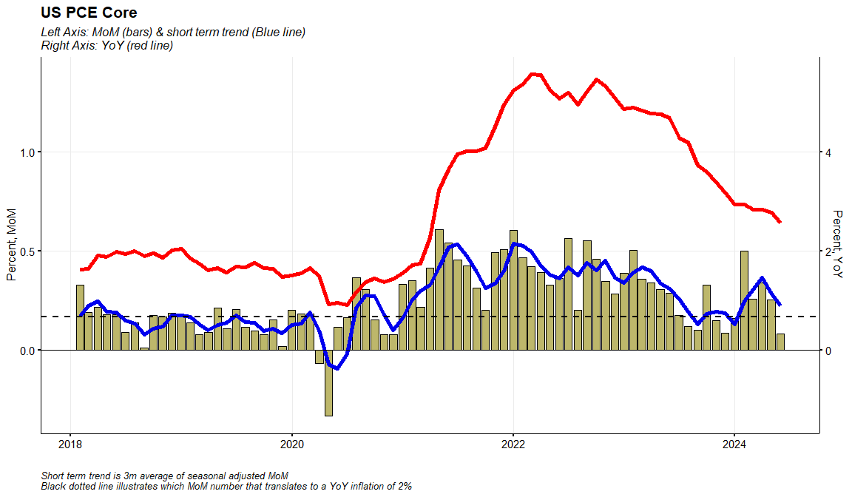
US PCE Core

Slide 38
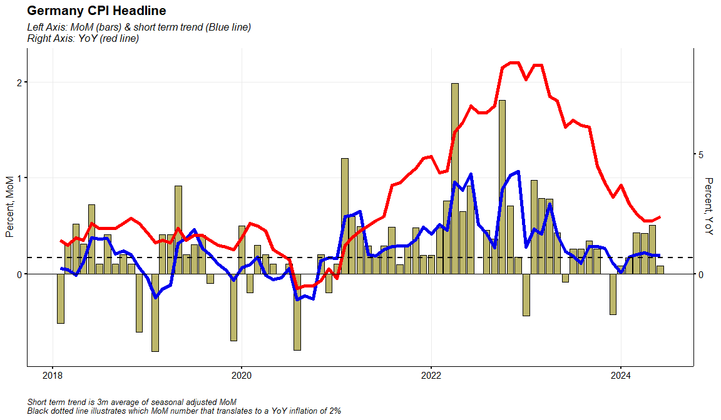
Germany CPI Headline

Slide 39
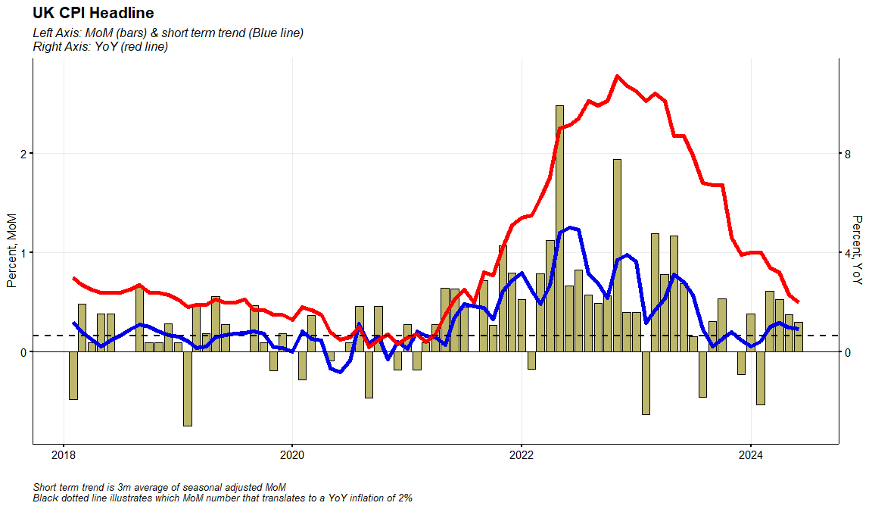
UK CPI Headline

Slide 40
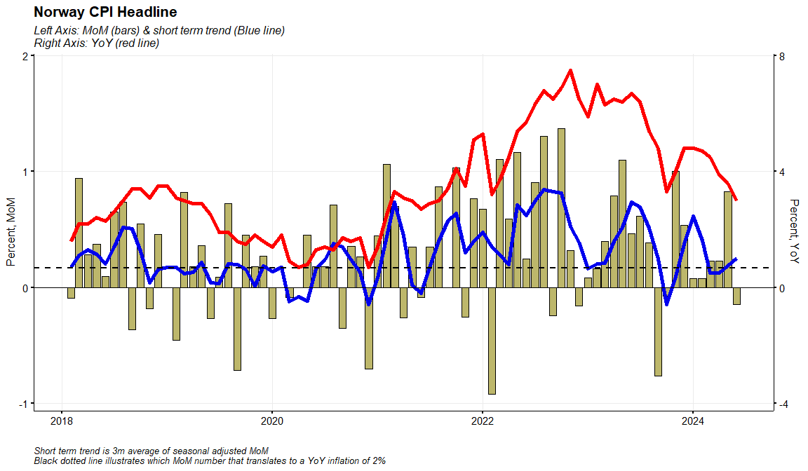
Norway CPI Headline

Slide 41
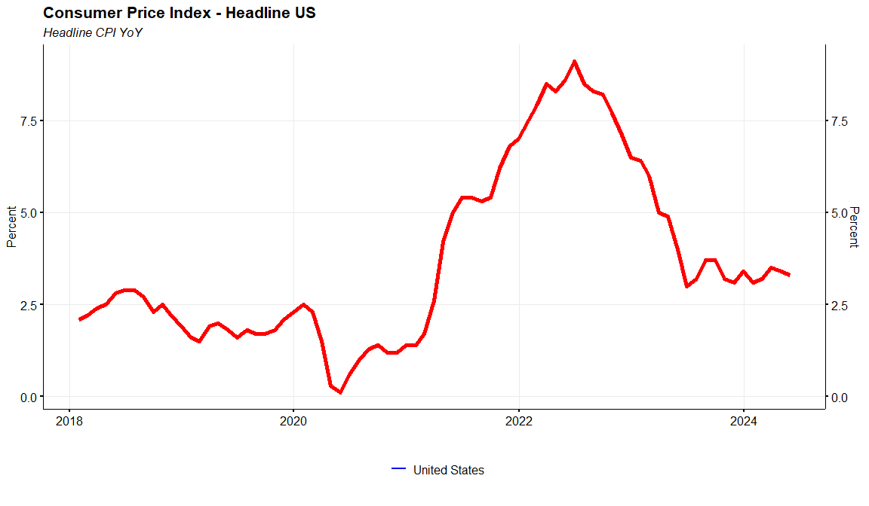
US CPI Headline

Slide 42
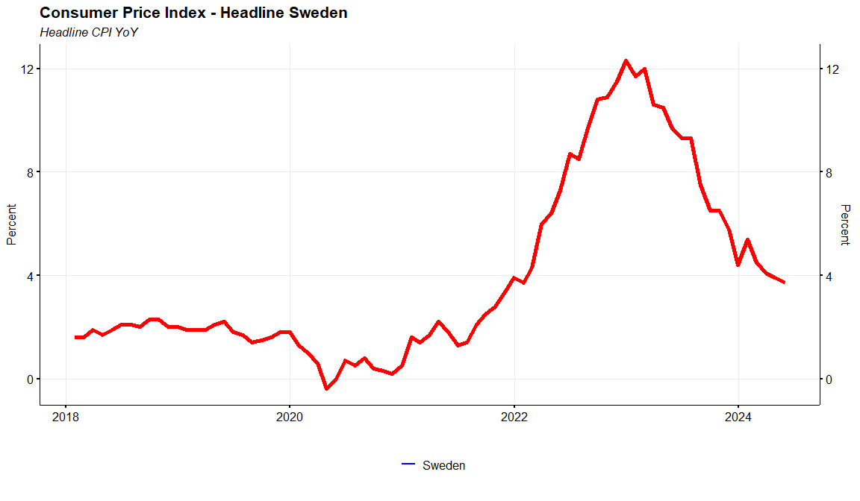
Sweden CPI Headline

Slide 43
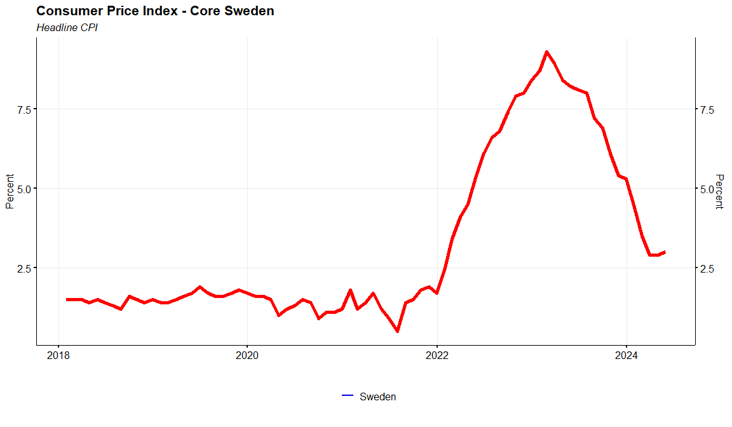
Sweden CPI Core

Slide 44
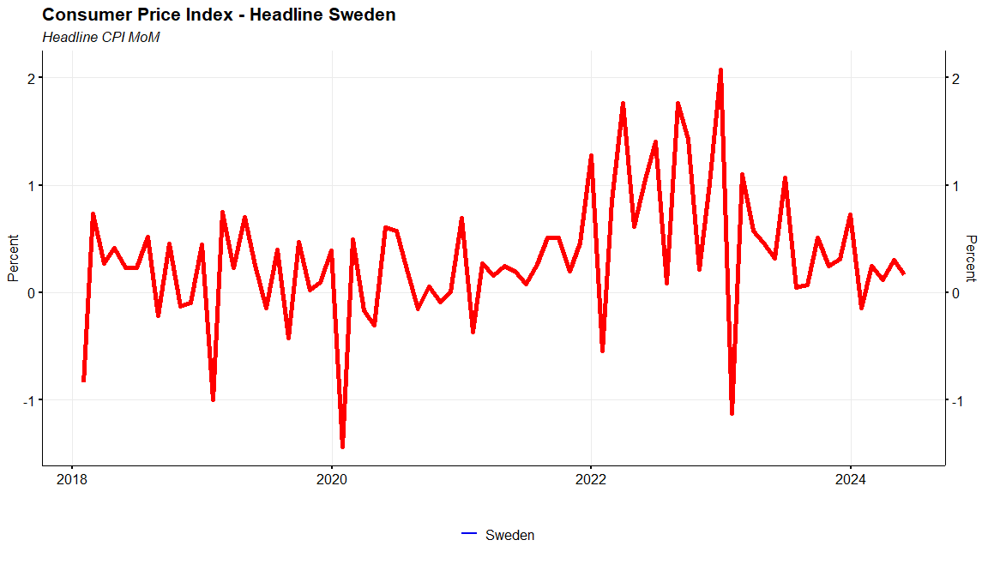
Sweden CPI Headline MoM

Slide 45
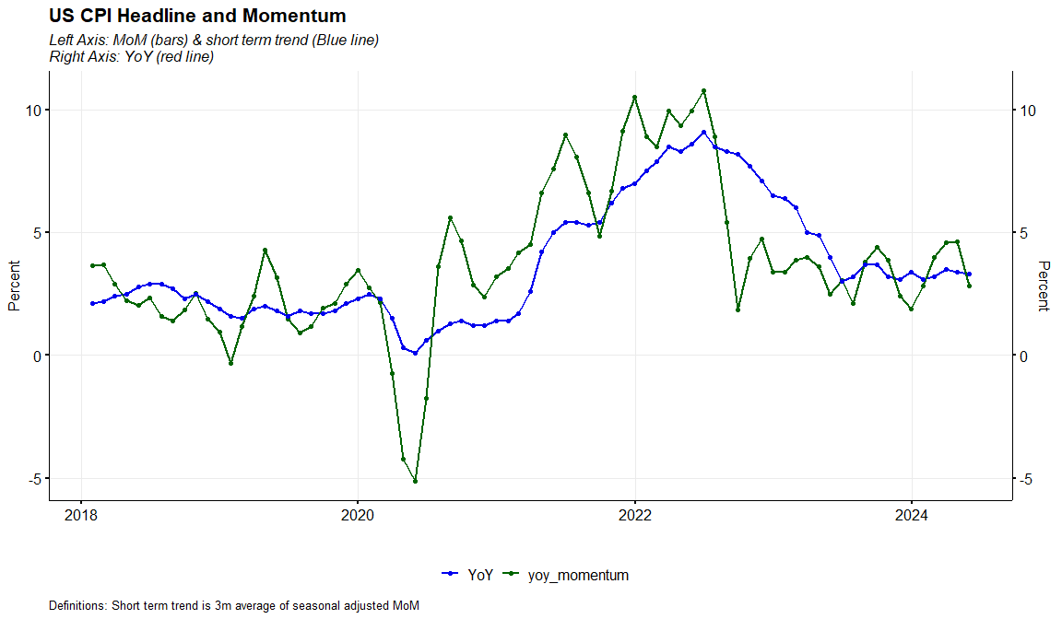
US CPI YoY & Momentum

Slide 46
Sweden CPI Headline

Slide 47
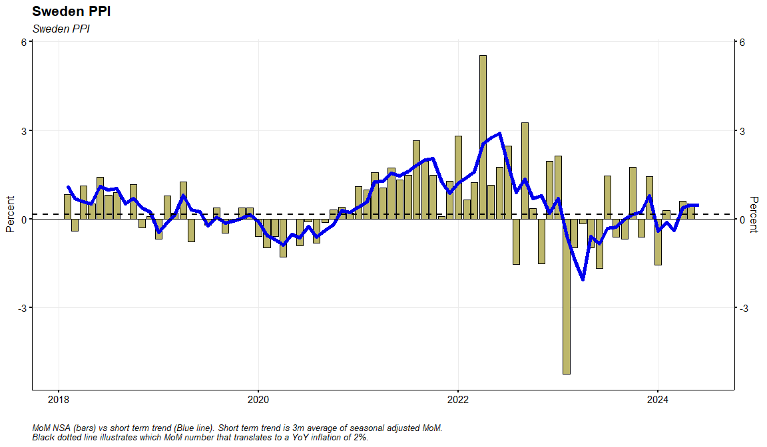
Sweden PPI

Slide 48
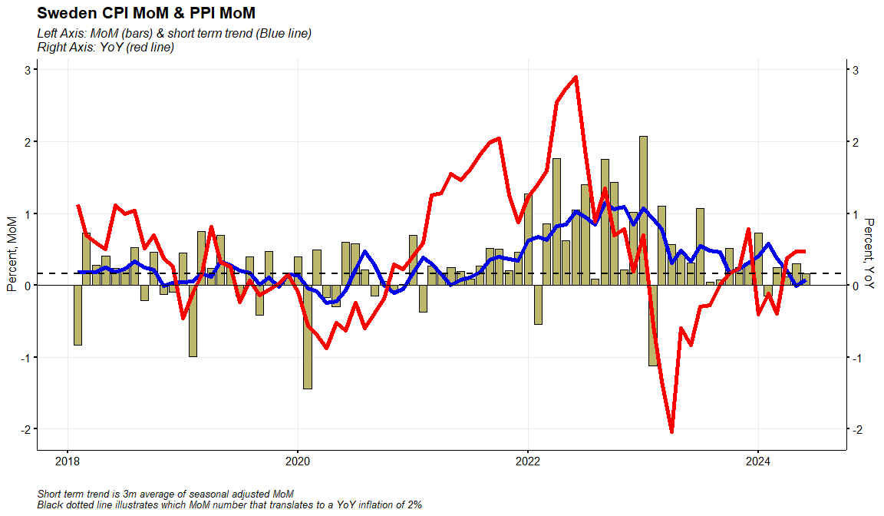
Sweden CPI MoM & PPI MoM

Slide 49
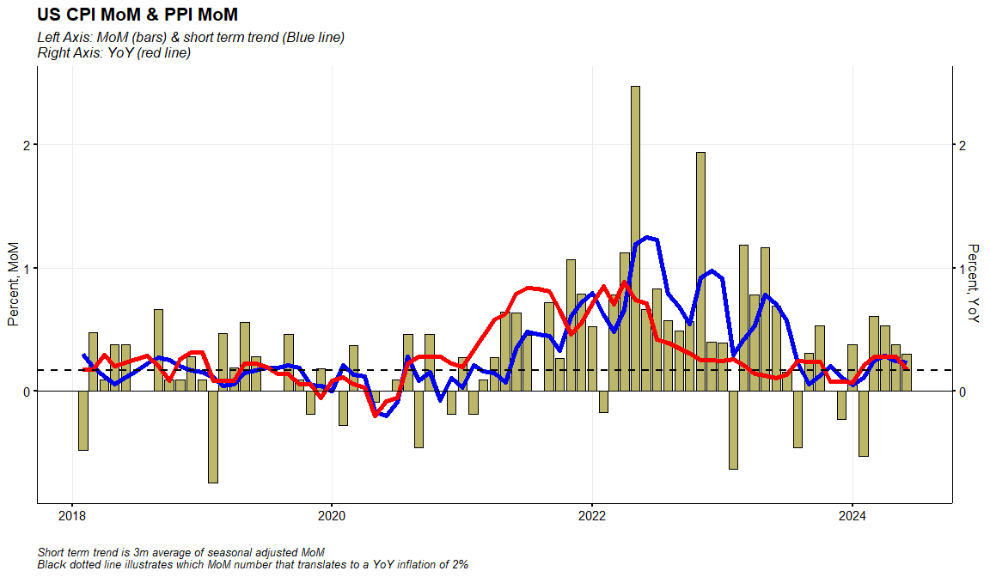
US CPI MoM & PPI MoM

Slide 50
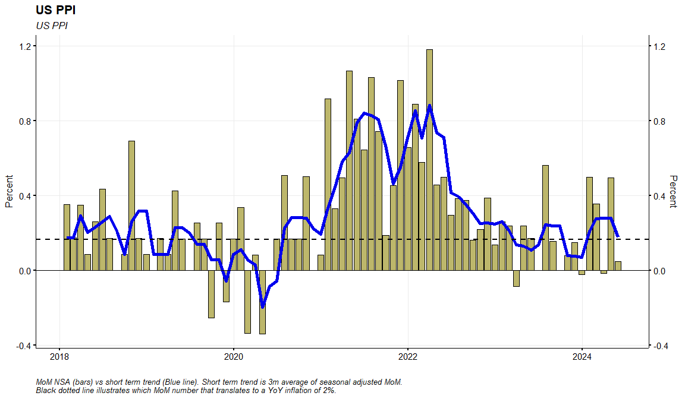
US PPI

