Slide 1
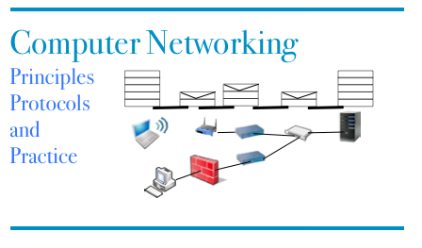
Part 10
Router traffic control
© O. Bonaventure, UCLouvain, 2023. Supplementary material for the Computer Networking : Principles, Protocols and Practice ebook, https://www.computer-networking.info

Slide 2
Agenda
Congestion Control
Principles
Additive Increase/Multiplicative Decrease
Explicit Congestion Notification
Modern TCP Congestion control
Router behavior

Slide 3
Ressources
K. Nichols, V. Jacobson, Controlling Queue Delay, Commun. ACM, 55 (7) (2012), pp. 42-50, https://doi.org/10.1145/2209249.2209264
RFC8289
RFC8290
Toke Høiland-Jørgensen, Per Hurtig, Anna Brunstrom, The Good, the Bad and the WiFi: Modern AQMs in a residential setting, Computer Networks,Volume 89, 2015, https://doi.org/10.1016/j.comnet.2015.07.014

Slide 4
Traffic control techniques
What are the techniques that a single router can use to provide different types of services to different applications ?
First step : identify the applications that need to obtain each service type
Second step : allocate network ressources to the different applications

Slide 5
Router output port
IP packets
IP packets with internal ID
IP packets
Input link 1
Classifier
Output link
Input link N

Slide 6
How would you implement a classifier ?
Per source classification ?
IP address, IP prefix, TCP/UDP ports ?
Per destination classification ?
IP address, IP prefix, TCP/UDP ports ?
Per application classification ?

Slide 7
Buffer Acceptance
How to decide which packets can be accepted inside the buffer ?
Input links
Classification
Buffer
Output link

Slide 8
Buffer Acceptance
The two key questions for a buffer acceptance algorithm
When should the BA algorithm decide to discard a packet ?
Which packet should be discarded ?

Slide 9
Buffer Acceptance Algorithms
Tail drop
Arrival (Packet p) : if isFull(Buffer) then discard p; else AddTail(Buffer, p);
What are its advantages and drawbacks ?

Slide 10
The traffic control building blocks on router
Scheduler
Chooses the packet to
be transmitted first on
the output link
Queuing strategy
Logical organisation of the
router's buffers
Q[1]
Q[2]
Classification
Q[3]
Output link
Input links
Q[N]

Slide 11
Priority scheduling
Flow 1, class A
Output buffer
Flow 2, class B
Class A
Flow 3, class B
Class B
Flow 4, class B
Class C
Flow N, class C
Packet transmission :
if (Queue(A) not empty)
serve Queue(A);
else
if (Queue(B) not empty)
serve Queue(B);
else
if (Queue(C) not empty)
serve Queue(C);
else ....

Slide 12


Priority scheduling
High priority Queue
D
A
Medium Priority Queue
F
E
B
Low Priority Queue
C
With the priority scheduler, what is the ordering of the packets on the output link ?

Slide 13
Round-Robin scheduling
Flow 1
Flow 1
Flow 2
Flow 2
Flow 3
Flow 3
Flow 4
Scheduler :
Flow 5
Flow N
F1
FN
F2
F4
F3

Slide 14
Round robin
Queue 1
B
A
Queue 2
F
E
D
Queue 3
G
If the RR scheduler starts with queue1 and serves them in numerical order, what is the ordering of the packets on the output link ?

Slide 15
Round-robin : example
Flow1(L=1)
F1
Flow2 (L=2)
F2
Flow3 (L=1)
F3
F1
Flow1 and Flow3 send packets of size 1
Flow 2 sends packets of size 2
F3
F2

Slide 16
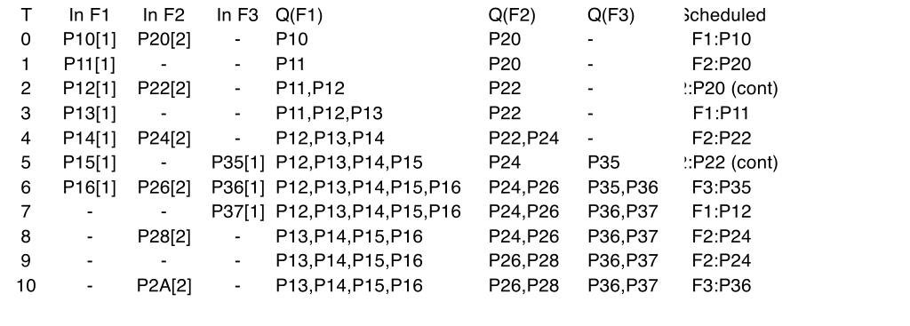
Example
Flow1(L=1)
F1
Flow2 (L=2)
F2
Flow3 (L=1)
F3
F1
Flow1 and Flow3 send packets of size 1
Flow 2 sends packets of size 2
F3
F2

Slide 17
Round-Robin
Advantage
Can provide fairness independently of the characteristics of the flows if flows use same packet size
Drawbacks
Difficult to scale to a very large number of flows
Unfair with different packet sizes

Slide 18
Deficit Round-Robin
Flow 1
Flow 1
Flow 2
Flow 2
Flow 3
Flow 3
Flow 4
Scheduler :
Flow 5
Flow N
F1
FN
F2
associate counter d[i] to each queue
increase d[i] by quantum every time queue[i] is visited
if first_packet of queue[i] larger than d[i] { packet stays in queue[i]; }
else { packet is transmitted on output link; d[i]=d[i]- packet length; if queue[i] is empty { d[i]=0; } }
F4
F3

Slide 19
Deficit Round-Robin : example
Flow1(L=1)
F1
Flow2 (L=2)
F2
Flow3 (L=1)
F3
F1
Flow1 and Flow3 send packets of size 1
Flow 2 sends packets of size 2
F3
F2

Slide 20
Deficit Round robin
Queue 1
B
A
Queue 2
F
D
Queue 3
G
If the DRR scheduler starts with queue1 and serves them in numerical order, what is the ordering of the packets on the output link ?

Slide 21
Weighted Round-Robin
Flow 1
Flow 1
Flow 2
Flow 2
Flow 3
Flow 3
Flow 4
Scheduler :
Flow 5
Flow 5
F1
F5
F2
F1
F1
F4
F3
F2
F1
Fraction of the bandwidth for each flow ?

Slide 22
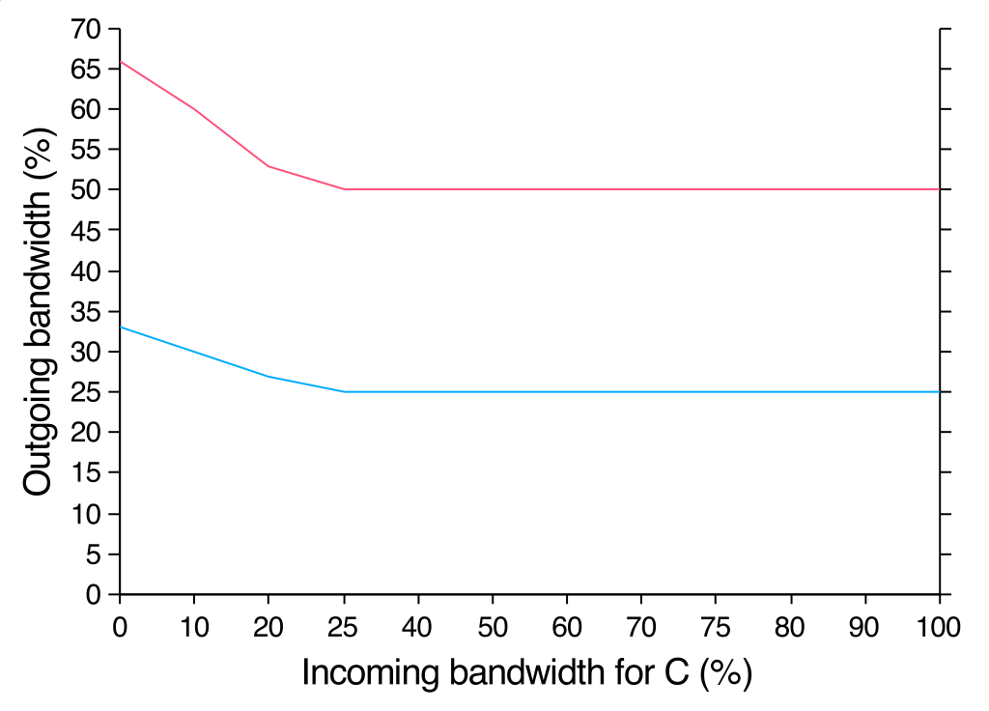
Weighted Round-Robin
Line rate
A : 25%
Line rate
B : 50%
Variable
C : 25%
B's share
A's share

Slide 23
Weighted Round Robin
A : 25%
B : 50%
C : 25%
Input Traffic pattern
A : 20%, regular
B: 60%
C: 50%

Slide 24
Weighted Round Robin
What is the impact of a burst of traffic ?
A : 75%
B : 24%
C : 1%
Input Traffic pattern
A : 20%, regular
B: 24%
C: 100%

Slide 25
Schedulers and buffer acceptance
Which buffer acceptance strategy should be used with DRR or WDRR ?
Can we identify the flow/queue that is causing congestion ?
Which packet should be discarded ?

Slide 26
Weighted Fair Queueing
What are the key characteristics of this scheduling technique ?
What are its benefits compared with DRR ?

Slide 27
Combining schedulers
Voice
Priority scheduler
Data1
66%
Data2
33%
100%
WFQ-like scheduler
Data3
1%
Input Traffic pattern
10% voice, regular
30% data1
60% data2
50% data3

Slide 28
The traffic control building blocks QoS-enabled router
Shaper
Delays flows which do not
follow some rules
Scheduler
Chooses the packet to
be transmitted first on
the output link
Queuing strategy
Logical organisation of the
router's buffers
Shaping
Q[1]
Q[2]
Classification
Q[3]
Output link
Input links
Policing
Q[N]
Policer
Verifies whether the incoming
flow follows some rules
Buffer acceptance
accepts or rejects an
incoming packet
Classifier
Identifies the flow to which
the arriving packet belongs

