Slide 1
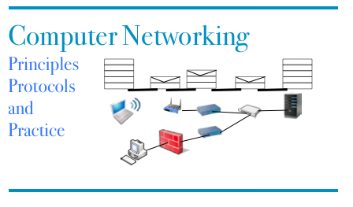
Part 3
Reliable data transfer over an unreliable network
© O. Bonaventure, UCLouvain, 2023. Supplementary material for the Computer Networking : Principles, Protocols and Practice ebook, https://www.computer-networking.info

Slide 2
Agenda
Reliable data transfer over a reliable network
How unreliable is the Internet ?
Reliable data transfer techniques
The Alternating Bit Protocol
Go-Back-N
Selective repeat

Slide 3



How to reliably transfer data ?
Hypothesis
Internet is fully reliable
A B
Data.request(a)
segment(a)
Data.request(b)
segment(b)
Data.ind(a)
Data.request(c)
segment(c)
Data.ind(b)
Data.ind(c)

Slide 4
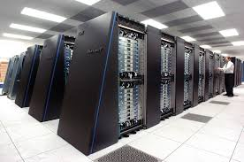
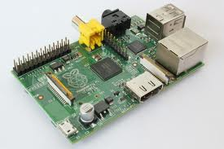
Does this always work ?

Slide 5
Question
What do we need to add to our “reliable” transfer to allow a datacenter to send data to an Internet of Things device without overflow ?

Slide 6
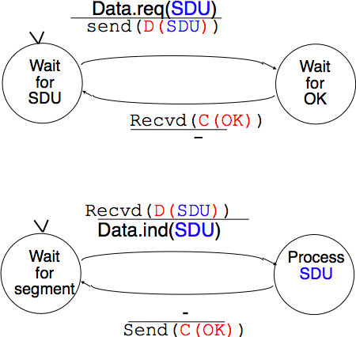
Finite State Machine
Sender
Receiver

Slide 7
Control and data segments
A B
Data.req(a)
D(a)
Data.req(b)
C(OK)
Data.ind(a)
D(b)
Round trip time (rtt)
C(OK)
Data.ind(b)
Header
Payload
Trailer

Slide 8

Question
Two hosts are connected with a 1 Gbps (10^9 bits/sec) network. It takes one msec to deliver a 1000 bits segment from host A to host B. What is the bandwidth that this protocol will achieve (in bits per second) ?

Slide 9
Agenda
Reliable data transfer over a reliable network
How unreliable is the Internet ?
Reliable data transfer techniques
The Alternating Bit Protocol
Go-Back-N
Selective repeat

Slide 10
The network is imperfect
What can happen to a packet sent over the Internet ?
Packet reaches destination
Packet can suffer transmission errors
Packet contents can be corrupted
Links have typically Bit Error Rates of 10⁻⁸ to 10⁻¹¹
Wireless suffers from more errors than cable and fiber
Packet can be dropped before reaching destination
Packet can be delayed

Slide 11
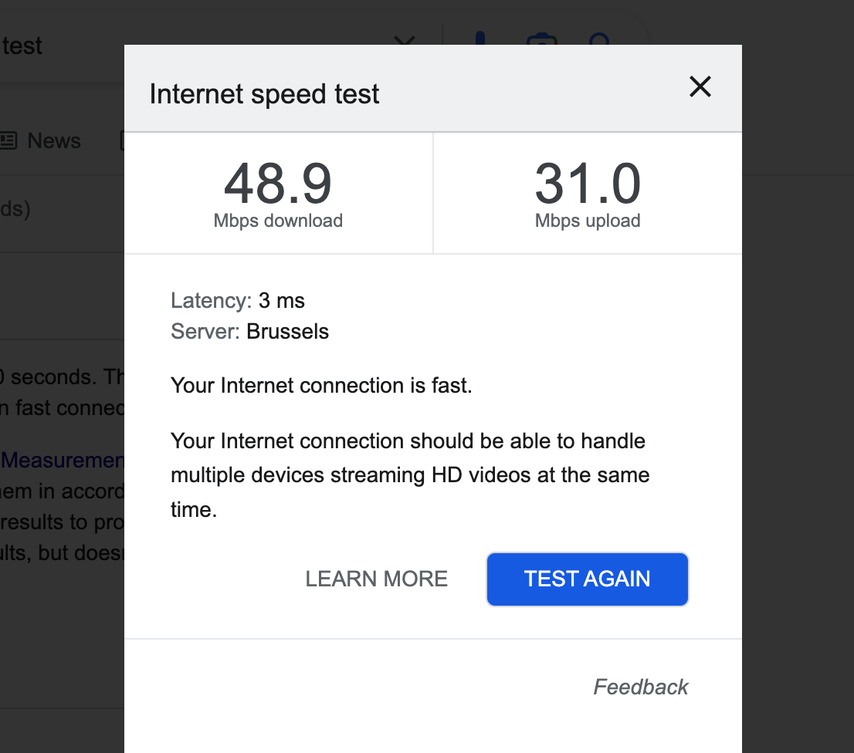
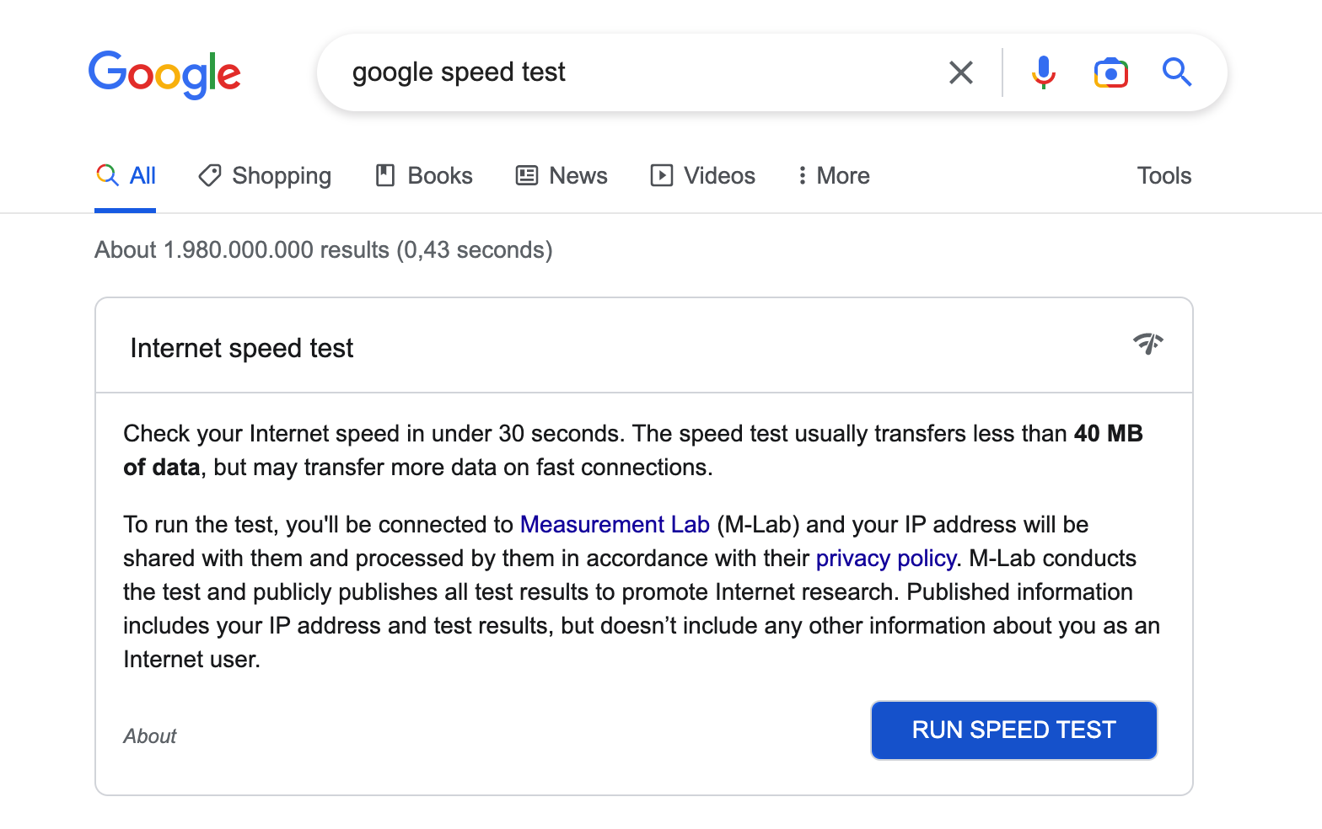
Measuring Internet performance

Slide 12
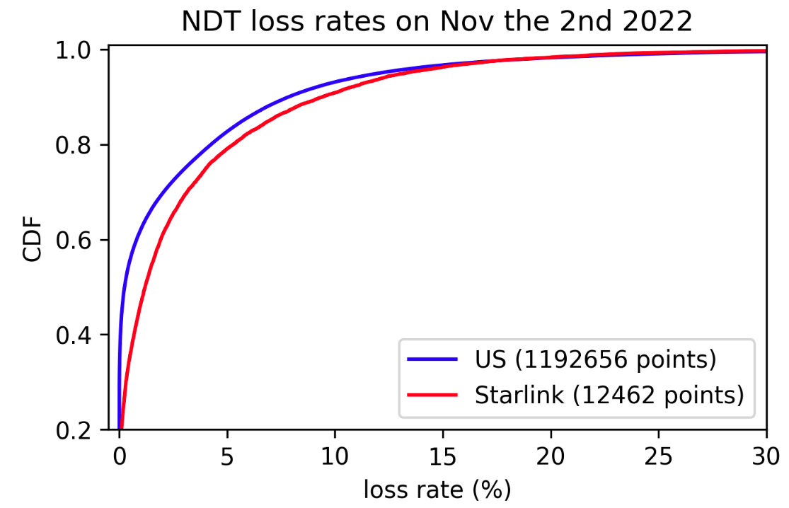
Internet packet losses
What can explain these packet loss ratios ?
Based on data extracted by François Michel from measurementlab’s big query

Slide 13
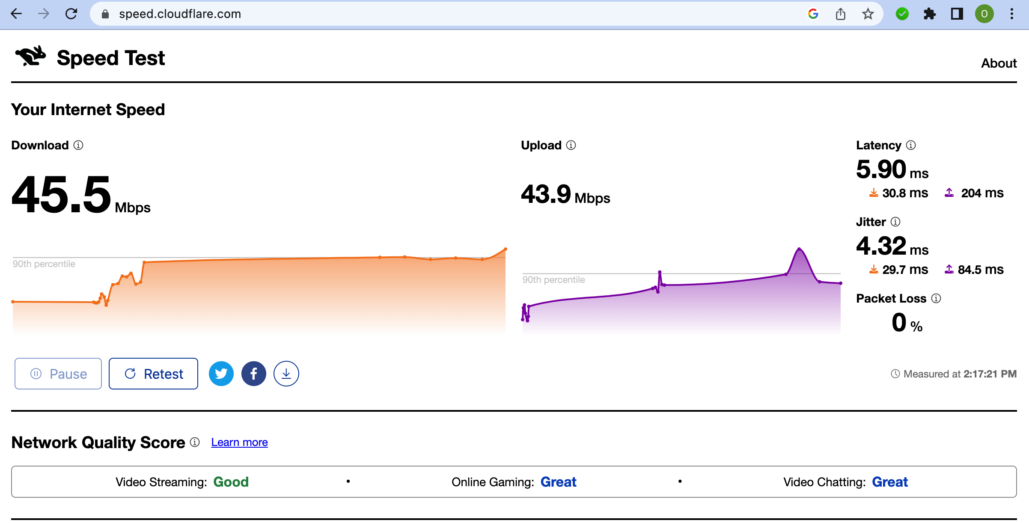
Measuring Internet performance (2)

Slide 14
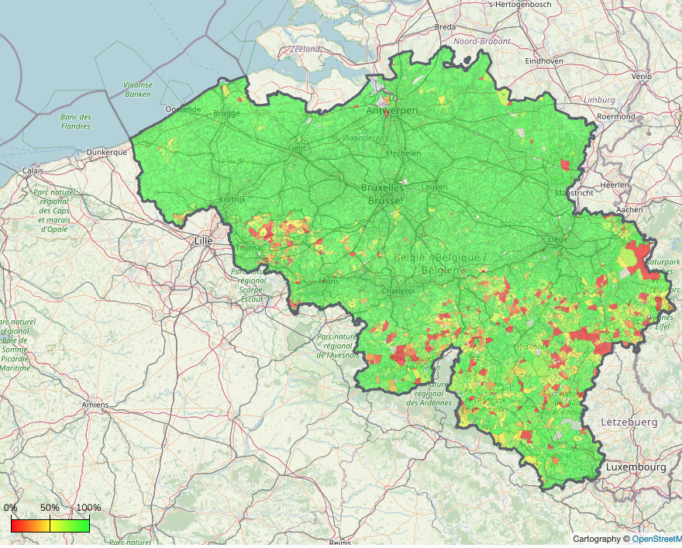

Internet performance in Wallonia
Broadband access at 30 Mbps or better

Slide 15
Initiative Amélie Améliorer Internet partout
Objectif
L’initiative Amélie vise à mettre sur pied une équipe d’étudiant.e.s bénévoles afin de proposer un service de diagnostic Internet d’habitations privées. L’objectif est d’aider les habitants à améliorer la qualité de leur connexion Internet sans nécessairement changer d’offre ou de fournisseur
Mise en oeuvre
Formation à l’analyse des performances en utilisant des outils adaptés et au diagnostic des facteurs qui réduisent les performances
Coaching par des chercheurs qui améliorent Internet et des étudiant.e.s de Master

Slide 16
Agenda
Reliable data transfer over a reliable network
How unreliable is the Internet ?
Reliable data transfer techniques
The Alternating Bit Protocol
Go-Back-N
Selective repeat

Slide 17
How to deal with transmission errors ?
The receiver must be able to detect that the content of a segment has been modified
Checksum, CRC

Slide 18
Question
How should a host react when it receives a data segment with an incorrect checksum ?

Slide 19
Coping with errors
A B
Data.req(a)
D(a)
Data.req(b)
C(OK)
Data.ind(a)
start timer
D(b)
timer expires
D(b)
Data.ind(b)
What do you think of this protocol ?

Slide 20
Coping with errors
A B
Data.req(a)
D(a)
Data.req(b)
C(OK)
Data.ind(a)
start timer
D(b)
C(OK)
Data.ind(b)
timer expires
D(b)
Data.ind(b)
Is this a problem for you ?

Slide 21
A better approach
Key ideas
Identify each data segment with a sequence number
allows to prevent duplication
one bit is sufficient
Indicate the sequence number of the last data segment in the acknowledgement

Slide 22
Alternating Bit Protocol : basics
A B
Data.req(a)
D(0,a)
Data.req(b)
C(OK0)
Data.ind(a)
D(1,b)
Data.req(c)
Data.ind(b)
C(OK1)
D(0,c)
Data.ind(c)
C(OK0)

Slide 23
Alternating Bit Protocol : reaction to losses
A B
Data.req(a)
D(0,a)
Data.req(b)
C(OK0)
Data.ind(a)
D(1,b)
Data.ind(b)
D(1,b) recvd
C(OK1)
Data.req(c)
D(0,c)
Lost
Retransmission timer
D(0,c)
Data.ind(c)
C(OK0)

Slide 24
Alternating Bit Protocol : early timer
A B
Data.req(a)
D(0,a)
Data.req(b)
C(OK0)
Data.ind(a)
D(1,b)
Retransmission timer
D(1,b)
Data.ind(b)
D(1,b) recvd
C(OK1)
Duplicate detected
Which ack to send ?
C(OK1)
D(1,b) recvd
Data.req(c)
D(0,c)
Data.ind(c)

Slide 25
Question
Do we need to place a checksum/CRC inside the control segments ?

Slide 26
Alternating Bit Protocol : unprotected control segments
A B
Data.req(a)
D(0,a)
Data.req(b)
C(OK0)
Data.ind(a)
D(1,b)
Retransmission timer
D(1,b)
Data.ind(b)
D(1,b) recvd
C(OK1)
Duplicate detected
Data.req(c)
C(OK0)
Undetected transmission error
D(0,c) recvd
D(0,c)
Lost
Data.req(d)
D(1,d)
C(OK1)
Duplicate detected

Slide 27
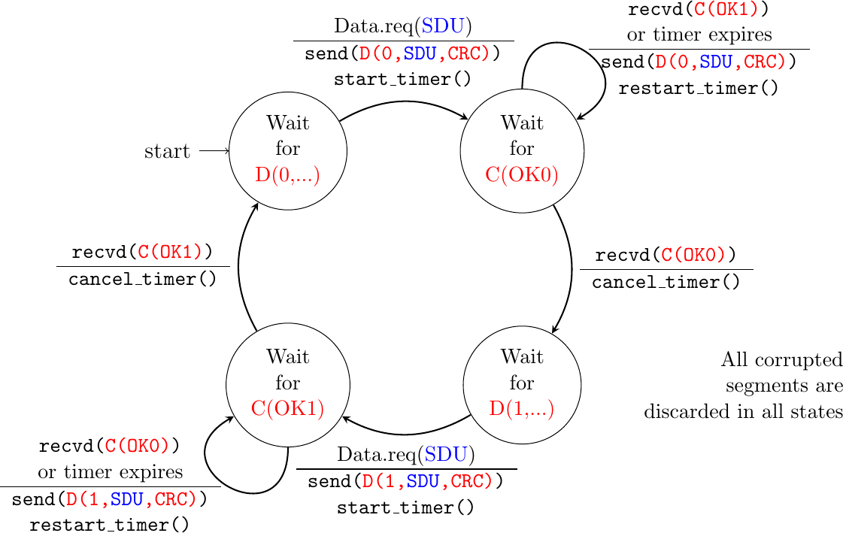
Alternating bit : sender

Slide 28
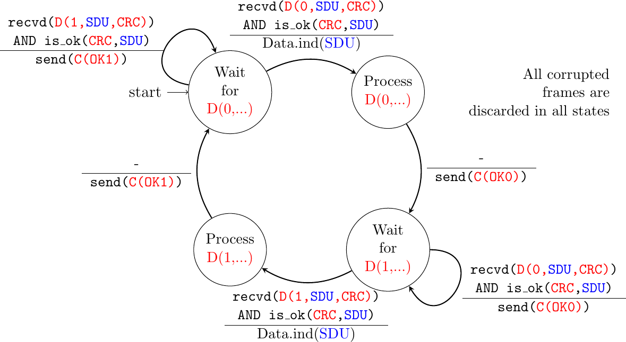
Alternating Bit : Receiver

Slide 29
Alternating Bit Protocol
A B
Data.req(a)
D(0,a)
Data.req(b)
C(OK0)
Data.ind(a)
D(1,b)
Retransmission timer
D(1,b)
Data.ind(b)
D(1,b) recvd
C(OK1)
Data.req(c)
C(OK0)
Duplicate detected
Transmission error
D(0,c) recvd
D(0,c)
Lost
Data.req(d)
D(1,d)
C(OK0)
Duplicate detected

Slide 30
Alternating Bit Protocol
Advantages
Simple to implement
Reliable data transfer
Drawback
Performance
only one segment per round-trip-time

Slide 31
Agenda
Reliable data transfer over a reliable network
How unreliable is the Internet ?
Reliable data transfer techniques
The Alternating Bit Protocol
Go-Back-N
Selective repeat

Slide 32
Pipelining
Key ideas
Allow the sender to send several segments without having an explicit ack
Sender stores unacked segments in a buffer called the sending window to be able to retransmit them

Slide 33
Pipelining
A B
Data.req(a)
D(0,a)
Data.req(b)
...
Data.ind(a)
Data.req(e)
...
D(4,e)
Data.ind(e)
How many segments can A send ?

Slide 34
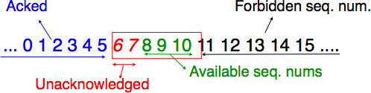
The sending window
Buffer managed by a sender
Stores segments sent but not yet acknowledged
Content of sending window can be retransmitted if needed
Sending window size limits the number of segments that a host can sent without acknowledgements

Slide 35
Pipelining example
A B
Sending window
0 1 2 3 4 5 6 7 8
Data.req(a)
0 1 2 3 4 5 6 7 8
0 1 2 3 4 5 6 7 8
Data.req(b)
D(0,a)
0 1 2 3 4 5 6 7 8
D(1,b)
Data.req(c)
D(2,c)
Data.ind(a)
0 1 2 3 4 5 6 7 8
Data.ind(b)
C(OK0)
Data.ind(c)
0 1 2 3 4 5 6 7 8
C(OK1)
Data.req(d)
C(OK2)
0 1 2 3 4 5 6 7 8
0 1 2 3 4 5 6 7 8
Data.req(e)
D(3,d)
0 1 2 3 4 5 6 7 8
Data.ind(d)
D(4,e)
Sending window must be larger than bandwidth x round-trip-time to fully use network

Slide 36
Sequence numbers are finite and reused
A B
Sending window
0 1 2 3
Data.req(a)
0 1 2 3
0 1 2 3
Data.req(b)
D(0,a)
0 1 2 3
D(1,b)
Data.req(c)
D(2,c)
Data.ind(a)
0 1 2 3
Data.ind(b)
C(OK0)
Data.ind(c)
0 1 2 3
C(OK1)
Data.req(d)
C(OK2)
0 1 2 3
0 1 2 3
Data.req(e)
D(3,d)
0 1 2 3
Data.ind(d)
D(0,e)

Slide 37
How to deal with losses ?
Go-back-n
Sender stores transmitted segments in sending window to be able to retransmit them if needed
Simple receiver, accepts only in-sequence segments. If a segment is errored, sender retransmits all unacked segments
Selective repeat
Sender stores transmitted segments in sending window to be able to retransmit them if needed
Advanced receiver, stores out-of-sequence segments. If a segment is errored, sender only retransmits the errored segments

Slide 38
Go-back-n
A B
Sending window
0 1 2 3
Data.req(a)
0 1 2 3
0 1 2 3
Data.req(b)
D(0,a)
Lost
0 1 2 3
D(1,b)
Data.req(c)
D(2,c)
Data.ind(a)
0 1 2 3
Retransmission
timer expires
C(OK,0)
Not expected seq num,
discarded
Data.req(d)
C(OK,0)
0 1 2 3
D(1,b)
0 1 2 3
Data.req(e)
D(2,c)
Data.ind(b)
Sending window is full
Data.ind(c)
D(3,d)
Data.ind(d)

Slide 39
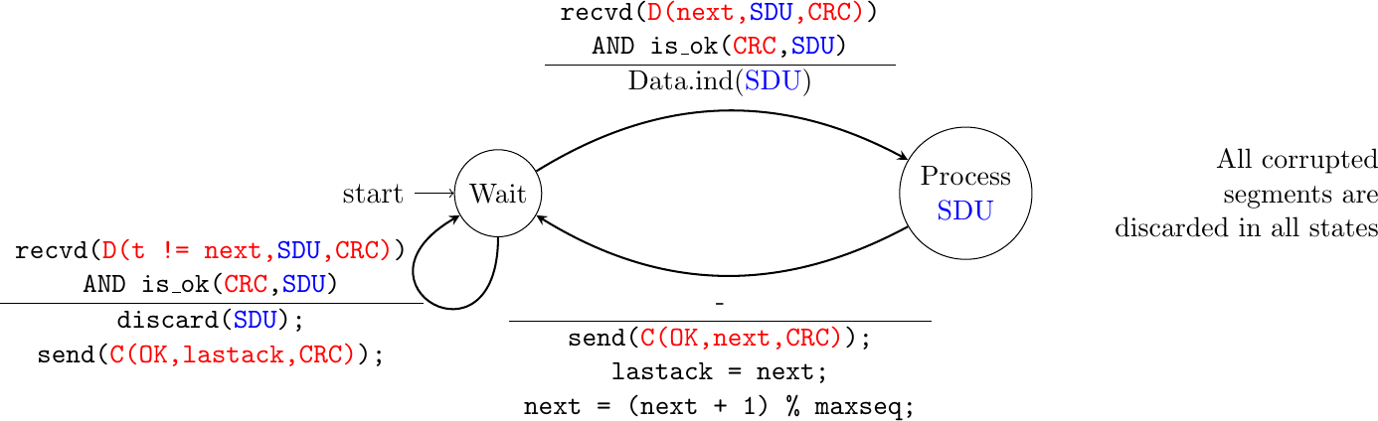
Go-back-n : receiver

Slide 40
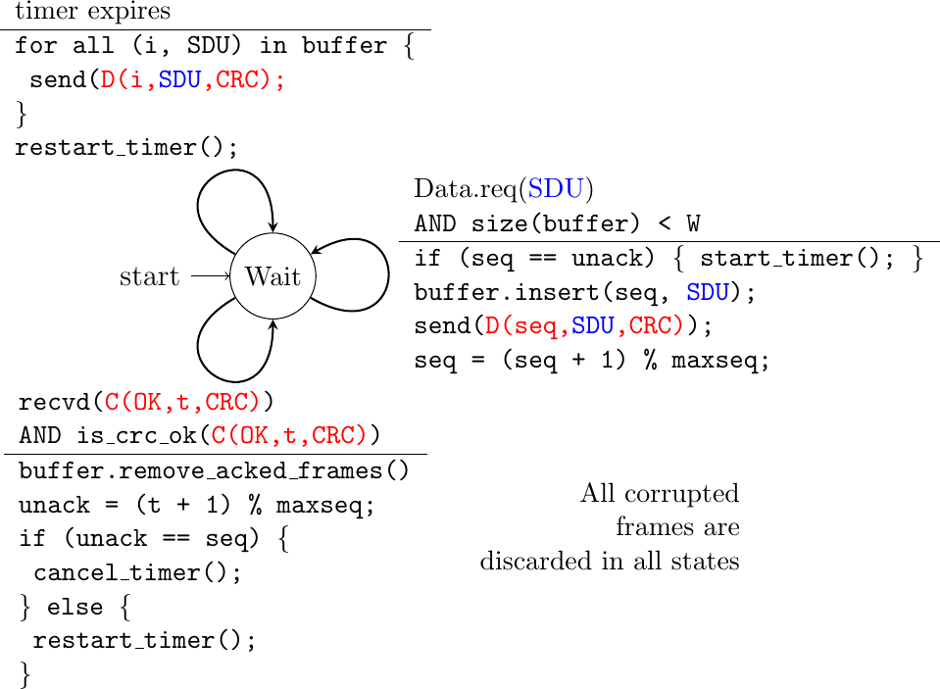
Go-back-n : sender

Slide 41
Go-back-n : example
A B
Sending window
0 1 2 3
Data.req(a)
0 1 2 3
0 1 2 3
Data.req(b)
D(0,a)
Lost
0 1 2 3
D(1,b)
Data.req(c)
D(2,c)
Data.ind(a)
0 1 2 3
Retransmission
timer expires
C(OK,0)
Not expected seq num,
discarded
Data.req(d)
C(OK,0)
0 1 2 3
D(1,b)
0 1 2 3
Data.req(e)
D(2,c)
Data.ind(b)
Sending window is full
Data.ind(c)
D(3,d)
Data.ind(d)

Slide 42
Question
You implement a go-back-n receiver using 3 bits to encode the sequence number. You have correctly received segment 7 and delivered its content. You now receive a correct segment 0, how do you react ?
you ignore the segment and send ACK(7)
you accept the segment, deliver it and send ACK(7)
you accept the segment, deliver it and send ACK(0)

Slide 43
Question
Go-back-n is used in a network where all data segments are correctly received, but every second acknowledgement is corrupted. How many data segments will be retransmitted by the sender if it needs to reliably send 20 data segments ?

Slide 44
Question
Go-back-n is used by a protocol that encodes sequence numbers using 5 bits. What is the largest possible sending window (in segments) ?

Slide 45
Question
Go-back-n is used in a satellite network with a round-trip-time of 1 sec. What is the minimum sending window (in segments) to fully use a 1 Mbps link using 10.000 bits segments ?

Slide 46
Agenda
Reliable data transfer over a reliable network
How unreliable is the Internet ?
Reliable data transfer techniques
The Alternating Bit Protocol
Go-Back-N
Selective repeat

Slide 47
The receive window
Buffer managed by receiver
Stores segments received out-of-order
Segments remain in receive window until gaps are filled
Receive window size limits the number of segments that the sender can send without acknowledgements
Sending window cannot be larger than the other side receive’s window
Not yet received
Received
Forbidden seq. num.
0 1 2 3 4 5 6 7 8 9 10 11 12 13 14
Already delivered
Window

Slide 48
Selective repeat
A B
Sending window
Rec. window
0 1 2 3
Data.req(a)
0 1 2 3
0 1 2 3
0 1 2 3
Data.req(b)
D(0,a)
Lost
0 1 2 3
D(1,b)
Data.req(c)
D(2,c)
Data.ind(a)
0 1 2 3
0 1 2 3
Retransmission timer expires
C(OK,0)
0 1 2 3
Segment stored
0 1 2 3
C(OK,0)
0 1 2 3
Data.req(d)
0 1 2 3
D(1,b)
D(3,d)
Data.ind(b)
0 1 2 3
Data.ind(c)
0 1 2 3
C(OK,2)
Data.ind(d)
C(OK,3)
0 1 2 3

Slide 49
Buffer management
A reliable transport serves a variable number of applications with a limited buffer
The buffer/window allocated to a given connection may need to change dynamically as connections start and stop

Slide 50
Buffer management
A B
Swin=3, rwin=1
Swin=3, rwin=1
Rwin=1
0 1 2 3
0 1 2 3
Data.req(a)
D(0,a)
0 1 2 3
Data.ind(a)
0 1 2 3
Swin=3, rwin=1
Swin=3, rwin=1
0 1 2 3
C(OK,0, w=1)
0 1 2 3
Data.req(b)
2 new buffers become available
C(OK,0,w=3)
Swin=3, rwin=3
D(1,b)
0 1 2 3
Data.req(c)
0 1 2 3
D(2,c)
Data.ind(b)
Data.req(d)
C(OK,1,w=3)
D(3,d)
0 1 2 3

Slide 51
Buffer management
A B
Swin=3, rwin=1
Swin=3, rwin=1
Rwin=1
0 1 2 3
0 1 2 3
Data.req(a)
D(0,a)
0 1 2 3
Receiver cannot handle segment immediately
C(OK,0, w=0)
Data.ind(a)
Swin=3, rwin=0
Data.req(b)
0 1 2 3
2 new buffers are
available
Window blocked No transmission possible
Lost segment
C(OK,0,w=3)
0 1 2 3
Waits for control segment
Waits for data segment
How to recover from this deadlock ?
Persistence timer on receiver, resend control segment after timer expiration

Slide 52
Bidirectional transfer
How to efficiently carry data in both directions ?

Slide 53
Piggybacking
A B
Data.req(a)
Data.req(b)
D(0,0,a)
Error
Data.req(w)
Data.req(c)
D(1,0,b)
Data.ind(a)
D(2,0,c)
Data.ind(w)
D(5,0,w)
Discarded
D(5,0,w) acks D(0,0,a)
Data.req(x)
D(6,0,x)
Retransmission
Segment -> buffer
D(1,5,b)
Data.req(d)
Data.ind(x)
Data.ind(b)
D(3,6,d)
Data.ind(c)
C(OK,2)
Data.ind(d)
C(OK,3)

Slide 54
Bytestream
How to provide a bytestream service ?

Slide 55
Byte stream service (2)
A B
Data.req(abcdef)
D(0,ab)
Lost segment
D(2,cd)
Data.ind(ab)
D(4,ef)
Expiration timer
Retransmission
C(OK,1)
Placed in buffer
C(OK,1)
Data.req(ijkl)
Data.req(mnop)
D(2,cd)
D(6,ijklmnop)
Data.ind(cdef)
C(OK,5)
Data.ind(ijklmnop)
C(OK,13)

Slide 56
Take back lessons
Usage of Checksums/CRCs
Finite State Machines
Cumulative acknowledgements
Bandwidth x delay product

