Slide 1
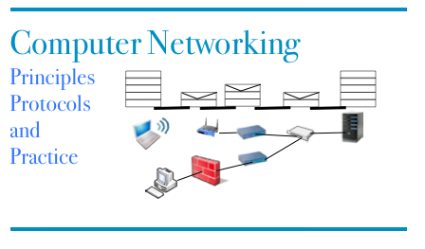
Part 4 Reliable transport and TCP
© O. Bonaventure, UCLouvain, 2023. Supplementary material for the Computer Networking : Principles, Protocols and Practice ebook, https://www.computer-networking.info

Slide 2
Agenda
Managing a connection
Connection establishment
Connection release
TCP
Connection establishment
Data transfer
Connection release
Modern TCP

Slide 3
Connection establishment
How to reliably open a connection ?
Connections
A<->B : ...
Connect.req
CR
Connect.ind
Connect.conf
CA
Connect.resp
Connection established
Connection established
Connections
A<->B : ...

Slide 4
Segment loss
CR
Connect.req()
Retransmission timer expires
CR
Connect.ind()
Connect.resp()
Connect.conf()
Connection established
Connection established
CA

Slide 5
Segments delayed
Connect.req()
CR
Connect.ind()
Connect.resp
Connect.conf()
CA
First connection established
CR
First connection established
First connection stopped
First connection stopped
Old previous CR
How to detect duplicates ?
CA
D
Notes:
In this example, the duplicate CR is likely to be a previous retransmission of the CR that was delayed in the network.

Slide 6
Delayed segments
How to deal with delayed segments ?
Network level guarantee
No packet will survive more than MSL seconds inside the network
Transport entities use on a local clock to detect duplicated connection establishment requests

Slide 7
Three-way handshake
Host A
Host B
Sequence number x read from local transport clock
Local state :
Connection to B :
- Wait for ack for CR (x)
- Start retransmission timer
CR (seq=x)
Sequence number y read from local transport clock
CA sent to ack CR
Local state :
Connection to A :
- Wait for ack for CA(y)
CA (seq=y, ack=x)
Received CA acknowledges CR
Send CA to ack received CA
Local state :
Connection to B :
- established
- current_seq = x
CA (seq=x, ack=y)
Local state :
Connection to A :
- established
- current_seq=y
Connection established
D(x)
Connection established
The sequence numbers used for the data segments will start
from x
D(y)
The sequence numbers used for the data segments
will start from y

Slide 8
Agenda
Managing a connection
Connection establishment
Connection release
TCP
Connection establishment
Data transfer
Connection release
Modern TCP

Slide 9
Closing a connection
Two different approaches
abrupt release
send a segment that immediately closes the connection –> may lead to losses
graceful release
send a marker that indicates the end of the date, once the marker is acked, all data has been received and connection is closed
independent release of the two directions

Slide 10
Abrupt release
CR (seq=z)
CA (seq=w, ack=z)
CA (seq=z, ack=w)
Data.req()
D
Data.req()
D
Data.ind()
Disc.req()
Disc.req()
Connection closed
DR
Connection closed
This segment will not be delivered !

Slide 11
Graceful release
D(‘a’,1233)
DISCONNECT.req (A-B)
DATA.ind(‘a’)
DR(A-B,1234)
DISCONNECT.ind(A-B)
ACK,1234
Incoming connection (A->B) closed
DISCONNECT.conf(A-B)
Outgoing connection (A->B)
closed
DISCONNECT.req(B-A)
DR(B-A,4567)
DISCONNECT.ind(B-A)
Incoming connection (B->A) closed
DISCONNECT.conf(A-B)
ACK,4567
Outgoing connection (B->A)
closed

Slide 12

Graceful release (2)
D(‘a’,1230)
DATA.ind(‘a’)
DISCONNECT.req (A-B)
ACK(1230)
DR(A-B,1234)
D(‘bcd’,1231)
ACK(1230)
DATA.ind(‘bcd’)
DISCONNECT.conf(A-B)
ACK(1234)
DISCONNECT.ind(A-B)
Outgoing connection (A->B)
closed
Incoming connection (A->B) closed

Slide 13
Agenda
Managing a connection
Connection establishment
Connection release
TCP
Connection establishment
Data transfer
Connection release
Modern TCP

Slide 14
TCP
Service provided
Connection-oriented
Reliable
No losses, no errors, no duplications
Bytestream

Slide 15

TCP port numbers
Request
Client : C
Source Port : 1234
Destination Port: 5678
Server : S
Source Port : 5678
Destination Port: 1234
Response
Established TCP connections on client
Local IP Remote IP Local Port Remote Port
C S 1234 5678
Established TCP connections on server
Local IP Remote IP Local Port Remote Port
S C 5678 1234

Slide 16
Multiple connections
Client: A
Server : S
TCP connections on host A
IP local IP remote Port local Port remote
A S 1234 80
A S 1235 80
TCP connections on server
IP local IP remote Port local Port remote
S A 80 1234
S A 80 1235
S B 80 1235
Client : B
TCP connections on host B
IP local IP remote Port local Port remote
B S 1235 80

Slide 17
TCP segment
32 bits
Flags :
used to indicate the function of a segment
SYN : used during establishment
FIN : used during connection release RST : used in case of problems
ACK : if true, means that the Acknowledgement number inside the segment is valid
Source port
Destination port
Sequence number
Acknowledgement number
20 bytes
THL Reserved Flags
Window
Checksum
Urgent pointer
Optional header extension
Segment header length
Payload
Computed over the entire segment and part of the IP header
Notes:
Urgent pointer is rarely used and will not be described.
The THL is indicated in blocs of 32 bits. The TCP header may contain options, these will be discussed later.

Slide 18
TCP’s Three-way handshake
CONNECT.req
Initial sequence number (x)
Read from a clock incremented
Every 4 musec and after each
connection
SYN(seq=x)
CONNECT.ind
CONNECT.resp
CONNECT.conf
SYN+ACK(ack=x+1,seq=y)
Initial sequence number (y)
Read from a clock incremented
Every 4 musec and after each
connection
Connection established
The sequence numbers of all segments A->B will start at x+1
ACK(seq=x+1, ack=y+1)
Connection established
The sequence numbers of all segments B->A will start at y+1
Notes:
MSL in IP networks : 120 seconds

Slide 19
TCP’s three-way handshake and SYN losses
CONNECT.req
Initial sequence number (x)
SYN(seq=x)
retransmission
SYN(seq=x)
Initial sequence number (y)
CONNECT.ind
CONNECT.resp
CONNECT.conf
SYN+ACK(ack=x+1,seq=y)
Connection established
ACK(seq=x+1, ack=y+1)
Connection established

Slide 20
TCP’s three-way handshake and SYN losses
CONNECT.req
Initial sequence number (x)
SYN(seq=x)
CONNECT.ind
SYN+ACK(ack=x+1,seq=y)
CONNECT.resp
Initial sequence number (y)
retransmission
SYN(seq=x)
CONNECT.conf
SYN+ACK(ack=x+1,seq=y)
Connection established
ACK(seq=x+1, ack=y+1)
Connection established

Slide 21
TCP’s three-way handshake and SYN delays
CONNECT.req
Initial sequence number (x)
SYN(seq=x)
Old segment delayed
SYN+ACK(ack=z+1,seq=y)
Invalid SYN, discarded
retransmission
SYN(seq=x)
SYN+ACK(ack=x+1,seq=y)
ACK(seq=x+1, ack=y+1)

Slide 22
TCP’s three-way handshake and SYN delays
Old segment delayed
SYN(seq=z)
SYN+ACK(ack=z+1,seq=y)
No connection in progress
Initial sequence number (x)
RST(seq=x+1, ack=y+1)

Slide 23
TCP’s three-way handshake and SYN delays
Old segment delayed
SYN(seq=z)
Initial sequence number (y)
CONNECT.ind
CONNECT.resp
SYN+ACK(ack=z+1,seq=y)
Old segment delayed
ACK(seq=z+1, ack=w+1)
Invalid acknowledgement

Slide 24
TCP FSM
Init
!SYN
?SYN / !SYN+ACK
!SYN
SYN RCVD
?SYN / !SYN+ACK
SYN Sent
?SYN+ACK / !ACK
?ACK
?ACK
Established

Slide 25
Simultaneous open
CONNECT.req
SYN(seq=x)
CONNECT.req
SYN(seq=y)
SYN+ACK(seq=x, ack=y+1)
SYN+ACK(seq=y, ack=x+1)
CONNECT.conf
CONNECT.conf
Connection established
Connection established

Slide 26
Negotiating options
CONNECT.req
Initial sequence number (x)
Option proposed
SYN(seq=x),Option
CONNECT.ind
CONNECT.resp
CONNECT.conf
SYN+ACK(ack=x+1,seq=y) Option
Initial sequence number (y)
Option accepted
Connection established
Option accepted
The sequence numbers of all segments A->B will start at x+1
ACK(seq=x+1, ack=y+1)
Connection established
The sequence numbers of all segments B->A will start at y+1
Notes:
MSL in IP networks : 120 seconds

Slide 27
Negotiating Maximum Segment Size
CONNECT.req
Initial sequence number (x)
Accept segments up to 1234 bytes
SYN(seq=x),MSS=1234
CONNECT.ind
CONNECT.resp
CONNECT.conf
SYN+ACK(ack=x+1,seq=y) MSS=789
Initial sequence number (y)
Accepts segments up to 789 bytes
Connection established
Option accepted
The sequence numbers of all segments A->B will start at x+1
ACK(seq=x+1, ack=y+1)
Connection established
The sequence numbers of all segments B->A will start at y+1
Notes:
MSL in IP networks : 120 seconds

Slide 28
Connection refused
CONNECT.req
SYN(seq=x)
CONNECT.ind
DISCONNECT.req
DISCONNECT.ind
RST+ACK(ack=x+1,seq=0)
Connection refused
Can the client reply with a RST segment ?
A TCP entity MUST never send an RST segment upon reception of another RST segment

Slide 29
Agenda
Managing a connection
Connection establishment
Connection release
TCP
Connection establishment
Data transfer
Connection release
Modern TCP

Slide 30
Reliable data transfer
Which ack is returned ?
DATA.req ("abcd")
(seq=123,"abcd")
DATA.req ("efg")
(ack=127)
DATA.ind("abcd")
DATA.req ("hi")
(seq=127,"efg")
Which ack is returned ?
(seq=130,"hi")
DATA.req ("jkl")
(seq=132,"jkl")
DATA.ind("efghijkl")
(ack=135)
Which ack is returned ?

Slide 31

Reliable data transfer
(seq=123,"abcd")
(seq=127,"ef")
Retransmission timer
“ef” placed in buffer
(ack=123)
Retransmission of all unacked segments
(seq=123,"abcd")
(seq=127,"ef")
"abcdef"
(ack=129)
(ack=129)
unnecessary retransmission

Slide 32
Reliable data transfer
(seq=123,"abcd")
(seq=127,"ef")
Retransmission timer
“ef” placed in buffer
(ack=123)
Retransmission of all unacked segments
(seq=123,"abcd")
(seq=127,"ef")
"abcdef"
(ack=129)
(ack=129)
unnecessary retransmission

Slide 33
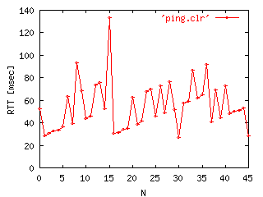
Retransmission timer
How to compute it ?
round-trip-time may change frequently during the lifetime of a TCP connection

Slide 34
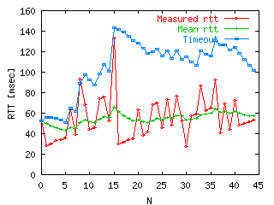
Retransmission timer
Algorithm
timer = mean(rtt) + 4*std_dev(rtt)
est_mean(rtt) = (1-α)*est_mean(rtt) +α*rtt_measured
est_std_dev=(1-β)*est_std_dev+ β*|rtt_measured - est_mean(rtt)|
Notes:
The computation of TCP’s retransmission timer is described in
RFC2988 Computing TCP's Retransmission Timer. V. Paxson, M. Allman. November 2000.
Usual values for alpha and beta are 1/8 and 1/4.

Slide 35
Multiple expirations of the retransmission timer
(seq=123,"abcd")
Retransmission timer
Retransmission of all unacked segments
(seq=123,"abcdef")
Retransmission timer
(seq=123,"abcdef")
If losses are due to network congestion, retransmitting all unacked segments quickly might not be the best idea
Exponential backoff : double the retransmission timer after each expiration for the same sequence number

Slide 36
RTT measurements
(seq=120,"xyz")
measured rtt
(ack=123)
(seq=123,"abcd")
which is the good rtt ?
Timer
(seq=123,"abcd")
(ack=128)
Solution (Karn/Partridge)
Do not measure rtt of retransmitted segments
Notes:
See
P. Karn, C. Partridge, Improving round-trip time estimates in reliable transport protocols, Proc. ACM SIGCOMM87, August 1987

Slide 37
Flow control
Last_ack=122, swin=100, rwin=4
To transmit : abcdefghijklm
(seq=122,"abcd")
Last_ack=122, swin=96, rwin=0
(ack=126,rwin=0)
Last_ack=126, swin=100, rwin=0
(ack=126,rwin=2)
Last_ack=126, swin=100, rwin=2
Last_ack=126, swin=98, rwin=0
(seq=126,"ef")
(ack=128,rwin=20)
Last_ack=128, swin=100, rwin=20
Last_ack=128, swin=93, rwin=13
(seq=128,"ghijklm")
(ack=135,rwin=20)
Last_ack=135, swin=100, rwin=20

Slide 38
TCP’s flow control
16 bits to represent the receive window in bytes
32 bits
Source port
Destination port
Sequence number
Acknowledgement number
20 bytes
THL Reserved Flags
Window
Checksum
Urgent pointer
Optional header extension
Payload
What is the maximum throughput of a TCP connection if rtt is 100 msec ?

Slide 39
Fast retransmit
(seq=120,"xyz")
(ack=123)
(seq=123,"abcd")
(seq=127,"ef")
(ack=123)
Out of sequence
First duplicate ack
(seq=129,"gh")
(ack=123)
Out of sequence
Second duplicate ack
(seq=131,"ij")
(ack=123)
Out of sequence
Third duplicate ack
Notes:
Don’t forget that TCP’s acknowledgements are cumulative.

Slide 40
Fast retransmit
(ack=123)
(seq=123,"abcd")
(seq=127,"ef")
(ack=123)
Out of sequence, in buffer
(seq=129,"gh")
(ack=123)
Out of sequence, in buffer
(seq=131,"ij")
(ack=123)
Out of sequence, in buffer
(seq=123,"abcd")
(ack=133)
"abcdefghij"
Which ack is returned ?
Notes:
See e.g.
RFC2001 TCP Slow Start, Congestion Avoidance, Fast Retransmit, and Fast Recovery Algorithms. W. Stevens. January 1997.

Slide 41
Agenda
Managing a connection
Connection establishment
Connection release
TCP
Connection establishment
Data transfer
Connection release
Modern TCP

Slide 42
Abrupt TCP connection release
Last sent data : x
DISCONNECT.req (abrupt)
RST(seq=x)
Connection closed
DISCONNECT.ind(abrupt)
State can be removed
Connection closed
State can be removed
Notes:
Some heavily loaded web servers, use abrupt release to close their connection to avoid maintaining state for 2*MSL seconds.

Slide 43
Abrupt TCP connection release
Last sent data : x
(seq=x,”y")
Retransmission timer
(seq=x,”y")
Retransmission timer
(seq=x,”y")
Many unsuccessful attempts
to reliably transmit data
DISCONNECT.ind(abrupt)
Connection closed
RST(seq=x)
DISCONNECT.ind(abrupt)
State can be removed
Connection closed
State can be removed
Notes:
Some heavily loaded web servers, use abrupt release to close their connection to avoid maintaining state for 2*MSL seconds.

Slide 44
TCP Connection release
Sent only after all data up to x has been received
Last sent data : x-1
DISCONNECT.req (A-B)
FIN(seq=x)
DISCONNECT.ind(A-B)
ACK(ack=x+1)
incoming connection closed
DISCONNECT.conf(A-B)
Last sent data : y-1
outgoing connection closed
DISCONNECT.req(B-A)
FIN(seq=y)
DISCONNECT.ind(B-A)
incoming connection closed
Time WAIT
Maintain state for this connection during twice MSL
to be able to retransmit ACK
if a segment is received from
the other entity
ACK(ack=y+1)
DISCONNECT.conf(A-B)
outgoing connection closed
State can be removed

Slide 45
TCP connection release in details
Many scenarios are possible depending when the FIN flag is set
Last sent data : x-1
Last sent data : y-1
DISCONNECT.req (A-B)
DISCONNECT.req(B-A)
FIN(seq=x)
DISCONNECT.ind(A-B)
FIN+ACK(ack=x+1, seq=y)
incoming connection closed
DISCONNECT.conf(A-B)
outgoing connection closed
DISCONNECT.ind(B-A)
ACK(ack=y+1)
DISCONNECT.conf(A-B)
incoming connection closed
outgoing connection closed
State can be removed
Time WAIT
Maintain state for this connection uring twice MSL
to be able to retransmit ACK
if a segment is received from
the other entity

Slide 46
Some servers operate as follows
Last sent data : x-1
DISCONNECT.req (A-B)
FIN(seq=x)
DISCONNECT.ind(A-B)
ACK(ack=x+1)
incoming connection closed
DISCONNECT.conf(A-B)
Last sent data : y-1
DISCONNECT.req(B-A)
outgoing connection closed
DISCONNECT.ind(B-A)
RST(ack=x+1, seq=y)
incoming connection closed
outgoing connection closed
State is removed
State is removed
What is the benefit of such an approach ?

Slide 47
TCP connection release
SYN RCVD
Established
?FIN/!ACK
!FIN
!FIN
CLOSE Wait
FIN Wait1
?FIN/!ACK
Closing
!FIN
?ACK
LAST-ACK
FIN Wait2
?ACK
?ACK
?FIN/!ACK
TIME Wait
Closed
Timeout[2MSL]

Slide 48
Agenda
Managing a connection
Connection establishment
Connection release
TCP
Connection establishment
Data transfer
Connection release
Modern TCP

Slide 49
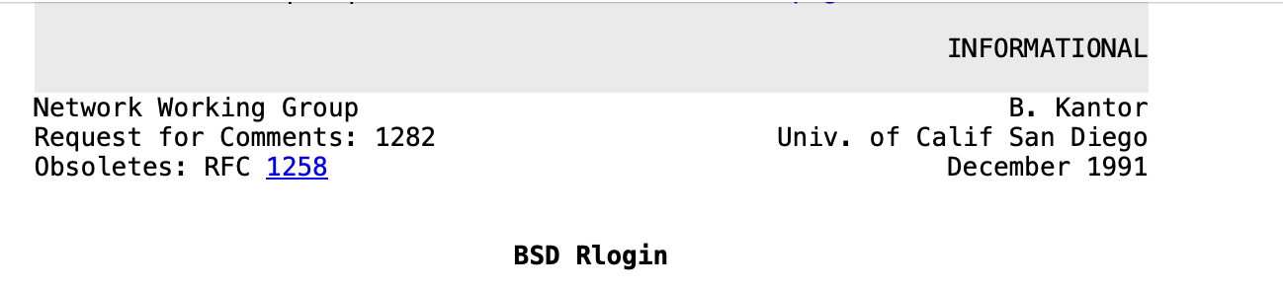
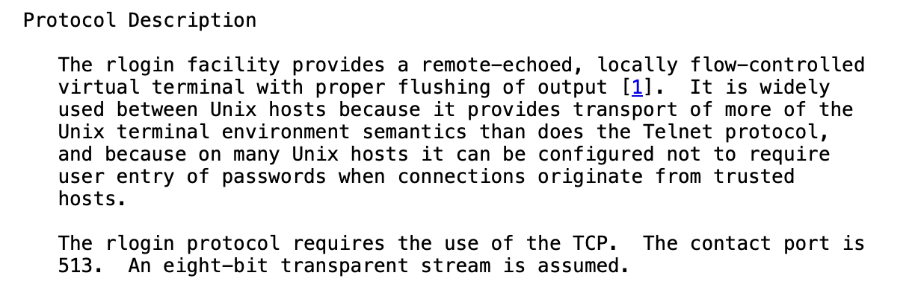
rlogin and rsh

Slide 50
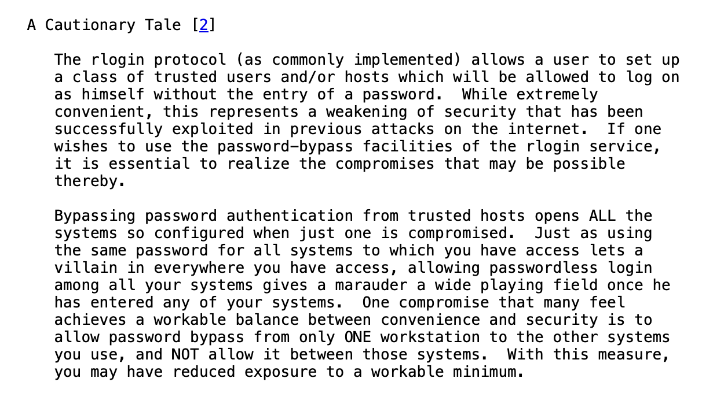
rlogin and rsh

Slide 51


The problem with trusted addresses
A
B
Connection coms from Alice’s IP address.
Bob does not need to ask username and password
SYN(seq=x)
SYN+ACK(ack=x+1,seq=y)
ACK(seq=x+1, ack=y+1)
DATA(seq=x+1, ack=y+1)
Can Terrence hijack this connection ?
T

Slide 52
TCP and spoofing
Terrence's view of the transfer
Bob
A
T
B
SYN(Src=A,seq=x)‏
Ignored if Alice is offline
Can Terrence predict y ?
SYN+ACK(Dst=A,ack=x+1,seq=y)‏
ACK(seq=x+1, ack=y+1)‏
Data(Src=A,seq=x+1)‏

Slide 53
Three-way handshake : initial specification
X is extracted from a local clock incremented every 4 musec
CONNECT.req
Initial sequence number (x)
SYN(seq=x)
CONNECT.ind
CONNECT.resp
CONNECT.conf
SYN+ACK(ack=x+1,seq=y)
Initial sequence number (y)
Connection established
The sequence numbers of all segments A->B will start at x+1
ACK(seq=x+1, ack=y+1)
Connection established
Y is extracted from a local clock incremented every 4 musec
The sequence numbers of all segments B->A will start at y+1
Can you improve TCP’s connection establishment ?
Notes:
MSL in IP networks : 120 seconds

Slide 54
Three-way handshake today
X is random
CONNECT.req
Initial sequence number (x)
SYN(seq=x)
CONNECT.ind
CONNECT.resp
CONNECT.conf
SYN+ACK(ack=x+1,seq=y)
Initial sequence number (y)
Connection established
The sequence numbers of all segments A->B will start at x+1
ACK(seq=x+1, ack=y+1)
Connection established
Y is random
The sequence numbers of all segments B->A will start at y+1
Notes:
MSL in IP networks : 120 seconds

Slide 55
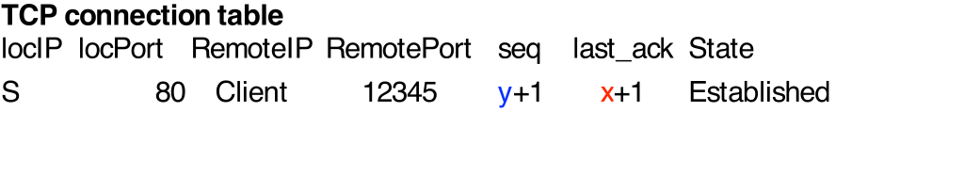

TCP connection establishment
CONNECT.req
SYN(seq=x)‏
CONNECT.ind
SYN+ACK(ack=x+1,seq=y)‏
ACK( seq=x+1, ack=y+1)‏
Server needs to maintain a connection table to check returned ack

Slide 56
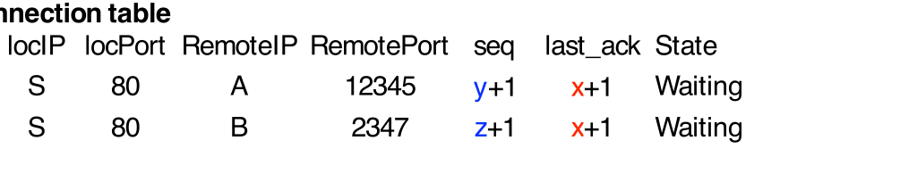
DoS attack
Attacker sends 1000s of (spoofed) SYNs
SYN(Src=A,seq=x)‏
CONNECT.ind
SYN+ACK(Dest=A,ack=x+1,seq=y)‏
SYN(Src=B,seq=x)‏
CONNECT.ind
SYN+ACK(Dest=B,ack=x+1,seq=z)‏
Some servers restrict the number of connections in the waiting state
Notes:
Most TCP implementations today have fixes for those problems. We will discuss them later.

Slide 57
Countering DoS attacks
Principle of the solution
Server should not create any state before being sure that the client can receive the segments that it sends
Server does not store anything
CONNECT.req
SYN(Src=C,seq=x)‏
SYN+ACK(Dest=C,ack=x+1,seq=y)‏
ACK(Src=A,seq=x, ack=y+1)‏
Server checks that third ACK is valid
and creates state
Notes:
Most TCP implementations today have fixes for those problems. We will discuss them later.

Slide 58
SYN Cookies
Server verifies third ack without any state
CONNECT.req
SYN(seq=x)‏
CONNECT.ind
No state created
y=Hash(IP_{Client},Port_{Client},Secret)‏
How should the server select y ?
CONNECT.conf
SYN+ACK(ack=x+1,seq=y)‏
ACK(seq=x+1, ack=y+1)‏
Verify that
ack=1+Hash(IP_{Client},Port_{Client},Secret)‏
State is created
Notes:
This utilization of a hash function to compute the value of the initial sequence number is usually called a SYN cookie.
In practice, the computation of the SYN cookie is slightly more complex than a simple hash function because the server must also remember inside the cookie the following information :
- the MSS value advertised by the client
- the optional utilization of TCP options such as RFC1323 large windows or timestamps or SACK by the sender
The original discussions that lead to the development of the SYN cookie solution may be found in :
http://cr.yp.to/syncookies/archive

Slide 59
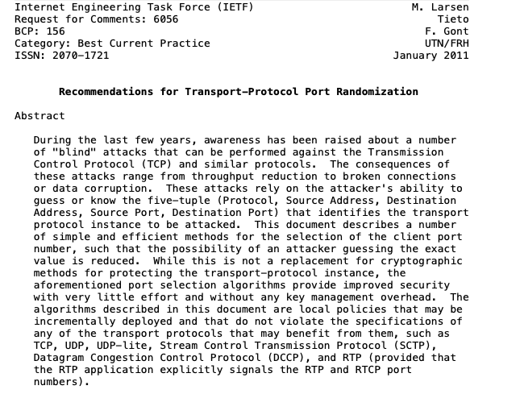
Simultaneous open
Is this frequent in practice ?
How does a client selects its source port ?

