Slide 1
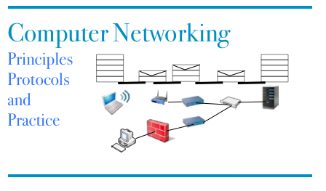
Part 5 Modern TCP and IP
© O. Bonaventure, UCLouvain, 2023. Supplementary material for the Computer Networking : Principles, Protocols and Practice ebook, https://www.computer-networking.info

Slide 2
Agenda
TCP
Improvements to the three-way handshake
Improvements to the data transfer
Congestion control (will be discussed later)
IPv6
IPv4

Slide 3
TCP segment
32 bits
Flags :
used to indicate the function of a segment
SYN : used during establishment
FIN : used during connection release RST : used in case of problems
ACK : if true, means that the Acknowledgement number inside the segment is valid
Source port
Destination port
Sequence number
Acknowledgement number
20 bytes
THL Reserved Flags
Window
Checksum
Urgent pointer
Optional header extension
Segment header length
Payload
Computed over the entire segment and part of the IP header
Notes:
Urgent pointer is rarely used and will not be described.
The THL is indicated in blocs of 32 bits. The TCP header may contain options, these will be discussed later.

Slide 4
TCP options
32 bits
Space in the header with new fields which can be exchanged over a connection
Source port
Destination port
Sequence number
Acknowledgement number
20 bytes
THL Reserved Flags
Window
Checksum
Urgent pointer
Caveat: header extension cannot be longer than 40 bytes
Optional header extension
Payload
Each TCP Option encoded as:
Type
Length
Value
Notes:
Urgent pointer is rarely used and will not be described.
The THL is indicated in blocs of 32 bits. The TCP header may contain options, these will be discussed later.

Slide 5
TCP options
Maximum Segment Size
Selective acknowledgements
Window Scale
Timestamps
Multipath TCP
...

Slide 6
Negotiating the utilization of TCP Options
CONNECT.req
Initial sequence number (x)
Option K proposed
SYN(seq=x),Option K
CONNECT.ind
CONNECT.resp
CONNECT.conf
SYN+ACK(ack=x+1,seq=y) Option K
Initial sequence number (y)
Option K accepted
Connection established
Option K accepted
The sequence numbers of all segments A->B will start at x+1
ACK(seq=x+1, ack=y+1)
Connection established
The sequence numbers of all segments B->A will start at y+1
Notes:
MSL in IP networks : 120 seconds

Slide 7
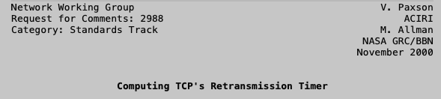

Protection against SYN losses
Which retransmission timer should we use when sending the first SYN ?

Slide 8
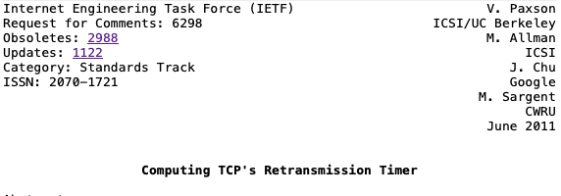

Faster reaction to SYN losses

Slide 9
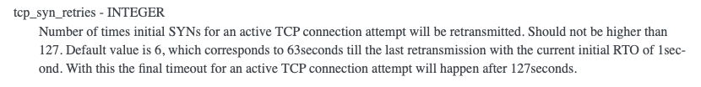
SYN retransmissions
How often are SYN segments retransmitted ?
Linux
https://www.kernel.org/doc/html/latest/networking/ip-sysctl.html

Slide 10

Latency matters
Can we we reduce the overhead of the three-way handshake ?
Putting data inside SYN and SYN+ACK
https://www.gigaspaces.com/blog/amazon-found-every-100ms-of-latency-cost-them-1-in-sales/

Slide 11

A short HTTP request takes two rtts
SYN(seq=x)
TCP handshake
SYN+ACK(ack=x+1,seq=y)
Can we reduce the total delay ?
ACK(seq=x+1, ack=y+1)
GET /index.html …
First HTTP Request
ACK(ack=x+33,seq=y+1)
HTTP/1.1 200 OK …
Notes:
MSL in IP networks : 120 seconds

Slide 12
TCP Fast Open
SYN(seq=x)
HTTP GET ‏
CONNECT.req+Data
CONNECT.ind+HTTP GET
SYN+ACK(ack=x+1,seq=y)
HTTP Resp ‏
ACK(ack=y+1seq=x)‏
Is this safe ?
Risk of denial of service attack

Slide 13
Safe TCP Fast Open
How to make TCP Fast Open safe in the presence of attackers ?
Server needs to ensure that SYN segment does not come from an attacker who sent a spoofed packet
How would you design such a solution ?

Slide 14
TCP Fast Open
First connection from client unsafe
SYN(seq=x)
FastOpen()GET /…
What is the information returned by the server in the FastOpen option ?
SYN+ACK(ack=x+1,seq=y)
FastOpen(0x65df)
New connection
Data delivered and acked, 2 rtt
ACK(seq=x+1, ack=y+1)
GET /…
SYN(seq=z)
FastOpen(0x65df) GET /…
SYN+ACK(ack=z+24,seq=w)
FastOpen(0x65df)
Second safe connection
Data delivered and acked, 1 rtt
Data (seq=w+1, <html> ….)
https://www.rfc-editor.org/rfc/rfc7413

Slide 15
Agenda
TCP
Improvements to the three-way handshake
Improvements to the data transfer
Congestion control (will be discussed later)
IPv6
IPv4

Slide 16
Delayed acknowledgments
Sending one ack per segment is costly
Tradeoff
In sequence data segment
no ack waiting, delay by up to 50 msec
one ack waiting, send immediately
Out-of-sequence data segment
send ack immediately
What is the benefit of delayed acks ?

Slide 17
When to send a segment with data ?
When should a segment be sent ?
Option 1
After each write system call
Lowest delay for application
Option 2
When there is a full segment of data
Lowest overhead for network

Slide 18
Nagle algorithm
A new data segment can be sent if either
This is a full segment (MSS bytes)
There are no unacknowledged bytes
https://www.rfc-editor.org/rfc/rfc896

Slide 19
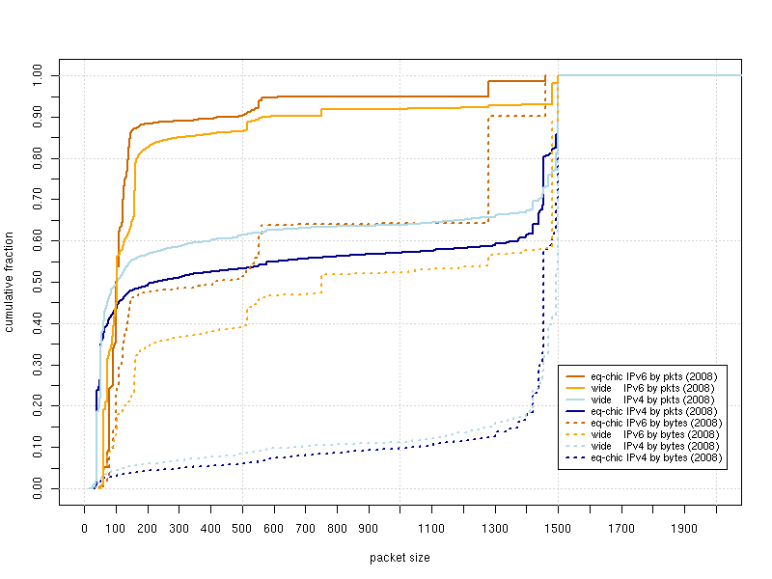
Observed IP packets
http://www.caida.org/research/traffic-analysis/pkt_size_distribution/graphs.xml

Slide 20
TCP Timestamps extension
Objective
Add two 32 bits timestamps to each TCP segment
TSVal is the current timestamp of the sender when sending the segment
TSecr is the last timestamp received from the remote host
Two different roles
Improve rtt measurements
Protection Against Wrapped Sequence Numbers (PAWS)

Slide 21
Negotiating the utilization of TCP Timestamps
Initial sequence number (x)
Current timestamp: 123
Last timestamp received ??
SYN(seq=x)
TSval=123, TSecr=456
SYN+ACK(ack=x+1,seq=y)
TSval=789, TSecr=123
Initial sequence number (y)
Current timestamp: 789
Last timestamp received : 123
Current timestamp: 124
Last timestamp received 123
ACK(seq=x+1, ack=y+1)
Tsval=124, Tsecr=789
Current timestamp: 791
Last timestamp received : 124
Notes:
MSL in IP networks : 120 seconds

Slide 22
RTT estimation Timestamp option
(seq=120,TS=1, TS echo=7, "xyz")
measured rtt
(ack=123, TS=12, TS echo=1)
(seq=123,TS=3, TS echo=12, "abcd")
timer
(seq=123,TS=5, TS echo=12, "abcd")
measured rtt
(ack=127, TS=17, TS echo=3)
Notes:
Les timestamps TCP ont étés introduits dans :
RFC1323 TCP Extensions for High Performance. V. Jacobson, R. Braden, D. Borman. May 1992.
L'utilisation de ces timestamps est négociée lors de l'établissement de la connexion TCP. La plupart des implémentations TCP actuelles supportent ces extensions.

Slide 23
TCP flow control
Performance function of window size
Throughput ~= window/rtt
TCP window : 16 bits field
rtt 1 msec 10 msec 100 msec
Window
8 Kbytes 65.6 Mbps 6.5 Mbps 0.66 Mbps
64 Kbytes 524.3 Mbps 52.4 Mbps 5.2 Mbps

Slide 24
RFC1323 Window scaling
Window maintained as a 32 bits integer by TCP implementations
But sent as a scaled 16 bits in segments
Scaling factor announced in WScale option in SYN/SYN+ACK segments
Client and server can use different scaling values
32 bits
32 bits receive window << scale
Source port
Destination port
Sequence number
Window
Acknowledgement number
THL Reserved Flags
Window
Checksum
Urgent pointer
Optional header extension
Payload

Slide 25
Benefits and limitations of Window Scaling
Increases maximum sending and receiving windows
Largest possible value is 2³⁰ bytes
Enables TCP to operate at higher bandwidth
Within MSL seconds, a TCP sender can send several times the same sequence number !
Need an efficient technique to detect duplicates
rtt 1 msec 10 msec 100 msec
Window
8 Kbytes 65.6 Mbps 6.5 Mbps 0.66 Mbps
64 Kbytes 524.3 Mbps 52.4 Mbps 5.2 Mbps
1 Mbytes 8.39 Gbps 839 Mbps 83.9 Mbps
1 Gbytes 8589 Gbps 859 Gbps 85.9 Gbps

Slide 26
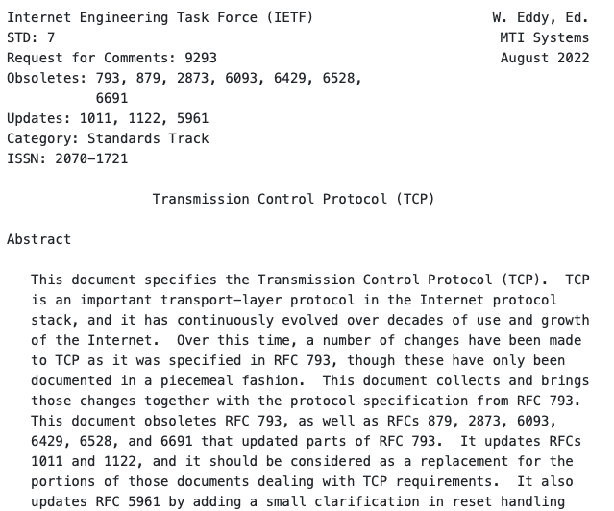
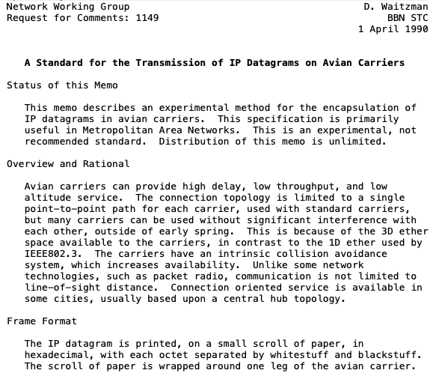

The Maximum Segment Lifetime

Slide 27
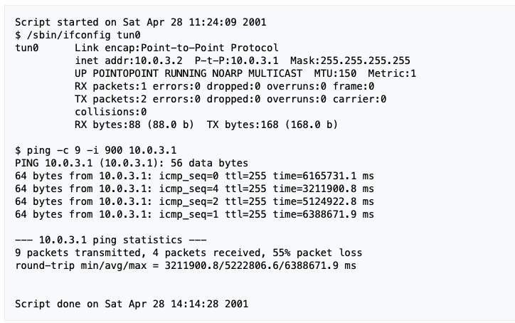
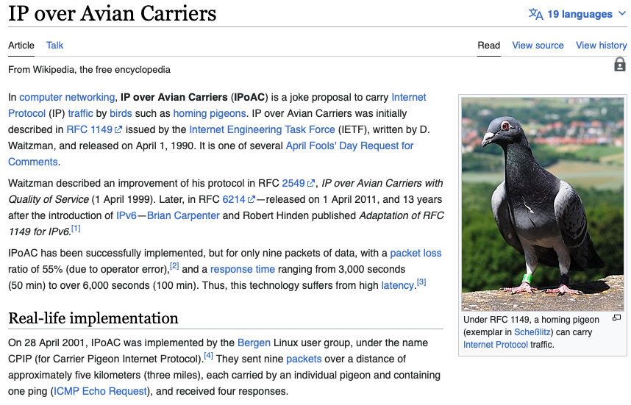
IP over avian carriers

Slide 28
Protection against wrapped sequence numbers
TCP’s reliable delivery assumes that segments do not survive for more than MSL seconds in the network
TCP uses 32 bits sequence numbers that wrap after 4 GBytes
Can a host send segments with the same sequence number within less than MSL seconds ?
At 1 Mbps, a host sends 4 GBytes within 34359 seconds
At 1 Gbps, a host sends 4 GBytes within 34 seconds
At 100 Gbps, a host sends 4 GBYtes within 0.34 seconds

Slide 29
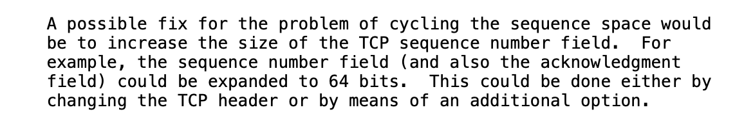
Possible solutions
Clean-slate approach
Extend TCP to use 64 bits sequence numbers
RFC1323 solution in 1992
Changing TCP sequence number is too complex
Require TCP timestamp options when TCP is used at high speed
Receiver uses TCP timestamps to detect delayed segments
https://www.rfc-editor.org/rfc/rfc1323

Slide 30
Selective acknowledgments
Receiver can indicate the sequence numbers that it has received when there are gaps
Negotiated during the three-way handshake
Initial sequence number (x)
SACK proposed
SYN(seq=x)
SACK-Permitted
SYN+ACK(ack=x+1,seq=y)
SACK Permitted
Initial sequence number (y)
SACK enabled
SACK enabled
ACK(seq=x+1, ack=y+1)
Tsval=124, Tsecr=789

Slide 31
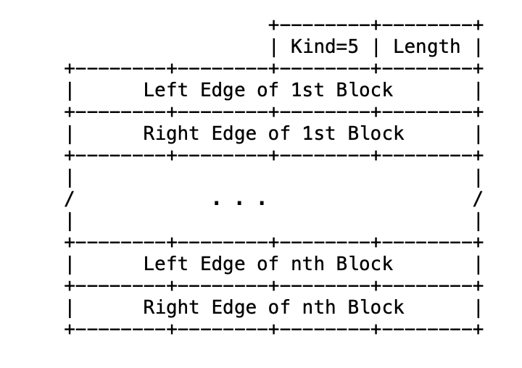

Selective Acknowledgments
Receiver reports SACK blocks
(ack=123)
(seq=123,"abcd")
(seq=127,"ef")
Lost
(ack=123,sack:127-128)
(seq=129,"gh")
(ack=123, sack:127-130)
Given the space available in the TCP header, receiver cannot usually report more than 3 SACK blocks
(seq=131,"ij")
(ack=123, sack:127-132)
only 123-126 must be retransmitted
(seq=123,"abcd")
(ack=133)
"abcdefghij"
Notes:
RFC2018 TCP Selective Acknowledgement Options. M. Mathis, J. Mahdavi, S. Floyd, A. Romanow. October 1996.

Slide 32
Improvements to Fast retransmit
(ack=123)
(seq=123,"abcd")
(seq=127,"ef")
(ack=123)
Out of sequence, in buffer
(seq=129,"gh")
(ack=123)
Out of sequence, in buffer
(seq=131,"ij")
(ack=123)
Out of sequence, in buffer
(seq=123,"abcd")
(ack=133)
"abcdefghij"
The initital design used a duplicate ack threshold of 3 to cope with reordering. Modern implementations leverage selective acknowledgements and dynamically adjust the duplicate ack threshold based on observed reordering.
Notes:
See e.g.
RFC2001 TCP Slow Start, Congestion Avoidance, Fast Retransmit, and Fast Recovery Algorithms. W. Stevens. January 1997.

Slide 33
Selective Acks
Receiver reports SACK blocks
Negotiated during establishment
How many SACK blocks
in one TCP segment ?
(ack=123)
(seq=123,"abcd")
(seq=127,"ef")
Lost
(ack=123,sack:127-128)
(seq=129,"gh")
(ack=123, sack:127-130)
(seq=131,"ij")
(ack=123, sack:127-132)
only 123-126 must be retransmitted
(seq=123,"abcd")
(ack=133)
"abcdefghij"
Notes:
RFC2018 TCP Selective Acknowledgement Options. M. Mathis, J. Mahdavi, S. Floyd, A. Romanow. October 1996.

Slide 34
RACK and Tail Loss Probe
Problem
The loss of the last segment of a block of data may have a large impact on the performance
DATA.req (”GET /index.html")
(seq=123,”GET /")
(ack=128)
DATA.ind(”GET /")
(seq=128,”index.html\r\n")
(seq=140,”Host:…")
https://www.rfc-editor.org/rfc/rfc8985.html

Slide 35
RACK and Tail Loss Probe
Two main ideas, but many tiny details
RACK
Sender maintains a timestamp for each transmitted segment
Sender estimates a reordering window (smaller than rtt) to cope with reordering
Thanks to SACK, sender can update reordering window and considers than segments that have not been acked within rtt+reordering window have been lost
RACK applied to both new segments and retransmissions

Slide 36
Tail Loss Probe
Main idea
If a sender has some unacknowledged data but did not receive enough acks to trigger a retransmission, it can resend a segment to probe the receiver
Short PTO timeout
DATA.req (”GET /index.html")
(seq=123,”GET /")
(ack=128)
DATA.ind(”GET /")
(seq=128,”index.html\r\n")
PTO
(seq=140,”Host:…")
(seq=140,”Host:…")
(ack=128, SACK(140,168)
Segment 128 can be retransmitted
(seq=128,”index.html\r\n")

Slide 37
Agenda
TCP
Improvements to the three-way handshake
Improvements to the data transfer
Congestion control (will be discussed later)
IPv6
IPv6 Addresses
IPv6 Packets
ICMPv6
IPv4

Slide 38



Hosts and routers
Host
Routers
A host
Sends new IP packets with its address as their source
Receives IP packets with its address as their destination
A host has a least one network interface, sometimes more
A router mainly
Forwards IP packets created by other hosts so that they can reach their final destination
Rarely send new IP packets or receive IP packets destined to itself
A router has several network interfaces
R2

Slide 39
IPv6 addresses
IPv4
IP version 6
Each IPv6 address is encoded in 128 bits
3.4 x 10^38 possible addressable devices
6.65 x 10^23 addresses per square meter
Why 128 bits ?
What is percentage of IPv6 users in Belgium ?
Notes:
IP version 4 supports 4,294,967,296 distinct addresses, but some are reserved for :
private addresses (RFC1918)
loopback (127.0.0.1)
multicast
...

Slide 40
IP addresses identify network interfaces
An IP address identifies an attachment point of a host to the network
A computer equipped with a single Ethernet interface will have one IP address associated to this interface
One IPv4 and one IPv6 address if the network is dual-stack
A smartphone equipped with a cellular and a Wi-Fi interface will have
One IP address associated to the Wi-Fi interface
One IP address associated to the cellular interface
A router will have an address on each of its network interfaces

Slide 41
Textual representation of IPv6 addresses
Hexadecimal format
FEDC:BA98:7654:3210:FEDC:BA98:7654:3210
1080:0:0:0:8:800:200C:417A
Compact hexadecimal format
Some IPv6 addresses contain lots of zero
use "::" for one or more groups of 16 zeros.
1080:0:0:0:8:800:200C:417A = 1080::8:800:200C:417A
FF01:0:0:0:0:0:0:101 = FF01::101
0:0:0:0:0:0:0:1 = ::1

Slide 42
IPv6 unicast addresses
128 bits
N bits
M bits
128-N-M bits
interface ID
global routing prefix
subnet ID
Can be used to identify the
ISP responsible for this address
Usually 64 bits
Random or based on MAC Address
A subnet in this ISP or a customer of this ISP
Notes:
Today, the default encoding for global unicast addresses is to use :
48 bits for the global routing prefix (first three bits are set to 001)
16 bits for the subnet ID
64 bits for the interface ID

Slide 43
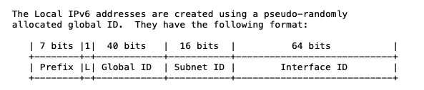
Some IPv6 addresses and prefixes
Loopback : ::1/128
Link local : FE80::/10
Local IPv6 addresses : FC00::/7
https://www.rfc-editor.org/rfc/rfc4193

Slide 44
Public IPv6 addresses and prefixes
www.facebook.com : 2a03:2880:f121:83:face:b00c:0:25de
UCLouvain’s DNS resolvers
2001:6a8:3081:1::53, 2001:6a8:3081:2::53, 2001:6a8:3082:1::53
Quad9’s public DNS resolvers : 2606:4700:4700::1111 and 2606:4700:4700::1001
Belnet’s network prefix : 2001:6a8::/32
Proximus’ network prefix : 2a02:a000::/26
Voo’s network prefix : 2a02:2788::/32
Orange’s network prefix : 2a01:c780::/32

Slide 45
Finding the owner of an IPv6 address
Address blocks are allocated by IANA to regional registries
RIPE, ARIN, APNIC, AFRINIC, LACNIC https://www.iana.org/assignments/ipv6-unicast-address-assignments/ipv6-unicast-address-assignments.xhtml
Regional registries assign prefixes to ISPs and enterprises
RIPE https://www.ripe.net/publications/docs/ripe-738#ir
/32 or larger for ISP
/48 for small enterprise
ISPs should allocate /56 for home users
Whois databases provide information about allocated addresse blocks

Slide 46
Using whois
Example : www.belgium.be
dig -t AAAA +short www.belgium.be
2a01:690:35:100::f5:79
whois 2a01:690:35:100::f5:79
% This is the RIPE Database query service.
% The objects are in RPSL format.
% …
% Abuse contact for '2a01:690::/29' is 'network@smals.be'
inet6num: 2a01:690::/29
netname: BE-SMALS-MVM-20071203
country: BE
org: ORG-SA112-RIPE
admin-c: SRO8-RIPE
tech-c: SRO8-RIPE
status: ALLOCATED-BY-RIR
%...
organisation: ORG-SA112-RIPE
org-name: SmalS vzw
country: BE
org-type: LIR
address: Avenue Fonsny, 20
address: 1060
address: BRUSSELS
address: BELGIUM
phone: +3227875711
fax-no: +3225111242

Slide 47
Agenda
TCP
Improvements to the three-way handshake
Improvements to the data transfer
Congestion control (will be discussed later)
Multipath TCP (will be discussed later)
IPv6
IPv6 Addresses
IPv6 Packets
ICMPv6
IPv4

Slide 48
The IPv6 packet format
Version=6
Traffic class
Quality of Service
CE and ECT bits
32 bits
Ver Tclass
Flow Label
Loop detection
Router forwards and decrement HL provided HL>0
otherwise, packet dropped and error returned to source
Payload Length
NxtHdr Hop Limit
Size of packet payload in bytes
Source IPv6 address
(128 bits)
Used to identify the type
of the next header (e.g. UDP, TCP, ...)
in the packet payload
Destination IPv6 address
(128 bits)
No checksum in IPv6 header
relies on datalink and transport checksums
What is the maximum length of an IPv6 packet in bytes ?
Notes:
The IPv6 packet format is described in
S. Deering, B. Hinden, Internet Protocol, Version 6 (IPv6) Specification , RFC2460, Dec 1998
Several documents have been written about the usage of the Flow label. The last one is
J. Rajahalme, A. Conta, B. Carpenter, S. Deering, IPv6 Flow Label Specification, RFC3697, 2004
However, this proposal is far from being widely used and deployed.

Slide 49
Sample packets
32 bits
32 bits
Ver Tclass
Flow Label
Payload Length
NxtHdr Hop Limit
Ver Tclass
Flow Label
Payload Length
NxtHdr Hop Limit
Source IPv6 address
(128 bits)
TCP (6)
Source IPv6 address
(128 bits)
Destination IPv6 address
(128 bits)
UDP (17)
Destination IPv6 address
(128 bits)
Source port
Destination port
Sequence number
Source port
Destination port
Acknowledgment number
Length
Checksum
THL Reserved Flags
Window
UDP
Checksum
Urgent pointer
TCP
Identification of a TCP connection
IPv6 src, IPv6 dest, Source and Destination ports
https://www.iana.org/assignments/protocol-numbers/protocol-numbers.xhtml
Notes:
IPv6 does not require changes to TCP and UDP for IPv4. The only modification is the computation of the checksum field of the UDP and TCP headers since this checksum is computed by concerning a pseudo header that contains the source and destination IP addresses.

Slide 50
Agenda
TCP
Improvements to the three-way handshake
Improvements to the data transfer
Congestion control (will be discussed later)
Multipath TCP (will be discussed later)
IPv6
IPv6 Addresses
IPv6 Packets
ICMPv6
IPv4

Slide 51
ICMP
Internet Control Message Protocol
Runs on top of IPv6 and provides various types of services
tools to aid debugging network problems
error reporting
autoconfiguration of addresses

Slide 52
ICMPv6
Types of ICMPv6 messages
Destination (addr,net,port) unreachable
Packet too big
Time expired (Hop limit exhausted)
Echo request and echo reply
Multicast group membership
Router advertisements, Neighbor discovery
Autoconfiguration
Notes:
ICMPv6 is defined in :
A. Conta, S. Deering, M. Gupta, Internet Control Message Protocol (ICMPv6) for the Internet Protocol Version 6 (IPv6) Specification, RFC4443, March 2006

Slide 53
ICMPv6 packet
Ver Tclass
Flow Label
Payload Length
NxtHdr Hop Limit
Source IPv6 address
(128 bits)
58 for ICMPv6
Covers ICMPv6 message and part of IPv6 header
Destination IPv6 address
(128 bits)
Type
ICMPv6 error messages
1 Destination Unreachable
3 Time Exceeded
2 Packet Too Big
4 Parameter Problem
ICMPv6 informational messages:
128 Echo Request
129 Echo Reply
Type Code
Checksum
Message body
Notes:
ICMPv6 uses a next header value of 58 inside IPv6 packets

Slide 54

The ping tool
A
D
R1
R2
Echo request(123)
delay=17 msec
Echo reply (123)
Echo request(124)
delay=19 msec
Echo reply (124)

Slide 55
ping6
#ping6 www.ietf.org
PING6(56=40+8+8 bytes) 2001:6a8:3080:2:3403:bbf4:edae:afc3 --> 2001:1890:123a::1:1e
16 bytes from 2001:1890:123a::1:1e, icmp_seq=0 hlim=49 time=156.905 ms
16 bytes from 2001:1890:123a::1:1e, icmp_seq=1 hlim=49 time=155.618 ms
16 bytes from 2001:1890:123a::1:1e, icmp_seq=2 hlim=49 time=155.808 ms
16 bytes from 2001:1890:123a::1:1e, icmp_seq=3 hlim=49 time=155.325 ms
16 bytes from 2001:1890:123a::1:1e, icmp_seq=4 hlim=49 time=155.493 ms
16 bytes from 2001:1890:123a::1:1e, icmp_seq=5 hlim=49 time=155.801 ms
16 bytes from 2001:1890:123a::1:1e, icmp_seq=6 hlim=49 time=155.660 ms
16 bytes from 2001:1890:123a::1:1e, icmp_seq=7 hlim=49 time=155.869 ms
^C
--- www.ietf.org ping6 statistics ---
8 packets transmitted, 8 packets received, 0.0% packet loss
round-trip min/avg/max/std-dev = 155.325/155.810/156.905/0.447 ms

Slide 56
The traceroute tool
A
D
R1
R2
HL=1, UDP(Sport=2345)
Hop=R1
delay=7 msec
ICMP Time exc.
HL=2, UDP(Sport=2346)
Hop=R2
delay=12 msec
ICMP Time exc.
HL=3, UDP(Sport=2347)
Hop=D
delay=15 msec
ICMP Dest. (port) unreachable

Slide 57
traceroute6
-n no DNS lookups -T send TCP segments
-q 1 one probe per hop
sudo traceroute6 -n -q 1 -T www.belgium.be
traceroute to www.belgium.be (2a01:690:35:100::f5:79), 30 hops max, 80 byte packets
1 2001:6a8:308f:9::1 0.470 ms
2 2001:6a8:308f:1::1 0.886 ms
3 *
4 fd5b:6a8:3080::4024:52 1.151 ms
5 fd5b:6a8:3080::4019:12 0.933 ms
6 fd5b:6a8:3080::4019:1 1.329 ms
7 fd5b:6a8:3080::4020:51 1.213 ms
Routers inside belnet
8 2001:6a8:a00:8015::1 1.434 ms
9 2001:6a8:0:5:1ff::1 2.240 ms
10 2001:6a8:1:4012::10 2.224 ms
11 2001:6a8:1:4023::69 2.720 ms
12 2001:6a8:8000:8001::1 2.969 ms
13 2001:6a8:8000:8001::2 4.303 ms
14 2a01:690:1:27::1 3.440 ms
15 2a01:690:35:1::5 3.957 ms
16 *
17 *
18 2a01:690:35:2::2 3.042 ms
19 2a01:690:35:2::4 3.306 ms
20 2a01:690:35:100::f5:79 3.796 ms
Private addresses, routers inside UCLouvain
Routers from SMALS

Slide 58
Reverse DNS
Objective
Query and IPv4 or IPv6 address and retrieve the corresponding DNS name
Solution for IPv4
Convert IPv4 address w.x.y.z into name z.y.x.w.in-addr.arpa
Query DNS for PTR record
dig -t PTR +short 4.4.8.8.in-addr.arpa
dns.google.
dig -t PTR +short 1.1.104.130.in-addr.arpa
ns1.sri.ucl.ac.be.

Slide 59
The IPv4 reverse DNS tree
dig -t NS in-addr.arpa +short
b.in-addr-servers.arpa.
d.in-addr-servers.arpa.
f.in-addr-servers.arpa.
e.in-addr-servers.arpa.
c.in-addr-servers.arpa.
a.in-addr-servers.arpa.
root
com
edu
arpa
dig -t NS 130.in-addr.arpa +short
u.arin.net.
z.arin.net.
y.arin.net.
r.arin.net.
arin.authdns.ripe.net.
x.arin.net.4
In-addr
8
9
130
dig -t NS 102.130.in-addr.arpa +short
ns2.dc.uq.edu.au.
ns1.dc.uq.edu.au.
ns4.dc.uq.edu.au.
ns3.dc.uq.edu.au.
102
103
104
105
106
107
dig -t NS 104.130.in-addr.arpa +short
ns2.sri.ucl.ac.be.
ns3.sri.ucl.ac.be.
ns1.sri.ucl.ac.be.

Slide 60
Reverse DNS for IPv6
Same principle as for IPv4, but with two differences :
Top-level domain is ip6.arpa
Reverse IPv6 address is encoded as a serie of 4 bits nibbles in hexadecimal separated by dots
Example : to find the PTR for 2001:db8::567:89ab we need to query
b.a.9.8.7.6.5.0.0.0.0.0.0.0.0.0.0.0.0.0.0.0.0.0.8.b.d.0.1.0.0.2.ip6.arpa

Slide 61
Traceroute with DNS names
sudo traceroute6 -q 1 -T www.belgium.be
traceroute to www.belgium.be (2a01:690:35:100::f5:79), 30 hops max, 80 byte packets
1 2001:6a8:308f:9::1 (2001:6a8:308f:9::1) 0.664 ms
2 2001:6a8:308f:1::1 (2001:6a8:308f:1::1) 0.617 ms
3 *
4 OSCarnoy-research.sri.ucl.ac.be (fd5b:6a8:3080::4024:52) 0.555 ms
5 FwCarnoy-research.sri.ucl.ac.be (fd5b:6a8:3080::4019:12) 0.501 ms
6 OsCarnoy-default.sri.ucl.ac.be (fd5b:6a8:3080::4019:1) 0.852 ms
7 OSPythagore-default.sri.ucl.ac.be (fd5b:6a8:3080::4020:51) 0.821 ms
8 xe.cr2.brueve.belnet.net.0.0.a.0.8.a.6.0.1.0.0.2.ip6.arpa (2001:6a8:a00:8015::1) 0.970 ms
9 2001:6a8:0:5:1ff::1 (2001:6a8:0:5:1ff::1) 7.109 ms
10 2001:6a8:1:4012::10 (2001:6a8:1:4012::10) 2.152 ms
11 2001:6a8:1:4023::69 (2001:6a8:1:4023::69) 5.057 ms
12 r1.brusou.belnet.net (2001:6a8:8000:8001::1) 4.864 ms
13 smals.r1.brusou.belnet.net (2001:6a8:8000:8001::2) 3.939 ms
14 2a01:690:1:27::1 (2a01:690:1:27::1) 3.225 ms
15 2a01:690:35:1::5 (2a01:690:35:1::5) 3.347 ms
16 *
17 *
18 2a01:690:35:2::2 (2a01:690:35:2::2) 3.377 ms
19 2a01:690:35:2::4 (2a01:690:35:2::4) 3.313 ms
20 2a01:690:35:100::f5:79 (2a01:690:35:100::f5:79) 3.448 ms

Slide 62
How does a host learns its IPv6 address ?
Host contacts a DHCPv6 server on the local network
DHCPv6 Server allocates one IPv6 address belonging to the network prefix to the host for some time
Host needs to renew address allocation regularly
DHCPv6 Server knows which host uses which IPv6 address
Routers regularly broadcast messages announcing the /64 prefix associated to each of their interfaces
ICMPv6
Upon reception of such a message, host can allocate its own address as
Prefix followed by 64 bits identifier
Prefix followed by 64 bits random identifiers
More details will be provided when we will discuss Local Area Networks

Slide 63
IPv6 network configuration of a host
ip -6 addr show lo
1: lo: <LOOPBACK,UP,LOWER_UP> mtu 65536 qdisc noqueue state UNKNOWN group default qlen 1000
inet6 ::1/128 scope host
Loopback interface
Network interface configuration
Address of default router
ip -6 addr show eth0
2: eth0: <BROADCAST,MULTICAST,UP,LOWER_UP> mtu 1500 qdisc fq_codel state UP group default qlen 1000
altname enp0s3
altname ens3
inet6 2001:6a8:308f:9:0:82ff:fe68:e51c/64 scope global
valid_lft forever preferred_lft forever
inet6 fe80::82ff:fe68:e51c/64 scope link
valid_lft forever preferred_lft forever

Slide 64
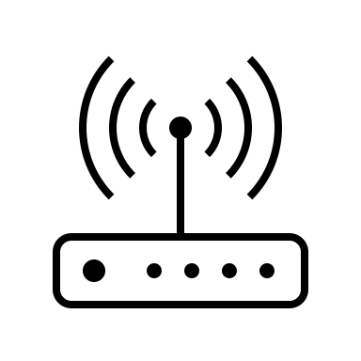

IPv6 addresses are grouped in subnets
All the addresses that belong to the same subnet as the local host can be reached directly through the local area network
The adresses that belong to other subnets are reachable via the default router
Internet
2001:db8:A:B::bad/64
2001:db8:A:B::cafe/64
2001:db8:A:C::dada/64

Slide 65
Agenda
TCP
Improvements to the three-way handshake
Improvements to the data transfer
Congestion control (will be discussed later)
IPv6
IPv6 Addresses
IPv6 Packets
ICMPv6
IPv4

Slide 66
IPv4 addresses
32 bits wide
Public IPv4 addresses
Allocated by IANA and RIRs to ISPs
https://www.iana.org/assignments/ipv4-address-space/ipv4-address-space.xhtml
Private IPv4 addresses
10.0.0.0/8
192.168.0.0/16
172.16.0.0/12
Link local addresses
169.254.0.0/16
Multicast
224.0.0.0 - 239.255.255.255
Reserved
240/4
https://www.rfc-editor.org/rfc/rfc1918

Slide 67
IP version 4
Header extensions, rarely used
Same role as DSCP in IPv6
Max. Packet length 64 KBytes
Packet format
20 bytes header
Ver IHL ToS
Total length
Identification
Flags Frag. Offset
Same role as HopLimit in IPv6
TTL Protocol
Checksum
Source IP address
Destination IP address
Payload
Source port
Destination port
Covers only IP header
6 for TCP, 17 for UDP, …
Sequence number
Acknowledgment number
THL Reserved Flags
Window
Checksum
Urgent pointer
Options
Payload

Slide 68
IPv4 packet carrying a TCP segment
Ver IHL ToS
Total length
Identification
Flags Frag. Offset
IP
TTL Protocol
Checksum
Source IP address
Destination IP address
Source port
Destination port
Sequence number
6 for TCP
Acknowledgment number
TCP
THL Reserved Flags
Window
Checksum
Urgent pointer
Options
Payload

Slide 69
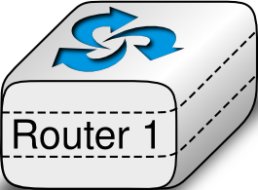
TCP segments processed by a router
Ver IHL ToS
Total length
Ver IHL ToS
Total length
Identification
Flags Frag. Offset
Identification
Flags Frag. Offset
IP
TTL Protocol
Checksum
TTL Protocol
Checksum
Source IP address
Source IP address
Destination IP address
Destination IP address
Source port
Destination port
Source port
Destination port
Sequence number
Sequence number
Acknowledgment number
Acknowledgment number
TCP
THL Reserved Flags
Window
THL Reserved Flags
Window
Checksum
Urgent pointer
Checksum
Urgent pointer
Options
Options
Payload
Payload

Slide 70
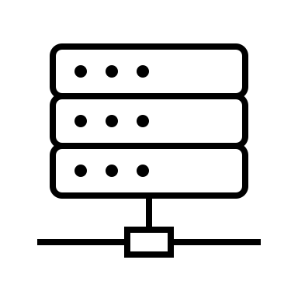

Network Address Translation (NAT)
A NAT allows to share a single public IP address among several hosts
Internet
10.0.0.8
5.6.7.8
1.2.3.4
10.0.0.6
How can a NAT share the same public IP among different hosts using private addresses ?
10.0.0.12
10.0.0.9

Slide 71
TCP segments processed by a NAT
Ver IHL ToS
Total length
Ver IHL ToS
Total length
Identification
Flags Frag. Offset
Identification
Flags Frag. Offset
TTL Protocol
Checksum
TTL Protocol
Checksum
Source IP address
Source IP address
Destination IP address
Destination IP address
Source port
Destination port
Source port
Destination port
Sequence number
Sequence number
Acknowledgment number
Acknowledgment number
THL Reserved Flags
Window
THL Reserved Flags
Window
Checksum
Urgent pointer
Checksum
Urgent pointer
Options
Options
Payload
Payload
Notes:
c

Slide 72
How does a host learns its IPv4 address ?
Host contacts a DHCPv4 server on the local network
DHCPv4 Server allocates one IPv4 address belonging to the network prefix to the host for some time
Host needs to renew address allocation regularly
DHCPv4 Server knows which host uses which IPv4 address
Manual configuration

Slide 73
IPv4 network configuration of a host
ip -4 addr show lo
1: lo: <LOOPBACK,UP,LOWER_UP> mtu 65536 qdisc noqueue state UNKNOWN group default qlen 1000
inet 127.0.0.1/8 scope host lo
valid_lft forever preferred_lft forever
Loopback interface
Network interface configuration
Address of default router
ip -4 addr show eth0
2: eth0: <BROADCAST,MULTICAST,UP,LOWER_UP> mtu 1500 qdisc fq_codel state UP group default qlen 1000
altname enp0s3
altname ens3
inet 130.104.229.28/25 brd 130.104.229.127 scope global eth0
valid_lft forever preferred_lft forever

Slide 74
IPv4 addresses are grouped in subnets
All the addresses that belong to the same subnet as the local host can be reached directly through the local area network
The adresses that belong to other subnets are reachable via the default router
Internet
192.168.0.12/24
192.168.0.23/24
10.0.0.2/23

