Slide 1

Feature Engineering & Feature Selection
Maruti Kumar Mudunuru,
Staff Scientist,
Computational Earth Science Group,
Earth and Environmental Sciences,
Los Alamos National Laboratory
Date: April-23-2019, SSA ML Workshop, LA-UR-19-23588.
Email: maruti@lanl.gov

Slide 2
Outline
Feature engineering
Feature extraction
Feature selection
Feature significance testing
Multiple test procedure
Data formats
Basics of time-series forecasting

Slide 3
Basics of feature engineering
Feature engineering is the process of transforming raw data into features that make machine learning algorithms work.
The goal is to better represent the underlying problem to the predictive models.
Intelligent feature engineering results in improved model accuracy on unseen data.
Most of the time is spent on engineering or creating features.
Deciding what features to create.
Checking how the created features work with your ML-model
Based on model performance, improving features (if needed)

Slide 4
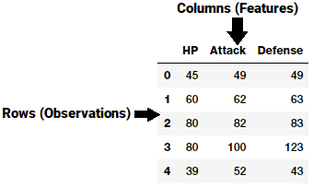
Engineering or creating features
A feature is an individual, measurable attribute, or characteristic of a phenomenon being observed.
Features can be numeric, strings, graphs etc.
A feature is typically a specific representation on top of raw data.
It is depicted by a column in a dataset.
For example, in a two-dimensional dataset, each observation is depicted by a row and each feature by a column
Note that features are very much dependent on the underlying problem.
In geophysics:
1. Attributes of seismic data, e.g., coherence and curvature
2. Feature examples from earthquake detection
X1 X2 X3

Slide 5
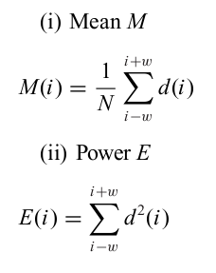
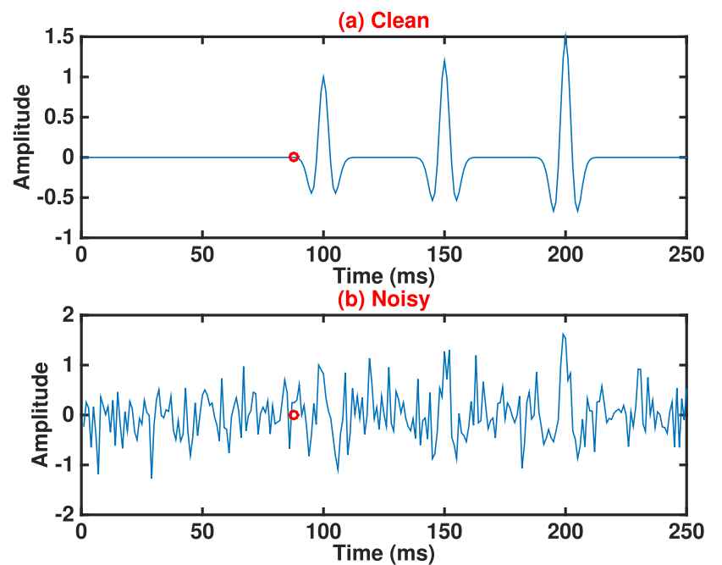
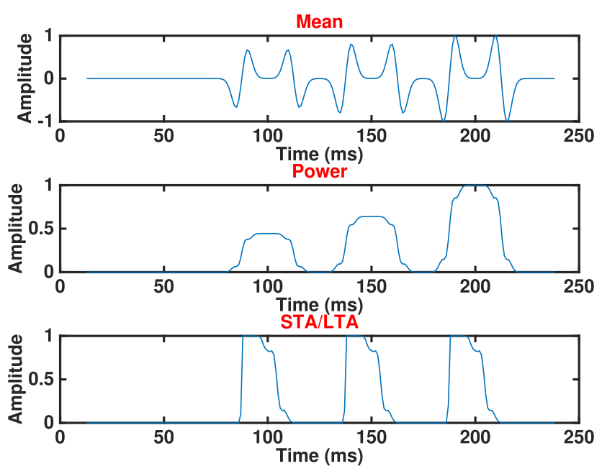
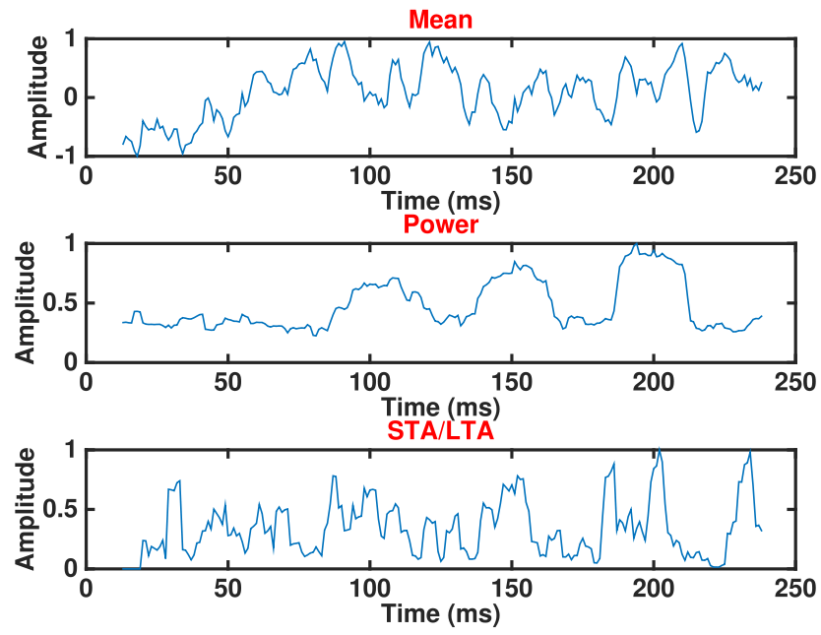
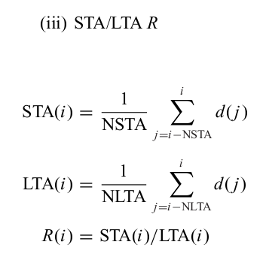
Example 1: Features for microseismic detection (mean, power, STA/LTA)
(Chen 2017)

Slide 6
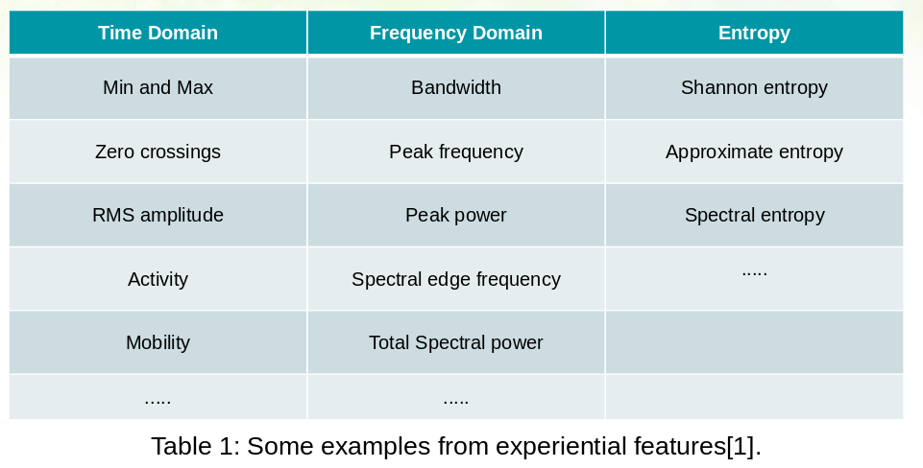
Example 2: earthquake detection using feature selection and dictionary learning (Zhou et al 2019) Experiential features
https://permalink.lanl.gov/object/tr?what=info:lanl-repo/lareport/LA-UR-18-26576

Slide 7
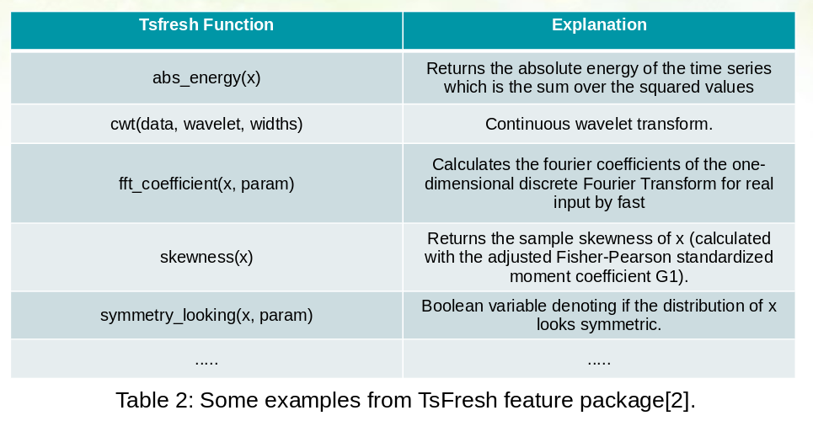
Example 2: earthquake detection using feature selection and dictionary learning (Zhou et al 2019) Tsfresh Features
https://permalink.lanl.gov/object/tr?what=info:lanl-repo/lareport/LA-UR-18-26576

Slide 8
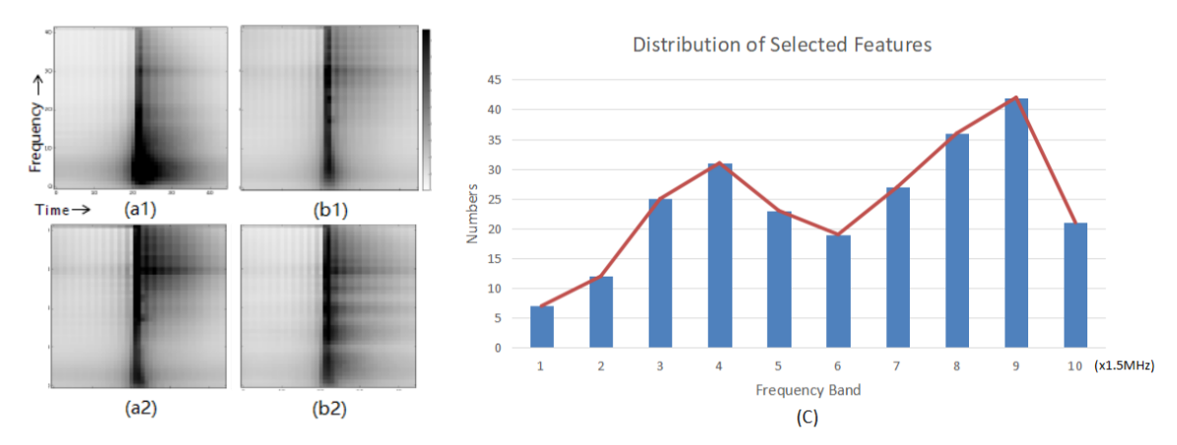
Test: examples of features
Certain frequency bands tend to play more important roles.
--some implications about the physical model
Small – big: various
(a1) (a2) a small earthquake (amplitude) and a big event;
(b1) (b2) examples do not contain earthquake events.
Frequency components of earthquakes tend to concentrate in certain frequency band, not too much complicated noise.

Slide 9
Feature Engineering packages (Python, R, and MATLAB)
hctsa -- MATLAB
pyopy
tsfresh
https://github.com/blue-yonder/tsfresh
tscompdata and tsfeatures -- R
Khiva
pyunicorn
FATS
seglearn
cesium-ml
tslearn

Slide 10
Advantages of tsfresh
Field tested
Unit tested
The filtering process is statistically/mathematically correct
Comprehensive documentation
Compatible with sklearn, pandas and numpy
Allows anyone to easily add their favorite features
Runs on your local machine or even on a cluster
https://github.com/blue-yonder/tsfresh

Slide 11
tsfresh – Time-series feature engineering
tsfresh is used to to extract characteristics from time series
tsfresh provides a library of functions to calculate features
Automatic extraction of 100s of features
If you want to install on your local machine:
pip install tsfresh
https://tsfresh.readthedocs.io/en/latest/text/quick_start.html
conda install -c conda-forge tsfresh
https://anaconda.org/conda-forge/tsfresh
At the top level the following are the three most important submodules of tsfresh:
extract_features
select_features
extract_relevant_features

Slide 12
Feature extraction

Slide 13
tsfresh – Feature calculators
Tsfresh module contains the feature calculators that take time-series as input and calculate the values of the feature.
For a complete list of features https://tsfresh.readthedocs.io/en/latest/text/list_of_features.html
There are two types of features:
Scalar-valued: feature calculators which calculate a single number (simple): Absolute energy, length, maximum, median, mean, standard deviation, skewness, kurtosis etc.
Vector-valued: feature calculators which calculate a bunch of features for a list of parameters at once (combiner). They return a list of (key, value) pairs for each input parameter: CWT coefficients, FFT coefficient

Slide 14

tsfresh – Feature extraction (extract_features)
from tsfresh import extract_features
X = extract_features(df, column_id='id', column_sort='time’)
https://tsfresh.readthedocs.io/en/latest/api/tsfresh.feature_extraction.html
What does it do?
Extract features from a pandas.DataFrame containing the different time series
Returns a pandas.DataFrame with the calculated features will be returned.
default_fc_parameters
MinimalFCParameters: includes only a handful of features and can be used for quick tests
EfficientFCParameters: features which are marked with the “high_comp_cost” are not calculated
ComprehensiveFCParameters: all features with parameters, each with different parameter combinations are calculated. This is the default for extract_features if you do not hand in a default_fc_parameters at all.

Slide 15
tsfresh – Feature extraction settings (extract_features)
MinimalFCParameters: length, max, mean, median, min, std, sum, var
EfficientFCParameters
ComprehensiveFCParameters

Slide 16
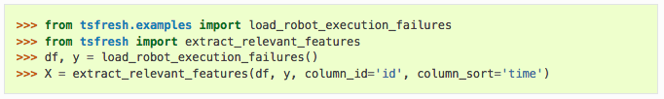
tsfresh – Feature extraction (extract_relevant_features)
from tsfresh import extract_relevant_features
X = extract_relevant_features(df, y, column_id='id', column_sort='time')
https://tsfresh.readthedocs.io/en/latest/api/tsfresh.convenience.html
What does it do?
High level convenience function to extract time series features from timeseries_container
timeseries_container – The pandas.DataFrame with the time series to compute the features for, or a dictionary of pandas.DataFrames
‘df’ is an example of timeseries_container
It returns feature matrix ‘X’ possibly augmented with relevant time-series features with respect to target vector ‘y’.

Slide 17
Feature selection

Slide 18
tsfresh – Feature selection basics (select_features)
Time series often contain noise, redundancies or irrelevant information.
As a result most of the extracted features will not be useful for the machine learning task at hand.
To avoid extracting irrelevant features, the tsfresh package has a built-in filtering procedure.
This filtering procedure evaluates the explaining power and importance of each characteristic for the regression or classification tasks at hand.
It is based on the well developed theory of hypothesis testing and uses a multiple test procedure.
As a result the filtering process mathematically controls the percentage of irrelevant extracted features.
from tsfresh import select_features

Slide 19
tsfresh – Feature selection (null hypothesis)
Each feature vector is evaluated individually and independently based on its importance for predicting the target or class label.
We are testing
H₀ = the Feature is not relevant and should not be added
against the following
H₁ = the Feature is relevant and should be kept
Or in other words
H₀ = Target and Feature are independent / the Feature has no influence on the target
H₁ = Target and Feature are associated / dependent

Slide 20
tsfresh – Feature selection (p-value)
When you perform a hypothesis test in statistics, a p-value helps you determine the significance of your results.
The p-value is a number between 0 and 1 and interpreted in the following way:
A small p-value (typically ≤ 0.05) indicates strong evidence against the null hypothesis that the feature is not relevant and should not be added
Meaning that, we reject the null hypothesis and the feature should be kept.
A large p-value (>0.05) indicates weak evidence against the null hypothesis, so we fail to reject the null hypothesis.
Always report the p-value so your readers can draw their own conclusions.

Slide 21

tsfresh – Feature selection (testing procedure)
Benjamini Hochberg procedure
It is a multiple testing procedure decides which features to keep and which to cut off (solely based on the p-values)
Determines if the null hypothesis for a given feature can be rejected.
For this the test regards the features’ p-values and controls the global false discovery rate
Global false discovery rate (FDR) is the ratio of false rejections by all rejections:

Slide 22
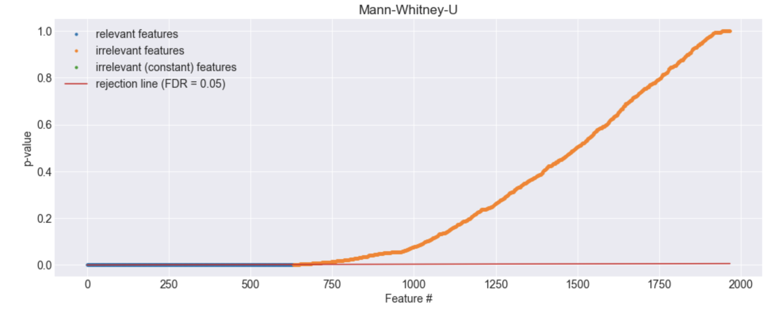
Example https://github.com/blue-yonder/tsfresh/tree/master/notebooks

Slide 23
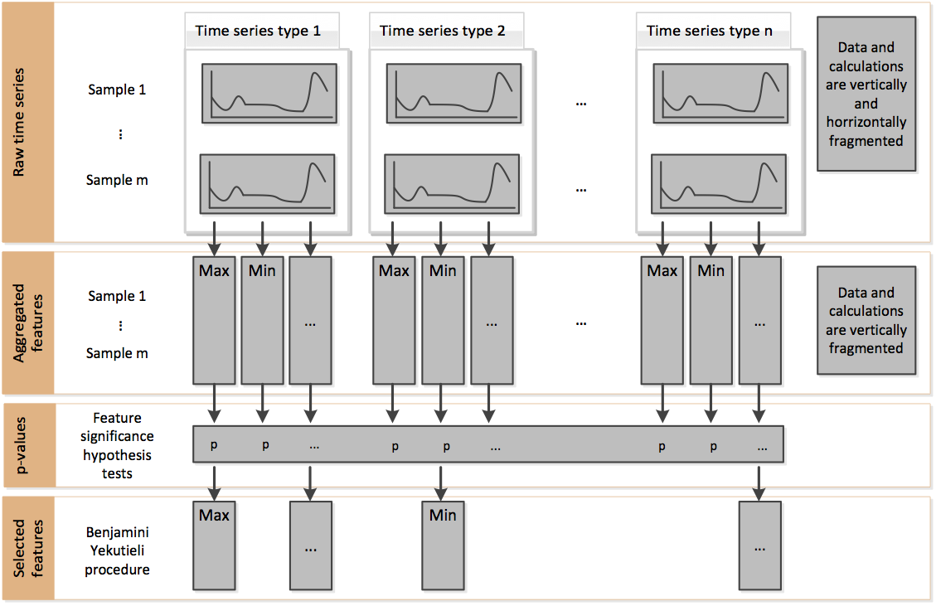
tsfresh – Feature selection summary

Slide 24
Data Format

Slide 25
tsfresh – Data Formats
Input format – pandas.DataFrame (2D tabular data)
http://pandas.pydata.org/pandas-docs/stable/reference/api/pandas.DataFrame.html#pandas.DataFrame
flat DataFrame: column_kind=None, column_value=None
Stacked DataFrame
Dictionary of flat DataFrames
https://tsfresh.readthedocs.io/en/latest/text/data_formats.html

Slide 26
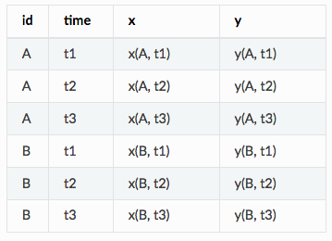
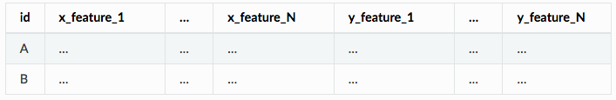
tsfresh – Data Formats (Flat DataFrame Example)
Input Data Format:
Imagine you record the values of time-series x and y for different objects A and B for three different times t1, t2 and t3.
Now you want to calculate some feature with tsfresh.
Your resulting DataFrame may look like this
You would pass
column_id="id", column_sort="time", column_kind=None, column_value=None
to extract functions, to extract features separately for all ids and
separately for the x and y values.
Output Format of Features:
The resulting feature matrix for all three input DataFrame options will be the same.
It will always be a pandas.DataFrame with the following layout

Slide 27
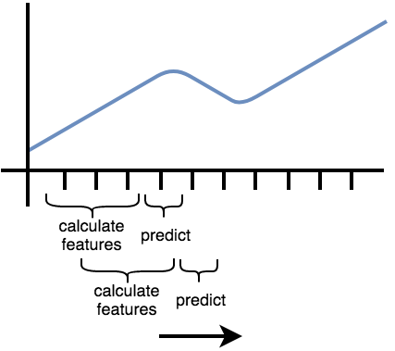
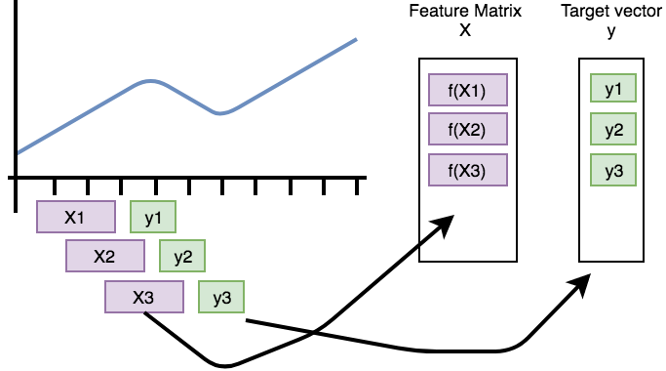
tsfresh – Basics of time-series forecasting

Slide 28
tsfresh – Summary of time-series forecasting
Features are calculated by rolling over the data
A rolling mechanism will give you the sub time series to construct the features.
So, we move the time-series window that extract the features and then predict the next time step (which was not used to extract features) forward
Both tsfresh and pandas provide methods for rolling mechanisms
tsfresh.utilities.dataframe_functions.roll_time_series
https://tsfresh.readthedocs.io/en/latest/api/tsfresh.utilities.html#tsfresh.utilities.dataframe_functions.roll_time_series
DataFrame.rolling
https://pandas.pydata.org/pandas-docs/stable/reference/api/pandas.DataFrame.rolling.html

Slide 29
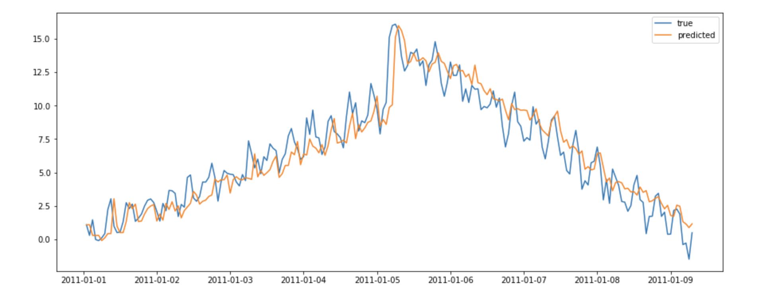
Example https://github.com/blue-yonder/tsfresh/tree/master/notebooks

Slide 30
Conclusions – Things to remember
Features are a different kind of input data instead of raw data to train a model. Relevant features can help improve the model accuracy.
Tsfresh package: input/output: pandas.DataFrame (2D tabular data)
Three important submodules can be used to extract and select features:
extract_features
select_features
extract_relevant_features

Slide 31
Questions?

Slide 32
Conclusions – Things to remember
Feature scaling is done to Normalize data so that priority is not given to a particular feature.
https://scikit-learn.org/stable/modules/preprocessing.html
Role of scaling is mostly important in algorithms that are distance based (e.g, Euclidean metric).
E.g., k-means clustering, Support Vector Machines, etc.
ASIDE -- Random Forest (RF) is a tree-based model and hence does not require feature scaling.
RF algorithm is based on partitioning, even if you apply Normalization then also the result would be the same.

Slide 33
References & Useful Resources
https://github.com/benfulcher/hctsa
https://tsfresh.readthedocs.io/en/latest/
https://github.com/blue-yonder/tsfresh
https://towardsdatascience.com/how-not-to-use-machine-learning-for-time-series-forecasting-avoiding-the-pitfalls-19f9d7adf424
https://towardsdatascience.com/how-to-use-machine-learning-for-anomaly-detection-and-condition-monitoring-6742f82900d7
https://towardsdatascience.com/understanding-feature-engineering-part-1-continuous-numeric-data-da4e47099a7b
https://towardsdatascience.com/feature-engineering-what-powers-machine-learning-93ab191bcc2d
https://machinelearningmastery.com/discover-feature-engineering-how-to-engineer-features-and-how-to-get-good-at-it/
https://developers.google.com/machine-learning/crash-course/representation/feature-engineering
Feature Engineering for Machine Learning: Principles and Techniques for Data Scientists – Alice Zheng & Amanda Casari, O’Reilly, 2018.
Feature Engineering Made Easy, Sinan Ozdemir, Divya Susarla, Packt, 2018.
Feature Extraction: Foundations and Applications, by Isabelle Guyon, Steve Gunn, Masoud Nikravesh, Lofti A. Zadeh, Springer 2006.
Feature Extraction, Construction and Selection: A Data Mining Perspective, Huan Liu, Hiroshi Motoda, Springer, 1998.

Slide 34
tsfresh – Parallelization
Parallelization is based on multiprocessing.Pool
For the feature extraction and feature selection parallelization parameters include
n_jobs and chunksize in extract_features and select_features
n_jobs corresponds to number of processors on the current system
On instantiation we set the Pool’s number of worker processes to n_jobs
Recommend setting it to the maximum number of available (and otherwise idle) processors
chunksize is the number of chunks that are submitted as one task to one worker process
E.g, if you set the chunksize to 10, then it means that one worker task corresponds to calculate all features for 10 id/kind time series combinations
To do performance studies and profiling, turn off parallelization.
This can be setting the parameter n_jobs to 0 and chunksize = None.

Slide 35
Predict future value given current values
Features
Machine learning algorithms
X = {X1, X2, X3 …}
Y
given
Y = f(X)
predict
Raw data (e.g., Time-series)

Slide 36
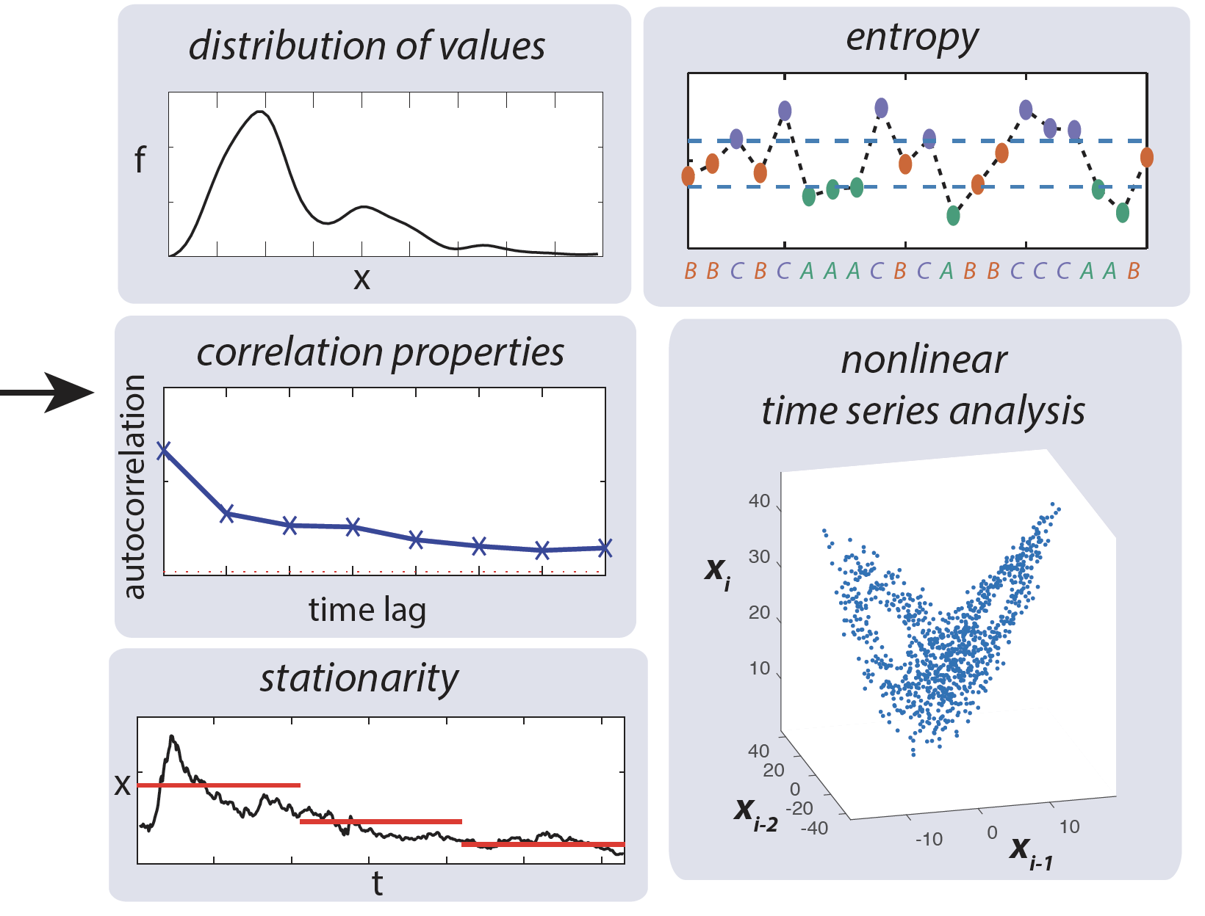
ML-approach: Feature extraction
given
predict
10 sample points

