Slide 1

Supervised learning

Slide 2
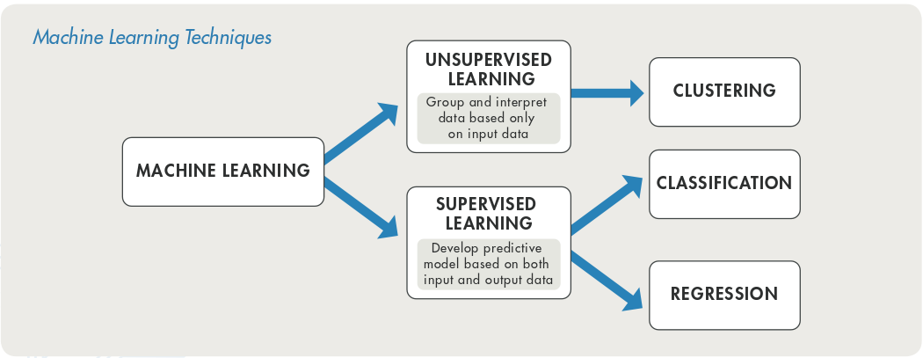
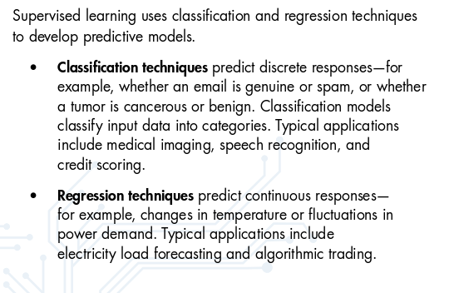
Classify the waveforms into earthquakes and noise (2 classes)
Predict the magnitude based on the features (amplitudes) of the waveforms

Slide 3
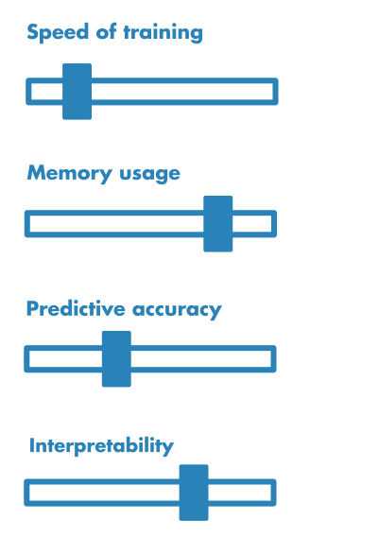
Common Classification Algorithms: Logistic Regression, k Nearest neighbor, support vector machine (concept), neural network (model structures), Naïve Bayes, Discriminant analysis, decision tree
Common Regression Algorithms:
Linear Regression, nonlinear regression, SVM regression, regression tress

Slide 4
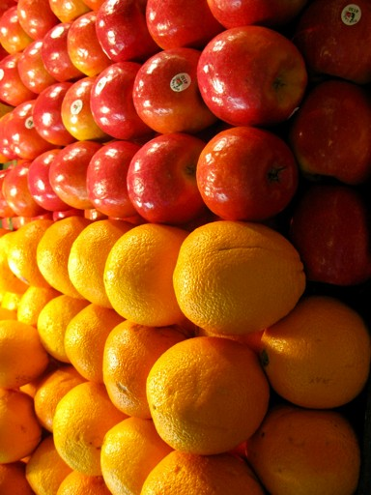
Example
Feature matrix (X)
n_features
Target (y)
n_samples
0
1
1
0
1
1
1
0
0
1
n_samples
Color Texture
Shape
Smell Has core?

Slide 5
Classification
Texture
Rough >>>>>>>>>>>>>>>>>>>>>>>>>>>>>>>> Smooth
Red >>>>>>>>>>>>>>>>>>>>>>>>>>>>>>>> Orange
Color

Slide 6
Classification
Texture
Rough >>>>>>>>>>>>>>>>>>>>>>>>>>>>>>>> Smooth
Red >>>>>>>>>>>>>>>>>>>>>>>>>>>>>>>> Orange
Color

Slide 7
Which one is better?

Slide 8
A new data point

Slide 9
Wide margin

Slide 10

Narrow margin

Slide 11
Support Vectors
It is maximize the margin!

Slide 12

ANN

Slide 13
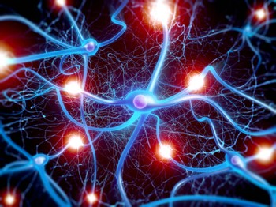

Slide 14
Input
X
1
ω
0
Output
ω₁ ω₂
feature2 ω₃
feature1
Σ g
y
X – input data
y – output target
ω_{i} – weights
Σ – summation
g – activation function Blue circle – bias
feature3
Z = Σ = ω₀x₀+ω₁x₁+ω₂x₂+ω₃x₃+…+ω_{n}x_{n}
y = g(ω₀x₀+ω₁x₁+ω₂x₂+ω₃x₃+…+ω_{n}x_{n})

Slide 15
Input
1
1
Hidden1
Σ | g
X
feature1
Output
Hidden2
Σ | g
Σ
g
y
feature2
Hidden3
Σ | g
X – input data
y – output target
Σ – summation
g – activation function blue circle - bias
feature3
Hidden4
Σ | g

Slide 16
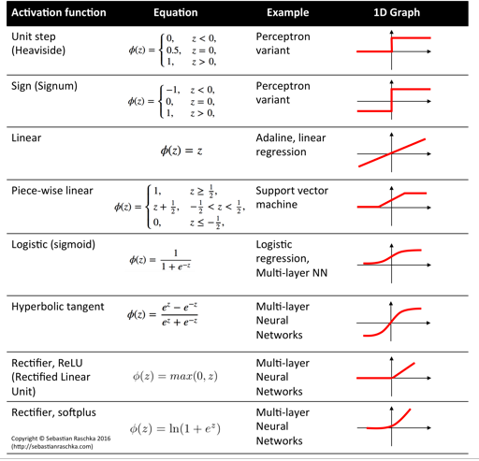

Slide 17


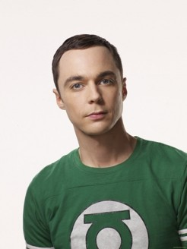
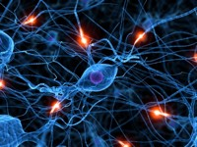
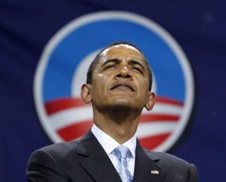
Intuitive
Artificial Neural Network
Input
Output
w₁
F(eye×w₁+nose×w₂+…+mouth×w_{n})
w₂
Sheldon
Cooper?
.
.
.
w_{n}

Slide 18

Intuitive
Artificial Neural Network
Input
Output
w₁
F(eye×w₁+nose×w₂+…+mouth×w_{n})
w₂
Sheldon
Cooper?
.
.
.
w_{n}
error feedback

Slide 19

Backpropagation
Input
1
1
Hidden1
Σ | g
X
feature1
Output
Hidden2
Σ | g
Σ
g
y
feature2
Hidden3
Σ | g
X – input data
y – output target
Σ – summation
g – activation function blue circle - bias
feature3
Hidden4
Σ | g
More details: https://www.youtube.com/watch?v=x_Eamf8MHwU

Slide 20
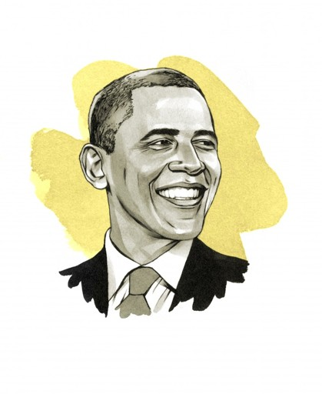
Intuitive
Artificial Neural Network
Input
Output
w₁
F(eye×w₁+nose×w₂+…+mouth×w_{n})
w₂
.
.
.
w_{n}

Slide 21
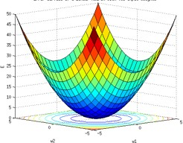
Ideal Cost Function

Slide 22
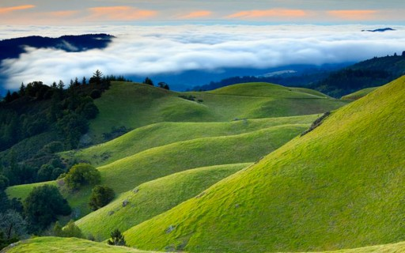
Real-world Cost Function

Slide 23
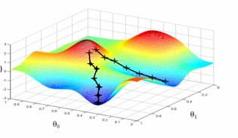
Gradient descend
E(ω)
ω2
ω1
More details: https://www.youtube.com/watch?v=TveJaJs5Fqk

Slide 24

Iterate many times

Slide 25
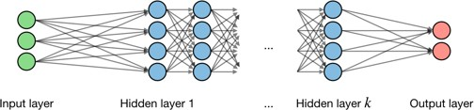
Deep neural network

Slide 26
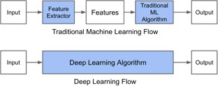
Benefits of deep learning
Simplicity

Slide 27
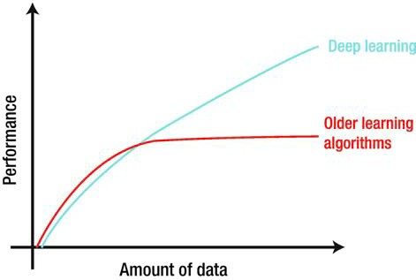
Benefits of deep learning
Accuracy
https://link.springer.com/chapter/10.1007/978-1-4842-3685-7_1

Slide 28
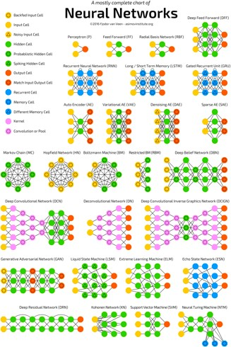
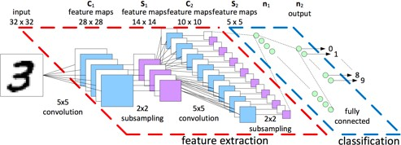
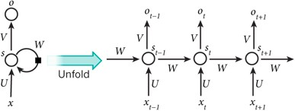
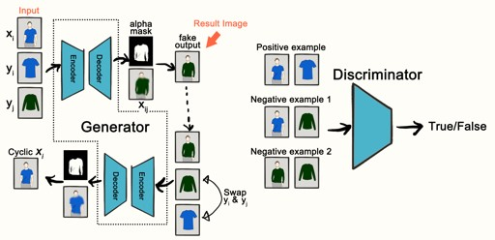
Benefits
Flexible
Convolutional Neural Network
Recurrent Neural Network
Generative Adversarial Network
https://towardsdatascience.com/the-mostly-complete-chart-of-neural-networks-explained-3fb6f2367464

Slide 29
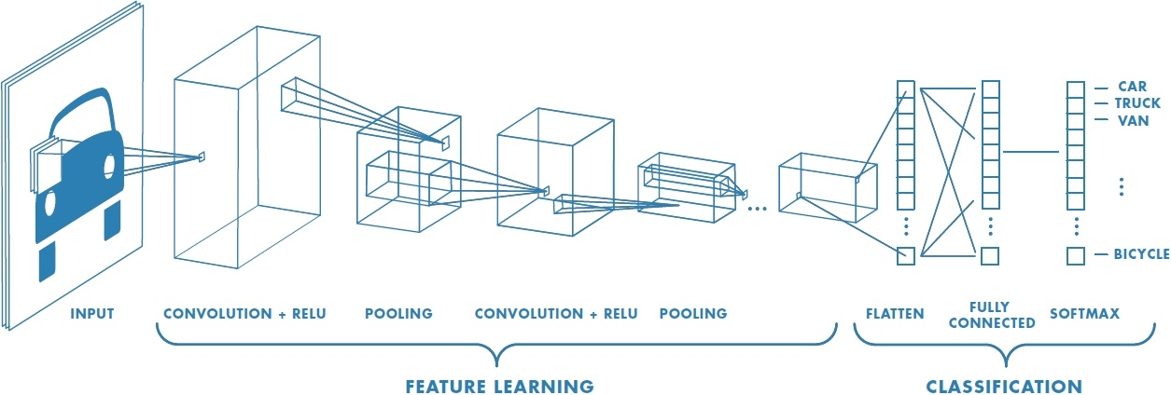
ConvNet architecture
(https://hackernoon.com/deep-learning-cnns-in-tensorflow-with-gpus-cba6efe0acc2)

Slide 30
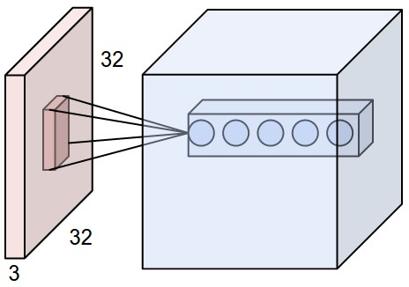
Convolution process: extract features from the image; keep the spatial relationship
Input
1st Convolutional layer
1st Convolutional layer* (Parameters)
ReLU
Pooling
Padding zeros
…
Fully connected*(Parameters)
‘filter’
Category prediction
Input 32*32*3
1st conv layer, 5 features maps from
filters (3*3*3, sum up all depth)
input

Slide 31
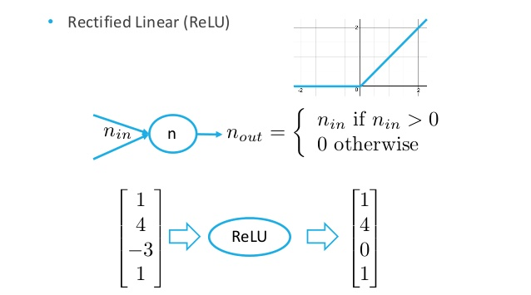
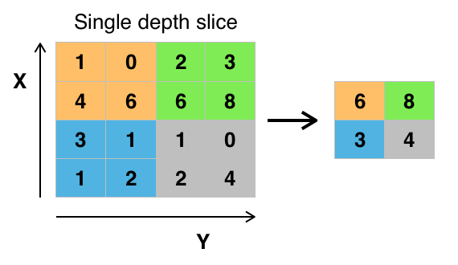
ReLU: non-linear operation & Pooling
Input
1st Convolutional layer* (Parameters)
ReLU
Pooling
…
Fully connected*(Parameters)
Category prediction

Slide 32
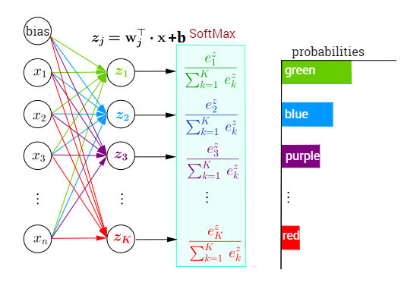
Classification:
Input
(1) Fully connected layer: connected all the layers z=W*x+b
(2) Softmax: to get probabilities
1st Convolutional layer* (Parameters)
ReLU
Pooling
…
Fully connected*(Parameters)
Category prediction (SoftMax)

Slide 33
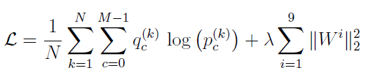
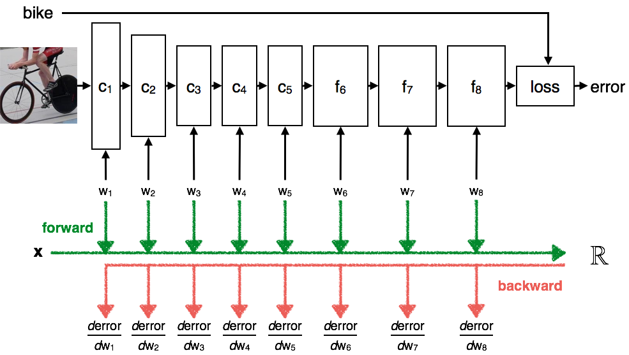
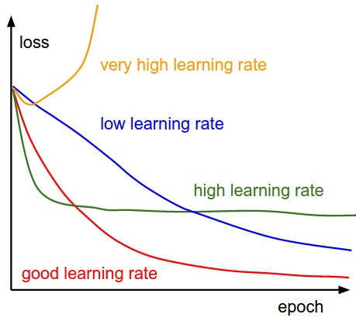
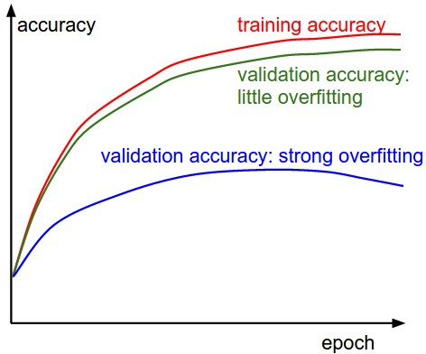
Training and Validation

Slide 34
ConvNet architecture
(https://hackernoon.com/deep-learning-cnns-in-tensorflow-with-gpus-cba6efe0acc2)

Slide 35
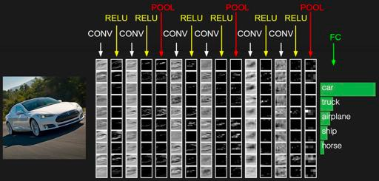
CNN example

Slide 36
Evaluate performance
Confusion matrix
Precision & Recall
ROC curve (Receiver operating characteristic)

Slide 37
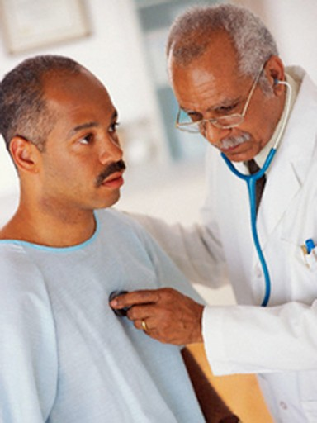
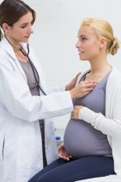
False Negative
False Positive
You’re not pregnant
You’re pregnant

Slide 38
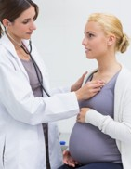
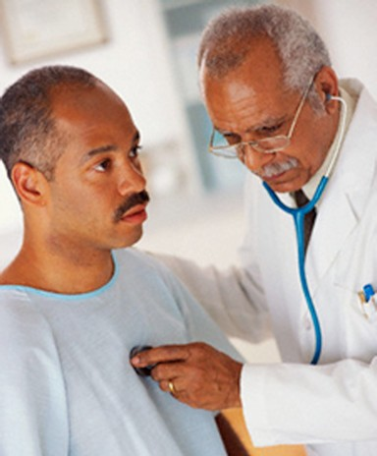
Confusion
Predicted class
P N
matrix
TP You’re pregnant | FN You’re not pregnant
FP You’re pregnant | TN You’re not pregnant
P
True class
N

Slide 39
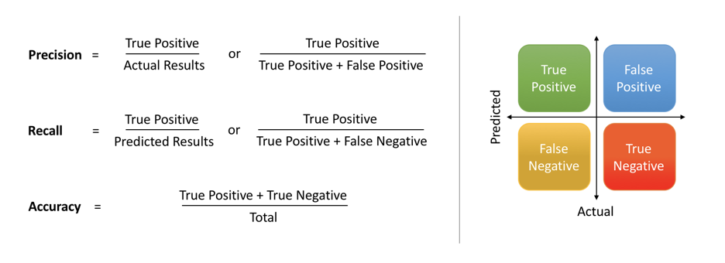
Precision and Recall

Slide 40
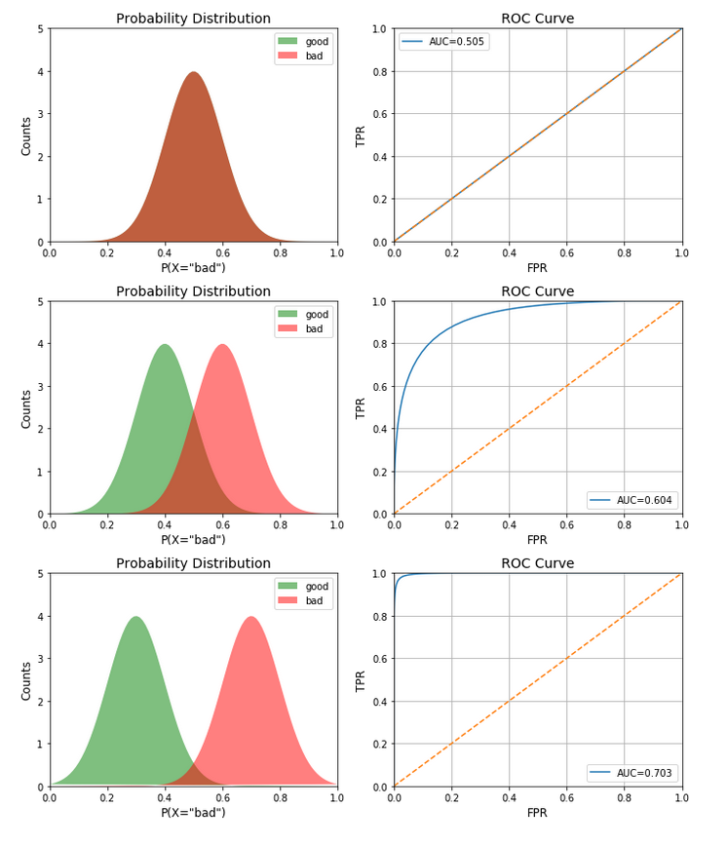
Accuracy metrics (ROC curve)
How well the model separates the two classes: grids containing earthquakes and grids not containing earthquakes
Accuracy: receiver operating characteristic (ROC) analysis (binary classifier) — true positive rate vs false positive rate for all thresholds
AUC: area under ROC curve quantifies the overall performance; random assignment near 1:1, AUC0.5; better above 1:1, AUC1.0
(https://towardsdatascience.com/receiver-operating-characteristic-curves-demystified-in-python-bd531a4364d0)

Slide 41
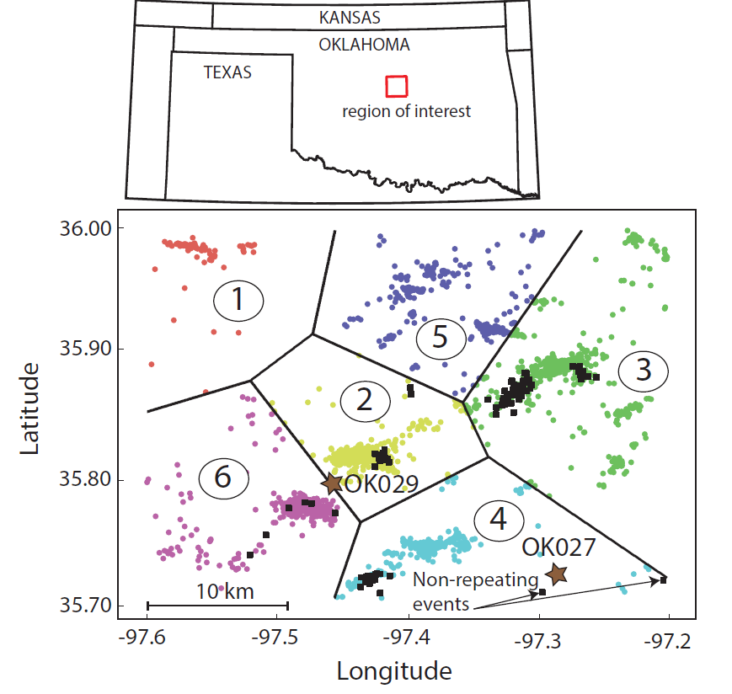
Example: earthquake detection and location (Perol et al 2018)
Features:
‘Earthquake’ vs ‘noise’: different features in the image
‘Location’: different groups (K-Means) have different features.
Category: noise 0, cluster 1-6

Slide 42
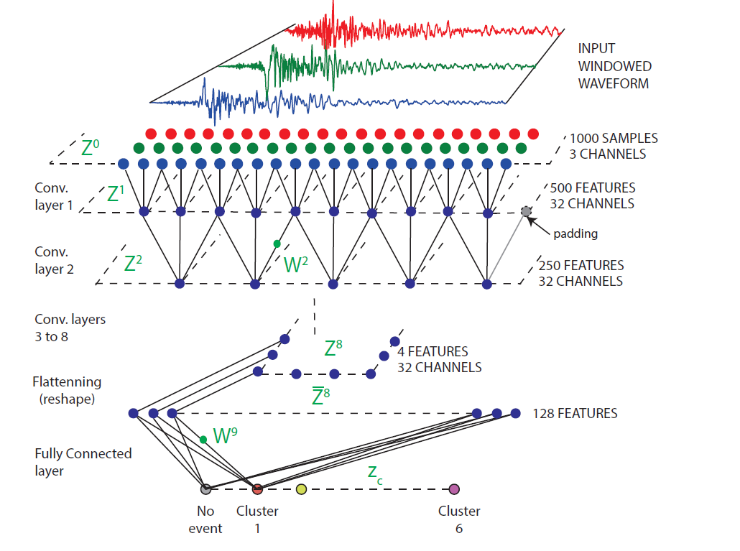
Method: convolutional neural network input (waveform) →Conv*8 →classification (cluster #)
Filters:
1st Conv: 32 3*3*3+1
2nd to 8th Conv: 32 3*3*32+1
FC: 128*7+1
~66529 parameters
Training sets: Feb 2014--Nov 2016
2 station * 3 components
2709 events and 700,039 windows of noise
Testing sets: July 2014
209 events and 131,072 windows of noise

Slide 43
Go to the notebook

Slide 44
Thanks

Slide 46

Thanks
kongqk@Berkeley.edu
http://seismo.berkeley.edu/qingkaikong/

Slide 47
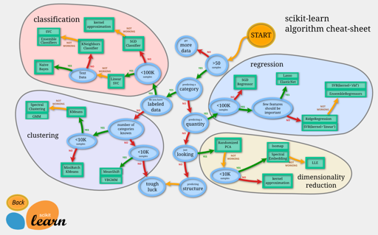
Interactive version: http://scikit-learn.org/stable/tutorial/machine_learning_map/index.html

Slide 48




Pipeline of training a machine learning model.
Data examples
Tunable Model
Trained Model
Optimization algorithm

Slide 49
Classification
Qingkai Kong
http://seismo.berkeley.edu/qingkaikong/

Slide 50
Some useful resources
https://playground.tensorflow.org
https://seat.massey.ac.nz/personal/s.r.marsland/MLBook.html
http://neuralnetworksanddeeplearning.com/
Python machine learning - Sebastian Raschka
Deep learning with Python - Francois Chollet
Machine Learning - An Algorithmic Perspective - Stephen Marsland
Datasets put together by Men-Andrin and Zach Ross
http://scedc.caltech.edu/research-tools/deeplearning.html
Many pictures in this talk are from internet, I thank all the authors here!

Slide 51
Some useful resources
http://cs231n.github.io/convolutional-networks/
https://ujjwalkarn.me/2016/08/11/intuitive-explanation-convnets/
http://neuralnetworksanddeeplearning.com/
Deep learning with Python - Francois Chollet
Deep learning – Ian Goodfellow
Datasets put together by Men-Andrin and Zach Ross
http://scedc.caltech.edu/research-tools/deeplearning.html
Many pictures in this talk are from internet, I thank all the authors here!

