Slide 1


Institute of Technologies of Cambodia
Genie Information and Communication
Real-Estate
Tutor: Mr. Tal Tongsreng
Team: Ann Liratanak
Chhun Tonglin
Chhorn Nypisit
Som Chanpiset

Slide 2
Content
Introduction
Specification
Planning
Technologies
Development Method
Conclusion

Slide 3

I. Introduction
Real-Estate, web application, was decided to create in order to facilitate to find something such as rent house or room .etc. Because of this web application consist information of house such as address and owner’s contact. So, we can get that information easily.
3

Slide 4
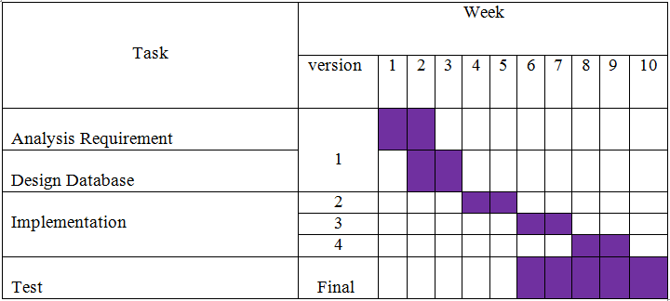
III. Planning
4

Slide 5
II. Specification
Functionalities
Concept database
Table authorities
5

Slide 6
II.1. Functionalities
Login
Logout
Change password
Search house
List houses
CRUD house
CRUD house’s owner profile
6

Slide 7
II.1. Functionalities (cont.)
Vote house
Comment
Allow user authorities
Map
List user
Message to user
7

Slide 8
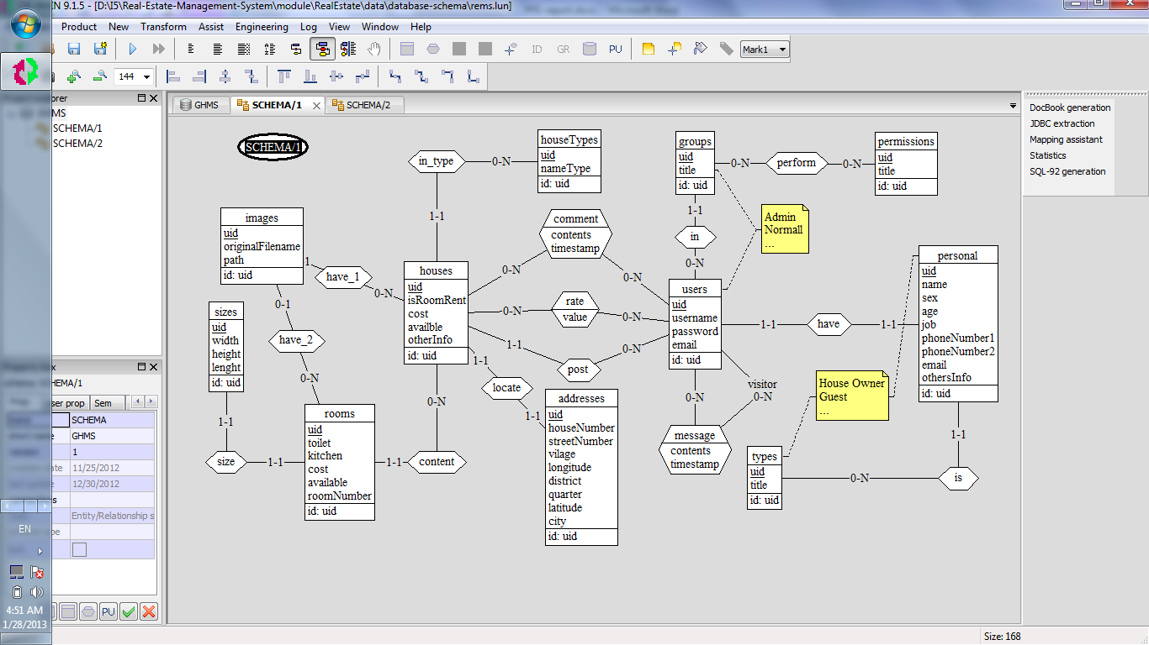
II.2. Concept database
8

Slide 9
II.3. Table authorities
 | Users
Functionalities | Admin | Owner | Visitor
Allow user’s authority | √ | √
Login | √ | √
Logout | √ | √
Search house | √ | √ | √
Change password | √ | √
View all house | √ | √ | √
View one house detail | √ | √ | √
Create house | √ | √
Upload image | √ | √
Update house | √ | √
Delete house | √ | √
Create owner profile | √
Update owner profile |  | √
Delete owner profile | √
View owner profile | √ | √
Vote house | √ | √
Comment | √ | √
View Map | √ | √ | √
Image slide show | √ | √ | √
List user | √
Message to user |  | √
9

Slide 10
IV. Technologies
PHP Zend framework
MySQL
Twitter bootstrap
JavaScript
jQuery
Ajax
Google map API
Git
10

Slide 11
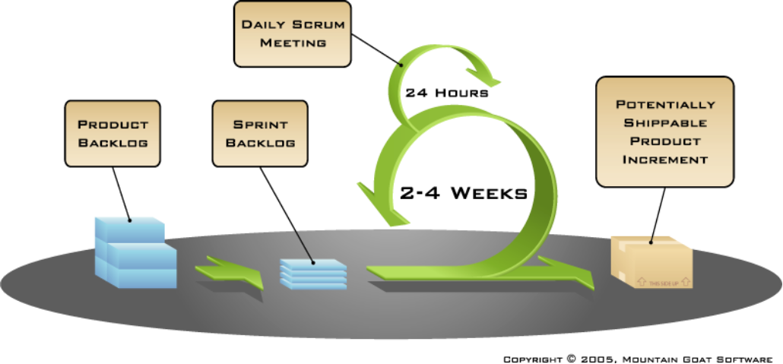
V. Development method
Scrum
11

Slide 12
V. Development method
Responsibility
Ann Liratanak | Chhun Tonglin | Chhorn Nypisit | Som Chanpiset
Google Map API | Template/layout | Login | Search
Message | Image slide show | logout | List house
CRUD owner prof | Vote house | Change password | CRUD house
List User | Comment house | User management | View house detail
12

Slide 13
VI. Conclusion
Result
Remaining tasks
Strong point
Weak point
Perspective
13

Slide 14
VI.1. Result
Login
Logout
Change password
Search house
List houses
CRUD house’s owner profile
Vote house
Comment
Allow user authorities
Map
List user
Message to user
14

Slide 15
VI.2. Remaining tasks
Update house
Delete house
15

Slide 16
VI.3. Strong point
Security
Performance
Extensibility
Ease of use
Dynamic content
Robust
16

Slide 17
VI.4. Weak point
Dependency to others projects and plugins
Bugs
17

Slide 18
VI.5. Perspective
Improve application performance
Search via map
Multi language (currency also)
Manage house
18

Slide 19

Thank for your attention

