Slide 1
A Study on the Major Determining Factors for Box Office Success in the Film Industry
CSCI 4502/5502: Fall 2021
Notes:
Binge watchers

Slide 2
Team members
Connor Dixon
codi2763@colorado.edu
CSCI 4502
Kaylee Engelhardt
kaylee.engelhardt@colorado.edu
CSCI 4502
Baci Brunet
sebr8260@colorado.edu
CSCI 4502
Aidan Aarts
aiaa4302@colorado.edu
CSCI 4502

Slide 3
Introduction (What Problem is Being Addressed?)
Crucial that a production company have some estimate as to what a film will make
Otherwise, impossible to know if movie is a wise investment
This project:
Analyzed and normalized past box office data
Evaluated trends and patterns
Use said data to create models to predict the performance of upcoming films
Determine whether or not these films wise investments for these companies
Dataset
Main source, tMDB, has over 703,000 movies, with dozens of attributes
Notes:
Kaylee - This project attempted to discern what factors are most important and most beneficial for making good movies. If that isn’t known companies essentially just have to shoot in the dark when guessing if a movie will be a success. This project analyzed many movies off of the Movie Database with dozens of attributes to predict the performance and determine whether the movie will be a success, or at least not a flop.

Slide 4


Motivation
John Carter (2012)
Estimated loss was $127 - 225 million
Popular genre and based off of a book
Pan (2015)
Estimated loss was $94 - 164 million
Popular genre and based off a book and has an existing movie
Why did these movies fail?
Notes:
Kaylee - Both John Carter and Pan were modern movies with respectable budgets released recently. They were released in popular genres and at good times of the year. They failed due to a variety of little things, for John carter it was marketing and an entirely wrong idea about why the book was good, for Pan it seemed like a flop even Hollywood saw that and pushed off the release to reshoot. Could we predict which movies will bomb annd how badly?

Slide 5
Literature Review
A previous literature review was done by Eon Smit and N. A. Pangarker in 2013.^{[1]}
Largely focused on movies from the United States
Very thorough
Jia Xiao, Xin Li, et al., attempt to explore the connection between movies trailer success with the success of the movie^{[2]}
Many factors explored
A paper from Russia by Sophia Gaenssle, Oliver Budzinski, and Daria Astakhova^{[3]}
Explored cross-cultural movie success
Notes:
Kaylee - There was a literature review already done buy Eon Smit and N A Pangarker in 2013 but it largely focused on movies from the United States and missed of lot of the recent huge box office flops. The authors mainly focused on whether movies had stars in them or were sequels as the primary methods of determine movie success.
Jia Xiao, Xin Li, et al. explore the connection between movies trailers and the number of comments posted about them with the success of the movie. As well as a variety of other factors including investment, title length, script length, movie length, release schedule, rival, genre, cast, awards, and advertising.
A paper from Russia by Sophia Gaenssle, Oliver Budzinski, and Daria Astakhova explored cross-cultural movie success by “seasonality, time span between the world and local release, attendance of international stars at Russian movie premieres, and title adaptation to Russian culture.” It showed based on the available data cross-cultural movie success was nearly unpredictable

Slide 6
Data Collection
Used TMDB api to collect a set of movies spanning over the following time range 1918-2020
Variables collected:
Title
Revenue
Budget
Release date
Original language
Cast and Crew
(along with their individual popularity scores)
Genres
Runtime
There were more parameters, however many were post-release data, which helpful, defeats the purpose of the project
Data was initially collected & stored in a Linode-hosted cloud SQL database
However, later converted to a locally stored .csv format, to allow for the easiest access from libraries and functions:
pandas
numpy
sklearn
While possible to use with SQL, a locally stored data store is much faster
These models require speed to function as best as possible

Slide 7
Data Analysis (Mainly Preparation for Models):
One-Hot Encoding of variables using:
Top 500 actors and crew members
Top 50 production companies
Top 50 production companies accounted for over 85% of the movies in our data set so we decided to stop there
50 original languages
19 genres
Binning of release dates
104 bins to account for years between 1918-2020
Averaging of the popularity scores associated with each actor
Since each movie had a dictionary of cast & crew members with respective popularity scores, averaged each dictionary and stored in new variable “cast_and_crew_average”
Notes:
Connor
one hot encoding: each attribute assigned a column in the dataset, and then should that attribute appear, gets assigned a true boolean value (1)
Movie 1: a, b, c
Movie 2: b, c, e
Movie 3: a, c, e
Unique values: [a, b, c, e]
One Hot encoding:
Movie 1: [1, 1, 1, 0]
Movie 2: [0, 1, 1, 1]
Movie 3: [1, 0, 1, 1]

Slide 8
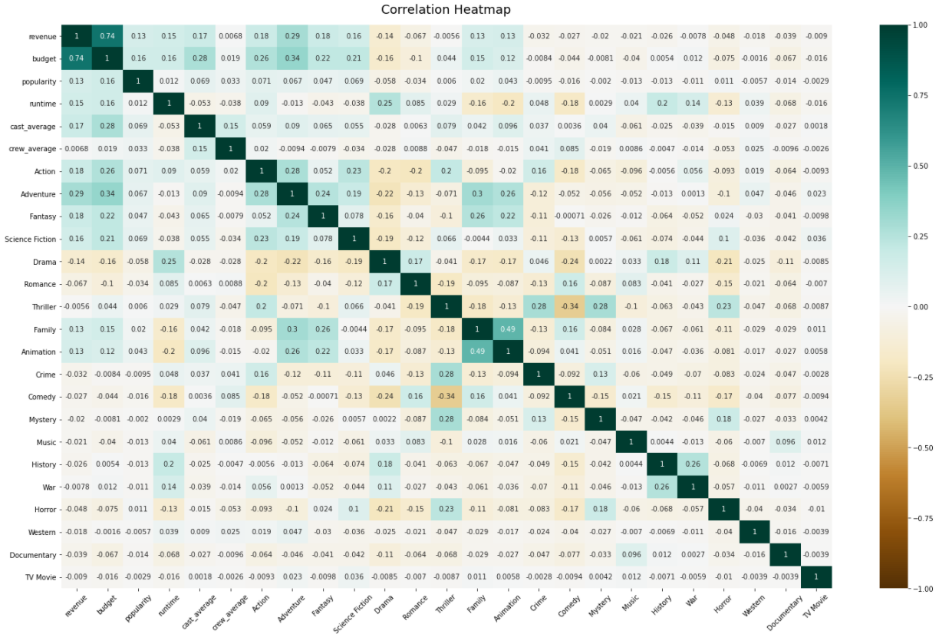
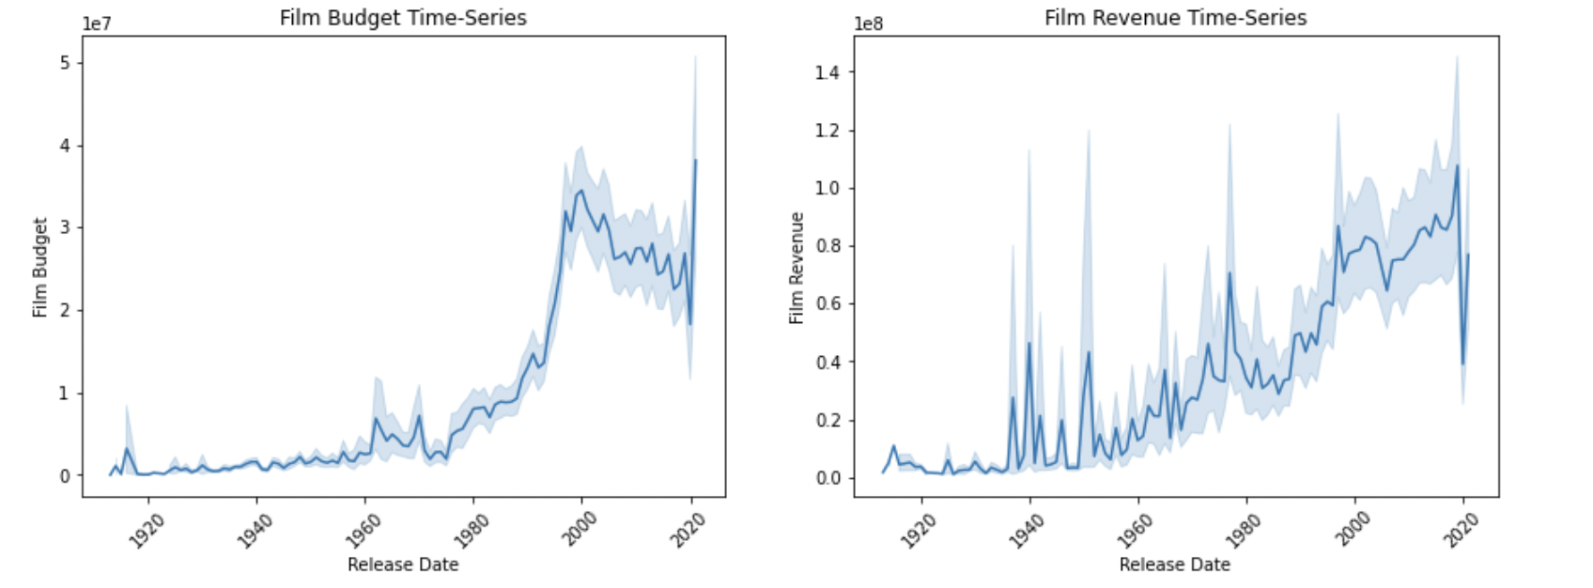
Data Analysis
Correlation Heatmap: Allows for us to see the correlation between various attributes in the dataset
Time Series Analysis: Allows for us to see the correlation and change over time between revenue/budget and the year released
Notes:
Connor

Slide 9
Model Selection
Ensemble Learning
Bagging: Random Forest Regressor (Sklearn)
Boosting: Extreme Gradient Boosted Regressor (XGBoost)
Train-Test Split
90/10
Notes:
Baci

Slide 10
Model Tuning
Normalization (Log Transformation)
Budget
Target Variable (revenue)
Hyperparameter Tuning
GridSearchCV (Sklearn)
Feature Selection
RFECV (Sklearn)
Notes:
Baci

Slide 11
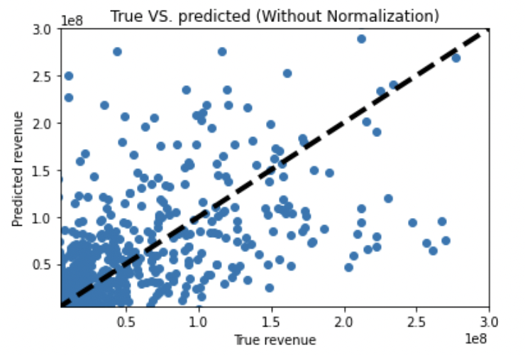
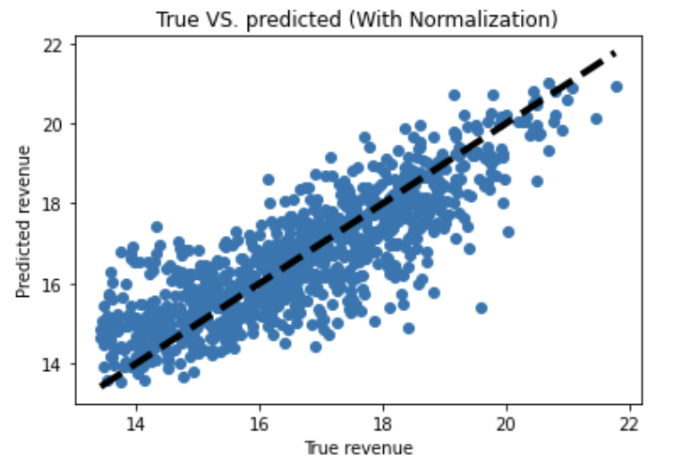
Model Evaluation
Best Model
Extreme Gradient Boosted Regressor
Scoring
R-Squared (Sklearn)
Best Score: 0.694
Notes
The log transformation of budget and our target variable improved the performance of our model by around 11%.
The hyperparameter tuning increased model performance by around 21%
Notes:
Baci

Slide 12
Evaluations
Crew Members (Top 5)
Peter Hyams (17 films grossing 500 million)
Juan Peralta
Marshall Winn
Shelley Roden
J. Michael Muro
Actors (Top 10)
Frank Welker (3rd highest grossing actor of all time)
Samuel L. Jackson
Liam Neeson
Robert De Niro
Bruce Willis
Nicolas Cage
Morgan Freeman
Willem Dafoe
John Goodman
Steve Buscemi
Production Companies (Top 5)
Warner Bros. Pictures (13th highest grossing film ever)
Universal Pictures
Paramount
20th Century Fox
Columbia Pictures

Slide 13
Conclusions
Improvements:
Adjusting revenue based on year
Inflation
Era’s of film
Computer Limitations
With more time and computing power we would have liked to be able to run our model through a more extreme parameter grid -- allowing us to pick even better parameters.
Notes:
Aidan

Slide 14
Future Work
In the future to build upon our model there’s a few key things we could do:
Use larger datasets
Increase number of parameters
Improve our Variables
Predict more precisely the final gross revenue of future films
Predict the worth of a variable to the overall gross revenue
Notes:
Aidan
Increase number of parameters
-We were limited in the number of parameters we could use in order to train/run the model within our time frame. So being able to use more variables from the original dataset could improve our r^2 score
Improve or variable
-Some of our variables we decided to limit to only the highest performing of their class. For instance production companies we limited from the original __ that was in the dataset to only the top 25, as well as limiting the original number of actors and actresses from __ to 500. Originally the thought process was because the top 25 production companies make up such a large majority of the data that the influence of the other companies would not impact the accuracy of our model to much.
Predict the worth of a variable to the overall gross revenue
Predict the worth of a variable to the overall gross revenue

Slide 15
References
Eon Smit and N. A. Pangarker. 2013. The determinants of box office performance in the film industry revisited. Research Article. South African Journal of Business Management, (September 2013). https://www.researchgate.net/publication/281730174_The_determinants_of_box_office_performance_in_the_film_industry_revisited
Jia Xiao, Xin Li, et al. 2017. An inside look into the complexity of box-office revenue prediction in China. Research Article. SAGE Publications, (January 2017). https://journals.sagepub.com/doi/10.1177/1550147716684842
Sophia Gaenssle, Oliver Budzinski, and Daria Astakhova. 2019. Conquering the Box Office: Factors Influencing Success of International Movies in Russia. Research Article. Review of Network Economics, (October 2019) https://www.degruyter.com/document/doi/10.1515/rne-2019-0017/html
Notes:
References for the Literature Review

