Slide 1




ReviewerNet
A visualization tool for scholarly data
April 2019
Mario Leonardo Salinas, Paolo Cignoni, Daniela Giorgi, Federico Ponchio
1. University of Pisa m.salinas@studenti.unipi.it
2. ISTI VC-Lab, CNR Pisa
1 2 2 2
ReviewerNet.org

Slide 2
Problem
reviewer finding by journal editors and IPC members:
  Identify research communities searching the literature
  Look for active experts with good topic coverage
  Check conflict of interest and distribution of candidate in the community

Slide 3
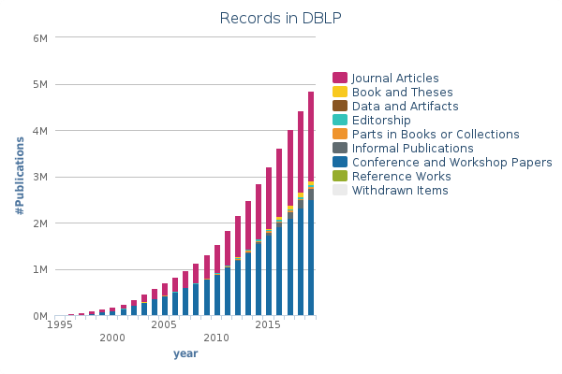
Introduction
The number of academic documents grows very fast
The volume, variety and velocity generated satisfies the big data definition

Slide 4
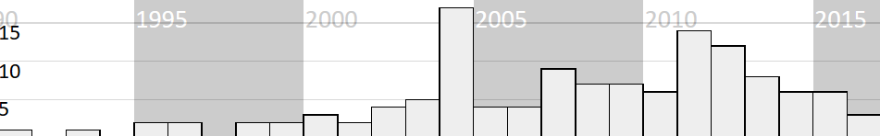
Related Work
Number of visual approaches per publication year [FED17]
most of the works focused on the visualization of document collections
more specific goal: provide enough understanding to help editors in picking reviewers
[FED17] Paolo Federico, Florian Heimerl, Steffen Koch, and Silvia Miksch. “A Survey on Visual Approaches for Analyzing Scientific Literature and Patents”.
In: IEEE Transactions on Visualization and Computer Graphics 23.9 (2017), pp. 2179–2198.

Slide 5
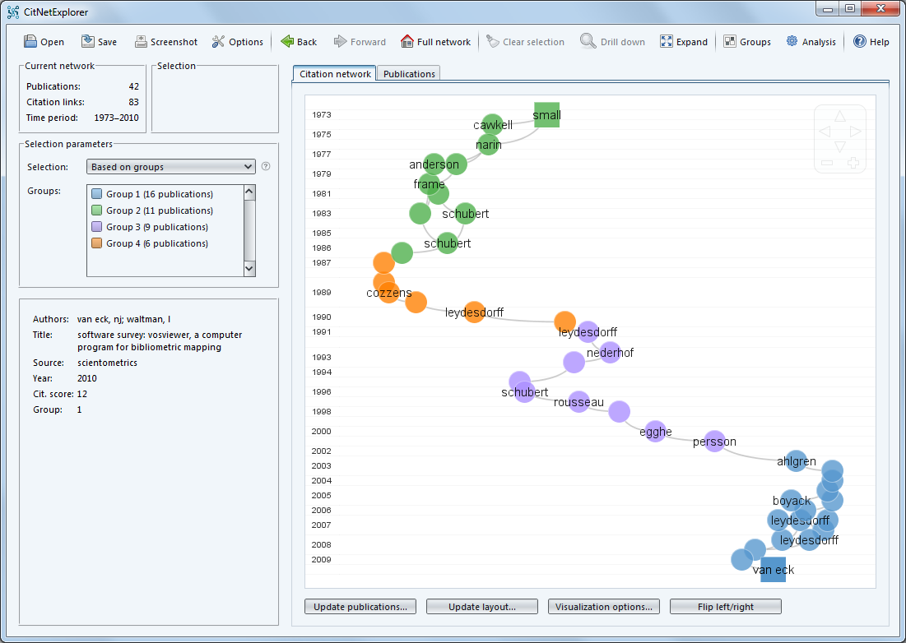
Related Work
the visualization of bibliometric networks is an active area of research
history and development of research fields can be analyzed with citation networks
CiteNetExplorer

Slide 6
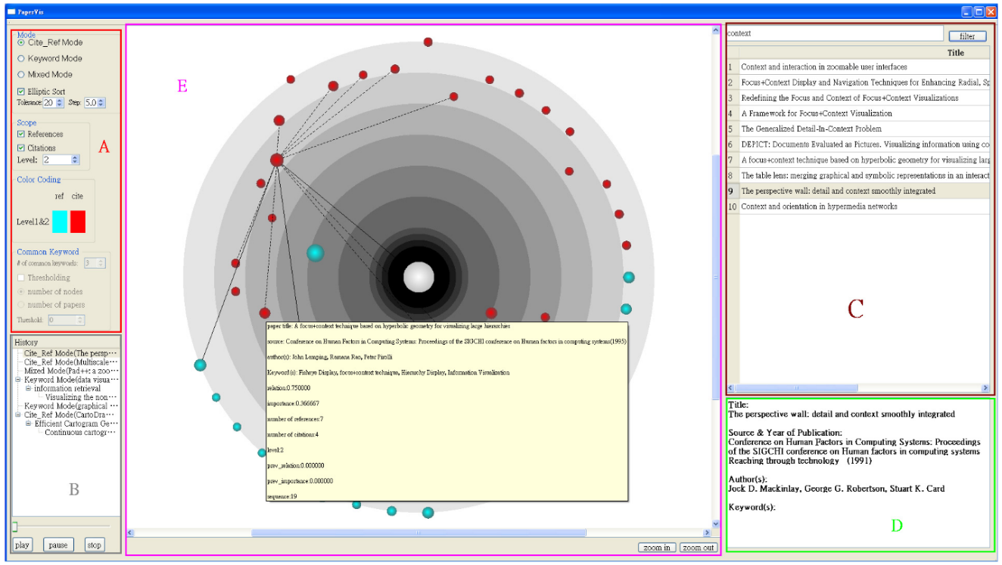
Related Work
exploit graph structure to obtain semantically meaningful hierarchies
PaperViz

Slide 7
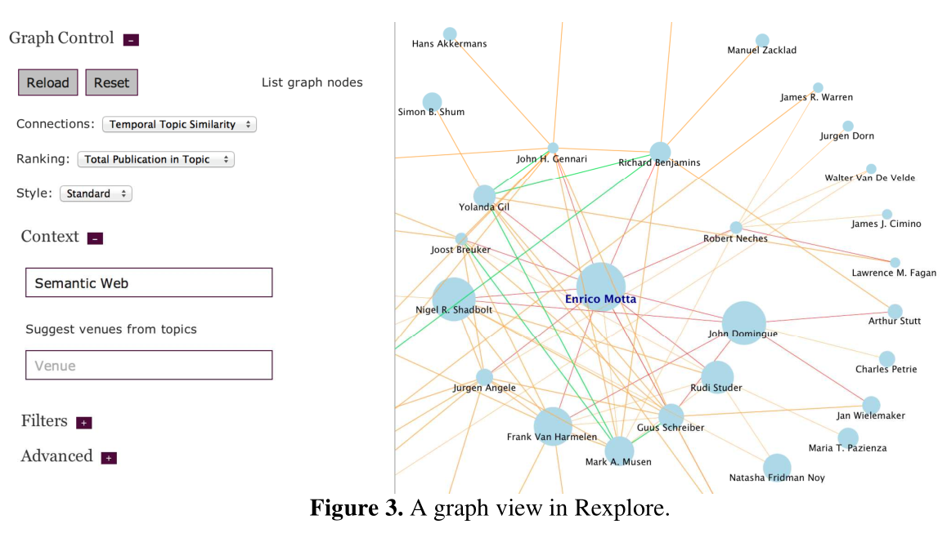
Related Work
Rexplore includes a graph connecting similar authors
Rexplore

Slide 8
Main Intuition & The Reviewer Selection Process
To support the user in the reviewer selection process we only rely on citations.
We combine visualization about papers and researchers
Navigate&Expand Citations Network
Assess goodness and conflicts of researchers
Authors of relevant papers are good candidate reviewers
Identify relevant papers

Slide 9
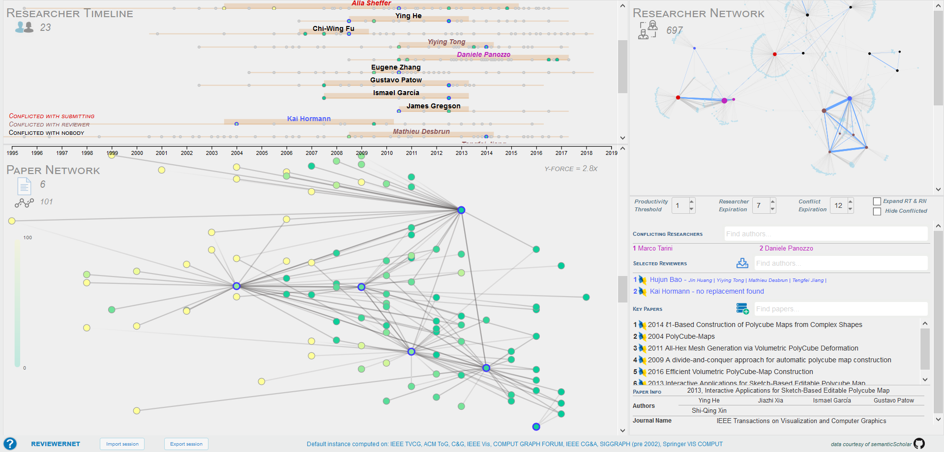
User Interface
ReviewerNet User Interface

Slide 10
User Interface
ReviewerNet User Interface

Slide 11
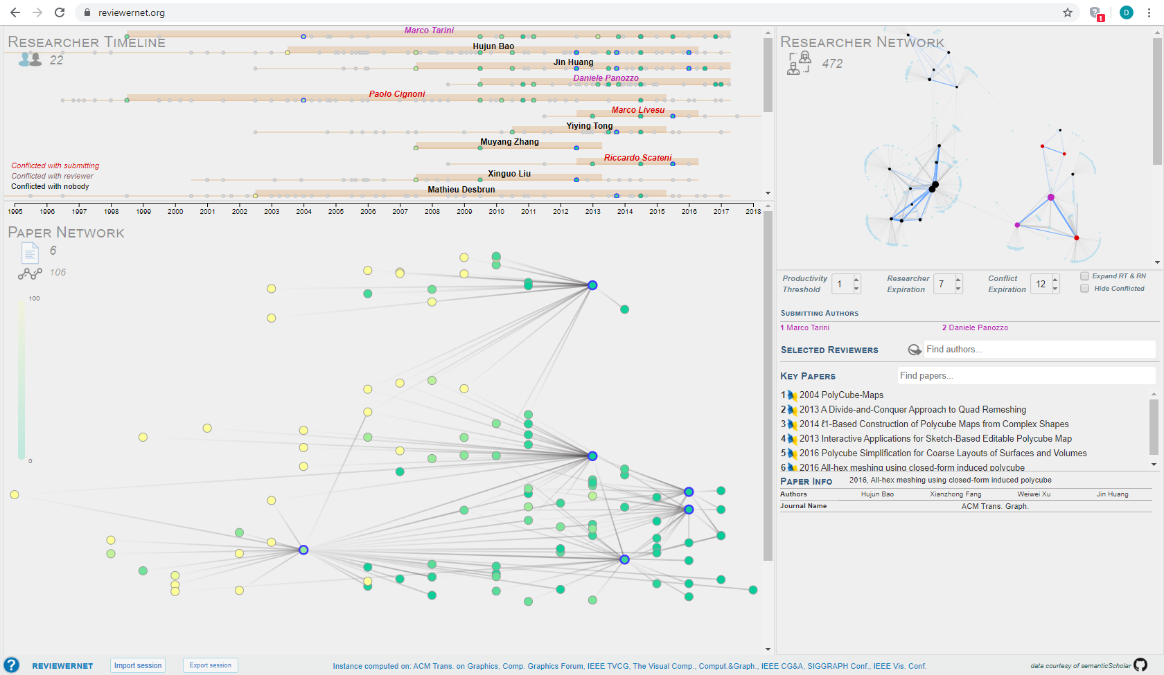
User Interface: the Paper Network

Slide 12
User Interface: the Paper Network
RELEVANT/KEY PAPERS

Slide 13
User Interface
ReviewerNet User Interface

Slide 14
User Interface: the Researcher Timeline

Slide 15
User Interface: the Researcher Network

Slide 16
User Interface
ReviewerNet User Interface

Slide 17
User Interface: the Control Panel

Slide 18
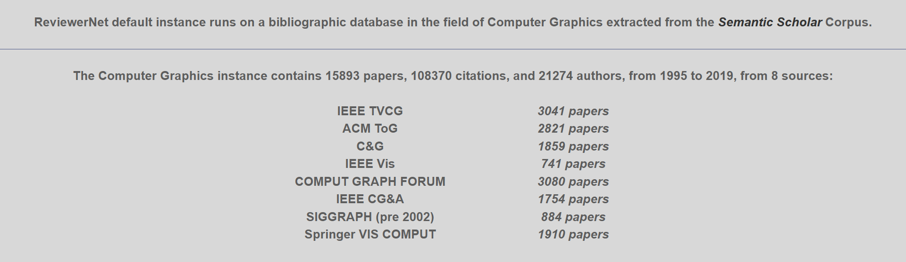


Dataset
The Semantic Scholar corpus contains more than 70M publications
We filtered the dataset to keep complexity low and offer a cleaner visualization.
Computer Graphics Instance statistics

Slide 19
Architecture & Implementation Detais
Data source Semantic Scholar
Python for preprocessing
HTML, JS for UI and D3js for graph drawing
ReviewerNet is a client-side application
{
"id": "4cd223df721b722b1c40689caa52932a41fcc223",
"title": "Knowledge-rich, computer-assisted composition of Chinese couplets",
"paperAbstract":
…
"year": 2016,
"venue": "DSH",
"journalName": "DSH"
}
Generic JSON record of the Semantic Scholar corpus

Slide 20

Platform publicly available @ reviewernet.org
Code on github @ cnr-isti-vclab/ReviewerNet
Now a brief demonstration

Slide 21

Conclusions
ReviewerNet fully supports the reviewer selection process
Only relies on citations and
co-authorship
Avoids conflicts and builds a distributed pool of reviewers

Slide 22


Conclusions: pros&cons
easy to use
fast to learn
multifunctional
page-zero problem
no customizable data coverage

Slide 23

Conclusions:
Further Work
easy to use
fast to learn
multifunctional
Automated choice of key papers
user-friendly procedure to generate custom instances
page-zero problem
no customizable data coverage

Slide 24
Thanks for your attention

