Slide 1
Real Options
Valuing Investment Flexibility
Dr. Keith M. Howe
Scholl Professor of Finance

Slide 2

Call Option
The right, not the obligation, to buy the underlying asset at the stated price on or before a specified date.
Put ?

Slide 3
Behavior of Call Option Prices
Key Variables
Call Prices
Stock price = S C
Time = T C
Exercise price = E C
Variance = Var C
Risk-free rate = R C

Slide 4
Value of a Call Option
On Expiration
C
Value of
Option
c = 0 E S
Stock Price
C = S - E
Value of
Option

Slide 5
Real Options
Real Options: The flexibility to alter the course of action in a real assets decision, depending on future developments.

Slide 6
The Point of Real Options
Managing a company’s portfolio of assets to maximize value requires that real options be considered and properly evaluated.
Standard DCF approaches ignore a key source of value (real options) and therefore undervalue most capital investments.

Slide 7
Real Options Analysis: A Conceptual Tool
A language and framing tool for decision making
  A shorthand language for communicating opportunities
  Identify and understand the nature of key uncertainties
  Recognize, create, and optimally manage flexibility
Key insights (build on options intuition)
  Don’t automatically dismiss a project with NPV<0
  Don’t necessarily invest (today) in a project with NPV>0
  Don’t fixate on most likely scenario
  Invest in stages - each step provides information
  Pursue several paths at once (and expect failure…)
  Think explicitly about “downstream decisions”; remain flexible
  Volatility can enhance value if you keep your options open

Slide 8
… and an Analytic Valuation Tool
A valuation tool that properly measures the risk of complex projects, and uses the appropriate risk-return relationships from financial markets.
  Line up strategy with shareholder value creation
  NPV/DCF are theoretically correct, but the traditional application of these techniques is inappropriate in cases where option value is significant:
    Cash flows are altered by downstream decisions, so they need to be mapped out very carefully
    Discount rates are very difficult to estimate accurately since risk changes over project life and across different scenarios

Slide 9
I. Key Concepts of Real Options
Investment Project
Managerial Flexibility
Time
Risk/Uncertainty

Slide 10
An Investment Opportunity:
The Contingent Decision
S
$
V
X
Today
T
Time
V = Value of the expansion option (captures the upside potential of S)
S = The investment's payoff
X = The investment's cost
σ = Volatility of payoff's value

Slide 11
Project
Value
Contingent investment strategy
(EXPAND)
A
Fixed investment strategy
(DCF PLAN)
B
CURRENT
PROJECT
VALUE
Contingent investment strategy
(CLOSE)
PROJECT
START
TODAY
PROJECT
END
Time

Slide 12
Learning Styles
Passive Learning
  Simply watch the underlying variable move
  (e.g., oil prices, stock index)
Active Learning
  Invest to learn more (no spending, no learning)
  (e.g., market acceptance rate, trial well drilling, drug testing)

Slide 13
Two types of risk
Market-priced risks
  Risks that depend on the prices of assets traded in competitive markets. (e.g., price of securities, oil, minerals, jet fuel and commodity prices)
Private risks
  The sources of uncertainty that are not directly related to the value of market-traded assets. (e.g., size of oil resources, the rate of technology acceptance, and failure rates)

Slide 14
Framing - Uncertainties and Strategic Alternatives
Expand to other lines
(Basic DCF if no expansion)
Successful
Defer expansion
Invest in single product platform
Reconfigure
Low demand
Global expansion
Invest in several product lines
Invest at smaller scale
Invest
Positive response
Delay and run test marketing
Lukewarm response
Delay
Partner with or acquire .com
Decision Node
Uncertainty Node

Slide 15
Examples of real options
Growth options
    R&D
    Land
    Oil Exploration
    Staged investments; expansion options
    Follow-on or sequential investments (M&A program, brands)
Contraction options
    Abandonment of Project or Division
    Contract scale or temporarily shut down
Switching options
    Input or output mix flexibility
    Global production flexibility

Slide 16
Options can be found in all industries
Industry Key Options
Automobile
Recently GM delayed its investment in a new Cavalier and switched its resources into producing more SUVs.
Computers
HP moved to delay final assembly of its printers for overseas markets till an actual order was received -- this increased costs but created the option to tailor production to demand.
Aircraft
Manufacturers
Parallel development of cargo plane designs created the option to choose the more profitable design at a later date.
Oil leases, exploration, and development are options on future production
Refineries have the option to change their mix of outputs among heating oil, diesel, unleaded gasoline and petrochemicals depending on their individual sale prices.
Oil & Gas
Pharma
R&D has several stages - a sequential growth option.
Telecom
Lay down extra fiber as option on future bandwidth needs
Existing customer base, products and service agreements serve as a platform for future investments

Slide 17
Options can be found in all industries, cont
Industry Key Options
Utilities
Developing generating plants fired by oil & coal creates the option to reduce input costs by switching to lower cost inputs.
Delay the decommissioning of nuclear plants in the event that decommission costs come down.
Peaking plants produce energy at a cost higher than the average price of energy. The owners have the option to operate the plant only when the price of energy spikes and shutdown if the production of energy is not profitable.
Real Estate
Land is often left undeveloped so that developers retain their option to develop the land for a more profitable use than exists today.
Multipurpose buildings (hotels, apartments, etc.) that can be easily reconfigured create the option to benefit from changes in real estate trends.
Airlines
Airlines can delay committing to firm orders until sufficient uncertainty has been resolved. This can help to mitigate overcapacity problems.
Alternatively, aircraft manufacturers may grant the airlines contractual options to deliver aircraft. These contracts specify short lead times for delivery (once the option is exercised) and fixed purchase prices.
Airlines may also be offered “contingency rights” that give the airline the option to choose type of aircraft delivered within a family of aircraft types.

Slide 18
Sources of Real Option Value
Real options can be created or purchased:
  Patents, production flexibility, rights to develop land or natural resources (e.g., oil), rights to contract or abandon
Real options can evolve naturally in a company due to existing competencies in a firm:
  Advertising, technical expertise, market share, branding, etc.

Slide 19
How are companies using “Real Options”?
A survey of 39 managers at 34 companies conducted in Spring 2001 revealed three primary ways in which real options is currently used in practice:
  Real Options as a “way of thinking”
  Real Options as an analytical tool
  Real Options as an organizational process
See “Real Options: State of the Practice” by Alex Triantis and Adam Borison, Journal of Applied Corporate Finance, Summer 2001 (pp. 8-24).

Slide 20
Real Options as a “Way of Thinking”
Options language improves internal and external communication
Mindset of thinking about uncertainty in positive light
Heightened awareness of creating or extinguishing options
Increased appreciation for learning/information acquisition
Framing exercise to map out future scenarios and decisions
Contractual arrangements as bundles of options

Slide 21
Real Options as an Analytic Tool
There are four approaches used in practice to value options:
  Black-Scholes formula (or other “standard” formulas)
  Binomial Option Pricing Model
  Risk-adjusted Decision Trees
  Monte-Carlo Simulation
All of these are based on the same underlying principles:
  Map out evolution of some underlying variable(s) over time
  Determine cash flows for each scenario
  Risk-adjust the probabilities of obtaining different cash flows (or the expected future cash flows), rather than the discount rates
  Discount back risk-adjusted expected cash flows at risk-free rate

Slide 22
Binomial Approach: one-period binomial tree
PV(stock price)
Option Tree
T = 0 T = 1
T = 0 T = 1
p = .5
150
p = .5
Max(150-100,0)
= 50
100
C = ?
70
1-p = .5
1-p = .5
Max(70-100,0)
= 0
Volatility = 40%, Exercise price = 100, Risk-free rate = 5%

Slide 23
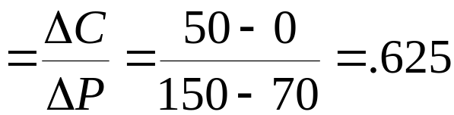
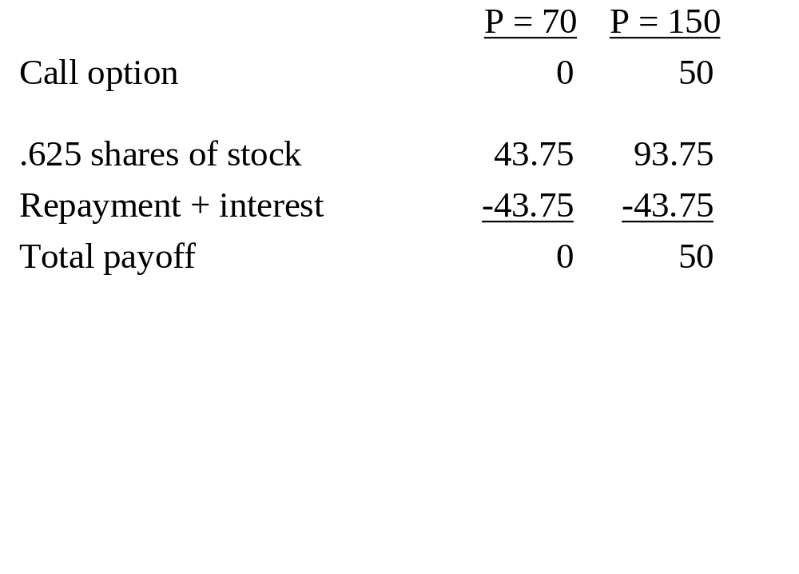
Method 1: Replicating portfolio
Hedge ratio = Delta
Value of call = value of .625 shares of stock - loan
= (.625* 100) - PV(43.75) = $20.83

Slide 24
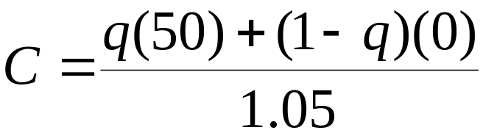
Method 2: Using risk-adjusted probabilities (q)
Option Tree
q
50
C = ?
1-q
0
2) Use a risk-free rate
1) Risk adjust cashflows downward
How do we get q ?

Slide 25
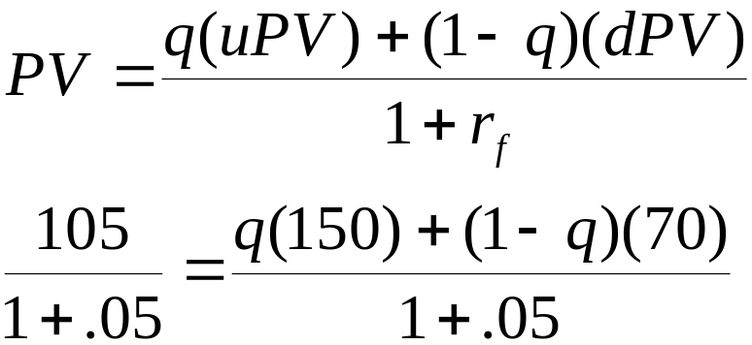
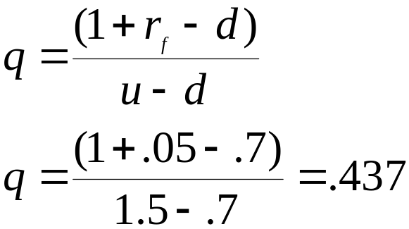
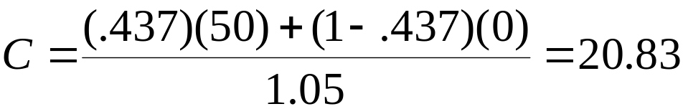
Method 2: Using risk-adjusted probabilities (q)
Risk Adjusted Probabilities (q, 1-q)
We can use the underlying asset to derive the risk-adjusted probabilities, q
q
150
100
1-q
70

Slide 26
Launching Drug Problem
A company is contemplating acquiring a patent on a new drug which expires in three years. The market analysis suggests that the present value of introducing the drug to the market is $120 million, with an estimated annual volatility of 15%. The required investment to start operations is $140 million. The risk-free rate is 5%. The company feels that it can successfully introduce the drug within the next two years if the NPV turns positive. What is the value of the opportunity to market the new drug?

Slide 27
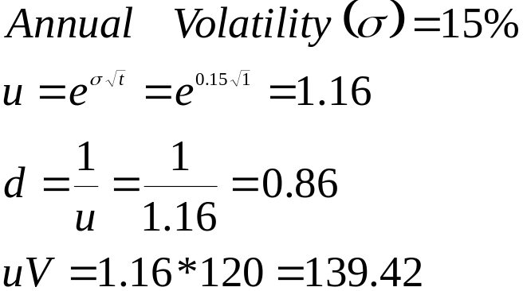
Present value tree for the project
161.98
139.42
120.00
120.00
103.28
88.90
time
0
1
2

Slide 28
Present value tree for the project
One period binomial
161.98
139.42
120.00
120.00
103.28
88.90
time
0
1
2

Slide 29
One period binomial
PV of the project
Option Tree
T = 1 T = 2
T = 1 T = 2
161.98
Max(161.98-140,0)
= 21.98
139.42
C = ?
120.00
Max(120-140,0)
= 0
Volatility = 15%, Exercise price = 140, Risk-free rate = 5%

Slide 30
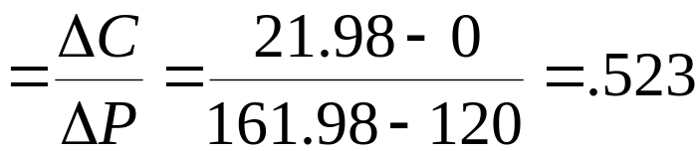
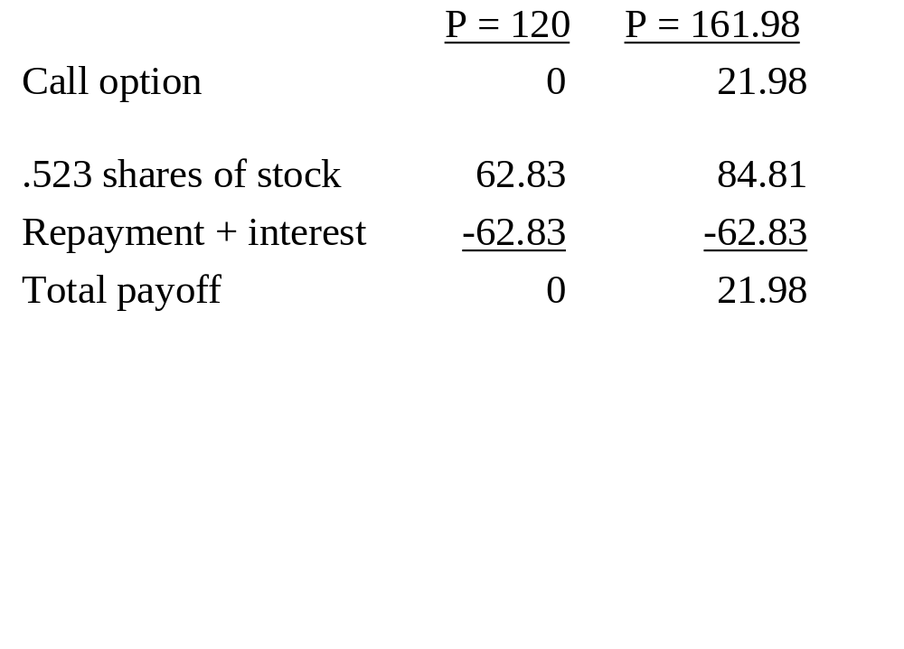
Find the option value using the replicating portfolio
Hedge ratio = Delta
Value of call = value of .523 shares of stock - loan
= (.523)139.42 - PV(62.83) = $13.16

Slide 31
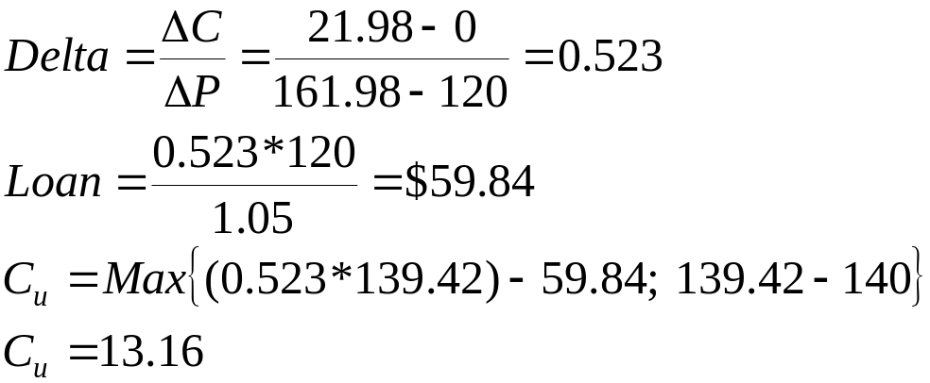
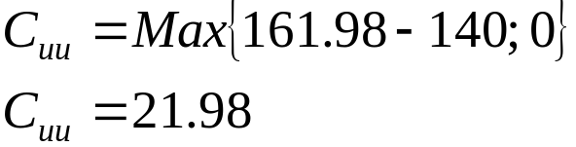
Present value tree for the option
21.98
13.16
7.88
0.00
0.00
0.00
time
0
1
2

Slide 32
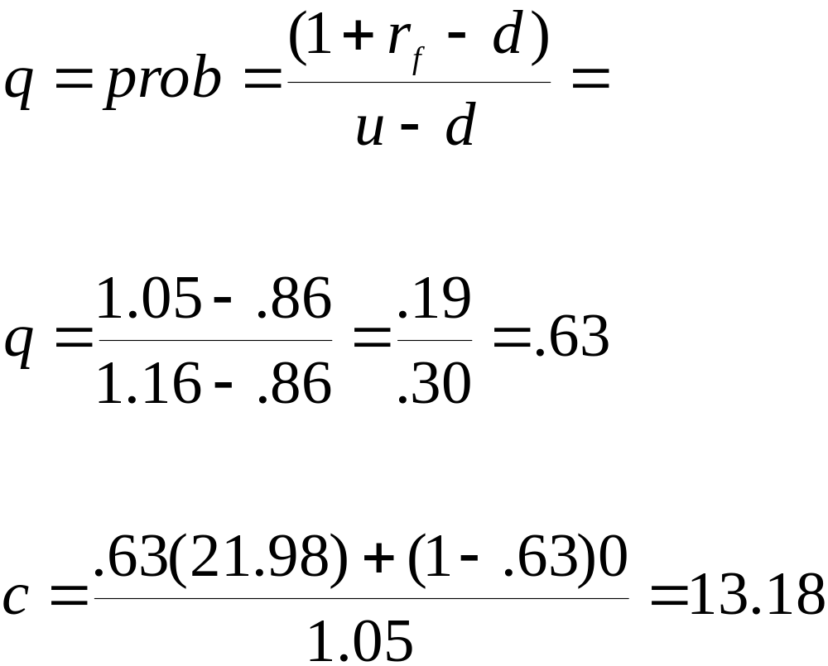
Same Problem: Option Value using Risk-Neutral Method
u = 1.16
d = .86

Slide 33
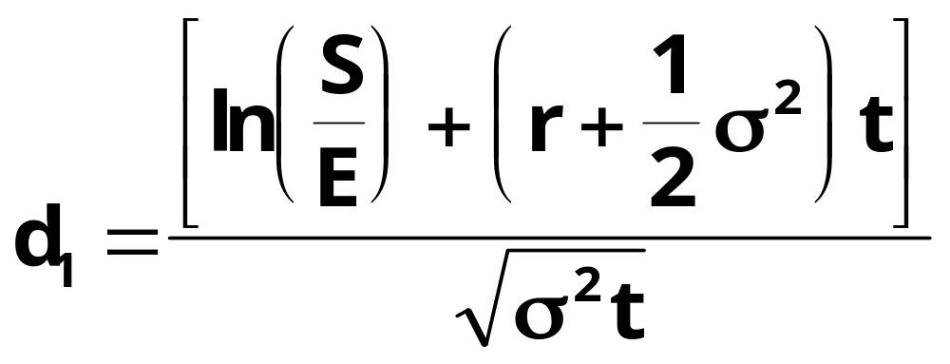
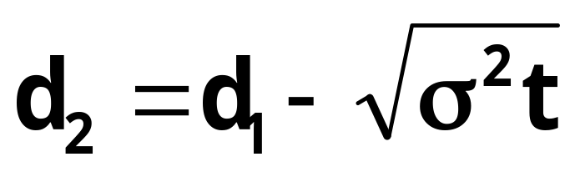
Black-Scholes Formula:
C = S x N(d₁) - Ee^{-rt} N(d₂)

Slide 34
Numerical Example: Black-Scholes Model
S = $50 E = $49 r = 0.07 σ² = 0.09 per year
t = 199/365 (199 days to maturity)
Calculate d1 = 0.3743 and d2 = 0.1528
Calculate N(d1) = 0.6459 and N(d2) = 0.5607 (from table of cumulative standardized normal distribution)
Substitute in formula and solve:
C = (50 x 0.6459) - (49 x e^{-.7(199/365)} ) x 0.5607)
= $5.85

Slide 35
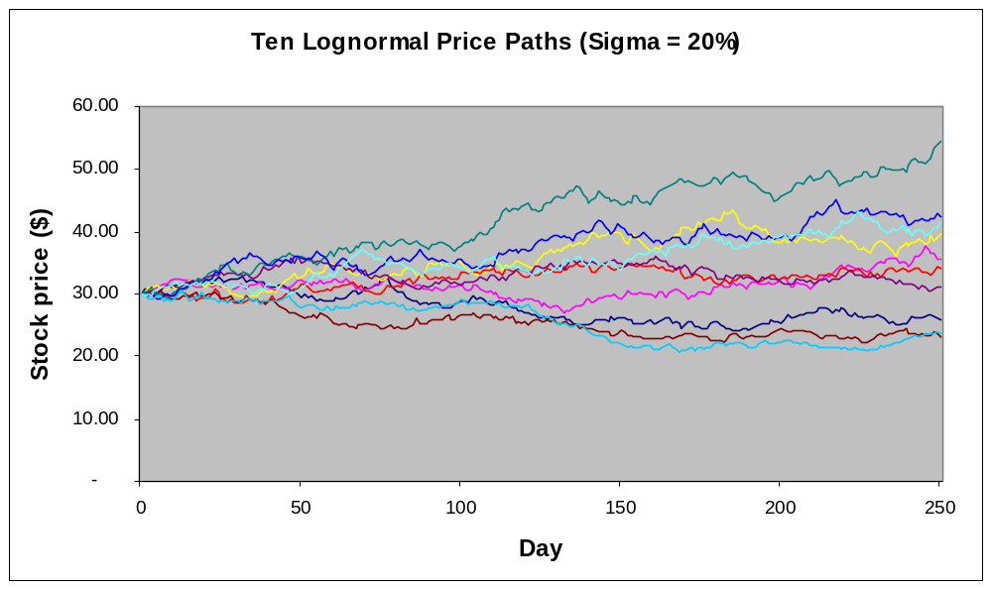

Slide 36
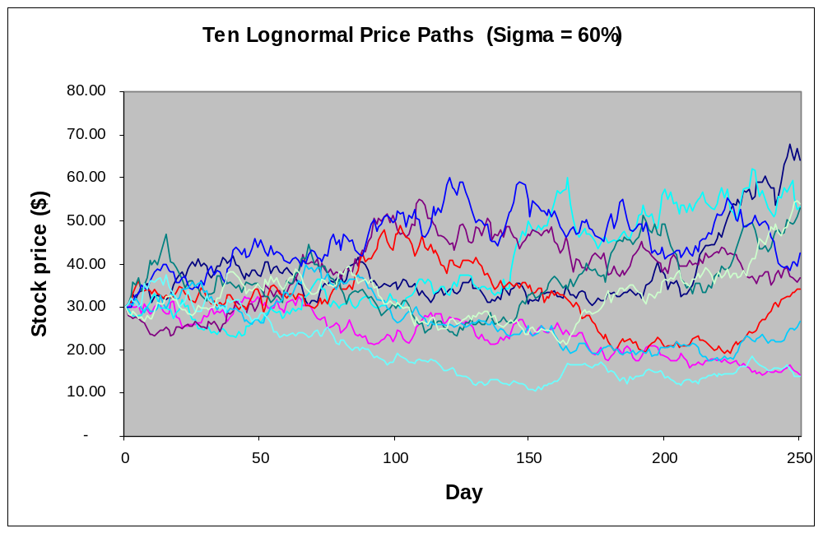

Slide 37
Metrics of the Black-Scholes Model
Converting the five variables in the Black-Scholes model to two new metrics. Combining five variables into two lets us locate opportunities in two-dimensional space.
Investment Opportunity
Call Option
Variable
Option Value Metrics
Present value of a project’s operating assets to be acquired
Stock price
S
X
T
r_{f}
σ²
Expenditure required to acquire the project assets
NPVq
Exercise price
Length of time the decision may be deferred
Time to expiration
Time value of money
Risk-free rate of return
σ√t
Riskiness of the project assets
Variance of returns on stock

Slide 38
Locating the Option Value in Two-Dimensional Space
We can locate investment opportunities in this two-dimensional space.
NPVq
1.0
Lower values
Higher values
Lower values
Call option value increases in these directions.
σ√t
Higher values

Slide 39
Real Options example
You own a 1-year call option on 1 acre of Los Angeles real estate. The exercise price is $2 million, an the current, appraised market value of the land is $1.7 million. The land is currently used as a parking lot, generating just enough money to cover real estate taxes. Over the last 5 years, similar properties have appreciated by 20 percent per year. The annual standard deviation is 15 percent and the interest rate is 12 percent. How much is your call worth? Use the Black-Scholes formula.

Slide 40
Real Options solution
2 parameters approach:
=
and
2) S/(PV(E)) = 1.7/(2/1.12) = .952
Table Value = 3.85%
Call Option Value = 3.85% x $1.7M
= $65,450
σ√t
.15√1

Slide 41

Example: Value of Follow-On Investment Opportunities
Issue: Should we introduce the Blitzen Mark I Micro?
Data:
CFs of Mark I yield a negative NPV.
r = 20% (because of the large R and D expenses).
$450 M total investment required.
NPV = -$46 Million
Reject Project

Slide 42
Cash flows: The Mark I Micro
Year
1982
1983
1984
1985
1986
1987
After-tax CFs
-200
+110
+159
+295
+185
0
CAPX
250
0
0
0
0
0
Δ NWC
0
50
100
100
-125
-125
Net CFs
-450
+60
+59
+195
+310
+125
NPV at 20% = -$46.45, or about -$46 million

Slide 43

Follow-On Investment II
Data for Mark II:
Invest in Mark II can be made after 3 years
The Mark II costs twice as much as Mark I.
    Total investment = $900M
Total CFs are also twice as much as Mark I.
    PV = $463M today.
CFs of Mark II have a std. deviation of 35% per year.
Translation: The Mark II opportunity is a 3 year call option
on an asset worth $463M with a $900M exercise price.
Call value = $55.5M

Slide 44
Cash flows: The Mark II Micro
1982
1985
1986
1987
1988
1989
1990
After-tax CFs
+220
+318
+590
+370
0
CAPX
100
200
200
-250
-250
Δ NWC
+120
+118
+390
+620
+250
PV@ 20%
+467
+807
Investment, PV @10%
676
900
Forecasted NPV in 1985 -93

Slide 45
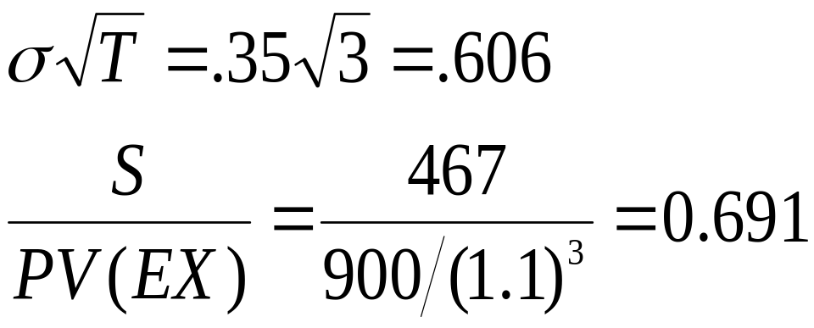
Value of Call Option
2 parameters approach:
Table Value = 11.9%
Call Option Value = (.119)(467) = $55.5 M

Slide 46
Total Value of Mark I Project
V = std. NPV + call value
= value w/o flexibility + value of flexibility
= -46+55.5
= 9.5 M

