Slide 1
HYPERLEDGER FABRIC
Tutorial

Slide 2
1. Hyperledger Fabric 개발 환경 구축

Slide 3
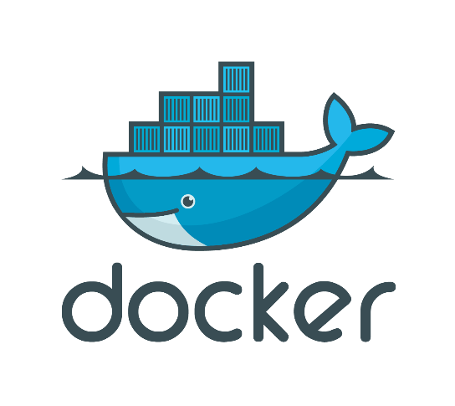
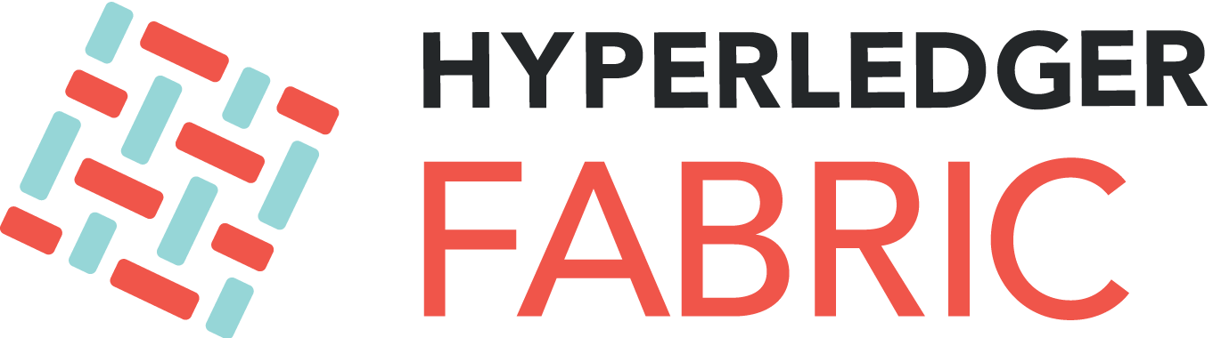
1. 하이퍼레저 개발 환경 구축
Hyperledger Fabric
Docker
Ubuntu Linux
cURL 설치
$ sudo apt install curl
2. 도커 설치
$ curl –fsSL https://get.docker.com/ | sudo sh
$ sudo usermode –aG docker $USER
$ sudo reboot
$ docker –v
2-1. 도커 컴포즈 설치
$ sudo curl –L “https://github.com/docker/compose/releases/download/1.22.0/docker-compose-
$ (uname –s)-$(uname –m)” –o /usr/local/bin/docker-compose
$ sudo chmod +x /usr/local/bin/docker-compose
$docker-compose –version
$ sudo apt-get install curl
$ curl –V
$ curl –fsSL https://get.docker.com/ | sudo sh
$ sudo usermod –aG docker $USER
$ sudo reboot
$ docker –v
$ sudo curl –L “https://github.com/docker/compose/releases/download/1.22.0/docker-compose-
$ (uname –s)-$(uname –m)” –o /usr/local/bin/docker-compose
$ chmod +x /usr/local/bin/docker-compose
$ docker-compose --version
https://github.com/cnrlab341/hyperledger_tutorial.git

Slide 4
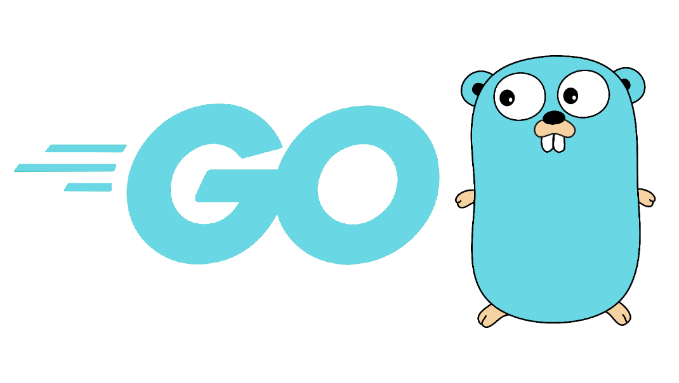
1. 하이퍼레저 개발 환경 구축
3. go 언어 설치
$ sudo wget https://storage.googleapis.com/golang/go1.11.1.linux-amd64.tar.gz
$ sudo tar –C /usr/local –xzf go1.11.1.linux-amd64.tar.gz
3-1. go 환경 변수 설정
$ echo ‘export PATH=$PATH:/usr/local/go/bin’ | sudo tee –a /etc/profile && \
$ echo ‘export GOPATH=$HOME/go’ | tee –a $HOME/.bashrc && \
$ echo ‘export PATH=$PATH:$GOROOT/bin:$GOPATH/bin’ | tee –a $HOME/.bashrc && \
$ mkdir –p $HOME/go/{src,pkg,bin|
$ sudo reboot
$ go version
3-2. GOPATH 확인
$ go env | grep GOPATH
$ cd /usr/local
$ sudo wget https://storage.googleapis.com/golang/go1.11.1.linux-amd64.tar.gz
$ sudo tar –C /usr/local –xzf go1.11.1.linux-amd64.tar.gz
$ echo ‘export PATH=$PATH:/usr/local/go/bin’ | sudo tee –a /etc/profile && \
$ echo ‘export GOPATH=$HOME/go’ | tee –a $HOME/.bashrc && \
$ echo ‘export PATH=$PATH:$GOROOT/bin:$GOPATH/bin’ | tee –a $HOME/.bashrc && \
$ mkdir –p $HOME/go/{src,pkg,bin}
$ sudo reboot
$ go version
$ go env | grep GOPATH

Slide 5



1. 하이퍼레저 개발 환경 구축
4. git 설치
$ sudo apt-get install git
$ git –version
5. 파이썬 2.7 설치
$ sudo apt-get install python2.7
$ sudo update-alternatives --config python
$ sudo update-alternatives --install /usr/bin/python python /usr/bin/python2.7 1
6. Node.js npm 설치
$ curl –o- https://raw.githubusercontent.com/creationix/nvm/v0.33.2/install.sh | bash
$ sudo reboot
$ nvm install 8
$ nvm use 8
$ npm install npm@5.6.0 –g
$ node –v
$ npm –v
7. VScode 설치
https://code.visualstudio.com/download
$ sudo apt-get install git
$ git --version
$ sudo apt-get install python2.7
$ sudo update-alternatives --config python
$ sudo update-alternatives --install /usr/bin/python python /usr/bin/python2.7 1
$ curl –o- https://raw.githubusercontent.com/creationix/nvm/v0.33.2/install.sh | bash
$ sudo reboot
$ nvm install 8
$ nvm use 8
$ npm install npm@5.6.0 –g
$ node –v
$ npm –v

Slide 6
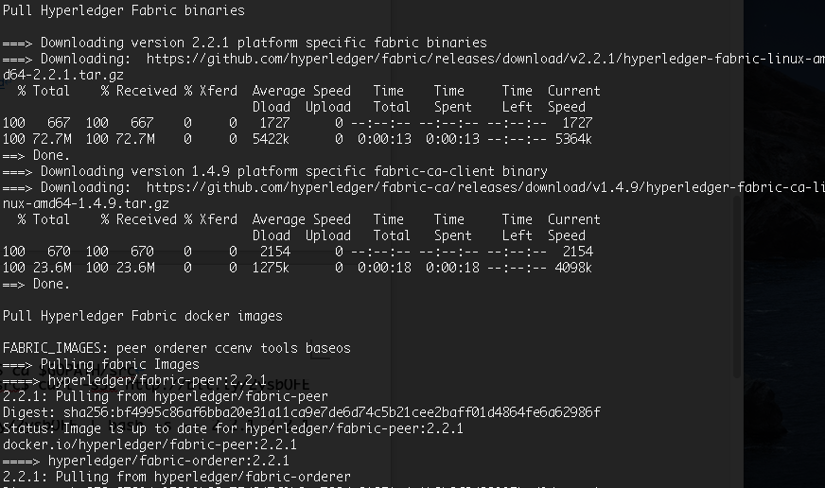
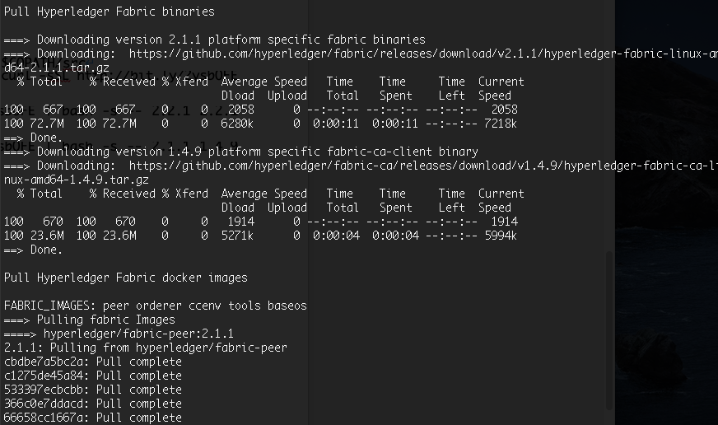
1. 하이퍼레저 패브릭 설치
$ cd $GOPATH/src
$ curl –sSL http://bit.ly/2ysbOFE | bash -s
$ curl –sSL http://bit.ly/2ysbOFE | bash -s -- 1.4.3 1.4.3 0.4.15

Slide 7
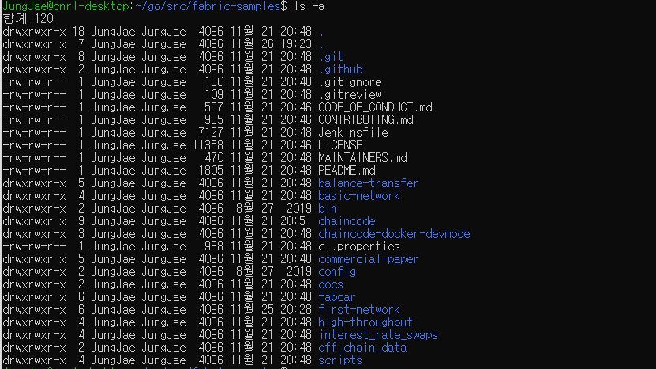
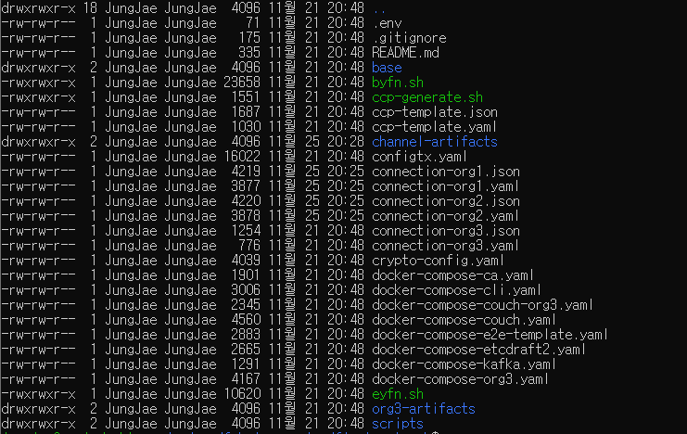
1. 하이퍼레저 개발 환경 구축
$ cd $GOPATH/src/fabric-samples
$ cd $GOPATH/src/fabric-samples/first-network
$ ls -al

Slide 8
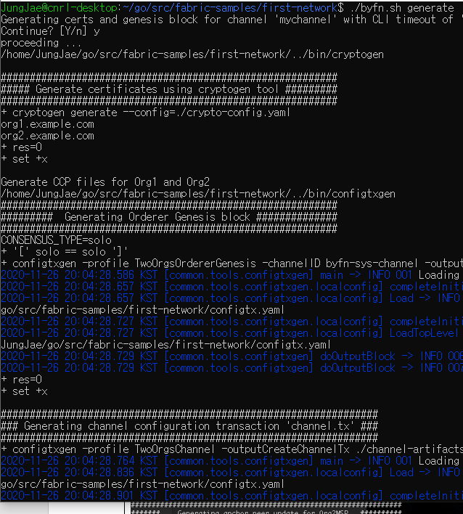
1. 하이퍼레저 개발 환경 구축
Building Your First Network
$ cd $GOPATH/src/fabric-samples/first-network/
$ ./byfn generate
$ ./byfn up
$ docker ps

Slide 9
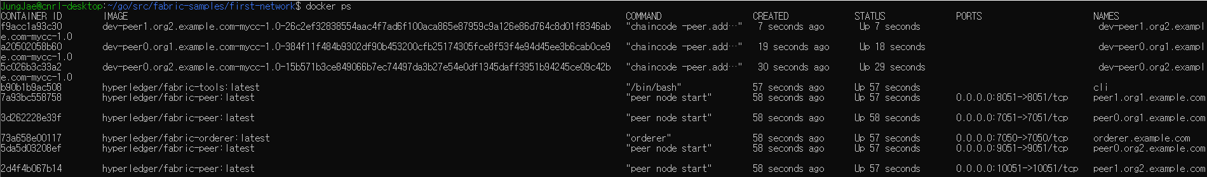
1. 하이퍼레저 개발 환경 구축
BYFN 구조
$ cd $GOPATH/src/fabric-samples/first-network/
$ docker ps
$ ./byfn down
컨테이너 환경
orderer
peer0
org1
peer1
org1
peer0
org2
peer1
org2
cli
chaincode
peer0
org2
chaincode
peer0
org1
chaincode
peer1
org2

Slide 10
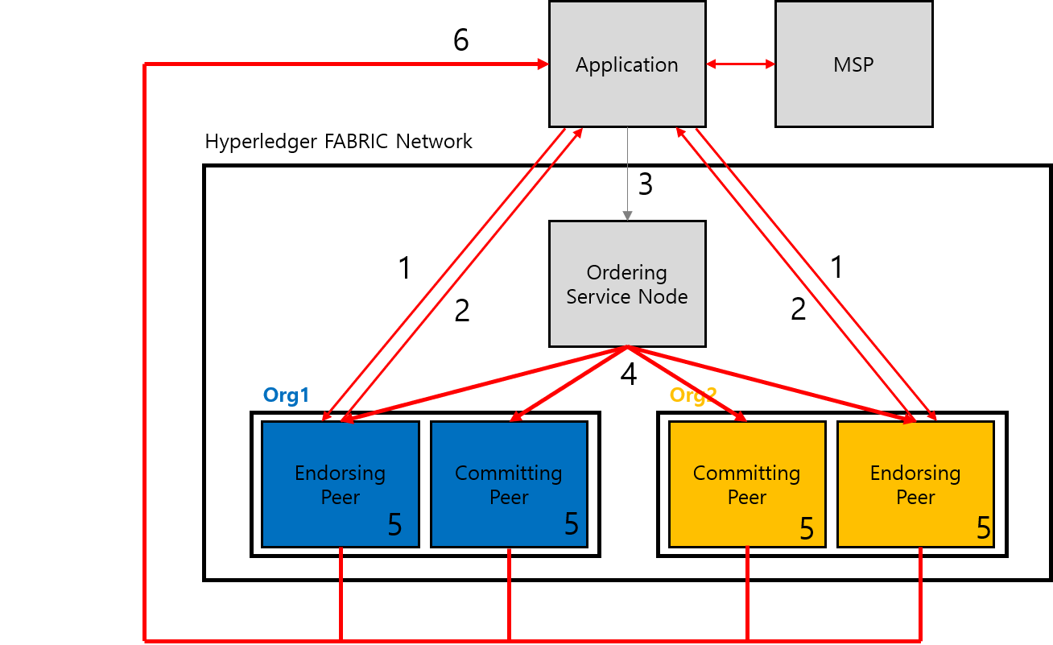
1. 하이퍼레저 개발 환경 구축
1 스마트 컨트랙이 호출되면, 트랜잭션 제안서를 Endorsing peer node에게 보낸다.
2 트랜잭션 제안서를 받은 Endorsing peer node는 트랜잭션 제안서가 올바른지 확인하고 서명이 유효한지 확인 후 Chain Code를 실행한다(시뮬레이션). TX결과를 생성해 반환한다.
3 Ordering service node는 이미 앞에서 검증이 이루어졌기 때문에 TX 수행을 위해 전체 내용을 전체 내용을 다시 검사하지 않고 TX이 들어오는 순서만 정렬한다.
4 Ordering Service node에서 생성된 TX블록을 Enodorsing peer node와 Committing Peer node에게 전달한다. 각 peer node는 보증 정책이 충족됐는지 확인 후에 원장 상태가 변경됐는지 확인한다.
5 Endorsing peer node, Committing peer node TX의 유효성을 검사한다.
6 유효성이 검증된 TX은 모든 피어 노드의 장부에 기록된다. 이후 트랜잭션의 성공 또는 실패 이벤트를 클라이언트 애플리케이션에 알린다.

Slide 11
2. Hyperledger Network 구성

Slide 12
2. cnrlpub.com Network Topology
cnrlpub.com
Ordering
Service
Node
channel1
channel2
Sales1 org
Customer org
Sales2 org
peer0
peer1
peer0
peer1
peer0
peer1

Slide 13
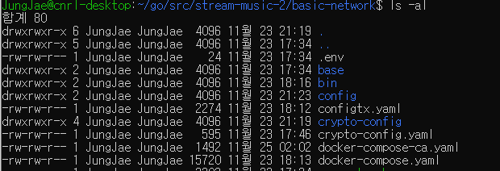
2. 프로젝트 디렉터리 및 설정 파일 생성
$ cd $GOPATH/src
$ mkdir stream-music && cd stream-music
$ mkdir basic-network && cd basic-network
$ mkdir crypto-config
$ touch crypto-config.yaml
$ touch configtx.yaml
$ touch docker-compose.yaml
$ export FABRIC_CFG_PATH=$PWD
$ cp –r $GOPATH/src/fabric-samples/bin ./

Slide 14
2. 오더러 및 피어 인증서 발급
모든 노드는 인증서를 발급 받는다.
하이퍼레저 패브릭 네트워크에 접근하는 관리자 및 사용자도 인증서를 발급 받아햐 접근할 수 있다.
$ cd $GOPATH/src/stream-music/basic-network
$ code crypto-config.yaml
./bin/cryptogen generate --config=./crypto-config.yaml
OrdererOrgs: #오더링 서비스 노드 조직 정의
- Name: Orderer
Domain: cnrlpub.com #도메인 네임
Specs:
- Hostname: orderer1
- Hostname: orderer2
PeerOrgs: #노드 조직 정의
- Name: Sales1 #조직 1
Domain: sales1.cnrlpub.com
Template: # 피어의 수
Count: 2
Users: # 사용자 수
Count: 1
- Name: Sales2 #조직 2
Domain: sales2.cnrlpub.com
Template:
Count: 2
Users:
Count: 1
- Name: Customer #조직 3
Domain: customer.cnrlpub.com
Template:
Count: 2
Users:
Count: 1
Channel1
- peer0.sales1.cnrlpub.com
- peer1.sales1.cnrlpub.com
- peer0.customer.cnrlpub.com
- peer1.customer.cnrlpub.com
Channel2
- peer0.sales2.cnrlpub.com
- peer1.sales2.cnrlpub.com
- peer0.customer.cnrlpub.com
- peer1.customer.cnrlpub.com

Slide 15
2. Kafka Ordering Service
solo 방식은 싱글 프로세스로 구성돼 있다. 따라서 실제 구동시 오더러 노드가 정지하면 네트워크 전체가 작동하지 않게 된다.
4개의 카프카 방식의 오더러에서는 카프카 구성이 디스크에 파일로 데이터를 저장하며 클러스터에서 데이터 복제본을 만든다.
카프카는 Zab 프로토콜을 사용하는 ZooKeeper 기반으로 동작한다.
Zoo
Keeper
Zoo
Keeper
Zoo
Keeper
cnrlpub.com
Ordering
Service
Node
Kafka
Kafka
channel1
channel2
Kafka
Kafka
Sales1 org
Customer org
Sales2 org
peer0
peer1
peer0
peer1
peer0
peer1
Kafka Cluster

Slide 16
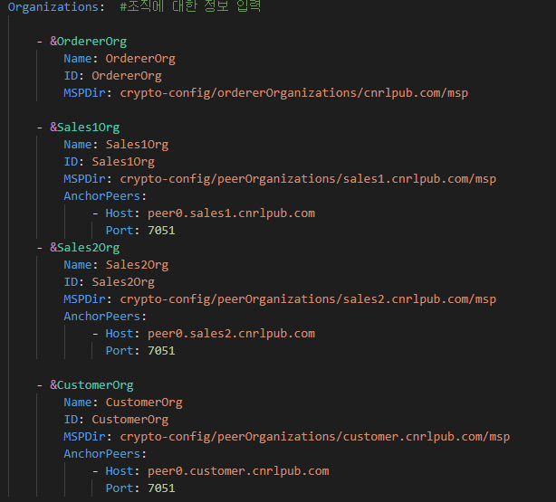
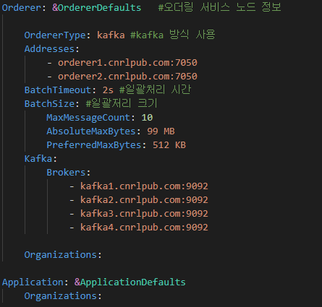
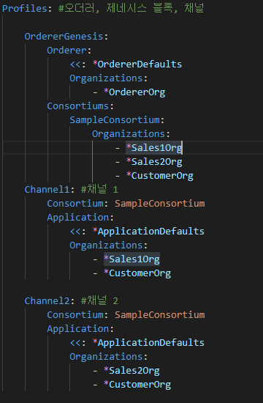
2. 제네시스 블록 및 채널, 앵커 피어 설정
$ cd $GOPATH/src/stream-music/basic-network
$ code configtx.yaml

Slide 17
2. 제네시스 블록 및 채널, 앵커 피어 설정
$ mkdir config
# 제네시스 블록 파일 생성
$ ./bin/configtxgen –profile OrdererGenesis –outputBlock ./config/genesis.block
# 채널에 대한 트랜잭션을 생성
$ ./bin/configtxgen –profile Channel1 –outputCreateChannelTx ./config/channel1.tx –channelID channelsales1
$ ./bin/configtxgen –profile Channel2 –outputCreateChannelTx ./config/channel2.tx –channelID channelsales2
# 각 조직에 대한 앵커 피어 설정
$ ./bin/configtxgen –profile Channel1 –outputAnchorPeersUpdate ./config/Sales1Organchors.tx –channelID channelsales1 –asOrg Sales1Org
$ ./bin/configtxgen –profile Channel2 –outputAnchorPeersUpdate ./config/Sales2Organchors.tx –channelID channelsales2 –asOrg Sales2Org
$ ./bin/configtxgen –profile Channel1 –outputAnchorPeersUpdate ./config/CustomerOrganchorsChannels1.tx –channelID channelsales1 –asOrg CustomerOrg
$ ./bin/configtxgen –profile Channel2 –outputAnchorPeersUpdate ./config/CustomerOrganchorsChannels2.tx –channelID channelsales2 –asOrg CustomerOrg

Slide 18
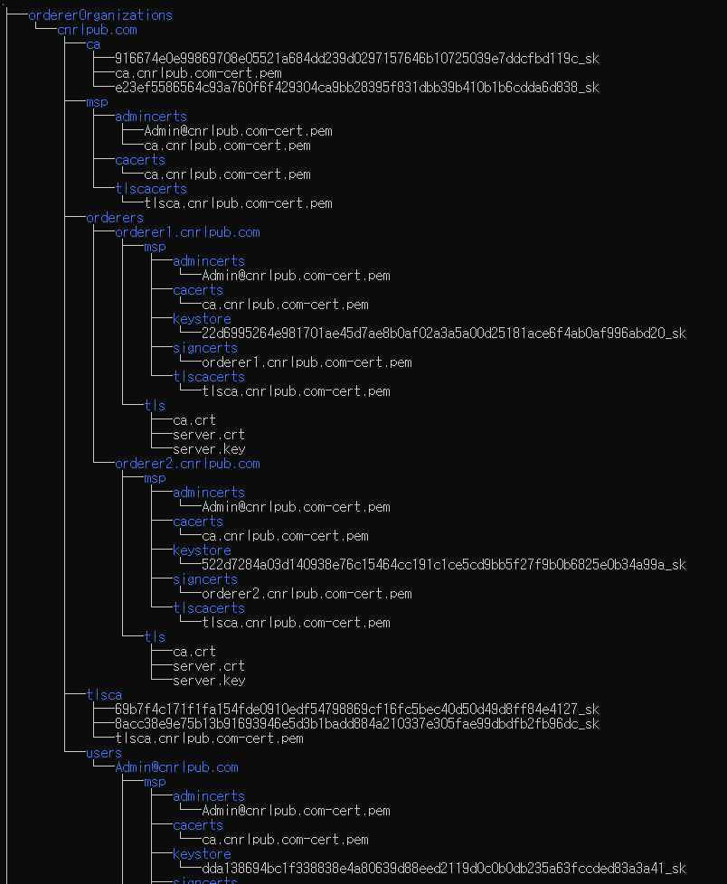
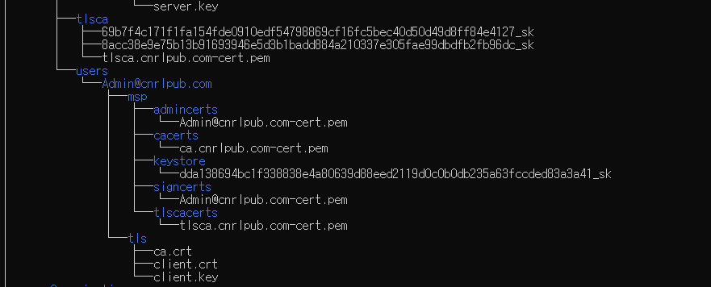
2. 인증서 파일

Slide 19
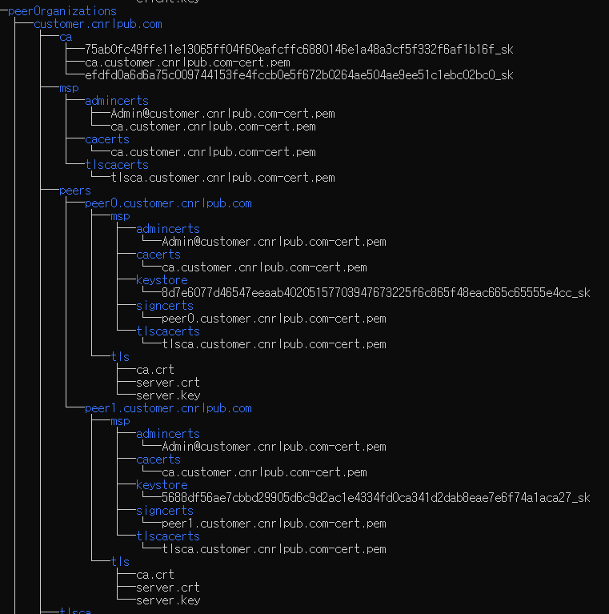
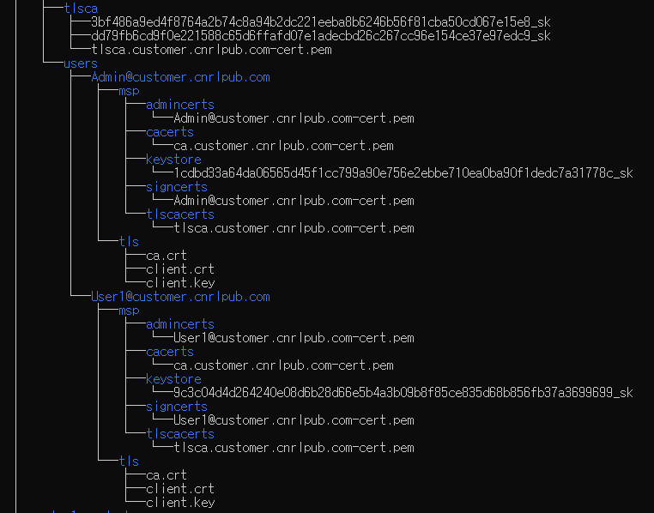
2. 인증서 파일

Slide 20
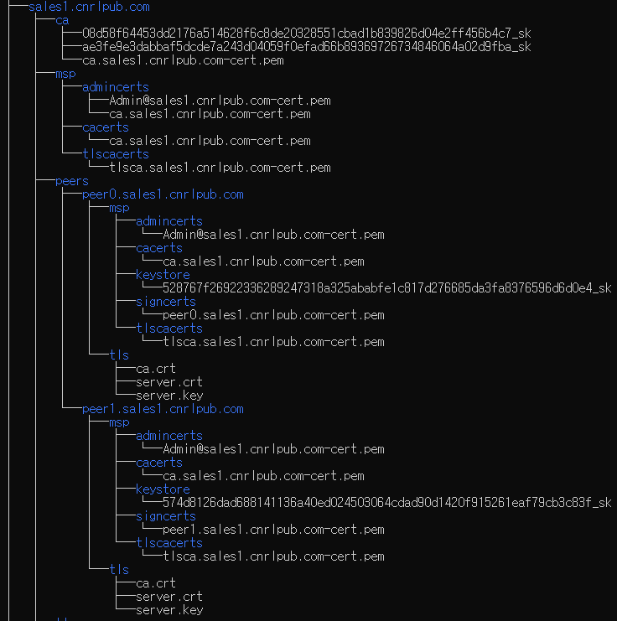
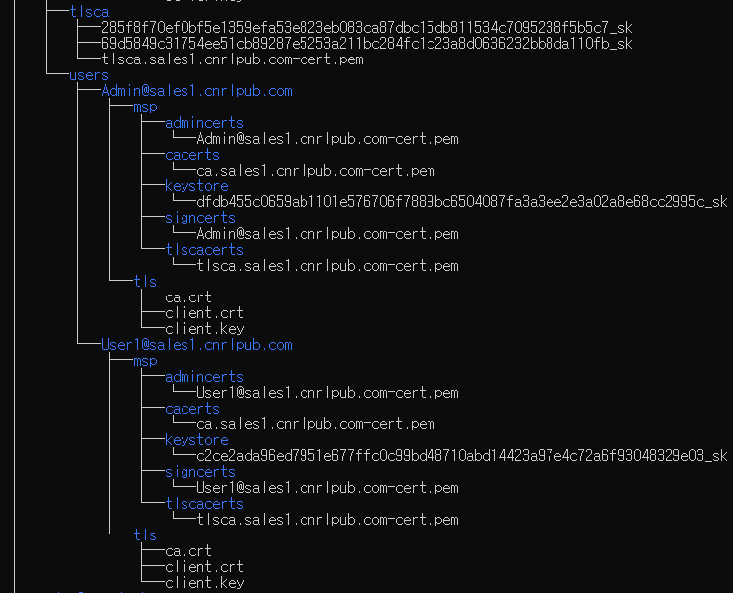
2. 인증서 파일

Slide 21
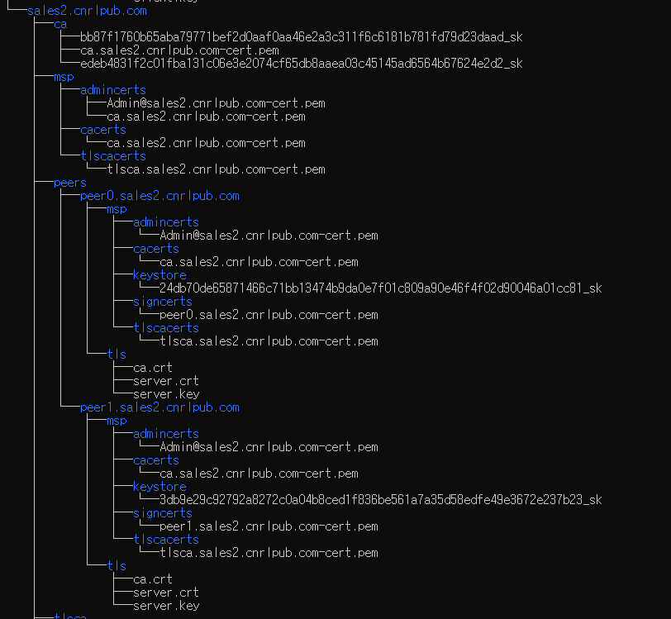
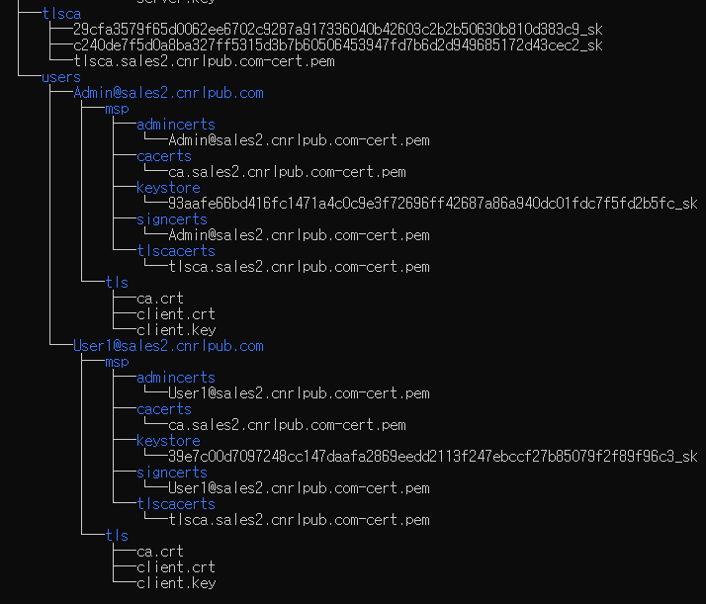
2. 인증서 파일

Slide 22
2. 도커 컨테이너 구성파일 작성
orderer1.cnrlpub.com:
container_name: orderer1.cnrlpub.com
image: hyperledger/fabric-orderer:1.4.3
environment:
- ORDERER_GENERAL_LOGLEVEL=debug #도커 로깅 레벨
- ORDERER_GENERAL_LISTENADDRESS=0.0.0.0
- ORDERER_GENERAL_GENESISMETHOD=file
- ORDERER_GENERAL_GENESISFILE=/etc/hyperledger/configtx/genesis.block
- ORDERER_GENERAL_LOCALMSPID=OrdererOrg
- ORDERER_GENERAL_LOCALMSPDIR=/etc/hyperledger/msp/orderer/msp
working_dir: /opt/gopath/src/github.com/hyperledger/fabric/orderer
command: orderer
ports:
- 7050:7050
volumes:
- ./config/:/etc/hyperledger/configtx
- ./crypto-config/ordererOrganizations/cnrlpub.com/orderers/orderer1.cnrlpub.com/:/etc/hyperledger/msp/orderer
depends_on:
- kafka1.cnrlpub.com
- kafka2.cnrlpub.com
- kafka3.cnrlpub.com
- kafka4.cnrlpub.com
networks:
- cnrl
orderer2.cnrlpub.com:
container_name: orderer2.cnrlpub.com
image: hyperledger/fabric-orderer:1.4.3
environment:
- ORDERER_GENERAL_LOGLEVEL=debug
- ORDERER_GENERAL_LISTENADDRESS=0.0.0.0
- ORDERER_GENERAL_GENESISMETHOD=file
- ORDERER_GENERAL_GENESISFILE=/etc/hyperledger/configtx/genesis.block
- ORDERER_GENERAL_LOCALMSPID=OrdererOrg
- ORDERER_GENERAL_LOCALMSPDIR=/etc/hyperledger/msp/orderer/msp
working_dir: /opt/gopath/src/github.com/hyperledger/fabric/orderer
command: orderer
ports:
- 8050:7050
volumes:
- ./config/:/etc/hyperledger/configtx
- ./crypto-config/ordererOrganizations/cnrlpub.com/orderers/orderer2.cnrlpub.com/:/etc/hyperledger/msp/orderer
depends_on:
- kafka1.cnrlpub.com
- kafka2.cnrlpub.com
- kafka3.cnrlpub.com
- kafka4.cnrlpub.com
networks:
- cnrl

Slide 23
1. 도커 컨테이너 구성파일 작성
kafka1.cnrlpub.com:
container_name: kafka1.cnrlpub.com
extends:
file: ./base/kafka-base.yaml
service: kafka
environment:
- KAFKA_BROKER_ID=1
ports:
- 9092:9092
- 9093:9093
depends_on:
- zookeeper1.cnrlpub.com
- zookeeper2.cnrlpub.com
- zookeeper3.cnrlpub.com
networks:
- cnrl
#카파카 방식은 주키퍼를 기반으로 동작함, 주키퍼: 분산시스템 동기화, 참가자 그룹핑, 이름관리
zookeeper1.cnrlpub.com:
container_name: zookeeper1.cnrlpub.com
extends:
file: ./base/kafka-base.yaml
service: zookeeper
environment:
- ZOO_MY_ID=1
ports:
- 2181:2181
- 2888:2888
- 3888:3888
networks:
- cnrl

Slide 24
1. 도커 컨테이너 구성파일 작성
peer0.sales1.cnrlpub.com: #sles1조직
container_name: peer0.sales1.cnrlpub.com
image: hyperledger/fabric-peer:1.4.3
environment:
- CORE_VM_ENDPOINT=unix:///host/var/run/docker.sock
- CORE_PEER_ID=peer0.sales1.cnrlpub.com
- CORE_LOGGING_PEER=debug
- CORE_CHAINCODE_LOGGING_LEVEL=DEBUG
- CORE_PEER_LOCALMSPID=Sales1Org
- CORE_PEER_MSPCONFIGPATH=/etc/hyperledger/msp/peer/
- CORE_PEER_ADDRESS=peer0.sales1.cnrlpub.com:7051
- CORE_PEER_GOSSIP_BOOTSTRAP=peer0.sales1.cnrlpub.com:7051
- CORE_PEER_GOSSIP_ENDPOINT=peer0.sales1.cnrlpub.com:7051
- CORE_PEER_GOSSIP_EXTERNALENDPOINT=peer0.sales1.cnrlpub.com:7051
- CORE_VM_DOCKER_HOSTCONFIG_NETWORKMODE=net_cnrl
- CORE_LEDGER_STATE_STATEDATABASE=CouchDB
- CORE_LEDGER_STATE_COUCHDBCONFIG_COUCHDBADDRESS=couchdb1:5984
- CORE_LEDGER_STATE_COUCHDBCONFIG_USERNAME=
- CORE_LEDGER_STATE_COUCHDBCONFIG_PASSWORD=
working_dir: /opt/gopath/src/github.com/hyperledger/fabric
command: peer node start
ports:
- 7051:7051
- 7053:7053
volumes:
- /var/run/:/host/var/run/
- ./crypto-config/peerOrganizations/sales1.cnrlpub.com/peers/peer0.sales1.cnrlpub.com/msp:/etc/hyperledger/msp/peer
- ./crypto-config/peerOrganizations/sales1.cnrlpub.com/users:/etc/hyperledger/msp/users
- ./config:/etc/hyperledger/configtx
depends_on:
- orderer1.cnrlpub.com
- orderer2.cnrlpub.com
- couchdb1
networks:
- cnrl
couchdb1:
container_name: couchdb1
image: hyperledger/fabric-couchdb
environment:
- COUCHDB_USER=
- COUCHDB_PASSWORD=
ports:
- 5984:5984
networks:
- cnrl

Slide 25
1. zokeeper 환경변수 파일 생성
$ cd $GOPATH/src/stream-music/basic-network/
$ mkdir base && base
$ touch kafka-base.yaml && code kafka-base.yaml
version: '2'
services:
zookeeper:
image: hyperledger/fabric-zookeeper
environment:
- ZOO_SERVERS=server.1=zookeeper1.cnrlpub.com:2888:3888 server.2=zookeeper2.cnrlpub.com:2888:3888 server.3=zookeeper3.cnrlpub.com:2888:3888
restart: always
kafka:
image: hyperledger/fabric-kafka
restart: always
environment:
- KAFKA_MESSAGE_MAX_BYTES=103809024
- KAFKA_REPLICA_FETCH_MAX_BYTES=103809024
- KAFKA_UNCLEAN_LEADER_ELECTION_ENABLE=false
- KAFKA_MIN_INSYNC_REPLICAS=2
- KAFKA_DEFAULT_REPLICATION_FACTOR=3
- KAFKA_ZOOKEEPER_CONNECT=zookeeper1.cnrlpub.com:2181,zookeeper2.cnrlpub.com:2181,zookeeper3.cnrlpub.com:2181

Slide 26
1. 도커 컨테이너 실행 및 채널 제어
cd $GOPATH/src/stream-music/basic-network
touch .envcode .env && code net
-> COMPOSE_PROJECT_NAME=net
# sales1 조직의 peer0 노드 | channelsales1 생성
docker exec cli1 peer channel create -o orderer1.cnrlpub.com:7050 -c channelsales1 -f /etc/hyperledger/configtx/channel1.tx
# sales1 조직의 peer0 노드 | channelsales1 가입
docker exec cli1 peer channel join -b channelsales1.block
# sales1 조직의 peer0 노드 | channelsales1 채널에 앵커 피어로 업데이트
docker exec cli1 peer channel update -o orderer1.cnrlpub.com:7050 -c channelsales1 -f /etc/hyperledger/configtx/Sales1Organchors.tx
# sales1 조직의 peer1 노드 | channelsales1 가입
docker exec -e "CORE_PEER_ADDRESS=peer1.sales1.cnrlpub.com:7051" cli1 peer channel join -b channelsales1.block
# customer 조직의 peer0 노드 | channelsales1 가입
docker exec -e "CORE_PEER_LOCALMSPID=CustomerOrg" -e "CORE_PEER_MSPCONFIGPATH=/opt/gopath/src/github.com/hyperledger/fabric/peer/crypto/peerOrganizations/customer.cnrlpub.com/users/Admin@customer.cnrlpub.com/msp" -e "CORE_PEER_ADDRESS=peer0.customer.cnrlpub.com:7051" cli1 peer channel join -b channelsales1.block
# customer 조직의 peer0 노드 | channelsales1 의 앵커 피어로 업데이트
docker exec -e "CORE_PEER_LOCALMSPID=CustomerOrg" -e "CORE_PEER_MSPCONFIGPATH=/opt/gopath/src/github.com/hyperledger/fabric/peer/crypto/peerOrganizations/customer.cnrlpub.com/users/Admin@customer.cnrlpub.com/msp" -e "CORE_PEER_ADDRESS=peer0.customer.cnrlpub.com:7051" cli1 peer channel update -o orderer1.cnrlpub.com:7050 -c channelsales1 -f /etc/hyperledger/configtx/CustomerOrganchorsChannel1.tx
# customer 조직의 peer1 노드 | channelsales1 가입
docker exec -e "CORE_PEER_LOCALMSPID=CustomerOrg" -e "CORE_PEER_MSPCONFIGPATH=/opt/gopath/src/github.com/hyperledger/fabric/peer/crypto/peerOrganizations/customer.cnrlpub.com/users/Admin@customer.cnrlpub.com/msp" -e "CORE_PEER_ADDRESS=peer1.customer.cnrlpub.com:7051" cli1 peer channel join -b channelsales1.block
# sales1 조직의 peer0 노드 | channelsales2 생성
docker exec cli2 peer channel create -o orderer1.cnrlpub.com:7050 -c channelsales2 -f /etc/hyperledger/configtx/channel2.tx
# sales2 조직의 peer0 노드 | channelsales2 가입
docker exec cli2 peer channel join -b channelsales2.block
# sales2 조직의 peer0 도드 | channelsales2 채널에 앵커 피어로 업데이트
docker exec cli2 peer channel update -o orderer1.cnrlpub.com:7050 -c channelsales2 -f /etc/hyperledger/configtx/Sales2Organchors.tx
# sales2 조직의 peer1 노드 | channelsales2 가입
docker exec -e "CORE_PEER_ADDRESS=peer1.sales2.cnrlpub.com:7051" cli2 peer channel join -b channelsales2.block

Slide 27
1. 도커 컨테이너 실행 및 채널 제어
# customer 조직의 peer0 노드 | channelsales2 가입
docker exec -e "CORE_PEER_LOCALMSPID=CustomerOrg" -e "CORE_PEER_MSPCONFIGPATH=/opt/gopath/src/github.com/hyperledger/fabric/peer/crypto/peerOrganizations/customer.cnrlpub.com/users/Admin@customer.cnrlpub.com/msp" -e "CORE_PEER_ADDRESS=peer0.customer.cnrlpub.com:7051" cli2 peer channel join -b channelsales2.block
# customer 조직의 peer0 노드 | channelsales2 의 앵커 피어로 업데이트
docker exec -e "CORE_PEER_LOCALMSPID=CustomerOrg" -e "CORE_PEER_MSPCONFIGPATH=/opt/gopath/src/github.com/hyperledger/fabric/peer/crypto/peerOrganizations/customer.cnrlpub.com/users/Admin@customer.cnrlpub.com/msp" -e "CORE_PEER_ADDRESS=peer0.customer.cnrlpub.com:7051" cli2 peer channel update -o orderer1.cnrlpub.com:7050 -c channelsales2 -f /etc/hyperledger/configtx/CustomerOrganchorsChannel2.tx
# customer 조직의 peer1 노드 | channelsales2 가입
docker exec -e "CORE_PEER_LOCALMSPID=CustomerOrg" -e "CORE_PEER_MSPCONFIGPATH=/opt/gopath/src/github.com/hyperledger/fabric/peer/crypto/peerOrganizations/customer.cnrlpub.com/users/Admin@customer.cnrlpub.com/msp" -e "CORE_PEER_ADDRESS=peer1.customer.cnrlpub.com:7051" cli2 peer channel join -b channelsales2.block

Slide 28
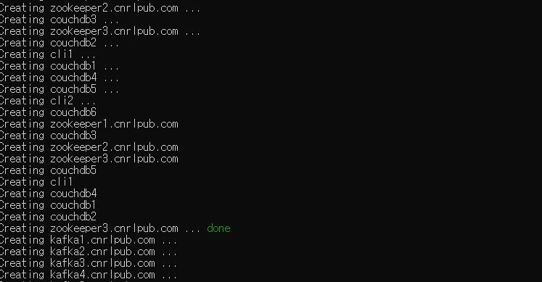
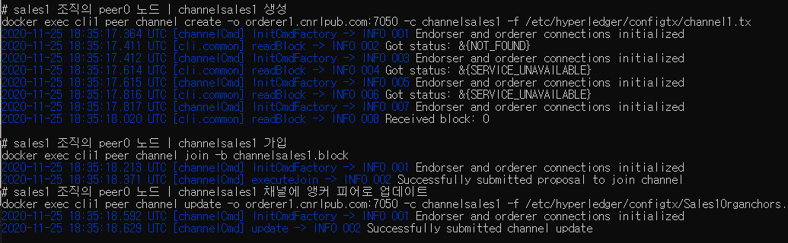
1. 도커 컨테이너 실행

Slide 29
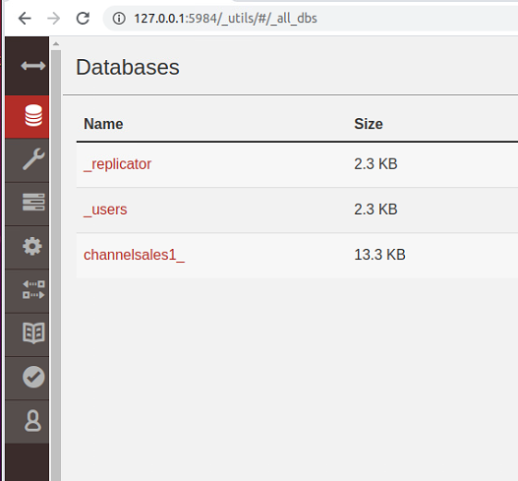
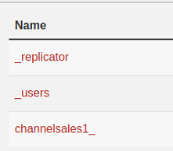
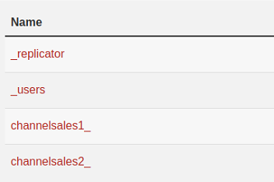
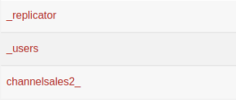
1. CouchDB 확인
http://127.0.0.1:5984/_utils
6984, 7984, 아까 peer별로 할당한 포트별로 couchDB 확인

Slide 30
3. Chaincode 개발

Slide 31
cd $GOPATH/src/stream-music
mkdir -r chaincode/go && cd chaincode/go
touch music.go && code music.go
package main
import (
"bytes"
"encoding/json"
"fmt"
"strconv"
"github.com/hyperledger/fabric/core/chaincode/shim"
pb "github.com/hyperledger/fabric/protos/peer"
) type SmartContract struct{}
func (s *SmartContract) Init(APIstub shim.ChaincodeStubInterface) pb.Response { //체인코드를 인스턴스화 할 때 호출되는 함수이다.
return shim.Success(nil)} func (s *SmartContract) Invoke(APIstub shim.ChaincodeStubInterface) pb.Response { //Invoke함수, 체인코드 호출을 제어, 실제 체인코가가 처리할 내용
function, args := APIstub.GetFunctionAndParameters() if function == "initWallet" {
return s.initWallet(APIstub)
} else if function == "getWallet" {
return s.getWallet(APIstub, args)
} else if function == "setWallet" {
return s.setWallet(APIstub, args)
} else if function == "getMusic" {
return s.getMusic(APIstub, args)
} else if function == "setMusic" {
return s.setMusic(APIstub, args)
} else if function == "getAllMusic" {
return s.getAllMusic(APIstub)
} else if function == "purchaseMusic" {
return s.purchaseMusic(APIstub, args)
} else if function == "changeMusicPrice" {
return s.changeMusicPrice(APIstub, args)
} else if function == "deleteMusic" {
return s.deleteMusic(APIstub, args)
}
fmt.Println("Please check your function : " + function)
return shim.Error("Unknown function")}

Slide 32
func main() {
err := shim.Start(new(SmartContract))
if err != nil {
fmt.Printf("Error starting Simple chaincode: %s", err)
}
}
type Wallet struct { //지갑 구조체
Name string `json:"name"`
ID string `json:"id"`
Token string `json:"token"`
}
func (s *SmartContract) initWallet(APIstub shim.ChaincodeStubInterface) pb.Response { //지갑 초기화시 호출
seller := Wallet{Name: "Hyper", ID: "1Q2W3E4R", Token: "100"} //판매자 에대한 지갑 정보
customer := Wallet{Name: "Ledger", ID: "5T6Y7U8I", Token: "200"} //구매자에 대한 지갑 정보
SellerasJSONBytes, _ := json.Marshal(seller) // Convert seller to byte
err := APIstub.PutState(seller.ID, SellerasJSONBytes)
if err != nil {
return shim.Error("Failed to create asset " + seller.Name)
}
CustomerasJSONBytes, _ := json.Marshal(customer) // Convert customer to byte
err = APIstub.PutState(customer.ID, CustomerasJSONBytes)
if err != nil {
return shim.Error("Failed to create asset " + customer.Name)
}
return shim.Success(nil)
}

Slide 33
func (s *SmartContract) getWallet(APIstub shim.ChaincodeStubInterface, args []string) pb.Response {
walletAsBytes, err := APIstub.GetState(args[0]) //WalletID를 GetState로 받아옴
if err != nil {
fmt.Println(err.Error())
}
wallet := Wallet{}
json.Unmarshal(walletAsBytes, &wallet)
var buffer bytes.Buffer
buffer.WriteString("[")
bArrayMemberAlreadyWritten := false
if bArrayMemberAlreadyWritten == true {
buffer.WriteString(",")
}
buffer.WriteString("{\"Name\":")
buffer.WriteString("\"")
buffer.WriteString(wallet.Name)
buffer.WriteString("\"")
buffer.WriteString(", \"ID\":")
buffer.WriteString("\"")
buffer.WriteString(wallet.ID)
buffer.WriteString("\"")
buffer.WriteString(", \"Token\":")
buffer.WriteString("\"")
buffer.WriteString(wallet.Token)
buffer.WriteString("\"")
buffer.WriteString("}")
bArrayMemberAlreadyWritten = true
buffer.WriteString("]\n")
return shim.Success(buffer.Bytes())
}

Slide 34
type Music struct { //음원 구조체
Title string `json:"title"`
Singer string `json:"singer"`
Price string `json:"price"`
WalletID string `json:"walletid"`
Count string `json:"count"` //determine about download music
}
type MusicKey struct { //음원 고유번호 중복안되게 설정하기 위해
Key string
Idx int
}
func generateKey(APIstub shim.ChaincodeStubInterface, key string) []byte { //음원등록시 고유 번호 생성
var isFirst bool = false
musickeyAsBytes, err := APIstub.GetState(key) //최근 키값 불러옴
if err != nil {
fmt.Println(err.Error())
}
musickey := MusicKey{}
json.Unmarshal(musickeyAsBytes, &musickey)
var tempIdx string
tempIdx = strconv.Itoa(musickey.Idx)
fmt.Println(musickey)
fmt.Println("Key is " + strconv.Itoa(len(musickey.Key)))
if len(musickey.Key) == 0 || musickey.Key == "" { //키값이 없을 경우->첫번째 키값
isFirst = true
musickey.Key = "MS"
}
if !isFirst {
musickey.Idx = musickey.Idx + 1 //musickey값 1씩 증가 시킴
}
fmt.Println("Last MusicKey is " + musickey.Key + " : " + tempIdx)
returnValueBytes, _ := json.Marshal(musickey)
return returnValueBytes
}

Slide 35
func (s *SmartContract) setWallet(APIstub shim.ChaincodeStubInterface, args []string) pb.Response {
if len(args) != 3 {
return shim.Error("Incorrect number of arguments. Expecting 3")
}
var wallet = Wallet{Name: args[0], ID: args[1], Token: args[2]} //지갑에 대한 정보를 입력 받아 wallet 객체에 저장
WalletasJSONBytes, _ := json.Marshal(wallet) //wallet 객체를 json 형태의 string 형으로 변환해 원장에 등록한다.
err := APIstub.PutState(wallet.ID, WalletasJSONBytes)
if err != nil {
return shim.Error("Failed to create asset " + wallet.Name)
}
return shim.Success(nil)
}
func (s *SmartContract) setMusic(APIstub shim.ChaincodeStubInterface, args []string) pb.Response {
if len(args) != 4 {
return shim.Error("Incorrect number of arguments. Expecting 4")
}
var musickey = MusicKey{} //최근 키값 받음
json.Unmarshal(generateKey(APIstub, "latestKey"), &musickey)
keyidx := strconv.Itoa(musickey.Idx)
fmt.Println("Key : " + musickey.Key + ", Idx : " + keyidx)
var music = Music{Title: args[0], Singer: args[1], Price: args[2], WalletID: args[3], Count: "0"}
musicAsJSONBytes, _ := json.Marshal(music) //파라미터 값들 json 변환
var keyString = musickey.Key + keyidx
fmt.Println("musickey is " + keyString)
err := APIstub.PutState(keyString, musicAsJSONBytes)
if err != nil {
return shim.Error(fmt.Sprintf("Failed to record music catch: %s", musickey))
}
musickeyAsBytes, _ := json.Marshal(musickey) //음원 번호 최신 값으로 업데이트
APIstub.PutState("latestKey", musickeyAsBytes)
return shim.Success(nil)
}

Slide 36
func (s *SmartContract) getAllMusic(APIstub shim.ChaincodeStubInterface) pb.Response {
// Find latestKey
musickeyAsBytes, _ := APIstub.GetState("latestKey")
musickey := MusicKey{}
json.Unmarshal(musickeyAsBytes, &musickey)
idxStr := strconv.Itoa(musickey.Idx + 1)
var startKey = "MS0"
var endKey = musickey.Key + idxStr
fmt.Println(startKey)
fmt.Println(endKey)
resultsIter, err := APIstub.GetStateByRange(startKey, endKey)
if err != nil {
return shim.Error(err.Error())
}
defer resultsIter.Close()
var buffer bytes.Buffer
buffer.WriteString("[")
bArrayMemberAlreadyWritten := false
for resultsIter.HasNext() {
queryResponse, err := resultsIter.Next()
if err != nil {
return shim.Error(err.Error())
} if bArrayMemberAlreadyWritten == true {
buffer.WriteString(",")
}
buffer.WriteString("{\"Key\":")
buffer.WriteString("\"")
buffer.WriteString(queryResponse.Key)
buffer.WriteString("\"")
buffer.WriteString(", \"Record\":")
buffer.WriteString(string(queryResponse.Value))
buffer.WriteString("}")
bArrayMemberAlreadyWritten = true
}
buffer.WriteString("]\n")
return shim.Success(buffer.Bytes())
}

Slide 37
func (s *SmartContract) purchaseMusic(APIstub shim.ChaincodeStubInterface, args []string) pb.Response {
var tokenFromKey, tokenToKey int // Asset holdings
var musicprice int // Transaction value
var musiccount int
var err error
if len(args) != 2 {
return shim.Error("Incorrect number of arguments. Expecting 2")
}
musicAsBytes, err := APIstub.GetState(args[1])
if err != nil {
return shim.Error(err.Error())
}
music := Music{}
json.Unmarshal(musicAsBytes, &music)
musicprice, _ = strconv.Atoi(music.Price)
musiccount, _ = strconv.Atoi(music.Count)
SellerAsBytes, err := APIstub.GetState(music.WalletID)
if err != nil {
return shim.Error("Failed to get state")
}
if SellerAsBytes == nil {
return shim.Error("Entity not found")
}
seller := Wallet{}
json.Unmarshal(SellerAsBytes, &seller)
tokenToKey, _ = strconv.Atoi(seller.Token)
CustomerAsBytes, err := APIstub.GetState(args[0])
if err != nil {
return shim.Error("Failed to get state")
}
if CustomerAsBytes == nil {
return shim.Error("Entity not found")
}
customer := Wallet{}
json.Unmarshal(CustomerAsBytes, &customer)
tokenFromKey, _ = strconv.Atoi(string(customer.Token))
customer.Token = strconv.Itoa(tokenFromKey - musicprice) //구매자 토큰 제거
seller.Token = strconv.Itoa(tokenToKey + musicprice) //판매자 토큰 추가
music.Count = strconv.Itoa(musiccount + 1)
updatedCustomerAsBytes, _ := json.Marshal(customer)
updatedSellerAsBytes, _ := json.Marshal(seller)
updatedMusicAsBytes, _ := json.Marshal(music)
APIstub.PutState(args[0], updatedCustomerAsBytes)
APIstub.PutState(music.WalletID, updatedSellerAsBytes)
APIstub.PutState(args[1], updatedMusicAsBytes)
// buffer is a JSON array containing QueryResults
var buffer bytes.Buffer
buffer.WriteString("[")
buffer.WriteString("{\"Customer Token\":")
buffer.WriteString("\"")
buffer.WriteString(customer.Token)
buffer.WriteString("\"")
buffer.WriteString(", \"Seller Token\":")
buffer.WriteString("\"")
buffer.WriteString(seller.Token)
buffer.WriteString("\"")
buffer.WriteString("}")
buffer.WriteString("]\n")
return shim.Success(buffer.Bytes())
}

Slide 38
func (s *SmartContract) getMusic(APIstub shim.ChaincodeStubInterface, args []string) pb.Response {
musicAsBytes, err := APIstub.GetState(args[0])
if err != nil {
fmt.Println(err.Error())
}
music := Music{}
json.Unmarshal(musicAsBytes, &music)
var buffer bytes.Buffer
buffer.WriteString("[")
bArrayMemberAlreadyWritten := false
if bArrayMemberAlreadyWritten == true {
buffer.WriteString(",")
}
buffer.WriteString("{\"Title\":")
buffer.WriteString("\"")
buffer.WriteString(music.Title)
buffer.WriteString("\"")
}
buffer.WriteString(", \"Singer\":")
buffer.WriteString("\"")
buffer.WriteString(music.Singer)
buffer.WriteString("\"")
buffer.WriteString(", \"Price\":")
buffer.WriteString("\"")
buffer.WriteString(music.Price)
buffer.WriteString("\"")
buffer.WriteString(", \"WalletID\":")
buffer.WriteString("\"")
buffer.WriteString(music.WalletID)
buffer.WriteString("\"")
buffer.WriteString(", \"Count\":")
buffer.WriteString("\"")
buffer.WriteString(music.Count)
buffer.WriteString("\"")
buffer.WriteString("}")
bArrayMemberAlreadyWritten = true
buffer.WriteString("]\n")
return shim.Success(buffer.Bytes())

Slide 39
func (s *SmartContract) changeMusicPrice(APIstub shim.ChaincodeStubInterface, args []string) pb.Response {
if len(args) != 2 {
return shim.Error("Incorrect number of arguments. Expecting 2")
}
musicbytes, err := APIstub.GetState(args[0])
if err != nil {
return shim.Error("Could not locate music")
}
music := Music{}
json.Unmarshal(musicbytes, &music)
music.Price = args[1]
musicbytes, _ = json.Marshal(music)
err2 := APIstub.PutState(args[0], musicbytes)
if err2 != nil {
return shim.Error(fmt.Sprintf("Failed to change music price: %s", args[0]))
}
return shim.Success(nil)
}
func (s *SmartContract) deleteMusic(APIstub shim.ChaincodeStubInterface, args []string) pb.Response {
if len(args) != 1 {
return shim.Error("Incorrect number of arguments. Expecting 1")
}
A := args[0]
// Delete the key from the state in ledger
err := APIstub.DelState(A)
if err != nil {
return shim.Error("Failed to delete state")
}
return shim.Success(nil)
}

Slide 40
2. 체인코드 실행 및 테스트
#!/bin/bash
set -ev
# channel1 에 체인코드 설치
docker exec cli1 peer chaincode install -n music-cc-ch1 -v 1.0 -p chaincode/go
# -l 옵션을 이용해 다른 언어도 사용가능
peer chaincode install –l java –n music-cc –v 1.0 –p ./chaincode/java
# channel1 에 체인코드 인스턴스화
docker exec cli1 peer chaincode instantiate -o orderer1.cnrlpub.com:7050 -C channelsales1 -n music-cc-ch1 -v 1.0 -c '{"Args":[""]}' -P "OR ('Sales1Org.member','CustomerOrg.member’)”
# channel1 에서 initWallet 함수 호출 | Invoke
docker exec cli1 peer chaincode invoke -o orderer1.cnrlpub.com:7050 -C channelsales1 -n music-cc-ch1 -c '{"function":"initWallet","Args":[""]}'
# channel1 에서 setMusic 함수 호출 | Invoke
docker exec cli1 peer chaincode invoke -o orderer1.cnrlpub.com:7050 -C channelsales1 -n music-cc-ch1 -c '{"function":"setMusic","Args":["Fabric", "Hyper", "20", "1Q2W3E4R"]}’
# channel1 에서 getMusic 함수 호출 | Query
docker exec cli1 peer chaincode query -o orderer1.cnrlpub.com:7050 -C channelsales1 -n music-cc-ch1 -c '{"function":"getMusic","Args":["MS0"]}'
# channel2 에 체인코드 설치
docker exec cli2 peer chaincode install -n music-cc-ch2 -v 1.0 -p chaincode/go
# channel2 에 체인코드 인스턴스화
docker exec cli2 peer chaincode instantiate -o orderer1.cnrlpub.com:7050 -C channelsales2 -n music-cc-ch2 -v 1.0 -c '{"Args":[""]}' -P "OR ('Sales2Org.member','CustomerOrg.member’)”
# channel2 에서 initWallet 함수 호출 | Invoke
docker exec cli2 peer chaincode invoke -o orderer1.cnrlpub.com:7050 -C channelsales2 -n music-cc-ch2 -c '{"function":"initWallet","Args":[""]}'
# channel2 에서 setMusic 함수 호출 | Invoke
docker exec cli2 peer chaincode invoke -o orderer1.cnrlpub.com:7050 -C channelsales2 -n music-cc-ch2 -c '{"function":"setMusic","Args":["Fabric", "Hyper", "10", "1Q2W3E4R"]}’
# channel1 에서 getMusic 함수 호출 | Query
docker exec cli2 peer chaincode query -o orderer1.cnrlpub.com:7050 -C channelsales2 -n music-cc-ch2 -c '{"function":"getMusic","Args":["MS0"]}'

Slide 41
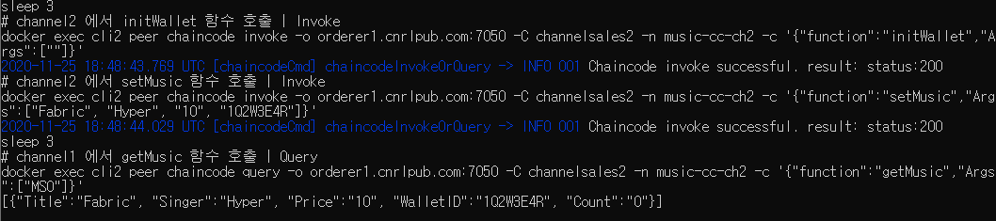
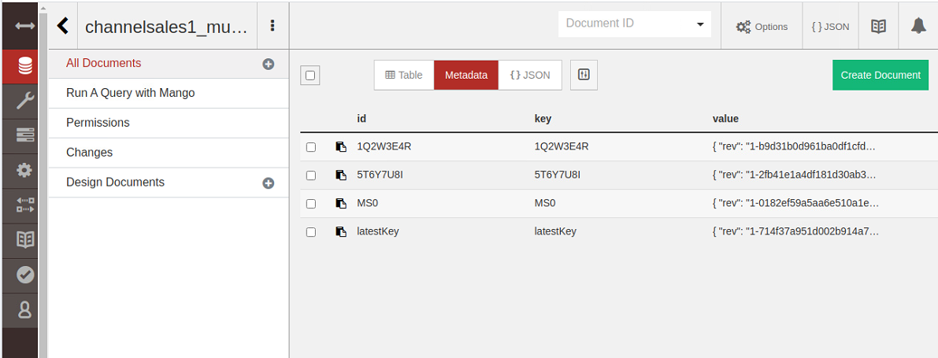
2. 체인코드 실행 및 테스트

Slide 42
4. CA 서버 구성

Slide 43
4. 하이퍼레저 패브릭 SDK
Client
Server
(Node.js Web)
SDK
(Node.js)
gRPC
Hyperledger Fabric
Network
Angular JS
Express
cnrlpub.com
Ordering
Service
Node
Fabric
Client
Fabric
CA Server
API
channel1
channel2
Sales1 org
Customer org
Sales2 org
peer0
peer1
peer0
peer1
peer0
peer1

Slide 44
4. npm 라이브러리 설치 및 디렉터리 구성
$ cd $GOPATH/src/stream-music
$ mkdir –p application/sdk && application/sdk
$ touch enrollAdmin.js
$ touch registUser.js
$ cd $GOPATH/src/stream-music/application
$ touch pakage.json
$ code pakage.json
{
"name": "fabric-acorn-music",
"version": "1.0.0",
"description": "Hyperledger Fabric CNRL Music Application",
"main": "server.js",
"dependencies": {
"fabric-ca-client": "^1.4.0",
"fabric-client": "^1.4.0",
"fabric-network": "~1.4.0",
"grpc": "^1.9.1",
"express": "latest",
"body-parser": "latest",
"ejs": "latest",
"angular": "^1.4.3"
},
"license": "Apache-2.0",
"keywords": [
"Hyperledger",
"Fabric",
“CNRL",
"Music",
"Application"
]
}
$ npm install --save

Slide 45
4. connection.json
cd $GOPATH/src/stream-music/basic-network/
touch docker-compose-ca.yaml && code docker-compose-ca.yaml
version: '2'
networks:
cnrl:
services:
ca.sales1.cnrlpub.com:
image: hyperledger/fabric-ca
environment:
- FABRIC_CA_HOME=/etc/hyperledger/fabric-ca-server
- FABRIC_CA_SERVER_CA_NAME=ca.sales1.cnrlpub.com
- FABRIC_CA_SERVER_CA_CERTFILE=/etc/hyperledger/fabric-ca-server-config/ca.sales1.cnrlpub.com-cert.pem
- FABRIC_CA_SERVER_CA_KEYFILE=/etc/hyperledger/fabric-ca-server-config/ae3fe9e3dabbaf5dcde7a243d04059f0efad66b89369726734846064a02d9fba_sk
ports:
- "7054:7054"
command: sh -c 'fabric-ca-server start -b admin:adminpw -d'
volumes:
- ./crypto-config/peerOrganizations/sales1.cnrlpub.com/ca/:/etc/hyperledger/fabric-ca-server-config
container_name: ca.sales1.cnrlpub.com
networks:
- cnrl
ca.sales2.cnrlpub.com:
image: hyperledger/fabric-ca
environment:
- FABRIC_CA_HOME=/etc/hyperledger/fabric-ca-server
- FABRIC_CA_SERVER_CA_NAME=ca.sales2.cnrlpub.com
- FABRIC_CA_SERVER_CA_CERTFILE=/etc/hyperledger/fabric-ca-server-config/ca.sales2.cnrlpub.com-cert.pem
- FABRIC_CA_SERVER_CA_KEYFILE=/etc/hyperledger/fabric-ca-server-config/bb87f1760b65aba79771bef2d0aaf0aa46e2a3c311f6c6181b781fd79d23daad_sk
ports:
- "8054:7054"
command: sh -c 'fabric-ca-server start -b admin:adminpw -d'
volumes:
- ./crypto-config/peerOrganizations/sales2.cnrlpub.com/ca/:/etc/hyperledger/fabric-ca-server-config
container_name: ca.sales2.cnrlpub.com
networks:
- cnrl
$GOPATH/go/src/stream-music-2/basic-network/crypto-config/peerOrganizations/sales1.cnrlpub.com/ca/

Slide 46
4. connection.json
cd $GOPATH/src/stream-music/application
touch connection.json && code connection.json
CA서버에 관리자와 사용자를 등록
{
"name": "basic-network",
"version": "1.0.0",
"client": {
"organization": "Sales1",
"connection": {
"timeout": {
"peer": {
"endorser": "300"
},
"orderer": "300"
}
}
},
"channels": {
"channelsales1": {
"orderers": [
"orderer1.cnrlpub.com"
],
"peers": {
"peer0.sales1.cnrlpub.com": {}
}
}
},
"organizations": {
"Sales1": {
"mspid": "Sales1Org",
"peers": [
"peer0.sales1.cnrlpub.com"
],
"certificateAuthorities": [
"ca.sales1.cnrlpub.com"
],
"adminPrivateKey": {
"path":"../../basic-network/crypto-config/peerOrganizations/sales1.cnrlpub.com/users/Admin@sales1.cnrlpub.com/msp/keystore/dfdb455c0659ab1101e576706f7889bc6504087fa3a3ee2e3a02a8e68cc2995c_sk"
},
"signedCert":{
"path":"../../basic-network/crypto-config/peerOrganizations/sales1.cnrlpub.com/users/Admin@sales1.cnrlpub.com/msp/signcerts/Admin@sales1.cnrlpub.com-cert.pem"
}
}
},
$GOPATH/go/src/stream-music-2/basic-network/crypto-config
/peerOrganizations/sales1.cnrlpub.com/users/Admin@sales1.cnrlpub.com/msp/keystore/

Slide 47
4. connection.json
"orderers": {
"orderer1.cnrlpub.com": {
"url": "grpc://localhost:7050",
"grpcOptions":{
"ssl-target-name-override":"orderer1.cnrlpub.com",
"grpc-max-send-message-length": -1
},
"tlsCACerts": {
"path": "../../basic-network/crypto-config/ordererOrganizations/cnrlpub.com/orderers/orderer1.cnrlpub.com/msp/tlscacerts/tlsca.cnrlpub.com-cert.pem"
}
}
},
"peers": {
"peer0.sales1.cnrlpub.com": {
"url": "grpc://localhost:7051",
"tlsCACerts": {
"path": "../../basic-network/crypto-config/peerOrganizations/sales1.cnrlpub.com/peers/peer0.sales1.cnrlpub.com/msp/tlscacerts/tlsca.sales1.cnrlpub.com-cert.pem"
},
"grpcOptions": {
"ssl-target-name-override": "peer1.sales1.cnrlpub.com",
"hostnameOverride": "peer1.sales1.cnrlpub.com"
}
}
},
"certificateAuthorities": {
"ca.sales1.cnrlpub.com": {
"url": "http://localhost:7054",
"caName": "ca.sales1.cnrlpub.com",
"tlsCACerts": {
"path": "../../basic-network/crypto-config/peerOrganizations/sales1.cnrlpub.com/ca/ca.sales1.cnrlpub.com-cert.pem"
},
"registrar":{
"enrollId": "admin",
"enrollSecret": "adminpw",
"caName": "casales1"
},
"httpOptions": {
"verify": false
}
}
}
}

Slide 48
4. enrollAdmin.js
cd $GOPATH/src/stream-music/application/sdk
code enrollAdmin.js
등록된 admin 사용자의 인증서를 .hfc-key-customer 디렉터리에 발급한다.
'use strict';
const FabricCAServices = require('fabric-ca-client');
const { FileSystemWallet, X509WalletMixin } = require('fabric-network');
const fs = require('fs');
const path = require('path');
const ccpPath = path.resolve(__dirname, '..', 'connection.json');
const ccpJSON = fs.readFileSync(ccpPath, 'utf8');
const ccp = JSON.parse(ccpJSON);
console.log(ccp.certificateAuthorities['ca.sales1.cnrlpub.com']);
async function main() {
try {
const caInfo = ccp.certificateAuthorities['ca.sales1.cnrlpub.com'];
const caTLSCACerts = caInfo.tlsCACerts.pem;
const ca = new FabricCAServices(caInfo.url, { trustedRoots: caTLSCACerts, verify: false }, caInfo.caName);
const walletPath = path.join(process.cwd(), '..', 'wallet');
const wallet = new FileSystemWallet(walletPath);
console.log(`Wallet path: ${walletPath}`);
const adminExists = await wallet.exists('admin');
if (adminExists) {
console.log('An identity for the admin user "admin" already exists in the wallet');
return;
}
const enrollment = await ca.enroll({ enrollmentID: 'admin', enrollmentSecret: 'adminpw' });
const identity = X509WalletMixin.createIdentity('Sales1Org', enrollment.certificate, enrollment.key.toBytes());
await wallet.import('admin', identity);
console.log('Successfully enrolled admin user "admin" and imported it into the wallet');
} catch (error) {
console.error(`Failed to enroll admin user "admin": ${error}`);
process.exit(1);
}
}
main();

Slide 49
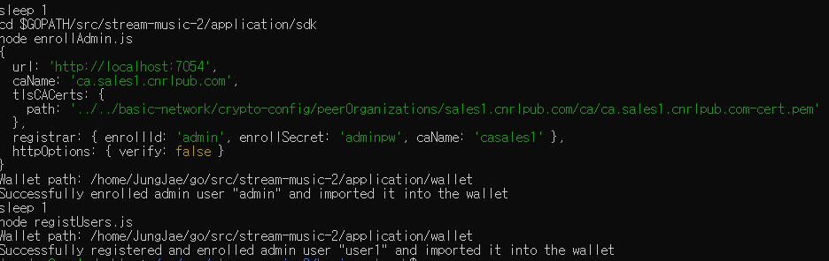
4. enrollAdmin.js
실행 후 다음과 같이 등록됐다는 메시지와 함께 인증서가 로그로 출력 된다.
인증서가 발급되면 admin 관리자가 SDK를 통해 CA 서버에 정상적으로 등록됐음을 의미한다.

Slide 50
4. registUser.js
cd $GOPATH/src/stream-music/application
code registUser.js
user1 사용자를 생성하고 신원등록
'use strict';
const { FileSystemWallet, Gateway, X509WalletMixin } = require('fabric-network');
const path = require('path');
const ccpPath = path.resolve(__dirname, '..', 'connection.json');
async function main() {
try { const walletPath = path.join(process.cwd(), '..', 'wallet');
const wallet = new FileSystemWallet(walletPath);
console.log(`Wallet path: ${walletPath}`);
const userExists = await wallet.exists('user1');
if (userExists) {
console.log('An identity for the user "user1" already exists in the wallet');
return;
}
const adminExists = await wallet.exists('admin');
if (!adminExists) {
console.log('An identity for the admin user "admin" does not exist in the wallet');
console.log('Run the enrollAdmin.js application before retrying');
return;
}
const gateway = new Gateway();
await gateway.connect(ccpPath, { wallet, identity: 'admin', discovery: { enabled: true, asLocalhost: true } });
const ca = gateway.getClient().getCertificateAuthority();
const adminIdentity = gateway.getCurrentIdentity();
const secret = await ca.register({ affiliation: 'org1.department1', enrollmentID: 'user1', role: 'client' }, adminIdentity);
const enrollment = await ca.enroll({ enrollmentID: 'user1', enrollmentSecret: secret });
const userIdentity = X509WalletMixin.createIdentity('Sales1Org', enrollment.certificate, enrollment.key.toBytes());
await wallet.import('user1', userIdentity);
console.log('Successfully registered and enrolled admin user "user1" and imported it into the wallet');
} catch (error) {
console.error(`Failed to register user "user1": ${error}`);
process.exit(1);
}
}
main();

Slide 51
4. registUser.js
user1 사용자를 생성하고 신원등록하기 위한 파일
실행 후 다음과 같이 user1 사용자 신원정보가 등록된것을 확인할 수 있다.

Slide 52
4. server.js 생성
Express를 이용해서 MVC 모델 개발 한다.
$ cd $GOPATH/src/stream-music/application/
$ mkdir server && mkdir client
$ cd server
$ touch server.js
$ touch controller.js
$ touch sdk.js
$ code server.js
var express = require('express');
var app = express();
var bodyParser = require('body-parser');
var http = require('http')
var fs = require('fs');
var Fabric_Client = require('fabric-client');
var path = require('path');
var util = require('util');
var os = require('os');
app.use(bodyParser.urlencoded({ extended: true }));
app.use(bodyParser.json());
var app = express();
require('./controller.js')(app); //REST API
app.use(express.static(path.join(__dirname, '../client')));
var port = process.env.PORT || 8000;
app.listen(port,function(){
console.log("접속 포트: " + port);
});

Slide 53
4. controller.js 생성
controller.js 에서 REST API로 요청된 값에 따라 해당 체인코드를 호출하는 컨트롤러 기능
var sdk = require('./sdk.js');
module.exports = function(app){
app.get('/api/getWallet', function (req, res) { //query
var walletid = req.query.walletid;
let args = [walletid];
sdk.send(false, 'getWallet', args, res);
}); app.get('/api/setWallet', function(req, res){ //invoke
var name = req.query.name;
var id = req.query.id;
var coin = req.query.coin;
let args = [name, id, coin];
sdk.send(true, 'setWallet', args, res);
}); app.get('/api/getMusic', function(req, res){ //query
var musickey = req.query.musickey;
let args = [musickey];
sdk.send(false, 'getMusic', args, res);
});
app.get('/api/setMusic', function (req, res) { //invoke
var title = req.query.title;
var singer = req.query.singer;
var price = req.query.price;
var walletid = req.query.walletid;
let args = [title, singer, price, walletid];
sdk.send(true, 'setMusic', args, res);
});
app.get('/api/getAllmusic', function (req, res) { //query
let args = [];
sdk.send(false, 'getAllMusic', args, res);
}); app.get('/api/purchaseMusic', function (req, res) { //invoke
var walletid = req.query.walletid;
var musickey = req.query.musickey;
let args = [walletid, musickey];
sdk.send(true, 'purchaseMusic', args, res);
}); app.get('/api/changeMusicPrice', function(req, res){ //invoke
var musickey = req.query.musickey;
var price = req.query.price;
let args = [musickey, price];
sdk.send(true, 'changeMusicPrice', args, res);
}); app.get('/api/deleteMusic', function(req, res){ //invoke
var musickey = req.query.musickey;
let args = [musickey];
sdk.send(true, 'deleteMusic', args, res);
});
}

Slide 54
4. sdk.js 생성
원장을 업데이트하는 invoke 함수와 원장을 조회 검색하는 query 함수 작성
$ cd $GOPATH/src/stream-music/application/server
$ code sdk.js
'use strict';
const { FileSystemWallet, Gateway } = require('fabric-network');
var path = require('path');
const ccpPath = path.resolve(__dirname, '..', 'connection.json');
async function send(type, func, args, res){
try {
const walletPath = path.join(process.cwd(), '..', 'wallet');
const wallet = new FileSystemWallet(walletPath);
console.log(`Wallet path: ${walletPath}`);
const userExists = await wallet.exists('user1');
if (!userExists) {
console.log('An identity for the user "user1" does not exist in the wallet');
console.log('Run the registUser.js application before retrying');
return;
}
const gateway = new Gateway();
await gateway.connect(ccpPath, { wallet, identity: 'user1', discovery: { enabled: true, asLocalhost: true } });
const network = await gateway.getNetwork('channelsales1');
const contract = network.getContract('music-cc-ch1');
if(type){
await contract.submitTransaction(func, ...args);
console.log('Transaction has been submitted');
await gateway.disconnect();
res.send('success');
}else{
const result = await contract.evaluateTransaction(func, ...args);
console.log(`Transaction has been evaluated, result is: ${result.toString()}`);
res.send(result.toString());
}
} catch (error) {
console.error(`Failed to submit transaction: ${error}`);
res.send(`Failed to submit transaction: ${error}`);
}
}
module.exports = {
send:send
}

Slide 55
4. AngularJS로 front end 구축
$ cd $GOPATH/src/stream-music/application/client
$ touch index.html
$ touch app.js
$ code index.html
<!DOCTYPE html>
<html>
<head>
<title>Hyperledger Fabric Music Application</title>
<link rel="stylesheet" href="https://maxcdn.bootstrapcdn.com/bootstrap/3.3.7/css/bootstrap.min.css">
<script src="https://ajax.googleapis.com/ajax/libs/jquery/3.2.0/jquery.min.js"></script>
<script src="https://maxcdn.bootstrapcdn.com/bootstrap/3.3.7/js/bootstrap.min.js"></script>
<script src="https://ajax.googleapis.com/ajax/libs/angularjs/1.4.3/angular.min.js"></script>
<style type="text/css">
header{
background-color: lightgray;
font-size:20px;
padding:20px;
}
header, .form-group{
margin-bottom: 3%;
}
.form-group{
width:50%;
}
#body{
margin-left:3%;
margin-right:3%;
}
.form-control{
margin: 8px;
}
#right_header{
width:20%;
font-size:15px;
margin-right:0px;
}
#left_header{
margin-left:0;
width:40%;
display:inline-block;
}
#id {
width:49%;
display: inline-block;
}
table {
font-family: arial, sans-serif;
border-collapse: collapse;
width: 100%;
}
td, th {
border: 1px solid #dddddd;
text-align: left;
padding: 8px;
}
tr:nth-child(even) {
background-color: #dddddd;
}

Slide 56
4. AngularJS로 front end 구축
</style>
</head>
<body ng-app="application" ng-controller="AppCtrl">
<header>
<div id="left_header">Hyperledger Fabric CNRL Music Application</div>
</header>
<div id="body">
<div class="form-group">
<h5 style="color:blue;margin-bottom:2%" id="success_getwallet">{{search_wallet}}</h5>
<label>Search Wallet</label>
<p><input class="form-control" type="text" placeholder="Ex: 1Q2W3E4R" ng-model="walletid">
<input id="getWallet" type="submit" value="Search" class="btn btn-primary" ng-click="getWallet()"></p>
</div>
<div class="form-group">
<h5 style="color:blue;margin-bottom:2%" id="success_getmusic">Success to query</h5>
<label>Search Music</label>
<p><input class="form-control" type="text" placeholder="Ex: MS1" ng-model="musickey">
<input id="getMusic" type="submit" value="Search" class="btn btn-primary" ng-click="getMusic()"></p>
<p><input id="getAllMusic" type="submit" value="Get all music" class="btn btn-primary" ng-click="getAllMusic()"></p>
</div>
<table id="allMusic" class="table" align="center">
<tr>
<th>ID</th>
<th>Title</th>
<th>Singer</th>
<th>Price</th>
<th>Owner</th>
<th>Count</th>
<th>Buy</th>
</tr>
<tr ng-repeat="music in allMusic">
<td>{{music.Key}}</td>
<td>{{music.title}}</td>
<td>{{music.singer}}</td>
<td>{{music.price}}</td>
<td>{{music.walletid}}</td>
<td>{{music.count}}</td>
<td><input id="purchaseMusic" type="submit" value="구매"

Slide 57
4. AngularJS로 front end 구축
ng-click="purchaseMusic(music.Key)"></td>
</tr>
<h5 style="color:blue;margin-bottom:2%" id="success_getallmusic">{{purchase_music}}</h5>
</table>
<div class="form-group">
<label>Create Music</label>
<h5 style="color:blue;margin-bottom:2%" id="success_setmusic">{{create_music}}</h5>
<br>
Title: <input class="form-control" type="text" placeholder="Ex: Fabric" ng-model="music.title">
Singer: <input class="form-control" type="text" placeholder="Ex: Hyper" ng-model="music.singer">
Price: <input class="form-control" type="text" placeholder="Ex: 20" ng-model="music.price">
Owner: <input class="form-control" type="text" placeholder="Ex: 5T6Y7U8I" ng-model="music.walletid">
<input id="setMusic" type="submit" value="Create" class="btn btn-primary" ng-click="setMusic()">
</div>
<div class="form-group">
<label>Change Music Price</label>
<h5 style="color:blue;margin-bottom:2%" id="success_changemusicprice">{{change_music_price}}</h5>
<br>
Key: <input class="form-control" type="text" placeholder="Ex: MS0" ng-model="change.musickey">
Price<input class="form-control" type="text" placeholder="Ex: 10" ng-model="change.price">
<input id="changeMusicPrice" type="submit" value="Change" class="btn btn-primary" ng-click="changeMusicPrice()">
</div>
<div class="form-group">
<label>DeleteMusic</label>
<h5 style="color:blue;margin-bottom:2%" id="success_deletemusic">{{delete_music}}</h5>
<p>
Key: <input class="form-control" type="text" placeholder="Ex: MS0" ng-model="musickeydelete">
<input id="deleteMusic" type="submit" value="Delete" class="btn btn-primary" ng-click="deleteMusic()"></p>
</div>
</div>
</body>
<script type="text/javascript" src="app.js"> </script>
</html>

Slide 58
4. AngularJS로 front end 구축
$ code app.js
'use strict';
var app = angular.module('application', []);
app.controller('AppCtrl', function($scope, appFactory){
$("#success_setmusic").hide();
$("#success_getallmusic").hide();
$("#success_getmusic").hide();
$("#success_getwallet").hide();
$("#success_changemusicprice").hide();
$("#success_deletemusic").hide();
$scope.getWallet = function(){
appFactory.getWallet($scope.walletid, function(data){
$scope.search_wallet = data;
$("#success_getwallet").show();
});
}
$scope.getAllMusic = function(){
appFactory.getAllMusic(function(data){
var array = [];
for (var i = 0; i < data.length; i++){
parseInt(data[i].Key);
data[i].Record.Key = data[i].Key;
array.push(data[i].Record);
$("#success_getallmusic").hide();
}
array.sort(function(a, b) {
return parseFloat(a.Key) - parseFloat(b.Key);
});
$scope.allMusic = array;
});
}
$scope.getMusic = function(){
appFactory.getMusic($scope.musickey, function(data){
$("#success_getmusic").show();
var array = [];
for (var i = 0; i < data.length; i++){
data[i].Key = $scope.musickey;
data[i].title = data[i].Title;
data[i].singer = data[i].Singer;
data[i].price = data[i].Price;
data[i].walletid = data[i].WalletID;
data[i].count = data[i].Count;
array.push(data[i]);
}
$scope.allMusic = array;
});
}

Slide 59
4. AngularJS로 front end 구축
$scope.setMusic = function(){
appFactory.setMusic($scope.music, function(data){
$scope.create_music = data;
$("#success_setmusic").show();
});
}
$scope.purchaseMusic = function(key){
appFactory.purchaseMusic(key, function(data){
var array = [];
for (var i = 0; i < data.length; i++){
parseInt(data[i].Key);
data[i].Record.Key = data[i].Key;
array.push(data[i].Record);
$("#success_getallmusic").hide();
}
array.sort(function(a, b) {
return parseFloat(a.Key) - parseFloat(b.Key);
});
$scope.allMusic = array;
});
}
$scope.changeMusicPrice = function(){
appFactory.changeMusicPrice($scope.change, function(data){
$scope.change_music_price = data;
$("#success_changemusicprice").show();
});
}
$scope.deleteMusic = function(){
appFactory.deleteMusic($scope.musickeydelete, function(data){
$scope.delete_music = data;
$("#success_deletemusic").show();
});
}
});

Slide 60
4. AngularJS로 front end 구축
app.factory('appFactory', function($http){
var factory = {};
factory.getWallet = function(key, callback){
$http.get('/api/getWallet?walletid='+key).success(function(output){
callback(output)
});
}
factory.getAllMusic = function(callback){
$http.get('/api/getAllMusic/').success(function(output){
callback(output)
});
}
factory.getMusic = function(key, callback){
$http.get('/api/getMusic?musickey='+key).success(function(output){
callback(output)
});
}
factory.setMusic = function(data, callback){
$http.get('/api/setMusic?title='+data.title+'&singer='+data.singer+'&price='+data.price+'&walletid='+data.walletid).success(function(output){
callback(output)
});
}
factory.purchaseMusic = function(key, callback){
$http.get('/api/purchaseMusic?walletid=5T6Y7U8I&musickey='+key).success(function(output){
$http.get('/api/getAllMusic/').success(function(output){
callback(output)
});
});
}
factory.changeMusicPrice = function(data, callback){
$http.get('/api/changeMusicPrice?musickey='+data.musickey+'&price='+data.price).success(function(output){
callback(output)
});
}
factory.deleteMusic = function(key, callback){
$http.get('/api/deleteMusic?musickey='+key).success(function(output){
callback(output)
});
}
return factory;
});

Slide 61
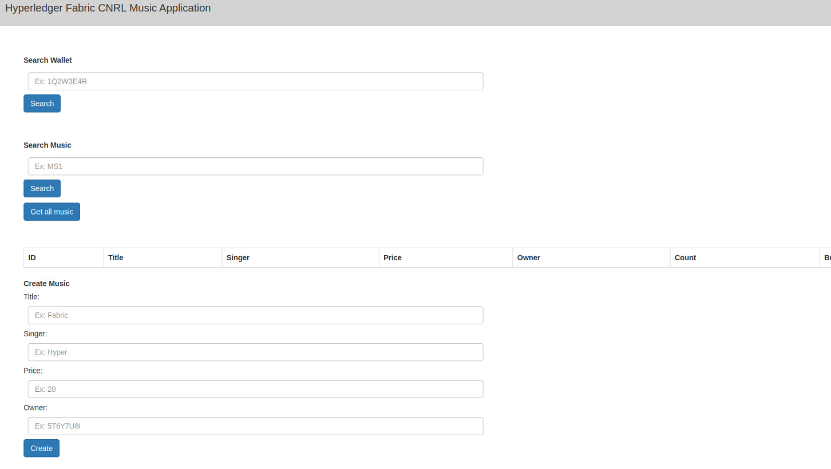
4. 서버 실행 및 테스트
$ cd $GOPATH/src/stream-music/basic-network
$ docker-compose –f docker-compose-ca.yaml up –d ca.saels1.cnrlpub.com
$ cd $GOPATH/src/stream-music/application/sdk
$ node enrollAdmin.js
$ node registUsers.js
$ cd cd ../applicaion/server
$ node server.js
http://localhost:8000/ 접속

Slide 62
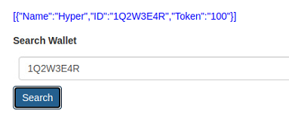
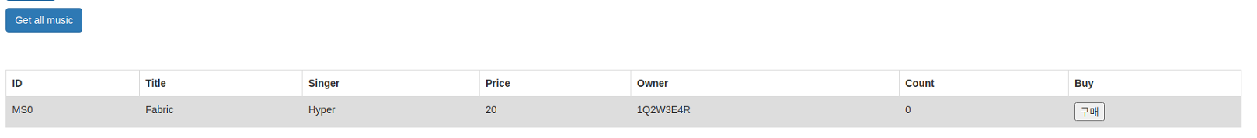

Slide 63
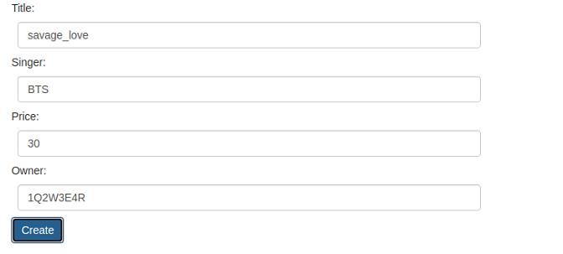
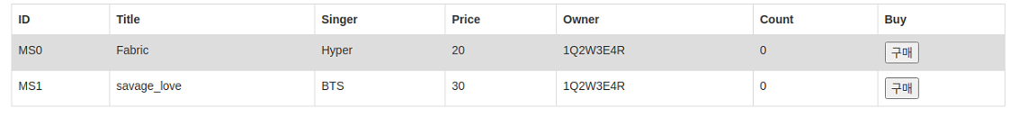

Slide 64
Thank you

