Slide 1
Introduction to Reinforcement Learning
Presenter:
Sepideh Nikookar https://web.njit.edu/~sn627/
Advisor:
Prof. Senjuti Basu Roy
https://web.njit.edu/~senjutib/
Department of Computer Science NJIT
Dec 1, 2022

Slide 2
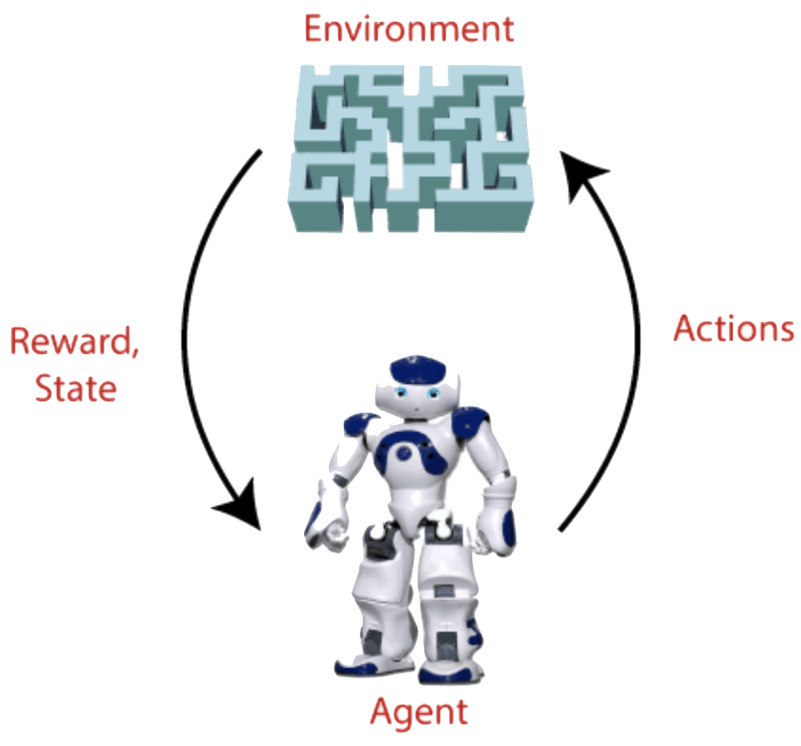
What is Reinforcement Learning?
Reinforcement learning is a type of machine learning method where an intelligent agent interacts with the environment and learns to act within that.
For each good action, the agent gets positive feedback, and for each bad action, the agent gets negative feedback or penalty.
RL solves a specific type of problem where decision making is sequential, and the goal is long-term.
The agent continues doing following three things:
Take action,
change state/remain in the same state
get feedback
By doing these actions, he learns and explores the environment.

Slide 3
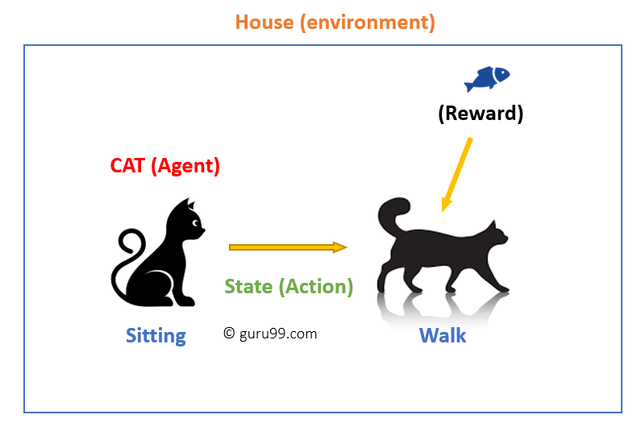
Reinforcement Learning Example
An example of a state could be your cat sitting, and you use a specific word for cat to walk.
Your cat reacts by performing an action transition from one “state” (sitting) to another “state” (walking).
The reaction of your cat is an action, and the policy is a method of selecting an action given a state in expectation of better outcomes.
After the transition, cat may get a reward or penalty in return.

Slide 4
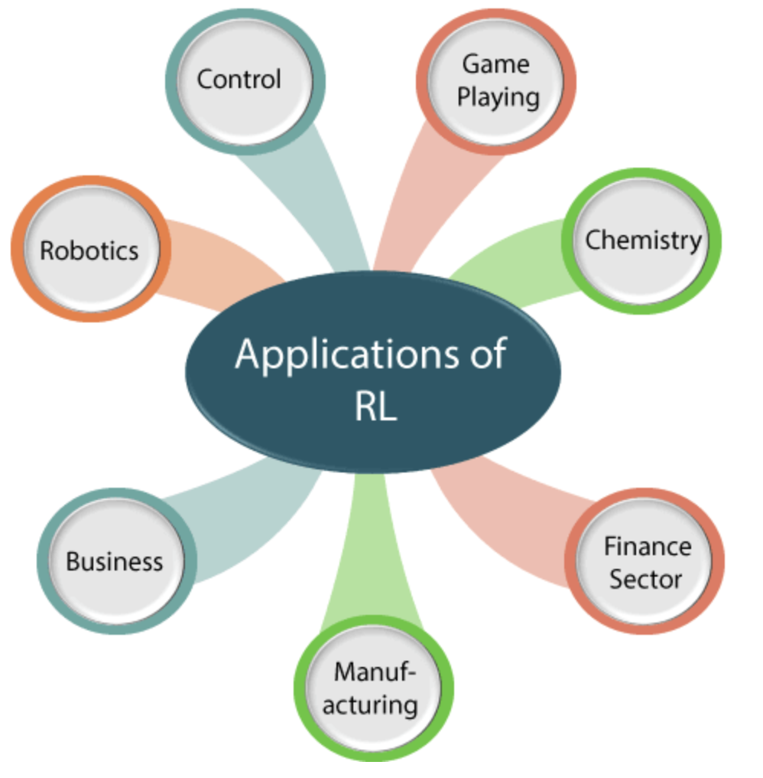
Reinforcement Learning Applications

Slide 5



Supervised vs. Unsupervised vs. Reinforcement Learning
Criteria | Supervised ML | Unsupervised ML | Reinforcement ML
Definition | Learns by using labelled data | Trained using unlabelled data without any guidance. | Works on interacting with the environment
Type of problems | Regression and classification | Association and Clustering | Exploitation or Exploration
Algorithms | Linear Regression, Logistic Regression, SVM, KNN etc. | K – Means, C – Means, Apriori | Q – Learning, SARSA
Aim | Calculate outcomes | Discover underlying patterns | Learn a series of action
Application | Risk Evaluation, Forecast Sales | Recommendation System, Anomaly Detection | Self Driving Cars, Gaming, Healthcare

Slide 6
Term Used in Reinforcement Learning
Agent
An entity that can perceive/explore the environment and act upon it.
Environment
A situation in which an agent is present or surrounded by.
Action
Actions are the moves taken by an agent within the environment.
State
State is a situation returned by the environment after each action taken by the agent.
Reward
A feedback returned to the agent from the environment to evaluate the action of the agent.
Policy
Policy is a strategy applied by the agent for the next action based on the current state.
Value
It is expected long-term retuned with the discount factor and opposite to the short-term reward.

Slide 7
Elements of Reinforcement Learning
There are four main elements of Reinforcement Learning, which are given below
1. Policy:
A policy can be defined as a way how an agent behaves at a given time. It maps the perceived states of the environment to the actions taken on those states.
The policy-based approach has mainly two types of policy:
Deterministic: The same action is produced by the policy (π) at any state.
Stochastic: In this policy, probability determines the produced action.
2. Reward Signal: The goal of RL is defined by the reward signal. Reward signals are given according to the good and bad actions taken by the learning agent. The main objective is to maximize the total number of rewards for good actions.
3. Value Function: Gives information about how good the situation and action are and how much reward an agent can expect.
4. Model: Mimics the behavior of the environment.

Slide 8
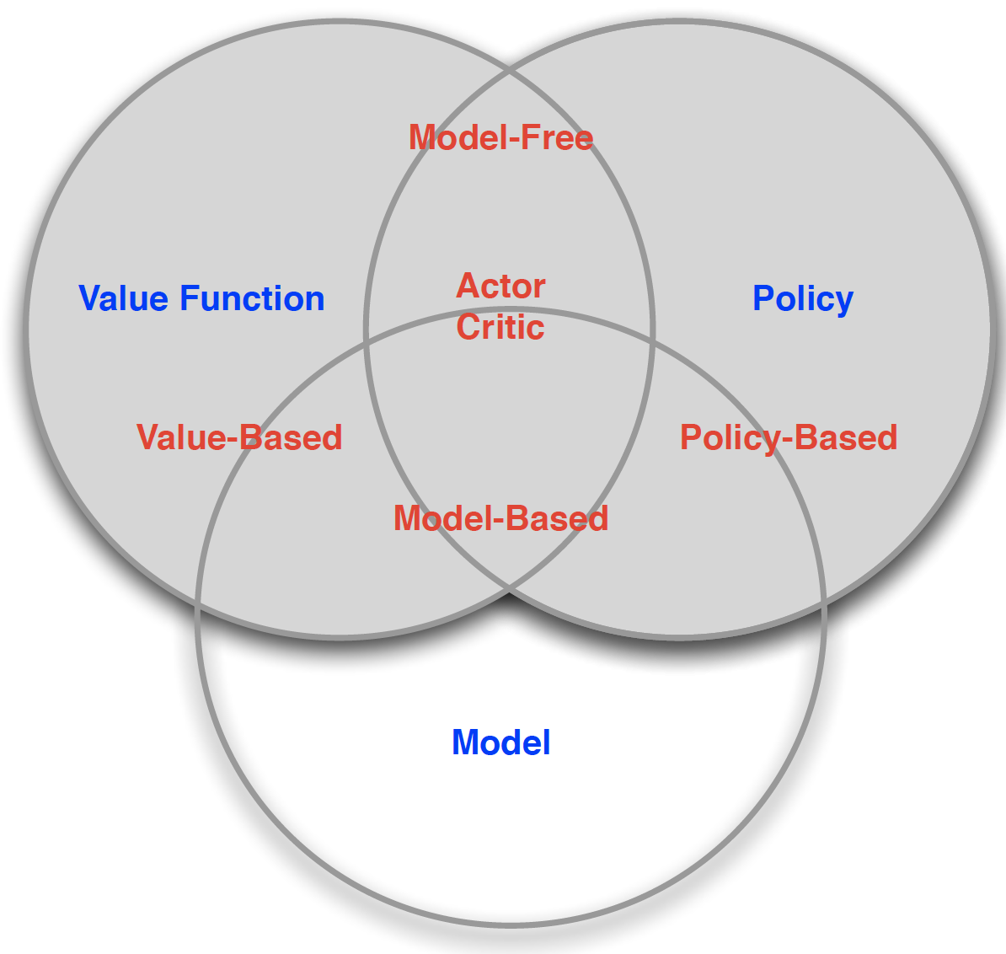
Reinforcement Learning Categories
Value Based
No Policy
Value Function
Policy Based
Policy
No Value Function
Actor Critic
Policy
Value Function
Model Free
Policy and/or Value Function
No Model
Model Based
Policy and/or Value Function
Model
Notes:
1. Value-based:
The value-based approach is about to find the optimal value function, which is the maximum value at a state under any policy. Therefore, the agent expects the long-term return at any state(s) under policy π.
2. Policy-based:
Policy-based approach is to find the optimal policy for the maximum future rewards without using the value function.
The policy-based approach has mainly two types of policy:
Deterministic: The same action is produced by the policy (π) at any state.
Stochastic: In this policy, probability determines the produced action.
3. Model-based:
In this approach, a virtual model is created for the environment, and the agent explores that environment to learn it.

Slide 9
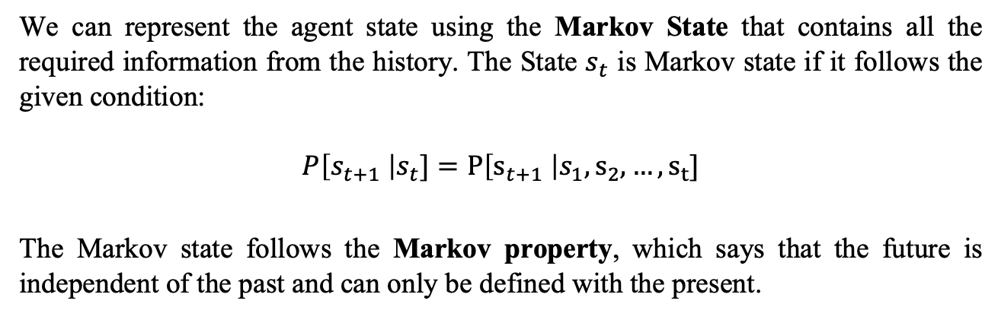
State Representation
We can represent the agent state using the Markov State that contains all the required information from the history. The State $s_{t}$ is Markov state if it follows the given condition:
$$P\left[s_{t+1} \right|s_{t}]=P\left[s_{t+1} \right|s_{1}, s_{2}, …, s_{t}]$$
The Markov state follows the Markov property, which says that the future is independent of the past and can only be defined with the present.
The RL works on fully observable environments, where the agent can observe the environment and act for the new state. The complete process is known as Markov Decision process.

Slide 10
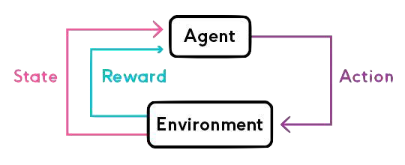
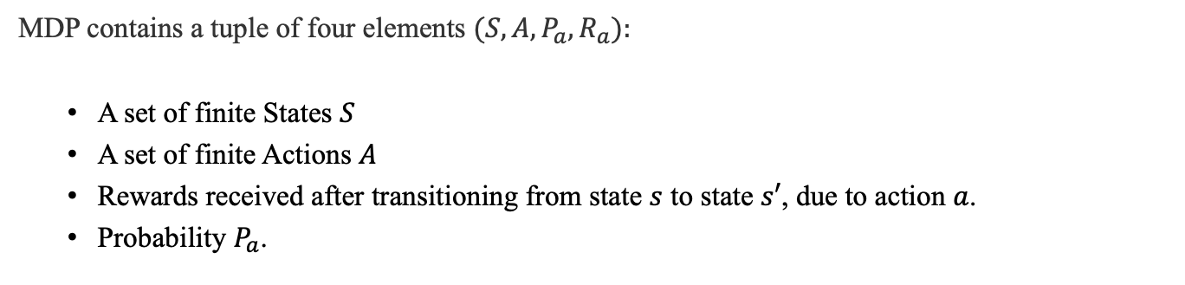
Markov Decision Process
Markov Decision Process or MDP, is used to formalize the Reinforcement Learning problems.
MDP contains a tuple of four elements $(S, A,P_{a}, R_{a}):$
A set of finite States $S$
A set of finite Actions $A$
Rewards received after transitioning from state $s$ to state $s′$, due to action $a$.
Probability $P_{a}$.

Slide 11
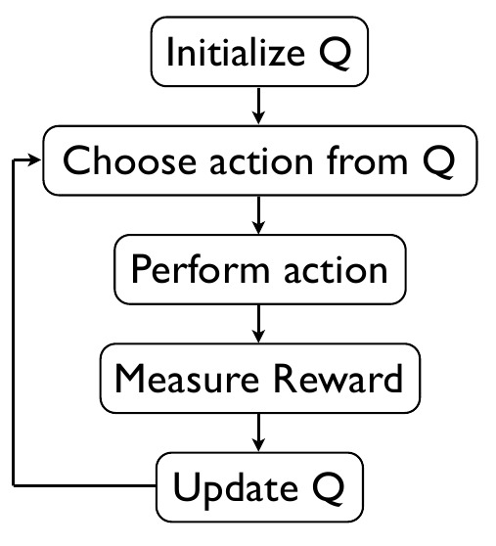
Reinforcement Learning Algorithms
RL algorithms are mainly used in AI applications and gaming applications. The main used algorithm is:
Q-Learning:
Q-learning is a popular model-free Reinforcement Learning algorithm based on the Bellman equation $V\left(s\right)= \max_{a}{(R\left(s, a\right)+γV(s′))}$.
Q-learning is a popular model-free Reinforcement Learning algorithm based on the Bellman equation 𝑉(𝑠)= max_𝑎⁡〖(𝑅(𝑠, 𝑎)+𝛾𝑉(𝑠′))〗.
The main objective of Q-learning is to learn the policy which can inform the agent that what actions should be taken for maximizing the reward under what circumstances.
It is an off-policy RL that attempts to find the best action to take at a current state.
$$Q_{new}\left(s_{t}, a_{t}\right)= Q\left(s_{t}, a_{t}\right)+α × (r_{t} +γ × max_{a} Q(s_{t+1}, a) − Q(s_{t}, a_{t}))$$

Slide 12

Please open your Jupyter Notebook for the hands-on experience .

Slide 13



