Slide 1
Stochastic Gradient Descent and How I Learned to Love the Randomness
William Joseph McCann

Slide 2
Sarge: Simmons was the one that led us to you after he stealthily avoided capture. Grif: Avoided capture!? They knocked him out first and picked me at random! Sarge: Yes. A randomness that Simmons used to save the day!
~Red vs. Blue, Episode 92: Where Credit is Due

Slide 3
Biographical Info
Came to NJIT for undergraduate degree
Double Major in Computer Science and Mathematics, Class of 2020 ( ☹ )
Currently working on Master’s in Data Science on Statistical Track
Working on Thesis Project with Professor Shirokoff
Love the intersection of Mathematics and CS

Slide 4

State of Artificial Intelligence

Slide 5
State of Artificial Intelligence
Modern AI modeling is very reactive
Take in prior data and fit your models to said data
Not a new idea, many of you already familiar

Slide 6
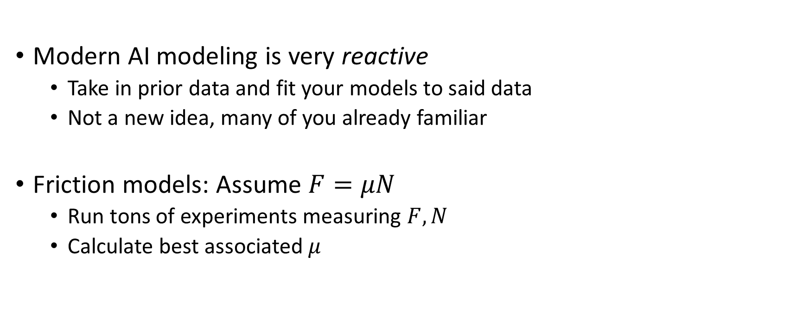
State of Artificial Intelligence
Modern AI modeling is very reactive
Take in prior data and fit your models to said data
Not a new idea, many of you already familiar
Friction models: Assume $F=μN$
Run tons of experiments measuring $F,N$
Calculate best associated $μ$

Slide 7
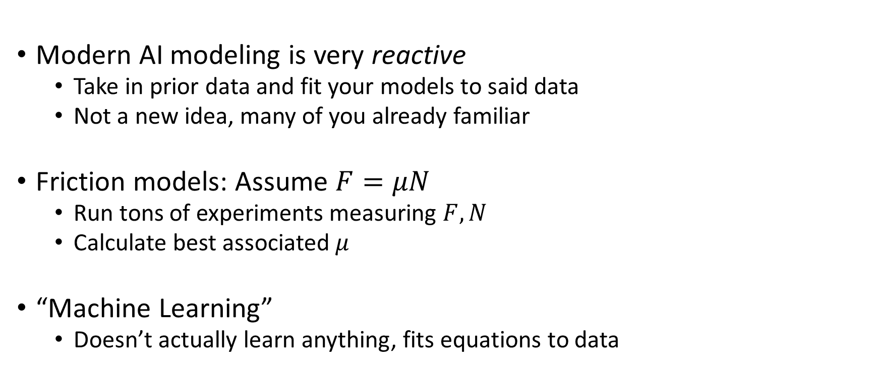
State of Artificial Intelligence
Modern AI modeling is very reactive
Take in prior data and fit your models to said data
Not a new idea, many of you already familiar
Friction models: Assume $F=μN$
Run tons of experiments measuring $F,N$
Calculate best associated $μ$
“Machine Learning”
Doesn’t actually learn anything, fits equations to data

Slide 8
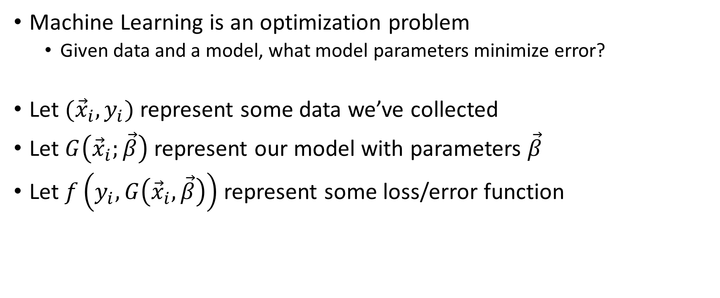
What is Machine Learning?
Machine Learning is an optimization problem
Given data and a model, what model parameters minimize error?
Let $({\vec{x}}_{i},y_{i})$ represent some data we’ve collected
Let $G\left({\vec{x}}_{i};\vec{β}\right)$ represent our model with parameters $\vec{β}$
Let $f\left(y_{i}, G\left({\vec{x}}_{i},\vec{β}\right)\right)$ represent some loss/error function

Slide 9
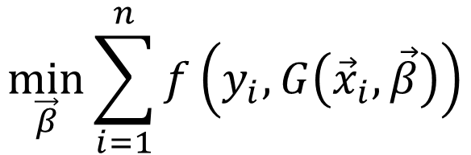
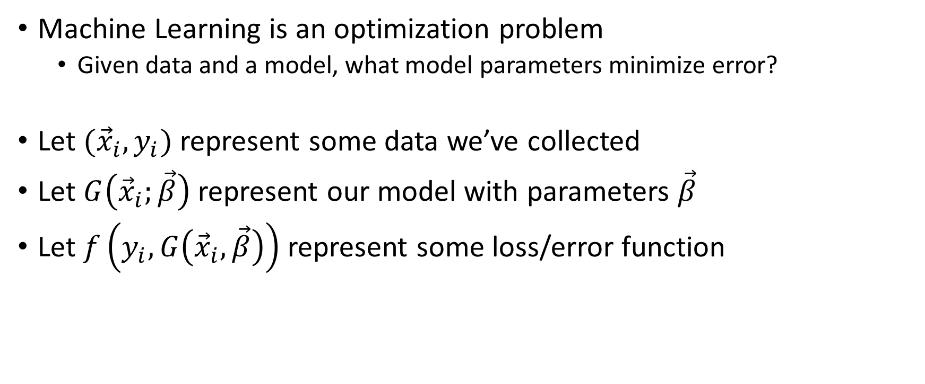
What is Machine Learning?
Machine Learning is an optimization problem
Given data and a model, what model parameters minimize error?
Let $({\vec{x}}_{i},y_{i})$ represent some data we’ve collected
Let $G\left({\vec{x}}_{i};\vec{β}\right)$ represent our model with parameters $\vec{β}$
Let $f\left(y_{i}, G\left({\vec{x}}_{i},\vec{β}\right)\right)$ represent some loss/error function
$$\min_{\vec{β}}{\sum_{i=1}^{n}{f\left(y_{i}, G\left({\vec{x}}_{i},\vec{β}\right)\right)}}$$

Slide 10
Real Example: Linear Regression
Given data points, find a line through them that minimizes error
$$\left(x_{1},y_{1}\right)=\left(0,0\right),\left(x_{2},y_{2}\right)=(1,1)$$

Slide 11

Real Example: Linear Regression
Given data points, find a line through them that minimizes error
$$\left(x_{1},y_{1}\right)=\left(0,0\right),\left(x_{2},y_{2}\right)=(1,1)$$
$$G\left(x_{i};m,b\right)=mx_{i}+b$$

Slide 12
Real Example: Linear Regression
Given data points, find a line through them that minimizes error
$$\left(x_{1},y_{1}\right)=\left(0,0\right),\left(x_{2},y_{2}\right)=(1,1)$$
$$G\left(x_{i};m,b\right)=mx_{i}+b$$
$$f\left(y_{i},G\left(x_{i};m,b\right)\right)={\left(y_{i}−\left(mx_{i}+b\right)\right)}^{2}$$

Slide 13
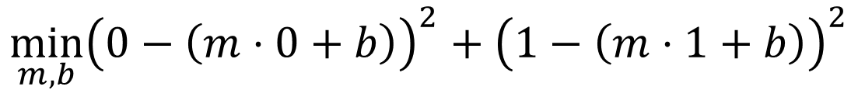
Real Example: Linear Regression
Given data points, find a line through them that minimizes error
$$\left(x_{1},y_{1}\right)=\left(0,0\right),\left(x_{2},y_{2}\right)=(1,1)$$
$$G\left(x_{i};m,b\right)=mx_{i}+b$$
$$f\left(y_{i},G\left(x_{i};m,b\right)\right)={\left(y_{i}−\left(mx_{i}+b\right)\right)}^{2}$$
$$\min_{m,b}{{\left(0−\left(m⋅0+b\right)\right)}^{2}+{\left(1−\left(m⋅1+b\right)\right)}^{2}}$$

Slide 14

Real Example: Linear Regression
Given data points, find a line through them that minimizes error
$$\left(x_{1},y_{1}\right)=\left(0,0\right),\left(x_{2},y_{2}\right)=(1,1)$$
$$G\left(x_{i};m,b\right)=mx_{i}+b$$
$$f\left(y_{i},G\left(x_{i};m,b\right)\right)={\left(y_{i}−\left(mx_{i}+b\right)\right)}^{2}$$
$$\min_{m,b}{{\left(0−\left(m⋅0+b\right)\right)}^{2}+{\left(1−\left(m⋅1+b\right)\right)}^{2}}$$
$$m=1, b=0$$

Slide 15

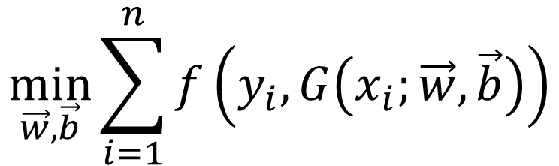
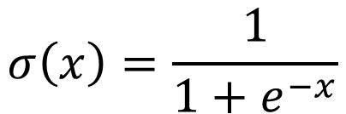
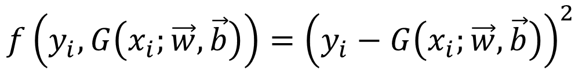
$$\vec{x_{i}}∈ℝ^{2}, y_{i}∈\left[0,1\right]$$
$$G\left({\vec{x}}_{i};\vec{w},\vec{b}\right)=σ\left(w_{5}σ\left(w_{1}x_{1}+w_{2}x_{2}+b_{1}\right)+w_{6}σ\left(w_{3}x_{1}+w_{4}x_{2}+b_{2}\right)+b_{3}\right)$$
$$σ\left(x\right)=\frac{1}{1+e^{−x}}$$
$$f\left(y_{i},G\left(x_{i};\vec{w},\vec{b}\right)\right)={\left(y_{i}−G\left(x_{i};\vec{w},\vec{b}\right)\right)}^{2}$$
$$\min_{\vec{w},\vec{b}}{\sum_{i=1}^{n}{f\left(y_{i},G\left(x_{i};\vec{w},\vec{b}\right)\right)}}$$

Slide 16











$$G\left({\vec{x}}_{i};\vec{w},\vec{b}\right)=σ\left(w_{5}σ\left(w_{1}x_{1}+w_{2}x_{2}+b_{1}\right)+w_{6}σ\left(w_{3}x_{1}+w_{4}x_{2}+b_{2}\right)+b_{3}\right)$$
$$x_{1}$$
$$w_{1}$$
$$b_{1}$$
$$w_{5}$$
$$w_{3}$$
$$b_{3}$$
$$w_{2}$$
$$w_{6}$$
$$w_{4}$$
$$x_{2}$$
$$b_{2}$$

Slide 17
How do we solve these problems?
Tragically, most models have no closed form solution
We need to numerically compute our parameters
Numerical optimization methods?

Slide 18
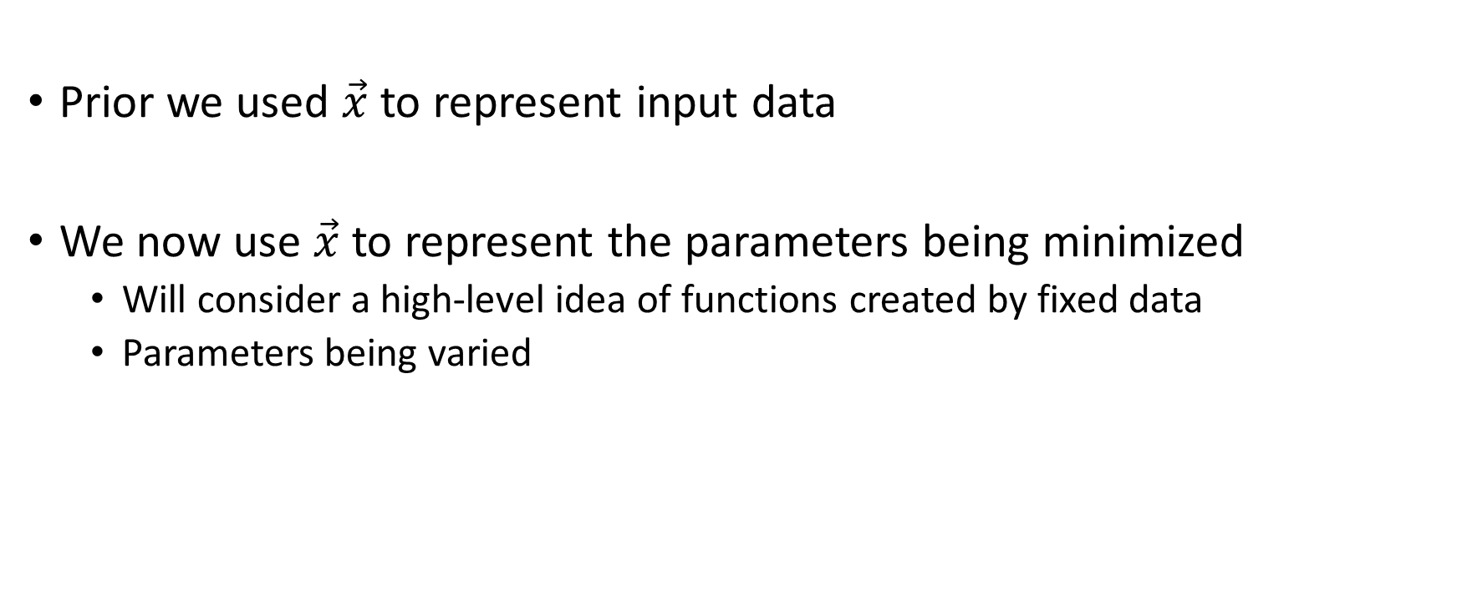
Quick Notation Change
Prior we used $\vec{x}$ to represent input data
We now use $\vec{x}$ to represent the parameters being minimized
Will consider a high-level idea of functions created by fixed data
Parameters being varied

Slide 19
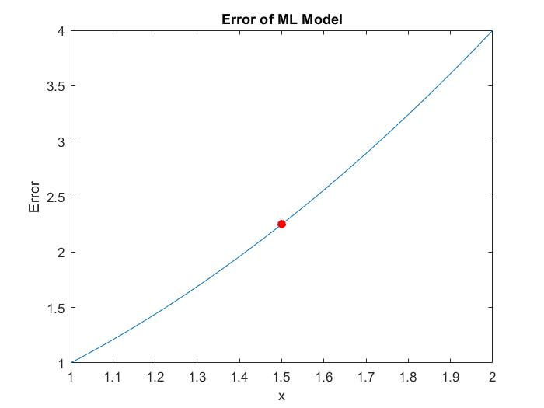

Slide 20
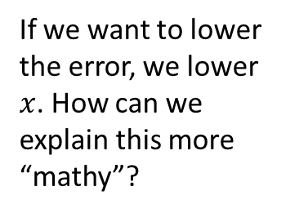
If we want to lower the error, we lower $x$. How can we explain this more “mathy”?

Slide 21
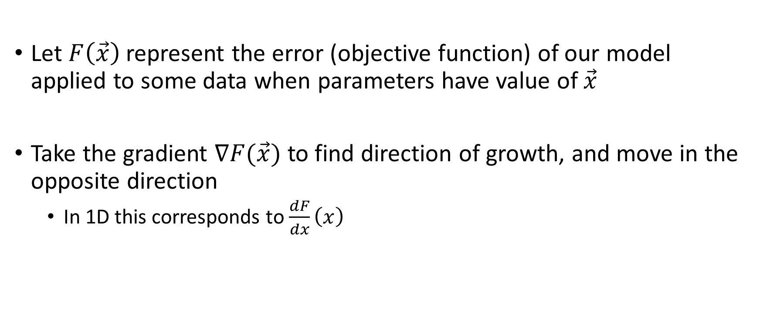
Gradient Descent
Let $F\left(\vec{x}\right)$ represent the error (objective function) of our model applied to some data when parameters have value of $\vec{x}$
Take the gradient $∇F(\vec{x})$ to find direction of growth, and move in the opposite direction
In 1D this corresponds to $\frac{dF}{dx}\left(x\right)$

Slide 22
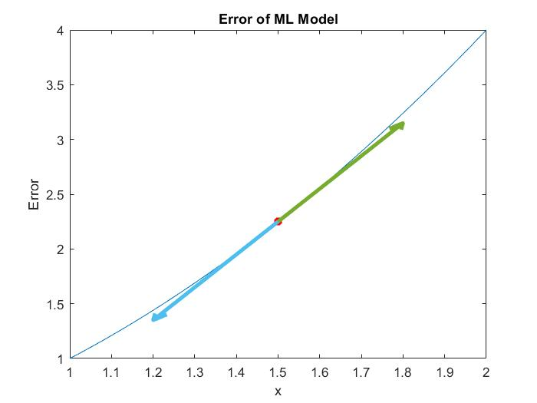

Slide 23
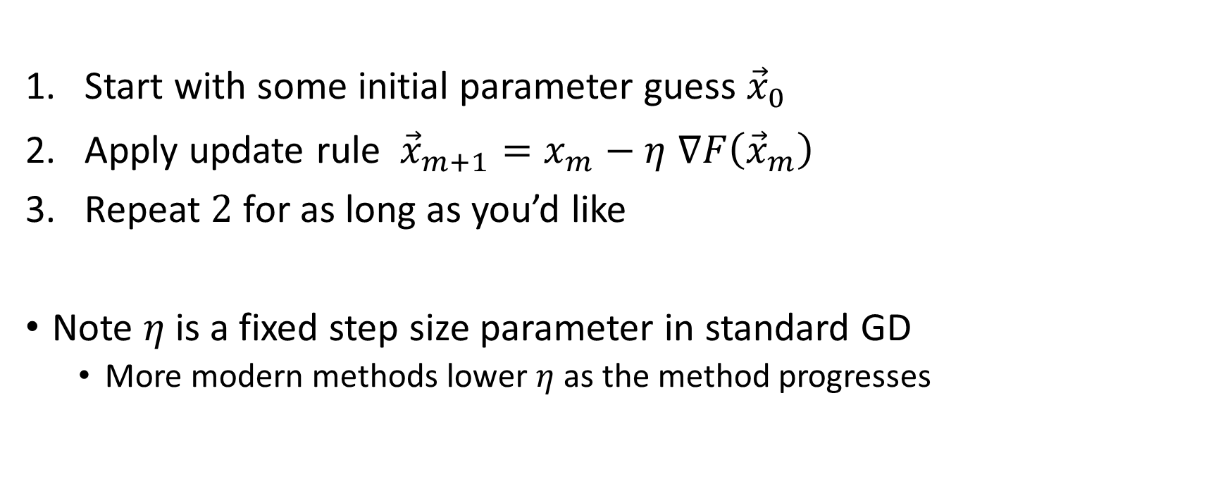
Gradient Descent (GD)
Start with some initial parameter guess ${\vec{x}}_{0}$
Apply update rule ${ \vec{x}}_{m+1}=x_{m}−η$ $∇F\left({\vec{x}}_{m}\right)$
Repeat $2$ for as long as you’d like
Note $η$ is a fixed step size parameter in standard GD
More modern methods lower $η$ as the method progresses

Slide 24
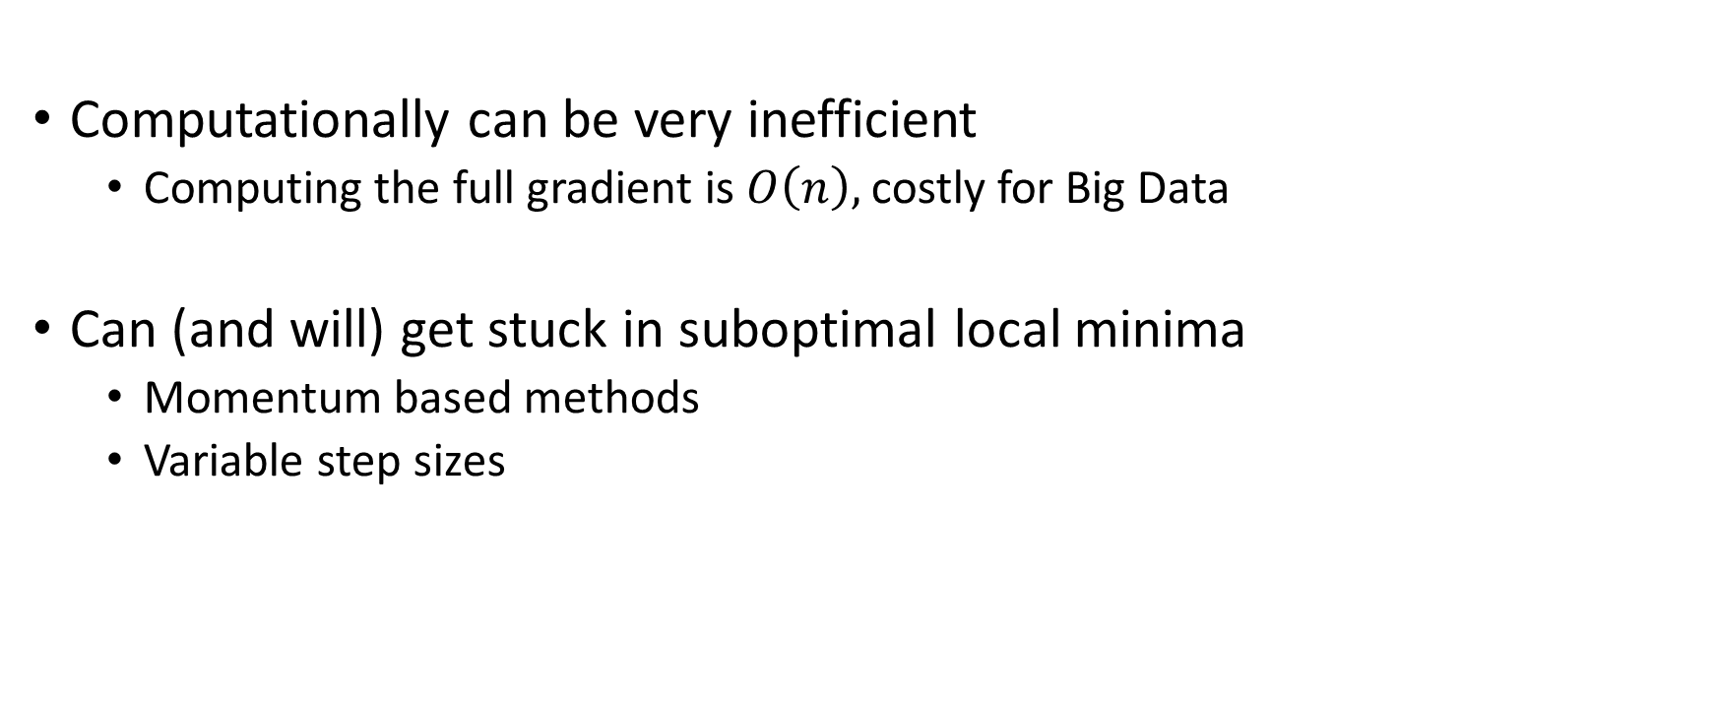
Problems with GD
Computationally can be very inefficient
Computing the full gradient is $O\left(n\right),$costly for Big Data
Can (and will) get stuck in suboptimal local minima
Momentum based methods
Variable step sizes

Slide 25
Stochastic Gradient Descent (SGD)
At each iteration, perform GD on random subset of data
Engineer’s Interpretation
Can drastically cut computational costs
Original reason people used SGD
Has been shown to have other beneficial properties
Prevent overfitting?

Slide 26
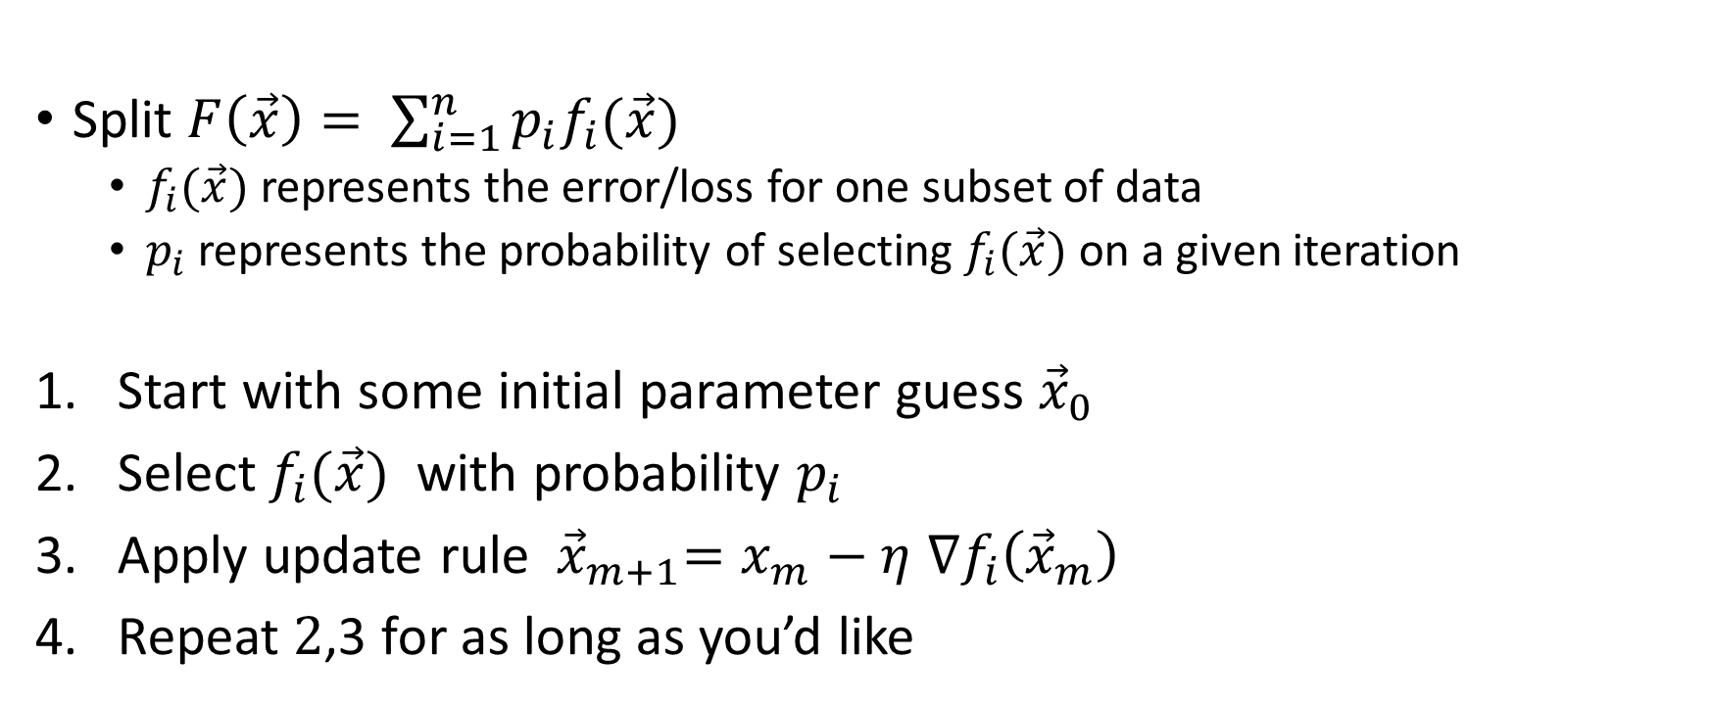
Stochastic Gradient Descent (SGD)
Split $F\left(\vec{x}\right)= \sum_{i=1}^{n}{p_{i}f_{i}(\vec{x})}$
$f_{i}(\vec{x})$ represents the error/loss for one subset of data
$p_{i}$ represents the probability of selecting $f_{i}(\vec{x})$ on a given iteration
Start with some initial parameter guess ${\vec{x}}_{0}$
Select $f_{i}(\vec{x})$ with probability $p_{i}$
Apply update rule ${ \vec{x}}_{m+1}=x_{m}−η$ $∇f_{i}\left({\vec{x}}_{m}\right)$
Repeat $2$,3 for as long as you’d like

Slide 27
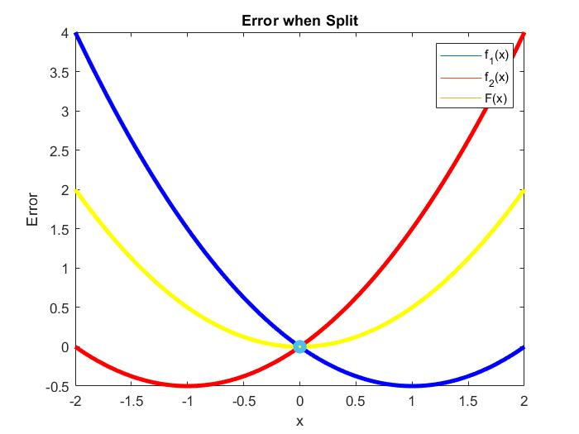

Slide 28
Stochastic Gradient Descent (SGD)
If we are randomly bouncing around every iteration, how do we know where we will end up?

Slide 29
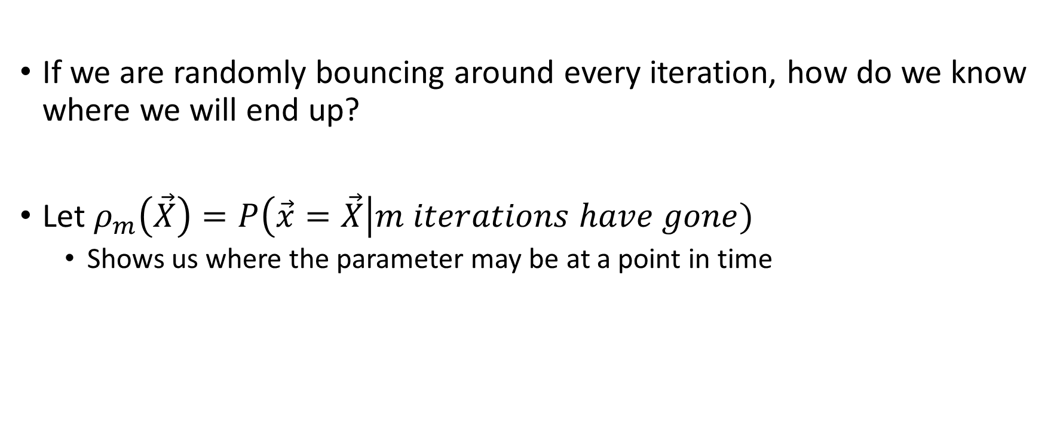
Stochastic Gradient Descent (SGD)
If we are randomly bouncing around every iteration, how do we know where we will end up?
Let $ρ_{m}\left(\vec{X}\right)=P\left(\vec{x}=\vec{X}\right|m iterations have gone)$
Shows us where the parameter may be at a point in time

Slide 30
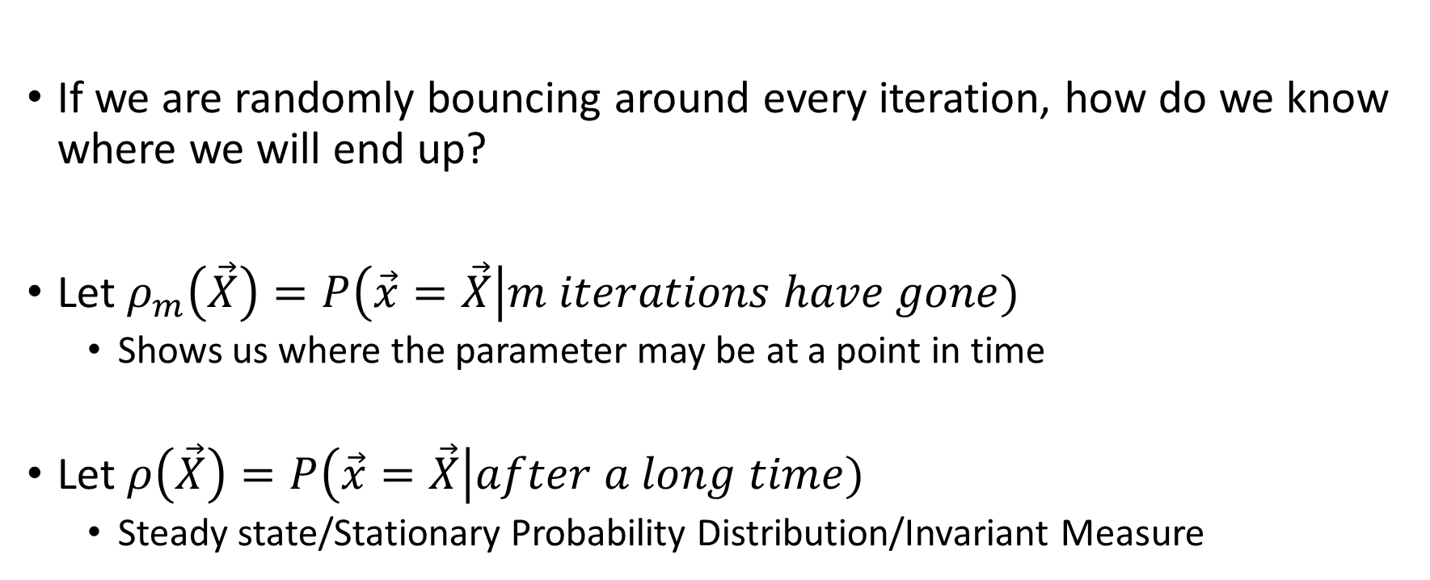
Stochastic Gradient Descent (SGD)
If we are randomly bouncing around every iteration, how do we know where we will end up?
Let $ρ_{m}\left(\vec{X}\right)=P\left(\vec{x}=\vec{X}\right|m iterations have gone)$
Shows us where the parameter may be at a point in time
Let $ρ\left(\vec{X}\right)=P\left(\vec{x}=\vec{X}\right|after a long time)$
Steady state/Stationary Probability Distribution/Invariant Measure

Slide 31



SGD as a Markov Chain
A Markov Chain is a set of rules that update a parameter with probabilities provided
$$2$$
$$1$$
$$3$$

Slide 32
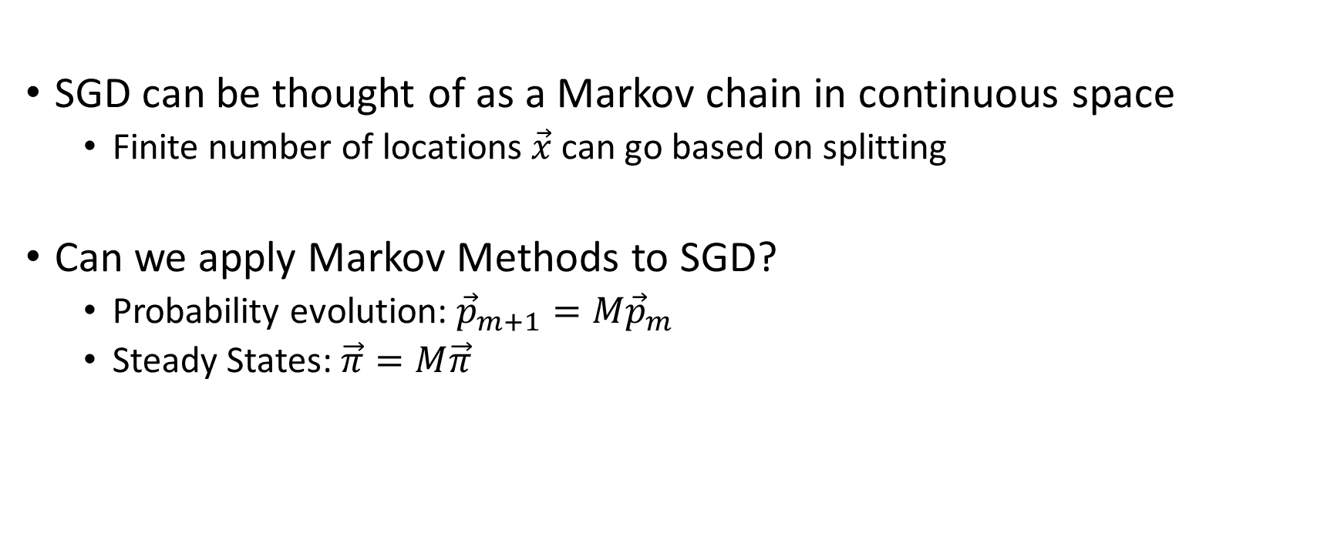
SGD as a Markov Chain
SGD can be thought of as a Markov chain in continuous space
Finite number of locations $\vec{x}$can go based on splitting
Can we apply Markov Methods to SGD?
Probability evolution: ${\vec{p}}_{m+1}=M{\vec{p}}_{m}$
Steady States: $\vec{π}=M\vec{π}$

Slide 33

The Markov Operator
We want an operator $ρ_{m+1}\left(\vec{x}\right)=\left(Pρ_{m}\right)(\vec{x})$

Slide 34

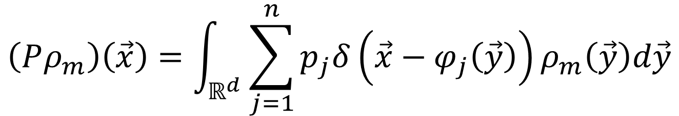
The Markov Operator
We want an operator $ρ_{m+1}\left(\vec{x}\right)=\left(Pρ_{m}\right)(\vec{x})$
Where we state that
$δ\left(\vec{x}\right)$ is the Dirac Delta Function: $0$ everywhere except the origin
$φ_{j}\left(\vec{x}\right)=\vec{x}−η∇f_{j}(\vec{x})$
$$\left(Pρ_{m}\right)\left(\vec{x}\right)=\int_{ℝ^{d}}{\sum_{j=1}^{n}{p_{j}δ\left(\vec{x}−φ_{j}\left(\vec{y}\right)\right)ρ_{m}\left(\vec{y}\right)d\vec{y}}}$$

Slide 35
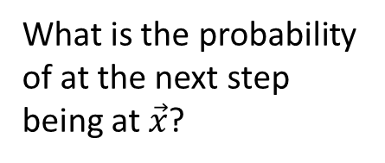
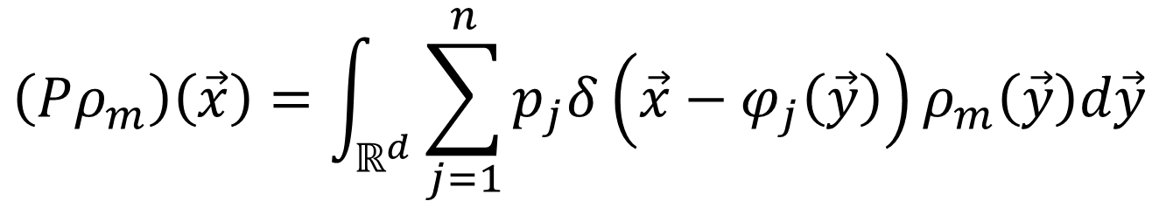
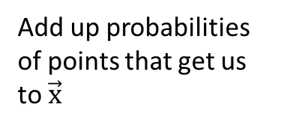
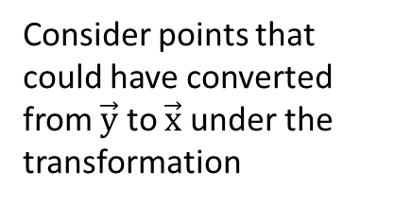
The Markov Operator
$$\left(Pρ_{m}\right)\left(\vec{x}\right)=\int_{ℝ^{d}}{\sum_{j=1}^{n}{p_{j}δ\left(\vec{x}−φ_{j}\left(\vec{y}\right)\right)ρ_{m}\left(\vec{y}\right)d\vec{y}}}$$
What is the probability of at the next step being at $\vec{x}$?
Consider points that could have converted from $\vec{y}$ to $\vec{x}$ under the transformation
Consider every part of the splitting
Continuous, so we integrate over entire parameter space
Add up probabilities of points that get us to $\vec{x}$

Slide 36

The Markov Operator Example
Suppose we want to know $ρ_{10}(3)$

Slide 37

The Markov Operator Example
Suppose we want to know $ρ_{10}(3)$
Suppose that $φ_{1}\left(2\right)=3, φ_{2}\left(1\right)=3$

Slide 38
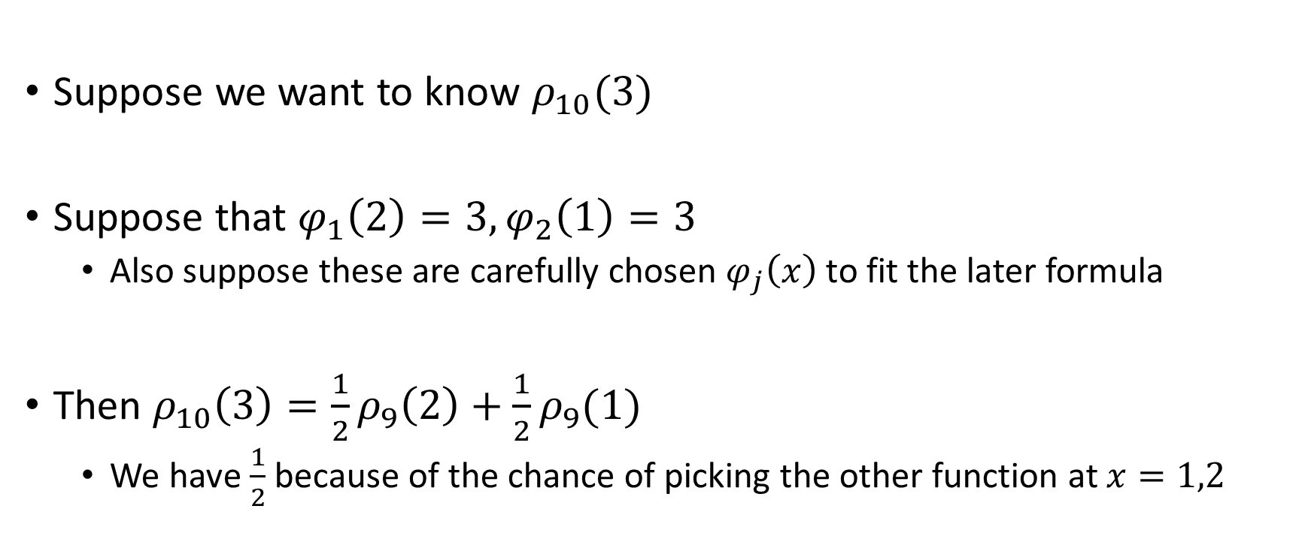
The Markov Operator Example
Suppose we want to know $ρ_{10}(3)$
Suppose that $φ_{1}\left(2\right)=3, φ_{2}\left(1\right)=3$
Also suppose these are carefully chosen $φ_{j}\left(x\right)$ to fit the later formula
Then $ρ_{10}\left(3\right)=\frac{1}{2}ρ_{9}\left(2\right)+\frac{1}{2}ρ_{9}(1)$
We have $\frac{1}{2}$ because of the chance of picking the other function at $x=1,2$

Slide 39

The Markov Operator
We can simplify the operator down to a nicer form for computations
With this formula we can actually find analytic solutions for some steady states
$$ρ_{m+1}\left(\vec{x}\right)=\sum_{j=1}^{n}{p_{j}\sum_{y∈φ^{−1}(\vec{x})}{\frac{ρ_{m}(y)}{\left|φ′(y)\right|}}}$$

Slide 40
The Markov Operator
These formulas are very complicated though
Would be very nice to have a simpler model we could solve

Slide 41
The Markov Operator
These formulas are very complicated though
Would be very nice to have a simpler model we could solve
Looks like its time for PDEs!
ODEs in our case arising from PDE steady states
Skipping derivation for today, will provide detail in my defense presentation
Inner product with smooth test function, integrate by parts, Taylor Expand

Slide 42
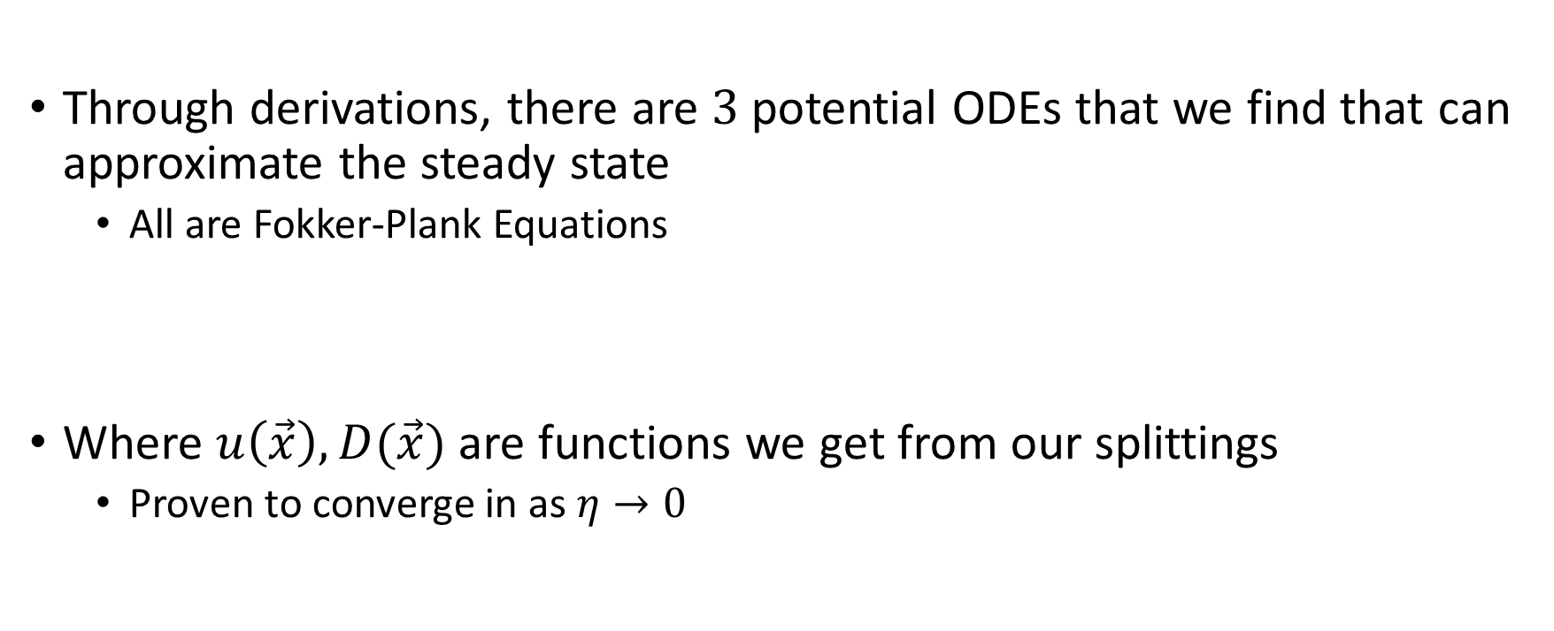
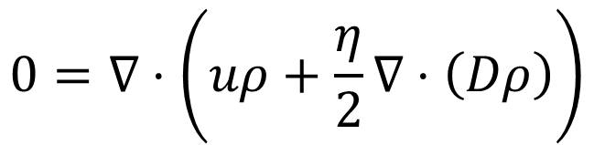
The ODE Approximations
Through derivations, there are $3$ potential ODEs that we find that can approximate the steady state
All are Fokker-Plank Equations
Where $u\left(\vec{x}\right),D(\vec{x})$ are functions we get from our splittings
Proven to converge in as $η→0$
$$0=∇⋅\left(uρ+\frac{η}{2}∇⋅\left(Dρ\right)\right)$$

Slide 43
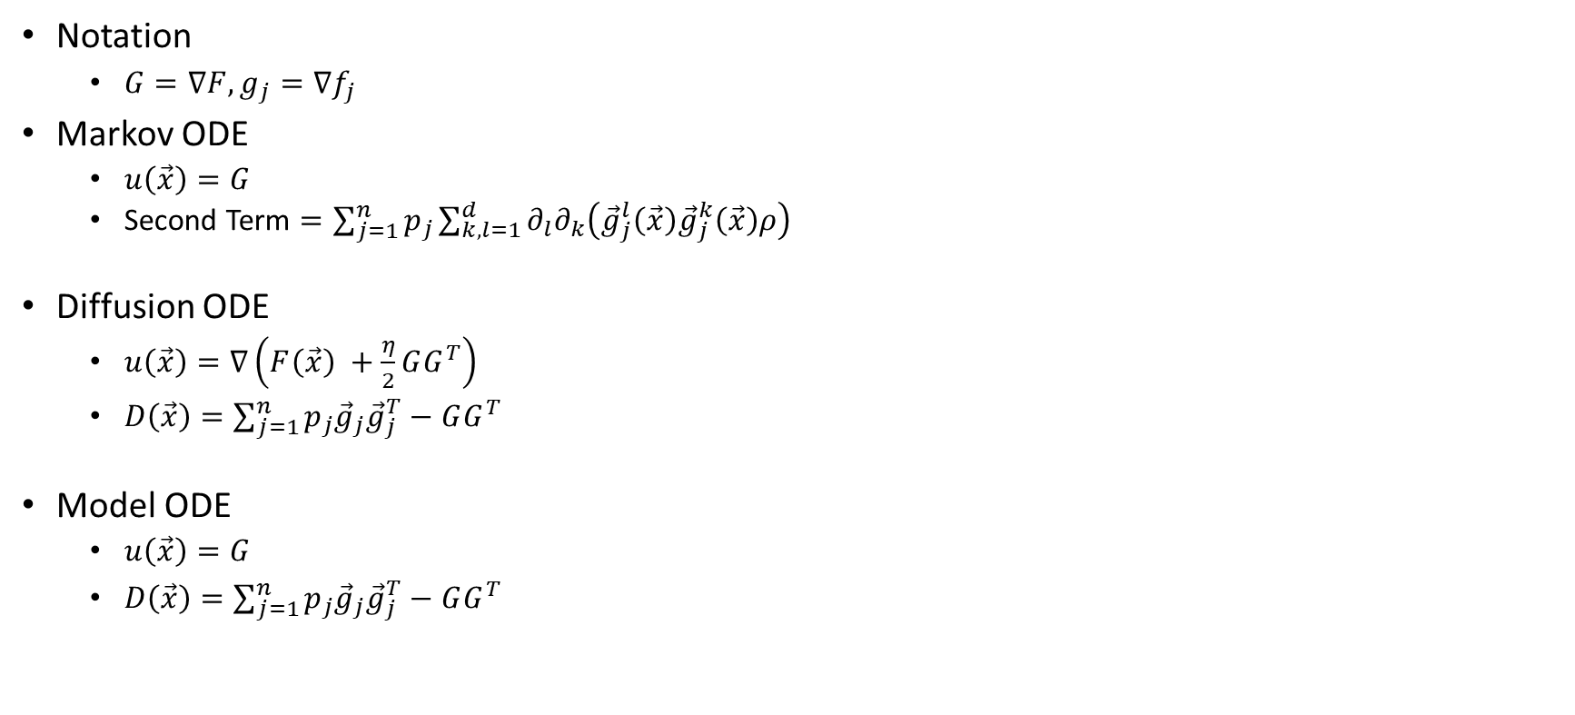
The ODE Approximations
Notation
$G=∇F, g_{j}=∇f_{j}$
Markov ODE
$u\left(\vec{x}\right)=G$
Second Term $=\sum_{j=1}^{n}{p_{j}}\sum_{k,l=1}^{d}{∂_{l}∂_{k}\left({\vec{g}}_{j}^{l}\left(\vec{x}\right){\vec{g}}_{j}^{k}\left(\vec{x}\right)ρ\right)}$
Diffusion ODE
$u\left(\vec{x}\right)=∇\left(F\left(\vec{x}\right) +\frac{η}{2}GG^{T}\right)$
$D\left(\vec{x}\right)=\sum_{j=1}^{n}{p_{j}{\vec{g}}_{j}{\vec{g}}_{j}^{T}}−GG^{T}$
Model ODE
$u\left(\vec{x}\right)=G$
$D\left(\vec{x}\right)=\sum_{j=1}^{n}{p_{j}{\vec{g}}_{j}{\vec{g}}_{j}^{T}}−GG^{T}$

Slide 44
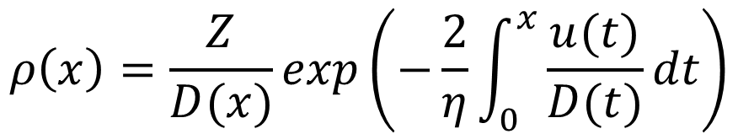
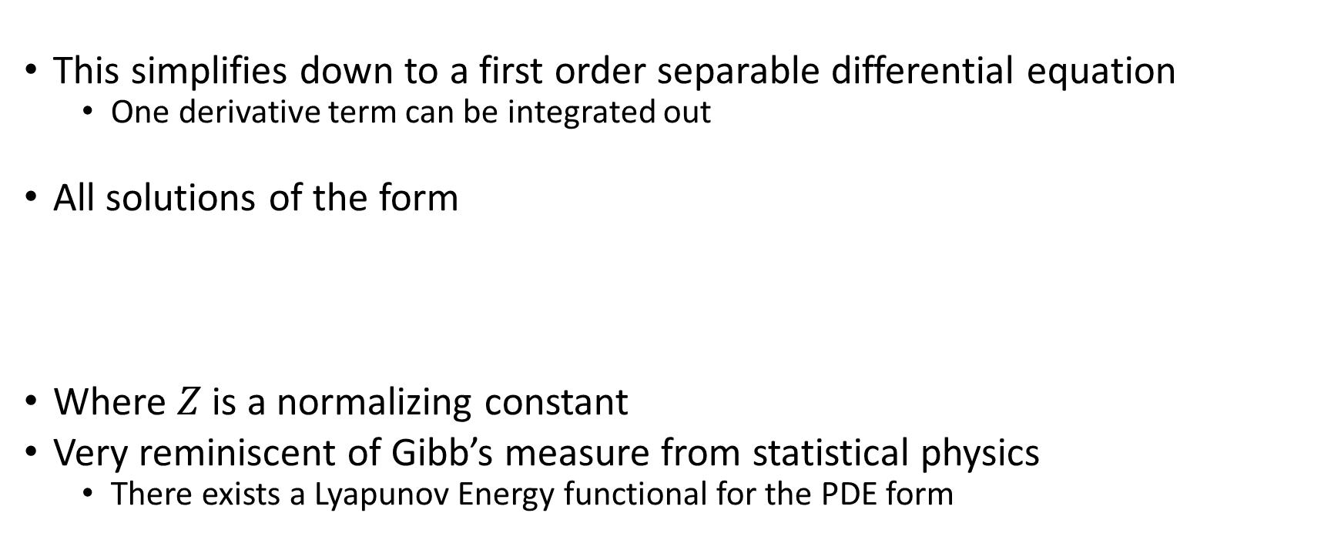
Solutions in 1D
This simplifies down to a first order separable differential equation
One derivative term can be integrated out
All solutions of the form
Where $Z$ is a normalizing constant
Very reminiscent of Gibb’s measure from statistical physics
There exists a Lyapunov Energy functional for the PDE form
$$ρ\left(x\right)=\frac{Z}{D(x)}exp\left(−\frac{2}{η}\int_{0}^{x}{\frac{u(t)}{D(t)}dt}\right)$$

Slide 45
We have these approximation models, how good are they?

Slide 46
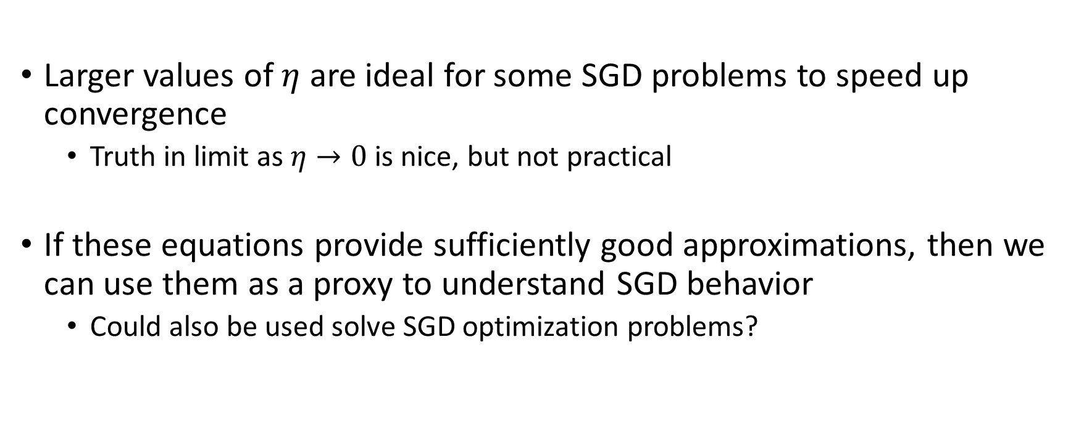
Why Should We Care?
Larger values of $η$ are ideal for some SGD problems to speed up convergence
Truth in limit as $η→0$ is nice, but not practical
If these equations provide sufficiently good approximations, then we can use them as a proxy to understand SGD behavior
Could also be used solve SGD optimization problems?

Slide 47
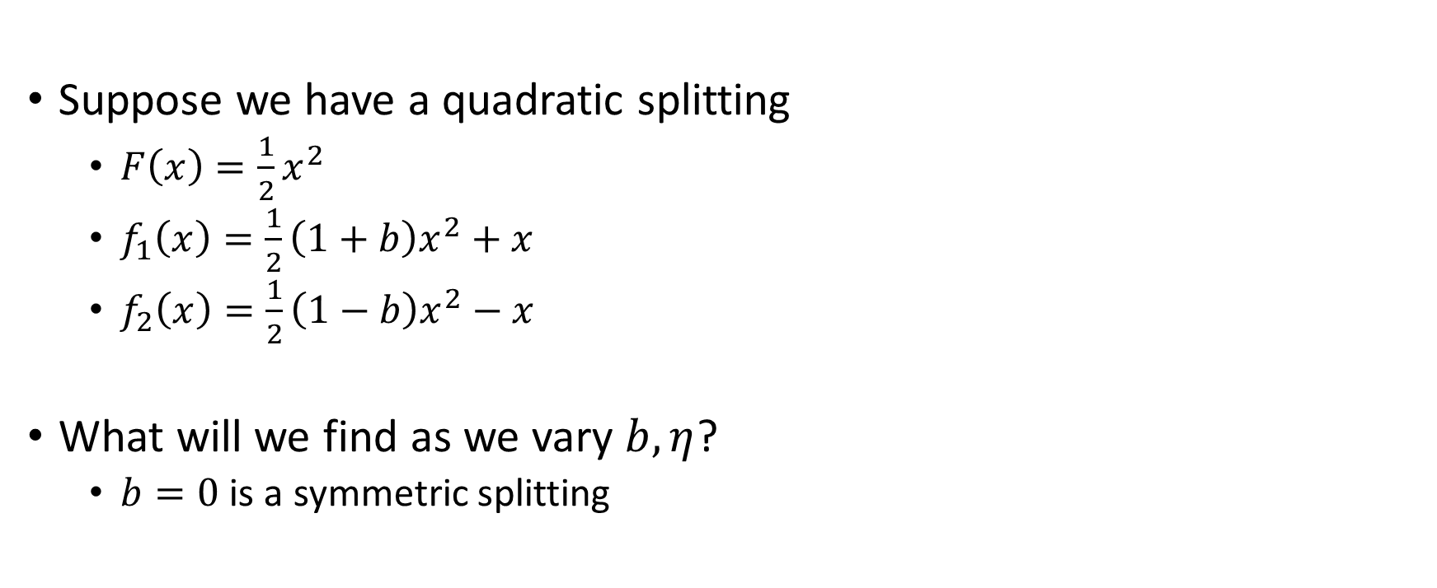
ODE Numerical Tests
Suppose we have a quadratic splitting
$F\left(x\right)=\frac{1}{2}x^{2}$
$f_{1}\left(x\right)=\frac{1}{2}\left(1+b\right)x^{2}+x$
$f_{2}\left(x\right)=\frac{1}{2}\left(1−b\right)x^{2}−x$
What will we find as we vary $b,η$?
$b=0$ is a symmetric splitting

Slide 48
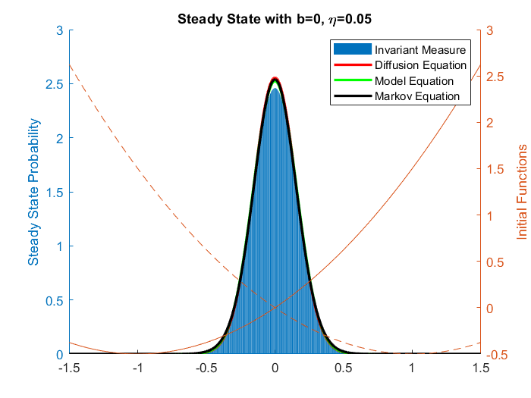
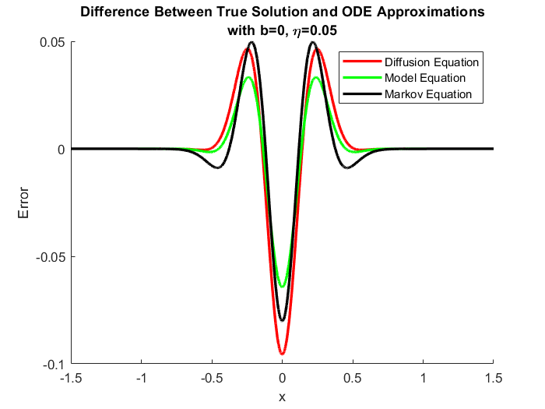

Slide 49
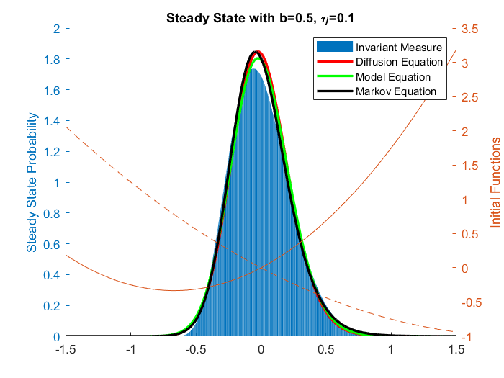
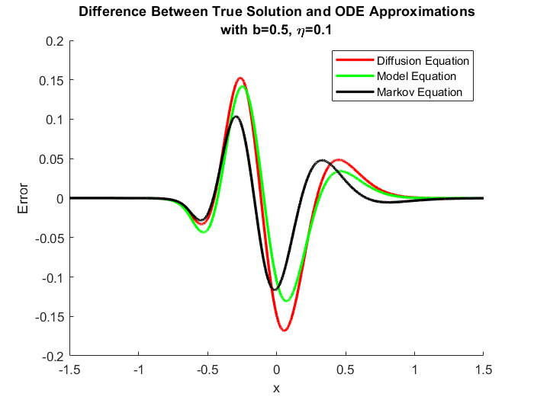

Slide 50
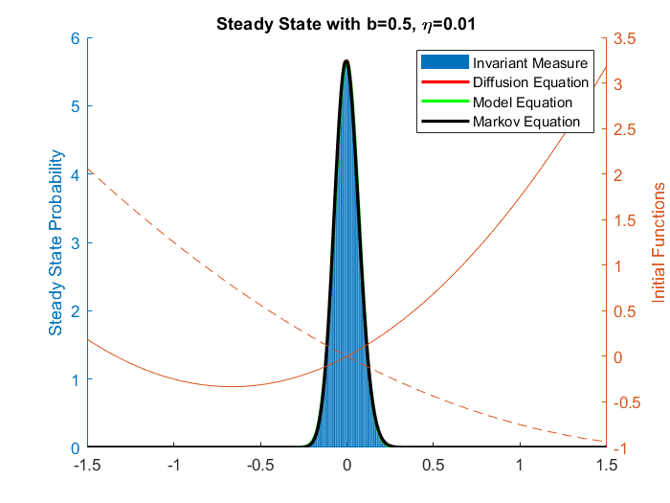
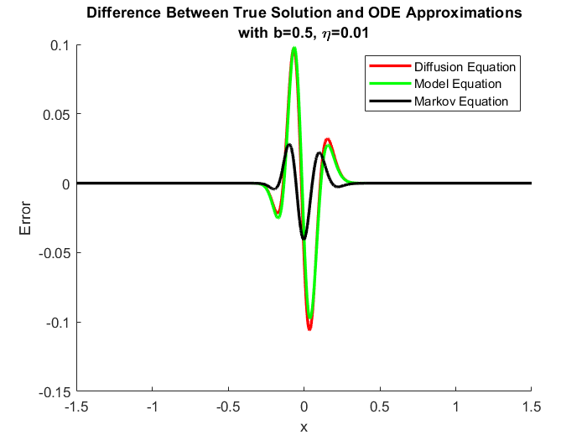

Slide 51
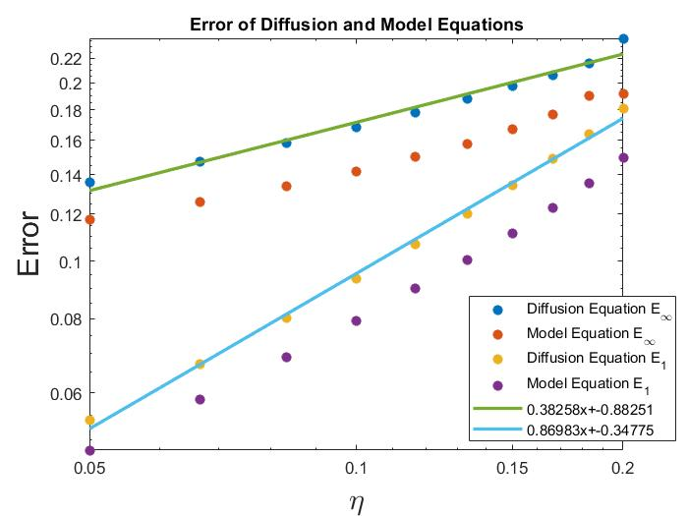

Slide 52
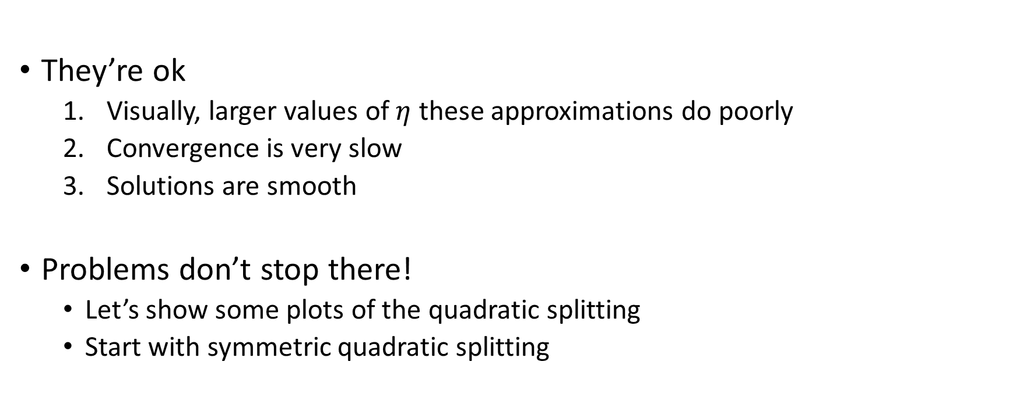
How good are these approximations?
They’re ok
Visually, larger values of $η$ these approximations do poorly
Convergence is very slow
Solutions are smooth
Problems don’t stop there!
Let’s show some plots of the quadratic splitting
Start with symmetric quadratic splitting

Slide 54
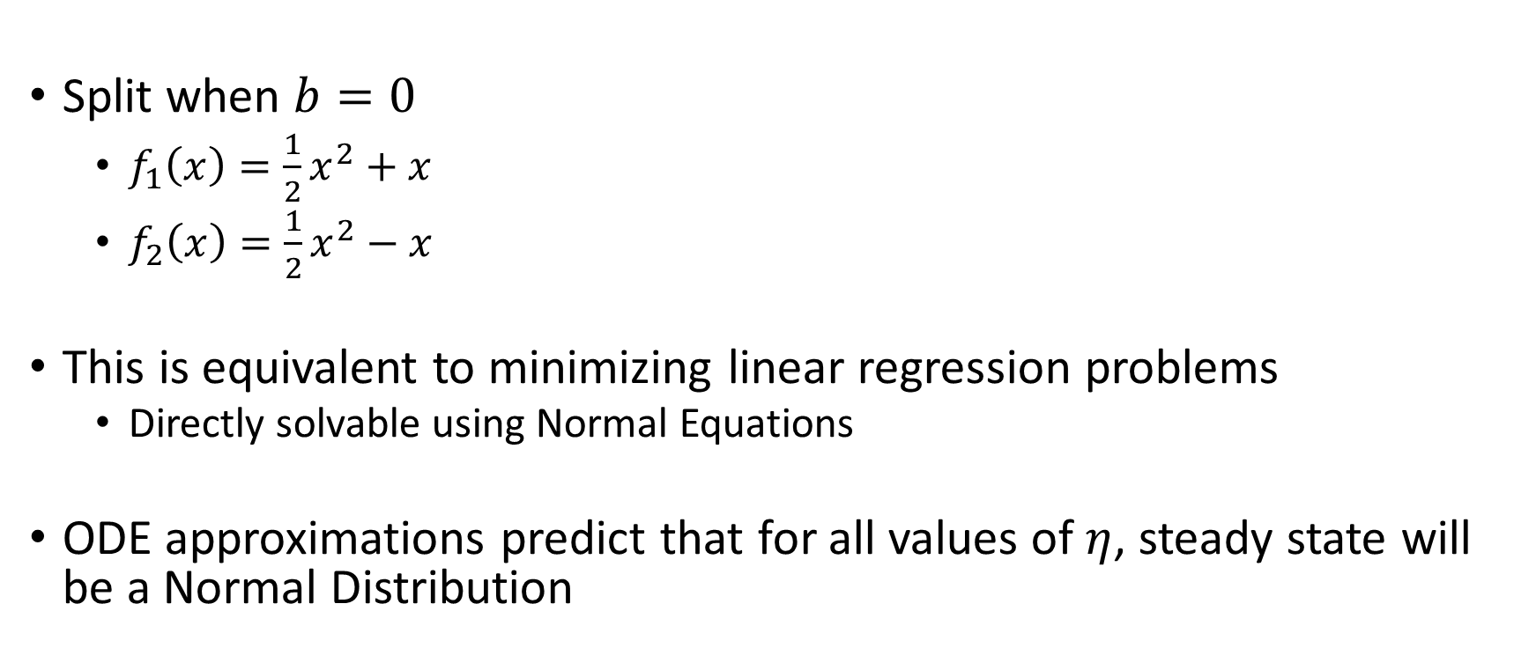
Symmetric Quadratic Splitting
Split when $b=0$
$f_{1}\left(x\right)=\frac{1}{2}x^{2}+x$
$f_{2}\left(x\right)=\frac{1}{2}x^{2}−x$
This is equivalent to minimizing linear regression problems
Directly solvable using Normal Equations
ODE approximations predict that for all values of $η$, steady state will be a Normal Distribution

Slide 55
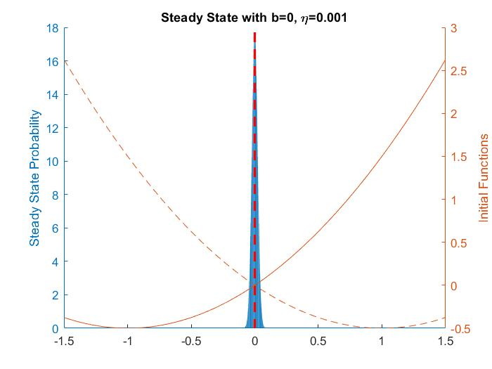
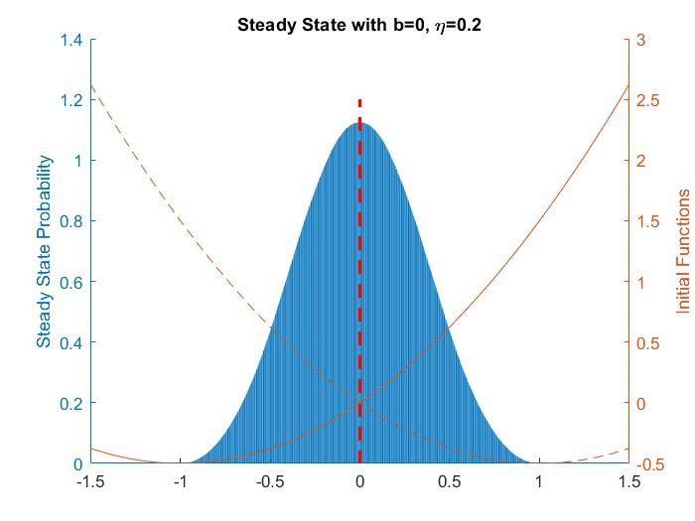

Slide 56
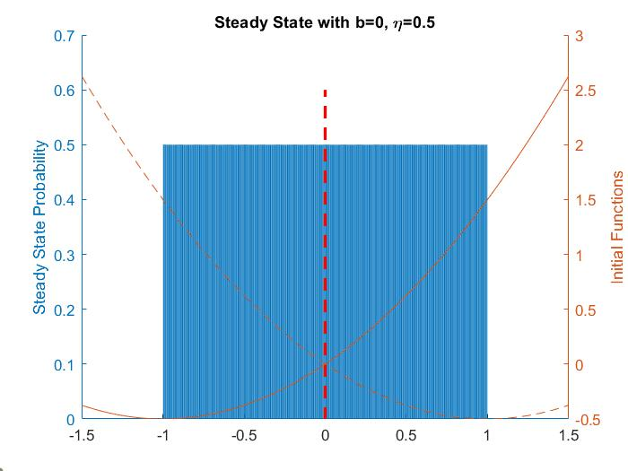


Slide 57



Slide 58

Symmetric Quadratic Splitting
When $η<.5$ we are normal-ish
When $η=.5, 1.5$ we have a uniform distribution
When $.5<η<1$ solution is not smooth (unstable)
Unstable as coefficients of terms grow unbounded
When $η=1$ solutions flips between $−1, 1$

Slide 59


Slide 60



Slide 61



Slide 62



Slide 63

Quadratic Splittings
For sufficiently small $η$, solution is smooth
Solution has finite support for quite large values of $η$
ODE approximations predict infinite support
Regardless of $η, b$ of number of splits, the expected value of $x$ is $0$
Simple by integration of steady state distribution
Includes unstable solutions!

Slide 64

Non-Convex Problems
We see some cool behavior from quadratics but lets expand
Most machine learning models are not convex
We will consider a model function now with $3$ local extrema calculated through integration
One well shallow wide, one deep narrow, but both relatively comparable
Can we visually observe the regularizing effects of SGD?

Slide 65



Slide 66


Slide 67



Slide 68


Slide 69

Non-Convex Problems
What I’m currently working on
There exists a value of $η$ where a bifurcation occurs to provide two steady state distributions
What $η$ provided splittings?
SGD appears to regularize based on splitting, $η$
Can we create a criteria for which well will be selected?
For what values of $η$ are wells smooth or non-smooth?

Slide 70

How good are the ODE approximations?
They’re ok
Visually, larger values of $η$ these approximations do poorly
Convergence is very slow
Solutions are smooth
They predict existence of one invariant measure
ODEs provide solutions with infinite support, even when the true solution does not
Good enough to see some behavior, but misses out on a lot

Slide 71

Future Questions and Directions
Higher dimensional parameter systems
Sadly cannot create nice visualizations
More non-convex problems
Simple neural network problems
How do higher order ODEs perform for larger values of $η$?
Does the smooth boundary provide a boundary for ODE reasonable approximations?
Are they reasonable to compute?
In higher dimensions, does there exist a Lyapunov Energy functional?

Slide 72
References
Alnur Ali, Edgar Dobriban, and Ryan Tibshirani. The implicit regularization of stochastic gradient flow for least squares. In International Conference on Machine Learning, pages 233–244. PMLR, 2020.
Hardt, Moritz, Ben Recht, and Yoram Singer. "Train faster, generalize better: Stability of stochastic gradient descent." International Conference on Machine Learning. PMLR, 2016.
Jiu Ding, Tien Yien Li, and Aihui Zhou. Finite Approximations of Markov Operators. Journal of Computational and Applied Mathematics, 147(1):137–152, 2002.
W. Hu, C.J. Li, L. Li, and J.-G. Liu.On the diffusion approximation of nonconvex stochastic gradient descent. Annals of Mathematical Sciences and Applications, 4:3–32, 2019.
Michael V Jakobson. Absolutely continuous invariant measures for one-parameter families of one-dimensional maps. Communications in Mathematical Physics,81(1):39–88, 1981.
Nikolas Kantas, Panos Parpas, and Grigorios A Pavliotis. The sharp, the flat and the shallow: Can weakly interacting agents learn to escape bad minima? arXivpreprint arXiv:1905.04121, 2019.
Stephan Mandt, Matthew Hoffman, and David Blei. A variational analysis of stochastic gradient algorithms. In International conference on machine learning, pages 354–363. PMLR, 2016.
Xiaoxia Wu, Edgar Dobriban, Tongzheng Ren, Shanshan Wu, Zhiyuan Li, Suriya Gunasekar, Rachel Ward, and Qiang Liu. Implicit regularization of normalization methods. arXiv preprint arXiv:1911.07956, 2019.

