Slide 1






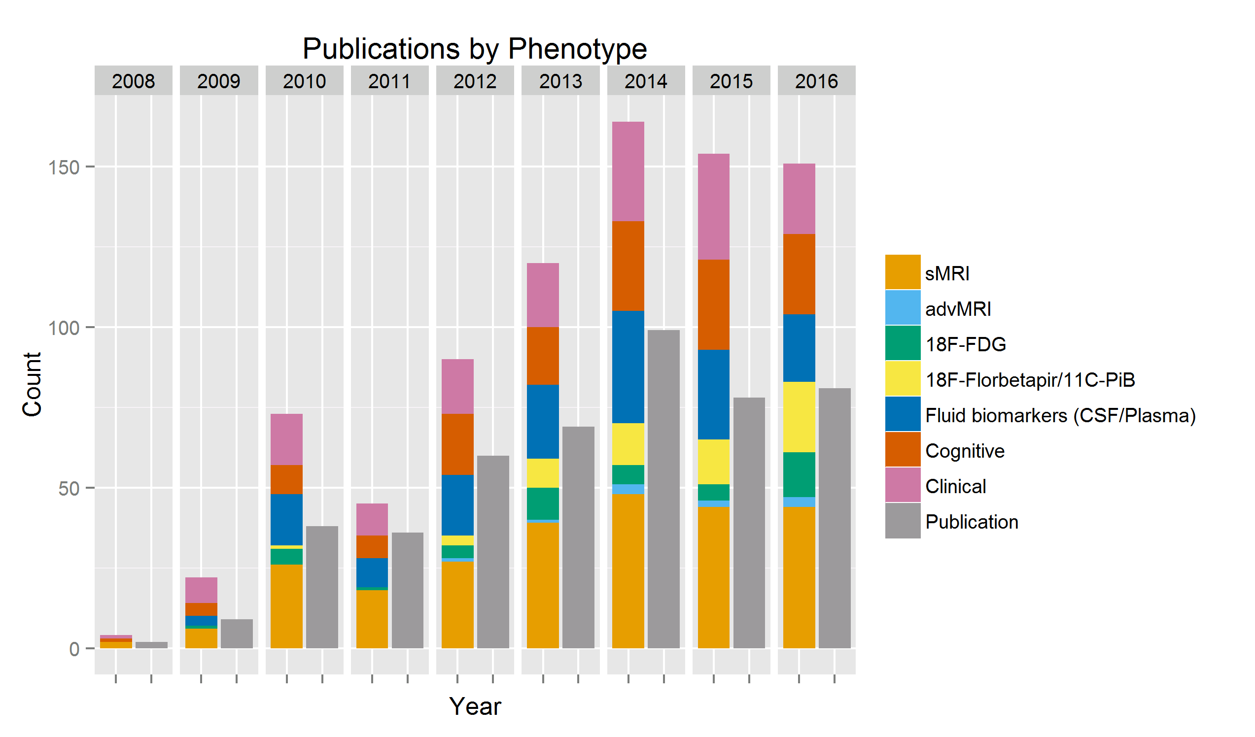
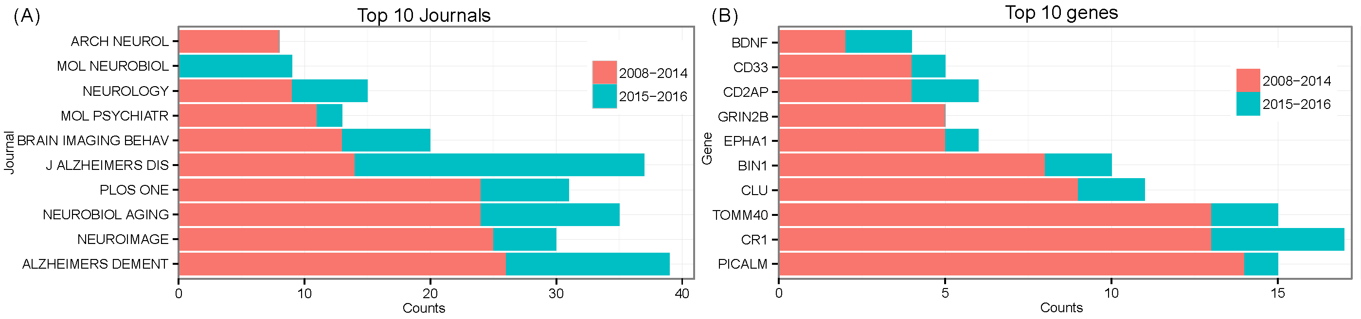
Genetic Findings Using ADNI Multimodal Quantitative Phenotypes: A 2016 Update
Xiaohui Yao^{1,2,*}, Jingwen Yan^{1,2}, Kwangsik Nho¹, Shannon L. Risacher¹, Katy Börner³, Andrew J. Saykin^{1,*},
Li Shen^{1,*}, for the Alzheimer’s Disease Neuroimaging Initiative
¹IU School of Medicine; ²IU School of Informatics and Computing, Indianapolis, IN, USA;
³IU School of Informatics and Computing, Bloomington, IN, USA;
*Correspondence to yao2@umail.iu.edu, asaykin@iupui.edu, shenli@iu.edu
1. Background
3. Results
The Genetics Core of the Alzheimer’s Disease Neuroimaging Initiative (ADNI) aims to provide genetic resources and facilitate research opportunities in qualitative and quantitative genetics using ADNI multidimensional phenotypes. Genotyping and sequencing data have been generated for ADNI-1/GO/2 participants and are available to the scientific community. Here we review the ADNI genetic publications as of 12/31/2016.
There were 78 and 81 ADNI genetics papers published in 2015 and 2016, respectively. Figure 1 shows the distribution of ADNI genetics publications grouped by assessed phenotype(s) from 2008 to 2016. Figure 2 illustrates the change of common journals and top common genes reported by ADNI genetics papers of 2015-2016 with those published between 2008-2014, respectively [1]. Compared with 174 findings collected from 2008 to 2014 [2,3], ADNI papers from 2015-2016 identified 25 previously reported genes and 96 new genes that individually or jointly associated with different types of AD-related traits including clinical status, structural and functional neuroimaging, fluid biomarkers, and neuropsychological assessments. These major findings were significantly enriched in several pathways and biological processes, including Alzheimer’s Disease (p<0.005), cell adhesion molecules (p<0.05), regulation of beta-amyloid formation (p=1.8e-4), regulation of neuron death (p=2e-4); see Table 1 for details.
(A) Total publications
Year | # of Publications | Year | # of Publications
2008 | 2 | 2013 | 69
2009 | 9 | 2014 | 99
2010 | 38 | 2015 | 78
2011 | 36 | 2016 | 81
2012 | 60
(B) Publications grouped by phenotype
2. Materials & Methods
A PubMed search was performed to identify papers published between 2008 and 2016, where ADNI APOE, genome wide association study (GWAS), or sequencing data were used. These studies were reviewed, grouped by assessed phenotypes, and major findings were assembled. Genomic pathway enrichment analyses were performed on genetic findings to get a high-level understanding of relevant biological pathways and processes. Information visualization was employed to track the evolution of where these papers were published and which genes were reported in 2015-2016 compared with 2008-2014.
Table 1. Gene set functional annotation
(a) Enrichment pathway maps: results with corrected p-value < 0.05 are shown.
# | KEGG pathway | p-value | corrected p | Hit genes | Total genes
1 | Alzheimer's disease | 1.84E-05 | 3.63E-03 | 11 | 168
2 | Amyotrophic lateral sclerosis (ALS) | 6.11E-04 | 3.46E-02 | 5 | 51
3 | Complement and coagulation cascades | 6.98E-04 | 3.46E-02 | 6 | 79
4 | Cell adhesion molecules (CAMs) | 7.03E-04 | 3.46E-02 | 8 | 142
5 | Hematopoietic cell lineage | 1.23E-03 | 4.23E-02 | 6 | 88
6 | Long-term depression | 1.29E-03 | 4.23E-02 | 5 | 60
7 | Axon guidance | 1.71E-03 | 4.49E-02 | 7 | 127
8 | Circadian entrainment | 1.83E-03 | 4.49E-02 | 6 | 95
9 | Fc epsilon RI signaling pathway | 2.25E-03 | 4.93E-02 | 5 | 68
(b) Enrichment GO Biological Processes: top 10 results are shown
# | GO Biological Process | p-value | corrected p | Hit genes | Total genes
1 | negative regulation of amyloid precursor protein catabolic process | 2.34E-08 | 6.81E-05 | 5 | 8
2 | single-organism behavior | 1.17E-07 | 1.70E-04 | 20 | 362
3 | regulation of beta-amyloid formation | 1.87E-07 | 1.81E-04 | 5 | 11
4 | behavior | 2.82E-07 | 2.05E-04 | 23 | 494
5 | negative regulation of neurogenesis | 3.67E-07 | 2.06E-04 | 5 | 13
6 | regulation of neuron death | 4.44E-07 | 2.06E-04 | 15 | 225
7 | regulation of amyloid precursor protein catabolic process | 5.09E-07 | 2.06E-04 | 21 | 437
8 | cellular component morphogenesis | 5.68E-07 | 2.06E-04 | 14 | 192
9 | negative regulation of cell development | 9.55E-07 | 3.09E-04 | 15 | 239
10 | negative regulation of nervous system development | 1.14E-06 | 3.32E-04 | 14 | 211
Figure 1. ADNI genetic data usage and published reports (2008–2016). Number of ADNI genetics publications grouped (A) by year and (B) by phenotype category.
4. Conclusions
Genetic studies of multidimensional ADNI phenotypes continue to confirm known AD genetic risk factors and discover novel susceptibility loci. With the recent release of ADNI whole genome sequencing data, gene expression data and metabolomics profiling data, we expect to see future studies exploring the power of next generation sequencing and multi-omics integration.
References:
[1] Saykin et al. Alzheimer’s & Dementia. 2015. 11: 792-814
[2] Shen et al. Brain Imaging Behav. 2014. Jun;8(2):183-207 [3] Yao et al. Alzheimers Dement. 2015. 11(supp7):P426
Acknowledgements: Supported in part by NIH R01 LM011360, R01 EB022574, U01 AG024904, R01 AG19771, P30 AG10133, P01 AG039347, U01 CA198934, R00 LM011384, K01 AG049050, R03 AG050856, UL1 TR001108 (Network PDT), R01 AG 042437, and R01 AG046171; NSF IIS-1117335; DOD W81XWH-14-2-0151, W81XWH-13-1-0259, and W81XWH-12-2-0012; NCAA 14132004; and CTSI SPARC Program.
Figure 2. (A) Common journals where papers using ADNI genetic data were published (2008–2016). (B) Common reported genes in ADNI genetics papers (2008–2016).

