Slide 1

Building Effective Visualization Tools for Everyday Business: Web Visualization Framework
Olga Scrivner
with contributions by Adam Simpson, Gagandeep Singh, Jivitesh Poojary, Sara Bouchard, and Katy Börner
Cyberinfrastructure for Network Science Center
Department of Intelligent Systems Engineering
School of Informatics, Computing, and Engineering
Indiana University, Bloomington, USA
October 18, 2017

Slide 2
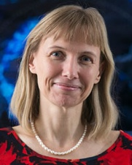


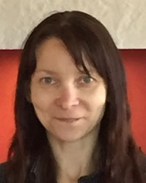

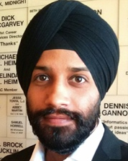






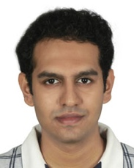







CNS Tools and Services are used by
hundreds of thousands around the globe.
Our mission is to advance datasets, tools, and services for the study of biomedical, social and behavioral science, physics, and other networks. A specific focus is research on the structure and evolution of science and technology (S&T) and the communication of results via static and interactive maps of science. Learn more at cishell.org.

Slide 3
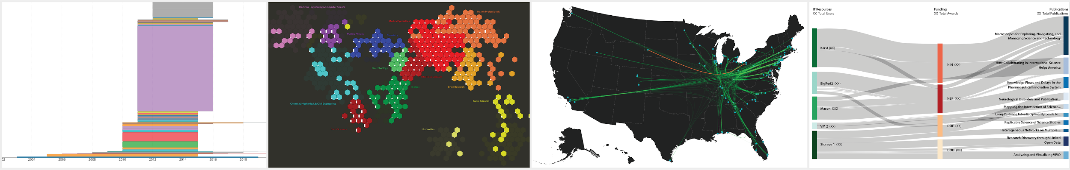
Visual Analytics

Slide 4
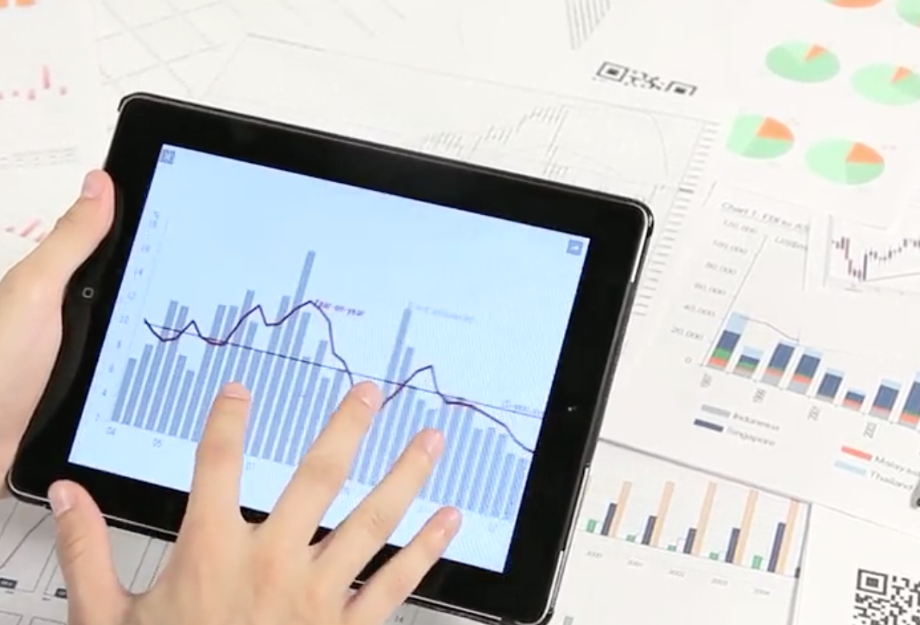


Transforming Data into Insight
“Information is the currency of this digital age”
Carly Fiorina, Former CEO
of HP
Data-Driven Decision Making (credits: PwC)

Slide 5
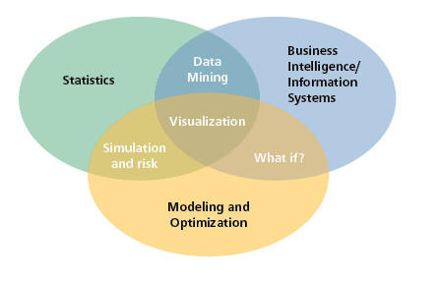
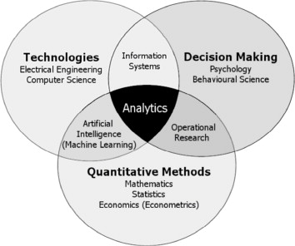
A Research Agenda for the Analytics Age
Figure 1. A Taxonomy of Disciplines (Mortenson et al., 2015 and Evans, 2012)

Slide 6
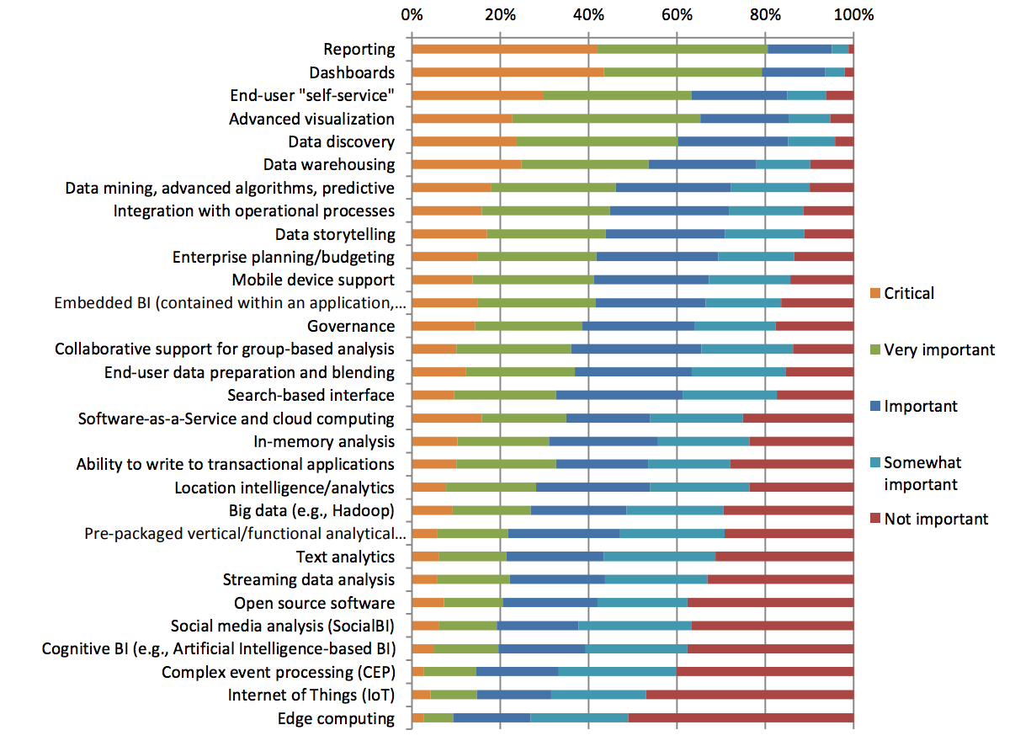
Dresner Advisory Report (2016):
Embedded Business Intelligence Market Study
Figure 2. Technologies and Initiatives Strategic to Business Intelligence

Slide 7

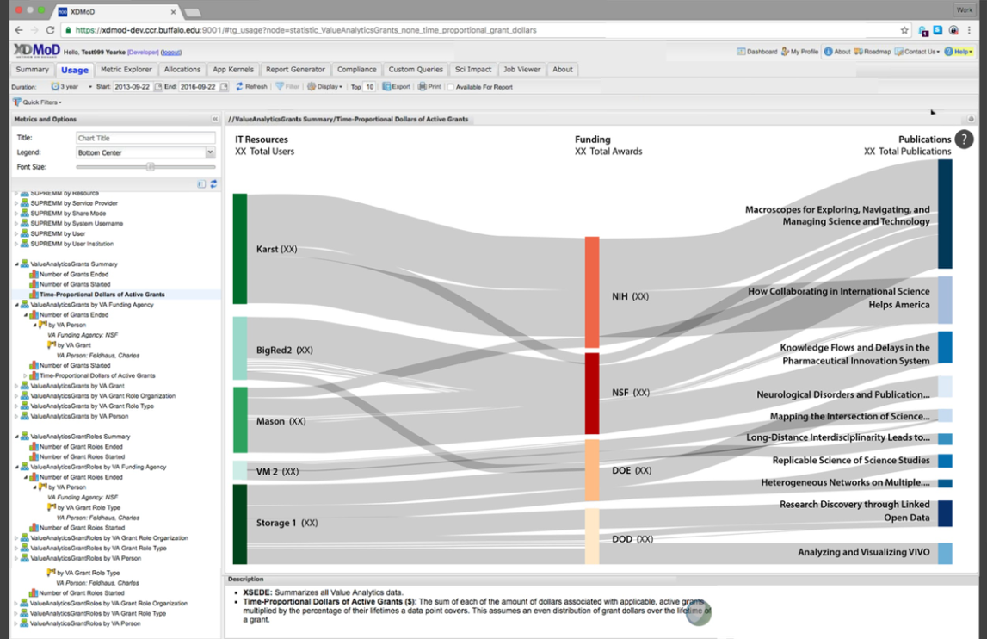
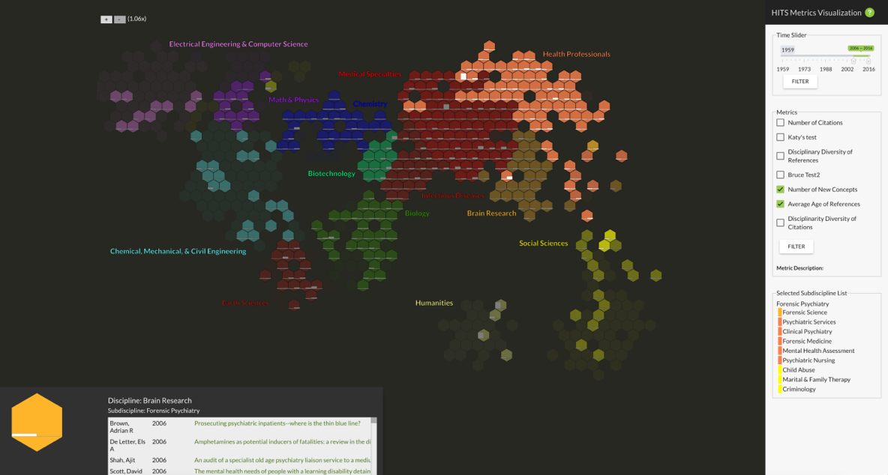
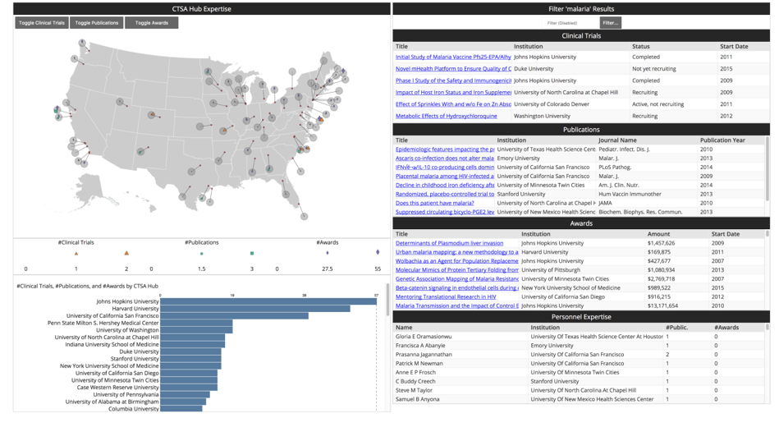
Dashboards
What's happening? What's happened? What's going to happen? Check the dashboard! (Markus, 2006)

Slide 8

Data Visualization
The goal is to turn data into information, and information into insight.
(Carly Fiorina, 2004)
The purpose of visualization is insight, not pictures.
(Ben Shneiderman, 1999)
Notes:
The use of computer-supported, interactive, visual representation of data to amplify cognition

Slide 9

Web Application versus Software Visualization
The impact of data scientists' work depends on how well others can understand their insights to take further actions.
(Jorge Castañón, 2016)
Interactive display and manipulation of data
No installation required
Easy to develop and share with clients and project teams
Open source libraries
Notes:
The accelerating evolution in information visualization research, the remarkable advances in hardware and software technologies and the rapid development of the medium World Wide Web led to a trend toward more generally usable visualization systems via web applications - general Web-based visualization systems, (Bender at al., 2000) .
The number of devices on which people view Web content is exploding.

Slide 10

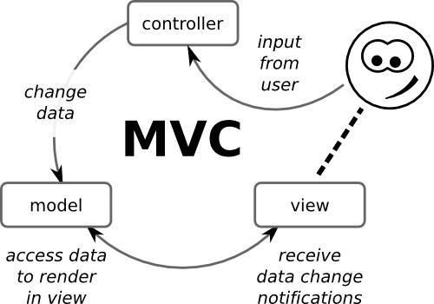
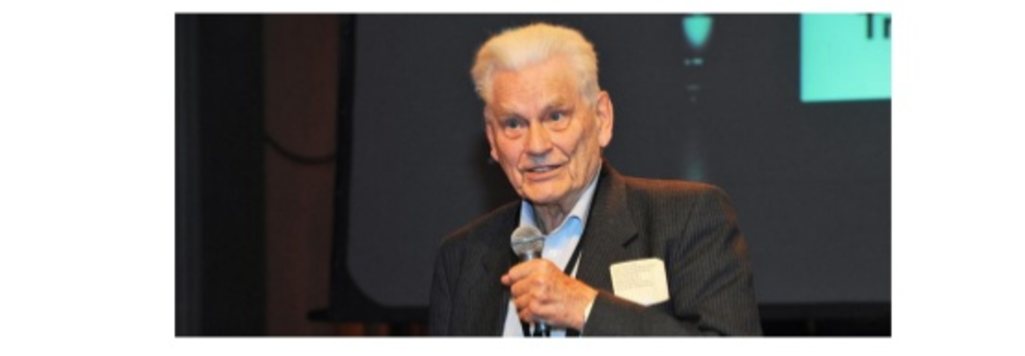
Past: Imperative Web Frameworks
The controller is essential and explicit: you have to specify what to do when you receive user requests and what resources you are going to mobilize to carry out the necessary tasks outlined in the model.
(Ribeiro 2016)
The Model-View-Controller was invented at Xerox Parc by Trygve Reenskaug in 1979.

Slide 11
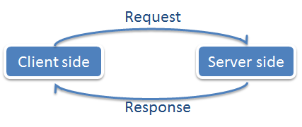
Present: Reactive Web Frameworks
Reactive Systems are highly responsive, giving users effective interactive feedback.
Reactive Manifesto - http://www.reactivemanifesto.org/
Image credit: http://littleactuary.github.io/blog/Web-application-framework-with-Shiny/

Slide 12
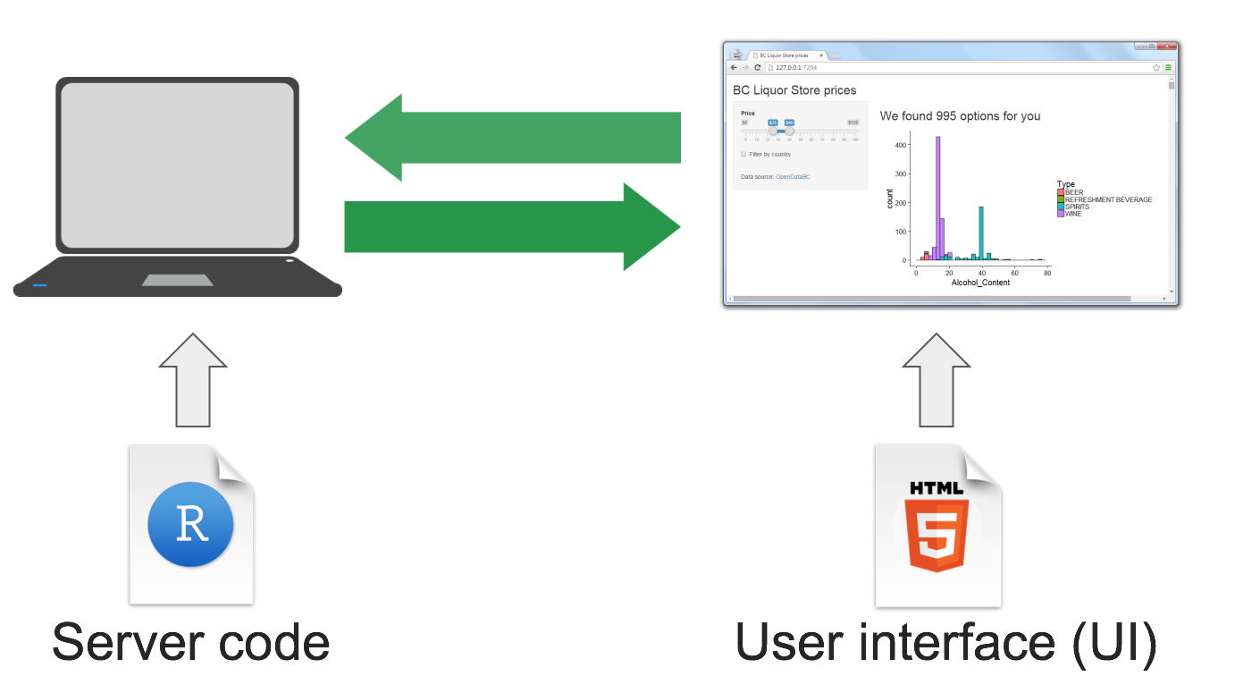

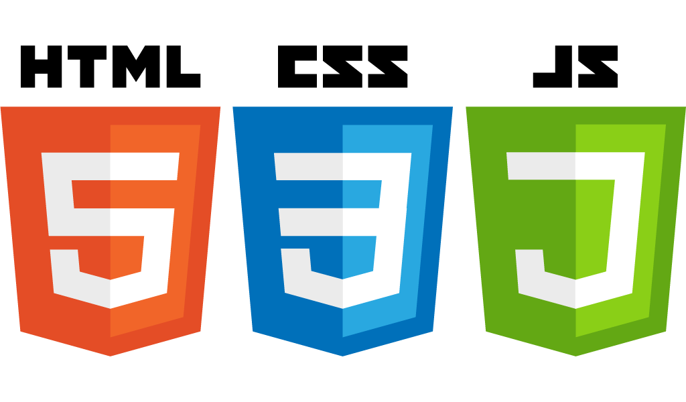

General Architecture
Image Credits: http://littleactuary.github.io/blog/Web-application-framework-with-Shiny/

Slide 13
Web Visualization Framework:
Shiny

Slide 14
Shiny Application
Primary language: R
Shiny is an R package open-sourced by Rstudio in 2012
HTML, CSS, JavaScript, D3 - optional
Shiny dashboards are comparable to Business Intelligence (BI) tools, such as Tableau, Spotfire, Qlikview

Slide 15
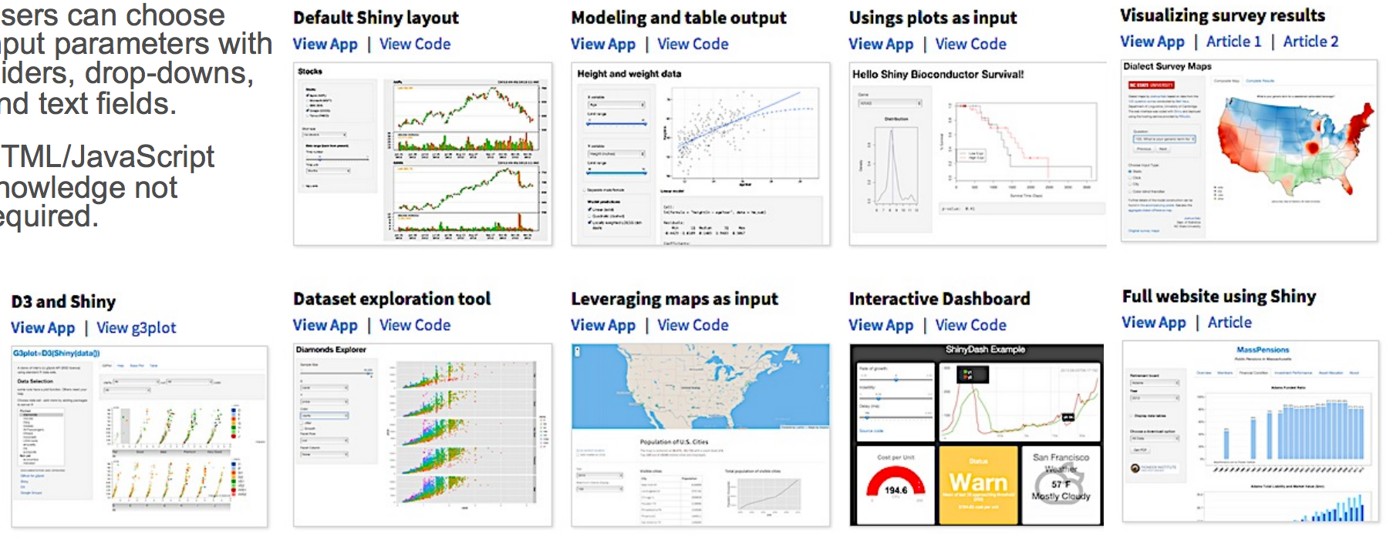
Shiny Application: Get Inspired
Shiny Gallery

Slide 16
CNS Shiny Framework:
Examples

Slide 17
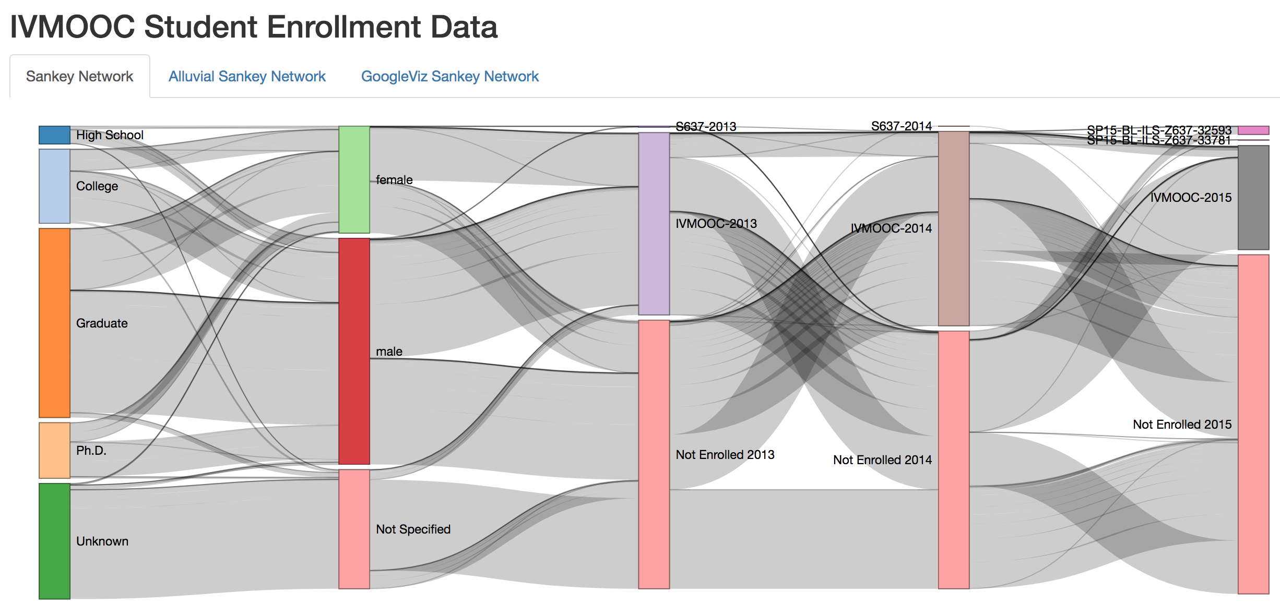
Visualization: Sankey
Figure 3. IU Information Visualization Massive Open Online Course (IVMOOC) from 2013 – 2015
Notes:
The goal of this visualization is to show the flow of students through Indiana University’s Information Visualization Massive Open Online Course (IVMOOC) from 2013 – 2015. The diagram was created using R+D3 with data from learning management systems (LMS), such as Google Course Builder and Canvas, but also student demographic data collected using surveys. The diagram shows demographic information regarding a student’s level of educational attainment and gender together with the year they took the course, broken down further by IVMOOC and IU sections of the course.

Slide 18
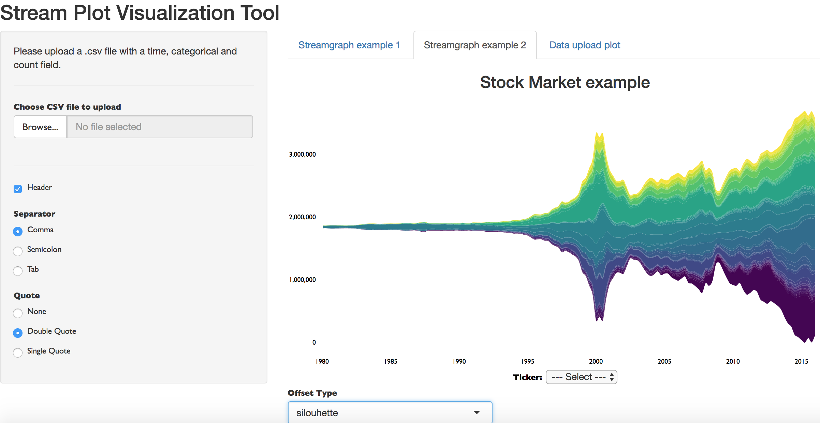
Visualization: Streamgraph
Figure 4. Interactive Streamgraph Visualization

Slide 19
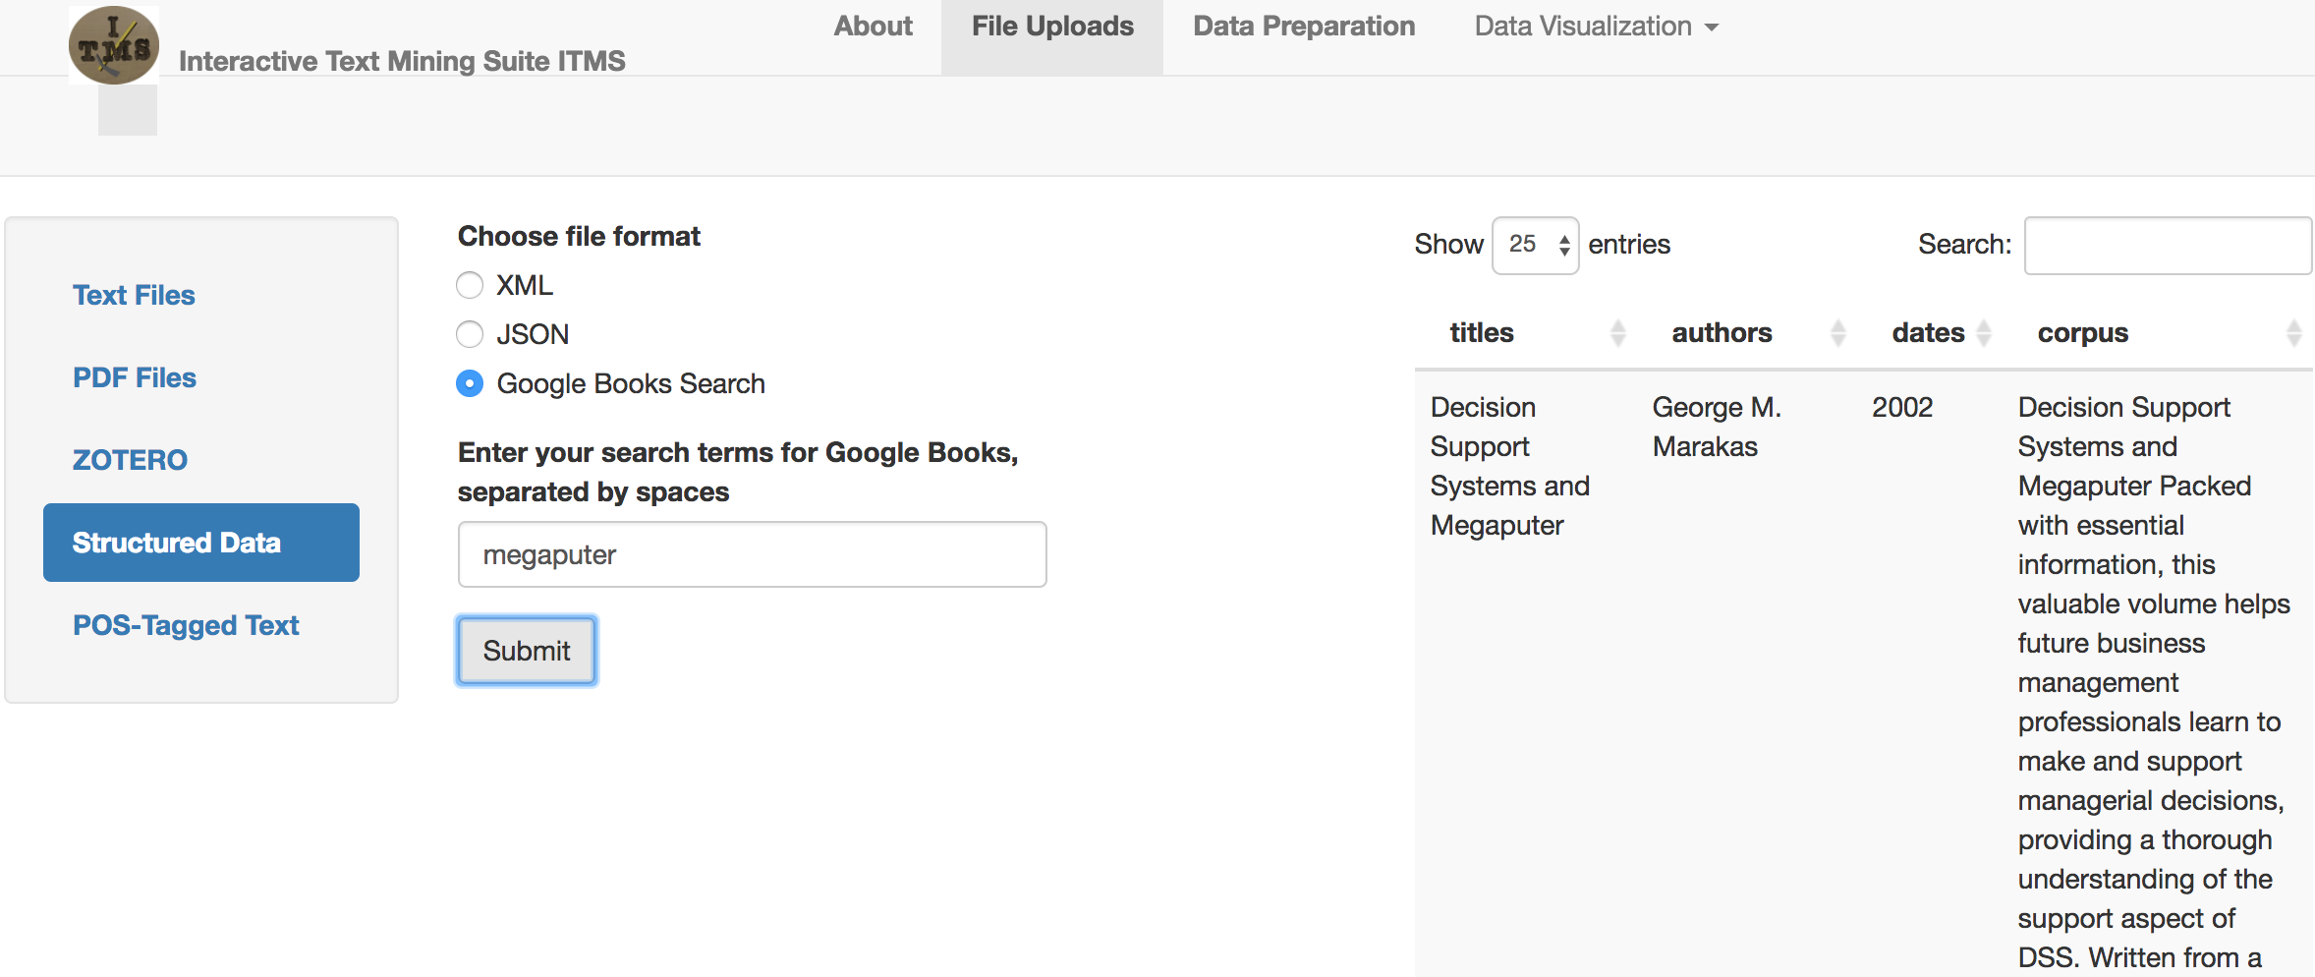

Interactive Text Mining Suite
Figure 5. Open Source Interactive Text Mining Suite - ITMS
www.interactivetextminingsuite.com

Slide 20
Web Visualization Framework:
WVF

Slide 21
WVF System Architecture
Developed by CNS team
Primary language: JavaScript
Build system: Grunt, NodeJS
Libraries: Grunt, AngularJS, D3, jQuery, HTML, CSS
Configuration-based customization
Framework Workspace - Default code and libraries
Plugins Workspace - D3 visualization code
Project Workspace - Project specific code (data, customization, styling, and instanced scripts)

Slide 22
CNS WVF Framework:
Examples

Slide 23
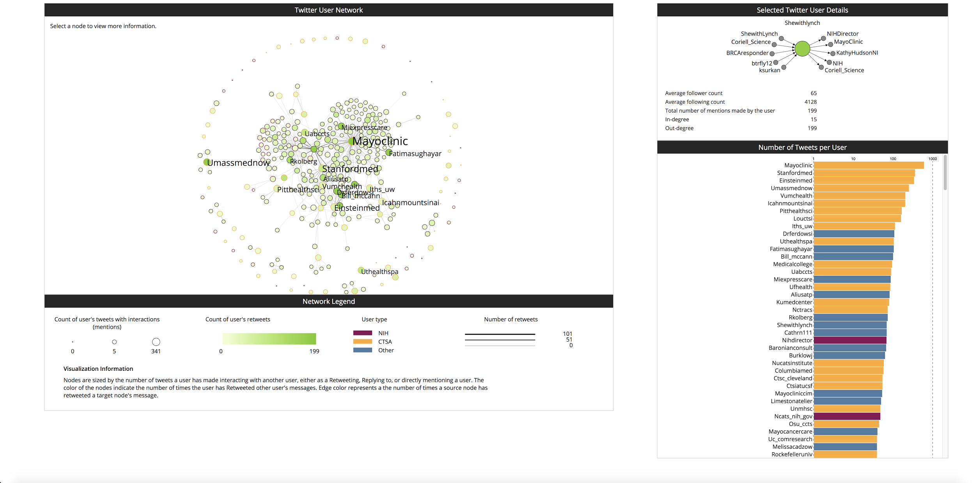
Visualization: Twitter Network
Project: IAI
Figure 6. Social Network from CTSA Hub and NIH Activities on Twitter
Notes:
This visualization shows CTSA hub and NIH activities on Twitter. The accounts and tweets associated with CTSA and NIH were collected between August 2015 - Sept. 2015, then processed and analyzed to create a social network based on the interaction behaviors of users. The layout of the user network is force-directed, meaning that nodes that are close to each other have a stronger connection to one another indicating which Twitter users interact with each other most often.

Slide 24
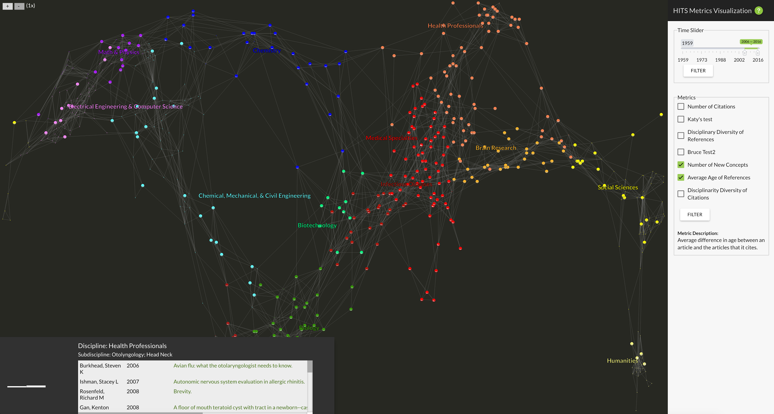
Visualization: UCSD Map of Science
Project: ECON demo.cns.iu.edu/client/econ-ucsdmap
Figure 7. Interactive Map for High-Impact and Transformative Science Metrics
Notes:
This interactive map supports the exploration and comparison of different high-impact and transformative science (HITS) metrics. Interactive map allows the user to hover over a discipline label to highlight all its sub-disciplines, and also hover over a subdiscipline to see all subdisciplines it is connected to.

Slide 25
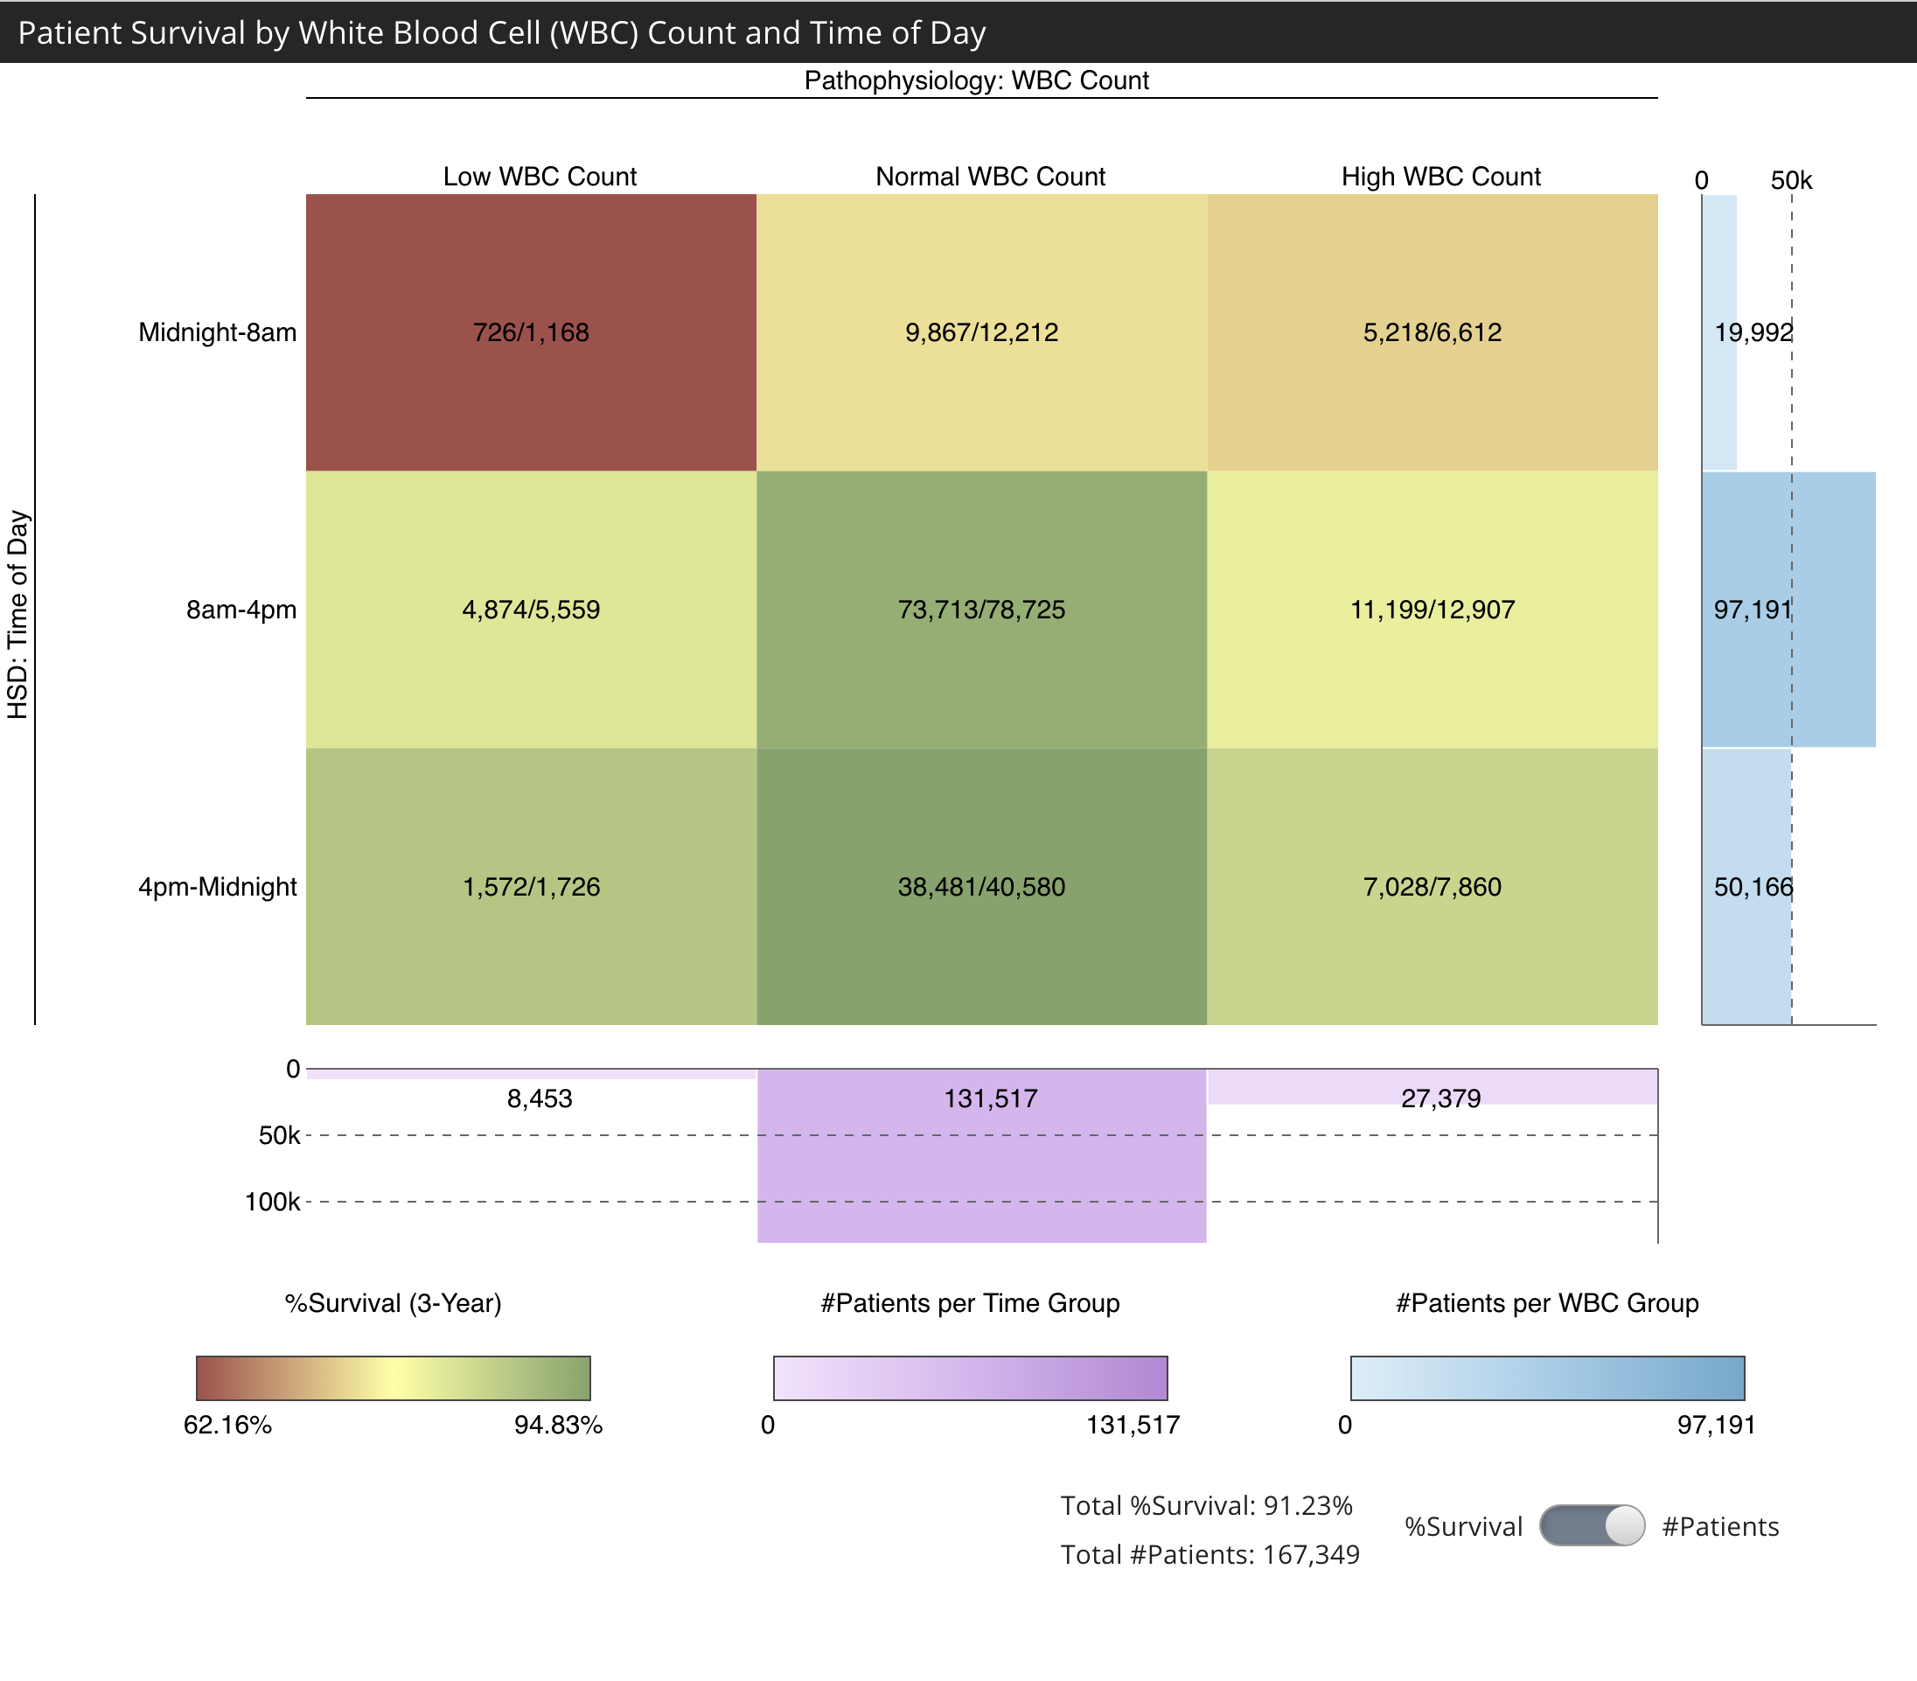
Visualization: Heatmap
Project: HSD demo.cns.iu.edu/client/hsd/static/heatmap_group.html
This visualization shows how white blood cell (WBC) laboratory tests correlate with three-year survival rates. The HSD dimension of the data (rows) is the time of the day of the test; and three-year survival rate (numbers and colors in the boxes) is an outcome variable.
Aggregation level for the HSD time of day are shown—three 8 hour blocks. The lowest survival rates are for patients with a low WBC value in the morning (specifically at 6am).
Figure 8. Patient Survival by White Blood Cell Count and Time of Day

Slide 26
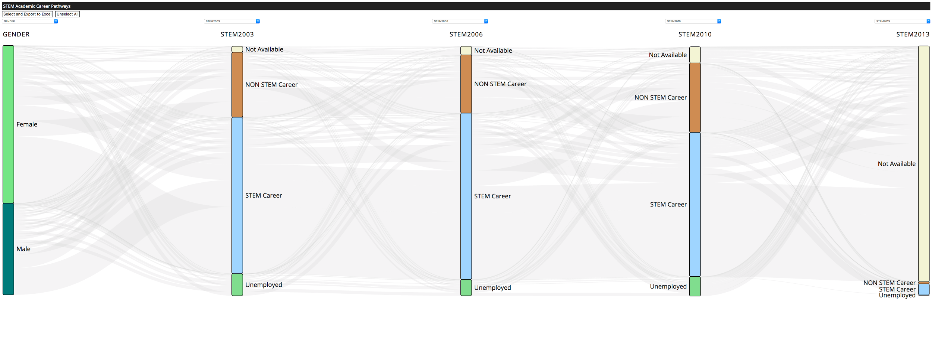
Visualization: Sankey
Project: STEM demo.cns.iu.edu/webvis/stem
Figure 9. STEM Pathways Visualization
Notes:
STEM (science, technology, engineering, math) pathways visualization. Data tool that will make it easier for researchers to visualize pathways and identify groups of individuals pursuing specific paths.
The primary goal of Sankey visualization was to understand the growth/decline of STEM career interests in students at various educational levels and across different demographics. Users will be able to precisely analyze and identify the group of students that flow in and out of the STEM career interest areas and in turn perform detailed research on these focus groups to study the reasons and influencing factors for the change in career interests.

Slide 27

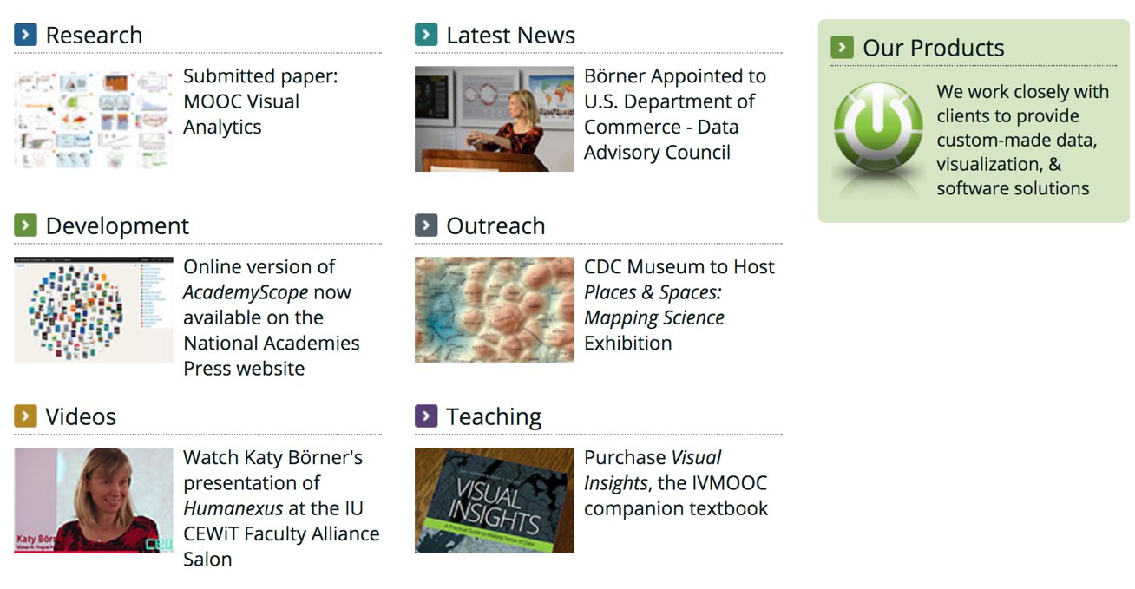
Visualization: Outlook
More robust workflow
Public-facing code and documentation
More visualization library support
Better cross-visualization integration
More visualization plugins
All papers, maps, tools, talks, press are linked from http://cns.iu.edu
These slides are at http://cns.iu.edu/presentations.html
CNS Facebook: http://www.facebook.com/cnscenter
Visualizations:
http://cns.iu.edu/visualizations.html
Tools:
http://cns.iu.edu/data_tools.html

Slide 28

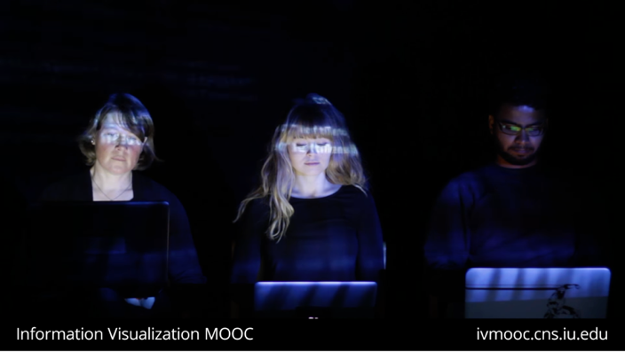
2018 IVMOOC
This course provides an overview about the state of the art in information visualization. It teaches the process of producing effective visualizations that take the needs of users into account.
Register for free: ivmooc.cns.iu.edu.
Class started Jan 9, 2018.

Slide 29


Slide 30


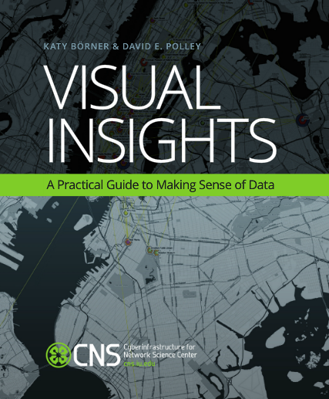

References
Börner, Katy, Chen, Chaomei, and Boyack, Kevin. (2003). Visualizing Knowledge Domains. In Blaise Cronin (Ed.), ARIST, Medford, NJ: Information Today, Volume 37, Chapter 5, pp. 179-255. http://ivl.slis.indiana.edu/km/pub/2003-borner-arist.pdf
Shiffrin, Richard M. and Börner, Katy (Eds.) (2004). Mapping Knowledge Domains. Proceedings of the National Academy of Sciences of the United States of America, 101(Suppl_1). http://www.pnas.org/content/vol101/suppl_1
Börner, Katy (2010) Atlas of Science: Visualizing What We Know. The MIT Press. http://scimaps.org/atlas
Scharnhorst, Andrea, Börner, Katy, van den Besselaar, Peter (2012) Models of Science Dynamics. Springer Verlag.
Katy Börner, Michael Conlon, Jon Corson-Rikert, Cornell, Ying Ding (2012) VIVO: A Semantic Approach to Scholarly Networking and Discovery. Morgan & Claypool.
Katy Börner and David E Polley (2014) Visual Insights: A Practical Guide to Making Sense of Data. The MIT Press.
Börner, Katy (2015) Atlas of Knowledge: Anyone Can Map. The MIT Press. http://scimaps.org/atlas2
30

Slide 31
References
Jorge Castañón. 2016. Shiny: a Data Scientist’s Best Friend. http://datascience.ibm.com/blog/shiny-a-data-scientist-best-friend/
Carly Fiorina. 2004. Information: the currency of the digital age . http://www.hp.com/hpinfo/execteam/speeches/fiorina/04openworld.html
Michael J. Mortenson, Neil F. Doherty, Stewart Robinson. (2015). Operational research from Taylorism to Terabytes: A research agenda for the analytics age. European Journal of Operational Research, 241, 3, 583-595.
Aaron Marcus. (2006). Dashboards in your future. Interactions 13, 1 (January 2006), 48-60.
Bradley Nice. (2012). Front-End vs Back-End vs Full Stack Development. March 2012. https://medium.com/level-up-web/front-end-vs-back-end-vs-full-stack-development-78267f545121
Dresner Advisory Report. (2016). Embedded Business Intelligence Market Study. http://www.marketwired.com/press-release/dresner-advisory-services-publishes-2016-embedded-business-intelligence-market-study-2174046.htm
Java - https://www.planet-source-code.com/vb/default.asp?lngWId=14
Python - https://realpython.com/learn/python-first-steps/
31

Slide 32
Thank you!
@obscrivn
@cnscenter

Slide 33


Questions
PRESENTED BY:
Olga Scrivner
Call (812) 349-8853
or email obscrivn@indiana.edu
Indiana University - Bloomington
1320 E. 10th St., Wells Library
Bloomington, IN 47405 USA

