Slide 1

Enhancing Circulation to Improve Health and Wellness

Slide 2


Standard of Care
1970’s - 2019

Slide 3

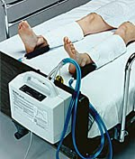
In Hospital Standard of Care
1970’s - 2019

Slide 4
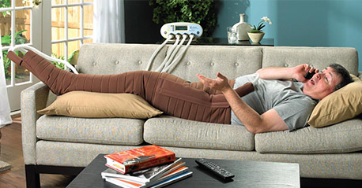
At Home Standard of Care
1990’s - 2019

Slide 5
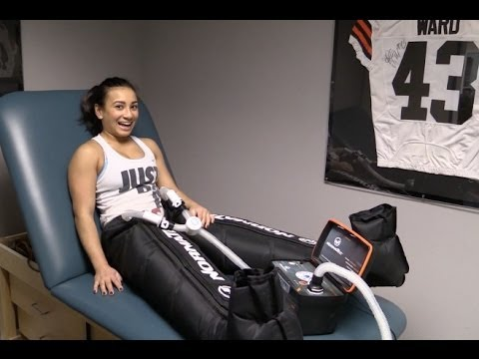
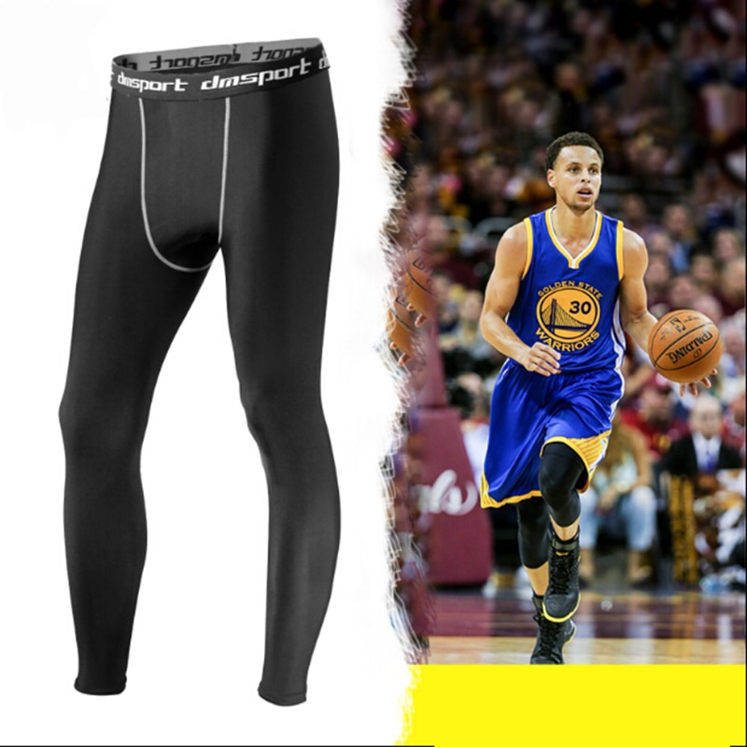
Athletic Standard of Care
2000’s - 2019

Slide 6

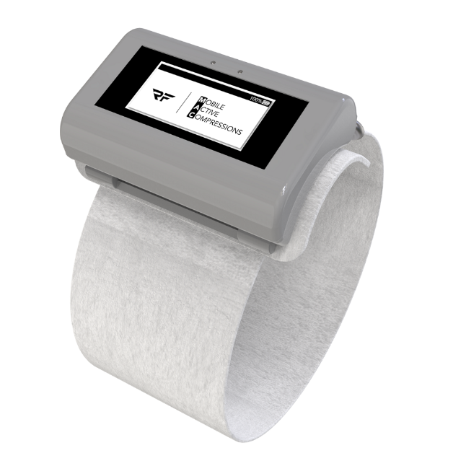
In Hospital Standard of Care
Beginning 2020

Slide 7




In Hospital Standard of Care
Beginning 2020

Slide 8
Enhancing Circulation to Improve Health and Wellness

